Slide 1
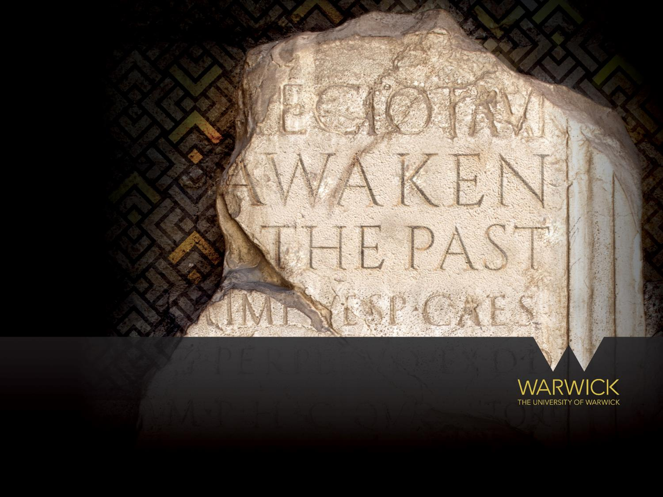
Department of Classics & Ancient History
Rated 7th among UK Classics Depts in Complete University Guide 2022

Slide 2

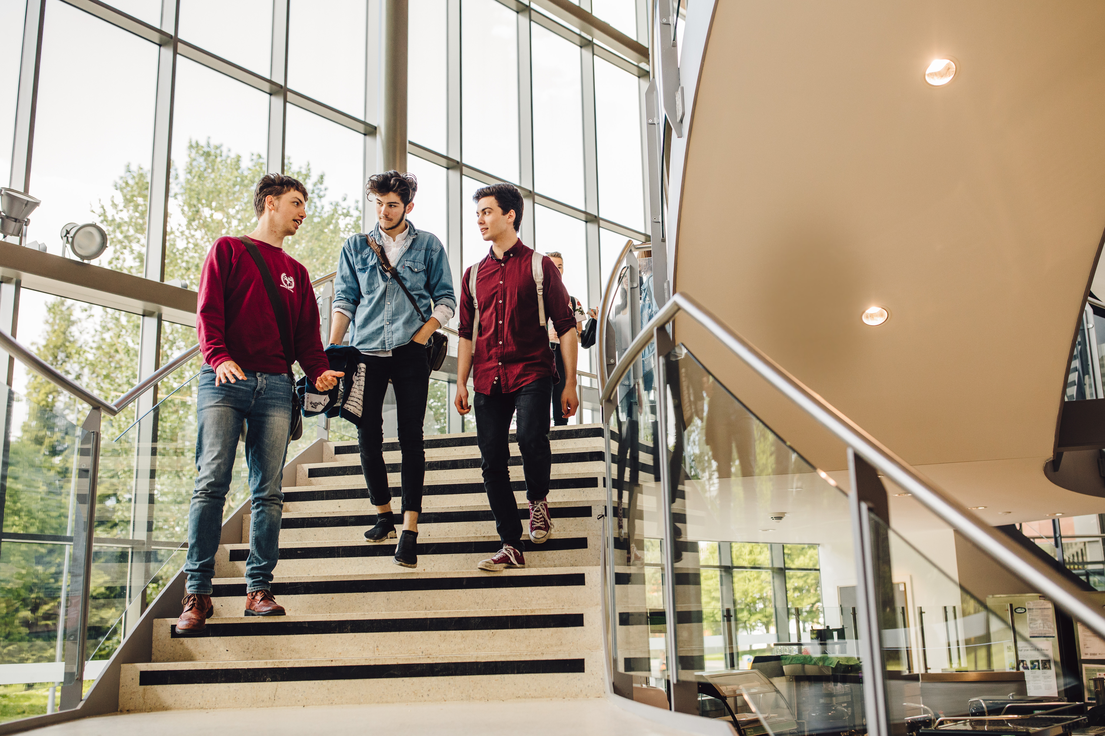

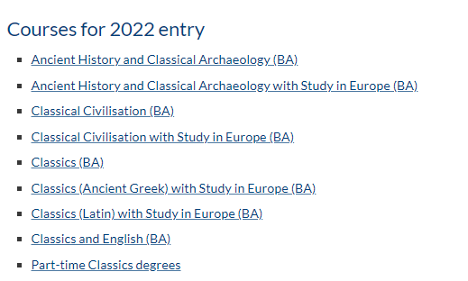
Classics at Warwick…

Slide 3
The Gritty Realities of the Ancient Olympic Games
Professor Michael Scott

Slide 4
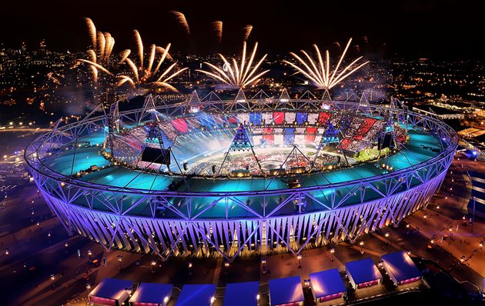
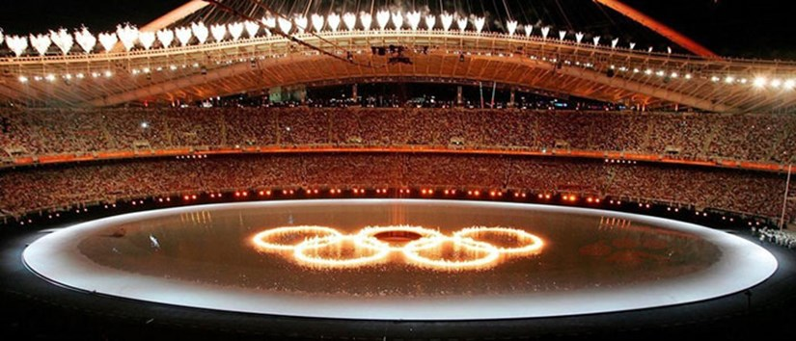
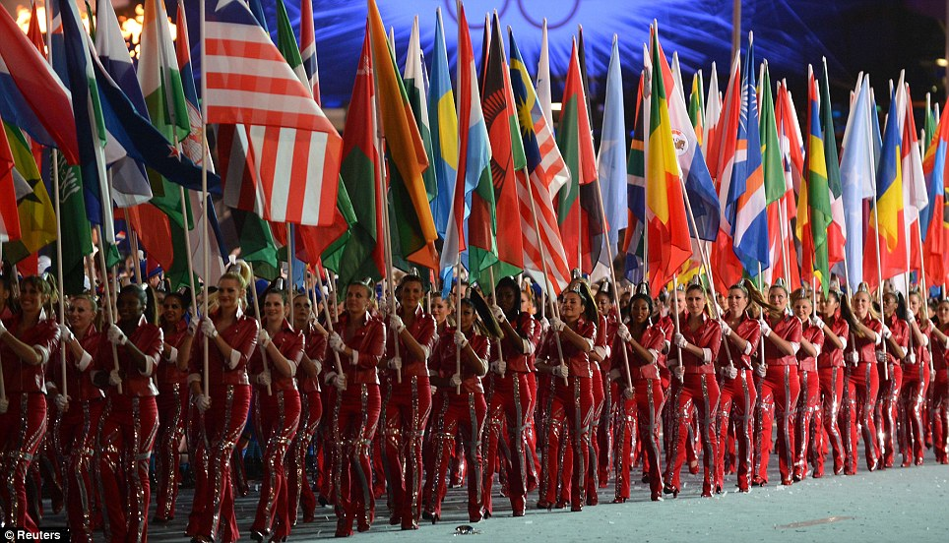

Slide 5
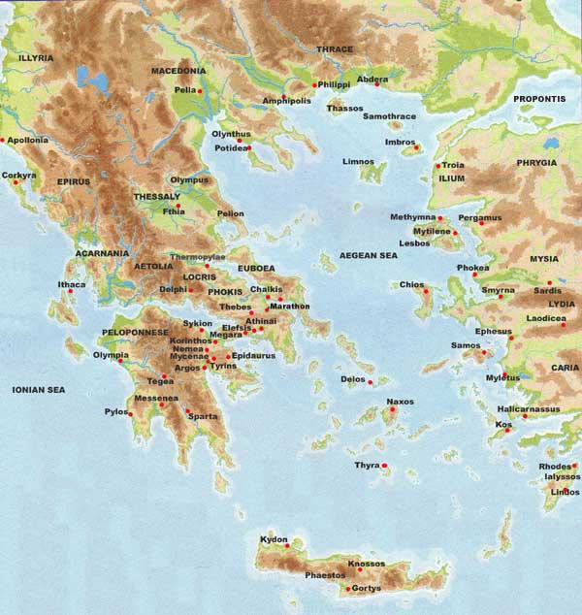

Slide 6
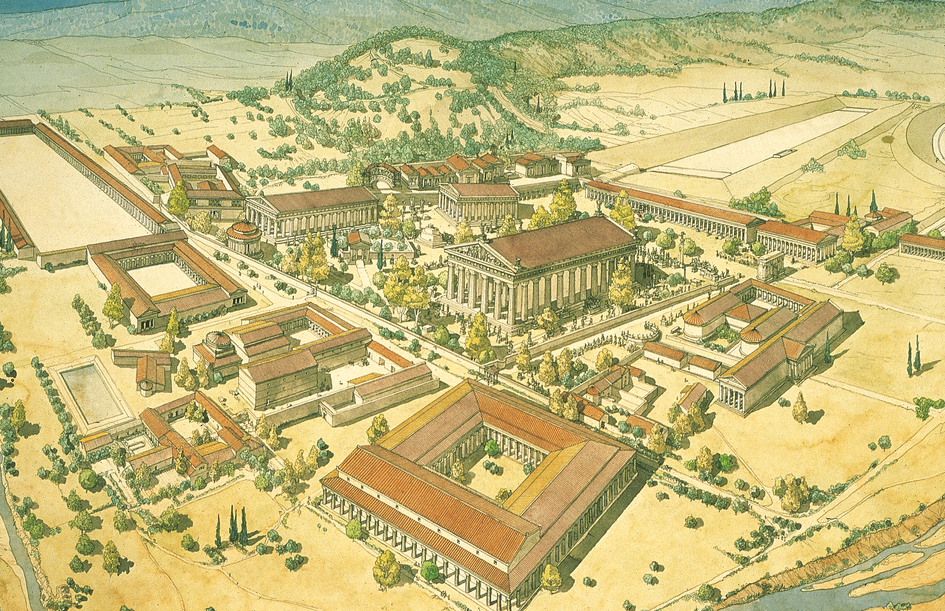

Slide 7
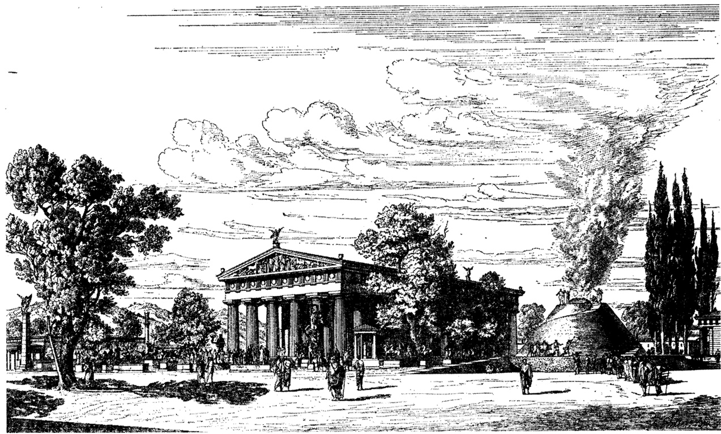

Slide 8
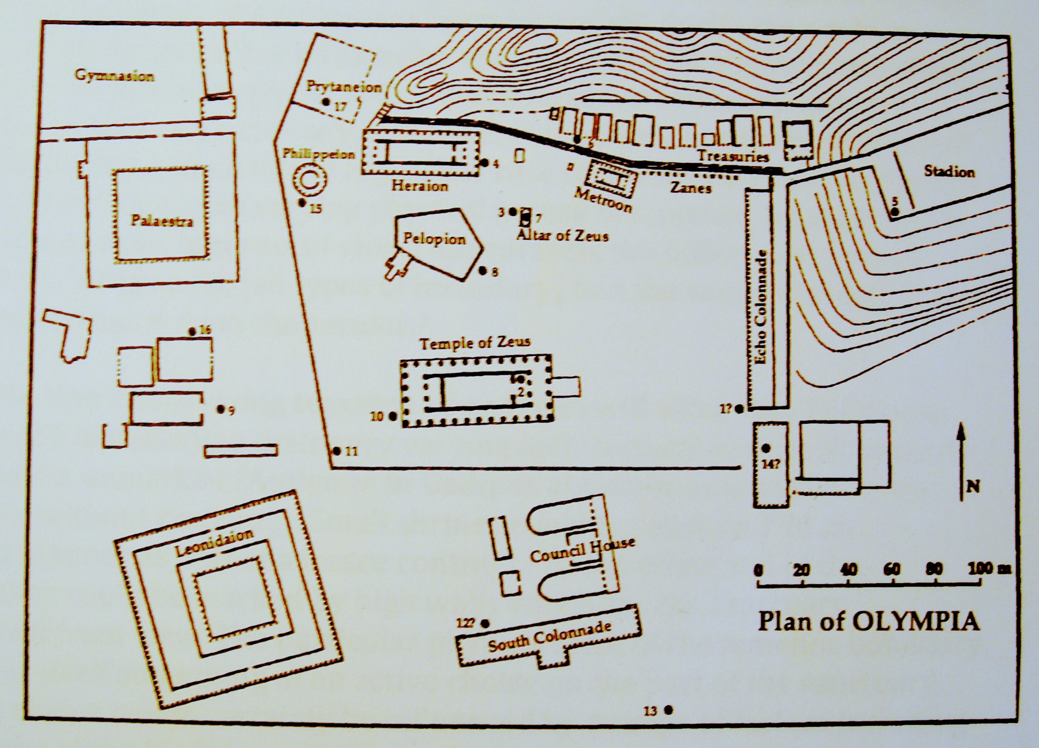

Slide 9
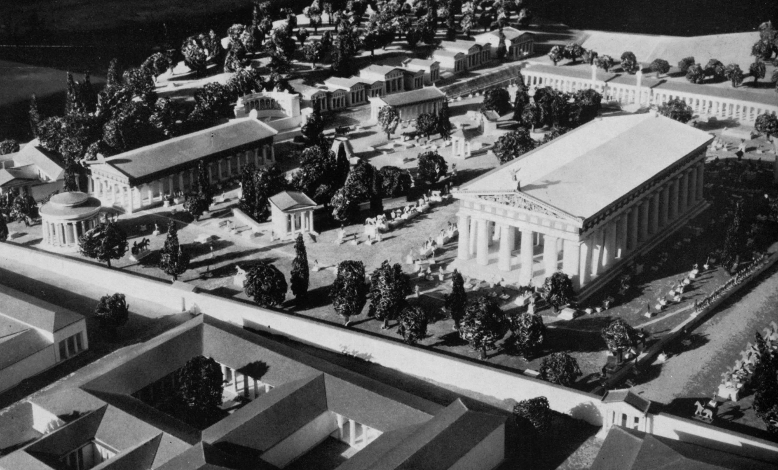

Slide 10
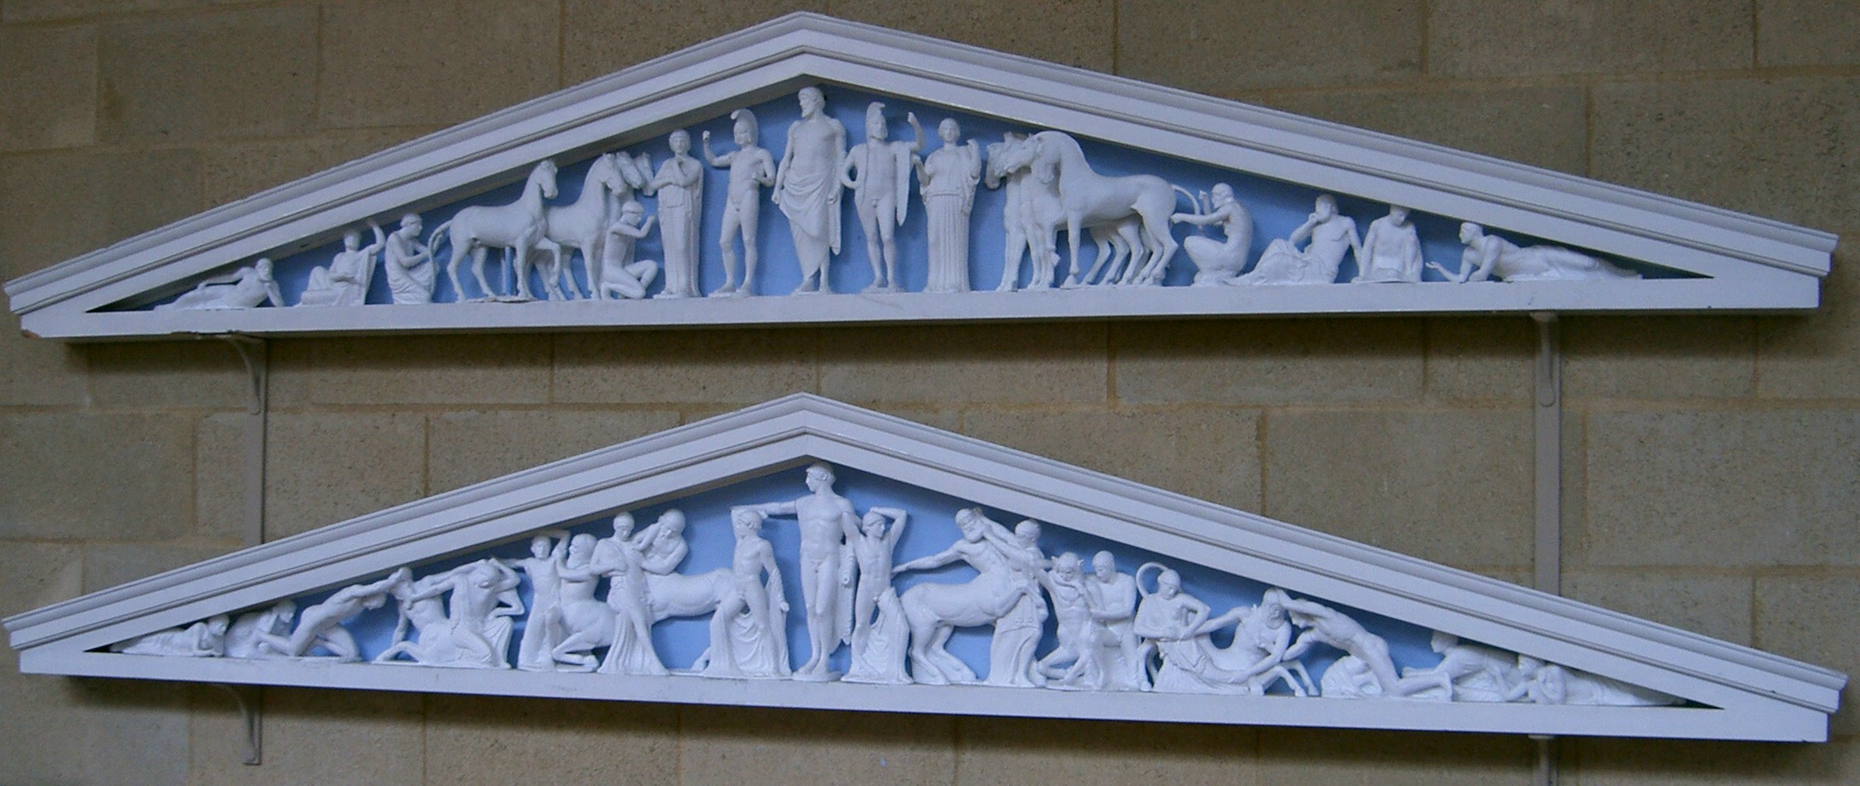

Slide 12
DAY 1:
Opening Ceremony
Contests for Heralds and Trumpeters
Boys’ races: short sprint, wrestling, boxing

Slide 13
DAY 2:
The horse events
Pentathlon

Slide 14
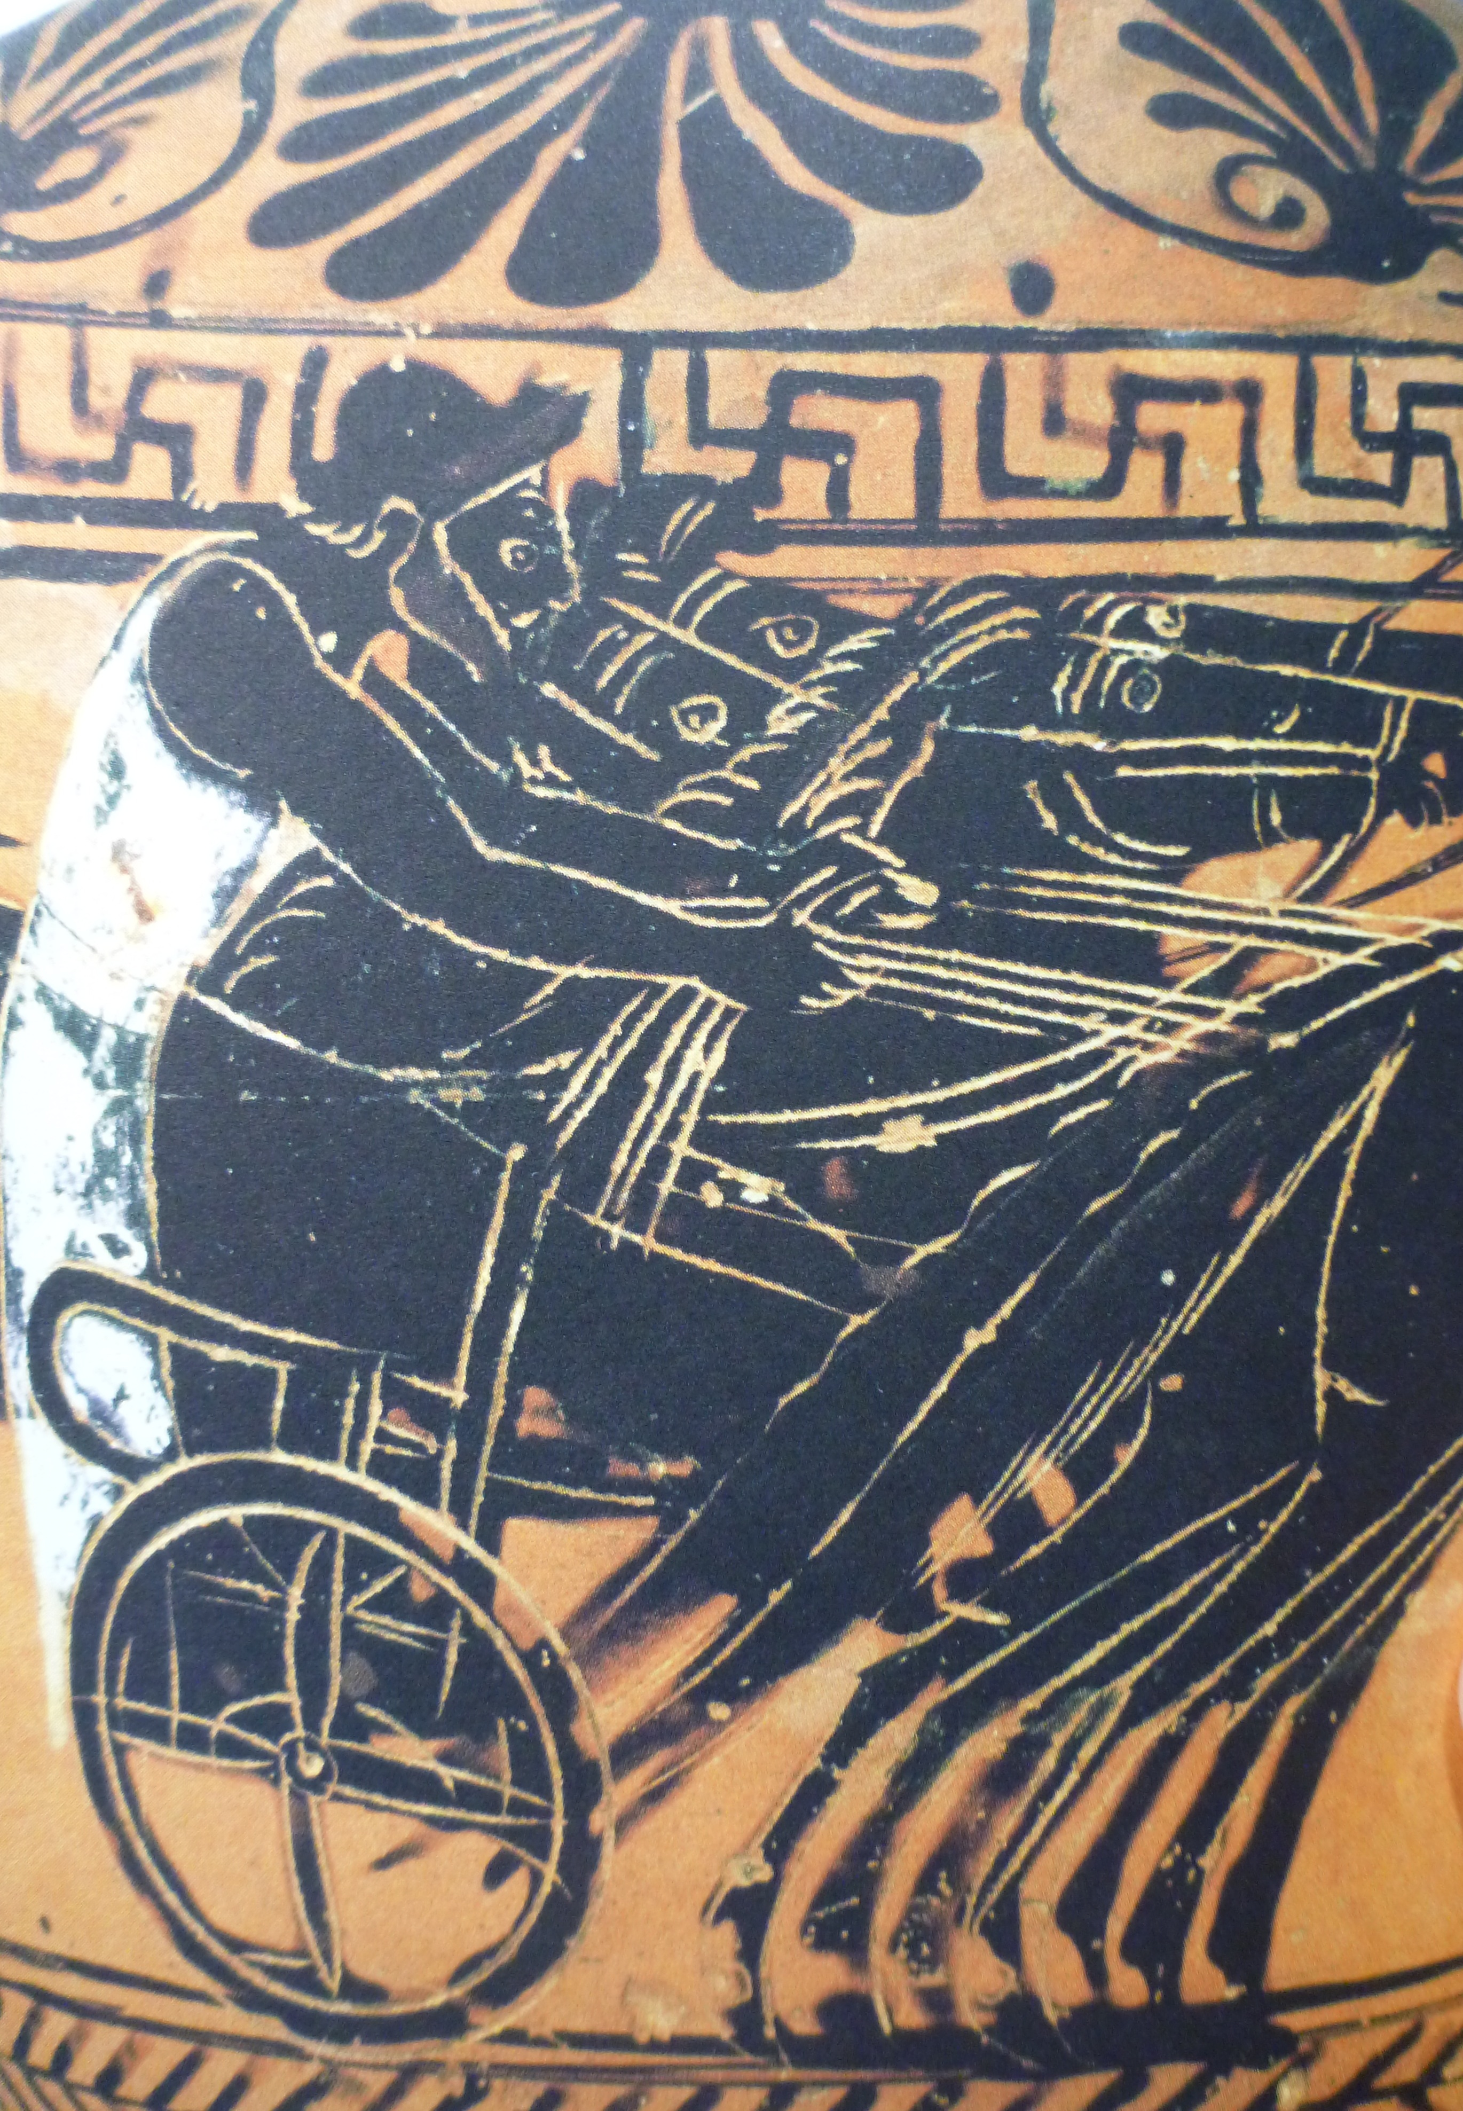

Slide 15
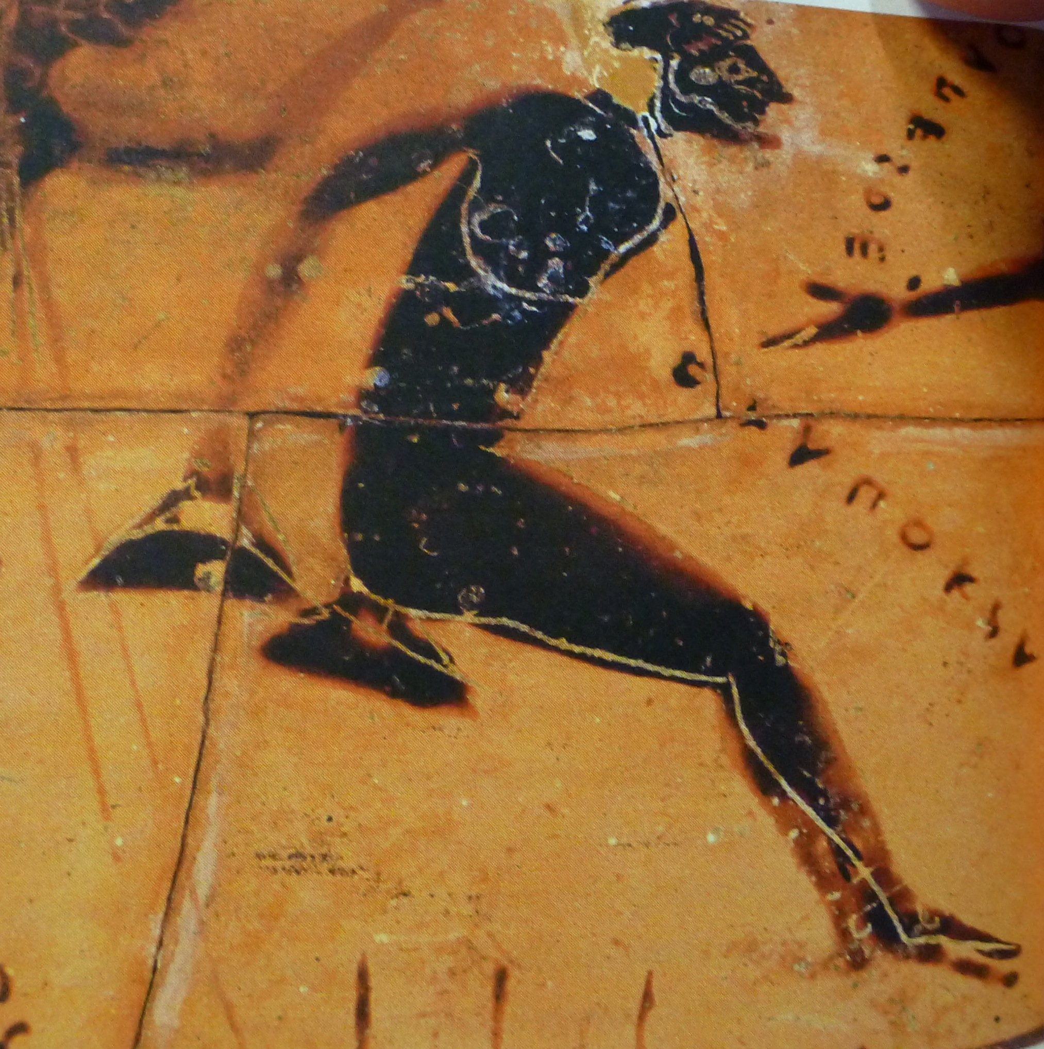

Slide 16
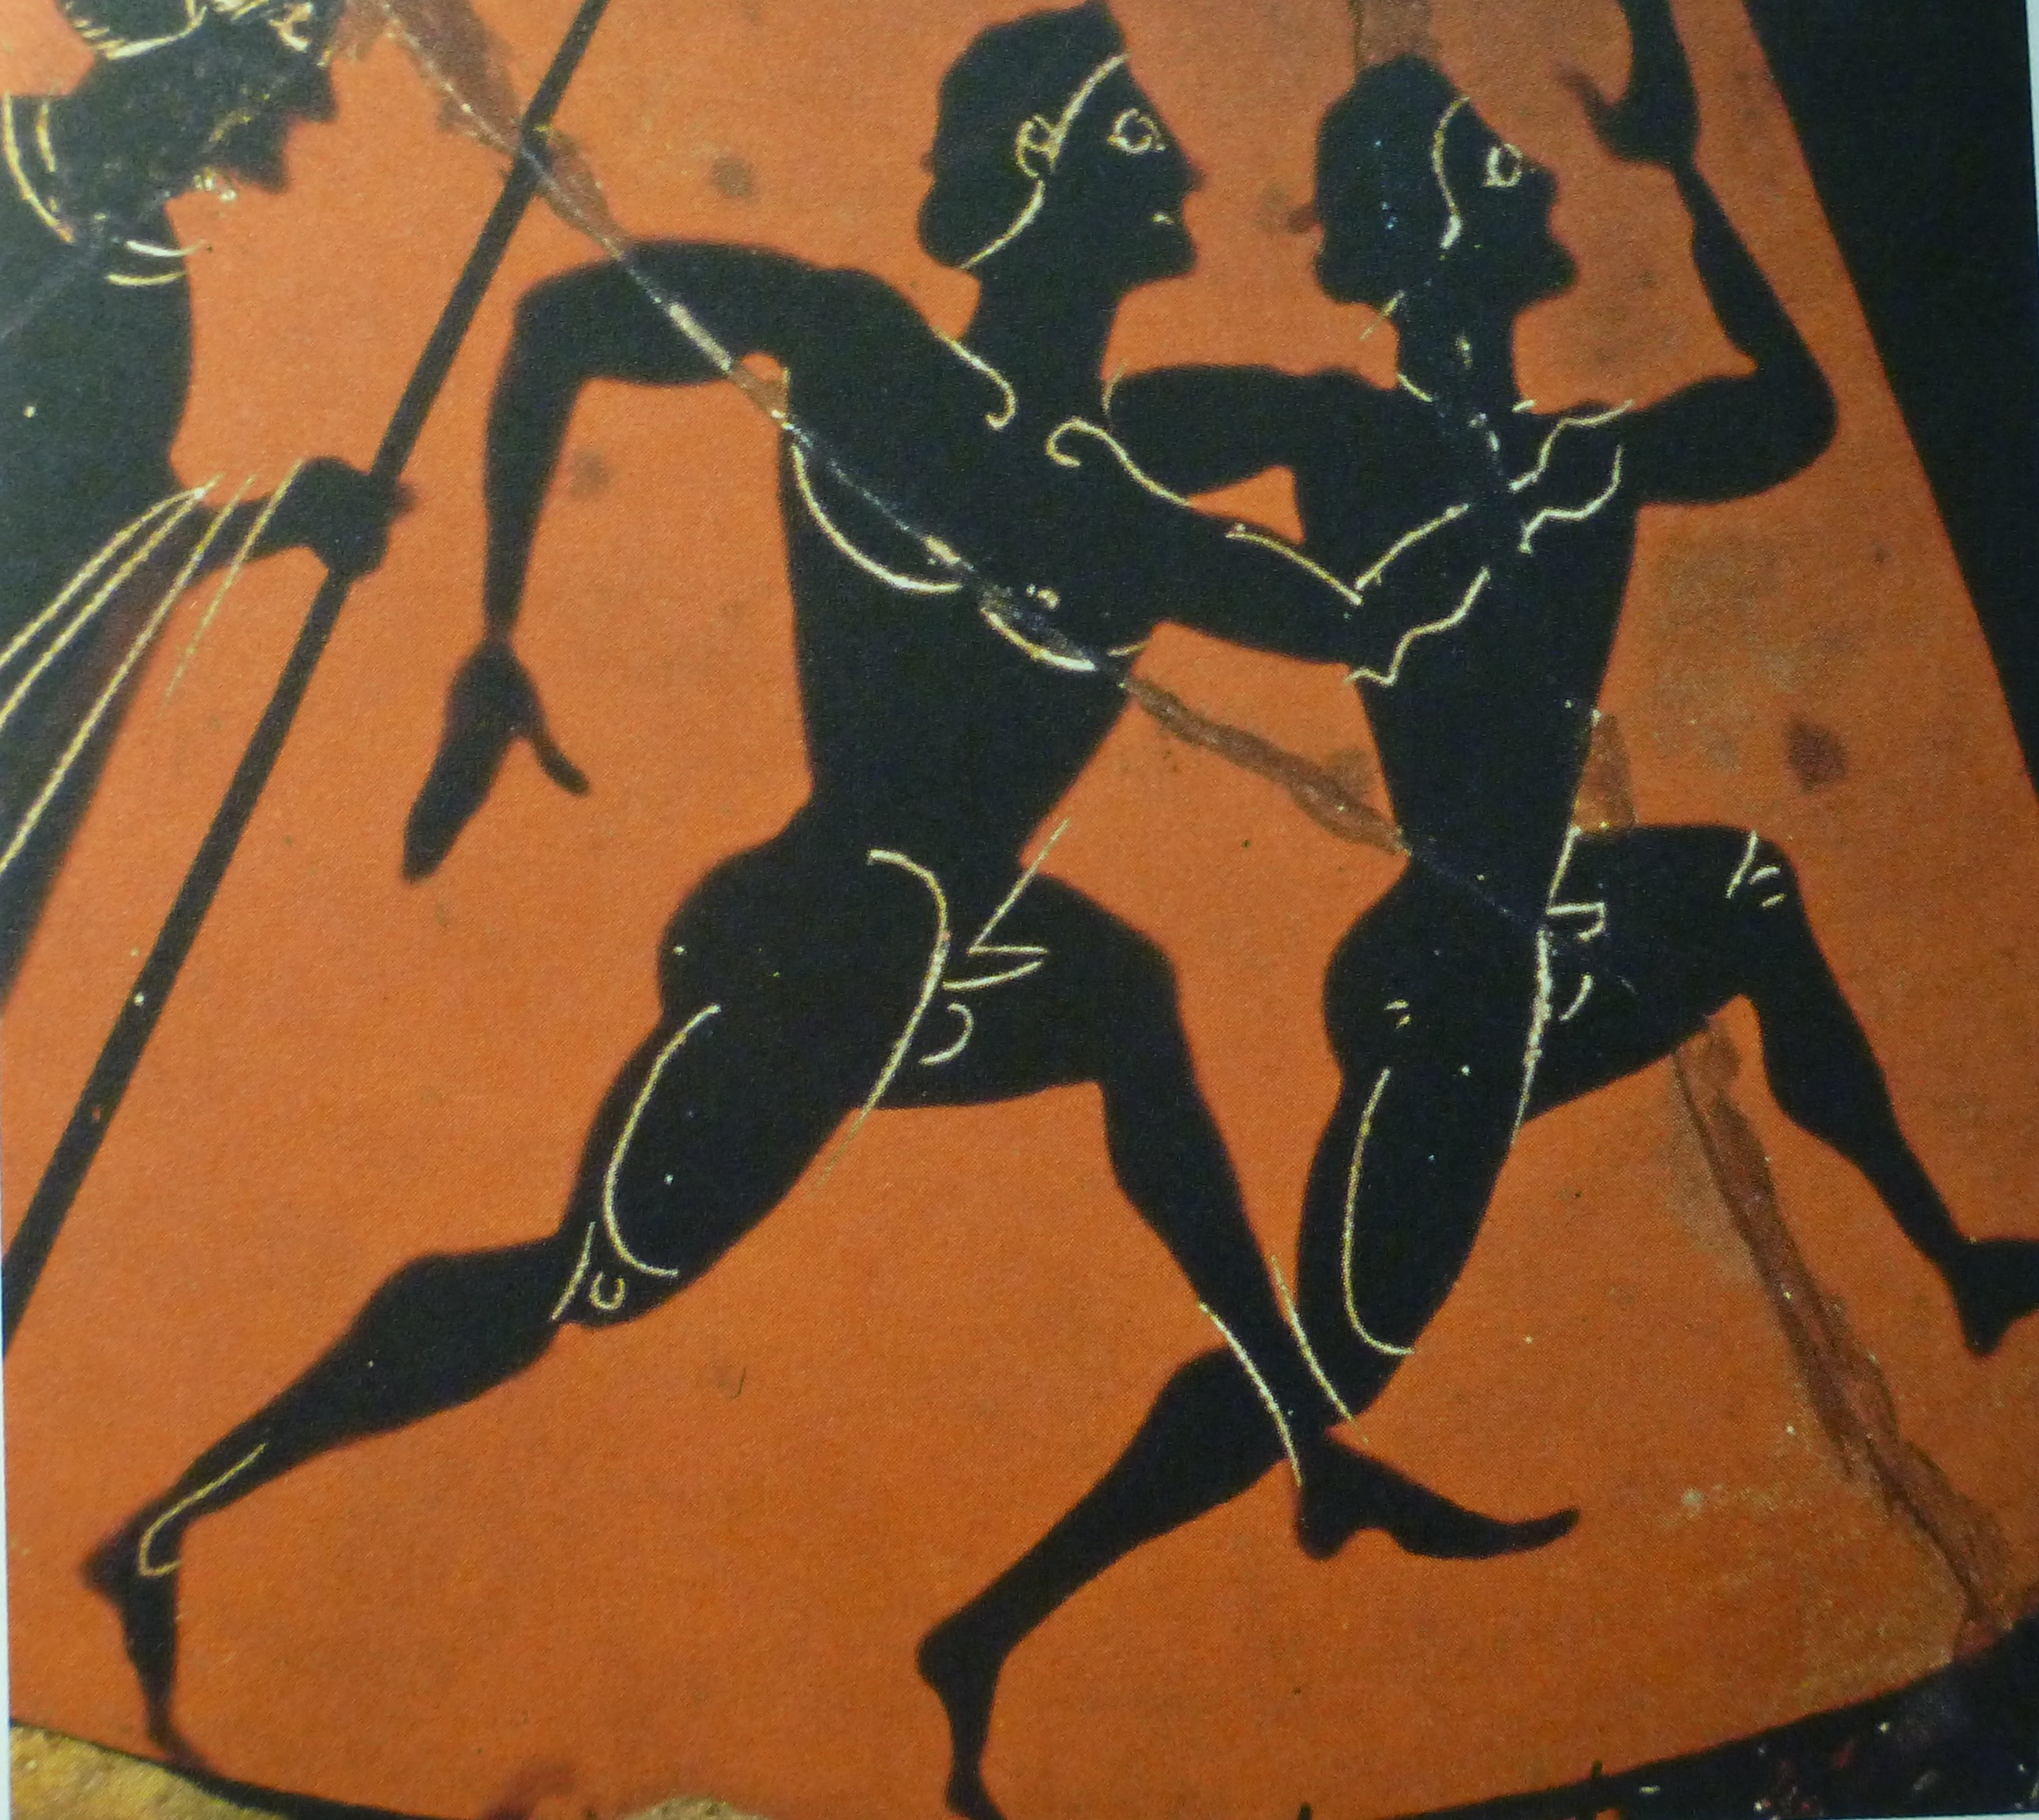

Slide 17
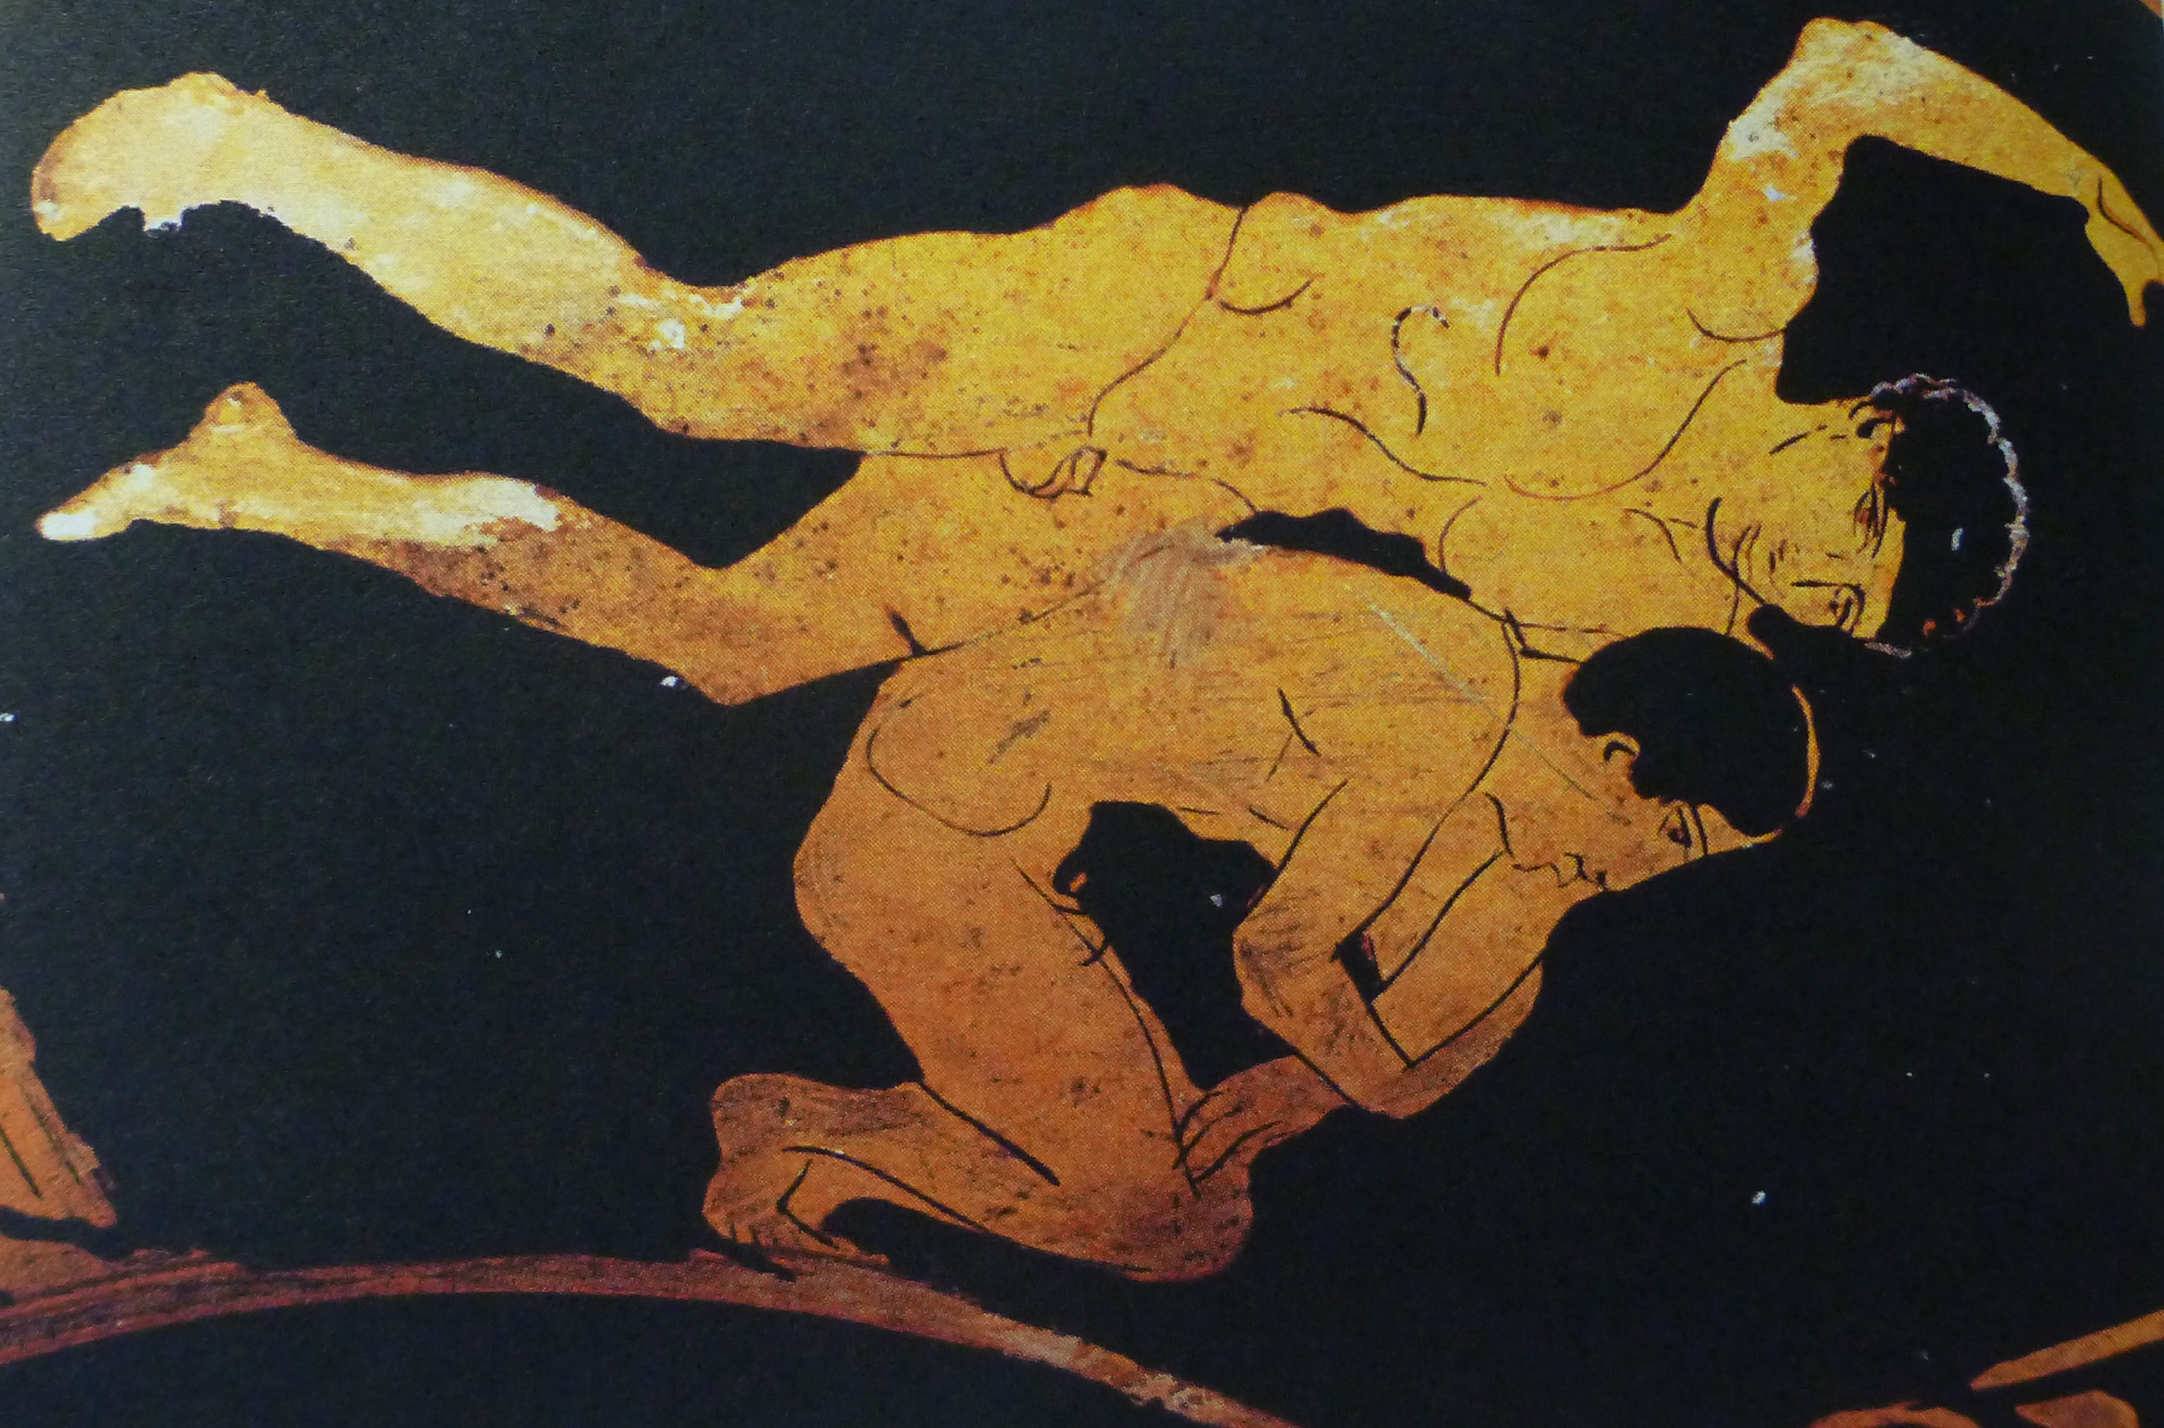

Slide 18
DAY 3:
The Sacrifice

Slide 20
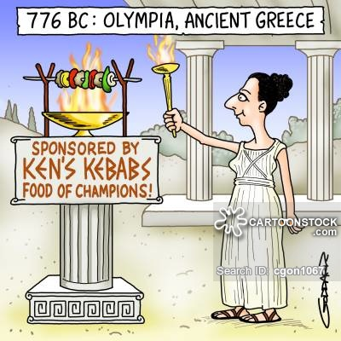

Slide 21
DAY 4:
The Running Races
The Wrestling and Boxing
The Pankration
Hoplitodromos

Slide 23
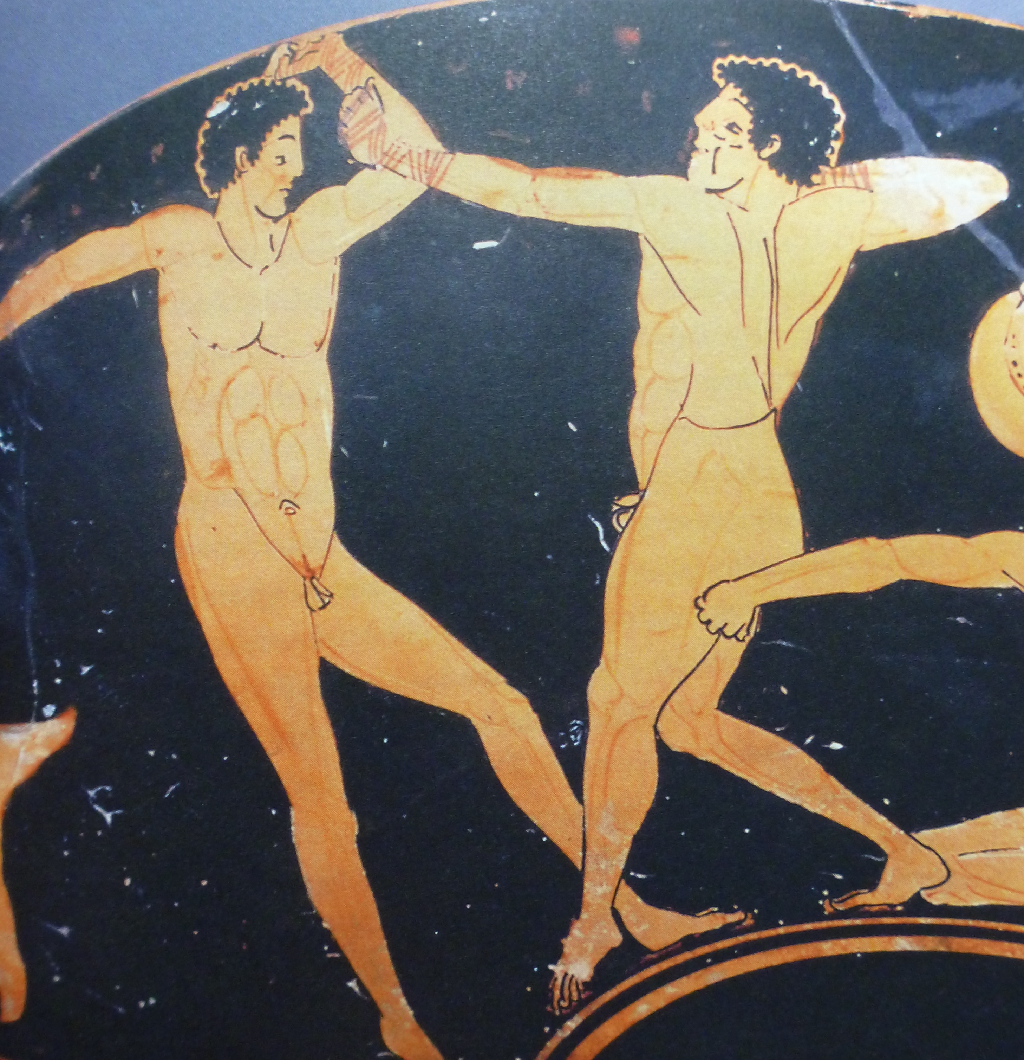

Slide 24
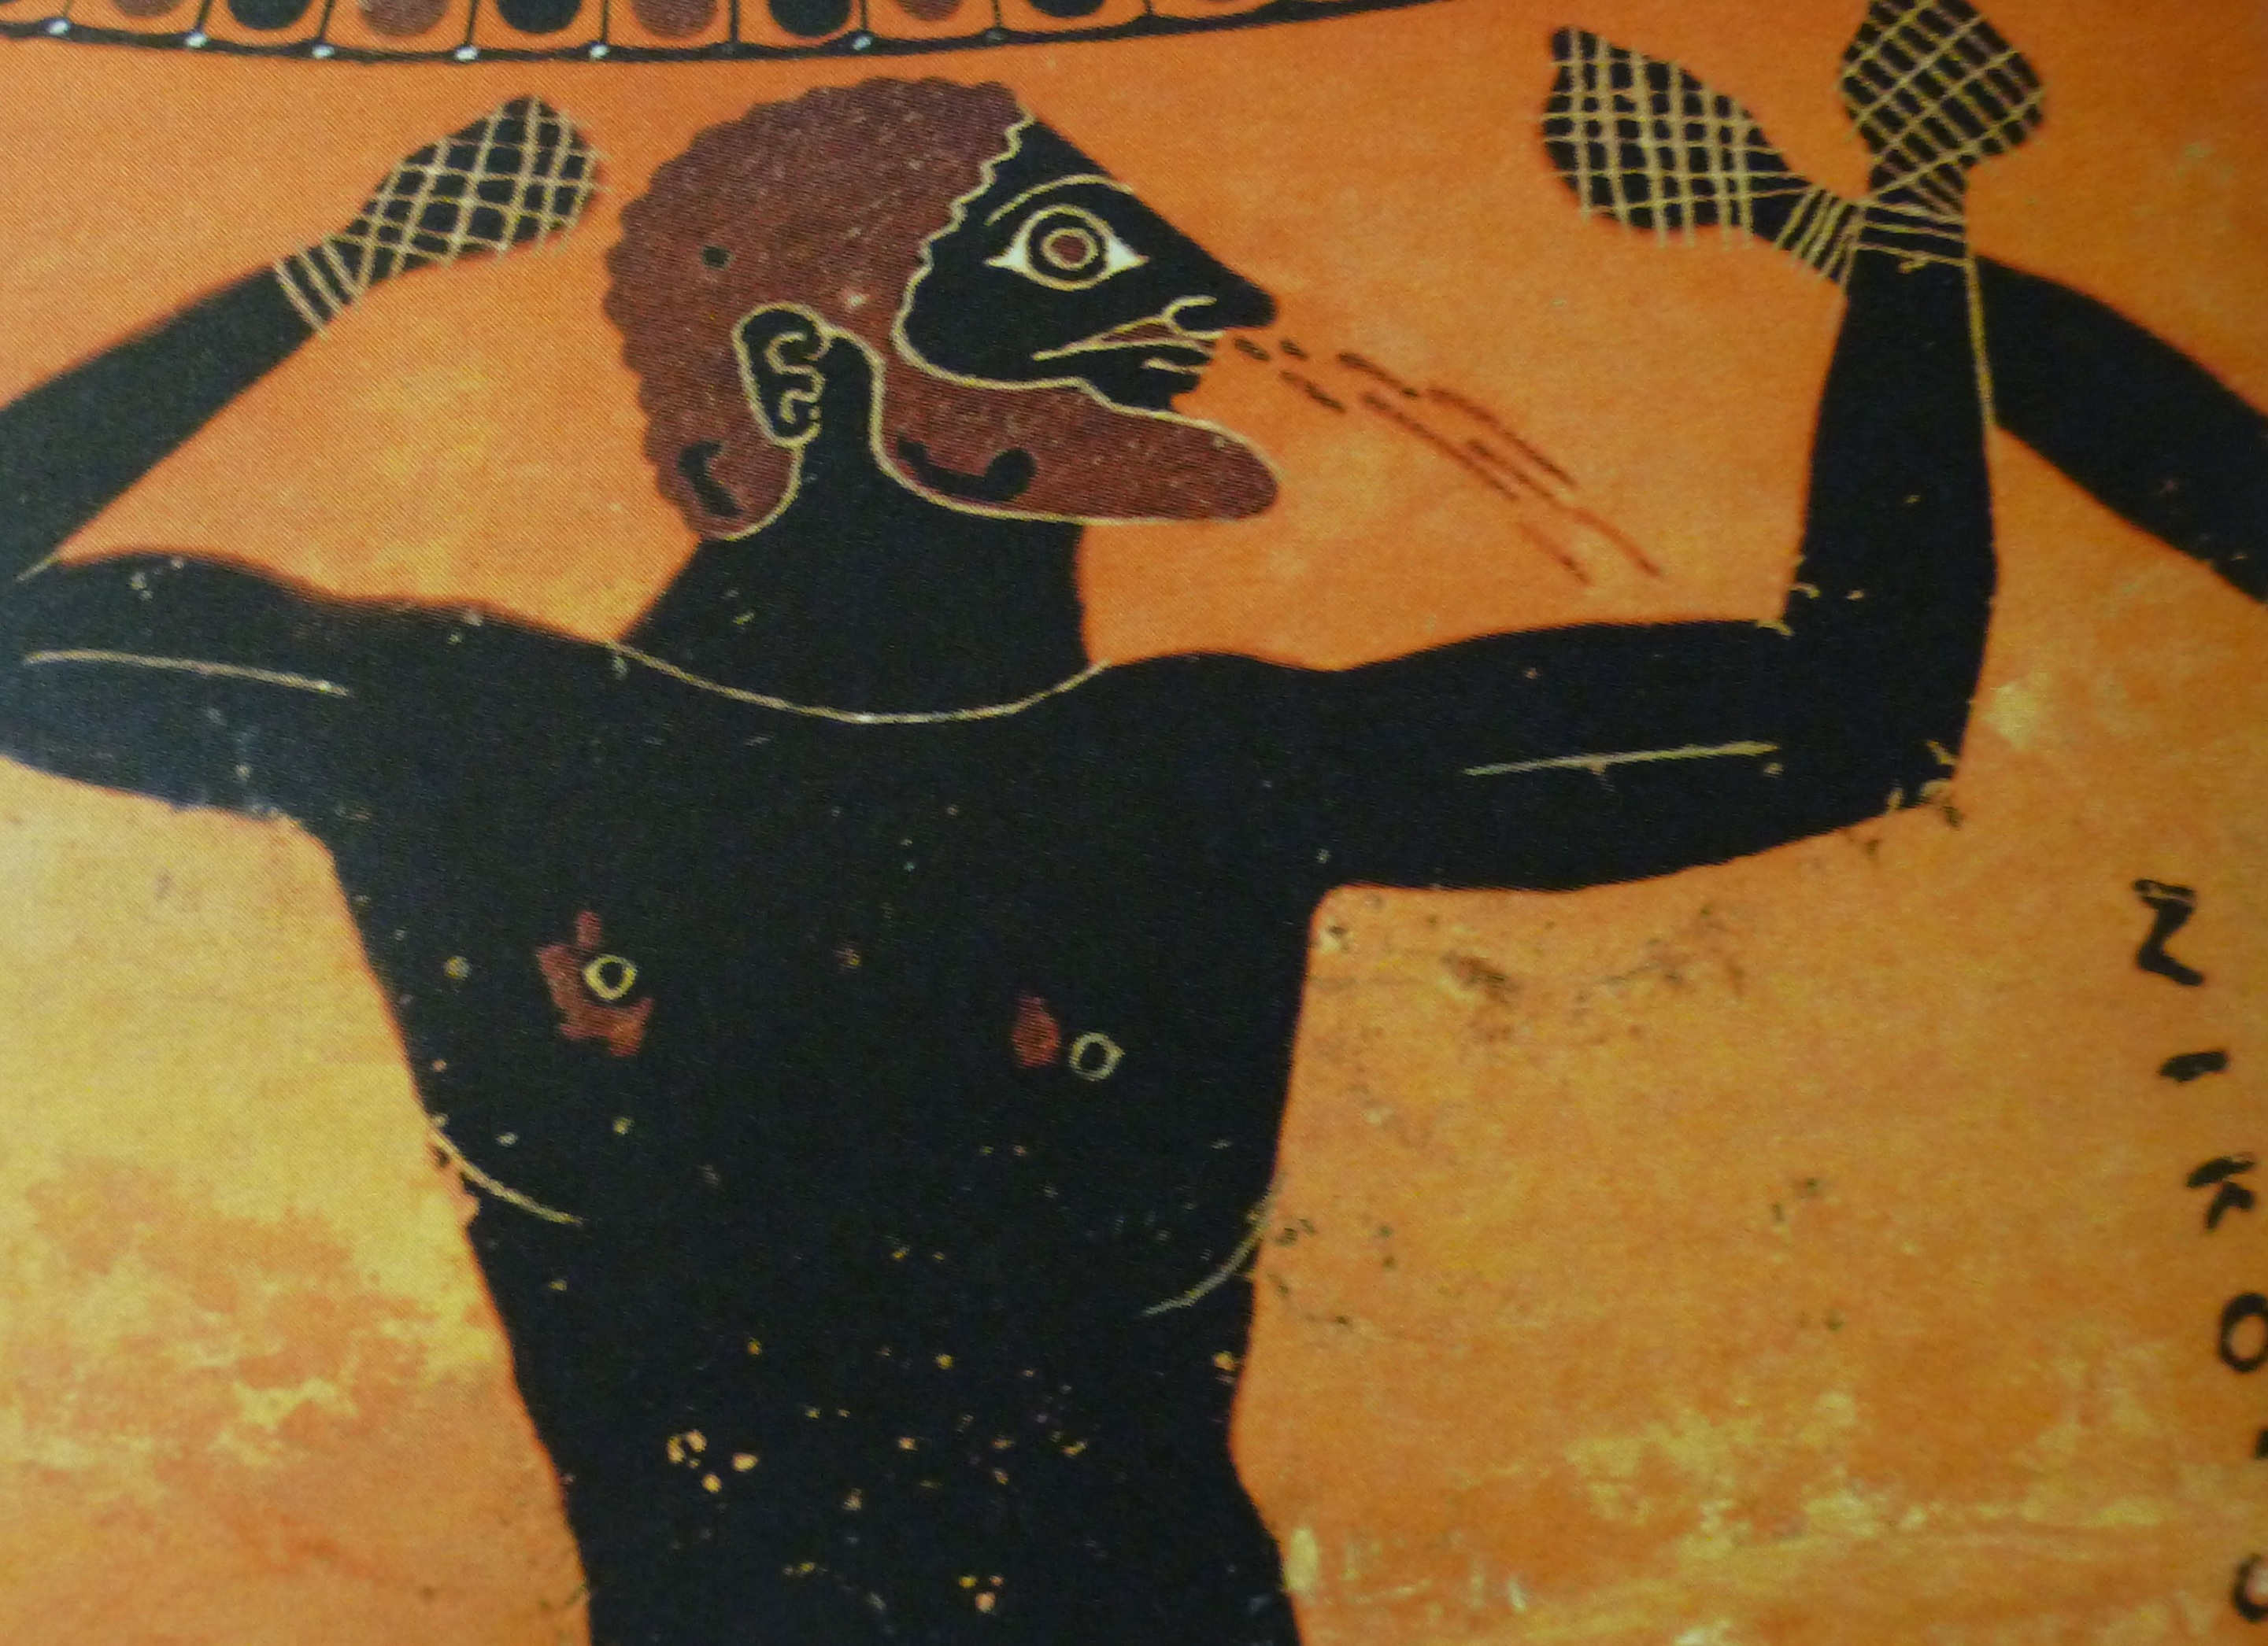

Slide 25
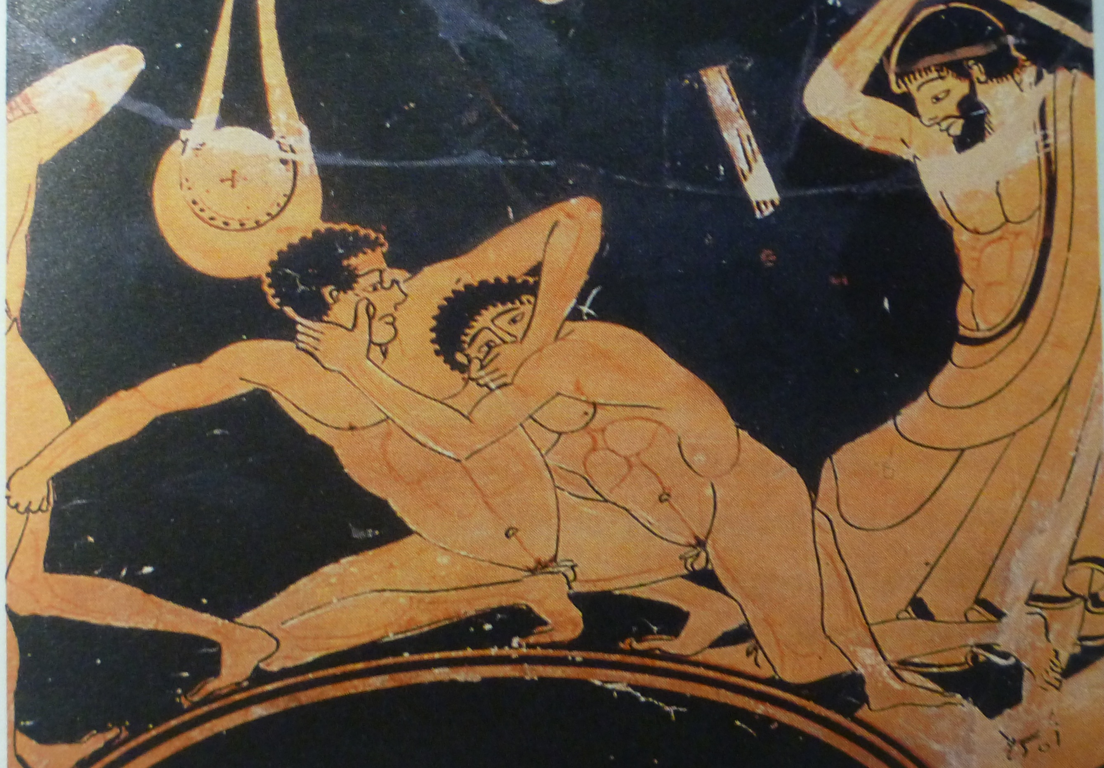

Slide 26
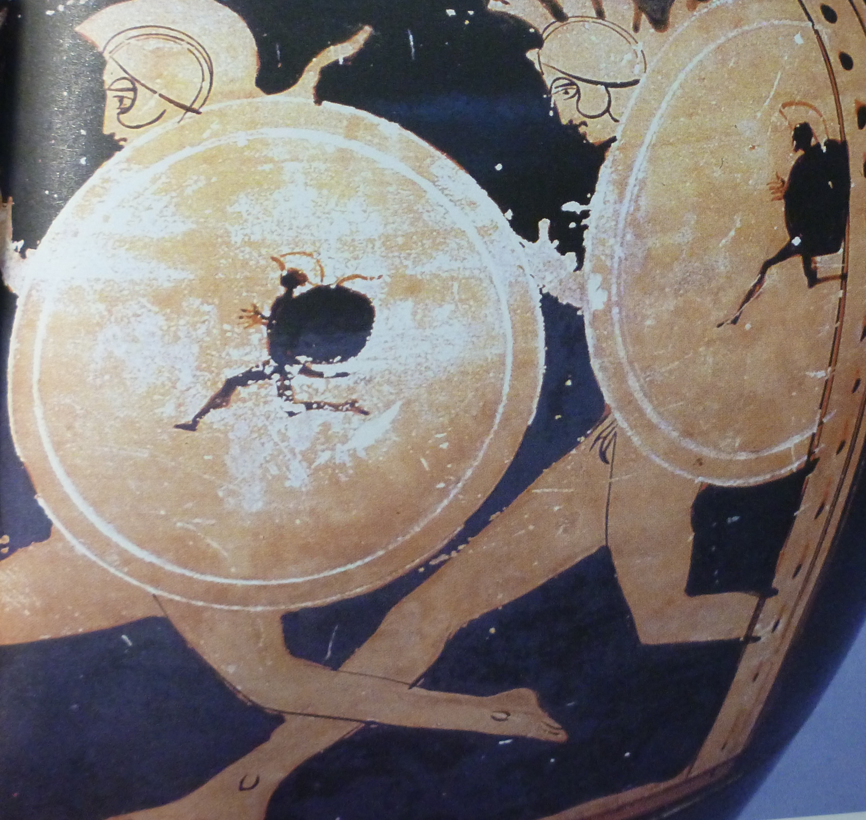

Slide 27
DAY 5:
Closing ceremony
The Party

Slide 29
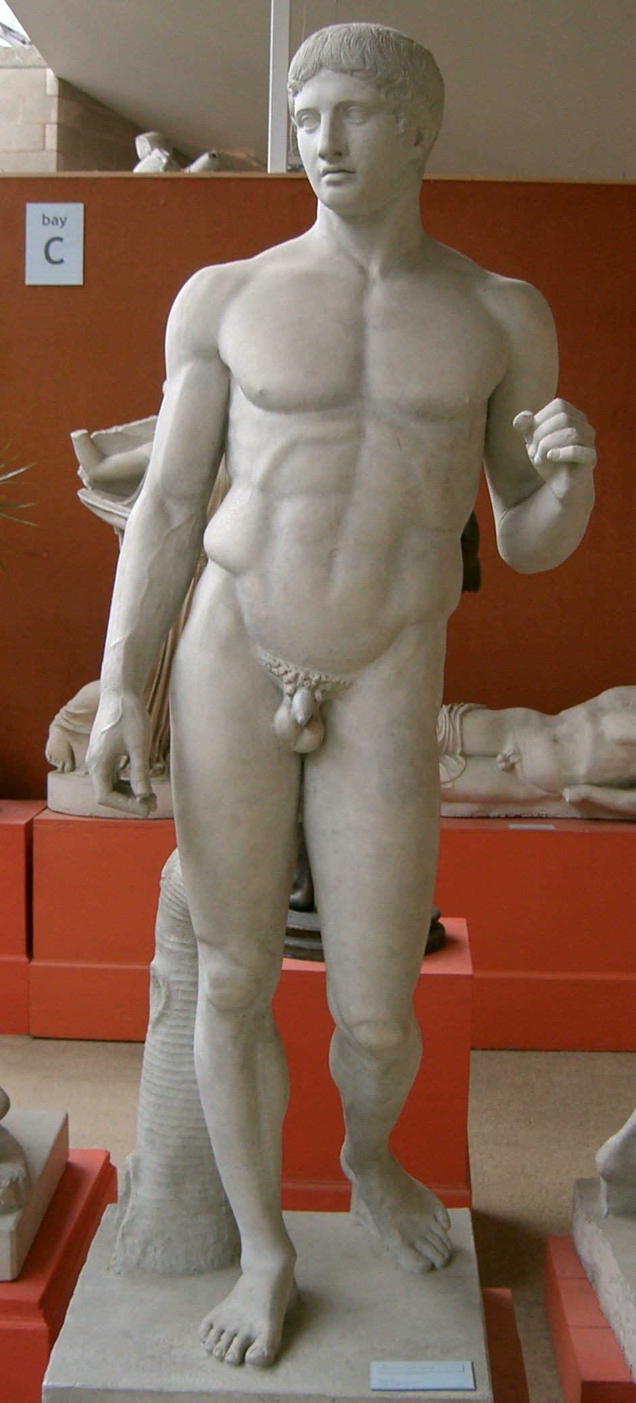

Slide 30
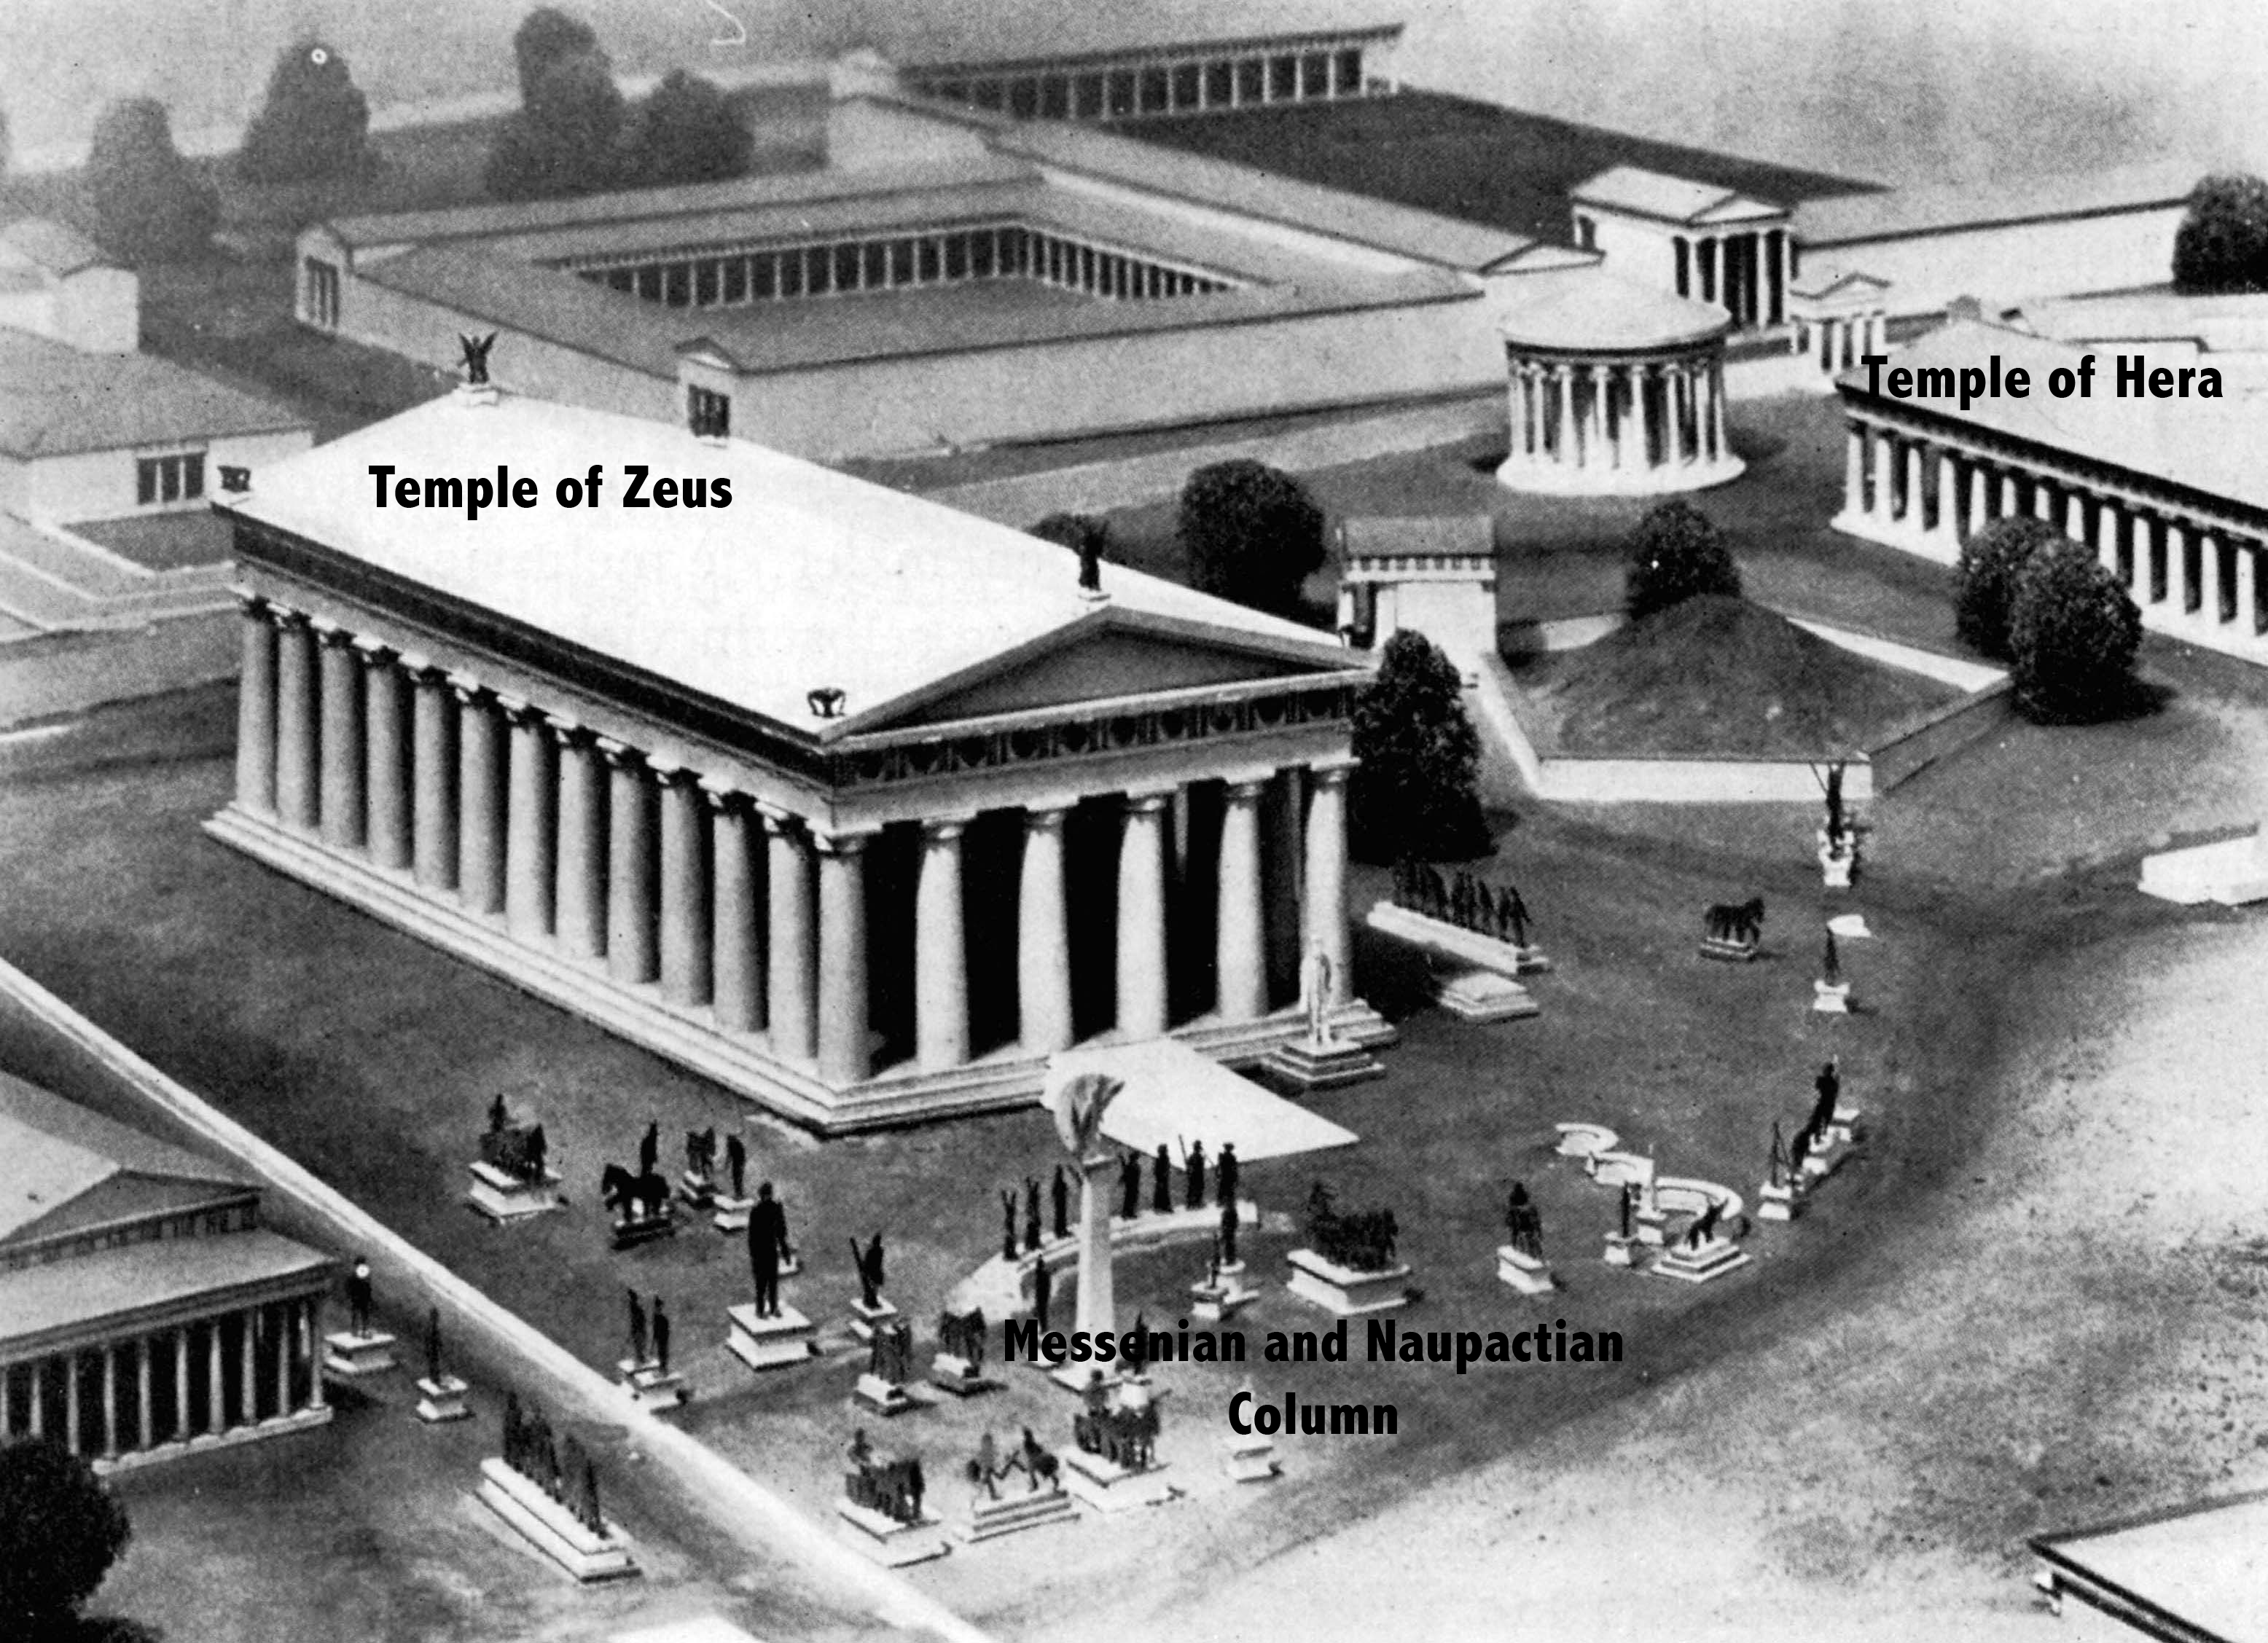

Slide 31
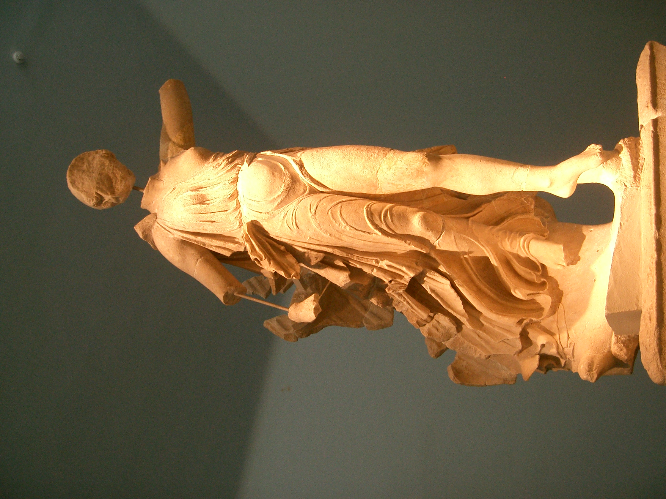

Slide 33
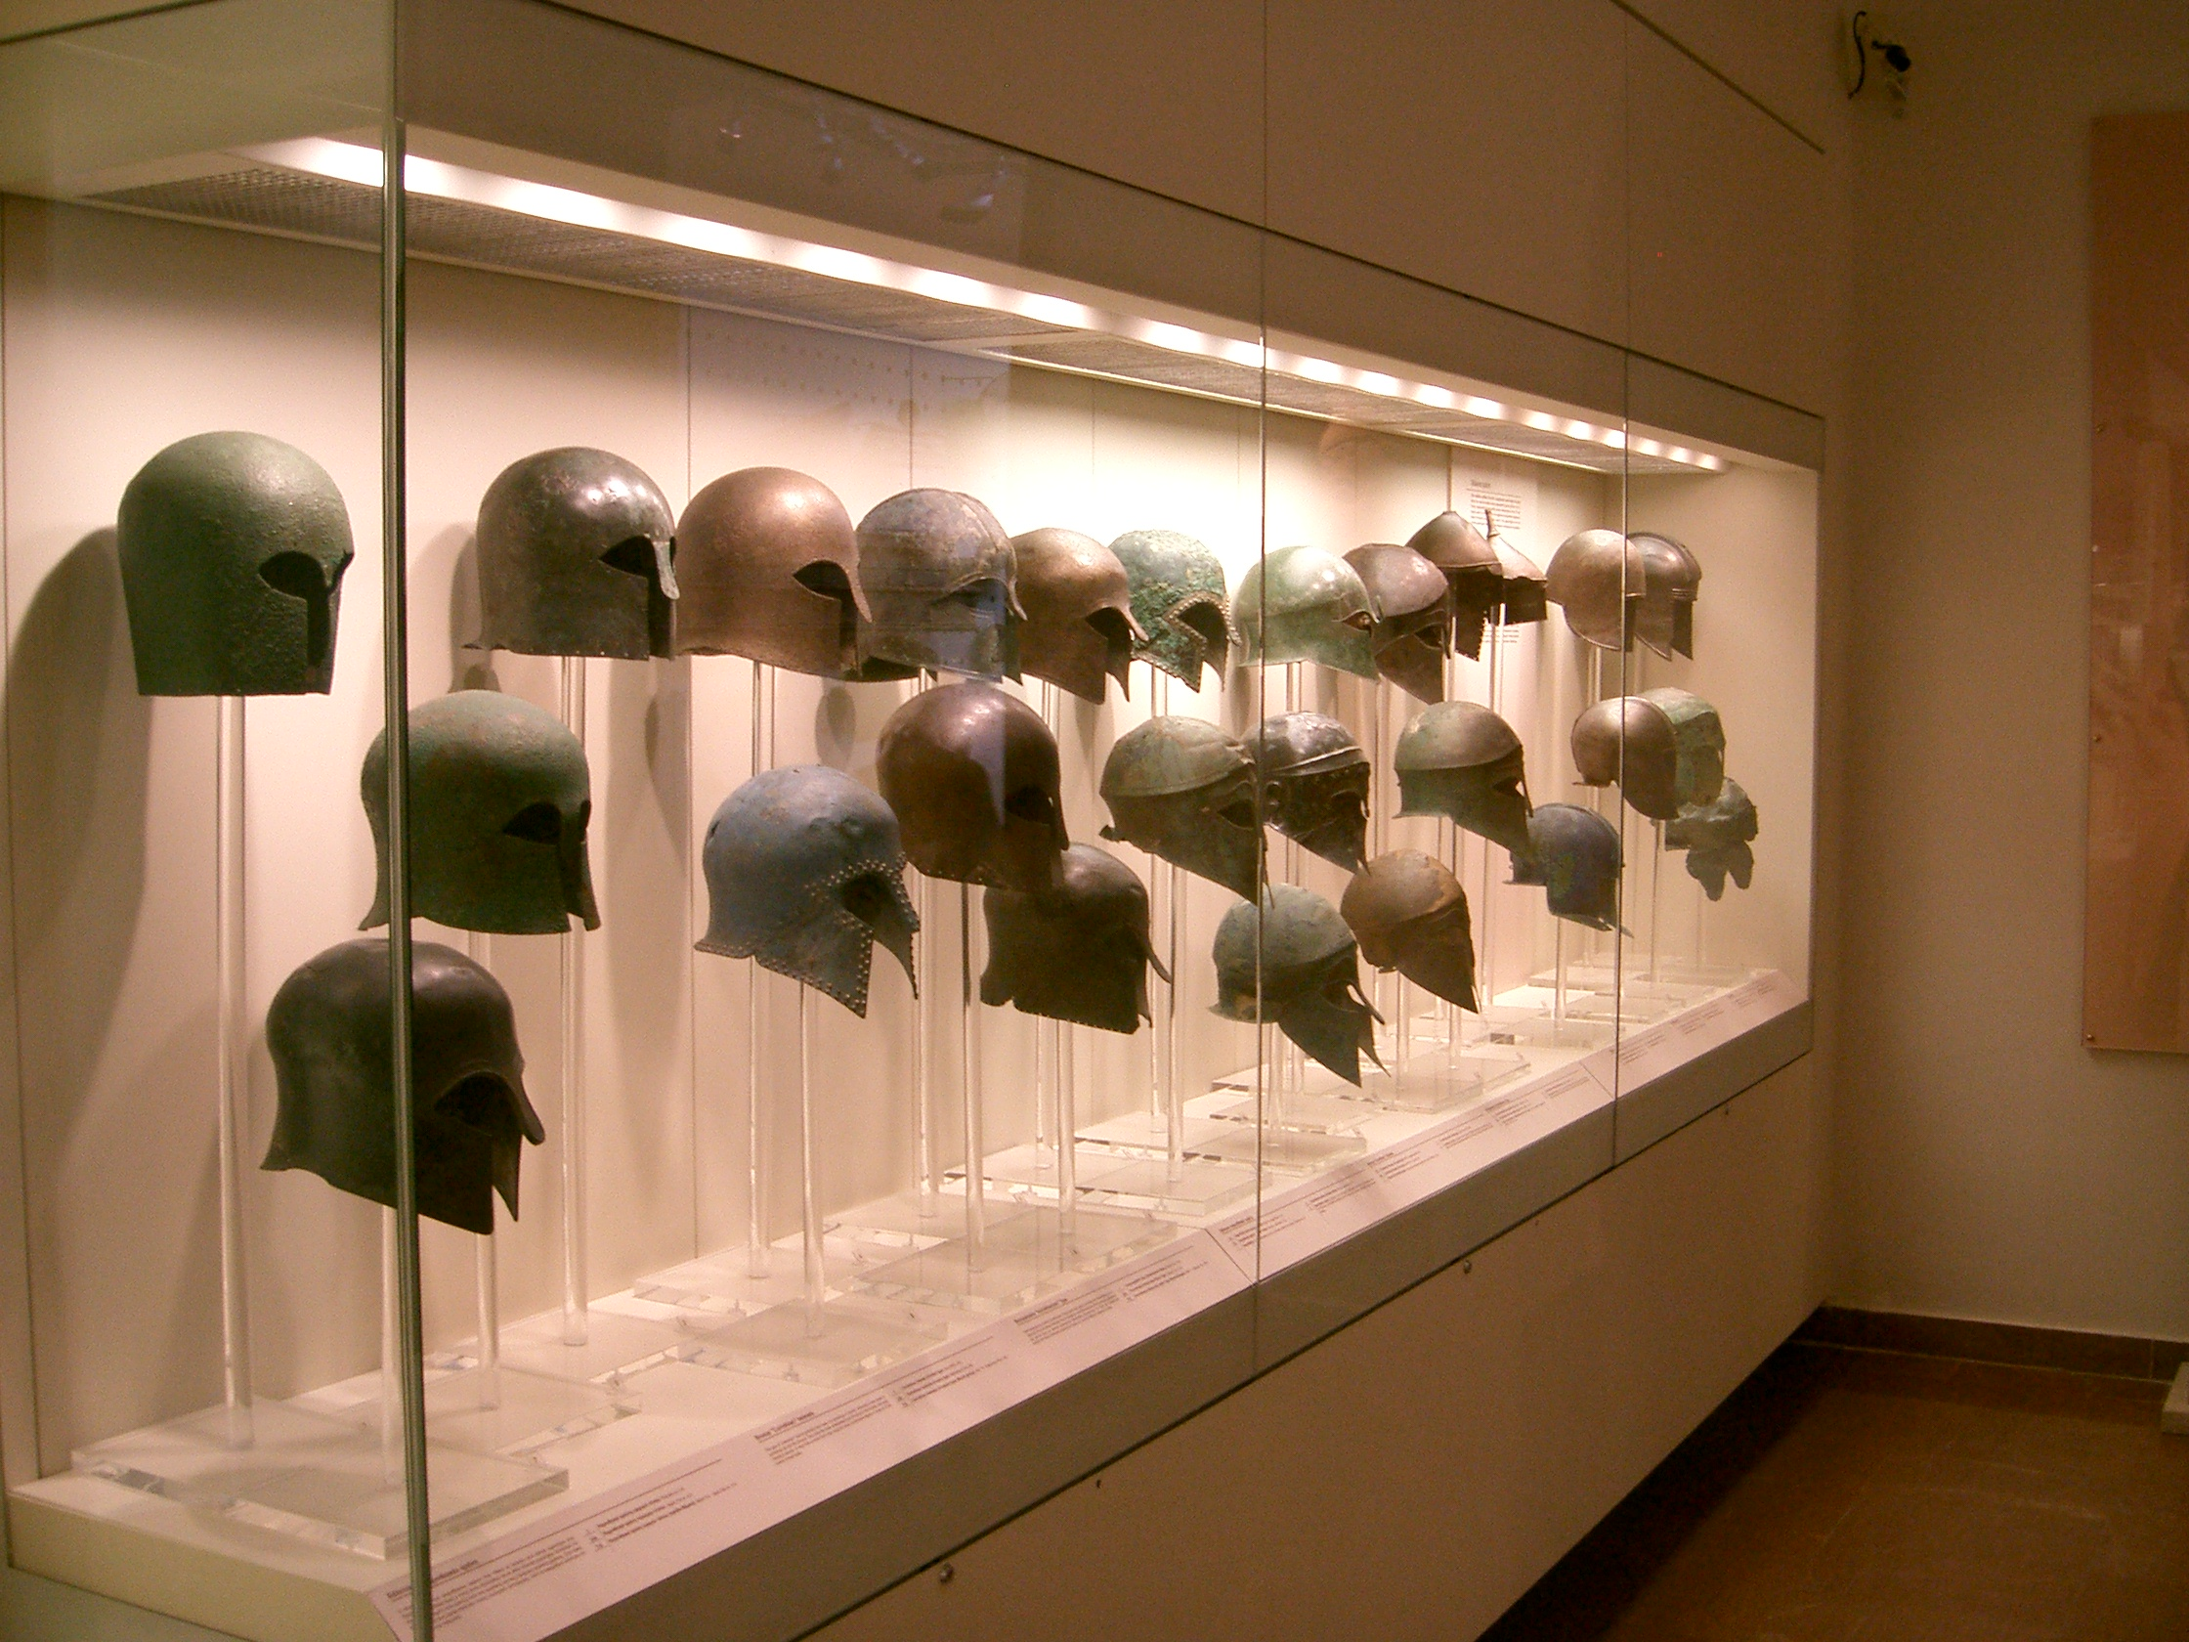

Slide 34
