Slide 1


Greek Festivals in the Roman Empire
Prof Zahra Newby
University of Warwick

Slide 2
What sorts of festivals?
Panhellenic: esp Olympia, Pythian Games at Delphi, Nemea, Isthmian
Regional/Local games: e.g. Panathenaia at Athens
Sacred, ‘crown’ games, bring prestige and exemptions at home
Prize games, award money prize
From Hellenistic period onwards, the upgrading of festivals to panhellenic and sacred status, ‘isolympic’, ‘isopythian’ – creates a Mediterranean wide festival culture.

Slide 3
Athletics and Greek Identity
Herodotus 5.22 (re Alexander I of Macedon)
Now that the men of this family are Greeks, sprung from Perdiccas, as they themselves affirm, is a thing which I can declare of my own knowledge, and which I will hereafter make plainly evident. That they are so has been already adjudged by those who manage the Pan-Hellenic contest at Olympia. For when Alexander wished to contend in the games, and had come to Olympia with no other view, the Greeks who were about to run against him would have excluded him from the contest- saying that Greeks only were allowed to contend, and not barbarians. But Alexander proved himself to be an Argive, and was distinctly adjudged a Greek; after which he entered the lists for the foot-race, and was drawn to run in the first pair. Thus was this matter settled.

Slide 4
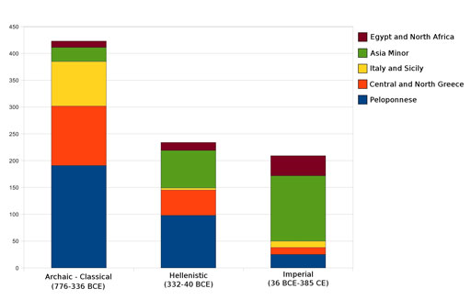
Increasing Geographical Spread of attested Olympic Victors

Slide 5
‘First of the Ionians’
Pausanias 6.2.6
‘By the statue of Thrasybulus stands Timosthenes of Elis, winner of the foot-race for boys, and Antipater of Miletus, son of Cleinopater, conqueror of the boy boxers. Men of Syracuse, who were bringing a sacrifice from Dionysius to Olympia, tried to bribe the father of Antipater to have his son proclaimed as a Syracusan. But Antipater, thinking naught of the tyrant's gifts, proclaimed himself a Milesian and wrote upon his statue that he was of Milesian descent and the first Ionian to dedicate his statue at Olympia.’(388BC)
C.f. IvO 184 (Moretti 1953, no .43; 1957 no. 590, c. 212 BC) Akestorides ‘first of the Trojans’ to win an Olympic victory, also victorious at Epidauros, Nemea and the Arcadian cities of Lusoi and Pheneus
Pausanias 6.4.9 (Moretti 1957, no. 597)
Sodamas of Assos, ‘the first of the Aeolians in this area to win the boy’s stade race at Olympia’

Slide 6
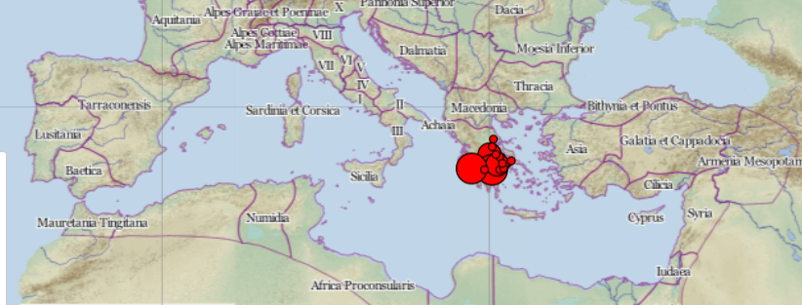
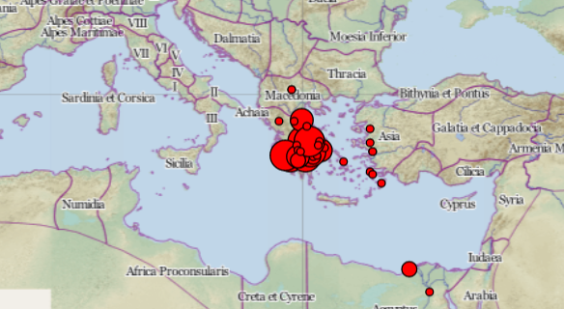
Hellenistic and Roman Periods: Expansion
Maps: http://www.connectedcontests.org/database/
Left: 500 BC
Below: by 200 BC

Slide 7
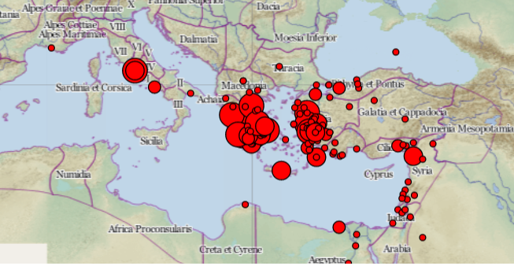
By AD 250

Slide 8
Athletics in Rome and Italy
Sebasta festival in Naples, started under Augustus, Flavian emperors acted as agonothetai.
Neronia Festival instituted in Rome by Nero, only ran AD 60 and 65
Capitoline Festival instituted in Rome by Domitian, AD 86 onwards.
More festivals in 2nd 3rd C.
Divided opinions?
Tacitus, Annals 14.20
‘Traditional morals, already gradually deteriorating, have been utterly ruined by this imported laxity! It makes everything potentially corrupting and corruptible flow into the capital, foreign influences demoralize our young men into shirkers, gymnasts and perverts…(gymnasia et otia et turpis amores)’ (trans. M. Grant).
Juvenal Satire 3.68
‘Your rustic roman…bears prizes of victory on an oiled neck’
(et ceromatico fert niceteria collo)

Slide 9
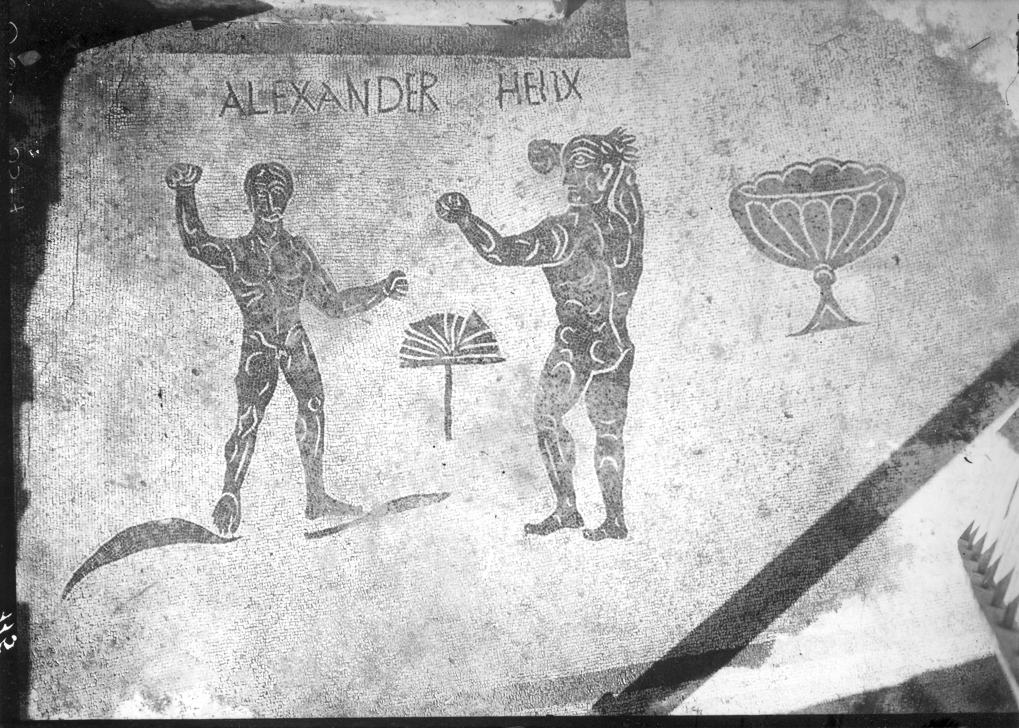
Inn of Alexander Helix, Ostia
Photo: Soprintendenza Archeologica di Ostia Antica (after Newby 2005: fig 3.5)

Slide 10
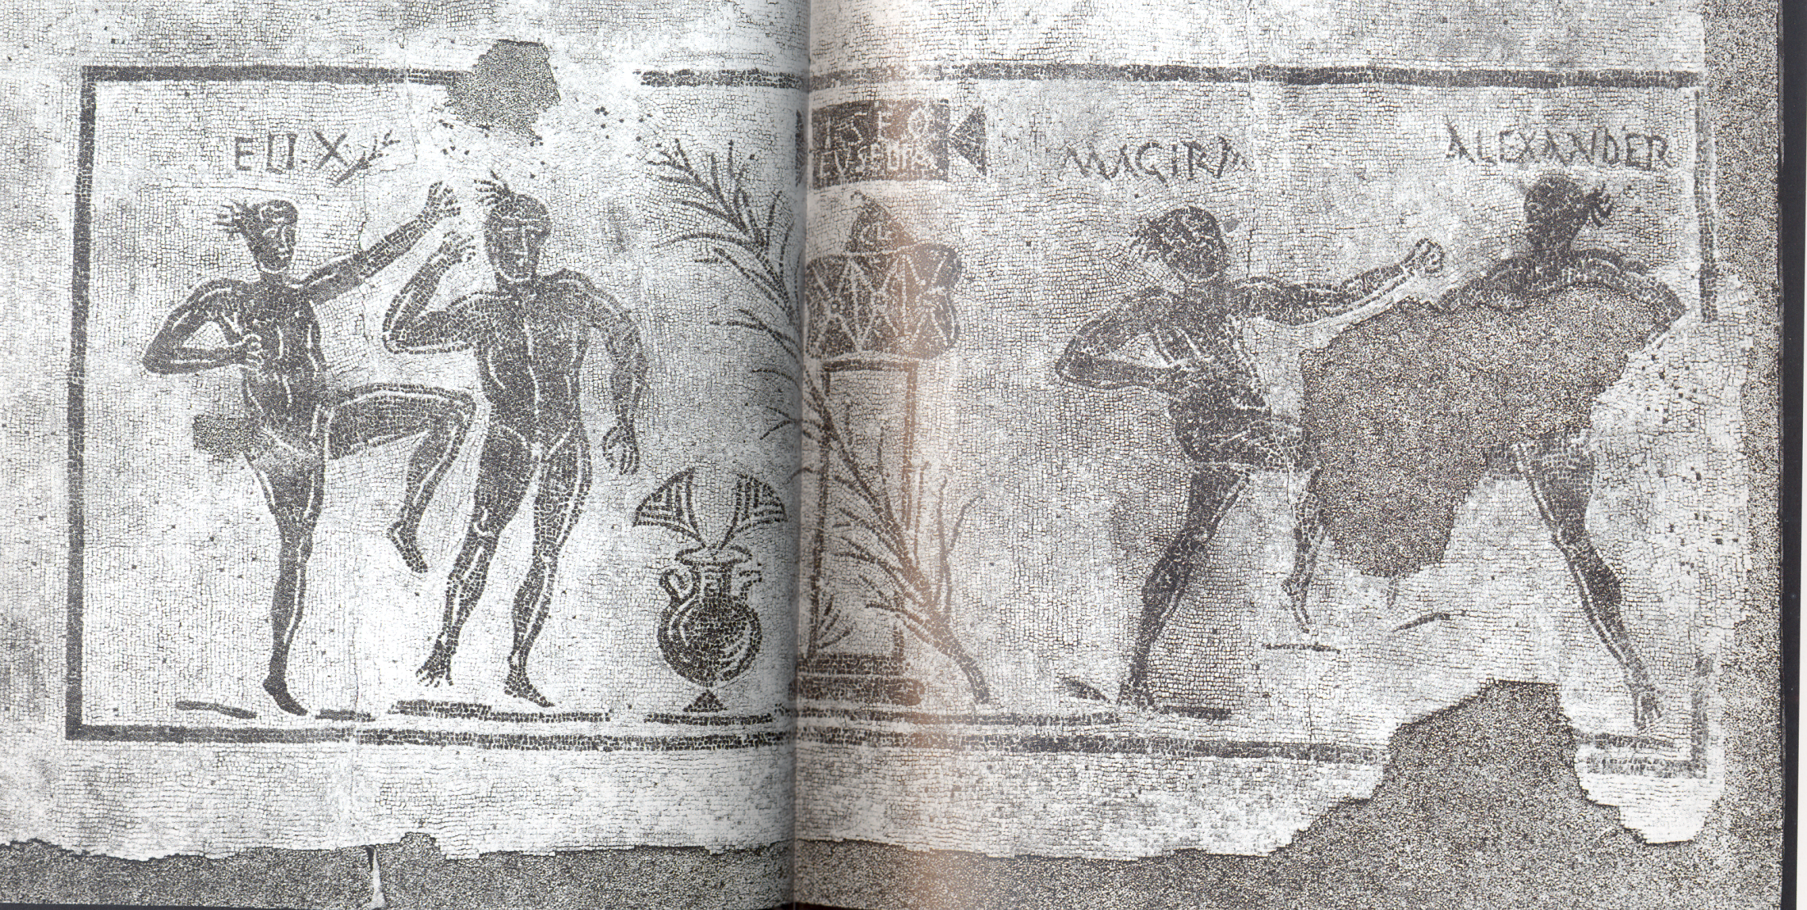
Mosaic from Puteoli

Slide 11
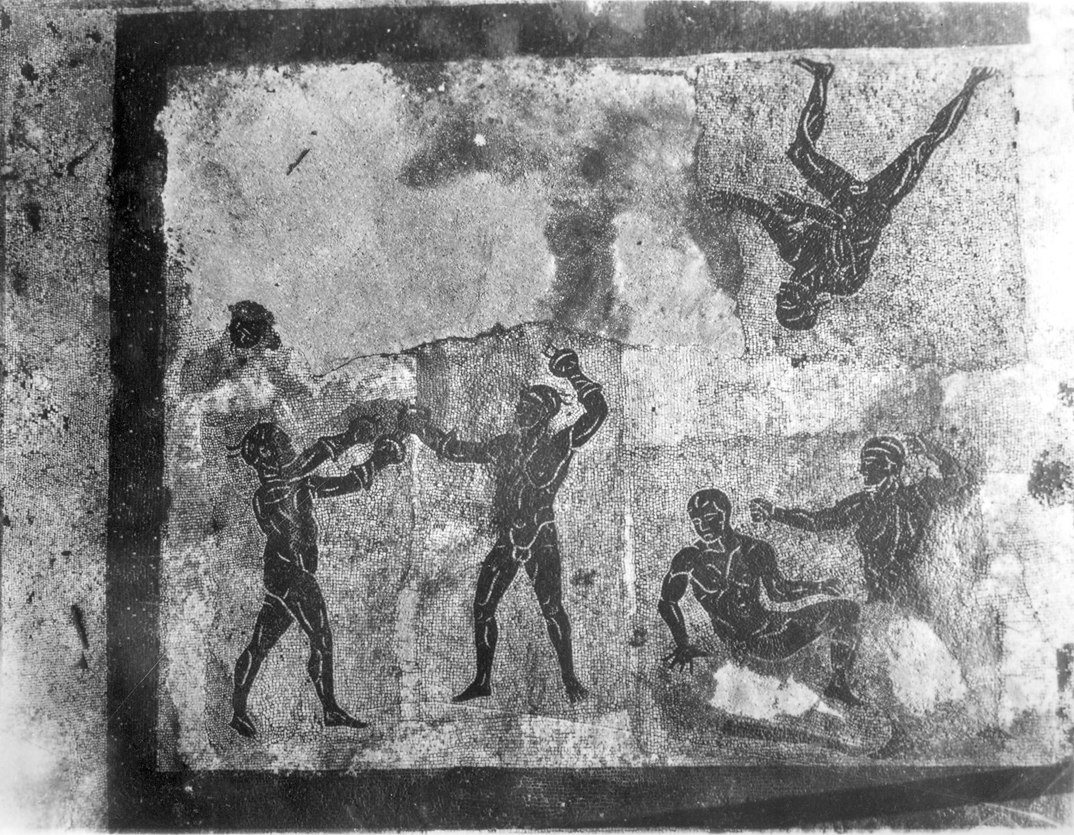
Baths of Neptune, Ostia
Photo: Soprintendenza Archeologica di Ostia Antica (after Newby 2005: fig 3.2)
Wrestler
Boxers (with spiked gloves)
Pancratiasts.
Professionals? Cirrus

Slide 12
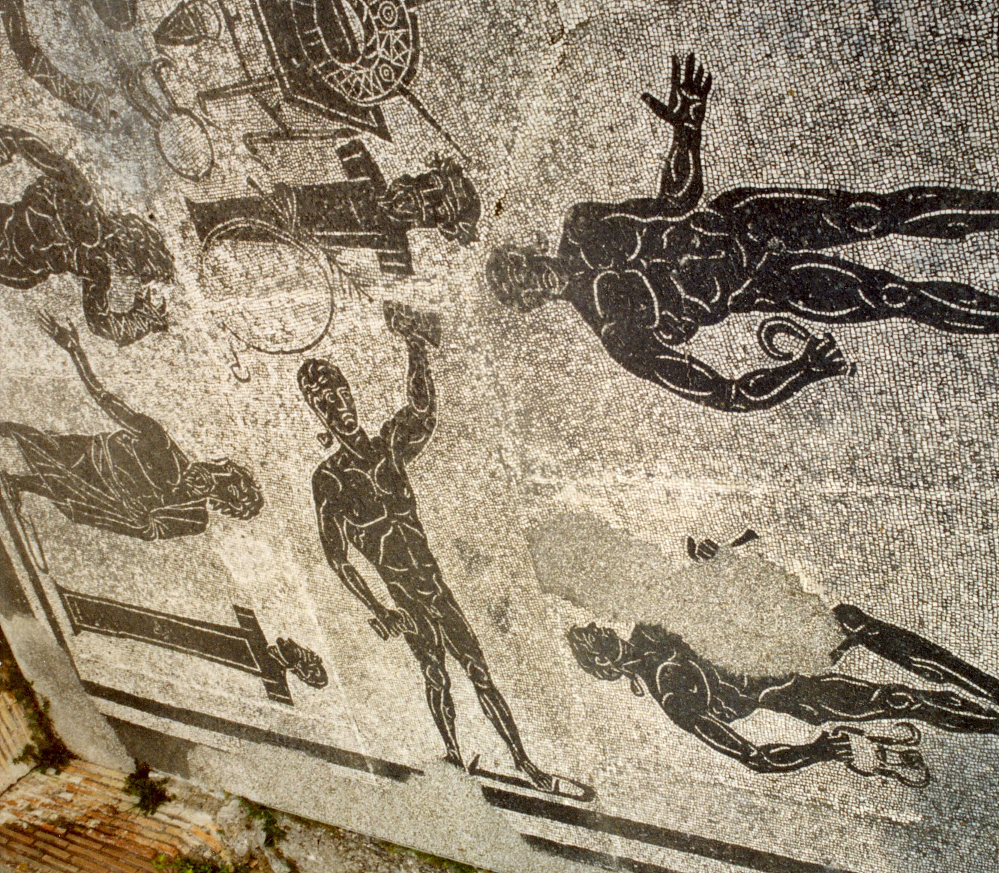

Slide 13
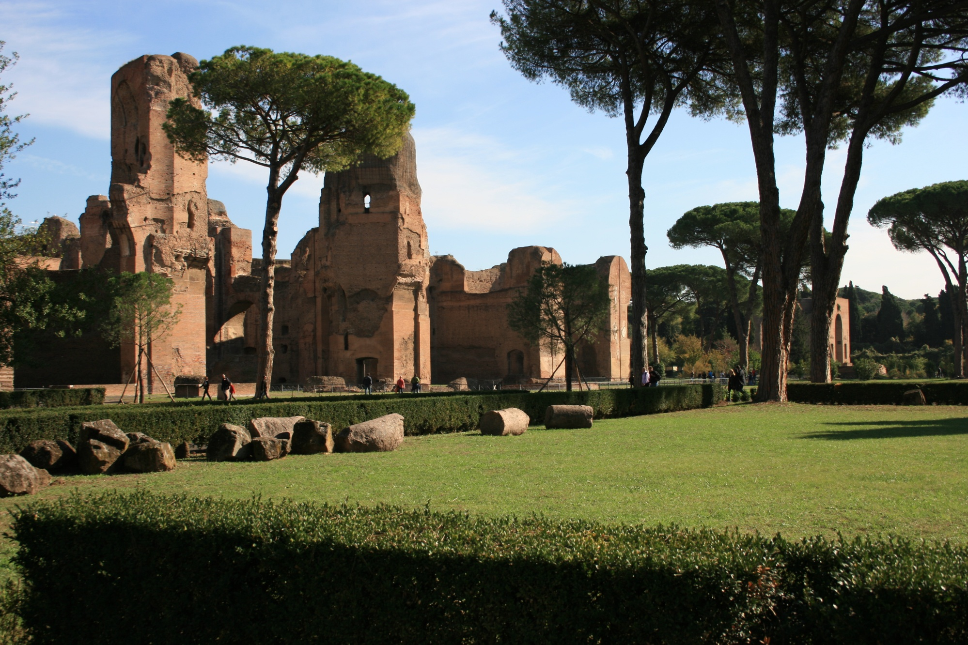
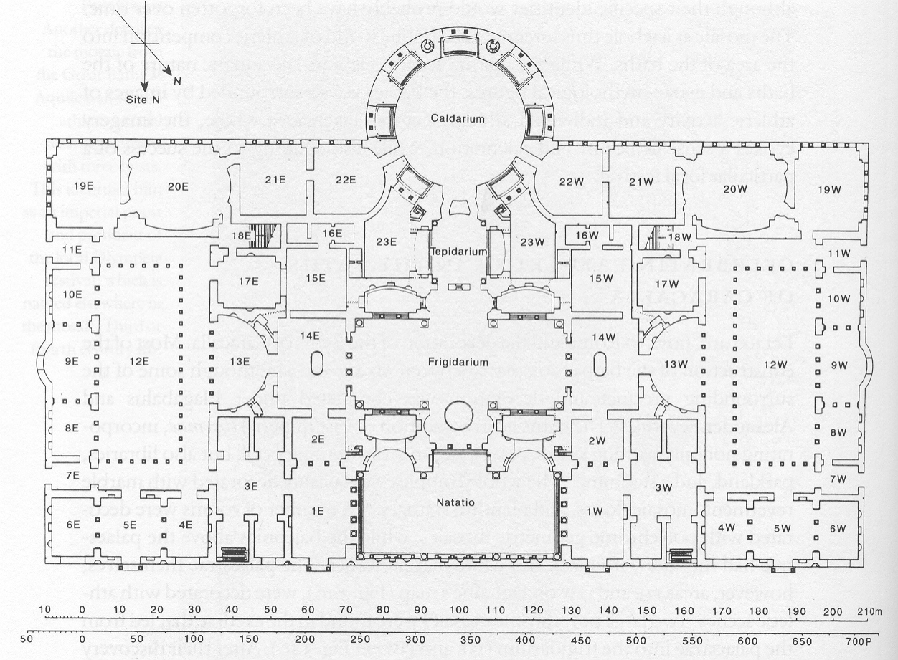
Baths of Caracalla, Rome

Slide 14
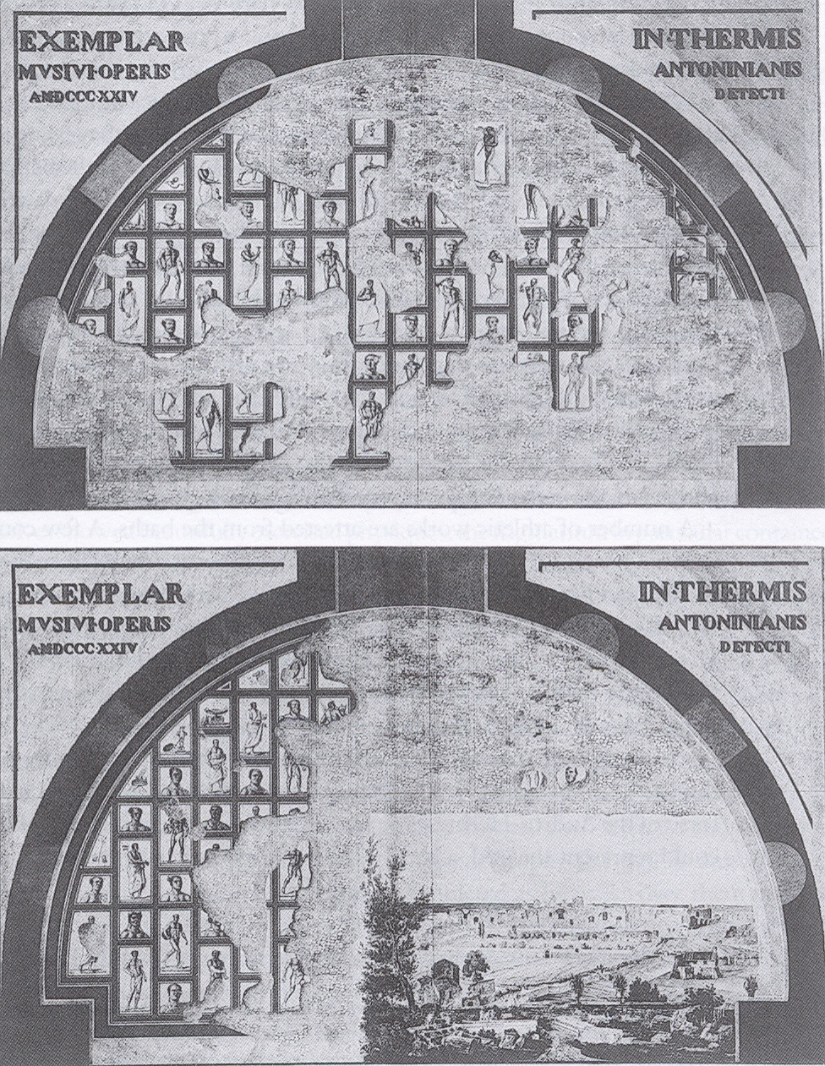

Slide 15
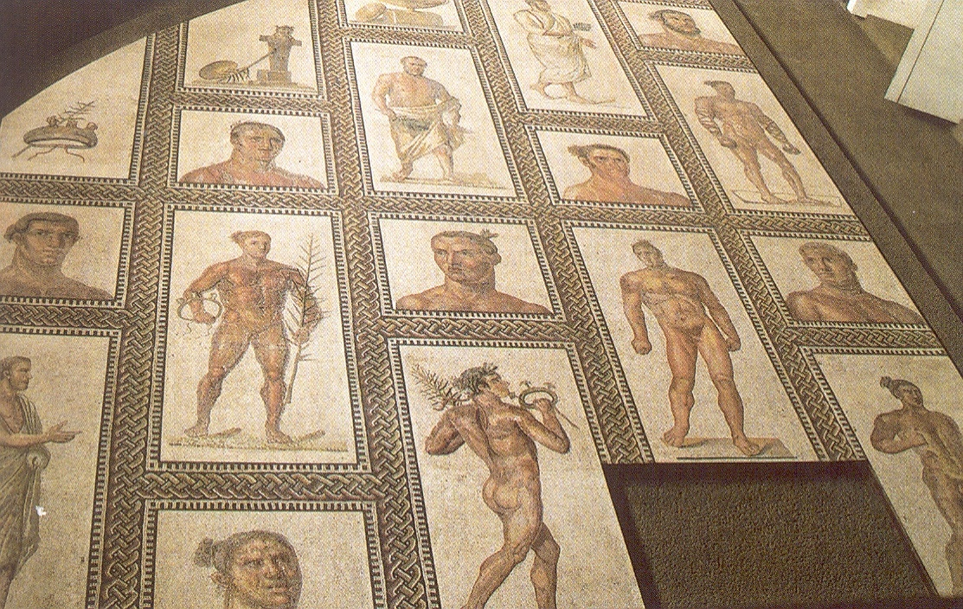

Slide 16
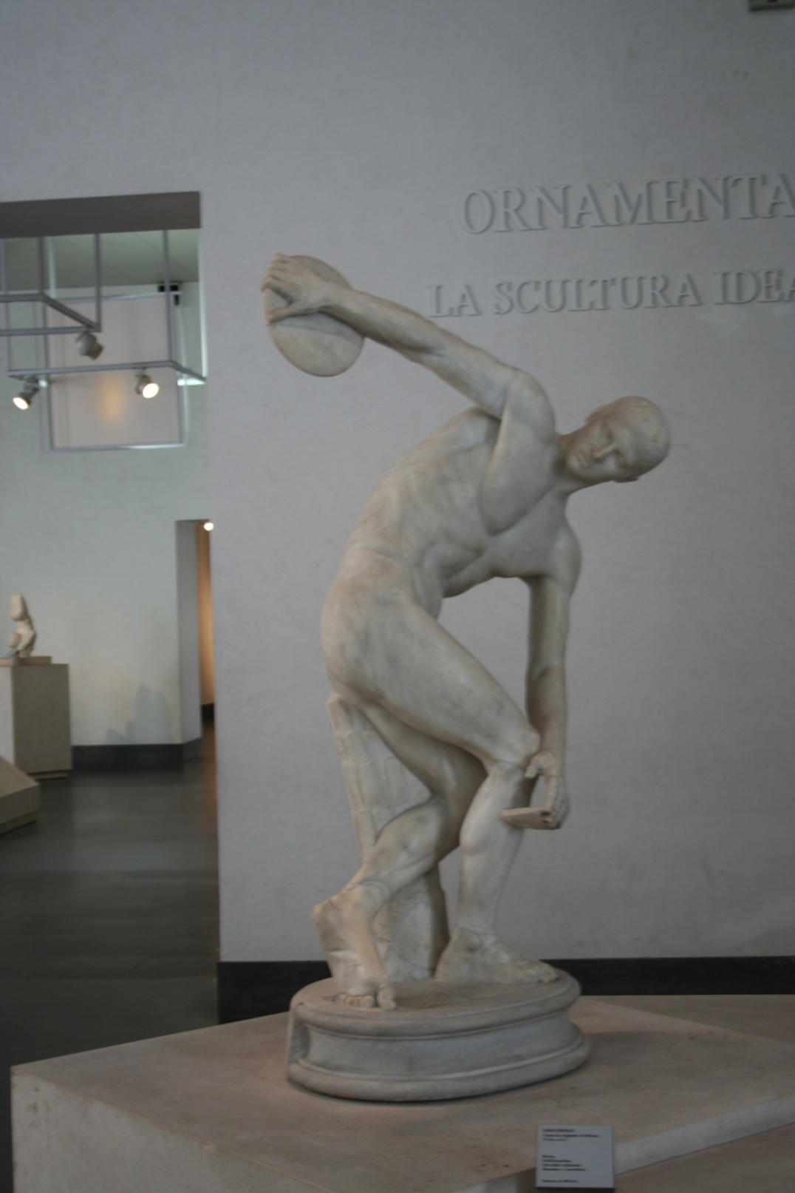
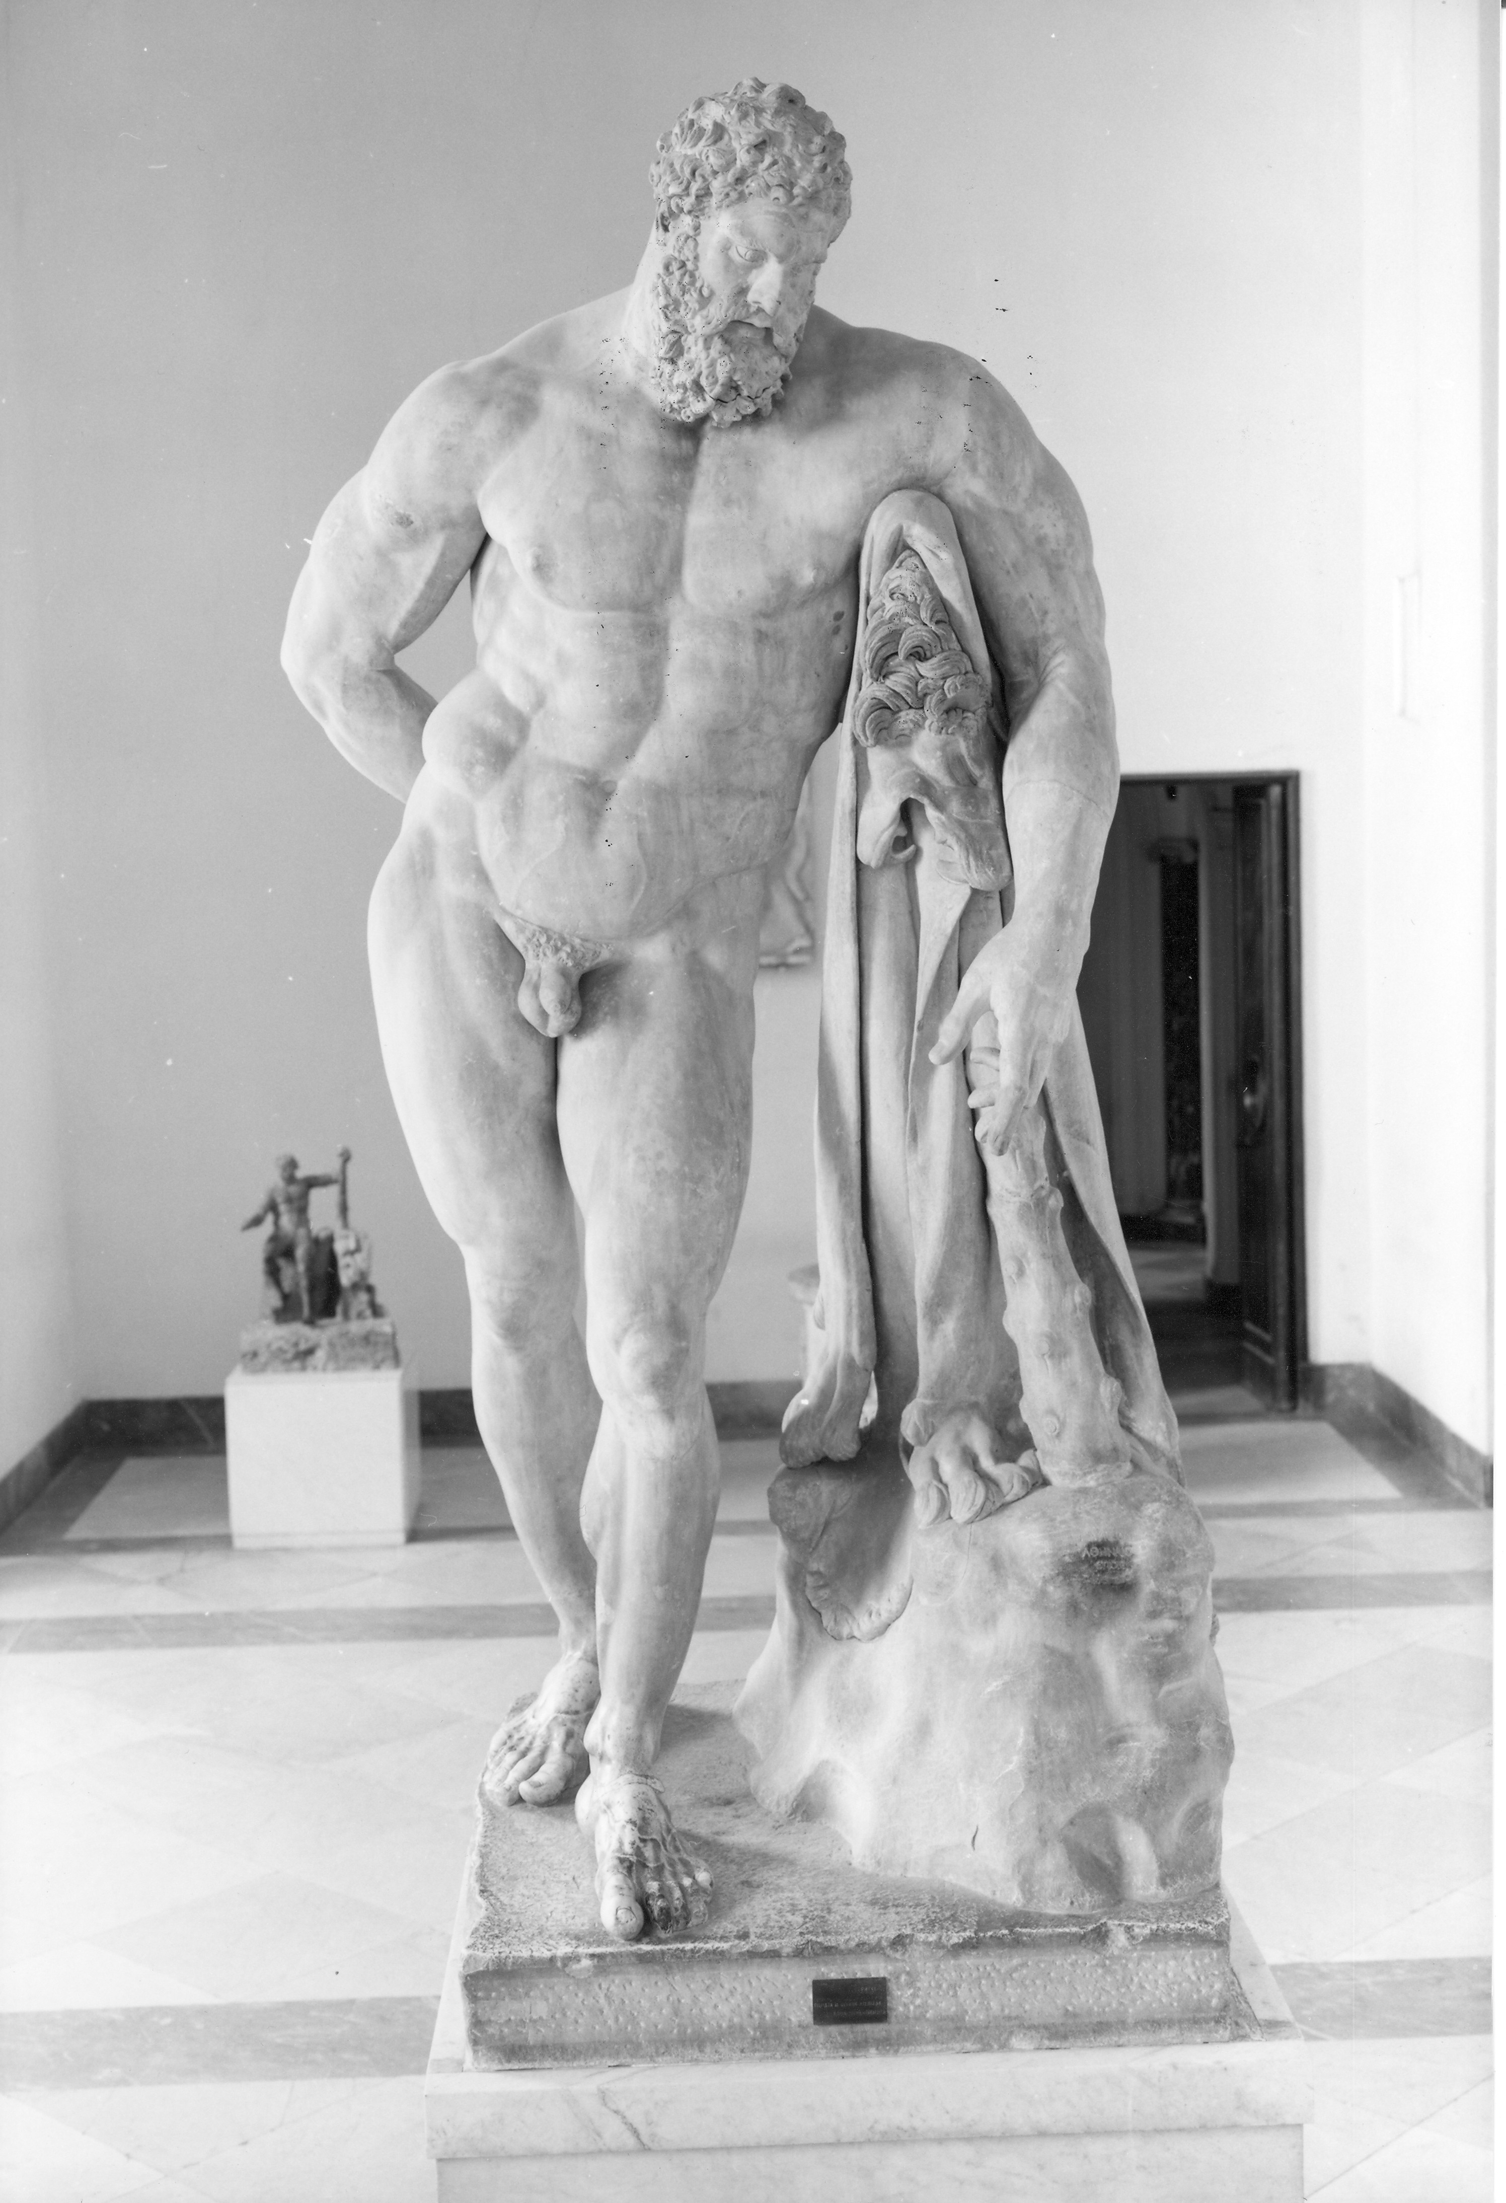

Slide 17
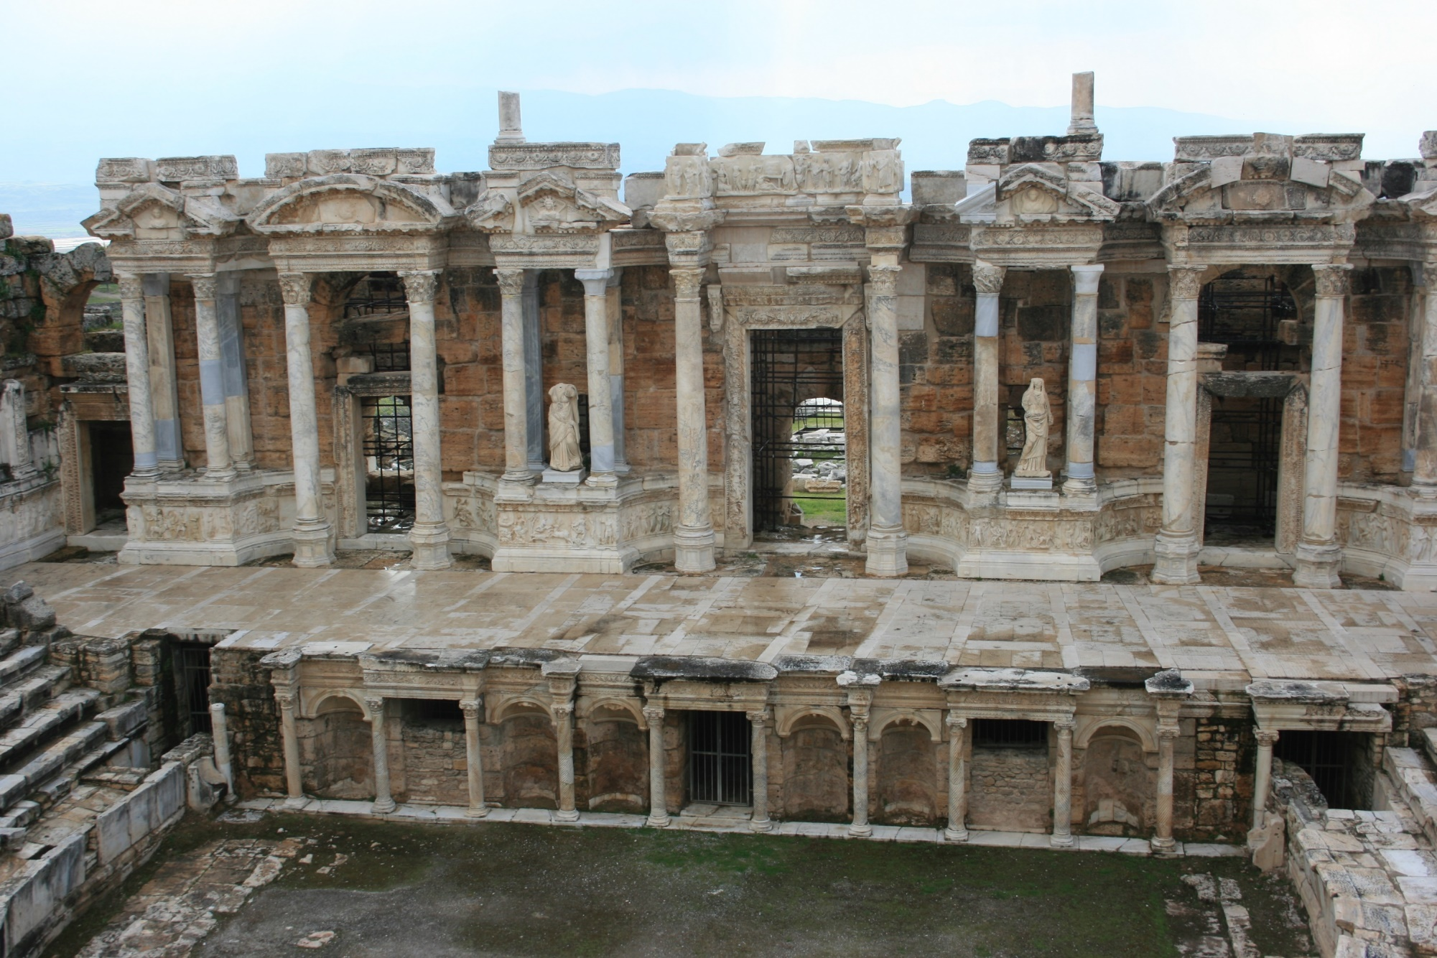
Theatre at Hierapolis, AD 206-8.
View of reconstructed scaenae frons (2018)

Slide 18
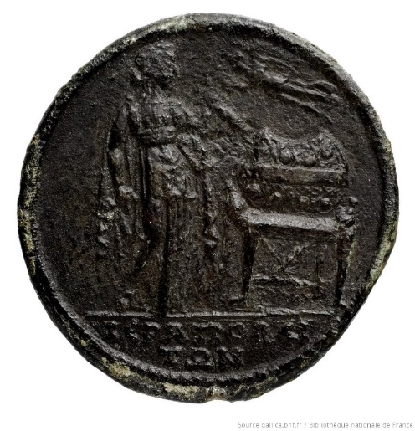
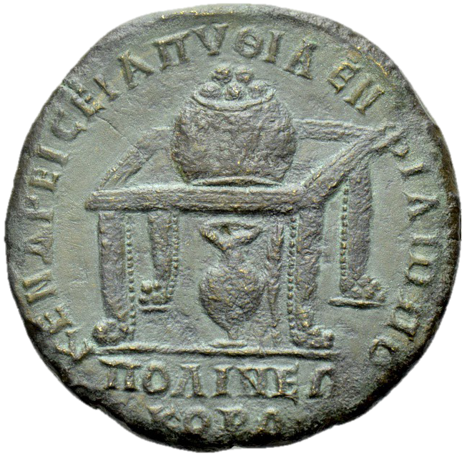
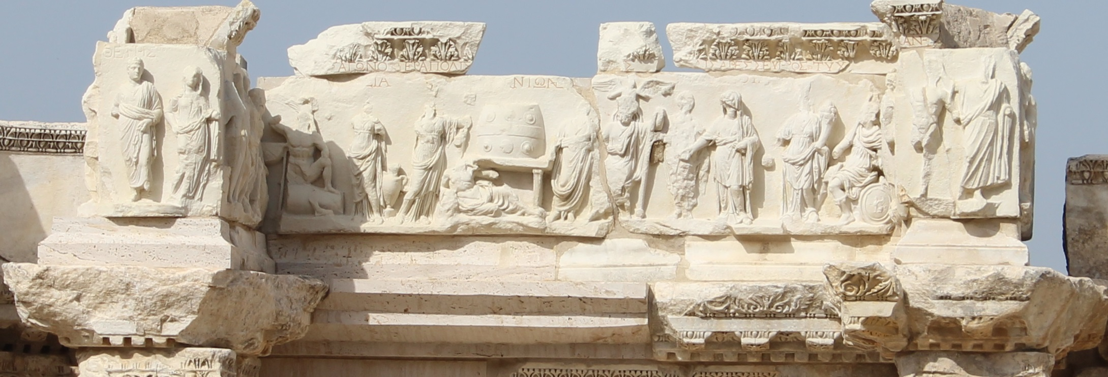

Slide 19
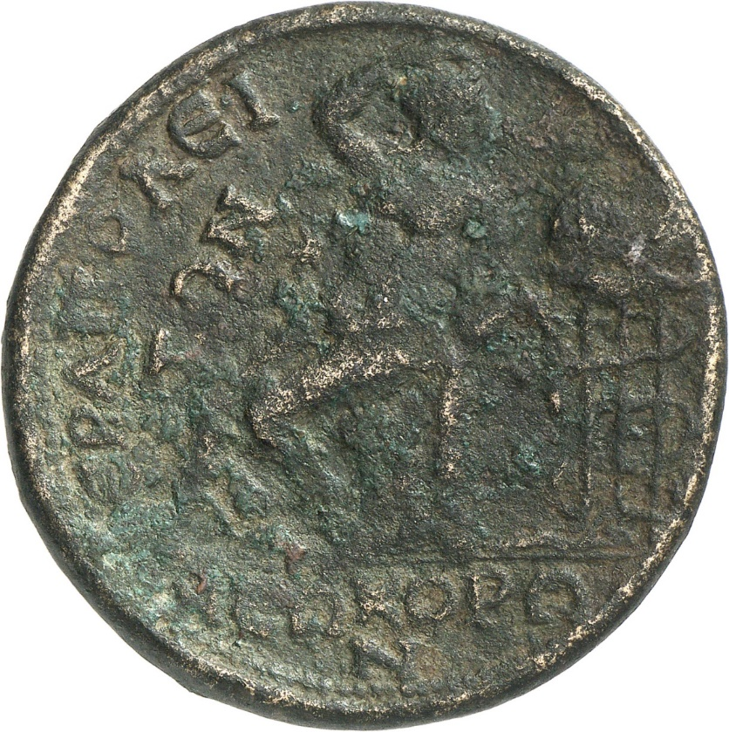
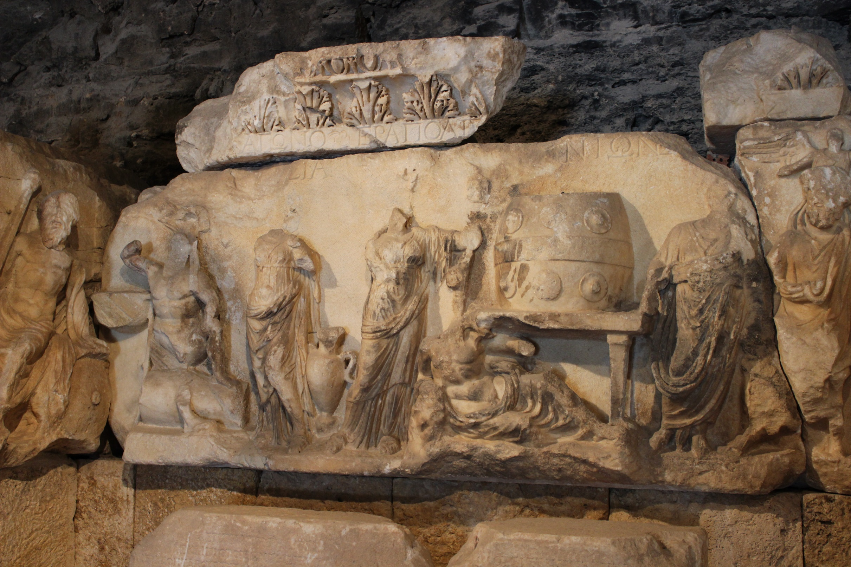
RPC VI 5424

Slide 20
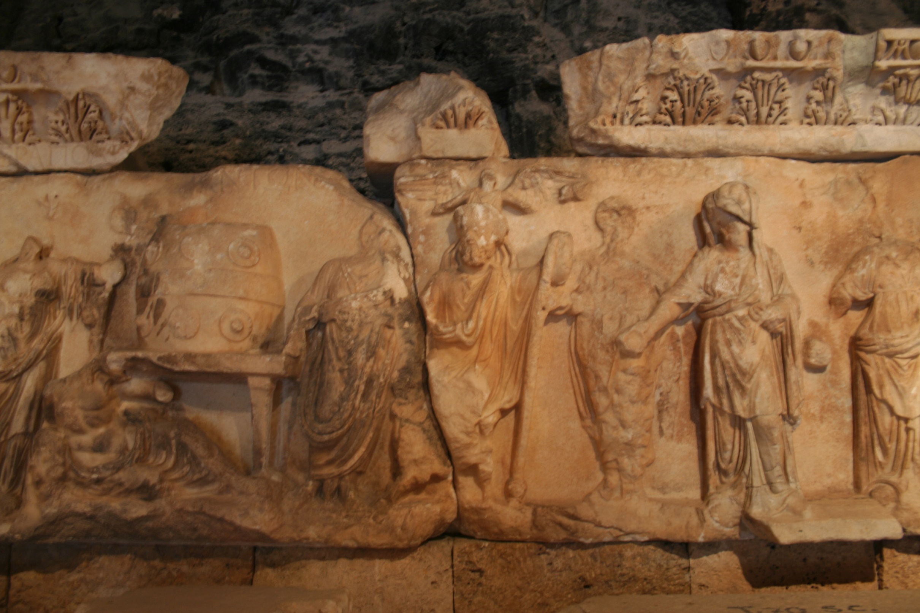

Slide 21
[ΣΑ]ΛΠΙ
ΚΤΗ[Σ]
trumpeter
ΠΥΘΙΚΟΣ A
Pythian boy
ΑΝΗ[Ρ?]
man

Slide 22
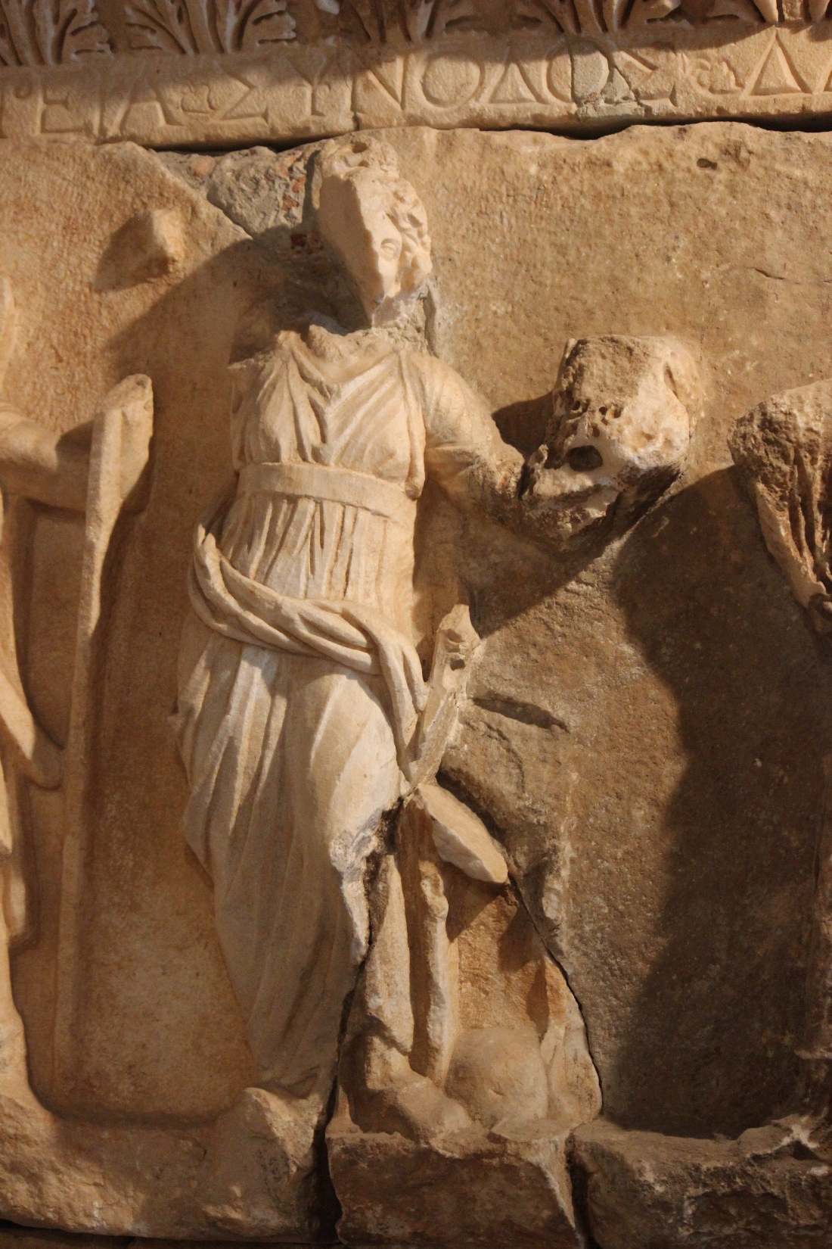
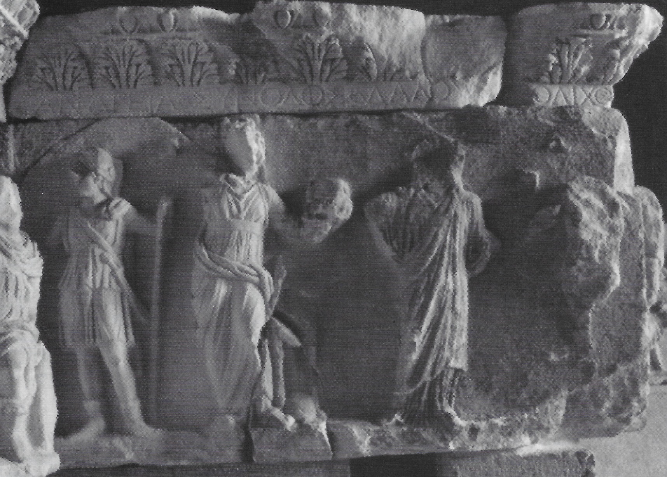
ΑΝΔΡΕΙΑ
courage
ΣΥΝΟΔΟΣ
Synod/guild
ΔΑΔΟΥ[ΧΟΣ] [Δ]ΟΛΙΧΟΣ
Torch bearer long race

Slide 23
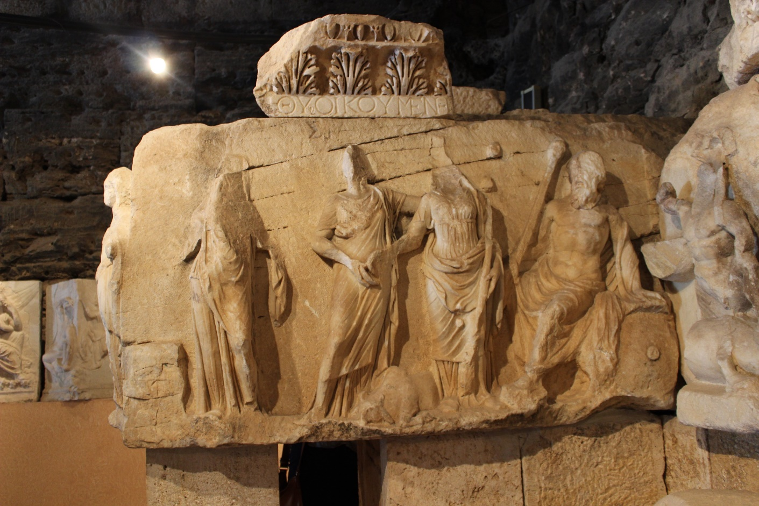
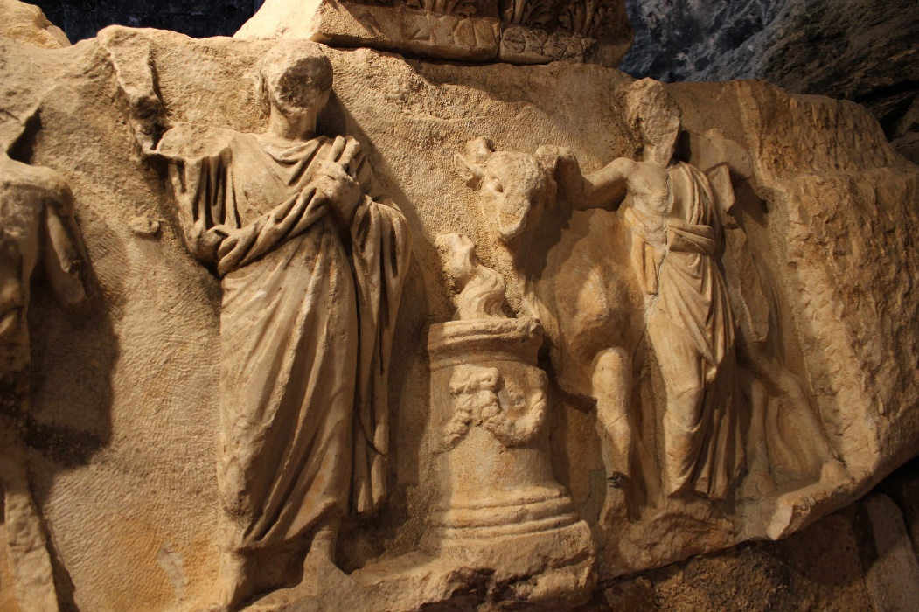
Synthusia oikoumenes -common sacrifice of the inhabited world.

Slide 24
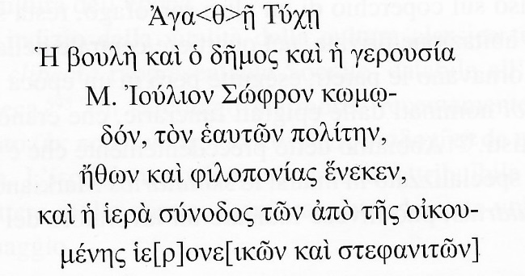
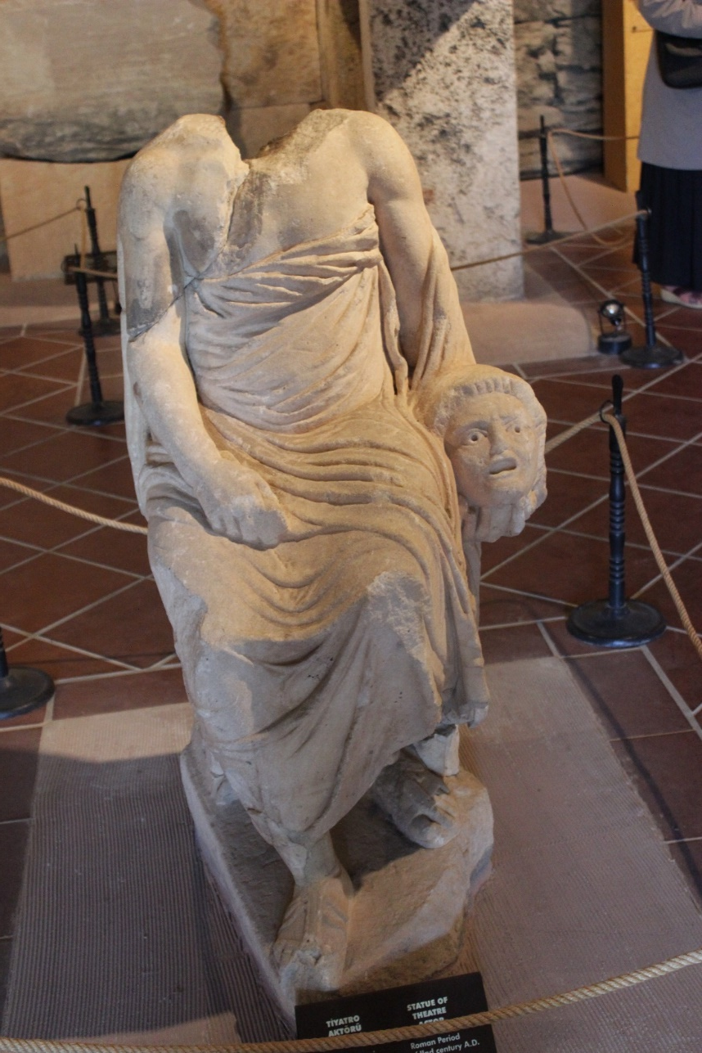
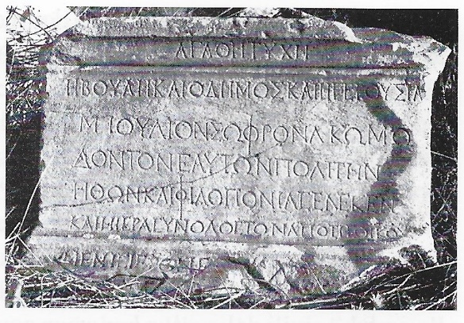
Synodos at Hierapolis
Boule, Demos and Gerousia along with the sacred synod of crowned sacred victors (set up) M. Julius Sophon, comedian, their own citizen, in recognition of his character and hard work.
Ritti 1985, n. 11

Slide 25
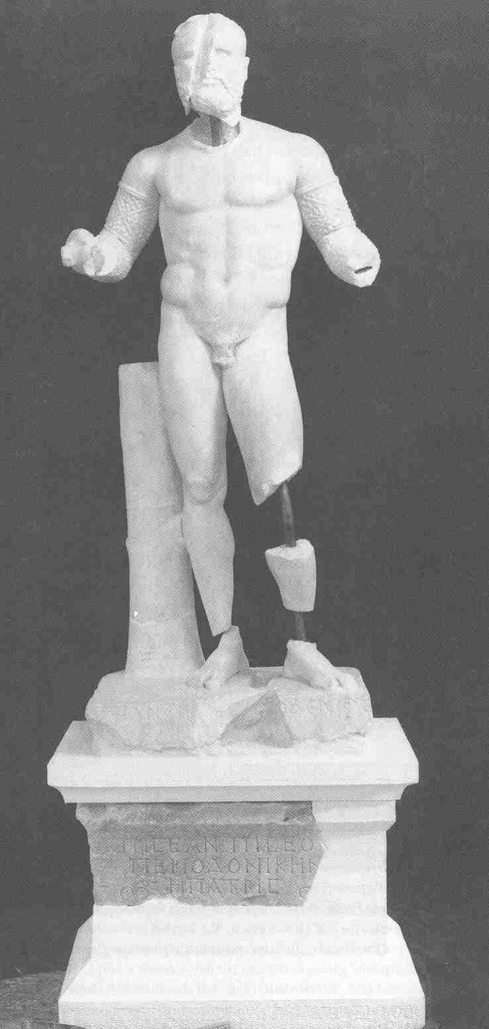
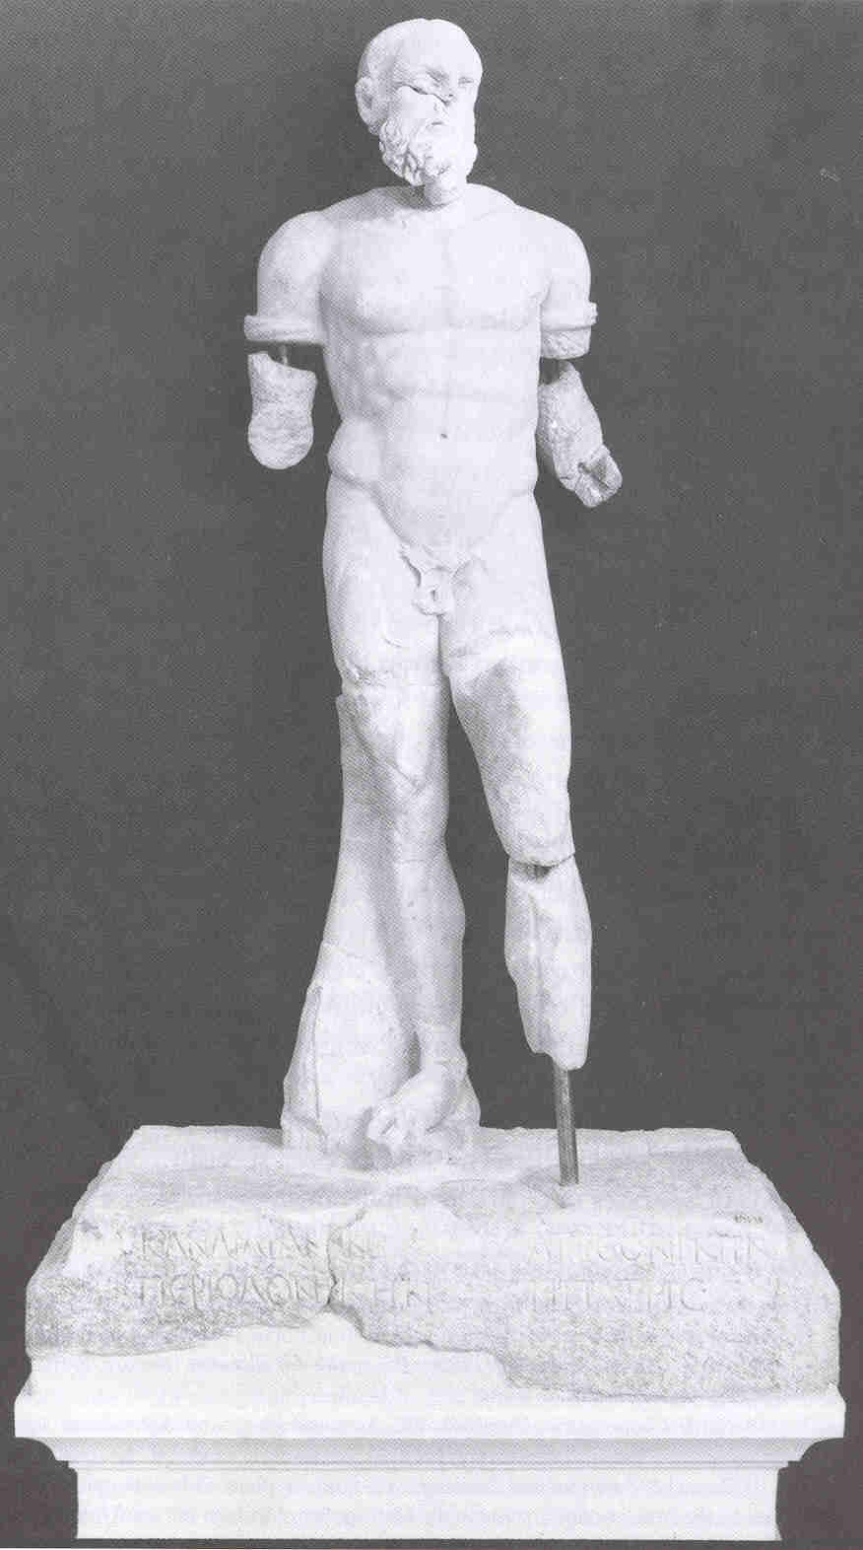
The Boxers Aphrodisias
Piseas and Candidianus ‘peridonikes’, ‘circuit victors’.
Early 3rd C AD

Slide 26
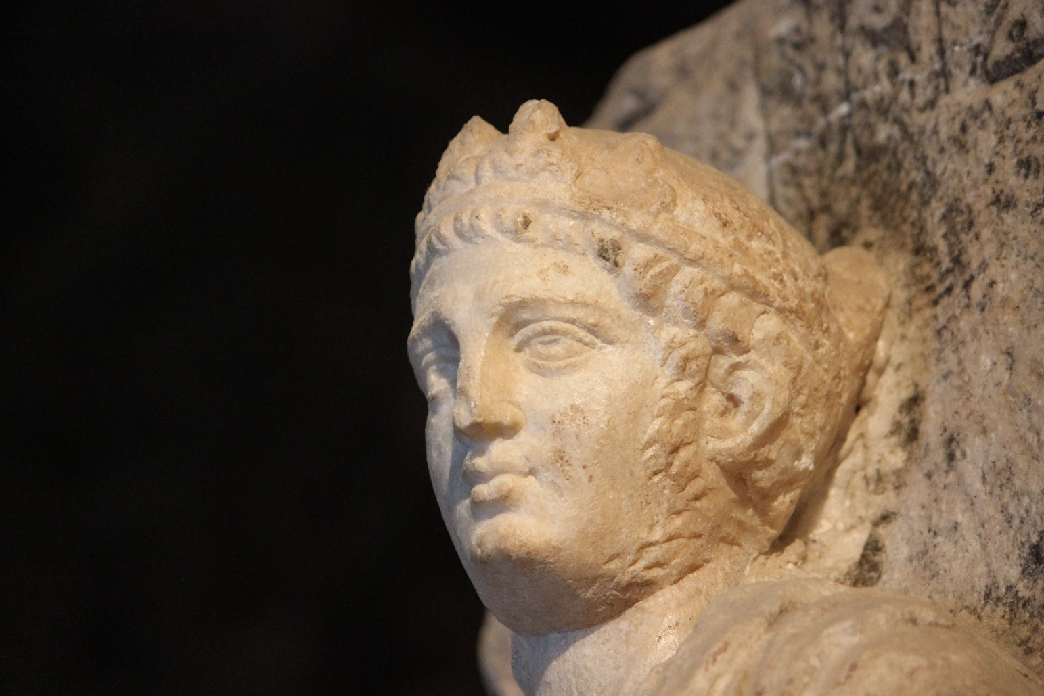
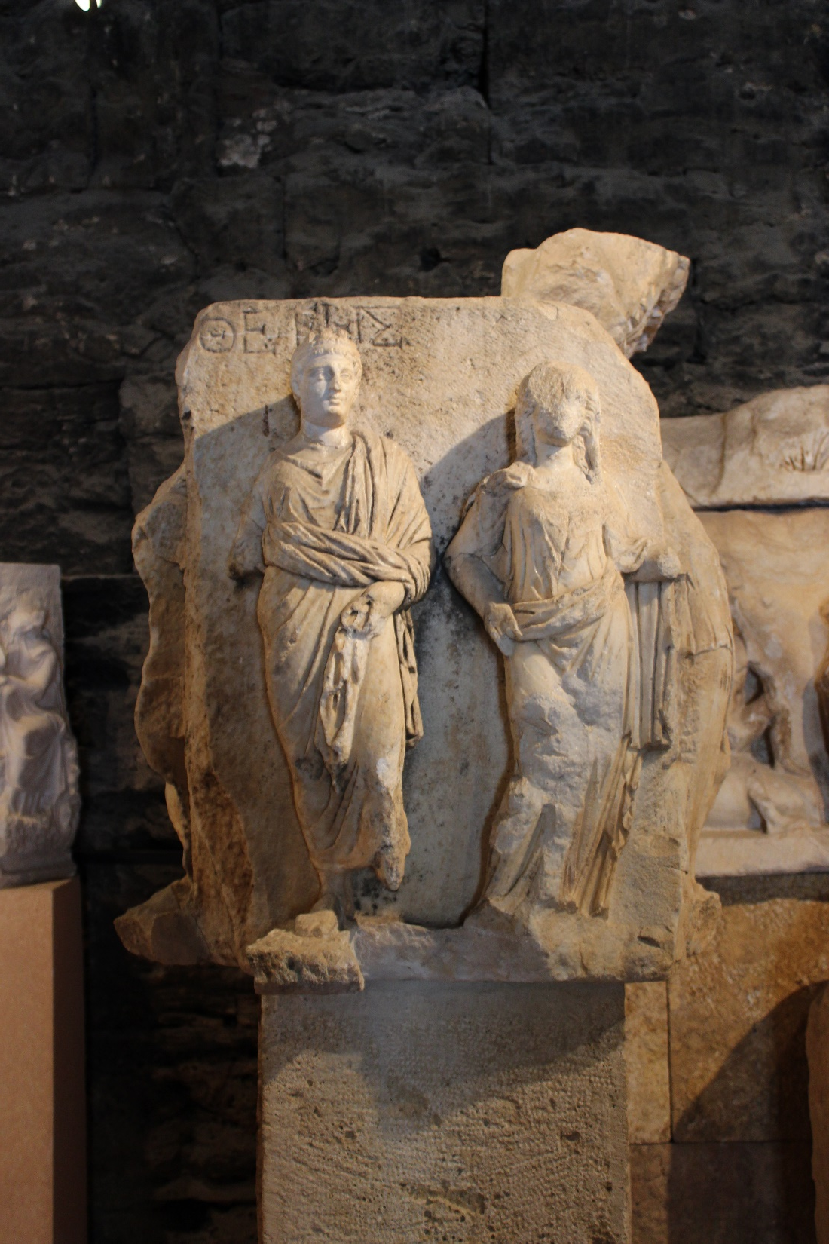
Agonothetes

Slide 27
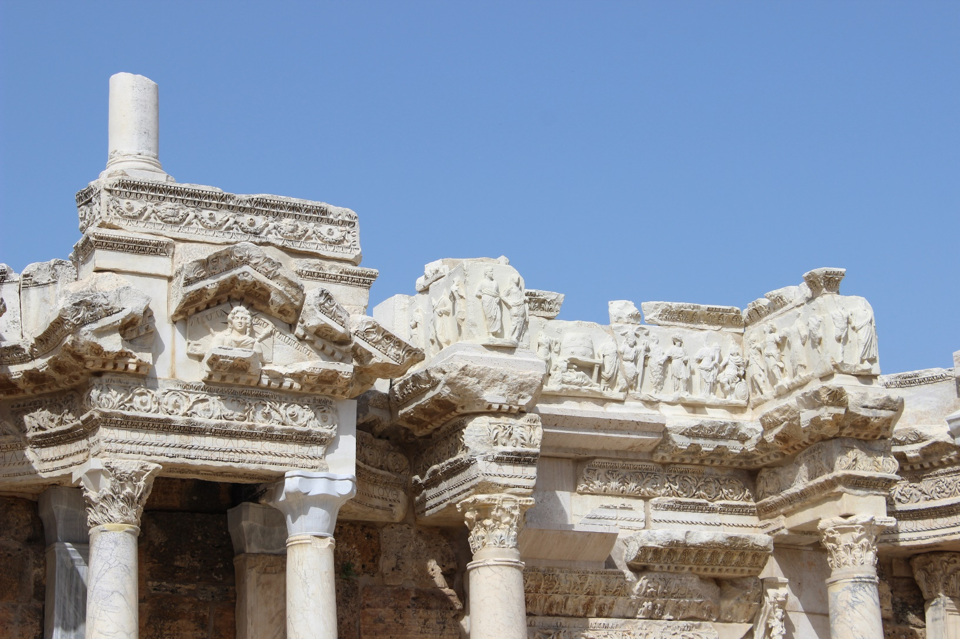
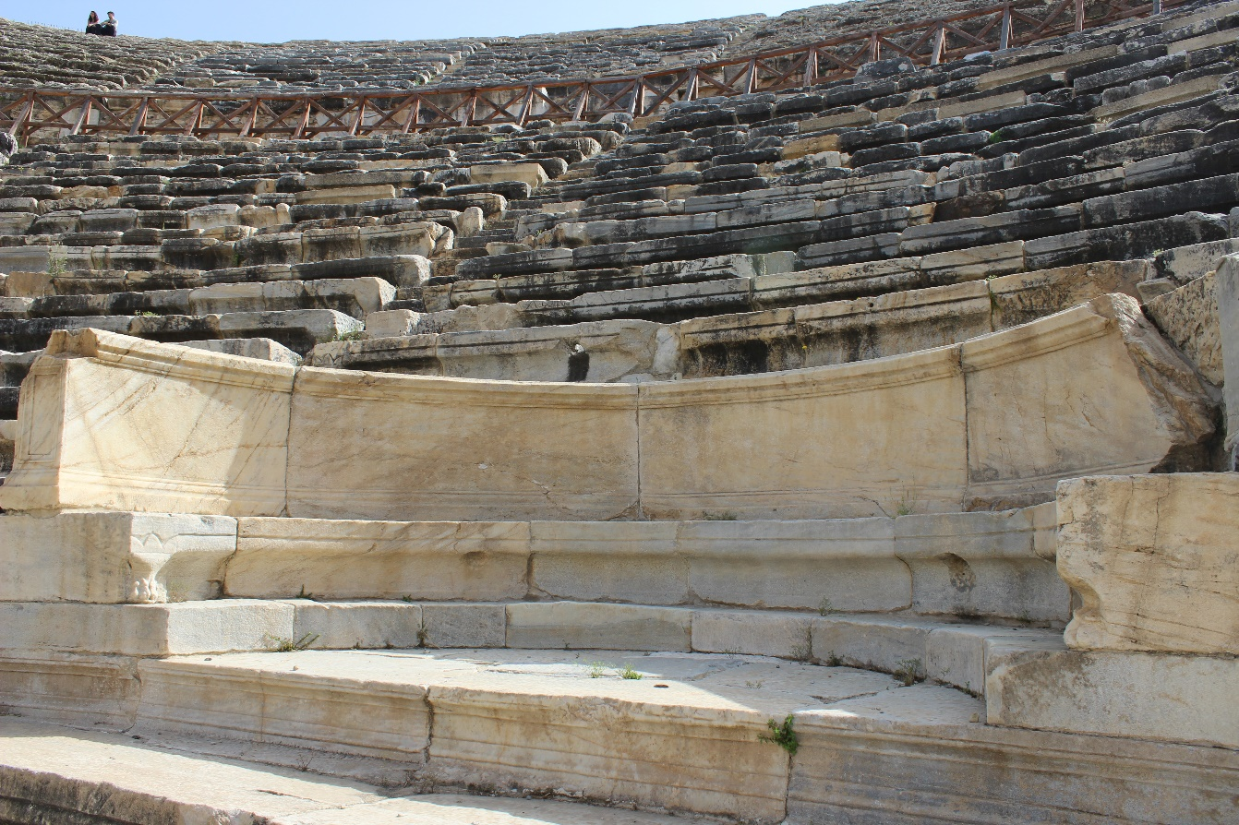
Demostheneia festival, Oinoanda.
‘The agonothete should wear the previously mentioned gold crown and a purple robe, and at the beginning of the New Year should make the ceremonial entrance, performing the pious rituals for the emperor and the gods of the home land on the Augustus day of the month Dios [1 January] and processing in company with the other magistrates, and he should take a front seat at meetings of the council and the assembly and at shows, wearing the previously mentioned attire’ (trans. Mitchell 1990)

