Slide 1
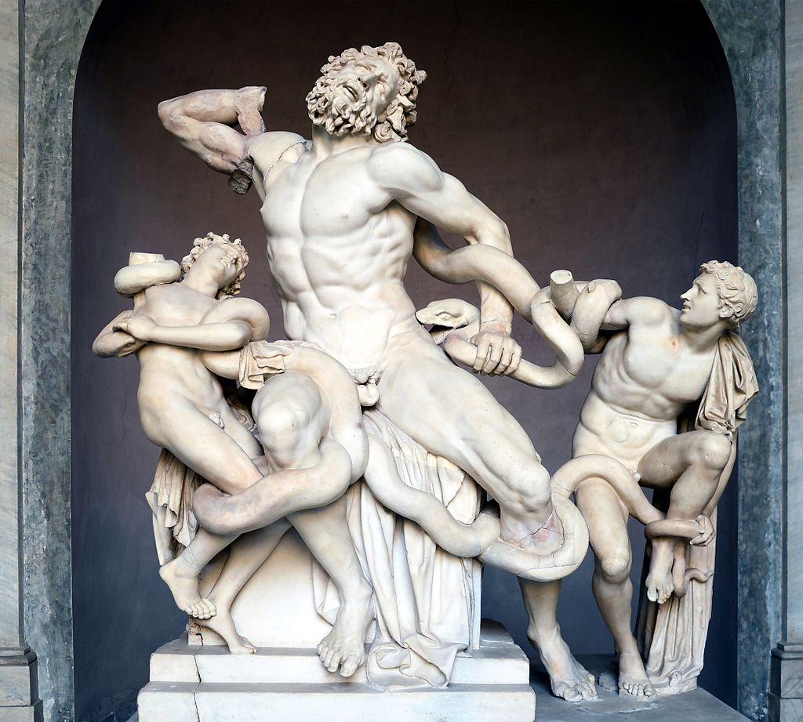
Epic in Greek and Roman Art: The Trojan War
Professor Zahra Newby

Slide 2
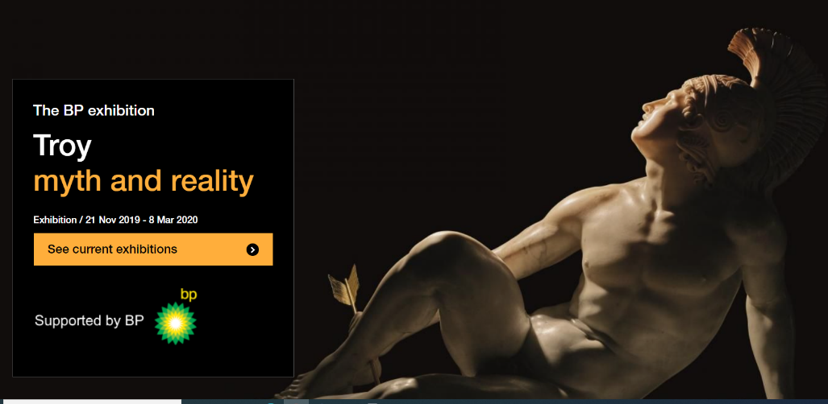



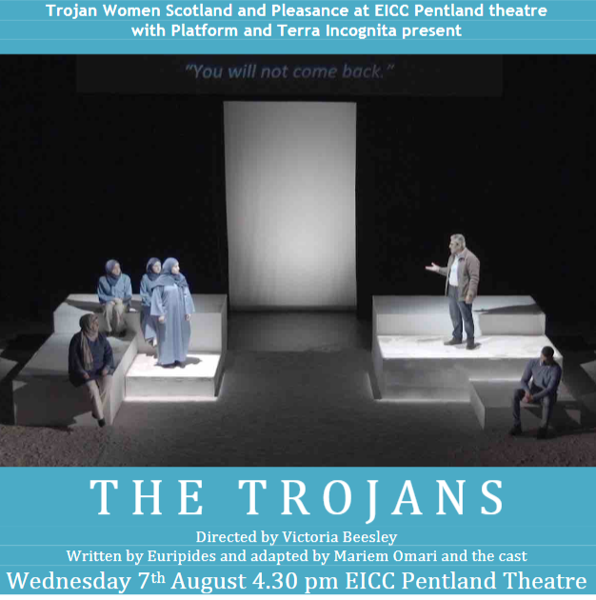
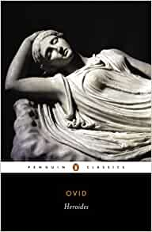
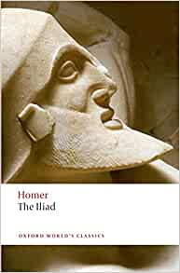
The Trojan War

Slide 3
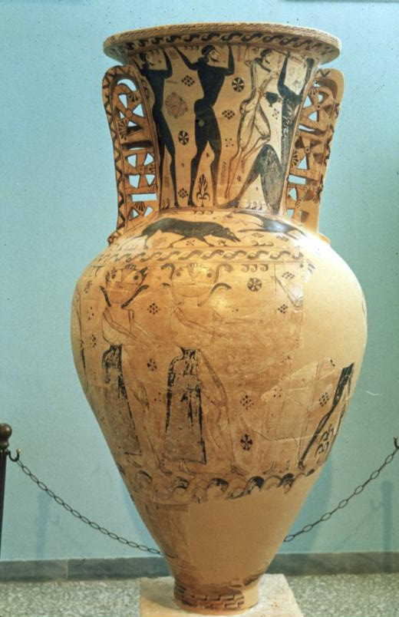
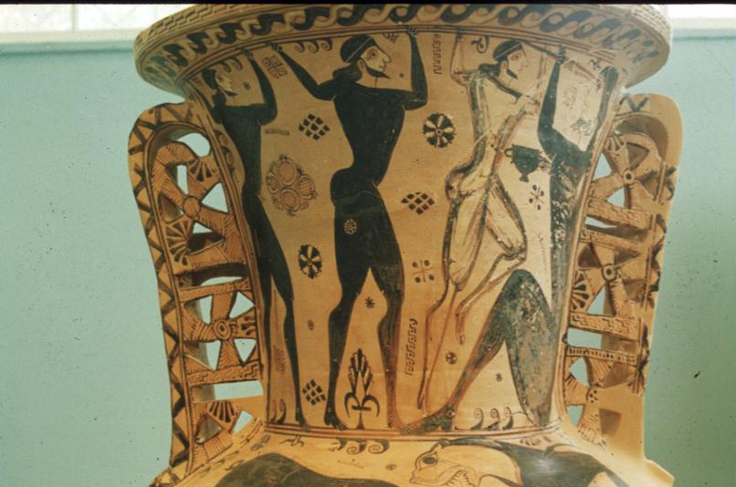
Early mythological images: Amphora in Eleusis Museum, from Cemetery at Eleusis. C. 675-650 BC
Photos: Newby

Slide 4
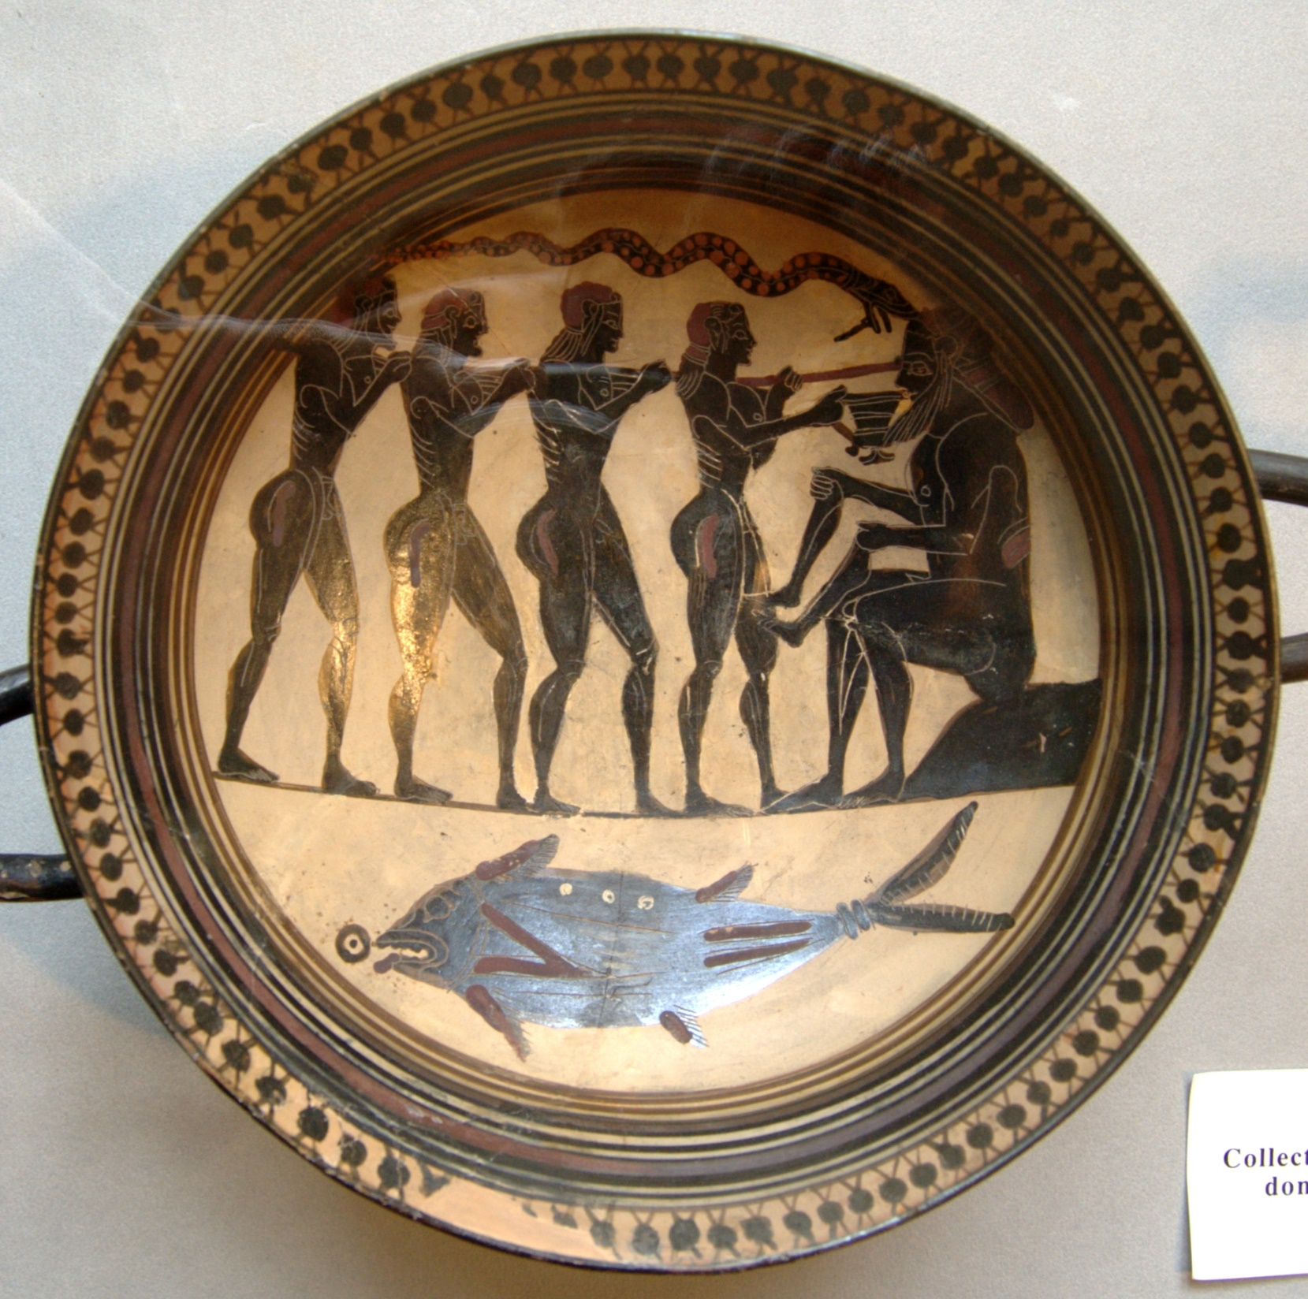
Laconian Cup, c. 550 BC
Paris, Cabinet des Medailles, 190.
https://commons.wikimedia.org/wiki/File:Odysseus_Polyphemos_Cdm_Paris_190.jpg

Slide 5
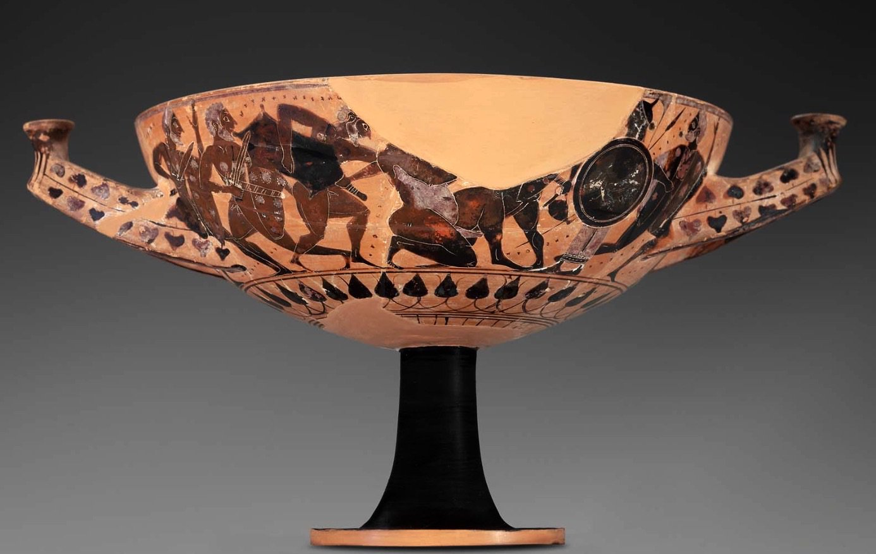
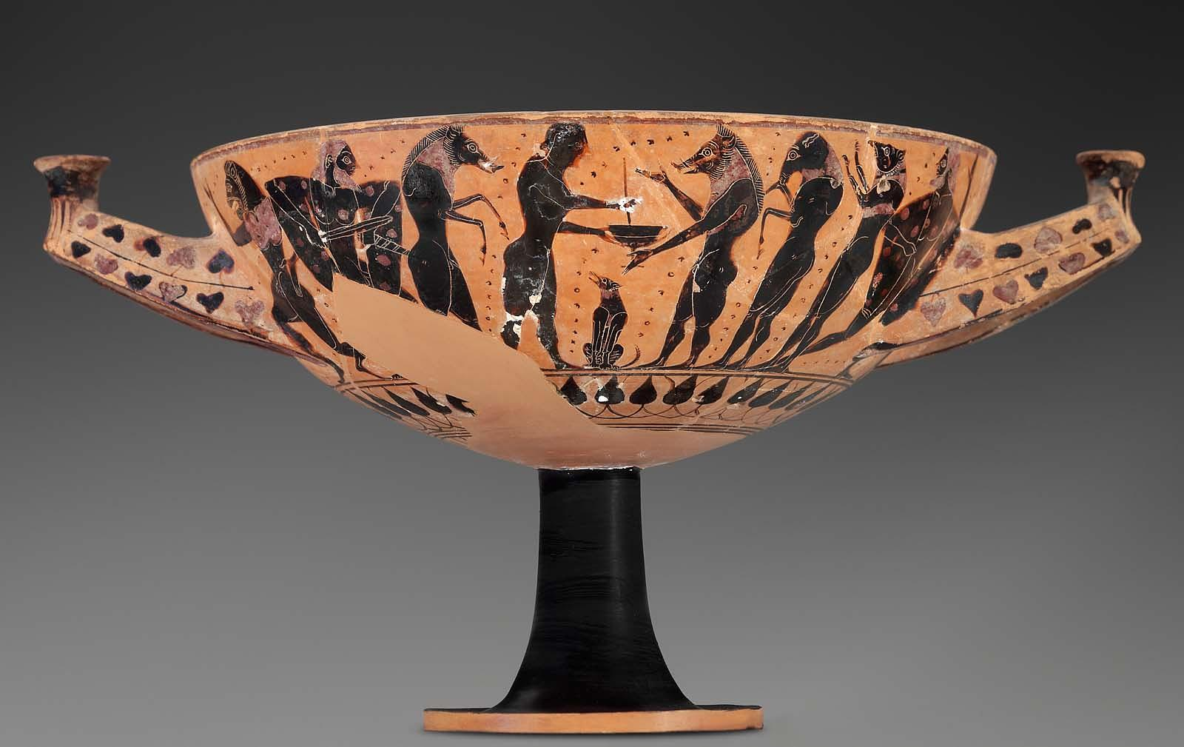
Black-figure Kylix, Boston Museum of Fine Arts 99.518
550-525 BC
Side A: Circe and Odysseus; Side B: Odysseus and Polyphemus
Photos: https://collections.mfa.org/objects/153469

Slide 6

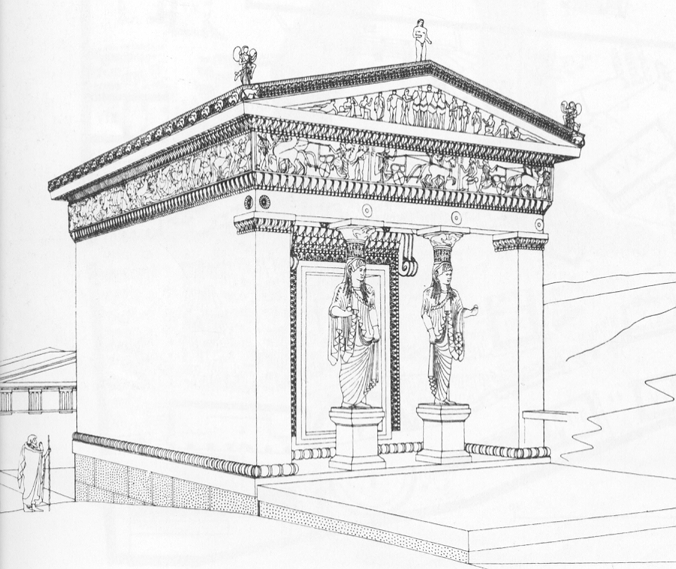
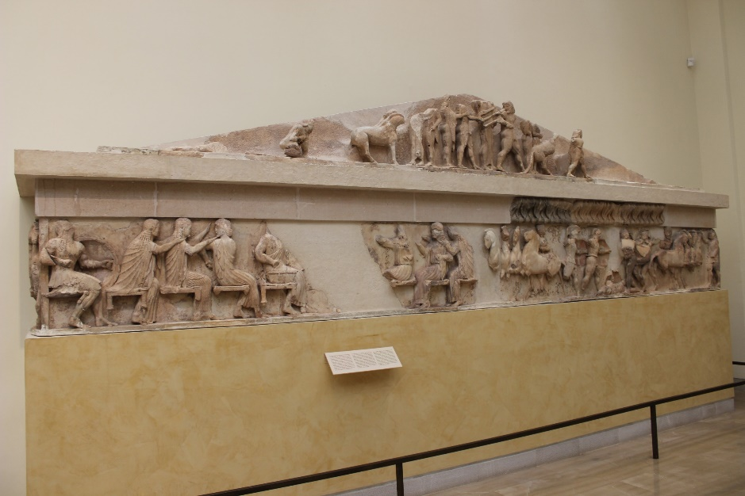
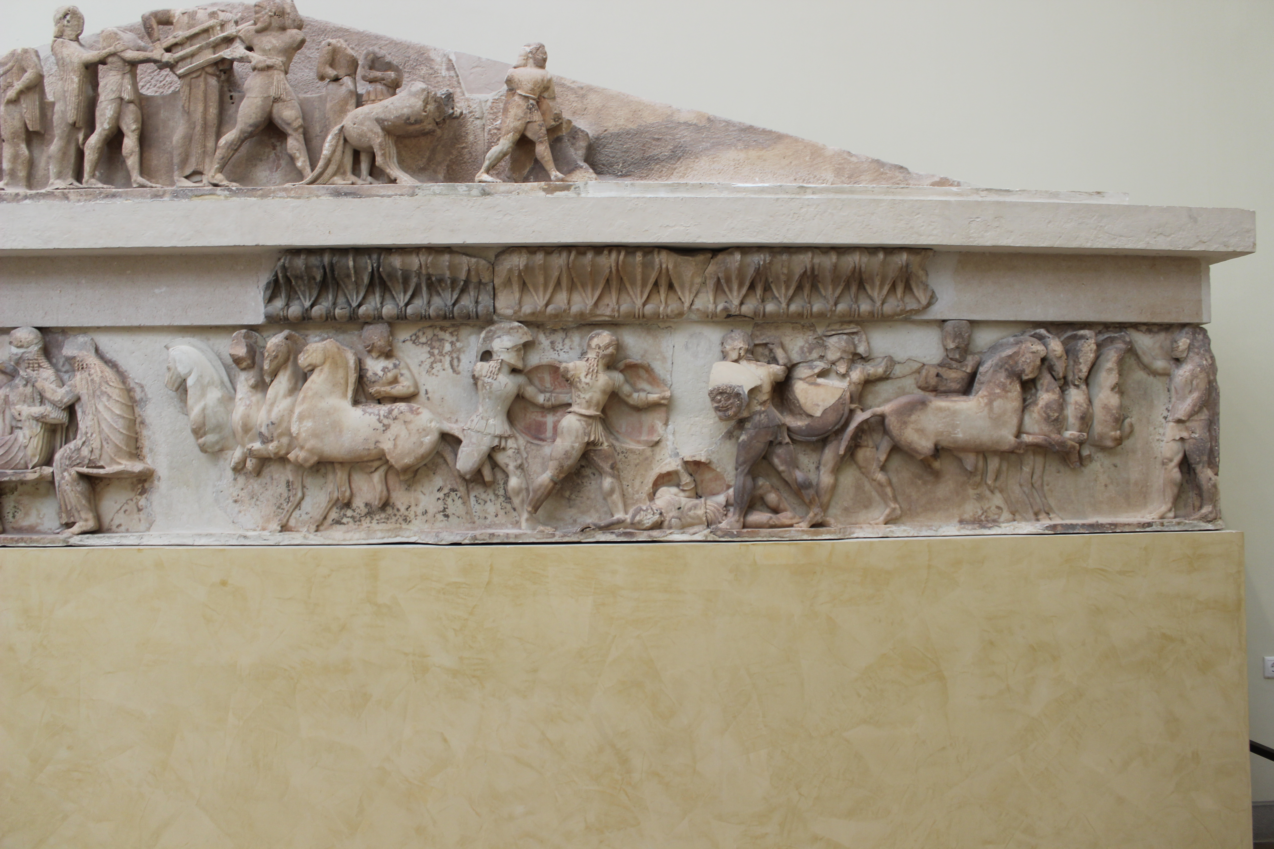
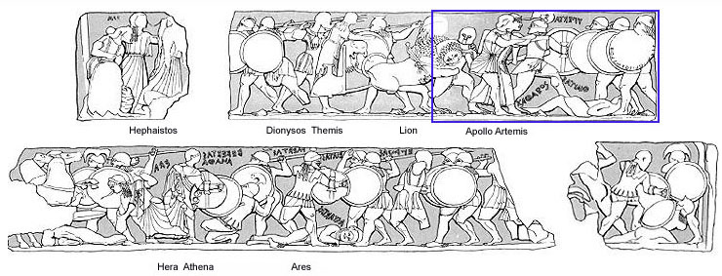
Siphnian Treasury, Delphi, c. 525 BC

Slide 7
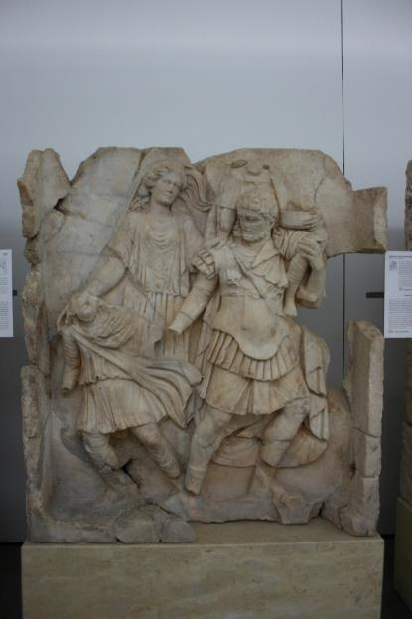
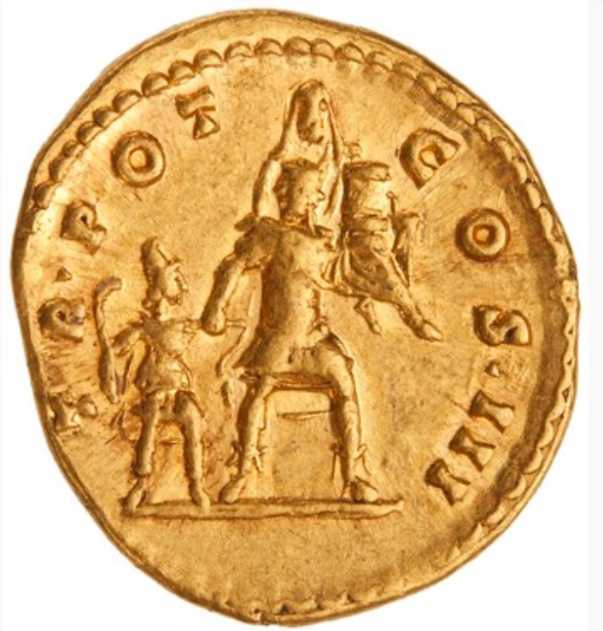
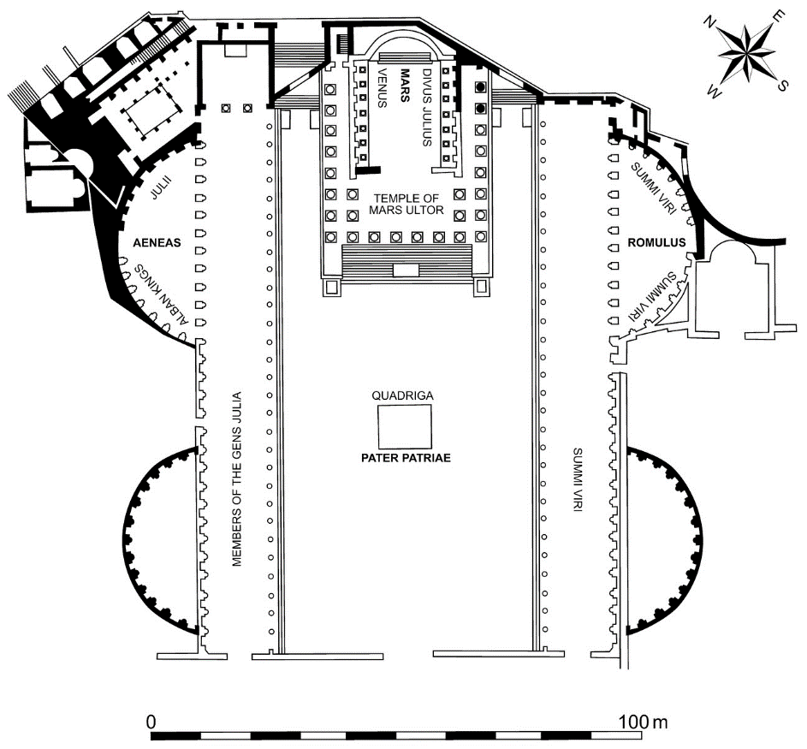
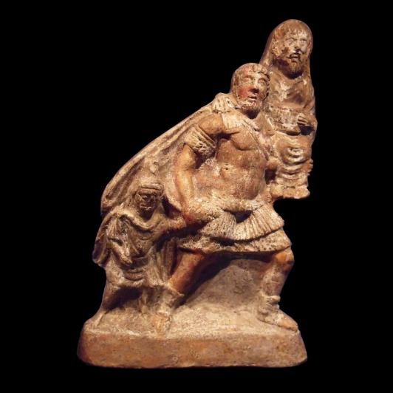

Relief with Aeneas from the Sebasteion in Aphrodisias
Pius Aeneas: from Troy to Rome
Forum of Augustus, Rome
pius Aeneas on the reverse of RIC III Antoninus Pius 91; 140-143 CE (above)
Terracotta replica of group (left)

Slide 8
Vergil Aeneid 1.453-493: The images on Juno’s Temple at Carthage
While, waiting for the queen, in the vast temple, he looks
at each thing: while he marvels at the city’s wealth,
the skill of their artistry, and the products of their labours,
he sees the battles at Troy in their correct order,
the War, known through its fame to the whole world,
the sons of Atreus, of Priam, and Achilles angered with both.
He halted, and said, with tears: ‘What place is there,
Achates, what region of earth not full of our hardships?
See, Priam! Here too virtue has its rewards, here too
there are tears for events, and mortal things touch the heart.
Lose your fears: this fame will bring you benefit.’
Trans. Kline, Poetryintranslation.com

Slide 9
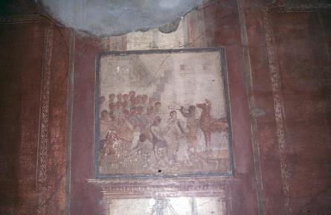
The Fall of Troy: Aeneid 2. The Trojan Horse and Death of Laocoon
After many years have slipped by, the leaders of the Greeks,
opposed by the Fates, and damaged by the war,
build a horse of mountainous size, through Pallas’s divine art,
and weave planks of fir over its ribs:
they pretend it’s a votive offering: this rumour spreads.
They secretly hide a picked body of men, chosen by lot,
there, in the dark body, filling the belly and the huge
cavernous insides with armed warriors.

Slide 10
Laocoon’s warning (Aen 2.40-56)
Then Laocoön rushes down eagerly from the heights
of the citadel, to confront them all, a large crowd with him,
and shouts from far off: ‘O unhappy citizens, what madness?
Do you think the enemy’s sailed away? Or do you think
any Greek gift’s free of treachery? Is that Ulysses’s reputation?
Either there are Greeks in hiding, concealed by the wood,
or it’s been built as a machine to use against our walls,
or spy on our homes, or fall on the city from above,
or it hides some other trick: Trojans, don’t trust this horse.
Whatever it is, I’m afraid of Greeks even those bearing gifts.’
So saying he hurled his great spear, with extreme force,
at the creature’s side, and into the frame of the curved belly.
The spear stuck quivering, and at the womb’s reverberation
the cavity rang hollow and gave out a groan.
And if the gods’ fate, if our minds, had not been ill-omened,
he’d have incited us to mar the Greeks hiding-place with steel:
Troy would still stand: and you, high tower of Priam would remain.

Slide 11
Laocoon’ Fate: Aen. 2.201-226
Laocoön, chosen by lot as priest of Neptune,
was sacrificing a huge bull at the customary altar.
See, a pair of serpents with huge coils, snaking over the sea
from Tenedos through the tranquil deep (I shudder to tell it),
and heading for the shore side by side: their fronts lift high
over the tide, and their blood-red crests top the waves,
the rest of their body slides through the ocean behind,
and their huge backs arch in voluminous folds….
Blanching at the sight we scatter. They move
on a set course towards Laocoön: and first each serpent
entwines the slender bodies of his two sons,
and biting at them, devours their wretched limbs:
then as he comes to their aid, weapons in hand, they seize him too, and wreathe him in massive coils: now encircling his waist twice, twice winding their scaly folds around his throat,
their high necks and heads tower above him.
He strains to burst the knots with his hands,
his sacred headband drenched in blood and dark venom,
while he sends terrible shouts up to the heavens,
like the bellowing of a bull that has fled wounded,
from the altar, shaking the useless axe from its neck.
But the serpent pair escape, slithering away to the high temple,
and seek the stronghold of fierce Pallas, to hide there
under the goddess’s feet, and the circle of her shield.

Slide 12
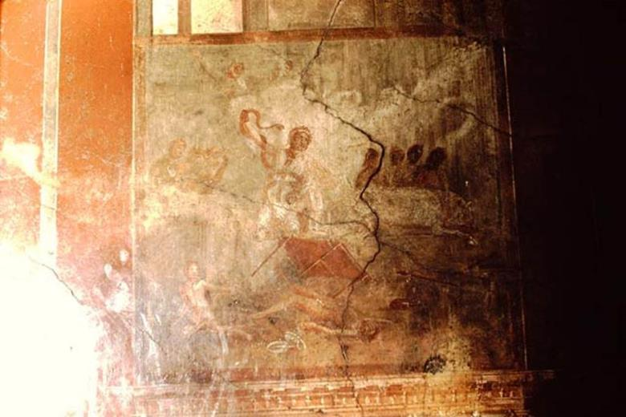
Laocoon Statue, Vatican Museums
C. 30-20 BC. Found on the Esquiline Hill, Rome
Photo: Livio Andronico CC-BY.

Slide 13
Pliny, Natural History 36.37
This is the case with the Laocoon in the palace of the emperor Titus, a work superior to any painting and any bronze. Laocoon, his children and the wonderful clasping coils of the snakes were carved from a single block in accordance with an agreed plan by those eminent craftsmen Hagesander, Polydorus and Athenodorus, all of Rhodes.
Photo: Livio Andronico CC-BY.

Slide 14
Why?
Vergil’s Account: a ploy by the gods to lure Trojans to accept the horse into Troy.
But also:
A punishment for Laocoon’s impiety (a priest of Apollo) who married & had children against Apollo’s wishes, thus Apollo sent the snakes to kill them (Servius commentary to Aen 2.21) . Cf also a lost tragedy of Laocoon by Sophocles.
Hyginus Fabulae 135: LAOCOON:
Laocoon, son of Acoetes, brother of Anchises, and priest of Apollo, against the will of Apollo had married and had children. By lot he was appointed to sacrifice to Neptune on the shore. Opportunity thus presenting itself, Apollo sent two snakes from Tenedos over the waves of the sea to kill his sons Antiphantes and Thymbraeus. When Laocoon tried to bring aid to them, the snakes killed him, too, in their folds. The Phrygians thought this happened because Laocoon had thrown his spear against the Trojan Horse.
Also as warning to Anchises to leave the city (Apollodorus, Bib 5.48)

Slide 15
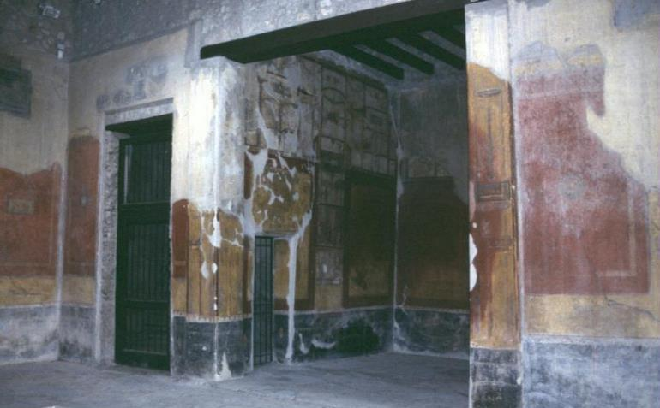
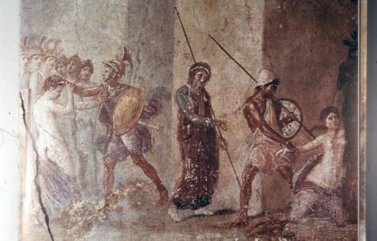
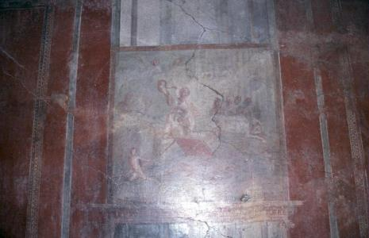
House of the Menander, Pompeii. Ala

Slide 16

Laocoon
Photo: Stanley A. Jashemski
CC-BY-SA4.0

Slide 17
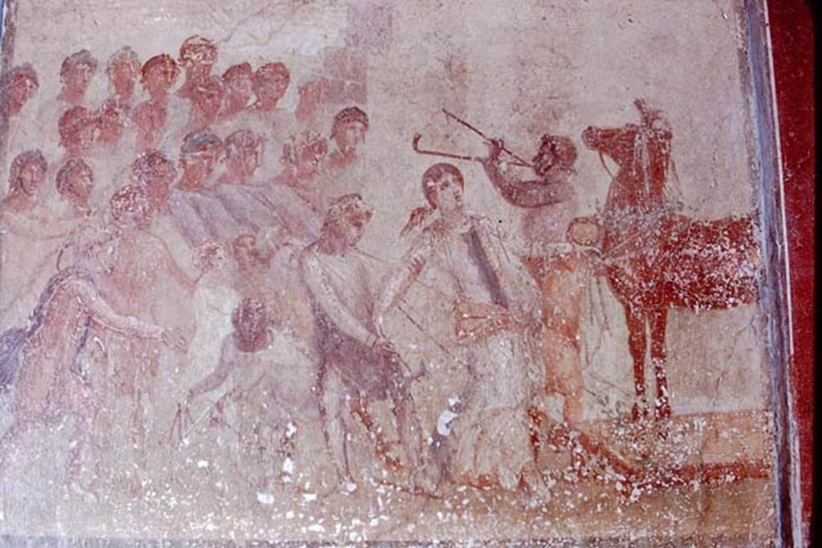
Trojan Horse and Cassandra Prophesizing
Photo: Stanley A. Jashemski
CC-BY-SA4.0

Slide 18

Ajax and Cassandra

Slide 19
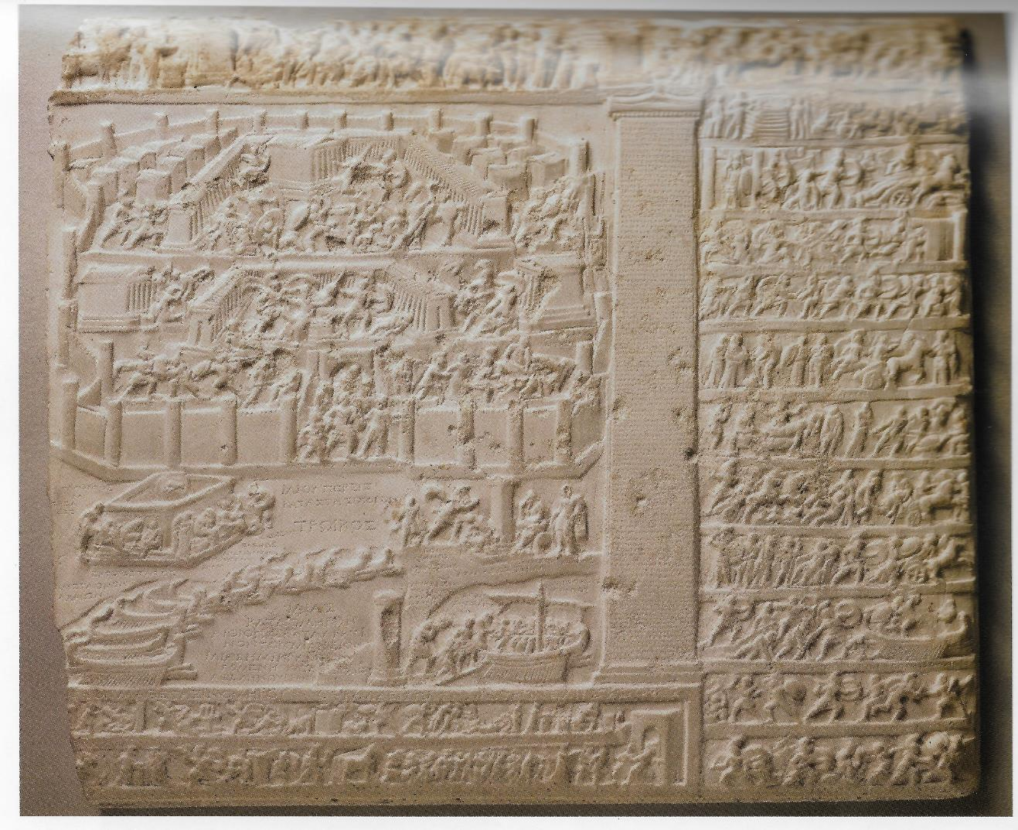
The Trojan War in a wider Context
Tabula Iliaca Capitolina, showing scenes and summaries of events from the Epic Cycle, including the Iliad and the Fall of Troy.
Rome, Capitoline Museum

Slide 20
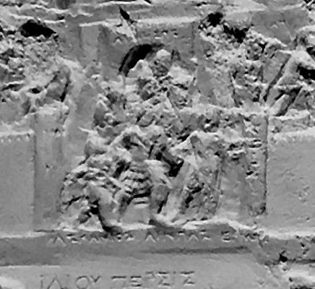

Slide 21
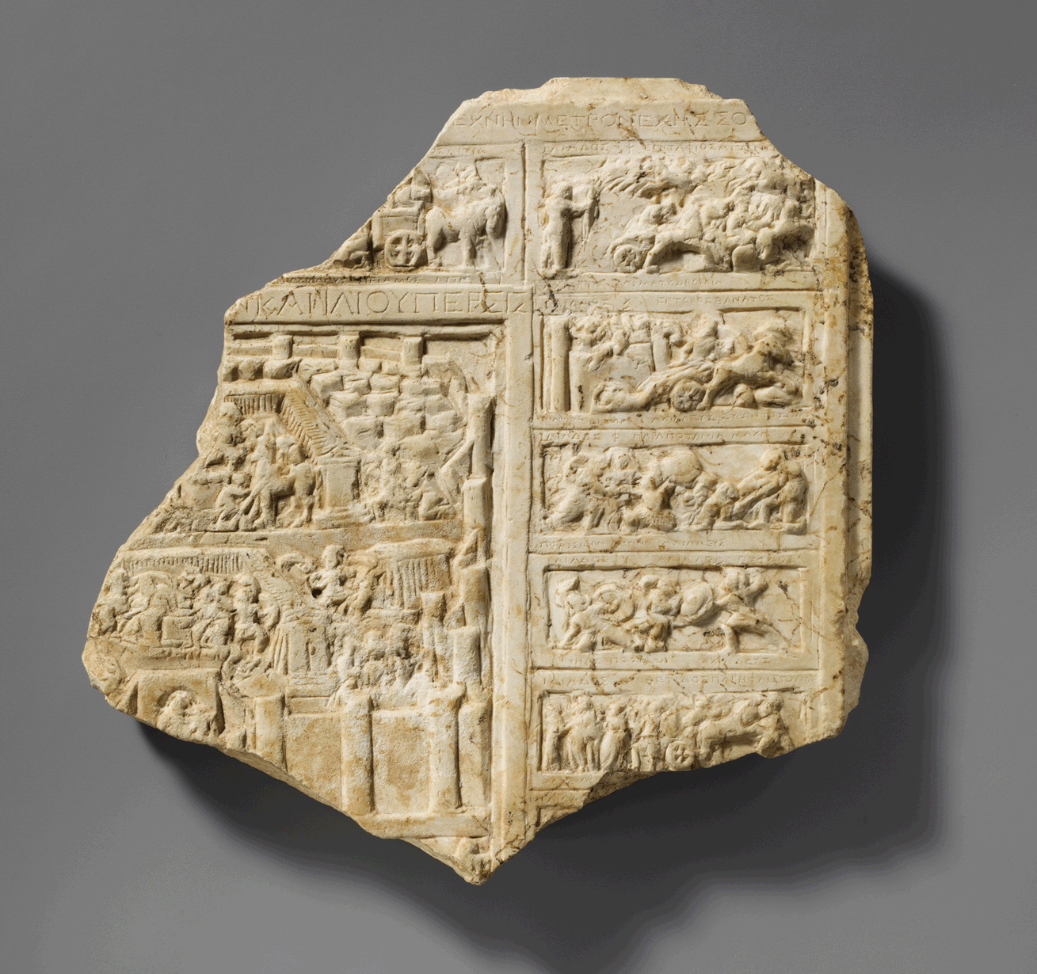
Tabula Iliaca – New York
After Squire 2011

Slide 22
The death of Hektor
Homer, Iliad 22.395-404 (greek)
ἦ ῥα, καὶ Ἕκτορα δῖον ἀεικέα μήδετο ἔργα. ἀμφοτέρων μετόπισθε ποδῶν τέτρηνε τένοντε ἐς σφυρὸν ἐκ πτέρνης, βοέους δ᾽ ἐξῆπτεν ἱμάντας, ἐκ δίφροιο δ᾽ ἔδησε, κάρη δ᾽ ἕλκεσθαι ἔασεν:
(English, trans Hammond)
So he spoke, and then he put glorious Hektor to shameful treatment. He cut through behind the tendons of both feet from heel to ankle, and pulled straps of ox-hide through them which he tied fast to his chariot, so the head would be left to drag.
Homer, Iliad 24.14-16 (greek)
ἀλλ᾽ ὅ γ᾽ ἐπεὶ ζεύξειεν ὑφ᾽ ἅρμασιν ὠκέας ἵππους, Ἕκτορα δ᾽ ἕλκεσθαι δησάσκετο δίφρου ὄπισθεν, τρὶς δ᾽ ἐρύσας περὶ σῆμα Μενοιτιάδαο θανόντος
English, trans. Hammond
‘He would harness the fast horses to his chariot, tie Hektor to it to drag behind the car, and pull him three times round dead Patroklos’ tomb’.

Slide 23
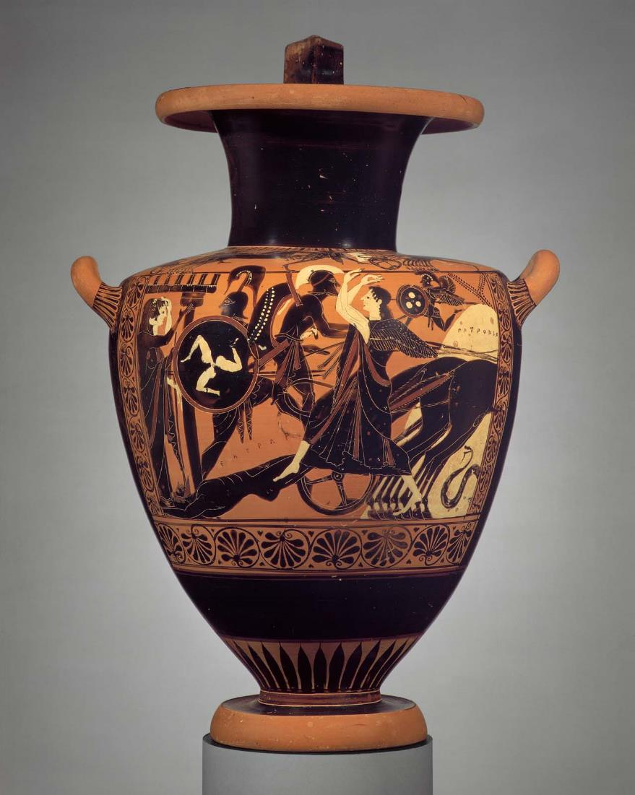
Black-figure Hydria showing Achilles’ dragging Hector’s body behind his chariot, c. 520-510 BC
Museum of Fine Arts, Boston, inv. 63.473
Photo: museum

Slide 24
Hyginus Fabulae 106 Hectoris Lytra
Quibus armis ille Hectorem occidit astrictumque ad currum traxit circa muros Troianorum, quem sepeliendum cum patri nollet dare, Priamus Iovis iussu duce Mercurio in castra Danaorum venit et filii corpus auro repensum accepit, quem sepulturae tradidit.
With these arms he killed Hektor and, having bound him to his chariot, dragged him around the walls of Troy, and when he did not wish to give the body to the father to be buried, Priam, at Jupiter’s command, and with Mercury as a guide came into the camp of the Danaians and received the body of his son, bought for an equal sum of gold, which he handed over to burial.

Slide 25
Vergil, Aeneid 1.483-7
Ter circum Iliacos raptaverat Hectora muros, exanimumque auro corpus vendebat Achilles. Tum vero ingentem gemitum dat pectore ab imo, ut spolia, ut currus, utque ipsum corpus amici, tendentemque manus Priamum conspexit inermis.
Three times around the Trojan walls had Achilles dragged Hector, and was selling the lifeless corpse for gold. Then indeed he (Aeneas) gave a deep groan from the depths of his heart, when he saw the spoils, the chariot, the very body of his friend and Priam stretching out his defenceless hands.
1.462
sunt lacrimae rerum et mentem mortalia tangunt
here, too, are tears for misfortune and human sorrows pierce the heart
(Fairclough trans)

Slide 26
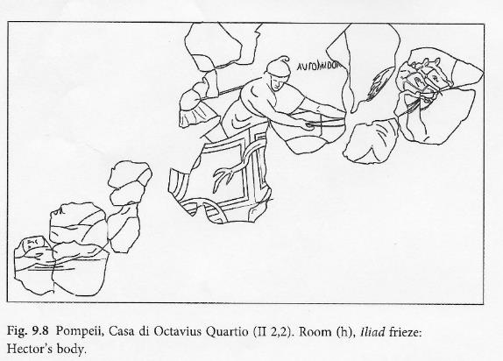
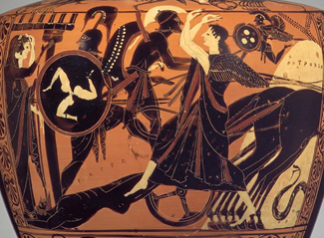
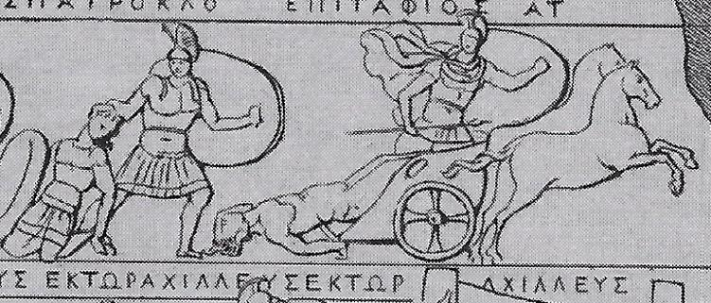
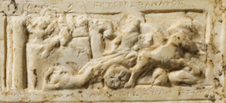
Scenes of the dragging of Hektor.
Right: Frieze in the house of Octavius Quartio, Pompeii
Boston hydria
Tabula Iliaca Capitolina
Tabula Iliaca, New York
RISD sarcophagus

Slide 27
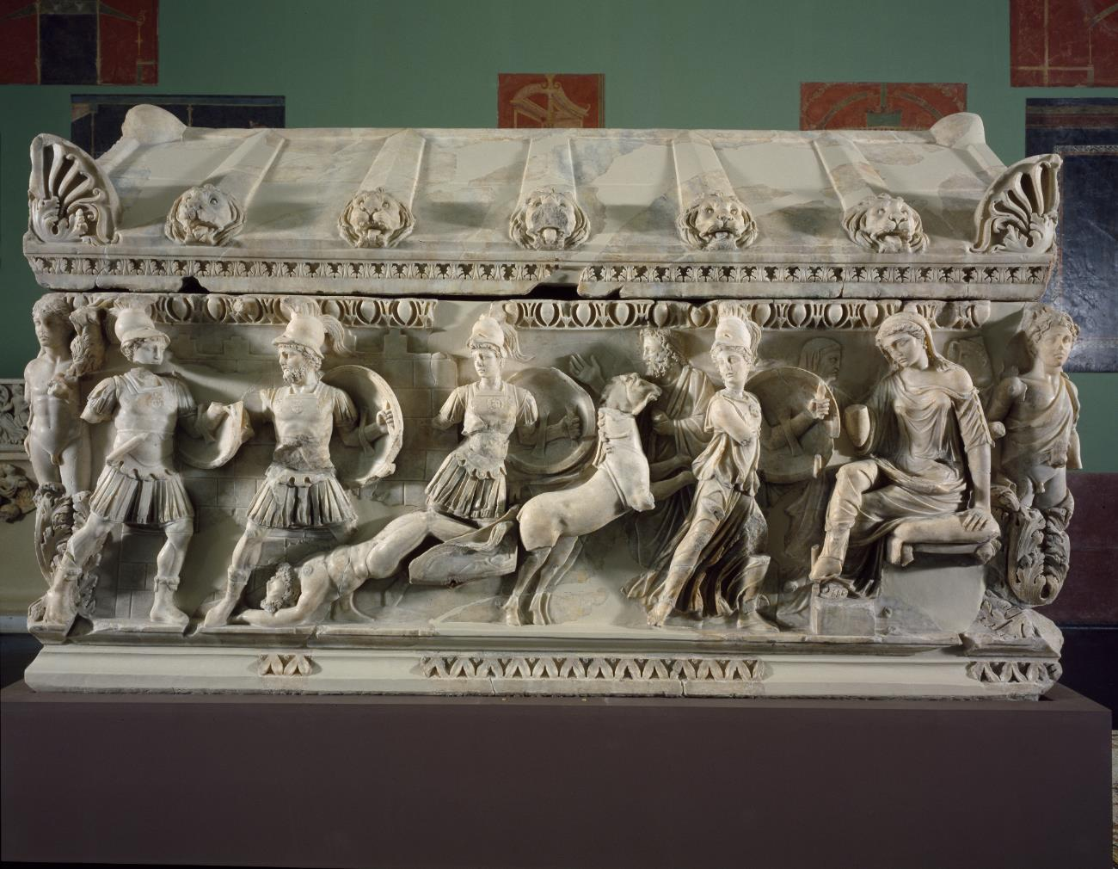
Sarcophagus in Dokimeion marble made in Asia Minor showing Achilles and Hektor fighting in front of the walls of Troy, the dragging of Hektor’s body and his grieving widow, Andromache.
Rhodes Island School of Design, originally found in Rome. c. AD 155-160. Photo: Museum

Slide 28
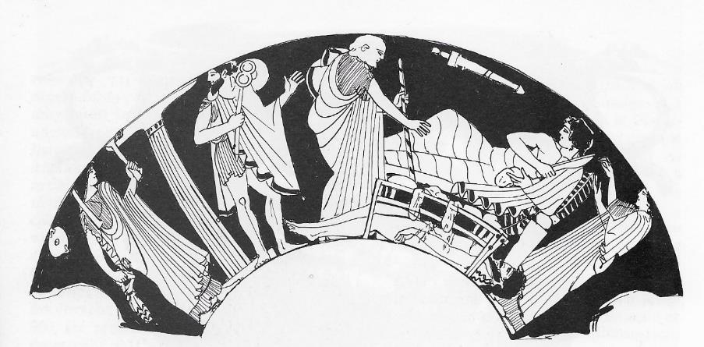
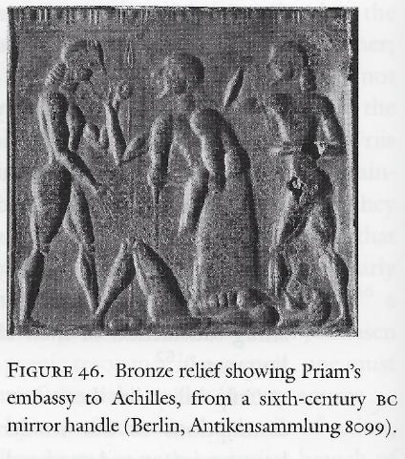
Priam and Achilles
Homer, Iliad 24, 477-9 (Greek)
τοὺς δ᾽ ἔλαθ᾽ εἰσελθὼν Πρίαμος μέγας, ἄγχι δ᾽ ἄρα στὰς χερσὶν Ἀχιλλῆος λάβε γούνατα καὶ κύσε χεῖρας δεινὰς ἀνδροφόνους, αἵ οἱ πολέας κτάνον υἷας.
Huge Priam came in unseen, and moving close to him took Achilles’ knees in his arms and kissed his hands, those terrible, murderous hands, which had killed many of his sons
Below: representations of the scene on a 6th C bronze mirror (Berlin) and an early 5th C kylix (New York.)

Slide 29
Attic sarcophagus showing the ransoming of Hector. Ioannina Archaeological Museum inv. 6176. End 2nd C. Photo: von Eickstedt, D-DAI-ATH-1993/266.

Slide 30
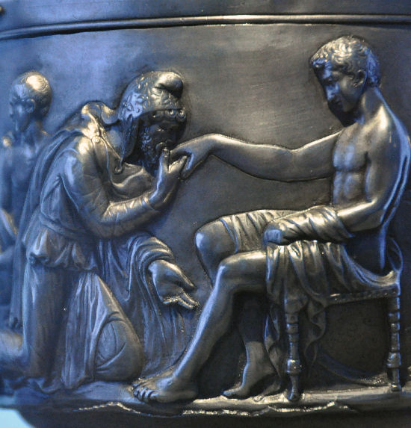
Detail of Priam and Achilles
Hoby Cup, Copenhagen, National Museum
Photo: Marco Prins, CC BY-NC-SA 4.0
Seneca, de ira 2.33 (Latin)
Quid ille Priamus ? Non dissimulavit iram et regis genua complexus est, funestam perfusamque cruore fili manum ad os suumretulit, cenavit ?
And what did great Priam do? Did he not disguise his anger and embrace the knees of the king? Did he not carry to his lips the murderous hand all stained with the blood of his son? Did he not dine?

Slide 31
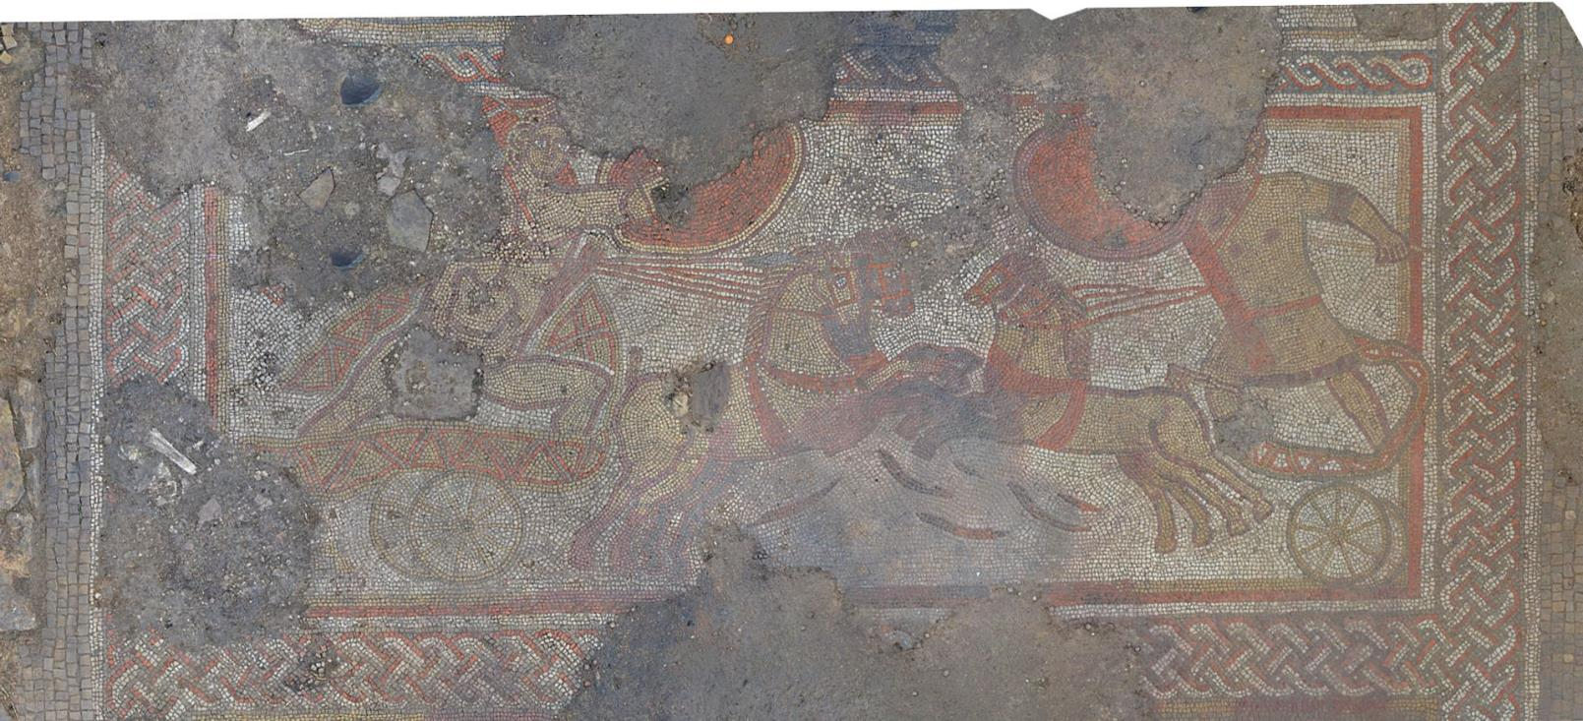
Death of Hektor in Britain – The Rutland Mosaic
Photos: University of Leicester Archaeological Services, www.theartnewspaper.com

Slide 32
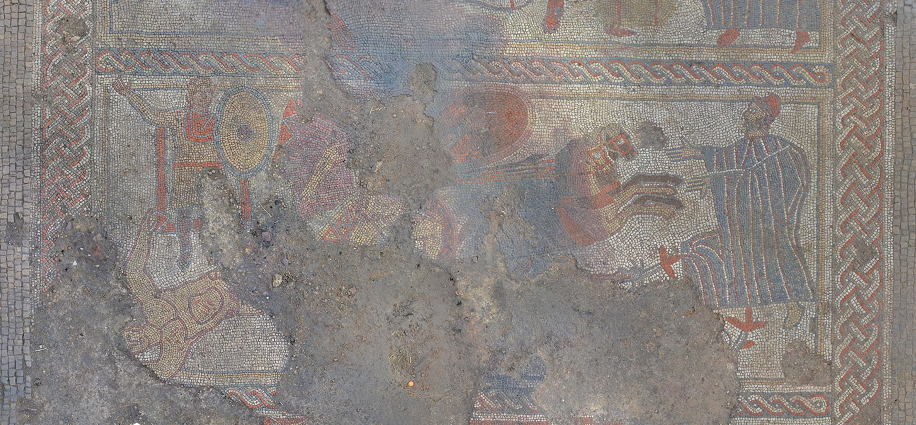

Slide 33
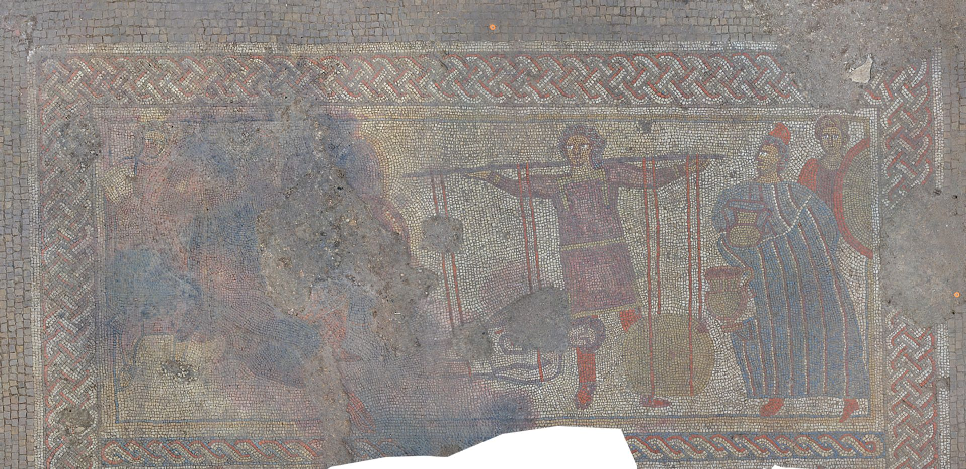

Slide 34
Myths in Art: Why?
Entertainment and discussion
Cultural knowledge / bonding
Respect for the gods
Warnings/meditations on the human condition
Cultural identity / inheritance
Showing off?

