Slide 1
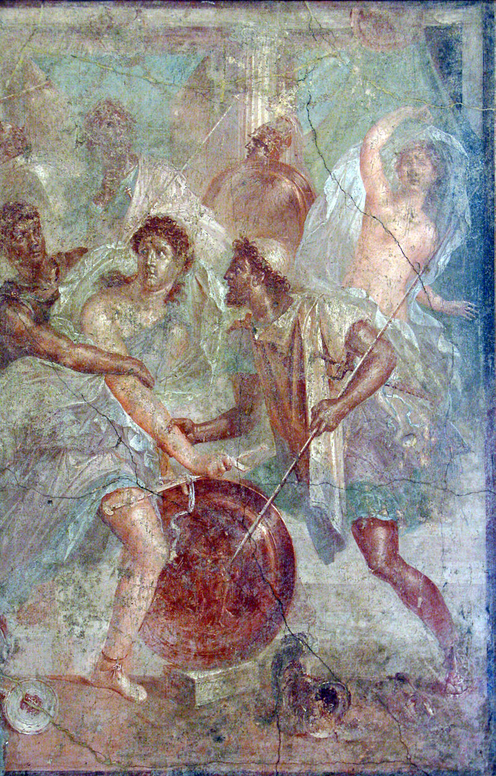
Achilles at the edge of epic
Gender, genre, and education in Statius’ Achilleid
Warwick Classics Network A. G. Leventis Ancient Worlds Day 2023
'Epic Worlds'
Dr. Nicolas Liney
Teaching Fellow in Latin Language and Literature

Slide 2
Epic genre and gender: all male, all war, all the time?
klea andron/κλέα ἀνδρῶν – the famous deeds of men (Homer Iliad 9.162)
andra moi ennepe/ἄνδρα μοι ἔννεπε – ‘tell me of the man’ (Od. 1.1)
Arma uirumque cano = I’ll sing of weapons, and the man (Virgil Aen. 1.1)
Cum canerem reges et proelia – when I was going to sing of kings and battles (Virgil Ecl. 6.1)
Res gestae regum ducumque et tristia bella – the deeds of kings and leaders and sad warfare. (Horace Ars Poetica 73)
Of Mans First Disobedience... (John Milton Paradise Lost 1.1)

Slide 3
When is epic not an epic?
Some loudly celebrate wars and their bloody weaponry; some sing of the exploits of your line, some of your own. As for me—envious nature has confined me within a narrow space, granting but slight powers to my talent. And yet that most favoured poet of your Aeneid brought his "arms and the man" to a Tyrian couch ( et tamen ille tuae felix Aeneidos auctor I contulit in Tyrios arma virumque toros), and no part of the whole work is more read than that union of illicit amor.
Ovid Tristia 2.529-536

Slide 5
Μῆνιν ἄειδε, θεά, Πηληιάδεω Ἀχιλῆος
οὐλομένην, ἣ μυρί᾿ Ἀχαιοῖς ἄλγε᾿ ἔθηκε,
πολλὰς δ᾿ ἰφθίμους ψυχὰς Ἄϊδι προΐα
ψενἡρώων, αὐτοὺς δὲ ἑλώρια τεῦχε κύνεσσιν
οἰωνοῖσί τε πᾶσι, Διὸς δ᾿ ἐτελείετο βουλή,
ἐξ οὗ δὴ τὰ πρῶτα διαστήτην ἐρίσαντε
Ἀτρεΐδης τε ἄναξ ἀνδρῶν καὶ δῖος Ἀχιλλεύς
The wrath sing, goddess, of Peleus’ son Achilles, the accursed wrath which brought countless sorrows upon the Achaeans, and sent down to Hades many valiant souls of warriors, and made the men themselves to be the spoil for dogs and birds of every kind; and thus the will of Zeus was brought to fulfilment. Of this sing from the time when first there parted in strife Atreus’ son, lord of men, and noble Achilles.
Homer Iliad 1.1-7

Slide 6
“The son of Philyra (Chiron) made the boy Achilles accomplished on the lyre, and by his peaceful art (placida arte) subdued those savage passions. He who terrified his friends so often and so often his foes, cowered, we are told, before an aged man. Those hands that Hector was to feel, he held out to the lash obediently, when his master bade.”
- Ovid Ars Amatoria 1.17-22
Basilica at Herculaneum, c. 65 -79 A.D, fresco
(National Archaeological Museum of Naples)

Slide 7
Gender, epic and education
“The reading of the poets is of use to the future orator. But do poets exist without music? If anyone should be blind enough to be doubtful about the others, this must at least be true of those who wrote songs for the lyre.... music has in fact lasted from the old days of Chiron and Achilles down to our own time among everyone who has not conceived a dislike for regular study ... Nevertheless, I think I ought to state more plainly that I do not recommend the effeminate music of the modern stage, emasculated by indecent rhythms, which has done so much to destroy any manly strength we still had left, but rather the music to which the praises of brave men were sung, and which brave men themselves used to sing.”
Quintilian Institutio Oratoria 1.10.31

Slide 8
House of the Dioscuri (VI.9.6-7) Pompeii.

Slide 9
cubiculum (25) of the House of Apollo (VI.7.23) Pompeii.

Slide 10
Mosaic in the impluvium (18), the Poseidon Villa the House of Poseidon at Zeugma

Slide 11
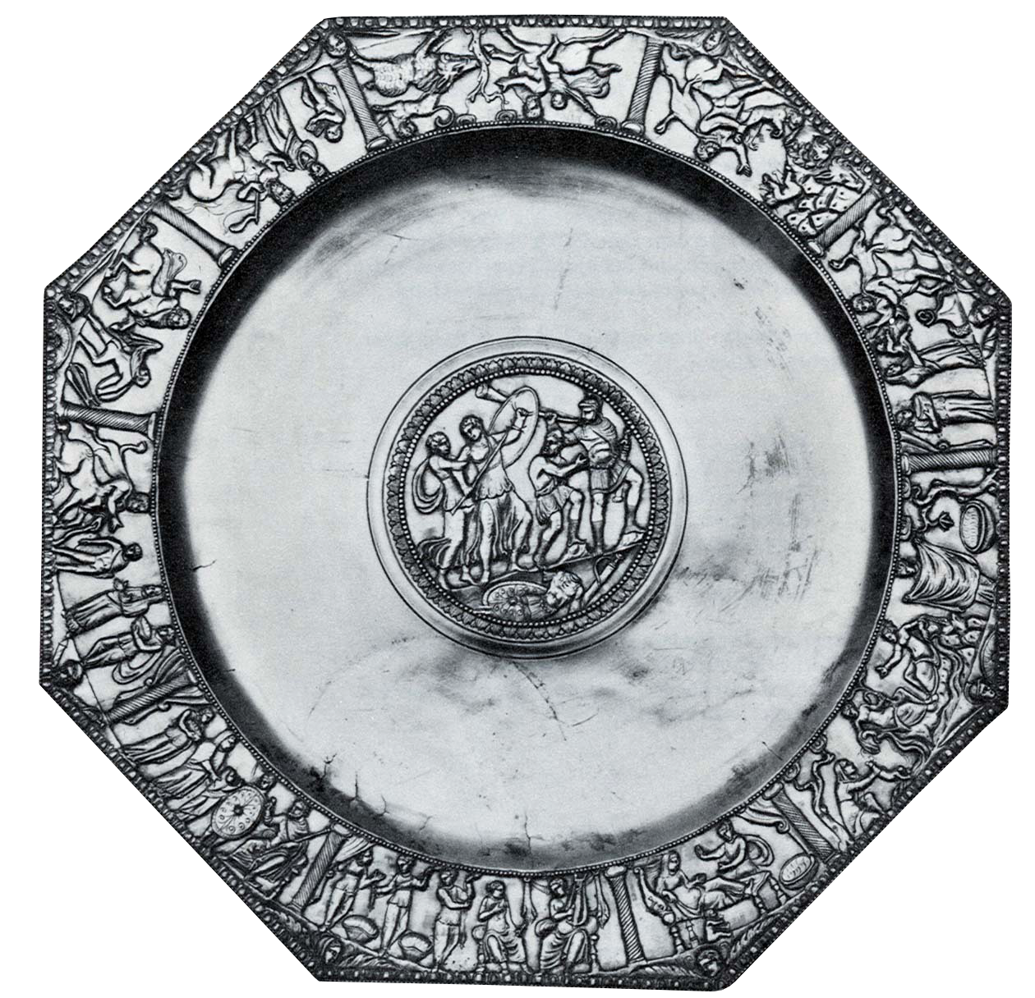
Kaiseraugst silver plate - 4th century

Slide 12
Unepic Achilles?
Shamefully, though he gave way to a mother’s prayer,
Achilles hid his manhood in women’s clothes.
What’s this, Aeacides? Spinning’s not your work:
your search for fame’s through Pallas’s other arts.
Why the basket? Your arm’s meant to bear a shield:
why does the hand that will slay Hector hold the yarn?
Throw away the spindle wound laboriously with thread!
The spear from Pelion’s to be brandished by this hand.
- Ovid Ars Amatoria 1.689-695

Slide 13
Publius Papinius Statius
Born around 45 AD – 96 AD
Naples
A ‘Flavian’ poet (writing under the Flavian emperors).
Famous father: a poet and grammarian (teacher)
Won important poetic competitions, Including the Alban Games, the games set up by Domitian in his villa in Alba.
Thebaid (famous epic about the Theban war – 92 AD)
Silvae (collection of occasional poems dedicated to the cultural elite of Domitian’s Rome 93-95 AD)
The Achilleid - 95 AD (?)

Slide 14
Beginning the Achilleid
Goddess, tell of great-hearted Aeacides and offspring feared of the Thunderer and forbidden to succeed to his father’s heaven. The hero’s deeds, it’s true, are much famed in Maeonian song, but more are yet to celebrate. Be it your pleasure that I (such is love) traverse the whole hero, bringing him forth by Dulichian trump as he hides in Scyros, nor stopping at Hector’s drag, but singing the youth through Troy’s whole story. And you, Apollo, if I have exhausted my old source with worthy draughts give me new founts of inspiration, and bind my hair with a favourable/second wreath...
Magnanimum Aeaciden formidatamque Tonanti
progeniem et patrio vetitam succedere caelo,
diva, refer. quamquam acta viri multum incluta cantu
Maeonio (sed plura vacant), nos ire per omnem
(sic amor est) heroa velis Scyroque latentem
Dulichia proferre tuba nec in Hectore tracto
sistere, sed tota iuvenem deducere Troia.
Tu modo, si veterem digno deplevimus haustu,
Da fontes mihi, Phoebe, novos ac fronde secunda
Necte comas.
Achilleid 1.1-10

Slide 15
A plot does not have unity, as some people think, simply because it deals with a single hero. Many and indeed innumerable things happen to an individual, some of which do not go to make up any unity, and similarly an individual is concerned in many actions which do not combine into a single piece of action. [20] It seems therefore that all those poets are wrong who have written a Heracleid or Theseid or other such poems. They think that because Heracles was a single individual the plot must for that reason have unity. But Homer, supreme also in all other respects, was apparently well aware of this truth either by instinct or from knowledge of his art.
- Aristotle Poetics 1451a

Slide 16
Seeing Achilles: 1.161-166
“There he was, magnificent in the profuse and dust,
But even amid all his weapons and exertion
Still sweet to look at (dulcis adhuc visu), a warm glow playing
on his snow-white face, his hair fairer than gold,
His first youth not yet transformed by wispy beard
The light in his eyes tranquil, and much of his mother
There in his face: like Apollo when he returns
From hunting in Lycia and exchanges
His quiver of sharp arrows for the plectrum and lyre.“

Slide 17
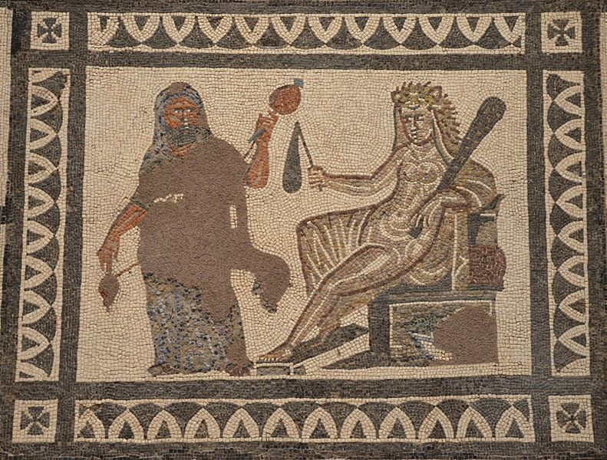
Convincing Achilles: 1.259-271
“You need to be a little less manly now and think it
Not unworthy of you to wear clothes like mine.
If Hercules carded Lydian wool with his hard hands
And carried dainty implements, if Bacchus
Swept his insteps with a gold-embroidered robe,
If Jupiter assumed a virgin’s limbs and torso,
And dual sexuality did not shatter great Caeneus,
Let’s dodge this threatening cloud in just the same way.
I will soon return you to your fields, your centaur’s
Romping grounds. By your present grace and charm
And the joys of youth still to come, I beg you:
...wear for a little while clothes that will keep you safe
And not harm your spirit”.

Slide 18
Educating by example
But it is not only the content of such studies as these which we should know and constantly turn over in our minds; even more important are the records of the notable sayings and actions of the past. Nowhere is there a larger or more striking supply of these than in the history of our own country. Could there be any better teachers of courage, justice, loyalty, self-control, frugality, or contempt for pain and death than men like Fabricius, Curius, Regulus, Decius, Mucius, and countless others?
- Quintilian Institutio Oratoria 12.1.10

Slide 19
Transforming Achilles: 1.323-357
He begins to soften and blushes
Casting bold sideways glances and relaxing the hand
That rejects the garments. His mother sees him waffling,
Sees he wants to be forced, and drapes the dress on him.
Then she massages his neck, drops his heavy shoulders,
Smoothes out his strong arms, arranges his unkempt hair
And transfers her necklace to that beloved neck.
Next, confining his steps with an embroidered hem,
She teaches him (docet) how to walk and move and speak with modesty
Just as an artist whose thumb moulds
Heated wax to a new shape and brings it to life,
So did the goddess transform her son.
Nor did he struggle long. Charm is his in plenty, though his manhood demur,
And an ambiguous sex cheats the view, hiding in the narrow divide.

Slide 20
Pygmalion
The ivory yielded to his touch, and lost its hardness, altering under his fingers, as the bees’ wax of Hymettus softens in the sun, and is moulded, under the thumb, into many forms, made usable by use. The lover is stupefied, and joyful, but uncertain, and afraid he is wrong, reaffirms the fulfilment of his wishes, with his hand, again, and again.

Slide 21
Exposing Achilles: 1.851-66
But when Aeacus’ fierce grandson saw the resplendent
disc of the shield, engraved with battle scenes
(and by chance spotted with blood from actual war)
As it leaned against the spear there, he yelled
And narrowed his eyes, and his hair bristled.
His mother’s mandates, his secret love meant nothing
Troy was all his heart...
... When he came closer and saw the reflection
Of his face in a light that rivalled his own
Saw himself as he was in that golden likeness,
He shuddered and blushed at the same time. Ulysses
Came up to him now and said in a low voice:
“what are you waiting for? We know its you,
Raised by the half-beast Chiron...”

Slide 22
Themes and interpretations
explores the constructedness of gender (and the ‘essence’ of gender) / and the role of women in Roman epic.
stages an interaction and battle between different ways of writing epic, and between different genres, both martial, masculine epic and the rejection of martial, masculine epic
Reflects upon education of young men which appeals to contemporary Roman obsessions about the correct performance of masculinity

