Slide 1
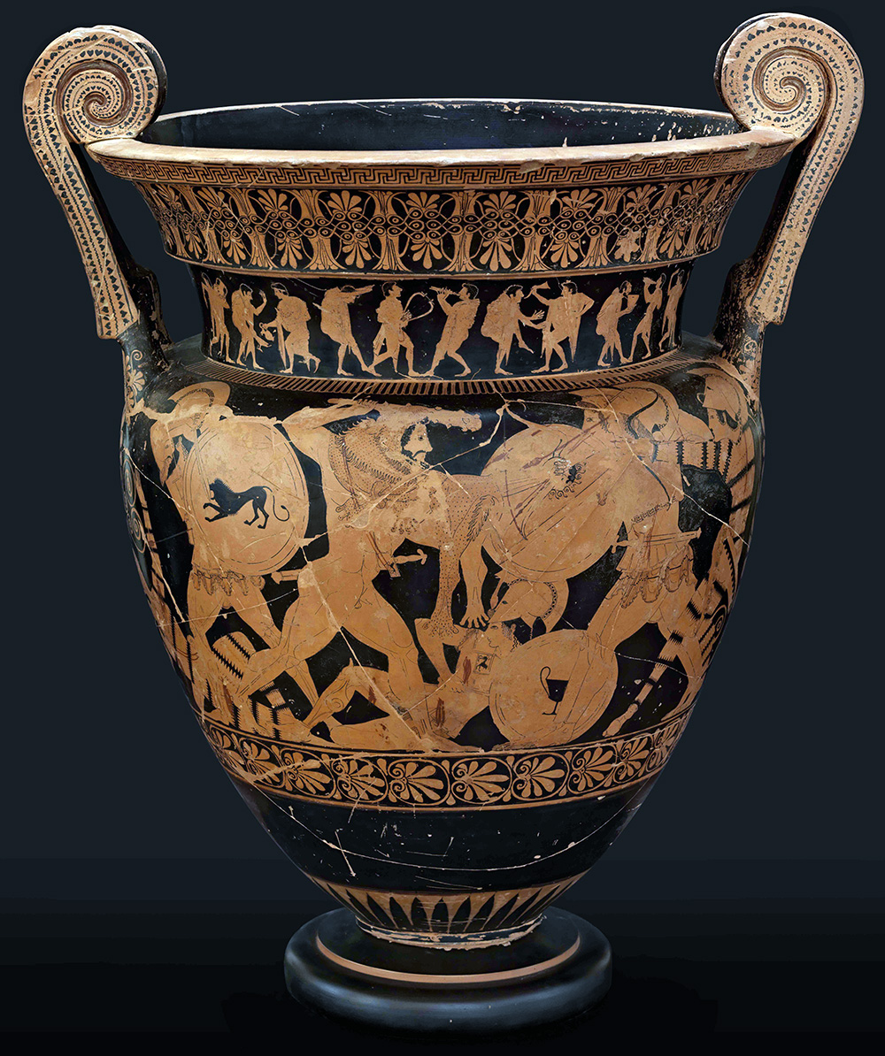
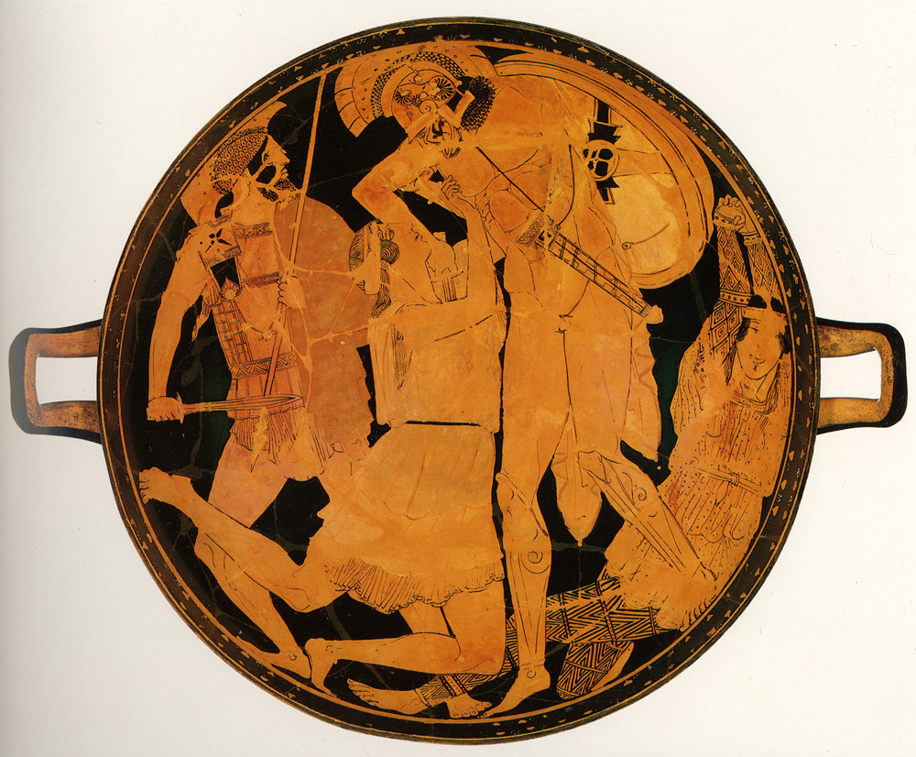
“Invention of the Barbarian”
2. Amazons (Persian Substitutes?)
M. C. Miller
Herakles and Amazons
Achilles and Penthesileia
Penthesileia Ptr., cup, 470-460, Munich 2688
Euphronios, volute krater, ca. 510, Arezzo 1465

Slide 2
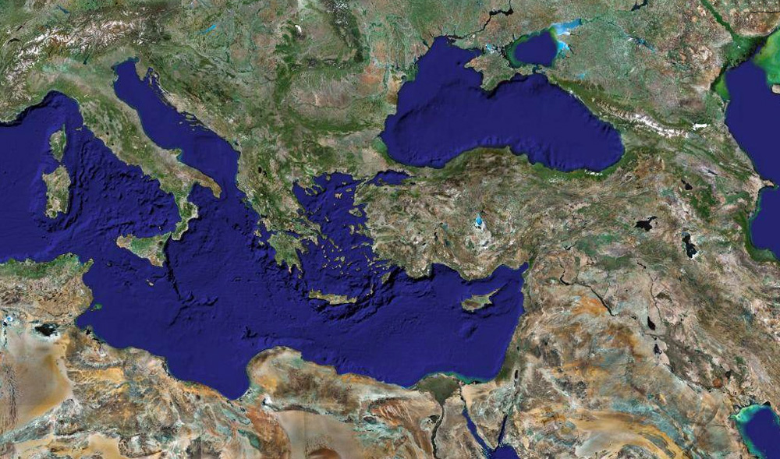
Amazons: Geography
[suspected link between Amazons and real nomadic people: female warrior kurgans*]
SAUROMATIANS
SCYTHIANS
X
AMAZONS
Caucasus
THRACIANS
AMAZONS
South Italy
Turkey
Greece
PERSIANS
*Ukraine – Caucasus – Altai: Occasional burials of women equipped with weapons, sometimes exhibiting battle-wounds
Google Earth

Slide 3
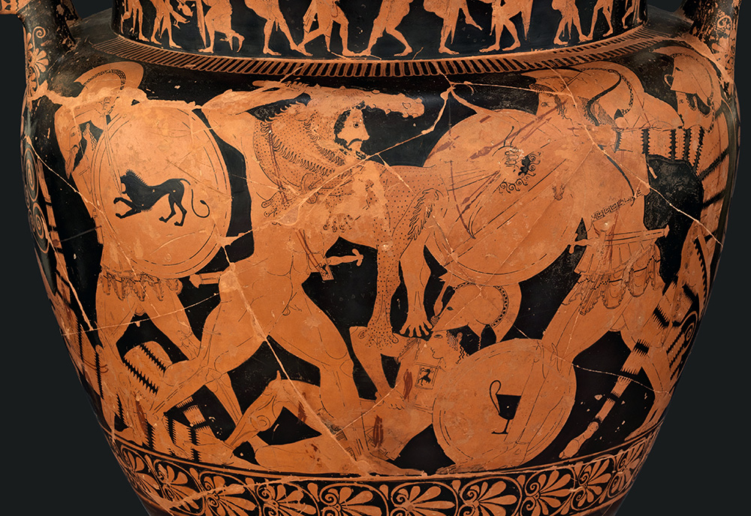
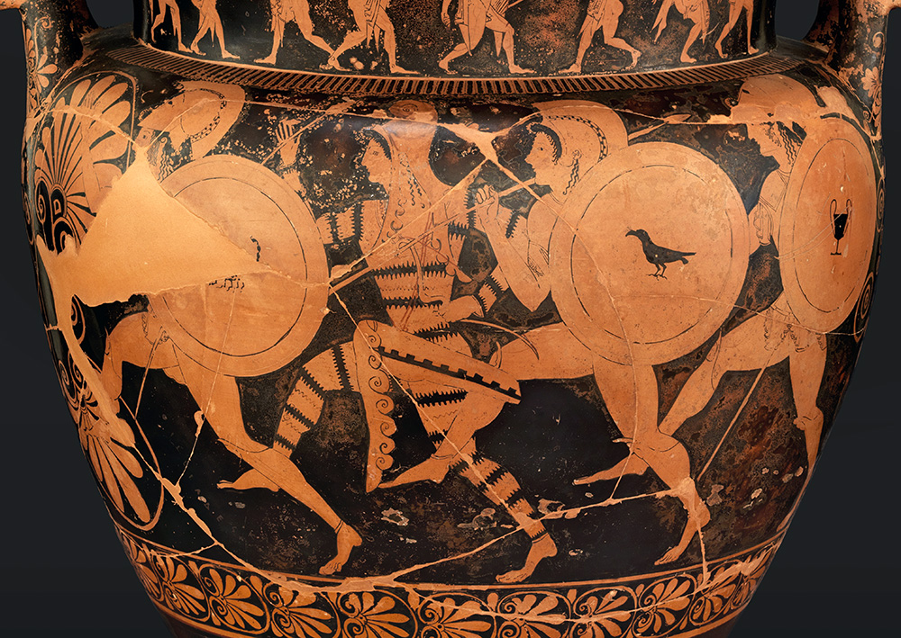
Amazons: Herakles and Amazons
Euphronios, volute krater, ca. 510, Arezzo 1465

Slide 4
Amazons: Herakles and Amazons
Euphronios, volute krater, ca. 510, Arezzo 1465
Amazons wear one-piece sprang suits

Slide 5
Amazons: Herakles and Amazons
Euphronios, volute krater, ca. 510, Arezzo 1465
Amazons equipped as hoplites

Slide 6
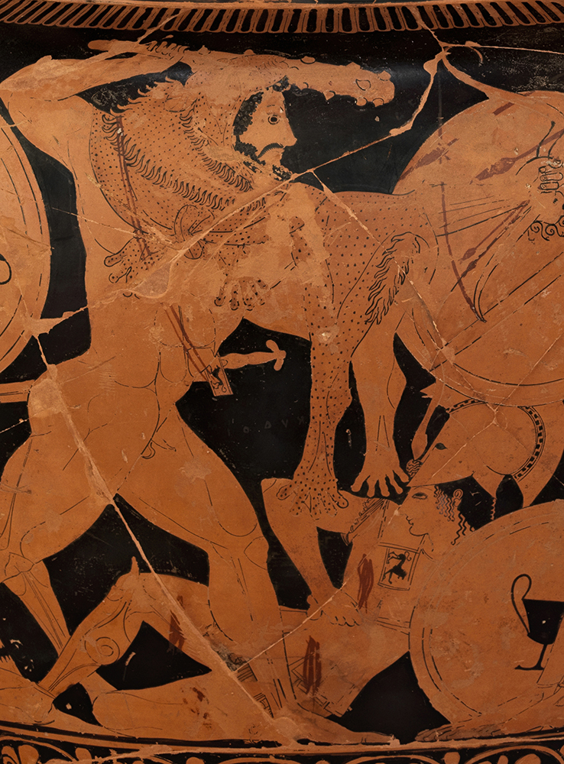
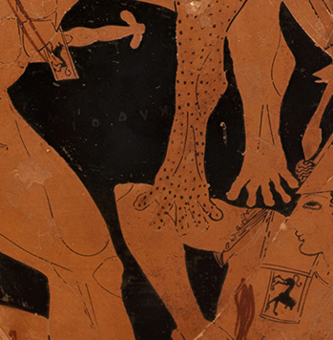
Amazons: Herakles and Amazons
Rampant lions
Euphronios, volute krater, ca. 510, Arezzo 1465

Slide 7
Amazons: Achilles and Penthesileia
Greek Hoplite
Persoid
Amazon
Penthesileia Ptr., cup, 470-460, Munich 2688

Slide 8
Amazons: Achilles and Penthesileia
Hellenic Penthesileia
Naked Achilles
Greek Hoplite
Persoid
Amazon
Penthesileia Ptr., cup, 470-460, Munich 2688

Slide 9
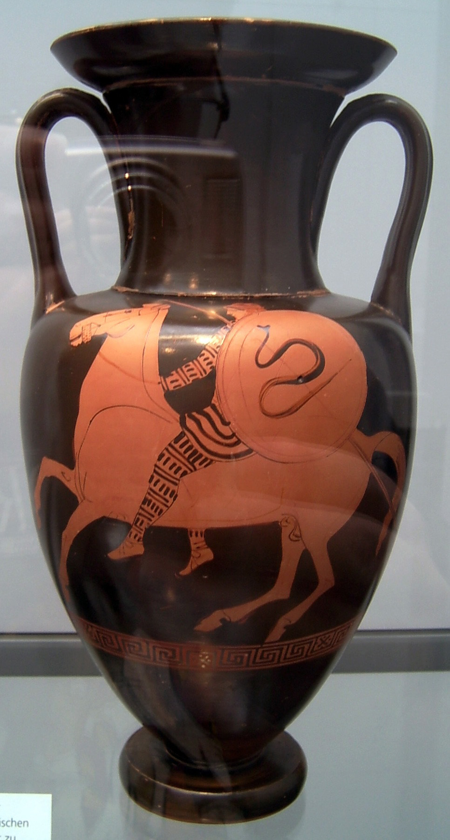
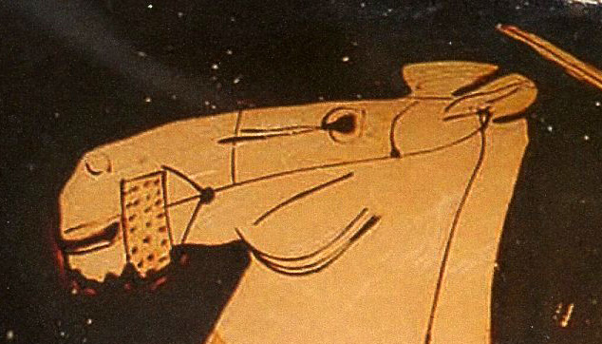
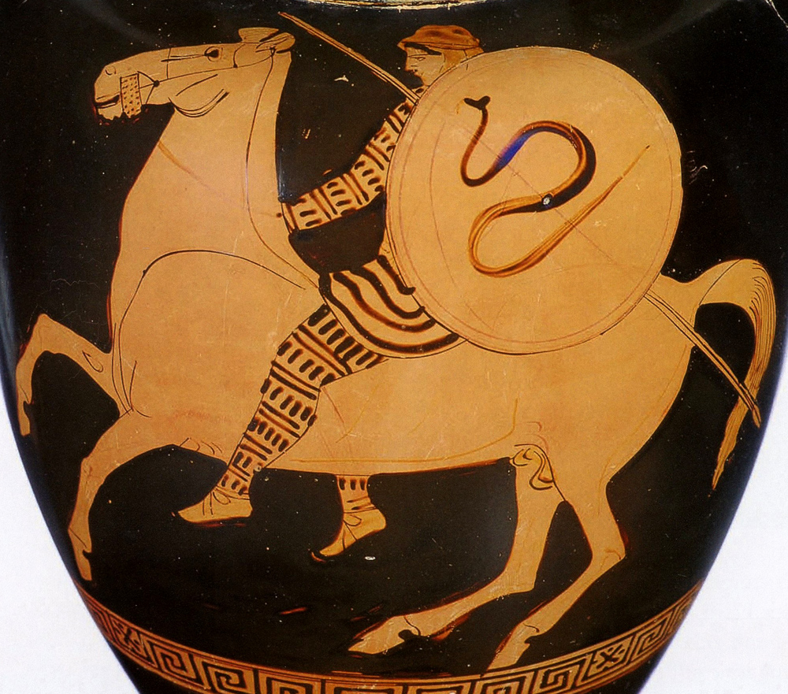
Amazons: Ethnographic Accuracy?
Bit mode from Kuban (Ukraine, north of Black Sea)
Persian Amazons 5th c. with imperial troops?
Clio Ptr., Nolan amphora, 440, Munich 2331
Starke Frauen
Anderson, J. K., 1961, Ancient Greek Horsemanship (Berkeley) 58-59
Photo Marcus Cyron, commons.wikimedia.org/wiki

Slide 10
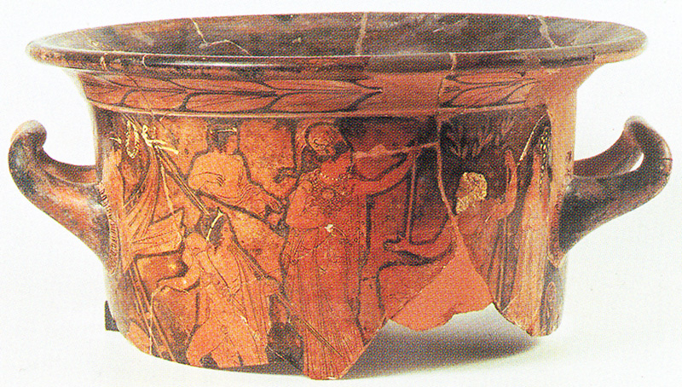
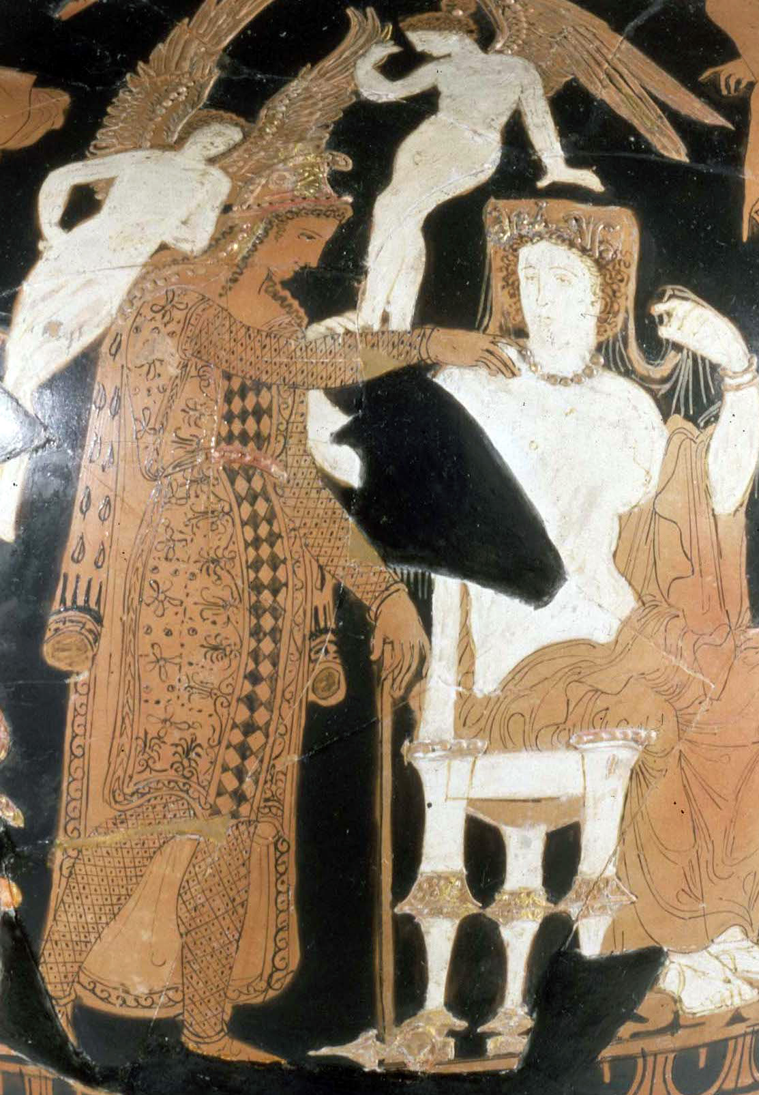
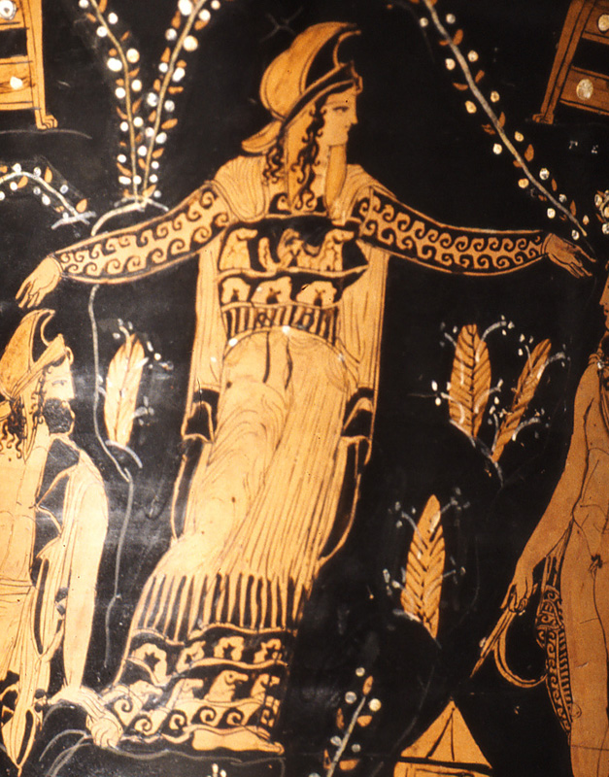
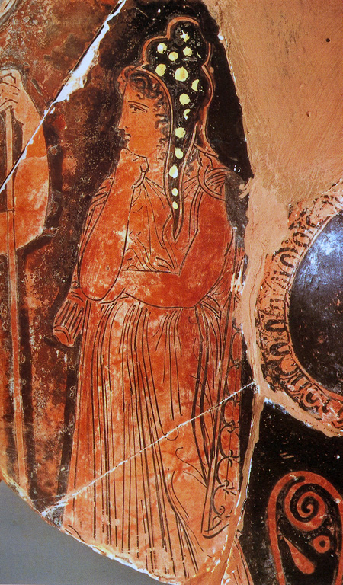
Persian Kandys worn by “Easterners”
i.e. the Persian model came to play played a formative role in Greek understanding of the world.
Paris of Troy
hydria, 380, Helena Ptr., St. Petersburg 1924
Andromeda
calyx krater, 400, unattributed, Berlin 3237
(Medea?) in scene with Theseus
bell krater, 430, Dinos Ptr., Gela

