Slide 1
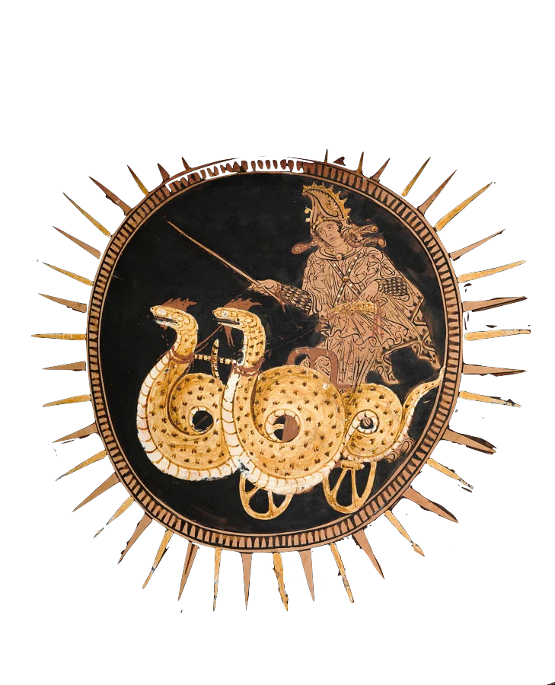
Invention of the barbarian
Euripides’ Medea and the discourse of barbarity
Dr Leo Kershaw
University of Warwick

Slide 2
“It is a play about the barbarian’s powerful ability to restore her own dignity and achieve justice, and it is a “radical” play because it uproots traditional beliefs related to gender, politics and culture which lay at the heart of Athenian society of the fifth century BCE.”
Olga Kekis
‘Medea adapted: The subaltern barbarian speaks.’
(2019: 89)

Slide 3
Herodotus 7.62
ἐκαλέοντο δὲ πάλαι πρὸς πάντων Ἄριοι, ἀπικομένης δὲ Μηδείης τῆς Κολχίδος ἐξ Ἀθηνέων ἐς τοὺς Ἀρίους τούτους μετέβαλον καὶ οὗτοι τὸ οὔνομα. αὐτοὶ περὶ σφέων ὧδε λέγουσι Μῆδοι.
The Medes were formerly called by everyone Arians, but when the Colchian woman Medea came from Athens to the Arians, they changed their name, like the Persians [after Perses]. This is the Medes’ own account of themselves.
Cf. Pausanias 2.3.8, Apollodorus i.9.28, Diodorus Siculus 4.40–58

Slide 4
Medea the barbarian?
Edith Hall, Inventing the Barbarian (1989: 2): ‘the poets created a whole new “discourse of barbarism”, […] a complex system of signifiers denoting the ethnically, psychologically, and politically “other”.’
Homer, Iliad 11.739–741:
Denys Page, Euripides Medea (1938: xxi): ‘Because she was a foreigner she could kill her children: because she was a witch she could escape in a magic chariot. She embodies the qualities which the fifth century Athenian believed to be oriental.’
Page (1938: xvii): ‘here it is important to understand that the poet has described not a Greek woman but a barbarian. Though her emotions are natural to all women of all times in her position, their expression and the dreadful end to which they lead are everywhere affected by her foreign origin.’
Μούλιον αἰχμητήν· γαμβρὸς δ᾽ ἦν Αὐγείαο, πρεσβυτάτην δὲ θύγατρ᾽ εἶχε ξανθὴν Ἀγαμήδνη, ἣ τόσα φάρμακα ᾔδη ὅσα τρέφει εὐρεῖα χθών. |  | the spearman Moulios; he was son-in-law to Augeias, and had his eldest daughter, blonde Agamede as wife, who knew as many medicines as the wide earth nourishes.

Slide 5
The discourse of barbarity
‘Barbaros’ is only used 4 times in Medea…
…never by the chorus, Creon, Aigeus, the nurse, tutor, or messenger…
…only by Jason (x2) and Medea herself (x2).
Helen Bacon, Barbarians in Greek Tragedy (1955: 5): three main meanings of barbaros in tragedy:
unintelligible
foreign, non-Greek (nationality)
foreign, ‘with some implication of inferiority’ (uncivilised)

Slide 6
Barbaros 1: Euripides’ Medea, 252-258
ἀλλ᾽ οὐ γὰρ αὑτὸς πρὸς σὲ κἄμ᾽ ἥκει λόγος:
σοὶ μὲν πόλις θ᾽ ἥδ᾽ ἐστὶ καὶ πατρὸς δόμοι
βίου τ᾽ ὄνησις καὶ φίλων συνουσία,
ἐγὼ δ᾽ ἔρημος ἄπολις οὖσ᾽ ὑβρίζομαι
πρὸς ἀνδρός, ἐκ γῆς βαρβάρου λελῃσμένη,
οὐ μητέρ᾽, οὐκ ἀδελφόν, οὐχὶ συγγενῆ
μεθορμίσασθαι τῆσδ᾽ ἔχουσα συμφορᾶς.
But your story and mine are not the same:
you have this city and your father’s house
and life’s delights and company of friends,
but I, deserted, city-less, am maltreated by
my husband, plundered from a barbarian land,
and have no mother, no brother, no relative
to provide refuge from this calamity.

Slide 7
Barbaros 2: Euripides’ Medea, 534-541
μείζω γε μέντοι τῆς ἐμῆς σωτηρίας
εἴληφας ἢ δέδωκας, ὡς ἐγὼ φράσω.
πρῶτον μὲν Ἑλλάδ᾽ ἀντὶ βαρβάρου χθονὸς
γαῖαν κατοικεῖς καὶ δίκην ἐπίστασαι
νόμοις τε χρῆσθαι μὴ πρὸς ἰσχύος χάριν:
πάντες δέ σ᾽ ᾔσθοντ᾽ οὖσαν Ἕλληνες σοφὴν
καὶ δόξαν ἔσχες: εἰ δὲ γῆς ἐπ᾽ ἐσχάτοις
ὅροισιν ᾤκεις, οὐκ ἂν ἦν λόγος σέθεν.
But in return for saving me you got
more than you gave, as I will prove.
First, in a Greek land rather than a barbarian
country you now live, and you know justice
and heed the law, with no concession to force.
All the Greeks recognise that you are clever
and you have a reputation; if you were living
on the world’s outskirts, there would be no talk of you.
Olga Kekis: Jason is ‘the arrogant coloniser that embodies two related attitudes: metropolitan arrogance and a male chauvinistic contempt for, even fear of women’ (‘Medea adapted: The subaltern barbarian speaks’, 2019: 92)

Slide 8
Barbaros 3: Euripides’ Medea, 591-592
ἀλλὰ βάρβαρον λέχος
πρὸς γῆρας οὐκ εὔδοξον ἐξέβαινέ σοι.
But a barbarian marriage-bed
in your old age was not reputable for you.

Slide 9
Barbaros 4: Euripides’ Medea, 1323-1341
ὦ μῖσος, ὦ μέγιστον ἐχθίστη γύναι
θεοῖς τε κἀμοὶ παντί τ᾽ ἀνθρώπων γένει,
ἥτις τέκνοισι σοῖσιν ἐμβαλεῖν ξίφος
ἔτλης τεκοῦσα κἄμ᾽ ἄπαιδ᾽ ἀπώλεσας.
[…]
… ἐγὼ δὲ νῦν φρονῶ, τότ᾽ οὐ φρονῶν,
ὅτ᾽ ἐκ δόμων σε βαρβάρου τ᾽ ἀπὸ χθονὸς
Ἕλλην᾽ ἐς οἶκον ἠγόμην, κακὸν μέγα…
[…]
οὐκ ἔστιν ἥτις τοῦτ᾽ ἂν Ἑλληνὶς γυνὴ
ἔτλη ποθ᾽, ὧν γε πρόσθεν ἠξίουν ἐγὼ
γῆμαι σέ, κῆδος ἐχθρὸν ὀλέθριόν τ᾽ ἐμοί
‘Detestable creature, most hateful woman
to gods and me and the whole human race,
who dared plunge the sword into the children
you birthed and destroyed me, leaving me childless!
[…]
…I’m in my senses now — then I was not —
when from your house in a barbarian land
I brought you to a Greek home, a great evil…
[…]
There is no Greek woman who would have
ever dared do this, instead of whom I decided
to marry you, a hateful and destructive match for me.’

Slide 10
Infanticide: a barbarian phenomenon?
μίαν δὴ κλύω μίαν τῶν πάρος
γυναῖκ᾽ ἐν φίλοις χέρα βαλεῖν τέκνοις,
Ἰνὼ μανεῖσαν ἐκ θεῶν, ὅθ᾽ ἡ Διὸς
δάμαρ νιν ἐξέπεμψε δωμάτων ἄλαις:
πίτνει δ᾽ ἁ τάλαιν᾽ ἐς ἅλμαν φόνῳ τέκνων δυσσεβεῖ,
ἀκτῆς ὑπερτείνασα ποντίας πόδα,
δυοῖν τε παίδοιν συνθανοῦσ᾽ ἀπόλλυται.
I know one, just one woman of all in existence,
who put her hand to her own children,
Ino, maddened by gods, when the wife of Zeus
sent her roaming from home;
the wretch fell into the salty sea with the impious murder of her children,
extending her foot over the sea’s edge,
she perished, dying with her two children.
Euripides’ Medea, 1289-1289

Slide 11
Barbarity in Euripides
Euripides, Iphigeneia in Tauris 1174: ‘Apollo! Not even among the barbarians would anyone have dared this.’ (Ἄπολλον, οὐδ᾽ ἐν βαρβάροις ἔτλη τις ἄν.)
Medea’s ‘savage nature’ (ἀγριωτέραν φύσιν, 1343)
Suzanne Saïd: ‘this anti-Barbarian talk, whose spokesmen are very suspect, is always invalidated by the context’ (‘Greeks and Barbarians in Euripides’ Tragedies: The End of Differences?’, 2001: 85).
Bernard Knox: ‘there is no suggestion in the play that anyone regards Medea as a barbarian, except, of course, in the end, Jason’ (Word and Action, 1986: 310).

Slide 12
Barbarity in Aeschylus’ Persians
‘Barbaros’ is used 10 times in Persians:
187: γαῖαν, ἡδὲ βάρβαρον earth, the barbarian earth
255: στρατὸς γὰρ πᾶς ὄλωλε βαρβάρων for the whole army of barbarians perished
337–338: βαρβάρων / ναῦς the fleet / of the barbarians
391: φόβος δὲ πᾶσι βαρβάροις παρῆν and fear came upon all the barbarians
423: βαρβάρου στρατεύματος barbarian army
434: πρόπαντι βαρβάρων γένει the whole race of barbarians
475: οὓς πρόσθε Μαραθὼν βαρβάρων ἀπώλεσεν barbarians whom Marathon destroyed before
635: βάρβαρ’ ἀσαφηνῆ barbarian incoherence
798: πᾶν στράτευμα βαρβάρων the whole army of barbarians
844: ἀκούσας βαρβάροισι πήματα hearing the barbarians’ calamities

Slide 13
Aeschylus’ Persians, 181-186
ἐδοξάτην μοι δύο γυναῖκ᾽ εὐείμονε,
ἡ μὲν πέπλοισι Περσικοῖς ἠσκημένη,
ἡ δ᾽ αὖτε Δωρικοῖσιν, εἰς ὄψιν μολεῖν,
[…]
… πάτραν δ᾽ ἔναιον ἡ μὲν Ἑλλάδα
κλήρῳ λαχοῦσα γαῖαν, ἡ δὲ βάρβαρον.
I dreamt that two beautifully-clad women,
one dressed in Persian peploi,
the other in Dorian attire, came into sight,
[…]
… and they dwelled in [two] fatherlands,
one was allotted Greece, the other, barbarian land.

Slide 14
Barbarity in Euripides’ tragedies
Euripides uses the word ‘barbaros’ 100 times in his surviving 18 tragedies.
Aeschylus uses ‘barbaros’ 14 times (across 7 plays).
Sophocles uses ‘barbaros’ 7 times (across 7 plays).

Slide 15
Barbaric behaviour?
Barbarian stereotypes: orientalism, effeminacy, luxury, softness, megalomania, hubris, savage cruelty, a fierce temper.
Denys Page: ‘She has nearly all the features of the type — unrestrained excess in lamentation, a readiness to fawn upon authority, the powers of magic, childish surprise at falsehood and broken promises, […] the inhuman cruelty of the child-murderess was a typically foreign quality’ (Euripides’ Medea,1938: xix–xx).
The Carians in Iliad 2.867 are βαρβαρόφωνος, ‘of foreign speech’.
Aeschylus’ Persians describe their ‘obscure barbaric speech’ (βάρβαρ᾽ ἀσαφηνῆ, 635).
Pat Easterling: ‘If Medea is to be seen as a distinctly oriental type, why does Euripides make her talk like a Greek, argue like a Greek, and to all appearances feel like a Greek?’ (‘The infanticide in Euripides’ Medea’, 1977: 180)

Slide 16
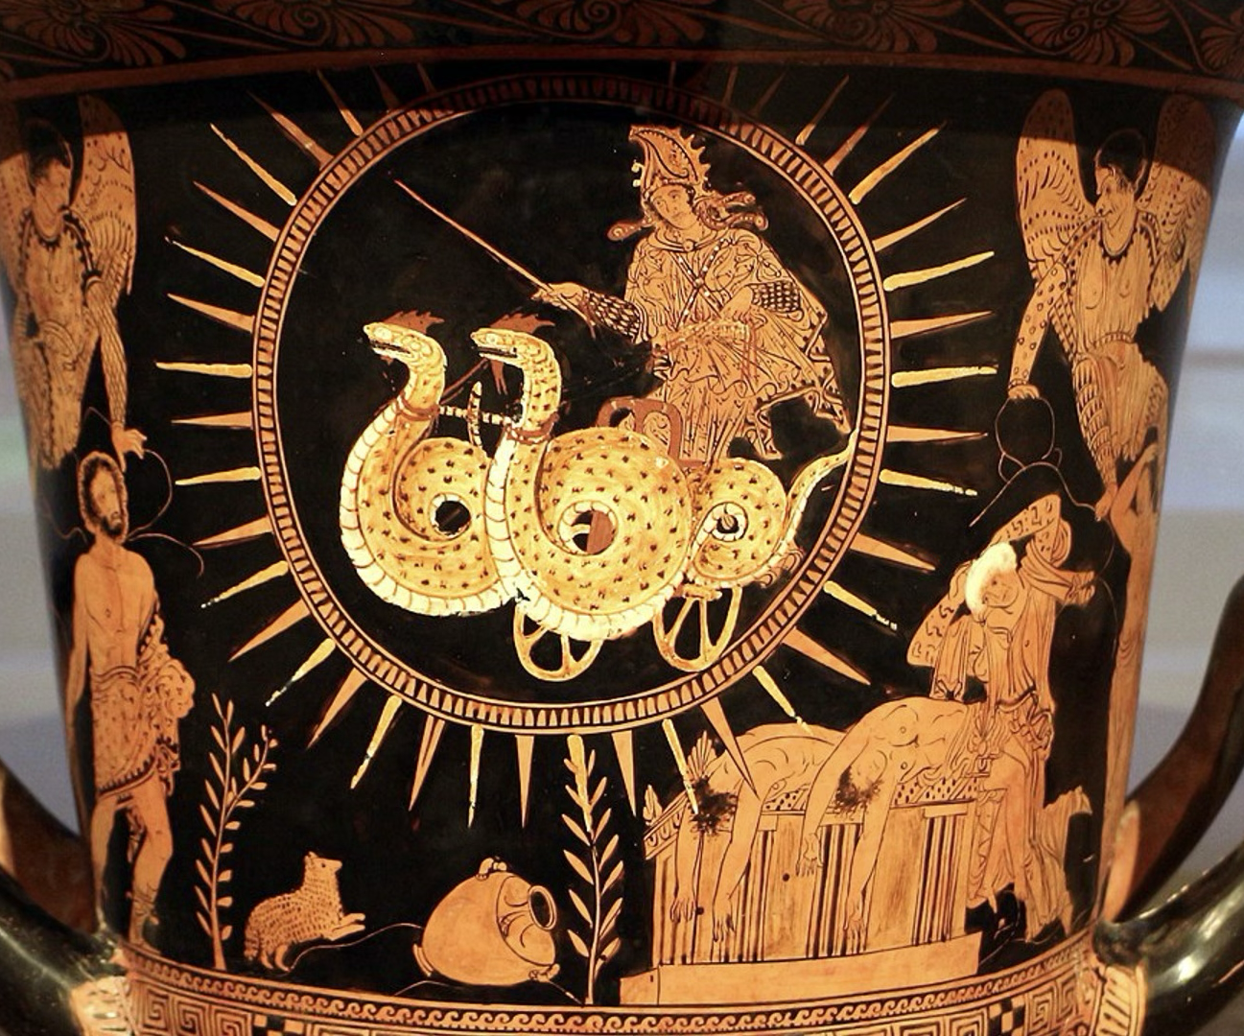
Medea’s appearance
Red-figure Lucanian calyx-krater, c.400 BCE, side A (Cleveland Art Museum 1991.1)

Slide 17
Medea’s Hellenisation
Medea’s ‘barbaric’ excessive lamentation, childishness, cruelty, and murderous tendencies are also seen in Ajax, Odysseus, Achilles, and Herakles…the figureheads of Greek heroism!
She shows many traits of a Greek hero: hubris, a strong will and fierce temper, a penchant for revenge, a concern for her kleos, and a fear of being laughed at.
She uses the language of honour, respect, and justice:
‘ill-fortuned Medea, dishonoured’ (Μήδεια δ᾽ ἡ δύστηνος ἠτιμασμένη, 20).
‘you were not about to dishonour (ἀτιμάσας) my marriage bed and live out a pleasant life laughing at me’ (ἐγγελῶν ἐμοὶ, 1354-5)
‘if I am caught sneaking into the house and plotting [its destruction], I will be killed, giving laughter to my enemies’ (ἐχθροῖς γέλων, 381-3).
Let no one think of me as feeble and weak, not peaceful, but the very opposite: a grave threat to my enemies, and kindly towards my friends: such are the qualities of a most glorious life’ (μηδείς με φαύλην κἀσθενῆ νομιζέτω / μηδ᾽ ἡσυχαίαν, ἀλλὰ θατέρου τρόπου, / βαρεῖαν ἐχθροῖς λαὶ φίλοισιν εὐμενῆ· / τῶν γὰρ τοιούτων εὐκλεέστατος βίος (807-11).

Slide 18
He might have made Medea a Clytemnestra figure — a magnificent criminal whose violence represents the primitive past of the race, posed against the civilized, rational values of male democracy, represented in this case by Jason. […] But he did none of these things: what he did was, like the endings of so many of his plays, unexpected.
Bernard Knox
Word and Action
(1986: 273)

Slide 19
While her opponents perceive Medea as a threatening barbarian presence, Medea’s own conception of herself is essentially heroic and strikingly ‘Greek’. […] Thus, as a foreign woman behaving like a Greek man, Medea’s self-conception cuts across the polarities of both gender and ethnicity.
Bill Allan
Euripides’ MEdea
(2002: 74–75)

Slide 20
Barbarian Medeas of the 19th century
From at least the latter half of the 19th century, representations of Greeks and ‘barbarians’ were shaped by theories of evolution.
Robert Brough’s Medea; or, the best of mothers, with a brute of a husband (1856):
Medea: ‘The fact is, I’m the daughter of a nation / A little backward in civilization.’ (1.1.201–202)
Jason: ‘’Twasn’t a happy match—I couldn’t tame her.’ (1.1.276–277)
Ideas of Medea’s ‘barbarity’ in the 19th and 20th century were informed by colonialism and scientific racism.

Slide 21
Gilbert Murray’s Medea
Translation published in 1906.
The first to include Medea’s first speech to the Corinthian women in full.
Informed by contemporary liberal politics, including women’s suffrage and international politics.
Murray believed that Euripides shared many of his own socio-political sentiments: ‘rational, liberal, humane, feminist’
Murray to actress Sibyl Thorndike Murray to Thorndike (30 June 1941)
‘Your symbolic interpretation of it is extremely interesting, and it never occurred to me before — Jason as civilisation and Medea as the wild forces savagely rebelling against it because it has done its work so badly.’

Slide 22
Gilbert Murray’s Medea
Oh, wild words! Did ye hear her cry […]? |  | κλύεθ᾽ οἷα λέγει […]; (168)
Tigress, not woman, beast of wilder breath Than Skylla shrieking o’er the Tuscan sea. |  | λέαιναν, οὐ γυναῖκα, τῆς Τυρσηνίδος Σκύλλης ἔχουσαν ἀγριωτέραν φύσιν (1342–3)
In sheer savageness of mood Thou drivest from thee every friend. |  | αὐθαδίᾳ φίλους ἀπωθῇ (621–622)
A wise-woman I am; and for that sin To divers ill names men would pen me in; A seed of strife; an eastern dreamer |  | σοφὴ γὰρ οὖσα, τοῖς μέν εἰμ’ ἐπίφθονος (303)

Slide 23
Gilbert Murray’s Medea
Thine old barbarian bride, The dog out of the east who loved thee sore, She grew grey-haired, she served thy pride no more. |  | ἀλλὰ βάρβαρον λέχος πρὸς γῆρας οὐκ εὔδοξον ἐξέβαινέ σοι (591–2)
I hear a voice and a moan, A voice of the eastern seas |  | ἔκλυον φωνάν, ἔκλυον δὲ βοὰν τᾶς δυστάνου Κολχίδος (131–132)
from savagery Of eastern chambers, from a cruel land |  | ἐκ δόμων σε βαρβάρου τ’ ἀπὸ χθονὸς (1330)
I sought to rear Our sons in nurture worthy of my race |  | παῖδας δὲ θρέψαιμ’ ἀξίως δόμων ἐμῶν (562)

Slide 24
Medea as an immigrant, 11–13
καὶ πρὶν μὲν εἶχε κἀνθάδ’ οὐ μεμπτὸν βίον
ξὺν ἀνδρὶ καὶ τέκνοισιν, ἁνδάνουσα μὲν
φυγὰς πολίταις ὧν ἀφίκετο χθόνα
At first she had an irreproachable life
with husband and kids, an immigrant pleasing
to the citizens to whose land she had come

Slide 25
Medea as phugas
11–12: ἁνδάνουσα μὲν / φυγὰς πολίταις an immigrant pleasing to the citizens
272–273: τῆσδε γῆς ἔξω περᾶν / φυγάδα leave this land as an exile
400: φυγὰς ἐμὰς χθονός my exile from the land
438: φυγὰς δὲ χῶρας an exile from this country
454: πᾶν κέρδος ἡγοῦ ζημιουμένη φυγῇ consider your punishment of exile a benefit
462–463: πόλλʼ ἐφέλκεται φυγὴ / κακὰ ξὺν αὑτῇ exile brings with it many troubles
554: φυγὰς γεγώς exile that I am
610–611: σαυτῇ φυγῆς / προσωφέλημα an aid to you in your exile
706: Κρέων μ᾽ ἐλαύνει φυγάδα γῆς Creon drives me from the land, an exile
938: ἐκ γῆς τῆσδʼ ἀπαροῦμεν φυγῇ we are being removed from this land in exile
967–968: τῶν δ᾽ ἐμῶν παίδων φυγὰς the exile of my children
1002: ἀφεῖνται παῖδες οἵδε σοι φυγῆς these boys have been spared exile
1024: εἶμι δὴ φυγάς I go as a refugee
1124: τί δʼ ἄξιόν μοι τῆσδε τυγχάνει φυγῆς; what is worthy of my flight?
1155: φυγὰς ἀφεῖναι spare from exile
1295: μεθέστηκεν φυγῇ; has she fled in exile?

Slide 26
Medea as migrant
Edith Hall: ‘Euripides prefers to test the validity of the conventional polarisation of Greek and barbarian’ (‘Black Sea Back Story: Euripides’ Medea’, 2019: 287).
Rebecca Futo Kennedy: Medea brings ‘temporary benefits’ to the city where she resides, so long as she is ‘contained within proper metic spaces’, which, by the end, she transgresses (Immigrant Women in Athens, 2014: 49).
Aigeus promises to act as Medea’s host and protector (προξενεῖν); the chorus describe her as being in need of ξενία.
Medea articulates her need for a land of refuge, γῆν ἄσυλον.

Slide 27
to read the tragedy as a day in the life of a PHUGAS is therefore to animate a critical exploration of how dislocation from the gender-structured family produces physical displacement and a need for asylum
Demetra Kasimis
‘Medea the refugee’
(2020: 394)

Slide 28
Bibliography
Allan, William. 2002. Euripides: Medea. London.
Bacon, Helen H. 1955. Barbarians in Greek Tragedy. New Haven.
Easterling, Pat. 1977. ‘The infanticide in Euripides' Medea.’ Yale Classical Studies 25: Greek Tragedy: 177–191.
Friedrich, Rainer. 1993. ‘Medea apolis: on Euripides’ dramatization of the crisis of the polis.’ In Sommerstein, Alan H., ed. Tragedy, Comedy and the Polis. Bari: 219–239.
Futo-Kennedy, Rebecca. 2014. Immigrant women in Athens: gender, ethnicity, and citizenship in the classical city. New York.
Hall, Edith. 2019. ‘Black Sea Back Story: Euripides’ Medea.’ In Braund, David; Hall, Edith and Wyles, Rosie, eds. Ancient Theatre and Performance Culture Around the Black Sea. Cambridge: 267–288.
Hall, Edith. 1989. Inventing the Barbarian. Greek Self-Definition through Tragedy. Oxford.
Hall, Jonathan M. 2002. ‘The Barbarian Enters the Stage.’ Hellenicity: Between Ethnicity and Culture. Chicago: 172–189, esp.175–178.
Kasimis, Demetra. 2020. ‘Medea the Refugee.’ The Review of Politics. Vol. 82(3): 393–415.
Kekis, Olga. 2019. ‘Medea adapted: The subaltern barbarian speaks.’ Hypertheatre: Contemporary Radical Adaptation of Greek Tragedy. London: 88–140, esp. 88–92.
Knox, Bernard. 1986. Word and Action: Essays on the Ancient Theater. Baltimore/London.
Murray, Gilbert. 1913. Euripides and his Age. London.
Page, Denys. 1938. Euripides Medea. Oxford.
Saïd, Suzanne. 2001. ‘Greeks and Barbarians in Euripides’ Tragedies: The End of Differences?’ In Harrison, Thomas, ed. Greeks and Barbarians. Edinburgh: 62–100.
Taplin, Oliver. 2007. Pots and Plays: interactions between tragedy and Greek vase-painting of the fourth century B.C. Los Angeles.

