Slide 1
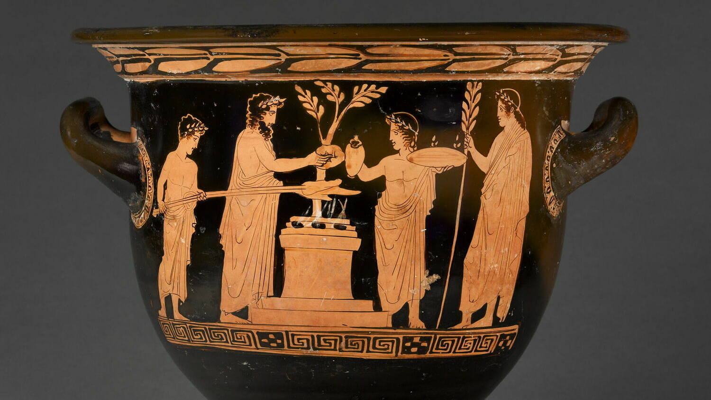
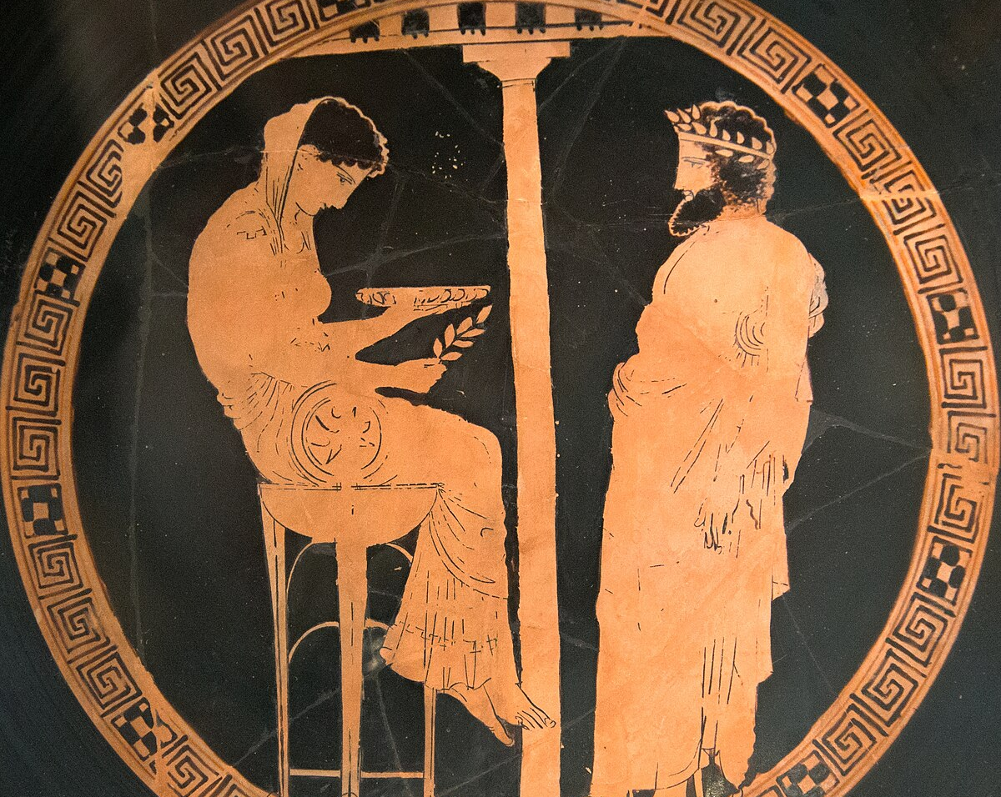
Greek Religion: Priests, Priestesses and Prophets
Dr Paul Grigsby
University of Warwick, Classical Civilisation Teachers Day 28th February 2025

Slide 2
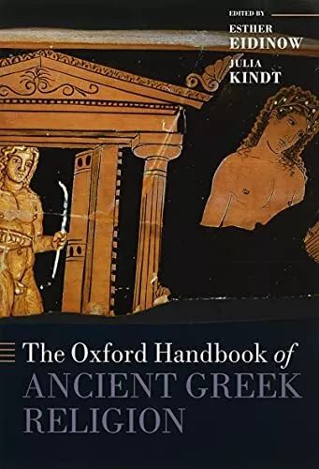
Introduction
hiereus (ἱερεύς) = ‘priest’
hiereia (ἱέρεια) = ‘priestess’
mantis (μᾰ́ντῐς) = ‘seer’, ‘prophet’
Flower uses native terms hiereus and hiereia rather than the English equivalents, as English terms have baggage:
  ‘…although convenient, [they] carry a great deal of cultural baggage and can never adequately convey the cultural meaning of indigenous terms. What we mean by ‘priest’, for instance, overlaps only minimally at best with the Greek conception of a hiereus. Likewise, ‘seer’ is a culturally loaded term, as are the other words commonly used to translate mantis, such as ‘prophet’, ‘diviner’, or ‘soothsayer’.’
(Flower, 2015, 294).

Slide 3


Slide 4
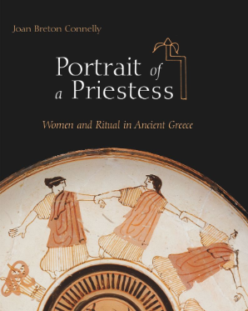
Portrait of a Priestess: Women and Ritual in Ancient Greece, Joan Breton Connelly, 2022
Modern accounts of ancient Greek priesthoods have often stressed the lack of training or qualifications for officeholders, their part-time status, and the absence of a vocation to direct them in their service. These preoccupations reflect culturally determined assumptions for an expectation that ancient religious offices should look like those we know today.
A more useful lens through which to understand Greek cult service is that of the collective groups that defined communality within the polis, groups based on family, gender, age class, and marital status. Social rituals defined communality as well, through activities such as poetic recitations, sacrificial meals, and symposia. For women, it was the female lyric chorus that played the critical role, educating them in Greek tradition and culture, including ritual and the origins of local myth.
(Connelly, 2022, 28)

Slide 5
Required qualifications…
It is not as if priesthood came without qualifications, it is just that these are not the qualifications that we might expect today. It was pedigree, wealth, health, and wholeness that qualified ancient Greek women for priesthood.
(Connelly, 2022, 29)
Health and wholeness - On Hellenistic Kos, inscriptions that advertise the sale of priesthoods stipulate that the men or women who purchased them had to be “healthy and whole” (oloklaros).
  ἔστω ὑγιὴς καὶ ὁλόκλαρος – [olokleros?]
  …be healthy and sound (IG XII,4)
So we need to avoid expecting ancient priests as mediators and specialists and imagine a broader range of ways of serving the gods as part of a range of cultural institutions.

Slide 6
Priests and Rituals: Other Difficulties
Thinking of religious ritual, we envisage a typical pattern of procession, sacrifice, feast, competition
But one size doesn’t fit all –– there were hundreds of different cults and sanctuaries, of different sizes, or types - healing, divination, other – each with variations
There is a tendency, in even the best modern scholarship, to combine evidence from different places (South Italy and Sicily, mainland Greece, the Aegean islands, Asia Minor) and time periods (the seventh century BC through the third century AD) in order to compile a composite picture of ritual activity
(Flower, 2015, 294)
But as in all Greek religion, the truth is complex and often contradictory.
If we want a generalisation, rather than imagining a priest as necessary to the communication with the divine (though there are specific cases otherwise - manteis), we might imagine priests as master of ceremonies, whose roles in a festival setting could still be delegated (see later).

Slide 7
There were no priests of all the gods or general priest of a god but always of a specific cult and sanctuary.
Generally, male priests served male gods and female priests served goddesses – particularly in Athens (see Holderman (1913) 26–28).
Exceptions can be found for priestesses of Dionysos Anthios (IG II2 1356. 9–10), Helios (IG II2 5093), Apollo Deiradiotes (Pausanias 2.24.2), Apollo Lykeios (Plutarch Pyrrhus 31.3), Apollo Delphinios, Zeus at Dodona, and some cults of Poseidon.
The wife of the archon basileus at Athens had certain religious duties involved in the worship of Dionysos ([Demosthenes] 59.73–76, 85).
Priests are known to have served in some cults of Demeter (hierophant at Eleusis), Aphrodite, and Athena (priests of Athena at Lindos on Rhodes, and boy priests for Athena at Tegea).
Pythia at Delphi was of course female.
Also, sometimes roles required people of a specific age – think Arrhephoroi, Daphnephoros etc etc.

Slide 8
Questions
How were they appointed?
What were their duties?
Appointing Hierioi and Hiereiai
By birth (Archaic)
by lot (Classical)
by sale (Hellenistic)

Slide 9
Appointment by birth
The oldest priesthoods in Athens were hereditary and were held for life. These were the prerogative of aristocratic clans or descent groups (called gene: sing. genos).
Members of a genos (usually chosen by lot within the genos)
Tenure often for life
hiereia of Athena Polias (Athens) and hiereus of Poseidon-Erechtheus (Athens) always from Eteoboutadai genos
hereditary priests of Eleusis - Eumolpidae and Kerkyes
Manteis could be hereditary as well - Branchidae – hereditary priests of Apollo at Didyma and Apollo Ptoion (see later)
Other hereditary priesthoods:
Kings of Sparta: “The kings have the following privileges, assigned to them by the Spartiates. They have two priesthoods, one of Zeus Lakedaimonos and one of Zeus Ouranos.” (Herodotus 6.56)

Slide 10
Appointment by lot or election
Around 5th and 4th centuries, new cults chosen by lot or election from all Athenian citizens (Democratic)
Annual tenure – perhaps.
e.g. hiereia of Athena Nike – earliest known example:
  “[Gla]ukos proposed: That the priestess of [Athena Nike], whoever [happens to be chosen by lot], be [chosen by lot] from all Athenian women.” IG I(3) 35 [#1]
  Myrrhine was first to look after the seat of Athena Nike, chosen in good fortune out of all by lot. IG I(3) 1330
The decree authorizing this, however, does not indicate how the sortition was to be conducted (from pre-selected candidates, for example?) or whether the tenure was to be for life or only for one year.

Slide 11
  As soon as I turned seven I was an arrephoros,
  then, I was an aletris*; when I was ten I shed
  my saffron robe for the Foundress, being a bear at the Brauronia;
  And once, when I was a beautiful maiden, I was a kanephoros,
  wearing a necklace of dried figs.
Aristophanes Lysistrata 641–47 [#2]
*aletris – grinder of sacred grain
Philippe II, daughter of Medeios of Piraeus, began her career on Delos, as a basket bearer at the Delia and sub-priestess of Artemis during the early first century BC. Later, she attained the highest office of priestess of Athena Polias at Athens.
(Connelly, 2022, 28)

Slide 12
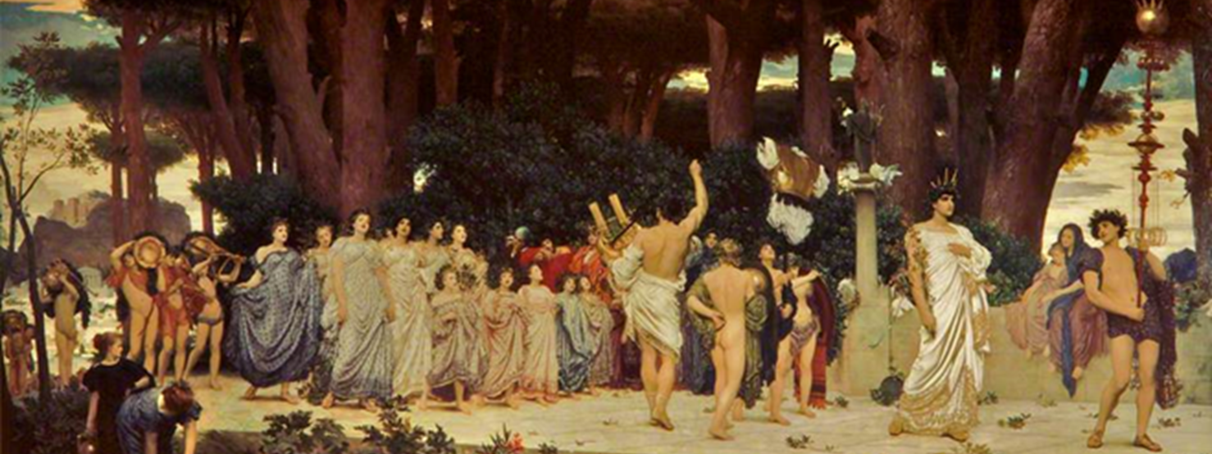
Annual tenure (and age)
Daphnephoros
Sources:
Pindar fr.94b - Daphnephorikon for Agasikles
Pausanias 9.10.4 – boy from aristocrats becomes yearly priest of Apollo
Proclus C5AD Chrest. in Photius (Cod. 239, pp. 321a-b Bekker)

Slide 13
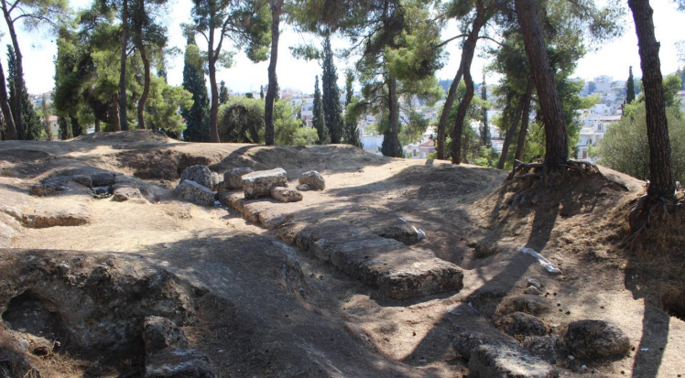
Sanctuary of Apollo Ismenios, Thebes

Slide 14
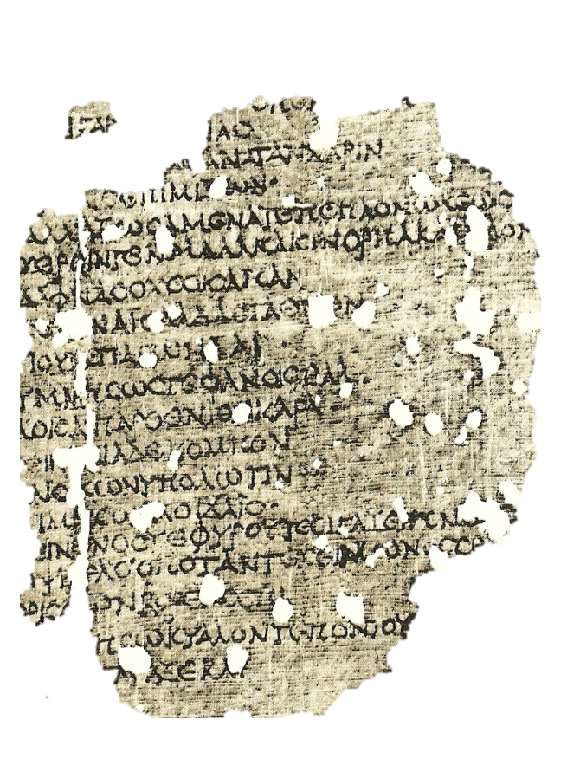
P. Oxy. 659 (4, 1904) - Pindar fr.94b Partheneion 2: ‘Daphnephorikon for Agasikles of Thebes’ [#3]
…But quickly tying up my robe
and carrying in my gentle hands a splendid branch
of laurel, I shall hymn
the all-glorious house of Aioladas
and of his son Pagondas…
…my maidenly head flourishing
with garlands,
and I shall imitate in my songs,
to the accompaniment of lotus pipes,
that siren’s loud song
As a faithful witness for Agasikles
I have come to the dance
and for his noble parents
. . .of Damaina, stepping forth now
with a . . . foot, lead the way for me, since the first
to follow you on the way will be your kindly daughter,
who beside the branch of leafy bay
walks on sandals….

Slide 15
Pausanias 9.10.4 – boy from aristocrats becomes yearly priest of Apollo [#4]
  [4] The following custom is, to my knowledge, still carried out in Thebes. A boy of noble family, who is himself both handsome and strong, is chosen priest of Ismenian Apollo for a year. He is called Daphnephoros [Laurel-bearer], for the boys wear wreaths of laurel leaves. I cannot say for certain whether all alike who have worn the laurel dedicate by custom a bronze tripod to the god; but I do not think that it is the rule for all, because I did not see many votive tripods there. But the wealthier of the boys do certainly dedicate them. Most remarkable both for its age and for the fame of him who dedicated it is a tripod dedicated by Amphitryon for Heracles after he had worn the laurel.
Proclus C5AD Chrest. in Photius (Cod. 239, pp. 321a-b Bekker) [#5]
  And the “laurel-carrying songs” he puts into the same category as these; for every nine years in Boeotia, priests bring in laurels to the sacred places of Apollo, singing to him with a chorus of young girls.

Slide 16
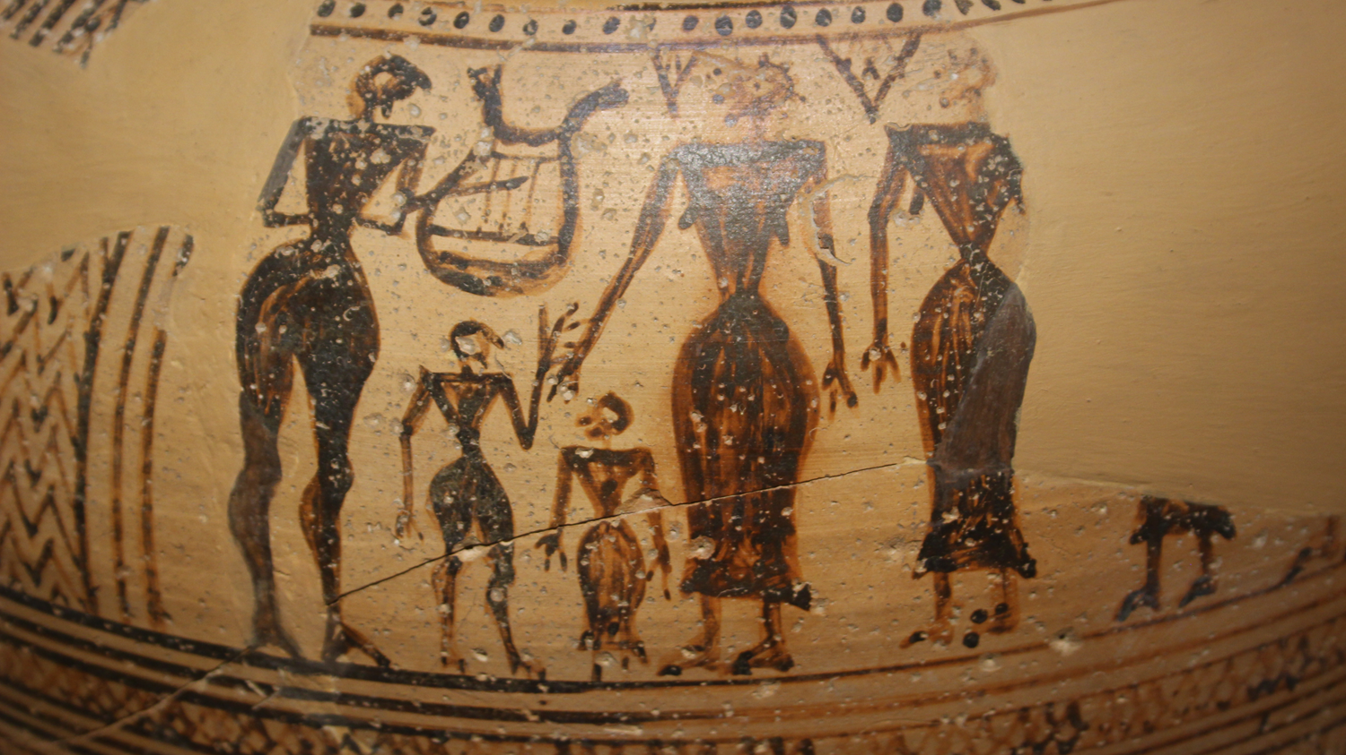
Pyri pithos – Thebes 8th Century BC

Slide 17
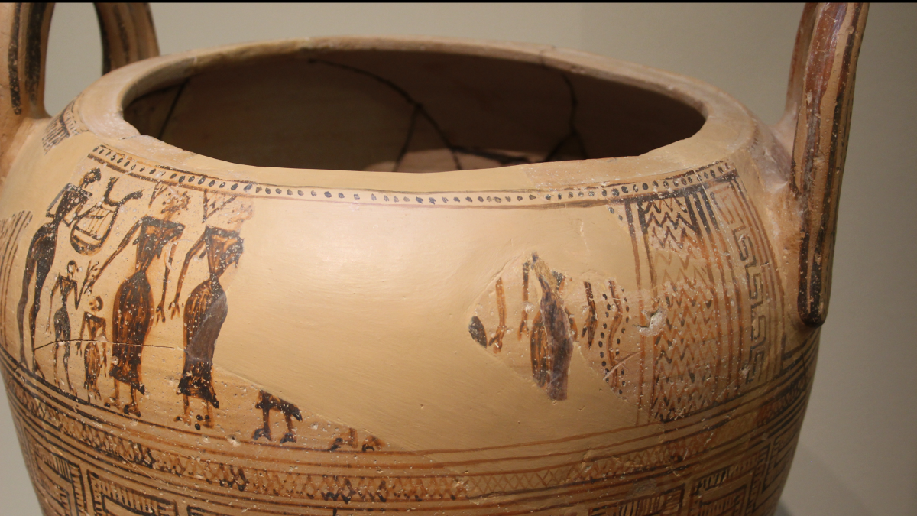
https://blogs.warwick.ac.uk/materialmusings/entry/whos_that_girl_1/

Slide 18
Appointment by sale
Hellenistic Asia Minor and islands in Eastern Aegean
  “The man who purchases the priesthood shall exercise it for life, provided he continues to live in the city. He is to be exempt from all taxes and receive for himself the first portions from the one who makes a sacrifice, of entrails, shanks, knees, tongue, two double portions of meat, Hermes-cakes, the offerings of which anyone makes burnt-sacrifices.
  And, in addition, an appropriate share of the banquet. If the city holds a banquet, he is to receive 1/12 gold stater. . ..”
Inscription from Chios (LSCG 77) [#6]

Slide 19
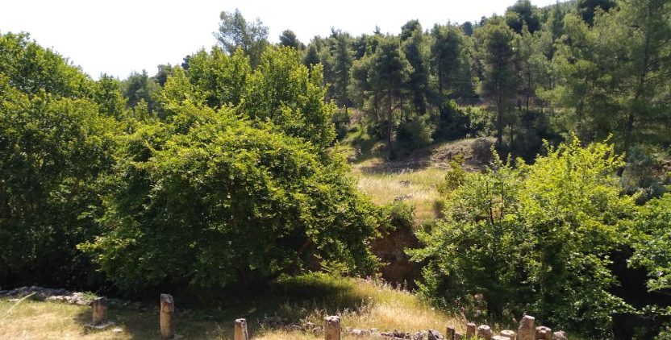
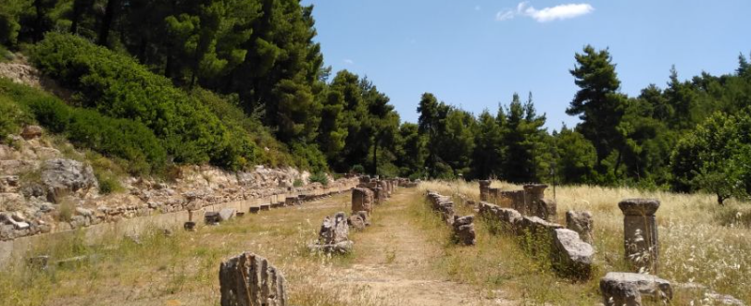
Duties of Hierioi and Hiereiai
In the most basic terms, the chief responsibility of the hiereus was to manage the hiera: the offerings, sacrifices, and the sanctuary itself and its property, all of which were hiera or ‘sacred’ (Mikalson 2004: 11 (295)
Some public sacrifice could be undertaken by magistrates, and even private citizens could sacrifice if a priest wasn’t present – so exclusive role of mediator is wrong – probably only true of mantis.

Slide 20
Inscription from the Amphiareion at Oropos, c. 386-377 (LSGC 69) – if priest not present – great code of the sanctuary, LSCG 69 (I. Oropos 277) [#7]
  When a person comes to be healed by the god, he is to donate a first-fruit offering of at least nine obols of silver, and deposit it in the treasury in the presence of the neokoros. When he is present, the priest is to say the prayers over the sacrifices and place the victim on the altar; when he is not present the person making the sacrifice is to do this. During the public sacrifice each person is to say the prayers for himself, but the priest is to say them over the public sacrifices, and he is to receive the skin of all the victims sacrificed within the sanctuary. Each person may offer whatever sacrifices he wishes. No portions of meat are to be carried out of the precinct. Sacrificers are to donate the shoulder-portion of each victim to the priest except during a festival; at that time he is to receive the shoulder portion only from the public victims. . .
Sacrifice - hiereus or hiereia could preside over it (making prayers) but didn’t even have to do the messy stuff:
Supported by a mageiros (or ‘butcher cook’) and a kreonomos (distributor of meat)

Slide 21
Also officials called neokoroi acting as a type of warden and could do things in the priests absence
Inscription from the Amphiareion at Oropos, c. 386-377 (LSGC 69) (I. Oropos 277) [#7]
  Gods! From the onset of winter until the spring ploughing season the priest of Amphiaraos is to go into the sanctuary when winter arrives and until the sowing season with no greater interval than three days between visits, and he is to be in residence there not less than ten days in each month. He is to require the neokoros [temple attendant] to care for the sanctuary in accordance with the law and also for those who visit the sanctuary. If anyone commits a crime in the sanctuary, whether stranger or member of the deme, the priest has authority to fine him up to a maximum of five drachmas, and he is to require security from the person so fined. Should he pay the fine, he is to deposit it in the treasury in the presence of the priest. If anyone suffers some private injury in the sanctuary, whether stranger or member of the deme, the priest is to give judgment up to a maximum of three drachmas; as for larger sums, the judgments provided in the laws for each victim are to be in effect here also. Any summons arising from an offense in the sanctuary must be issued on the same day. If the defendant does not make restitution, a trial is to be held on the next day.

Slide 22
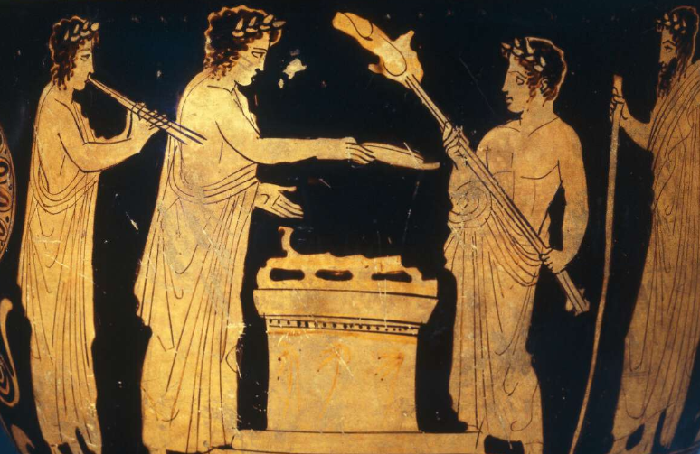
So roles could include:
Physical upkeep of sanctuary, opening it up, showing around visitors
Financing the sanctuary
Managing sacrificial calendar
Issuing curses
Rites of purification
But nothing in a sense which couldn’t be delegated at times…

Slide 23
In his Politics (1322b18–29) [#8], Aristotle reveals that many duties, as well as some sacrifices, might be the specific responsibility of various civic officials:
Another kind of supervision is that concerning the gods; for example, hiereis and supervisors of matters concerned with the temples (such as the preservation of existing buildings and the restoration of those that are in disrepair) and with all of the other things that have been set aside for the gods. It happens that in some places there is only one supervisory office of this sort, for instance in small cities, but in others there are many offices that are separate from the priesthood (hierosyne); for example hieropoioi (performers of sacred rites) and naophylakes (temple guardians) and tamiai (treasurers of sacred funds). Next to this is the supervision devoted to the management of all the public sacrifices that the law does not assign to the hiereis, but to the officials who derive their honour from the common hearth. These officials are sometimes called archons, sometimes kings, and sometimes prytaneis (presidents).

Slide 24
So one way to imagine a hiereus or hiereia would be as a type of ‘master of ceremonies’ in a public display of ritual performance, who (depending on the size and resources of the sanctuary) acted in concert with civic officials and was supported by a staff of variously skilled attendants. (Flower, 2015, 297)
Nonetheless, a famous story recorded by Thucydides (4.133.2–3) [#9] reveals that daily manual tasks, even in a large and wealthy sanctuary, could not necessarily be passed on to others:
  During the same summer [of 423 BCE] the temple of Hera near Argos was burnt down; Chrysis the hiereia had put a moveable lamp too near the woollen fillets and had then gone to sleep, so that they all caught fire and were in a blaze before she noticed. In her fear of the Argives she fled that very night to Phlius; and the Argives, in accordance with the established law, appointed another hiereia named Phaeinis. Chrysis had served for eight years of this war and half of the ninth when she went into exile.
We know that this Chrysis had been the hiereia of Hera at Argos for a total of fifty-six and a half years, since Thucydides (2.2.1) had used the forty-eighth year of her priesthood as one means of dating the first year of the Peloponnesian War (431–404 BCE). Pausanias (2.17.7) [#10] says her statue was not taken down – so the priestess was important enough to have this honour - still stands in front of burnt temple.

Slide 25
Good segway to…
Skilled or unskilled?
“And the cause of this inconsistency and confusion is that men believe that the office of king is, like that of priest, one which any man can fill, whereas it is the most important of human functions and demands the greatest wisdom.”
Isocrates, To Nicoles 6
In most cases, the hiereus or hiereia had no special religious training or knowledge to bring to their office. What expertise they had was acquired on the job. Yet individuals who held a lifetime priesthood might acquire a good deal of ritual and technical knowledge over the course of a career.
A famous example is Lysimache, who, in the fifth-century BCE, was the hiereia of Athena Polias for sixty-four
years (IG II 3453; 2 Pliny HN 34.76).

Slide 26
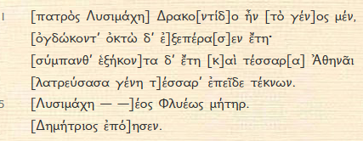
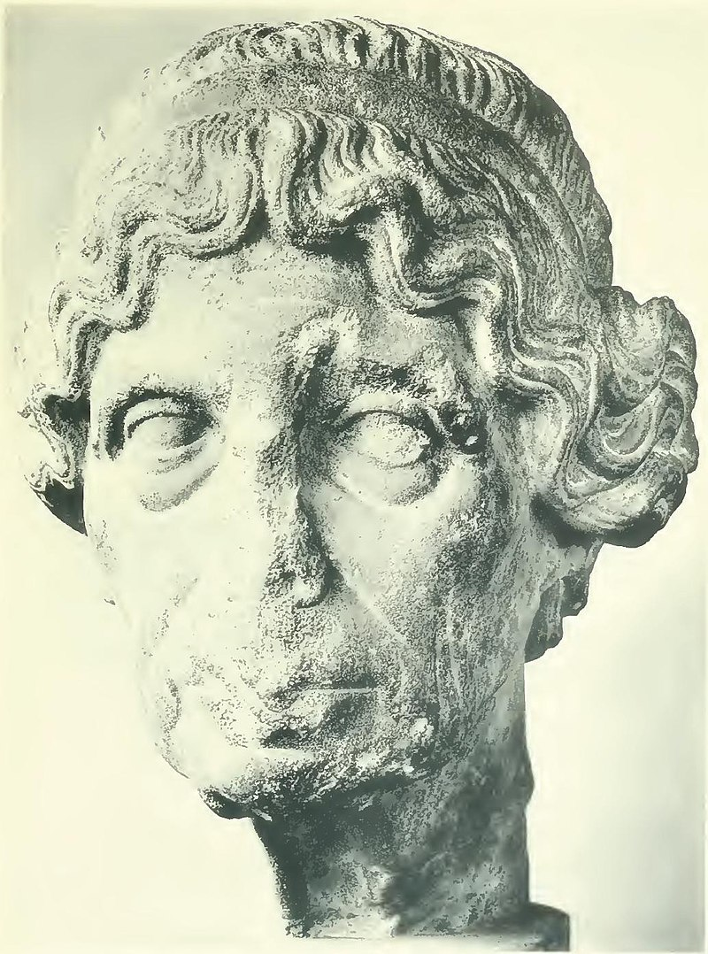
“[This . . . Lysimache] was by her descent (daughter) of Drakontides;
she completed [eighty-eight] years;
. . . sixty-four years she [served] Athena
and lived to see four [generations] of children.
[Lysimache] mother of - of Phlya.
Uninscribed space
[Demetrios] made it.”
Statue base of Lysimache, priestess of Athena Polias (IG II(2) 3453) (360 BC) [#11]
Marble portrait head of an old woman, sometimes identified as Lysimache, priestess of Athena

Slide 27
Dedication for the priestess Penteteris
https://www.atticinscriptions.com/inscription/IGII31/1056
IG II(3) 1.1056 (260-220 BC) [#12]
. . . . . . [for his (?) piety towards the gods and] [love of honour] towards the Council and the People; and the prytany secretary shall inscribe this decree on a stone stele and stand it [on the acropolis]; and for the inscription of the stele [the administrator] shall allocate [the expenditure].
col. 1
In crown
The Council
the People (crown)
the hiereia of Athena Polias, Penteteris
https://www.atticinscriptions.com/inscription/PriestsandPriestesses/11 [#13]

Slide 28


Sacrificial Calendar of Erchia
Ca. 375-350 BC
AIO 593 [#14]
Attic Inscriptions Online (AIO) Founded by Stephen Lambert and launched in 2012 – now site is run by BSA
Attic Inscriptions Education (AIE) contains resources facilitating the use of Attic inscriptions for teachers and students at pre-University level.
The calendar is divided into five columns of offerings the cost of which is approximately equal (ca. 110 dr. per column, ca. 550 dr. overall).
This presumably reflects the division of the costs of the programme among five individuals or groups

Slide 29
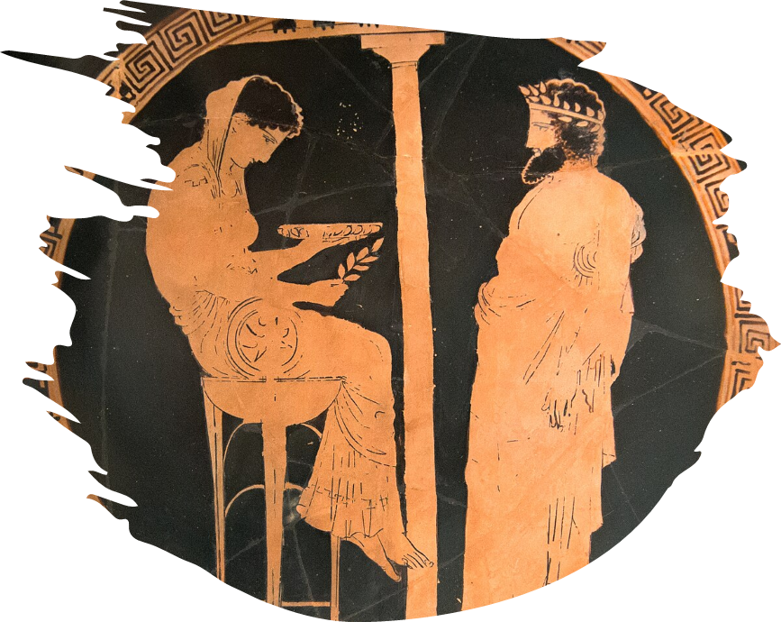
Manteis
Who were manteis - what did they do? Who could be a mantis?
Unlike the typical civic hiereus, a mantis was a purveyor of services that depended on technical knowledge, and, to a not negligible extent, on personal charisma (the ability to inspire confidence in oneself as someone possessing special skills, knowledge, and talents). We might describe manteis as ‘migrant charismatic specialists’ (Burkert 1992: 42), who travelled from city to offering supernatural services for a fee to anyone who was willing and able to pay.
(Flower, 2015, 298).
But, of course, exceptions – some settled in one place; some attached to armies.

Slide 30
Settled in one place…
At the sanctuary of Olympia two manteis (one from the family of the Iamidai and another from the Klytiadai) not only practised divination atop Zeus’ altar but were responsible for the care of the altar and for certain monthly sacrifices, which were duties of a kind that elsewhere normally belonged to hiereis (Paus. 5.13.11, 5.15.10; Weniger 1915).
Attached to armies…
Some manteis struck up long-term relationships with particular generals. Nikias is said to have relied upon Stilbides (Plut. Nic. 23.5) and Aristander of Telmessos served both Philip II and then Alexander the Great.
While on military campaign two types of sacrificial divination were of particular importance: one was the camp-ground sacrifice (called hiera), and the other was the battle-line sacrifice (called sphagia).

Slide 31

Duties of manteis
Expert in the art of divination
Also associated with healing and purification
In some cases, they function similar to hierioi
Authority and credibility often came from membership to a particular genos of seers (the four most renowned were the Melampodidai, Iamidai, Klytiadai, and Telliadai)

Slide 32
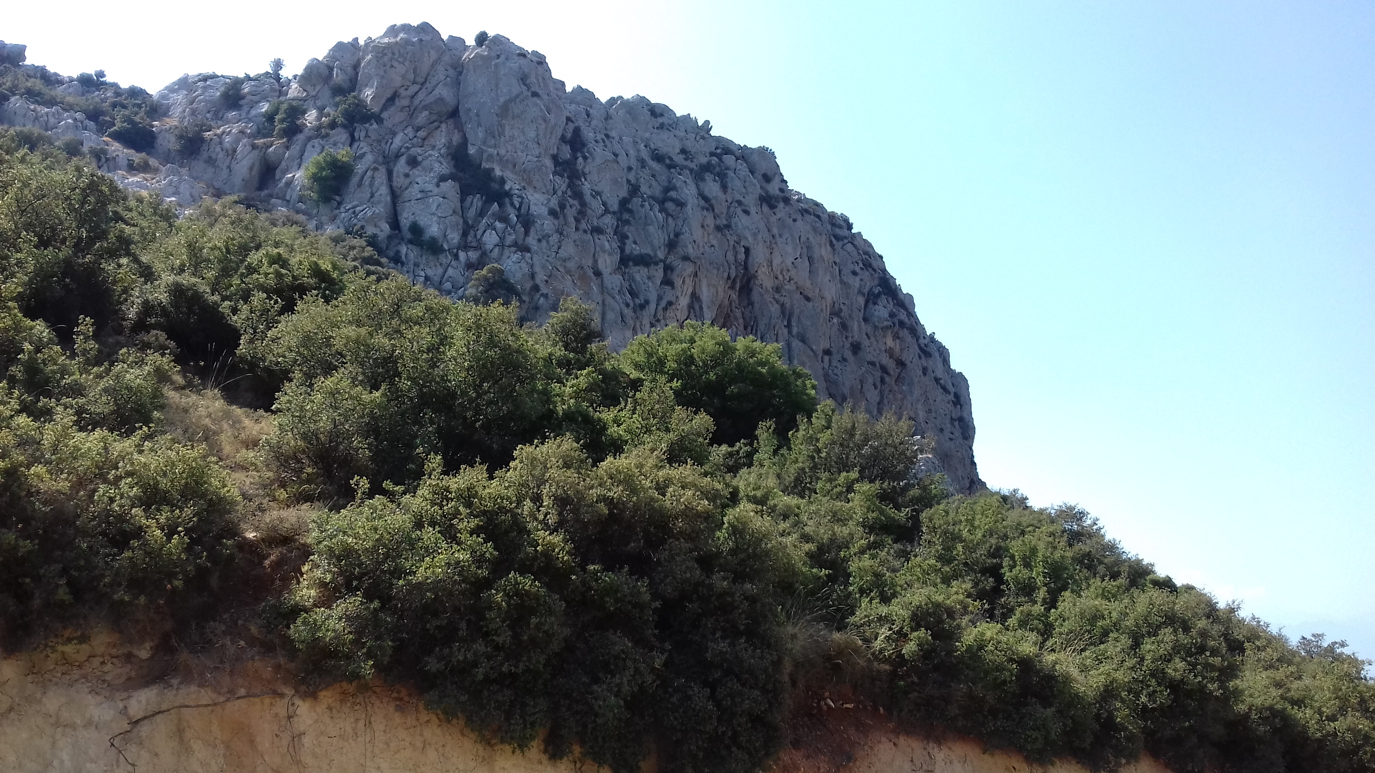

Slide 33
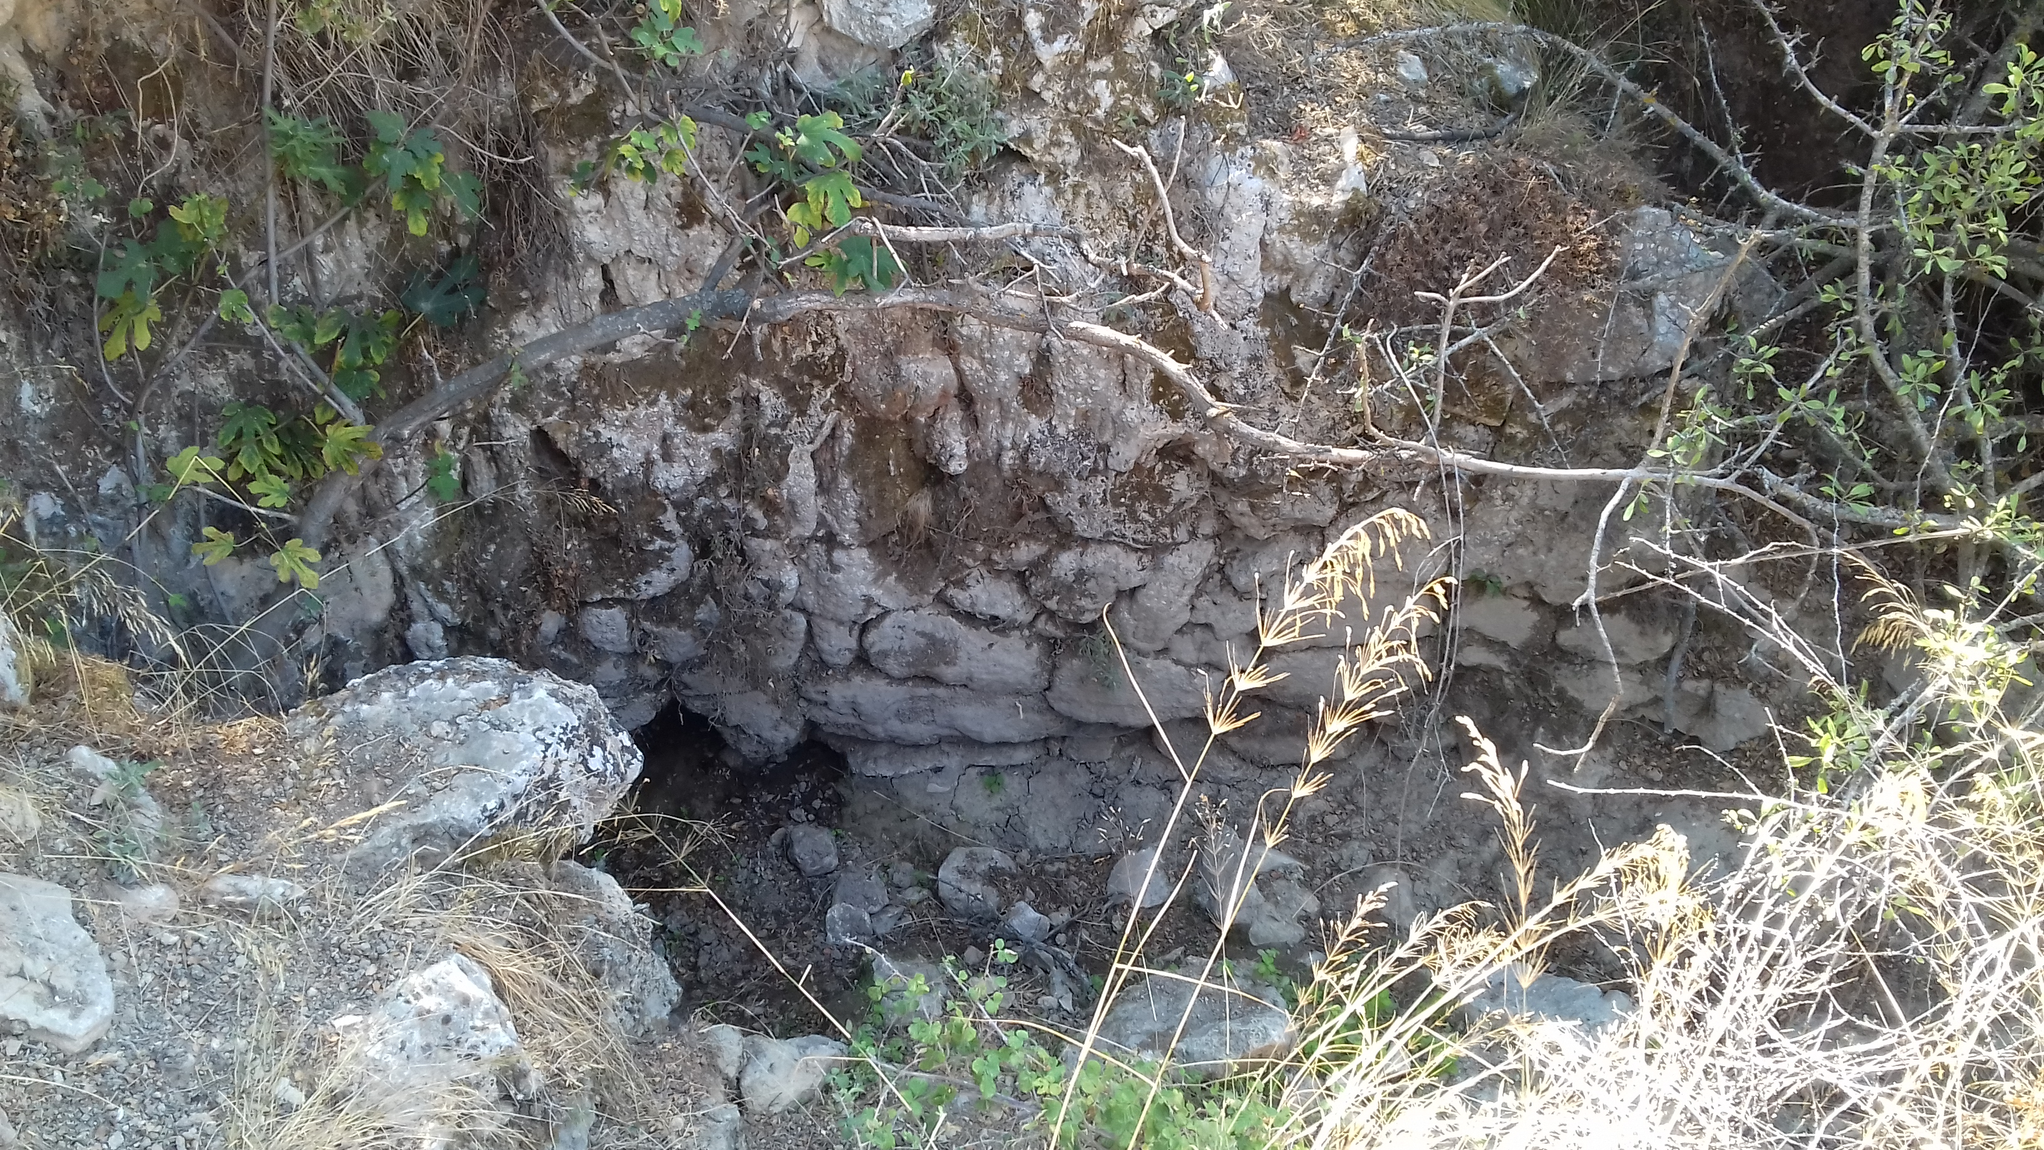

Slide 34
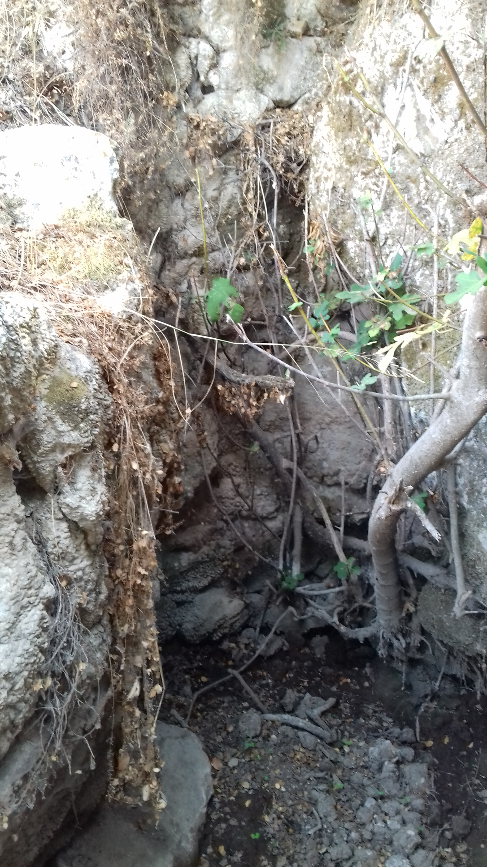
Genos at Ptoion
Ptoios golden-haired god of the oracle, to you this offering, Apollo, Pastrophos’ son Aristichos set up for you his image. You approved it and in exchange - according to the promise you made to me in person in darkness, when smiling, you responded to my voice - grant true for me and my ancestors the good word of prophecy that is fulfilled.
BCH 70 (1946) 217-232 [#15]

Slide 35
Female manteis
The Pythia often called mantis, prophetis, and Promantis
Female voice of a male god
How chosen?
Little is known.
Pythia was probably selected, at the death of her predecessor, from amongst a guild of priestesses of the temple. These women were all natives of Delphi and were required to have had a sober life and be of good character.

Slide 36
Chresmologoi
Professional collectors, chanters, and interpreters of oracles. An Athenian chresmologos visited Xerxes at Susa (Herodotus 7.6) [#16] :
  “Whenever he came into the king’s presence they would use high language concerning him and he would recite from his oracles; all that portended disaster to the Persian he left unspoken, but chose and recited such prophecies as were most favourable, telling of the Hellespont, how it must be bridged by a man of Persia, and how the host should march. So Xerxes was beset by Onomacritus with his oracles…”

Slide 37
Criticism of Manteis and Chresmologoi
Athenian reaction to the failed Sicilian Expedition (415-413 BC):
  “ When the news reached Athens, even though the actual soldiers who had escaped from the action itself gave a clear report, they for long refused to believe that the armament could have been so utterly destroyed. When, however, they were convinced, they were angry with the orators who had taken part in promoting the expedition—as though they had not voted for it themselves—and they were also enraged at the chresmologoi and manteis and whoever at that time by any practice of divination had led them to hope that they would conquer Sicily.”
Thucydides 8.1.1 [#17]

Slide 38
Other (derogatory?) terms
Magos - Magician
Goes/Goetis - Sorcerer/sorceress
Agyrtes - Begging priest
Pharmakeus/pharmakis - Provider of potions and spells
Oneiropolos - Dream interpreter
Criticisms of religious experts (1)
  “Those who first attributed a sacred character to this disease [epilepsy] seem to me to be like the magoi (sorcerers), kathartai (puriers), agyrtai (beggar-priests), and alazones (charlatans) of our own day, men who pretend to be exceedingly pious and to have superior knowledge.”
Hippocratic Corpus, On the Sacred Diseases 2 (5th cent. BC)

Slide 39
  Criticisms of religious experts (2)
    “Agyrtai and manteis frequent the doors of the rich and persuade them that they have obtained from the gods, through sacrifices and incantations, the power to heal them through pleasant rituals if some wrong was committed either by them or their ancestors. And if someone wishes to bring ruin upon an enemy, with small expense he will be able to harm the just and unjust alike, since they have the ability through certain enchantments and binding spells to persuade the gods, as they say, to serve them . . . . And they produce a noisy din of books of Musaios and Orpheus, the offspring of the Moon and of the Muses, as they claim, and using these books in their sacrifices, they manage to persuade not only private individuals but even whole cities that there really are releases and purifications from unjust deeds by means of sacrifices and pleasant sport, some for the living and others for the dead. These releases and purifications they call initiations (teletai), which deliver us from evils there [in the underworld], while terrible things await those who have not sacrificed.”
Plato, Republic 364b-e [#18]

Slide 40
Bibliography
Portrait of a Priestess: Women and Ritual in Ancient Greece by Connelly, Joan Breton 2022
The Orientalizing Revolution: Near Eastern Influence on Greek Culture in the Early Archaic Age, W. Burkert, Cambridge, MA. 1992
A Study of the Greek Priestess, Elizabeth Sinclair Holderman, University of Chicago Press 1913
‘Religious Expertise’, Mike Flower, in The Oxford Handbook of Ancient Greek Religion, Esther Eidinow (ed.), Julia Kindt (ed.), 2015, 293–308.
Ancient Greek Religion (Blackwell Ancient Religions) Jon D. Mikalson 2004

