Slide 1
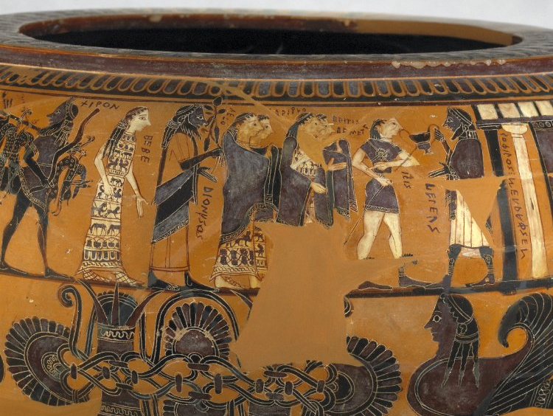
CSR
Cognitive Science of Religion

Slide 2
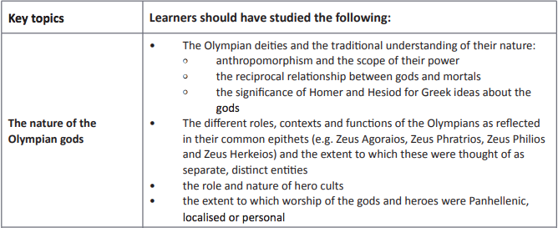
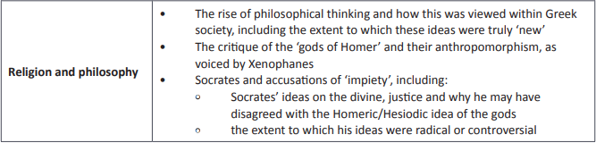

Slide 3
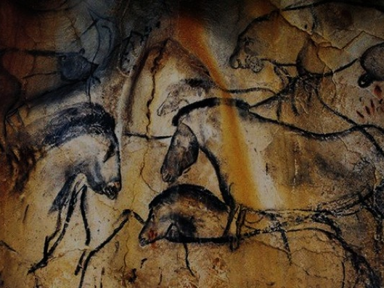
Xenophanes of Colophon (ca.570-475BC)
But if oxen, [horses] or lions had hands
Or could draw with their hands and create works like men,
Then horses would draw the shapes of gods like horses, and oxen like oxen,
And they would make the same kinds of bodies
As each one possessed its own bodily frame.
(D14 (B15) Clement of Alexandria, Stromata)

Slide 4
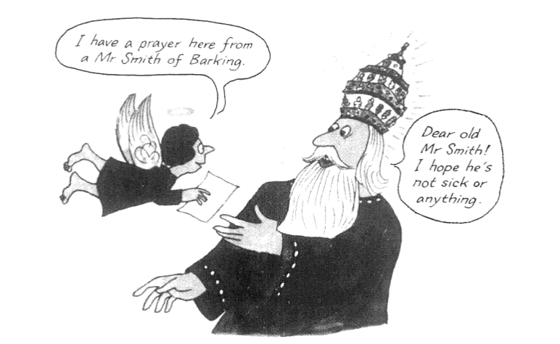
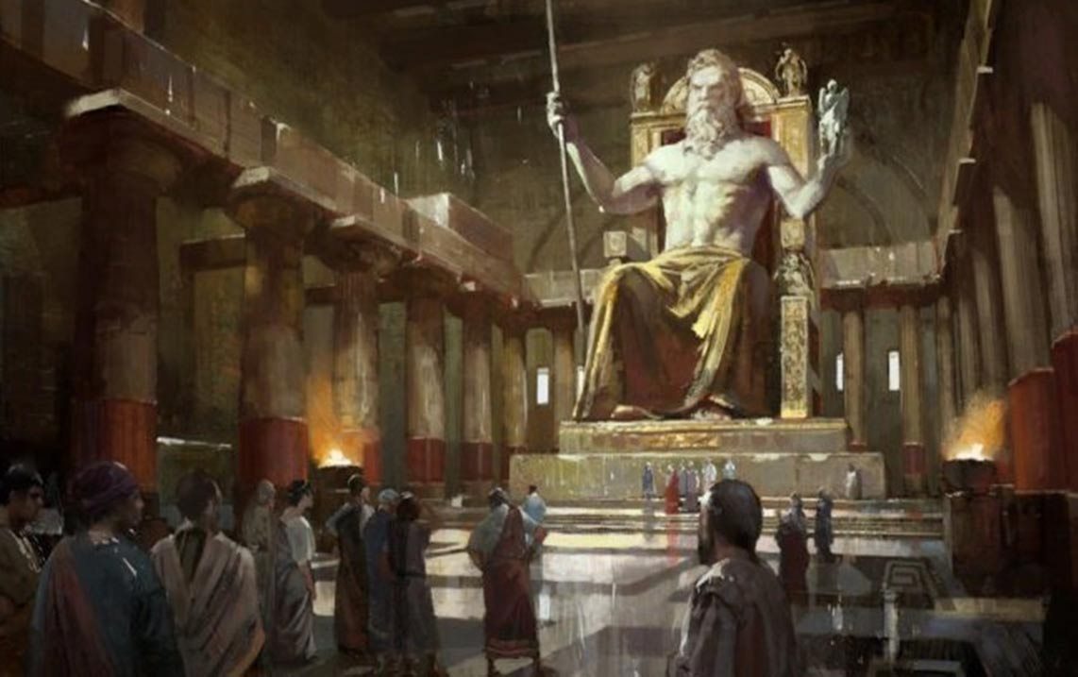
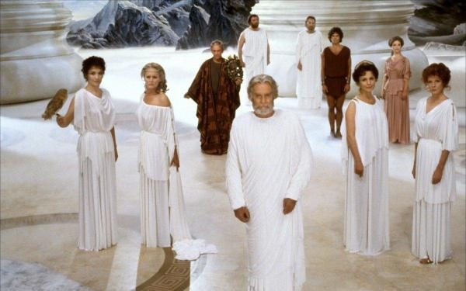

Slide 5
WHY BELIEVE WITHOUT REVELATION?

Slide 6


1. LOGICAL EVIDENCE: INTELLIGENT DESIGN
“In crossing a heath, suppose I pitched my foot against a stone, and were asked how the stone came to be there; I might possibly answer, that, for anything I knew to the contrary, it had lain there forever: nor would it perhaps be very easy to show the absurdity of this answer. But suppose I had found a watch upon the ground, and it should be inquired how the watch happened to be in that place; I should hardly think of the answer I had before given, that for anything I knew, the watch might have always been there.”
“... There must have existed, at some time, and at some place or other, an artificer or artificers, who formed [the watch] for the purpose which we find it actually to answer; who comprehended its construction, and designed its use. ... Every indication of contrivance, every manifestation of design, which existed in the watch, exists in the works of nature; with the difference, on the side of nature, of being greater or more, and that in a degree which exceeds all computation.” — William Paley, Natural Theology (1802)
In Ancient Greece there is no strong idea of a Creator God, especially with argument of intelligent design until C4BC
Paley was arguing to convince sceptics, but such arguments did not really exist in ancient Greece: everyone already believed, so logical proofs were not required [Parker, 2011, 5-6]

Slide 7
2. EMPIRICISM
(Knowledge based on experience through senses)
‘[T]he most potent of all evidences’ [Parker, 2011, 3-4].
Piety works and impiety costs. This can be seen in the very existence of dedications and votives
Xenophon Symposium (4.48) Hermogenes on his belief:
“Well, these gods, omniscient and omnipotent, feel so friendly toward me that their watchfulness never lets me out of their sight night or day, wherever my destination or whatever my business. And knowing also the outcome of any act, they send me as messengers, omens of sounds, dreams, and birds, to indicate what I ought to do and what not. And when I pay heed I never regret it, whereas the times I’ve disregarded them I’ve been punished.”
The rewards of piety explanation is really pseudo-empirical, deriving its force from selective vision [God saved me from a plane crash, ignoring that God killed everyone else – so substitute Poseidon and shipwreck]

Slide 8
3. INDOCTRINATION/HABIT
WEAK PROPOSITION FOR RELIGIOUS BELIEF
Endless rituals cause a channel in the mind, like water through rock, and so the gods become too omnipresent a feature of how things are for them not to be real [Parker, 2011, 12]
STRONG PROPOSITION FOR RELIGIOUS BELIEF
Rituals actually give a sense of contact with the divine, of living a meaningful life
Religion is a natural and compelling phenomena
This latter is the case argued by CSR…

Slide 9
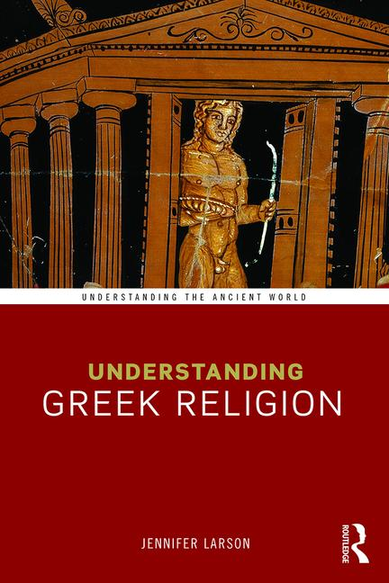

Slide 10
COGNITIVE SCIENCE OF RELIGION
CSR
The theorists of a relatively new discipline, the cognitive science of religion
(CSR), are offering surprising new definitions which refocus attention on the role
of gods and other superhuman beings in world religions [Larson, 2016, 2]
We are not blank slates (contra Burrhus Skinner – U.S. Behaviourist)
Our mental architecture creates a susceptibility to representations of superhuman agents, a tendency to find them memorable, compelling and plausible.
The same cognitive mechanisms underlie all religious experience. This refutes the persistent nineteenth-century paradigm of primitivism, of “lower” forms of religion succeeded by “higher” ones.
Religious thinking, it would seem, is natural.

Slide 11
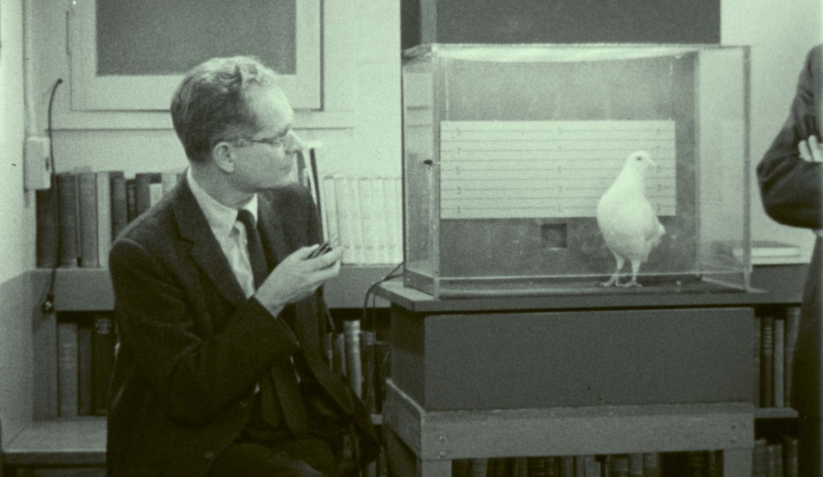


Slide 12
Intuitive Cognition Reflective Cognition
Fast, effortless, implicit Slow, effortful, explicit
Tied to emotions and Tied to logic/intellect
highly compelling cool and measured
When I throw a rock in the air, When I throw a rock at a
it comes back down (see Kant) policeman I get arrested
When I am hungry I eat Don’t eat twelve Mars Bars
The Sun sets The Earth moves
I pray to God as if he is a God is omnipotent and
listening human who needs to be told… omniscient
Zeus Chthonios lives in Olympia Zeus lives on Mt Olympos
I must sacrifice to both Zeus Olympios Zeus Olympios and Zeus Meilichios
and Zeus Meilichios as if they were separate are both just ‘Zeus’
We can hold contradictory intuitive and reflective cognitions at the same time

Slide 13
THEORY OF MIND
Theory of Mind centres on the importance in human evolution and the development of the human mind in being able to guess what someone else is thinking (due in part to our being highly social creatures)
It became important in our development to see other people as having the same thought processes as ourselves – i.e. to assume that other beings had intentions, and to guess what they were.
Part of this innate mechanism is the recognition of faces, and the projection of intentions and feelings onto those faces.

Slide 14



THEORY OF MIND

Slide 15

Theory of Mind

Slide 16
THEORY OF MIND (CONT)
Theory of Mind explains why it is instinctive (and correct) to imagine other humans have minds like ours, with intentions, aims and goals.
It explains our tendency to project human faces onto inanimate objects, and human-like intentions and feelings onto inanimate objects.
This instinct is so strong the object does not even need a recognisable face.
This tendency to project mind onto objects is extended naturally to processes (for actions imply intentions of a human-like mind), and especially exceptional processes (lightning, floods, plague).
When these processes become personified, this projection of human-like nature leads almost logically to Anthropomorphism. The Greeks were simply making explicit what was already implicit in the theory of mind.
Thus things beyond human control and to which humans were at the mercy of became personified in Ancient Greek belief (including abstractions).
Once a power has been personified, it suddenly becomes memorable and meaningful; it can be directly related to and treated almost as if an esteemed guest or especially a social superior.

Slide 17
MEMORABILITY OF THE GREEK GODS
MCI
Once a power has been personified, it suddenly becomes memorable and meaningful, because the concept of an invisible human-like power is a MCI.
MCI – Minimally Counter-Intuitive concept - prevalent in religious thought.
In simple terms, this is the ‘memorability of slightly odd things.’ Odd things seize the imagination and are imbued with meaning. Especially things which cross concept boundaries (i.e. human/animal) or violate intuitive assumptions (i.e. humans are visible) but not by too much.
An invisible human-like power is an excellent and very memorable MCI.
When humans become capable of thinking in this way, crossing category boundaries and being creative, we have our first evidence of religious thinking.

Slide 18
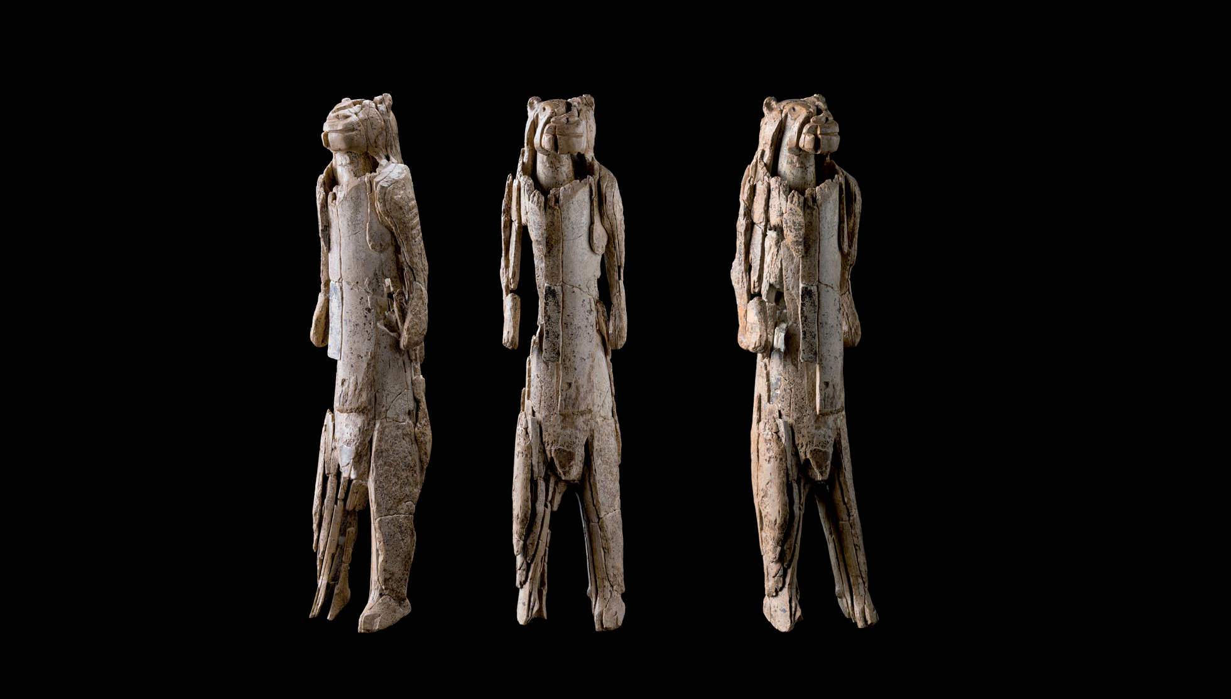
Lion Man from three angles. Stadel Cave, Baden-Württemberg, Germany, 40,000 years old

Slide 19
MEMORABILITY OF THE GREEK GODS
MCI
Memorability and being interesting are the most important features of an MCI concept.
If it is too complex, it won’t be remembered. If it is too boring, likewise.
A horse that paints is interesting.
An invisible horse who paints and can fly and speaks Russian is too complex to be memorable.
A man who can become a wolf is interesting; a man who can become a pencil, less so.
An invisible wolf is more memorable than an invisible pencil.

Slide 20


Slide 21
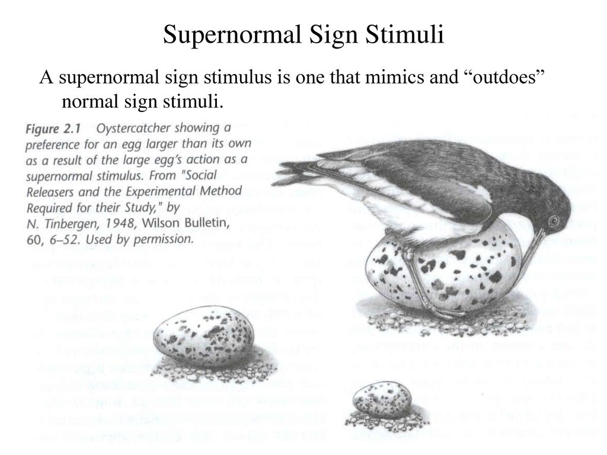
So MCIs, like invisible all-powerful gods, fire up the imagination once conceived and stick around in the mind. The gods become a human equivalent of the giant egg.

Slide 22
ZEUS AT OLYMPIA
Zeus Olympios (Olympian Zeus)
Zeus Laoetas (Zeus of the People)
Zeus Kataibatos (Zeus Descender – i.e. Lightning)
Zeus Areios (Warlike Zeus)
Zeus Herkeios (Zeus of the Courtyard)
Zeus Keraunos (Zeus of the Thunderbolt)
Zeus Chthonios (Zeus of the Earth)
What about Polytheism? How might CSR help us understand this complexity?
It is the intuitive approach which separates each of the separate Zeuses; each were worshipped in their own place as if physically present (intuitive)– but rationally (reflective), they could be seen as aspects of one Zeus who lived on Olympos.
The Greeks felt no need to reconcile these irreconcilable views.

Slide 23
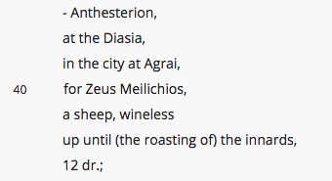

Sacrificial Calendar of Erchia
https://www.atticinscriptions.com/inscription/AIO/593
Column Α
line 40 - to Zeus Meilichios at Agrai, a sheep

Slide 24
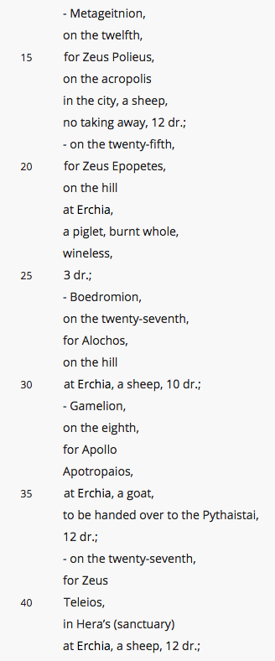
Sacrificial Calendar of Erchia
https://www.atticinscriptions.com/inscription/AIO/593
Column Γ
line 15 - to Zeus Polieus on the acropolis, a sheep
line 20 - to Zeus Epopetes on the hill, piglet holocaust
line 39 - to Zeus Teleios in Hera’s sanctuary, sheep

Slide 25

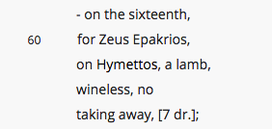
Sacrificial Calendar of Erchia
https://www.atticinscriptions.com/inscription/AIO/593
Column Ε
line 28 - to Zeus Horios piglet
line 60 - to Zeus Epakrios, on Hymettos, a lamb

Slide 26
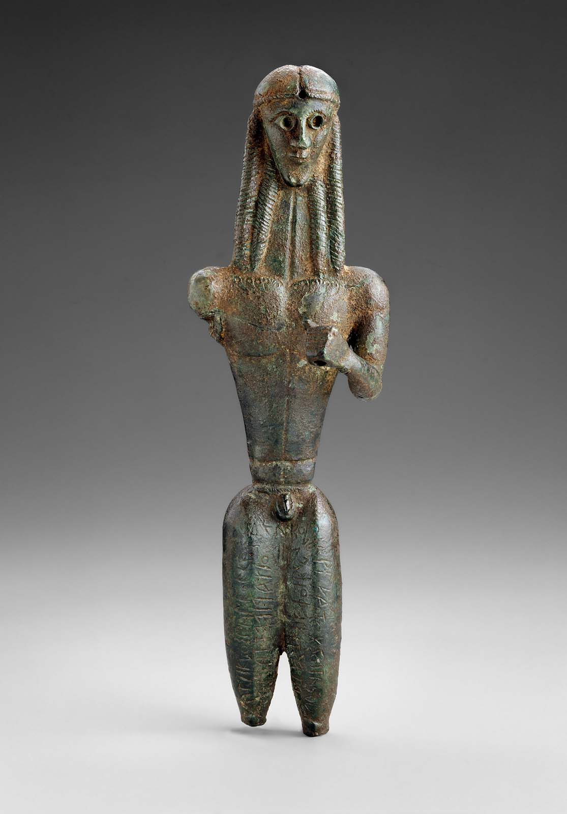
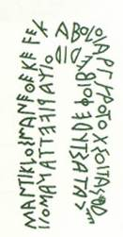
Μάντικλός μ’ ἀνέθεκε ϝεκαβόλοι ἀργυροτόξσοι / τᾶς δ δε-
κάτας· τὺ δέ, Φοῖβε, δίδοι χαρίϝετταν ἀμοιβ̣[άν]
Mantiklos dedicated me from his tithe to the Far Shooter of the Silver Bow. You, Phoebus, give something pleasing in return.
Implicit: Apollo could read Greek; he knew of the gift; he would appreciate it (as a human) and would give something back
Reflective – Apollo was an archer god; when people get good things they ought to share them with the gods
Mantiklos Apollo ca.700-675BC, Thebes, Boeotia

Slide 27
SUMMARY OF CSR
We are not blank slates.
Evolution has adapted us as social creatures to understand the intentions of others in our social group. Theory of mind reveals how we instinctively project human thoughts/intentions onto other people, inanimate objects, and even processes; and how we read intention in exceptional events.
Once processes and extraordinary events have become personified, these MCIs are naturally memorable and fascinating – i.e. our mental architecture creates a susceptibility to representations of superhuman agents, a tendency to find them memorable, compelling and plausible.
The anthropomorphism of Greek Gods is simply an admittance of an already inherent tendency – to humanise the world. The ‘humanity’ of the Greek Gods allows a close and reciprocal relationship, explaining such things as sacrifice and divination.
The instinctive recognition of disgust and corresponding concept of purity and cleanliness can explain the Greek concept of Miasma – pollution.

