Slide 1
Miasma
Bremmer Greek Religion p.5-6
“An important consequence of overstepping or breaking existing cosmological, social, and political boundaries was the incurring of pollution. The vocabulary of pollution and purity together with its concomitant practices was most frequently used in Greek religion to indicate proper boundaries or categories not to be mixed… The employment of this particular vocab with the corresponding rites of purification can, in one way, be seen as an important Greek way of dealing with maintaining religious and social norms and values in times when the legal process was still underdeveloped’
IG II² 1035.10 “It is the ancestral custom that in no temple precinct should anyone either be born or die”

Slide 2
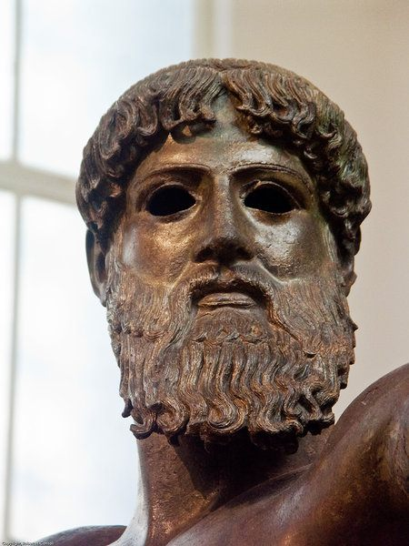
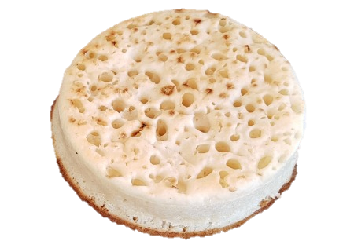
MIASMA/POLLUTION
Purity
Cleanliness is next to godliness
English
Cf. Bendlin (2007)
Divinity
Divinity
Normality
Disgust/Pollution
Pollution
Bodily Fluids
Sex
Birth
Death
Contamination
French

Slide 3
WHAT GETS YOU POLLUTED
Being involved in bloodshed (and yet the gods love sacrifice… cf Euripides Iphigenia among the Taurians 380-4).
Sex
Touching a new mother
Touching a corpse
Denying the right of burial (see Antigone)
Disrespecting a sanctuary (Thuc 1.128.1-2)
Not confirming to the law (cf. law on mourning from Gambreion 3rd c BC)
Not following the will of the gods properly (Thuc 5.1 – Athenians trying to cleanse Delos)
And the list goes on….

Slide 4
BLOODSHED AND MURDER
Sacred Law Salinas
“If a man [who has killed another man with his own hand] needs to be purified, having made a proclamation from wherever he wishes and whenever in the year he wishes, having made a declaration in whatever direction he wishes, let him be purified. On receiving him let he who receives him give water to wash with and a meal and salt to him and having sacrificed a piglet to Zeus let him go away from and let him be purified”
Sacred Law for Keos late C5BC
“When someone dies, when the person has been carried out, women are not to go to the house other than those who are polluted. The mother, the wife, the sisters and the daughters are polluted, but in addition to these not more than 5 women, the children of daughters and cousins, but no one else. The polluted men when they have washed their heads by pouring water are to be pure…… At the third day and at the annual commemoration those who perform it are to be pure, but not to go to a sanctuary, and their house is to be pure except while they come from the tomb”

Slide 5
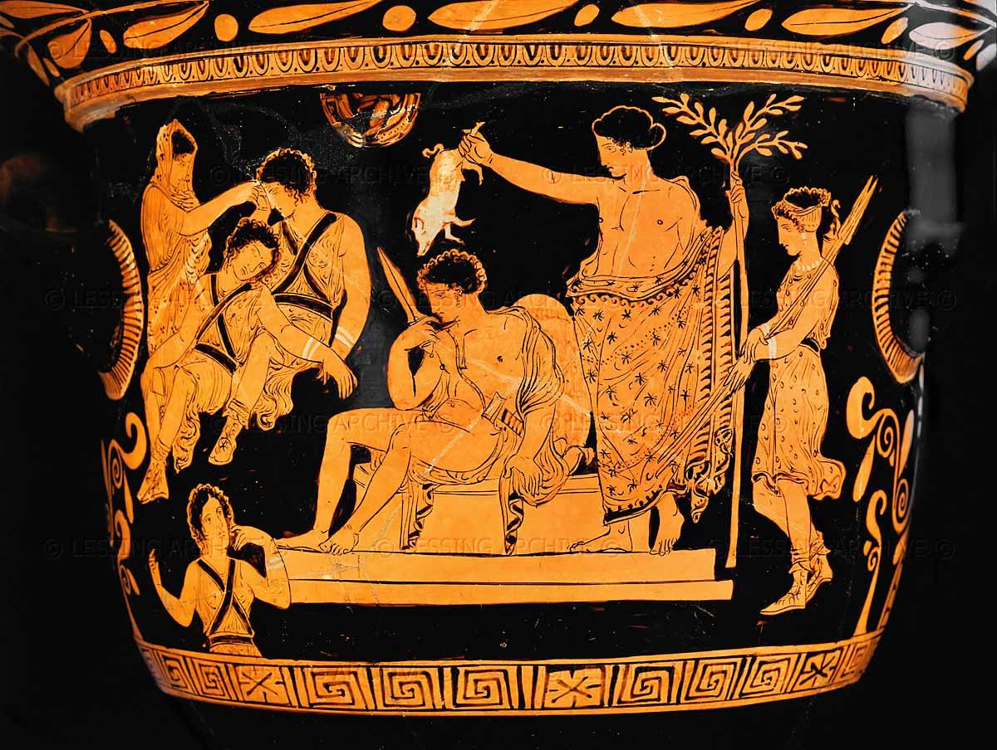
Orestes purified by Apollo at Delphi -Eumenides Painter 380-370BC

Slide 6
SEX
GDI 1156 Olympia C6BC
“If he commits fornication in the sacred precinct, one shall make him expiate it by the sacrifice of an ox and by complete purification”
Sacred Law of Kos (350 BC – RO 62)
“When they make libations let the priest choose one person as the slaughterer of the ox and let him proclaim that the slaughterer shall be pure from woman and man during the night” (LSCG 151 = Kearns 5.3.2)
Cult regulations of Athena Lindia, C3BC
…41 days from defloration; 41 days from bereavement; 7 days from washing the corpse, 3 days from entering the house, 3 days from contact with childbirth, 11 days from giving birth, from a prostitute 30 days. One is never pure from illegal acts.”

Slide 7
BIRTH
Cult regulations of Athena Lindia, 3rd c: “They must not bear arms and they must wear clean clothing, without headgear, being unshod or non-goatskin sandals, not wearing anything of goatskin, and with no knots in girdles 40 days from the miscarriage of a woman, dog or ass; 41 days from defloration; 41 days from bereavement; 7 days from washing the corpse, 3 days from entering the house, 3 days from contact with childbirth, 11 days from giving birth, from a prostitute 30 days. One is never pure from illegal acts.”
Asklepios cures 1.
[Cleo] was pregnant for five years. After already five years of pregnancy she came as a suppliant to the [god] and went to sleep in the innermost sanctuary. As soon as she came out of it and was outside the sanctuary, she gave birth to a boy, who as soon as he was born washed himself from the fountain and walked about with his mother. After being granted this favour she wrote the following inscription on her dedication: `It is not the greatness of the tablet that deserves admiration, but the divinity, as Cleo was pregnant with child in her womb for five years, until she went to sleep (sc. in the sanctuary), and the divinity restored her to health.’

