Slide 1
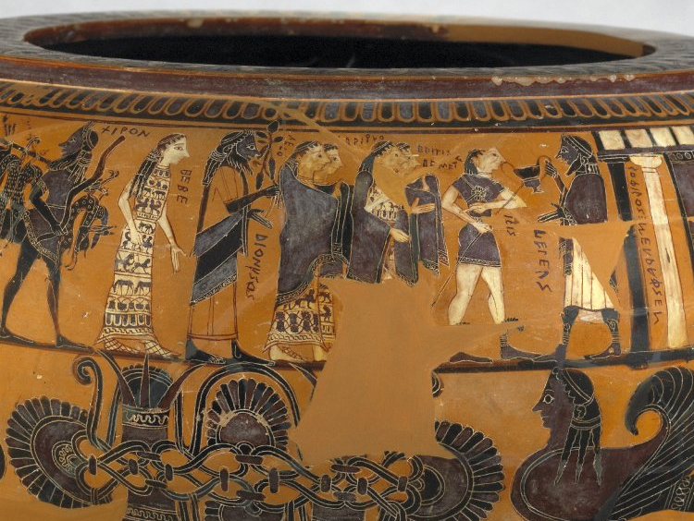

Classical Civilisation A-level Teachers Day 2022
Greek Religion
Dr Paul Grigsby

Slide 2
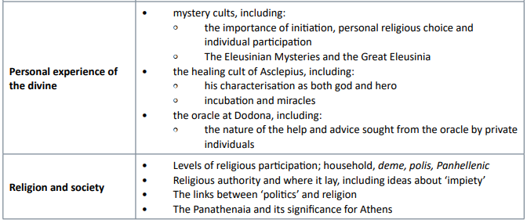
Aim: To point you towards general areas of modern scholarship which your students might find useful for certain parts of the curriculum
1. Links between politics and religion: Sourvinou-Inwood on polis religion
2. New ways of thinking about Greek religion – Julia Kindt – Rethinking Greek Religion (including example of Dodona)

Slide 3
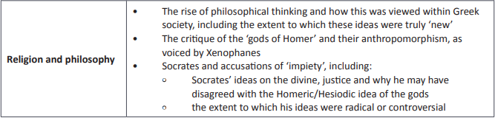
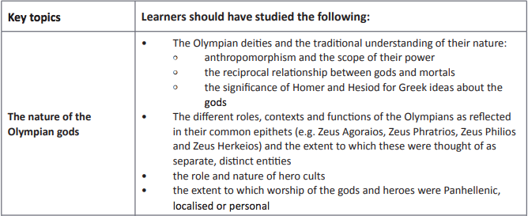
3. Tension between polis and individual - case of Socrates – both…
4. Looking at epithets – Larson Understanding Greek religion [CSR]

Slide 4

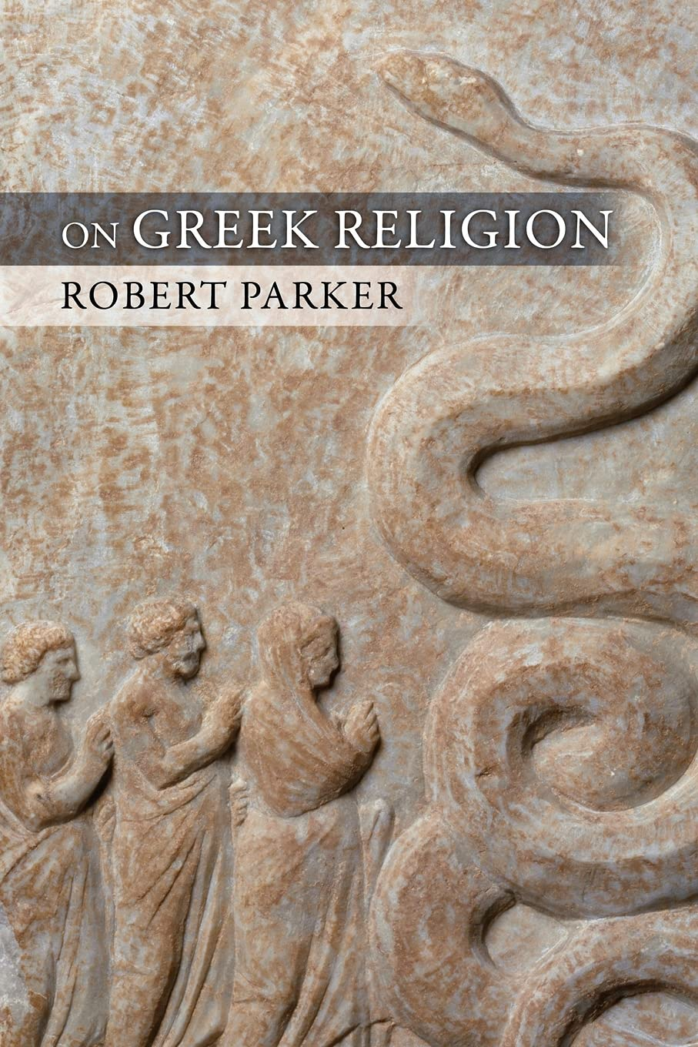

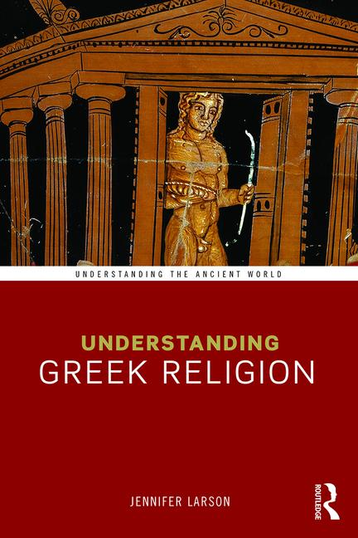

Slide 5
Levels of religious participation
Personal
Household
Gene (v. extended family)
Deme (e.g. Erchia)
Polis
Region
Pan-Hellenic

Slide 6

1. The Links Between Politics [politikos] and Religion
Christiane Sourvinou-Inwood - Polis Religion
‘The attempt to reconstruct, and make sense of, a religious system to which we have extremely limited access, and which is very different from those which have conditioned our own understanding of the category 'religion', demands a methodology which, as far as possible, prevents our own-culturally determined-assumptions from intruding into, and thus corrupting, the investigation.’ (13)
Looking for a way of getting a handle on something inexplicable in an objective way.
So focus is on action over belief (orthopraxy over orthodoxy)
Wave-particle duality.
It almost takes religion as belief out of the equation.
Sourvinou-Inwood, C. ‘What is polis religion?’, (13–37) and ‘Further aspects of polis religion’, (38–55) in Buxton, R. (ed.) (2000) Oxford Readings in Greek Religion. Oxford

Slide 7
Christiane Sourvinou-Inwood – Polis Religion
‘The polis provided the fundamental framework in which Greek religion operated.’ (13)
‘In a religion without a canonical body of belief, without revelation, without scriptural texts (outside certain marginal sects which did have sacred books but are irrelevant to our present discussion), without a professional divinely anointed clergy claiming special knowledge or authority, without a church, it was the ordered community, the polis, which assumed the role played in Christianity by the Church - to use one misleading comparison (for all metaphors derived from Christianity are inevitably misleading) ...’ (19-20)
Without doctrine or other guidance, the ordering principal of Greek religion was the polis.
More extremely…
‘According to Burkert (1995, 202) , the concept [polis religion] encompasses, first of all, self-representation of the community through religious cults; second, it suggests control of religious practices by the polis through its decision making organs; and third, polis religion sometimes implies that the polis created and transformed its religious institutions – effectively, the polis ‘actually makes religion’.’ (Kindt, 2012, 16-17).

Slide 8
Christiane Sourvinou-Inwood – Polis Religion
Negative view of religion. Religion itself as invented, and created to control… but it is reductive to link religion to the idea of ‘control’
Control suggests religious exclusion, or control of participation in festivals such as the Panathenaia - but as Kindt argues in Rethinking Greek Religion (2012), looking more generously, what Sourvinou-Inwood is proposing is that the polis was an important perceptual filter that shaped religious thought and action (Kindt, 2012, 19).
Important to remember that each polis did things differently – the monolith of polis religion is really no such thing

Slide 9
Christiane Sourvinou-Inwood – Polis Religion
Importance of polis visible at other levels:
‘The polis anchored, legitimated, and mediated all religious activity. This is true even in the Panhellenic sanctuaries where the polis mediated the participation of its citizens in a variety of ways. At Delphi the polis schema articulated the operation of the oracle. The oracle's religious personnel consisted of Delphians, and the participation of non-Delphians was mediated by Delphians who acted as proxenoi and offered the preliminary sacrifice before consultation by non-Delphians.’ (15).
‘Another manifestation of the fact that the polis mediated the individual's participation in Panhellenic cult can be seen in the order of consultation of the Delphic oracle.’ (15)
The polis was involved with some aspects such as Promanteia and the payment for the oracle, but…
… compare Kindt.

Slide 10
Julia Kindt - Rethinking Greek Religion (2012)
An oracular example:
‘While the economic side of oracle consultations thus fits into the framework of polis religion this is not always true for the questions asked and the responses received there. Our sources tell us, for example, of oracle consultations of a very personal nature, the significance of which was more embedded in personal circumstances than in polis concerns. In particular the corpus of responses from Dodona attests to a variety of personal issues on which divine advice was sought’ (Kindt, 2012, 18)
Thrasyboulos (asks) by having sacrificed to and appeased which of the gods, would I become healthier with regard to his eye? (Eidinow, 2007, 107)
Agis asks Zeus Naios and Dione about the coverings and pillows which he lost, whether someone from outside stole them? (Eidinow, 2007, 117)
‘The polis model is of little help to us in understanding the motivations, intentions and dynamics of these private oracle consultations.’ (Kindt, 2012, 18)

Slide 11
2. New ways of thinking about Greek religion
Julia Kindt – Rethinking Greek Religion (2021)
An expansion beyond Polis religion to include:
personal religion (religious belief)
Magic
theology

Slide 12
Julia Kindt - Rethinking Greek Religion (2012)
‘At the same time I argue that the polis model provides little, if any, help for understanding Greek personal religion and religious phenomena such as magic and mystery religions. I also argue that polis religion is focused more firmly on religious agency and neglects religious ideas and religious discourse.’ (Kindt, 2012, 13) [Orthopraxy vs orthodoxy.]
‘The representation of the social groupings of the polis in Greek religion, however, does not allow us to conclude the reverse: that Greek religion was entirely absorbed by the polis. There is plenty of evidence for religious practices unmediated by and with no obvious link to the polis.’ (Kindt, 2012, 17)
Unmediated practice – personal belief, magic, oracles, superstition…

Slide 13
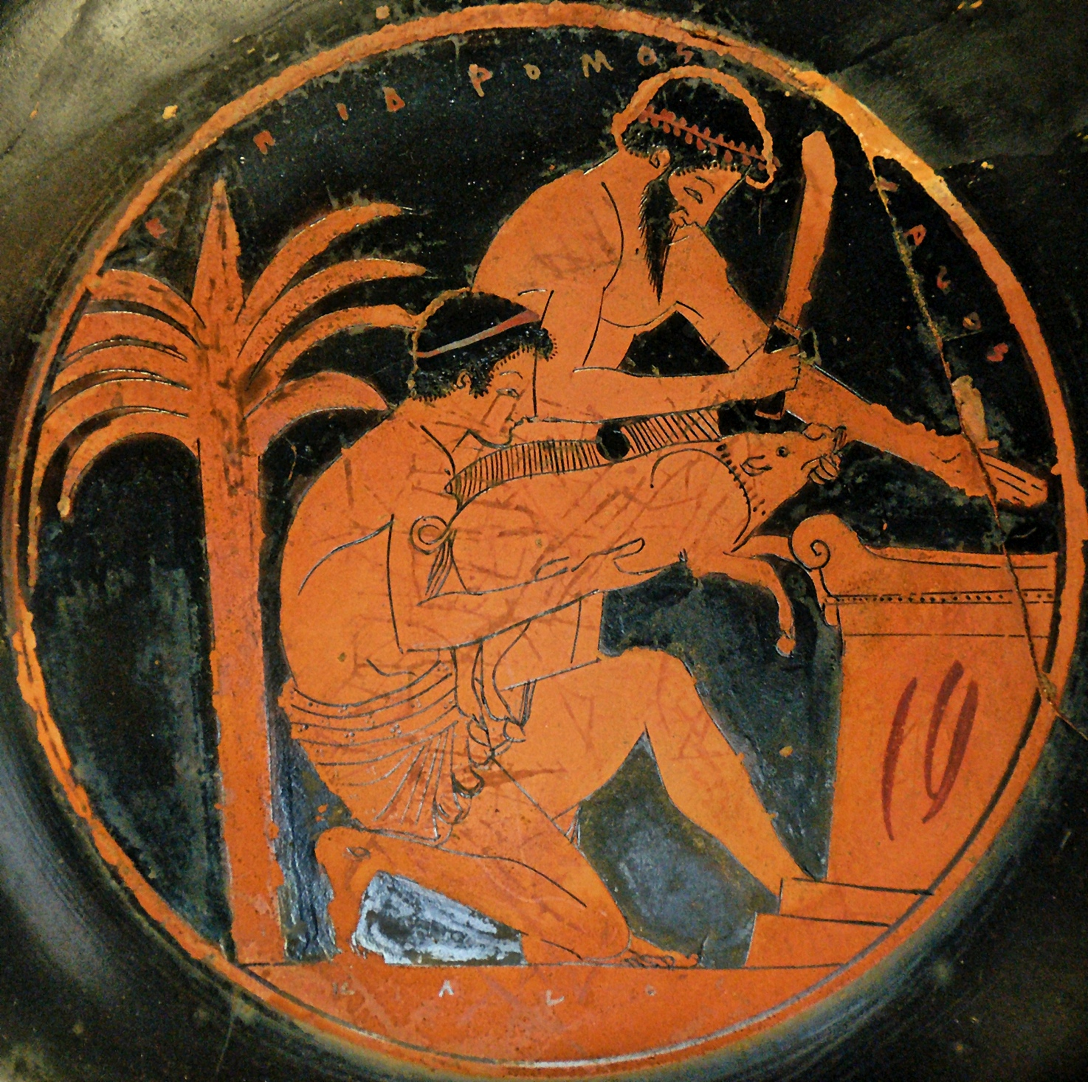
ORTHOPRAXY VS ORTHODOXY
As Parker outlines (2011, 36) the idea of Greek religion as one of orthopraxy rather than orthodoxy is a continuation of Bernard Le Bovier de Fontanelle Conversations on the Plurality of Worlds (1686) where he gave a formulation for Greek Religion along the lines of:
‘Do as the rest, but believe what you like’.
Fontanelle was not saying that Greeks did not believe: people clearly did believe – Greek Religion was not an empty puppet show. The whole of Greek literature is proof against any claim of a universal lack of actual belief, as are dedications.
Fontanelle’s point is rather that no attempt was made to police people’s beliefs.
Hence they were free to believe anything as long as they did what everyone else did.

Slide 14
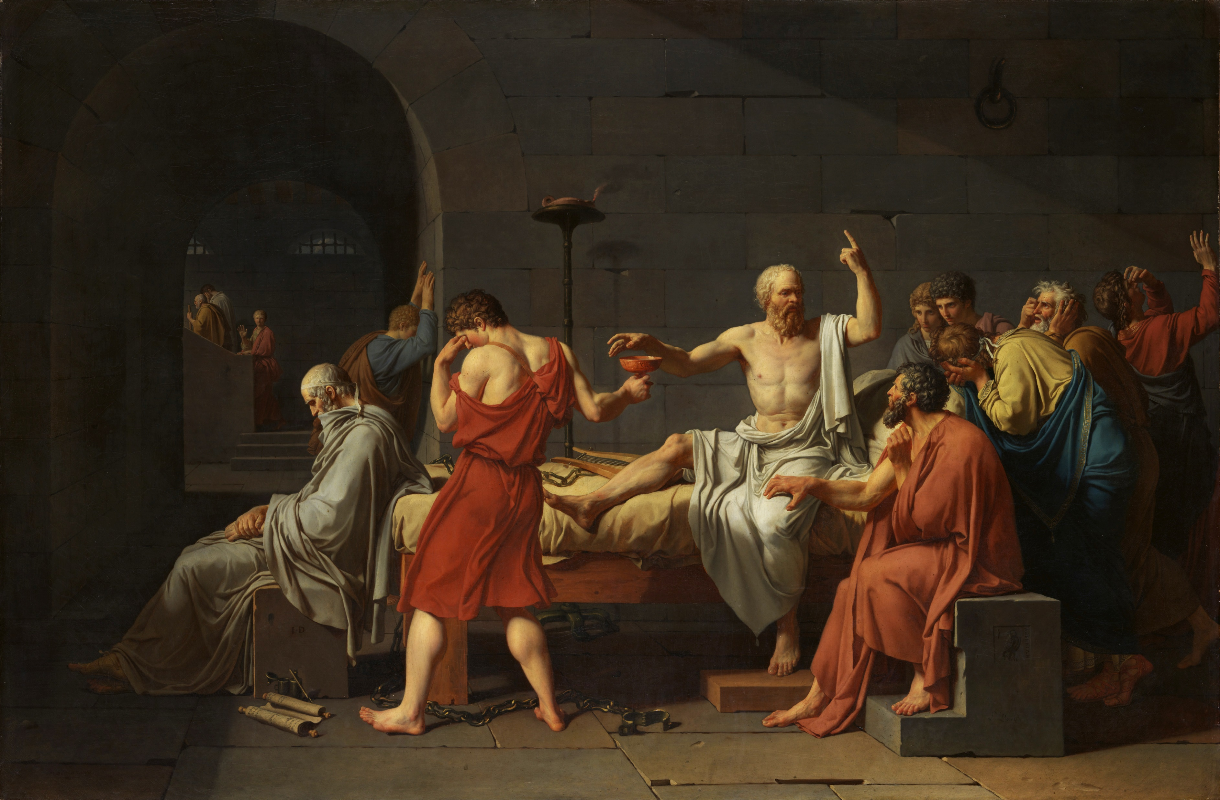
How Free was Speech about the Gods?
Robert Parker On Greek Religion (2011)
Orthopraxy vs orthodoxy put to the test
Socrates Indictment (according to Xenophon)
"Socrates is guilty of crime in refusing to recognise the gods acknowledged by the state, and importing strange divinities of his own; he is further guilty of corrupting the young.“ Xenophon Memorabilia 1.1.1
He was indicted for not ‘acknowledging’ (νομίζειν) the gods of the state. νομίζειν might be translated as either ‘believe’ or ‘practice’. Xenophon argued for ‘practice’ and thought Socrates’ sacrificing was proof enough for acquittal.

Slide 15
If orthopraxy (right practice) trumped orthodoxy (right belief) then if, as Xenophon says, Socrates at least made an outward show of sacrifice and ritual, why was he put on trial?
Clearly others must have seen that ‘belief’ was also important.
This suggests that ‘challenges to the bedrock of belief by influential teachers were not a matter of indifference’ Parker (2011, 37).
Personal belief was important.

Slide 16
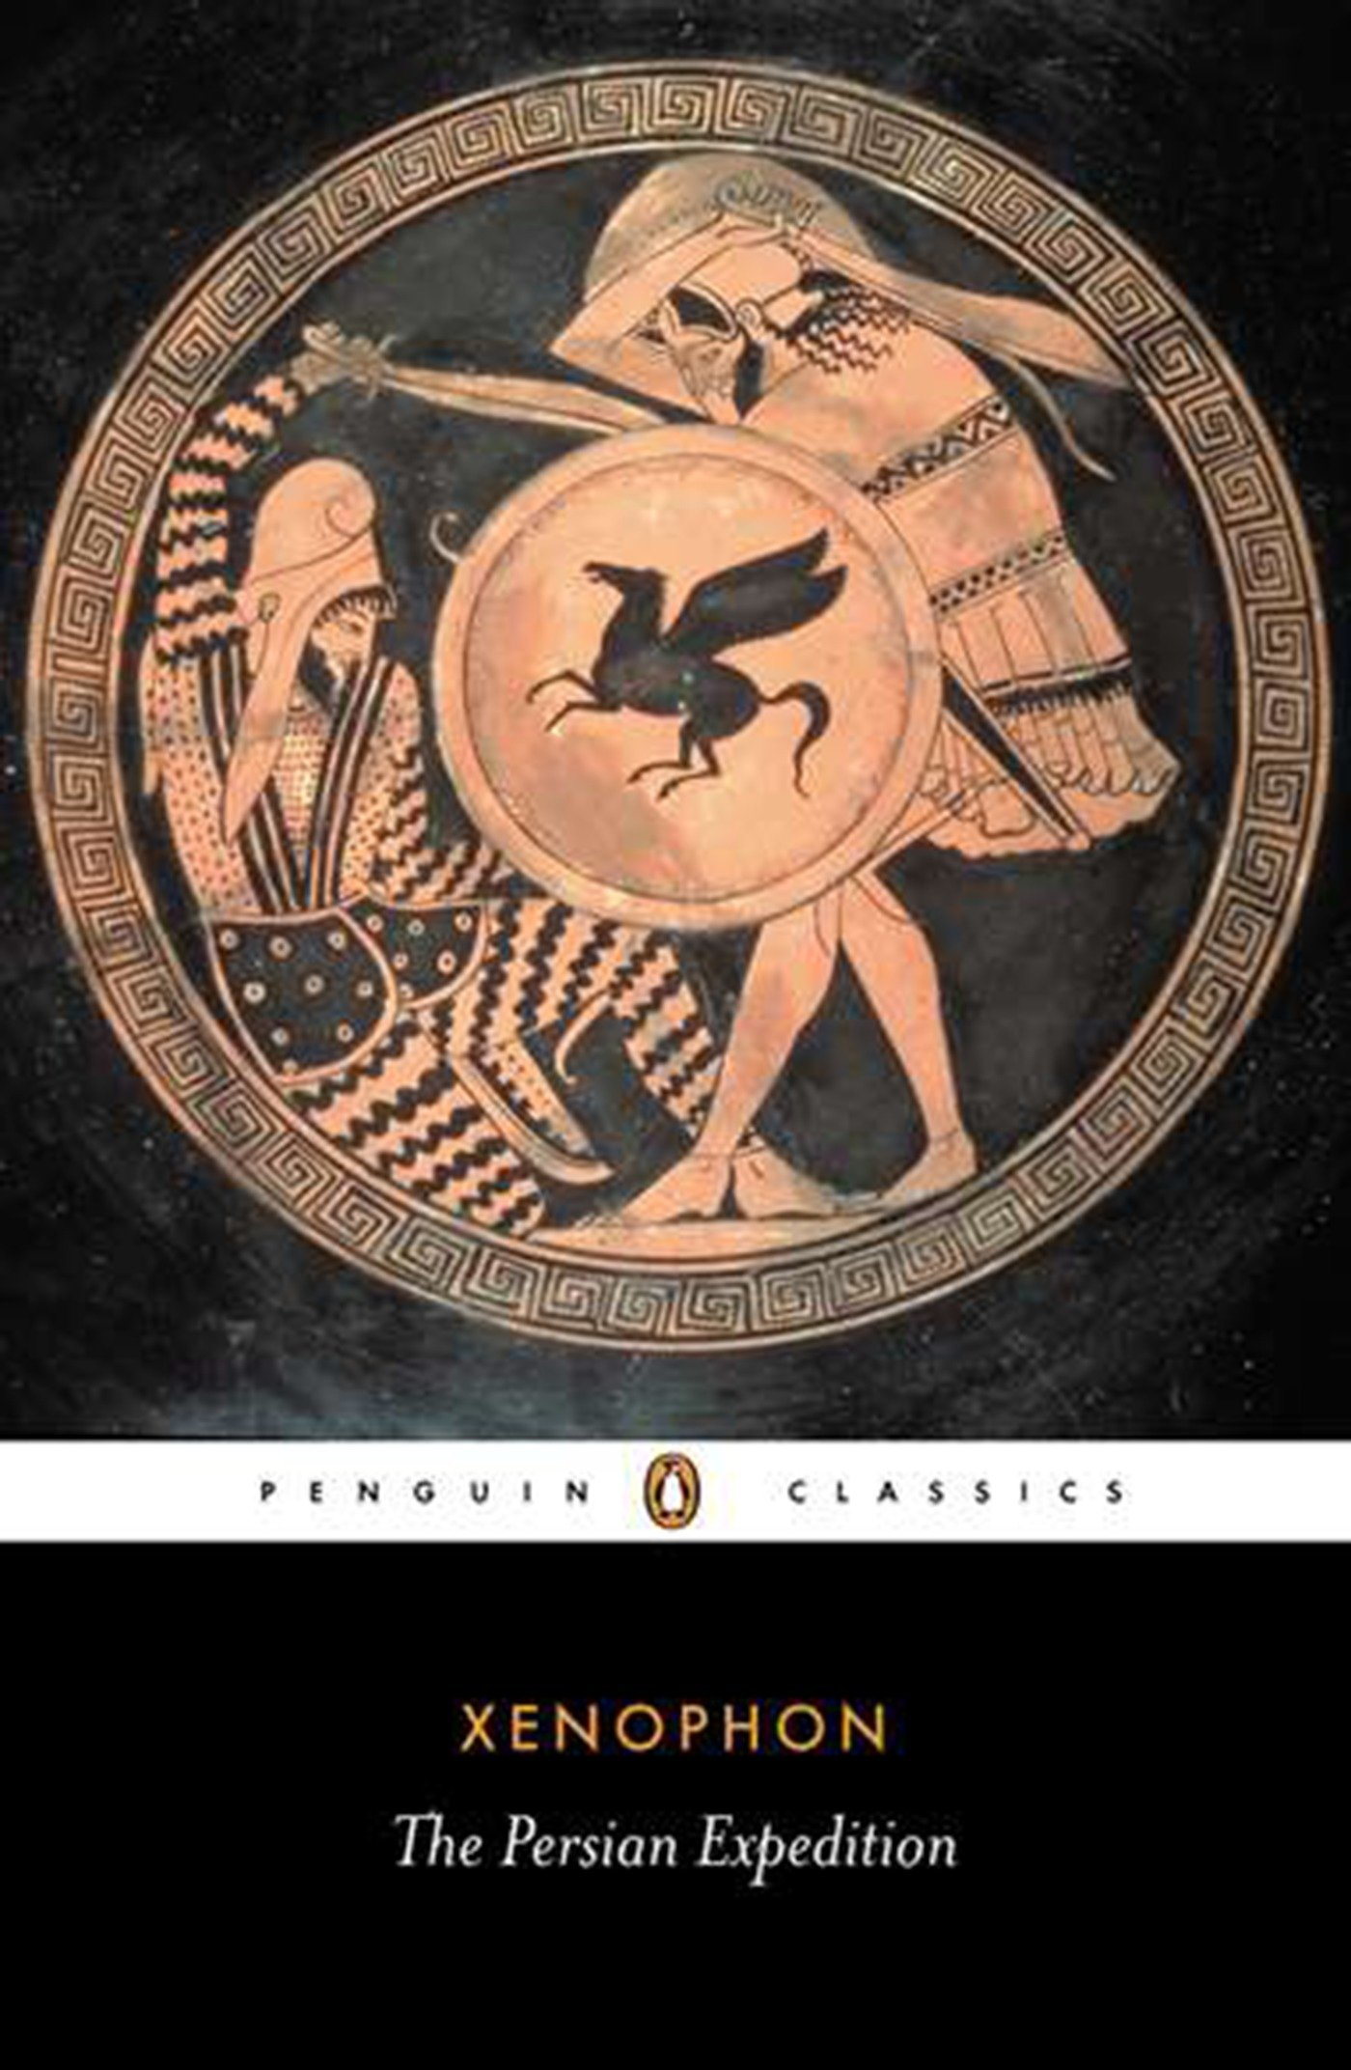
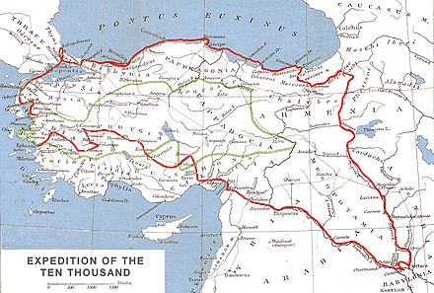
Epithets
Another example of non-Polis religion which will lead us on to epithets is dreams.
Xenophon’s dream:
[Having just learned they had been tricked into helping Cyrus against the King of Persia]
‘They did not know how to proceed, and he [Xenophon] was upset, along with the others, and could not sleep. When he did get a little sleep, he had a dream. It seemed to him that in the midst of thunder a lightening bolt fell on the house he had from his father. He judged that the dream was good in one way, because he dreamed that when he was in difficulty and danger he had seen a great light from Zeus, but he also worried because he thought that the dream had come to him from Zeus the King (Basileus) . . .’ Διὸς μὲν βασιλέως
Xenophon Anabasis 3.1.11 c. 400 BC
[Dreams as private communication with the gods – like incubation]

Slide 17
Xenophon and Zeus
Xenophon has led his men back almost to Greece…
[Anabasis 7.6.44] ‘Many other people also sent Xenophon this message, saying that he had been maligned and would better be on his guard. And he, hearing these reports, took two victims and proceeded to offer sacrifice to Zeus Basileus [Zeus the King], to learn whether it was better and more profitable for him to remain with Seuthes on the conditions that Seuthes proposed, or to depart with the army. The god directed him to depart.’

Slide 18
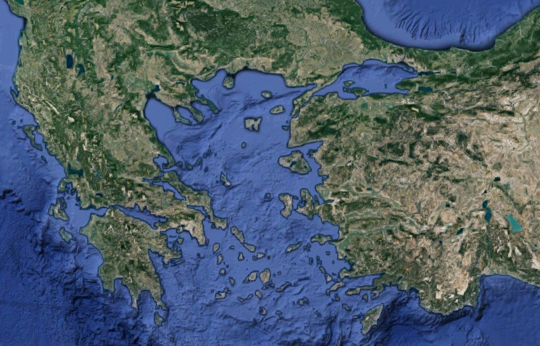
Xenophon Anabasis 7.8.1-6
‘From there they sailed across to Lampsacus, where Xenophon was met by Eucleides, the Phliasian seer... Eucleides congratulated Xenophon upon his safe return, and asked him how much gold he had got. He replied, swearing to the truth of his statement, that he would not have even enough money to pay his travelling expenses on the way home unless he should sell his horse and what he had about his person. And Eucleides would not believe him.’
‘But when the Lampsacenes sent gifts of hospitality to Xenophon and he was sacrificing to Apollo, he gave Eucleides a place beside him; and when Eucleides saw the vitals of the victims, he said that he well believed that Xenophon had no money. “But I am sure,” he went on, “that even if money should ever be about to come to you, some obstacle always appears—if nothing else, your own self.” In this Xenophon agreed with him.’
Lampsacus

Slide 19
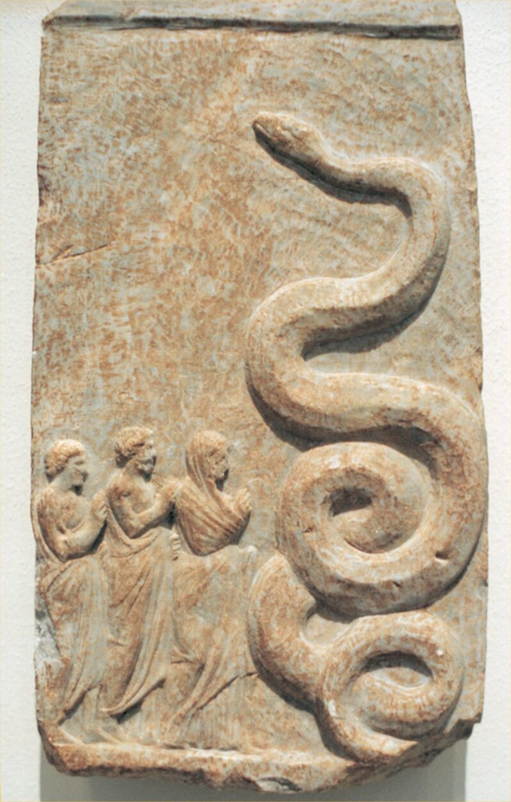
Xenophon Anabasis 7.81-86
‘Then Eucleides said, “Yes, Zeus Meilichios (Zeus the Merciful) is an obstacle in your way,” and asked whether he had yet sacrificed to him, “just as at home,” he continued, “where I was wont to offer the sacrifices for you, and with whole victims.” ‘
‘Xenophon replied that not since he left home had he sacrificed to that god.’
[ὁ δ᾽ οὐκ ἔφη ἐξ ὅτου ἀπεδήμησε τεθυκέναι τούτῳ τῷ θεῷ]
‘Eucleides, accordingly, advised him to sacrifice just as he used to do, and said that it would be to his advantage. And the next day, upon coming to Ophrynium, Xenophon proceeded to sacrifice, offering whole victims of swine after the custom of his fathers, and he obtained favourable omens.’
Votive to Zeus Meilichios from the harbour at Zea C4BC, now in Berlin

Slide 20
ONE ZEUS OR MANY?
‘A god with an epithet was not a different being, just one aspect seen in close up. And yet each part needed addressing as if separate, or almost as if separate, as Xenophon Anabasis attests [Xen. Ana. 7.81-86]’ Robert Parker (2011, 67)
[Brief look at CSR to make this clear in a bit]
Sometimes minor gods were treated as separate, sometimes as attributes of major gods
Nike and Eileithyia are sometimes separate, but c.f. Athena Nike and Artemis Eileithyia
It is not clear how the Greeks understood this, but we know it had an effect on actual cult (separate cults are attested for example to both Nike and Athena Nike).
More examples – Zeus and Olympia as seen by Pausanias…

Slide 21
GODS AND THEIR EPITHETS
ZEUS AT OLYMPIA
[Pausanias 5.14.4-10]
[4] Now that I have finished my account of the greatest altar, let me proceed to describe all the altars in Olympia…[The Eleans] sacrifice to Hestia first, secondly to Zeus Olympios (Olympian Zeus), going to the altar within the temple, thirdly to Zeus Laoetas (Zeus of the people) and to Poseidon Laoetas. This sacrifice too it is usual to offer on one altar. Fourthly and fifthly they sacrifice to Artemis and to Athena, Goddess of Booty, [5] sixthly to the Worker Goddess. The descendants of Pheidias, called Cleansers, have received from the Eleans the privilege of cleaning the image of Zeus from the dirt that settles on it, and they sacrifice to the Worker Goddess before they begin to polish the image. There is another altar of Athena near the temple, and by it a square altar of Artemis rising gently to a height.
[6] After the altars I have enumerated there is one on which they sacrifice to Alpheius and Artemis together. The cause of this Pindar, I think, intimates in an ode, and I give it in my account of Letrini. Not far from it stands another altar of Alpheius, and by it one of Hephaestus. This altar of Hephaestus some Eleans call the altar of Zeus Areios (Warlike Zeus). These same Eleans also say that Oenomaus used to sacrifice to Zeus Areios on this altar whenever he was about to begin a chariot-race with one of the suitors of Hippodameia.

Slide 22
GODS AND THEIR EPITHETS
ZEUS AT OLYMPIA
[7] After this stands an altar of Heracles surnamed Parastates （Assistant）; there are also altars of the brothers of Heracles—Epimedes, Idas, Paeonaeus, and Iasus; I am aware, however, that the altar of Idas is called by others the altar of Acesidas. At the place where are the foundations of the house of Oenomaus stand two altars: one is of Zeus Herkeios (Zeus of the Courtyard), which Oenomaus appears to have had built himself, and the other of Zeus Keraunos (Zeus of the Thunderbolt), which I believe they built later, when the thunderbolt had struck the house of Oenomaus.
[8] An account of the great altar I gave a little way back; it is called the altar of Olympian Zeus. By it is an altar of Unknown Gods, and after this an altar of Zeus Purifier, one of Victory, and another of Zeus—this time surnamed Chthonios (Underground). There are also altars of all gods, and of Hera surnamed Olympian, this too being made of ashes. They say that it was dedicated by Clymenus. After this comes an altar of Apollo and Hermes in common, because the Greeks have a story about them that Hermes invented the lyre and Apollo the lute.

Slide 23
GODS AND THEIR EPITHETS
ZEUS AT OLYMPIA
[9] Next come an altar of Concord, another of Athena, and the altar of the Mother of the gods. Quite close to the entrance to the stadium are two altars; one they call the altar of Hermes of the Games, the other the altar of Opportunity. I know that a hymn to Opportunity is one of the poems of Ion of Chios; in the hymn Opportunity is made out to be the youngest child of Zeus. Near the treasury of the Sicyonians is an altar of Heracles, either one of the Curetes or the son of Alcmena, for both accounts are given.
[10] On what is called the Gaeum (sanctuary of Earth) is an altar of Earth; it too is of ashes. In more ancient days they say that there was an oracle also of Earth in this place. On what is called the Stomium （Mouth） the altar to Themis has been built. All round the altar of Zeus Kataibatos (Zeus Descender – i.e., Lightning) runs a fence; this altar is near the great altar made of the ashes.
The reader must remember that the altars have not been enumerated in the order in which they stand, but the order followed by my narrative is that followed by the Eleans in their sacrifices. By the sacred enclosure of Pelops is an altar of Dionysus and the Graces in common; between them is an altar of the Muses, and next to these an altar of the Nymphs.

Slide 24
ZEUS AT OLYMPIA
Zeus Olympios (Olympian Zeus)
Zeus Laoetas (Zeus of the People)
Zeus Kataibatos (Zeus Descender – i.e. Lightning)
Zeus Areios (Warlike Zeus)
Zeus Herkeios (Zeus of the Courtyard)
Zeus Keraunos (Zeus of the Thunderbolt)
Zeus Chthonios (Zeus of the Earth)
How might CSR help us understand this complexity?

Slide 26
Intuitive Cognition Reflective Cognition
Fast, effortless, implicit Slow, effortful, explicit
Tied to emotions and Tied to logic/intellect
highly compelling cool and measured
When I throw a rock in the air, When I throw a rock at a
it comes back down policeman I get arrested
When I am hungry, I eat Don’t eat twelve Mars Bars
The Sun sets The Earth moves
I pray to God as if he is a God is omnipotent and
listening human who needs to be told… omniscient
Zeus Chthonios lives in Olympia Zeus lives on Mt Olympus
I must sacrifice to both Zeus Olympios Zeus Olympios and Zeus Meilichios
and Zeus Meilichios as if they were separate are both just ‘Zeus’
      We can hold contradictory intuitive and reflective cognitions at the same time

Slide 27
ZEUS AT OLYMPIA
Zeus Olympios (Olympian Zeus)
Zeus Laoetas (Zeus of the People)
Zeus Kataibatos (Zeus Descender – i.e. Lightning)
Zeus Areios (Warlike Zeus)
Zeus Herkeios (Zeus of the Courtyard)
Zeus Keraunos (Zeus of the Thunderbolt)
Zeus Chthonios (Zeus of the Earth)
How might CSR help us understand this complexity?
It is the intuitive approach which separates each of the separate Zeuses; each were worshipped in their own place as if physically present (intuitive)– but rationally (reflective), they could be seen as aspects of one Zeus who lived on Olympus.
The Greeks felt no need to reconcile these irreconcilable views.

Slide 28
Epithets
Veering towards orthopraxy, certain gods with epithets had certain locations and ways of being worshipped.
These local aspects required certain actions and rituals as if separate gods.
But going home afterwards the Greeks would have reflected that these different Zeuses, say, were all one and the same.
It is as if a god was responsible for many separate areas (Zeus Herkeios of boundaries, or Zeus Areios of war] , each reflected in a different aspect/epithet, each of which was addressed separately.
Each aspect had to be sacrificed to individually and specifically according to what was required.
There was no point sacrificing to Zeus Areios if you wanted your courtyard kept safe. He didn’t care.

Slide 29
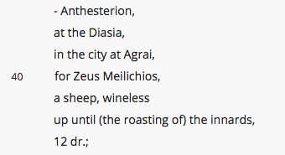

Sacrificial Calendar of Erchia
A great example for your students to see the range of sacrifices to different deities and their many aspects
https://www.atticinscriptions.com/inscription/AIO/593
Column Α
line 40 - to Zeus Meilichios at Agrai, a sheep

Slide 30
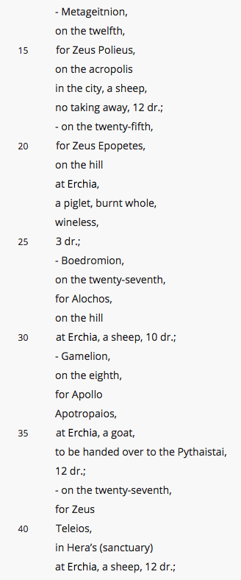
Sacrificial Calendar of Erchia
https://www.atticinscriptions.com/inscription/AIO/593
Column Γ
line 15 - to Zeus Polieus on the acropolis, a sheep
line 20 - to Zeus Epopetes on the hill, piglet holocaust
line 39 - to Zeus Teleios in Hera’s sanctuary, sheep

Slide 31

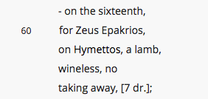
Sacrificial Calendar of Erchia
https://www.atticinscriptions.com/inscription/AIO/593
Column Ε
line 28 - to Zeus Horios piglet
line 60 - to Zeus Epakrios, on Hymettos, a lamb

Slide 32
Bibliography
‘Greek poleis and civic cults: some further thoughts’, Walter Burkert – in Studies in the Ancient Greek Polis by Hansen and Raaflaub (1995)
Oxford Readings in Greek Religion. Edited by Richard Buxton (2000)
Oracles, Curses, and Risk Among the Ancient Greeks Esther Eidinow (2007)
On Greek Religion Robert Parker (2011)
Rethinking Greek religion Julia Kindt. (2012)
The Oxford Handbook of Ancient Greek Religion Edited by Esther Eidinow and Julia Kindt (2016)
Understanding Greek Religion : a Cognitive Approach Jennifer Larson. (2016)

