Slide 1
Dido: World of the Heroine
Warwick Classics Network
Classical Civilisation Teachers Day
Elena Giusti
E.Giusti@Warwick.ac.uk

Slide 2
E. Giusti and V. Rimell (eds.) (2021) Vergil and the Feminine, Vergilius 67
On a macroscale, taken together, the papers act out the central dichotomy in feminist criticism... in that they tend either to diagnose misogyny, the exploitation of women, and oppressive gender norms, or make moves to recover female voices, characters, ways of being in the world that are downgraded qua female/ feminine, often in sympathy with what is construed as the text’s own disruptive or destabilizing potential. The question of whether and in what context those two methodologies (one damning, one recuperative) are compatible is a generalizable one for feminist thought but also has a particular edge for Classics as a field in crisis about its own value and implicatedness in reproducing structural oppressions rather than (or as well as) attending ethically to their long and complex evolution.

Slide 3

Hélène Cixous, La jeune née (1975)
“I am not Dido. I cannot inhabit a victim, no matter how noble. I resist: detest a certain passivity, it promises death for me. […] My sympathy, my tenderness, my sorrow, however, are all hers. But not me, not my life. I can never lay down my arms.”

Slide 4

Marilù Oliva (2022) L’Eneide di Didone
“‘How come everyone else bought the fable of the suffering queen who threw herself onto a sword just because Aeneas had walked away from her? A woman who had experience much worse than being abandoned...”

Slide 5




Am I always her, this other raging woman? This woman that I am, right here in Naples, in this very squalid house, and that if she could would kill this man, would thrust a knife in his heart with all my strength? Should I restrain this shadow – my mother, all my ancestors –, or should I unleash her?
E. Ferrante The Story of the Lost Child, 2014

Slide 6

Laura Marling Semper Femina (2017)
Oh Nouel, you must know me well
And I didn't even show you the scar
Fickle, unchangeable
Semper femina
She'd like to be the kind of free
Women can't be alone
I wish I could hit the switch
That keeps you from getting gone
Oh Nouel, it must hurt like hell
When you're so afraid to die
Semper femina
So am I
“I started out writing ‘Semper Femina’ as if a man was writing about a woman, and then I thought; ‘it’s not a man, it’s me’. I don’t need to pretend it’s a man to justify the intimacy, or the way I’m looking and feeling about women. It’s me looking specifically at women and feeling great empathy towards them, and by proxy, towards myself.”

Slide 7
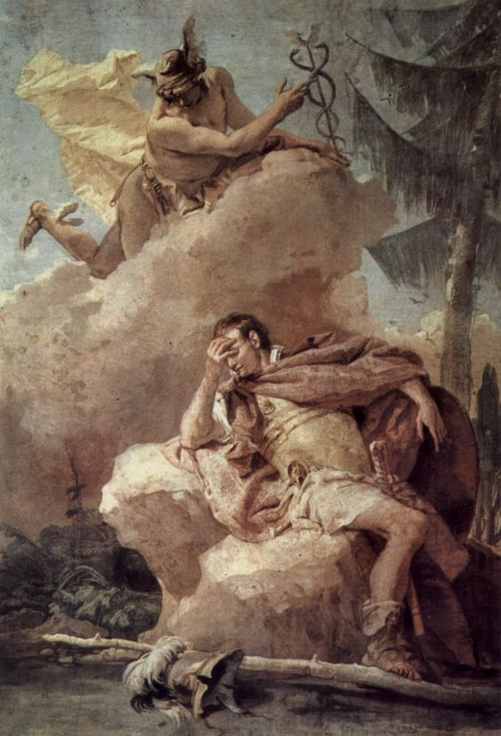
Aeneid 4.566-70
iam mare turbari trabibus saevasque videbis
conlucere faces, iam fervere litora flammis,
si te his attigerit terris Aurora morantem.
heia age, rumpe moras. varium et mutabile semper
femina.' sic fatus nocti se immiscuit atrae.
You will see her ships churning the sea and deadly torches blazing, and the shore seething with flames, if only dawn will you still lingering in this land. Up then, break off delay! Always a fickle and changeable thing is the woman.’ So he spoke and melted into the black night.

Slide 8

”The patriarchal perspectives of the critical establishment – often more purposefully patriarchal than the patriarchal discourses evident in the texts we read – deprive us of the ability to situate ourselves as women readers.” (Desmond 1994: 11)
“the tradition of reading Dido disrupts the patrilineal focus of the Aeneid” (Desmond 1994: 2)

Slide 9


Postcolonial Dido
Tunisian Literature:
Fawzi Mellah (1988) Elissa, la reine vagabonde
Sophie el Gulli (2004) Hashtart, à la naissance de Carthage
Other Postcolonial Contexts:
Argentinian Juan Cruz Varela’s 1823 Dido
Senegalese Léopold Sédar Senghor’s 1974 ‘L’Élégie de Carthage’

Slide 10
Timaeus 566 F82 (preserved in the Tractatus de Mulieribus Claris in Bello)
Theiosso is what Elissa was called in Phoenician – she being the sister of Pygmalion, king of Tyre. …she founded Carthage in Libya. When her husband was killed by Pygmalion, she put her possessions on shipboard and fled with some of the citizens, coming to Libya after great hardship. Because of her extensive wanderings, she was called ‘Deido’ by the Libyans in their local language. Once she had founded Carthage, the king of Libya desired her as wife, but she refused him. She was, however, pressured by her citizens. On a pretext of performing a ritual to free herself from her oaths (not to marry), she constructed a large pyre by her house, when it has been lighted, she threw herself from her abode into the pyre.

Slide 11
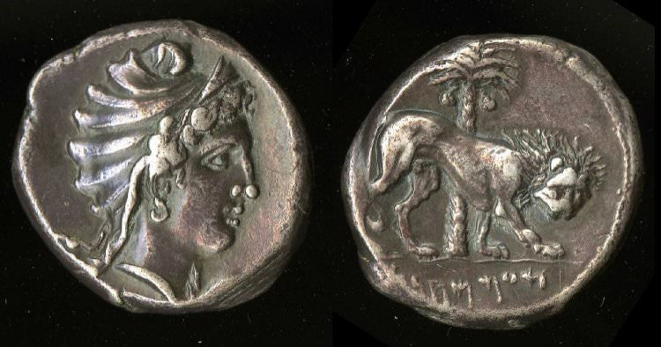
Elissa Dux of Carthage
Justinus, Epitome of the Philippic History of Pompeius Trogus 18.6
When the power of the Carthaginians, from success in their proceedings, had risen to some height, Hiarbas, king of the Maxitani, desiring an interview with ten of the chief men of Carthage, demanded Elissa in marriage, denouncing war in case of a refusal. The deputies... disclosed the king’s message, saying that “she herself, if she wished her city to be secure, must do what she required of others.” Being caught by this subtlety, she at last said... that “she would go whither the fate of her city called her.” Taking three months for the accomplishment of her resolution, and having raised a funeral pile at the extremity of the city, she sacrificed many victims, as if she would appease the shade of her husband, and make her offerings to him before her marriage; and then, taking a sword, she ascended the pile, and, looking towards the people, said, that “she would go to her husband as they had desired her,” and put an end to her life with the sword. As long as Carthage remained unconquered, she was worshipped as a goddess. This city was founded seventy-two years before Rome.

Slide 12
Macrobius Saturnalia 5.17.5
Our author treated that theme so subtly that the story of Dido lost in passion, which everyone knows is not true (quam falsam nouit universitas), has for so many generations now maintained the appearance of truth, and so flits about on the lips of men as though it were true...
[Traditional date of the Fall of Troy: 1184 BCE; Traditional date of Dido’s Foundation of Carthage: 814 BCE]

Slide 13
The Church Fathers on the Aeneid’s fable
Tertullian, de exhortatione castitatis 13.3
...Dido... who, refugee as she was on alien soil, when she ought rather to have desired, without any external solicitation, marriage with a king, did yet, for fear of experiencing a second union, prefer, contrariwise, to "burn" rather than to "marry;
Augustine, Confessions 1.22 Do not let those who sell or buy the teaching of literature cry out against me because, if I put a question to them (whether what the poet says is true, that Aeneas at one time came to Carthage) the less well-educated will reply that they do not know, while those who are better educated will go so far as to say that it is untrue.

Slide 14
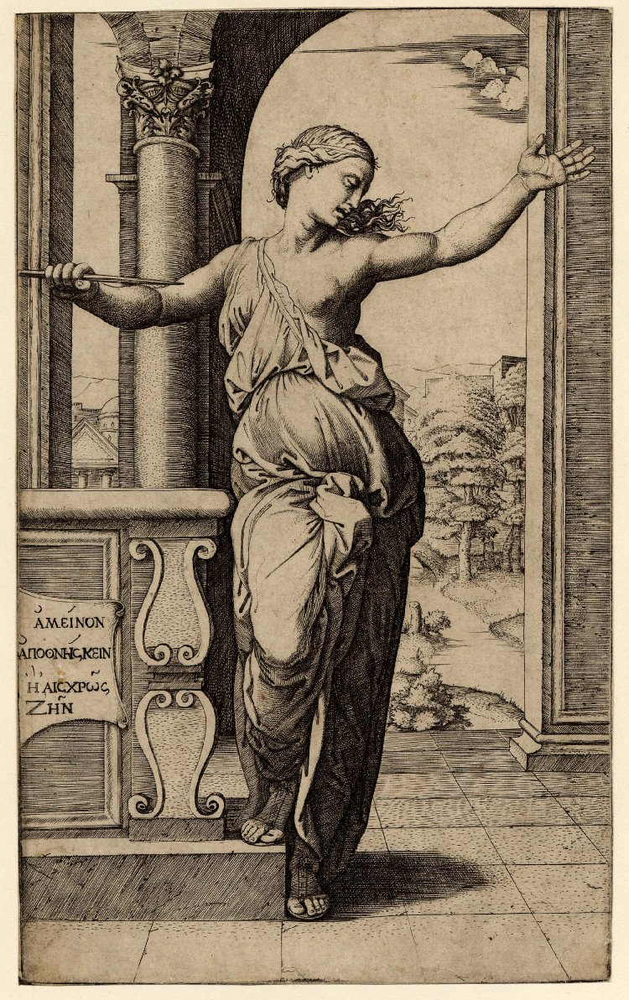
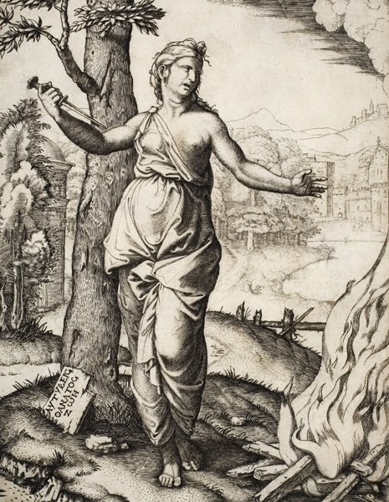
Dido the Chaste Widow
Dante, Inferno 5.61-2
L’altra è colei che s’ancise amorosa
e ruppe fede al cener di Sicheo
The next is she who killed herself for love and broke faith with the ashes of Sichaeus
Petrarch, Triumphus Pudicitie 1.155-9
Taccia il vulgo ignorante! Io dico Dido,
cui studio d’onestate a morte spinse
non vano amor, com’è ‘l publico grido
let the ignorant common herd be silent! I speak of Dido, who was driven to death by the pursuit of honesty, not by vain love as the common cry would have it

Slide 15
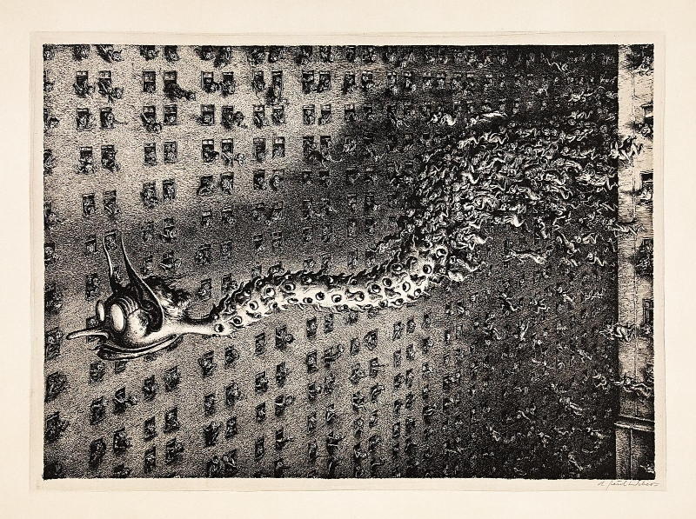
Virgil’s Fama
Rumour is quick of foot and swift on the wing, a huge and horrible monster, and under every feather of her body, strange to tell, there lies an eye that never sleeps, a mouth and a tongue that are never silent and an ear always pricked. By night she flies between earth and sky, squawking through the darkness, and never lowers her eyelids in sweet sleep. By day she keeps watch perched on the tops of gables or on high towers and causes fear in great cities, holding fast to her lies and distortions as often as she tells the truth. At that time she was taking delight in plying the tribes with all manner of stories, fact and fiction mixed in equal parts (Aen. 4.173ff.)
Paul Weber, Das Gerücht (1943)

Slide 16
The Riddle of the Septima Aestas
Aen. 1.755-6 it is now the seventh summer that carries you as a wanderer over every land and sea.
Aen. 5.626 The seventh summer is now on the wane since Troy’s overthrow
but cf. Aen. 4.193 (reports of Fama) Now they spend the winter, all its length, in wanton ease together…

Slide 17
Dux Femina Facti
Ipsa sed in somnis inhumati venit imago
coniugis, ora modis attollens pallida miris,
crudeles aras traiectaque pectora ferro
nudavit, caecumque domus scelus omne retexit.
Tum celerare fugam patriaque excedere suadet,
auxiliumque viae veteres tellure recludit
thesauros, ignotum argenti pondus et auri.
His commota fugam Dido sociosque parabat:
conveniunt, quibus aut odium crudele tyranni
aut metus acer erat; navis, quae forte paratae,
corripiunt, onerantque auro: portantur avari
Pygmalionis opes pelago; dux femina facti.
Devenere locos, ubi nunc ingentia cernis
moenia surgentemque novae Karthaginis arcem,
mercatique solum, facti de nomine Byrsam,
taurino quantum possent circumdare tergo.
Aen. 1.353-368
But in her sleep came the very ghost of her unburied husband; raising his pale face in wondrous wise, he laid bare the cruel altars and his breast pierced with steel, unveiling all the secret horror of the house. Then he bids her take speedy flight and leave her country, and to aid her journey brought to light treasures long hidden underground, a mass of gold and silver known to none. Moved by this, Dido made ready her flight and her company. Then all assemble who felt towards the tyrant relentless hatred or keen fear; ships, which by chance were ready, they seize and load with gold; the wealth of grasping Pygmalion is borne overseas, the leader of the enterprise a woman. They came to the place where today you will see the huge walls and rising citadel of new Carthage, and bought ground—Byrsa they called it therefrom—as much as they could encompass with a bull’s hide,

Slide 18
N. Horsfall 1973 ‘Dido in the light of history’
In the creation of Virgil’s Dido we can see at work a tradition which has nothing to do with the heroines of Greek literature, but which has its roots in Roman history and Roman prejudice...
...the violence, greed, duplicity and hatred which Dido displays in the Aeneid are...characteristics linked by Virgil and his contemporaries with the old hatreds of the Punic wars...

Slide 19
Intersectionality (see Kimberlé Crenshaw)
The interconnected nature of social categorizations such as race, class, and gender as they apply to a given individual or group, regarded as creating overlapping and interdependent systems of discrimination or disadvantage.

Slide 20
Treacherous Dido
Aen. 4.552 non seruata fides cineri promissa Sychaeo (I have not kept my promise to the ashes of Sychaeus)
Aen. 4.600-606 non potui abreptum divellere corpus et undis / spargere? non socios, non ipsum absumere ferro / Ascanium patriisque epulandum ponere mensis? (Couldn’t I have seized his body and torn it apart and scattered it in the waves? Couldn’t I have killed his companions with the sword, and Ascanius himself, and put him on his father’s table for him to banquet on?)

Slide 21
Venus’ prejudice
Aen. 1.661 quippe domum timet ambiguam Tyriosque bilinguis
For of course she fears this untrustworthy household and the two-tongued Tyrians
Cf. Plaut. Poen. 1034 bisulci lingua quasi proserpens bestia
with a two-forked tongue like a creeping beast

Slide 22
Mercury’s prejudice
Aen. 1.302-4
Et iam iussa facit, ponuntque ferocia Poeni
corda volente deo; in primis regina quietum
accipit in Teucros animum mentemque benignam
At once he carries out the commands, and the Punics put their fierce hearts aside, at the will of the god. Most of all the queen welcomes a serene spirit and a benevolent mind towards the Teucrians.
Cf. Livy 9.6.13 Romanam uirtutem ferociamque (‘Roman virtue and fierceness’)
Cf. Aen. 4.563-70 illa dolos dirumque nefas in pectore versat (‘she is turning in her heart a deceptive and abominable, unspeakable crime’)

Slide 23
Dido’s discrimination
Aen. 1.575
Tros Tyriusque mihi nullo discrimine agetur
Aen. 1.616
Quae uis immanibus applicat oris?
I will not discriminate between Trojans and Tyrians
What power has driven you to these savage shores?
Aen. 1.338-9
Punica regna vides, Tyrios et Agenoris urbem;
sed fines Libyci, genus intractabile bello.
It is a Punic kingdom you are looking at: Tyrian people, and the city of Agenor. But at its borders are the Libyans, a race impossible to handle in war.

Slide 24
Punic colonization
Justin 18.5.4-5 The Cypriots used to send the virgins to prostitute themselves on the shore, in determined days before they would get married, so as to procure themslves a dowry and make offerings to Venus to ensure fidelity to their future husbands. Elissa ordered for eighty of these women to be abducted when they were still virgins and carried onto her ships, so that the Tyrian youth could get married and the city could ensure a progeny (harum igitur ex numero LXXX admodum virgines raptas navibus inponi Elissa iubet, ut et iuventus matrimonia et urbs subolem habere posset)
Aen. 1.621-2 genitor tum Belus opimam
uastabat Cyprum, et uictor dicione tenebat...
at the time when my father Belus was laying waste on rich Cyprus, and kept it under his rule as a conqueror

Slide 25
Dido’s discrimination / Dido’s Africanisation
Aen. 4.39-43
nec venit in mentem quorum consederis arvis?
hinc Gaetulae urbes, genus insuperabile bello,
et Numidae infreni cingunt et inhospita Syrtis;
hinc deserta siti regio lateque furentes
Barcaei.
Don’t you remember what sort of people live in the land in which you’ve settled? On this side the cities of the Gatulians surround you, a race unconquerable in war, and the unbridled Numidians, and the inhospitable Syrtis; on this other, a waterless desert, and the Barcaei roam furiously on a large territory.
Cf. Venus at Aen. 1.339
sed fines Libyci, genus intractabile bello

Slide 26
Dido and the as Massylian sacerdos
Aen. 4.480-6
Oceani finem iuxta solemque cadentem 480
ultimus Aethiopum locus est, ubi maximus Atlas
axem umero torquet stellis ardentibus aptum:
hinc mihi Massylae gentis monstrata sacerdos,
Hesperidum templi custos, epulasque draconi
quae dabat et sacros servabat in arbore ramos, 485
spargens umida mella soporiferumque papaver.
Aen. 4.492-3
testor, cara, deos et te, germana, tuumque
dulce caput, magicas invitam accingier artis.
Aen. 4.497-8
abolere nefandi
cuncta viri monimenta iuvat monstratque sacerdos.'
Near Oceanus and the setting of the sun is the most distant part of the world, the land of the Ethiopians, where mightiest Atlas turns on his shoulders the axis of the sky, studded with its burning stars. From here came a Massylian priestess who was shown to me, she used to me the guardian of the temple of the Hesperides, the one who fed the serpent and watched over the sacred branches of the tree, sprinkling oozing honey and narcotic poppy seeds
I promise you, sister, I swear on your dear head and on the gods, it is against my will that I have recoursed to magic.
I want to erase everything that reminds me of that unmentionable man, and this is what the priestess advises

Slide 27
Dido and the as Massylian sacerdos
Aen. 4.504-21
At regina, pyra penetrali in sede sub auras
erecta ingenti taedis atque ilice secta, 505
intenditque locum sertis et fronde coronat
funerea; super exuvias ensemque relictum
effigiemque toro locat haud ignara futuri.
stant arae circum et crinis effusa sacerdos
ter centum tonat ore deos, Erebumque Chaosque 510
tergeminamque Hecaten, tria virginis ora Dianae.
sparserat et latices simulatos fontis Averni,
falcibus et messae ad lunam quaeruntur aenis
pubentes herbae nigri cum lacte veneni;
quaeritur et nascentis equi de fronte revulsus 515
et matri praereptus amor.
ipsa mola manibusque piis altaria iuxta
unum exuta pedem vinclis, in veste recincta,
testatur moritura deos et conscia fati
sidera; tum, si quod non aequo foedere amantis 520
curae numen habet iustumque memorque, precatur.
But the queen, having raised a huge pyre under the open sky in the very heart of the palace, made of pine torches and holm oak, hangs the place with garlands, and crowns it with the foliage of death; and above she set the things he wore, and the sword he left, and an image of him, on the couch. She knew well what the future held. There were altars all around and, her hair loose, the priestess calls with a voice of thunder upon three hundred gods, Erebus, Chaos, and triple Hecate, and the three faces of virgin Diana. And shehad also sprinkled water to represent the spring of lake Avernus, and with bronze sickle by moonlight potent herbs with a milk of black poison were found and harvested, and a love-charm was fetched, ripped from the brow of a foal as it came to birth, the love snatched away from the mother.
She herself took the meal in her hands and worshipped, standing by the altars with one foot freed and her dress unbound, calling the gods to witness her incoming death, and the stars to witness her fate; then, if there are any just and mindful powers who care about lovers who have been betrayed, she prays to them.

Slide 28

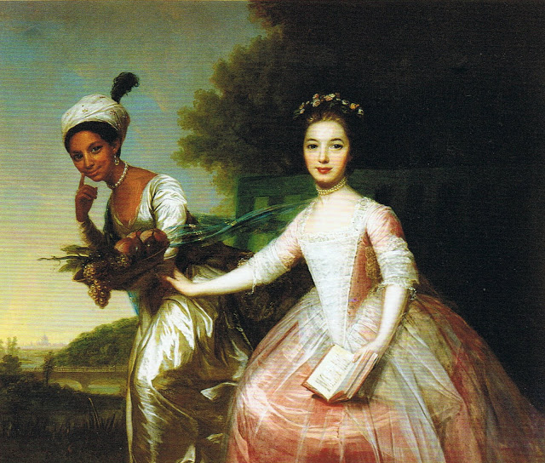
Dido Elizabeth Belle (1761-1804)
Gugu Mbatha-Raw as Dido Elizabeth in Amma Asante’s Belle (2013)
Dido Elizabeth Belle with her cousin Elizabeth Murray at Kenwood House in London,
unattributed 18th century painting, currently in Scone Palace, Perth
Notes:
She was born into slavery; her mother, Maria Belle, was an African slave in the British West Indies. Her father was Sir John Lindsay, a British career naval officer who was stationed there. entrusting her raising to his uncle William Murray, 1st Earl of Mansfield,
Lord Chief Justice, ruled in a significant slavery case, finding in 1772 that slavery had no precedent in common law in England, and had never been authorised under positive law

Slide 29
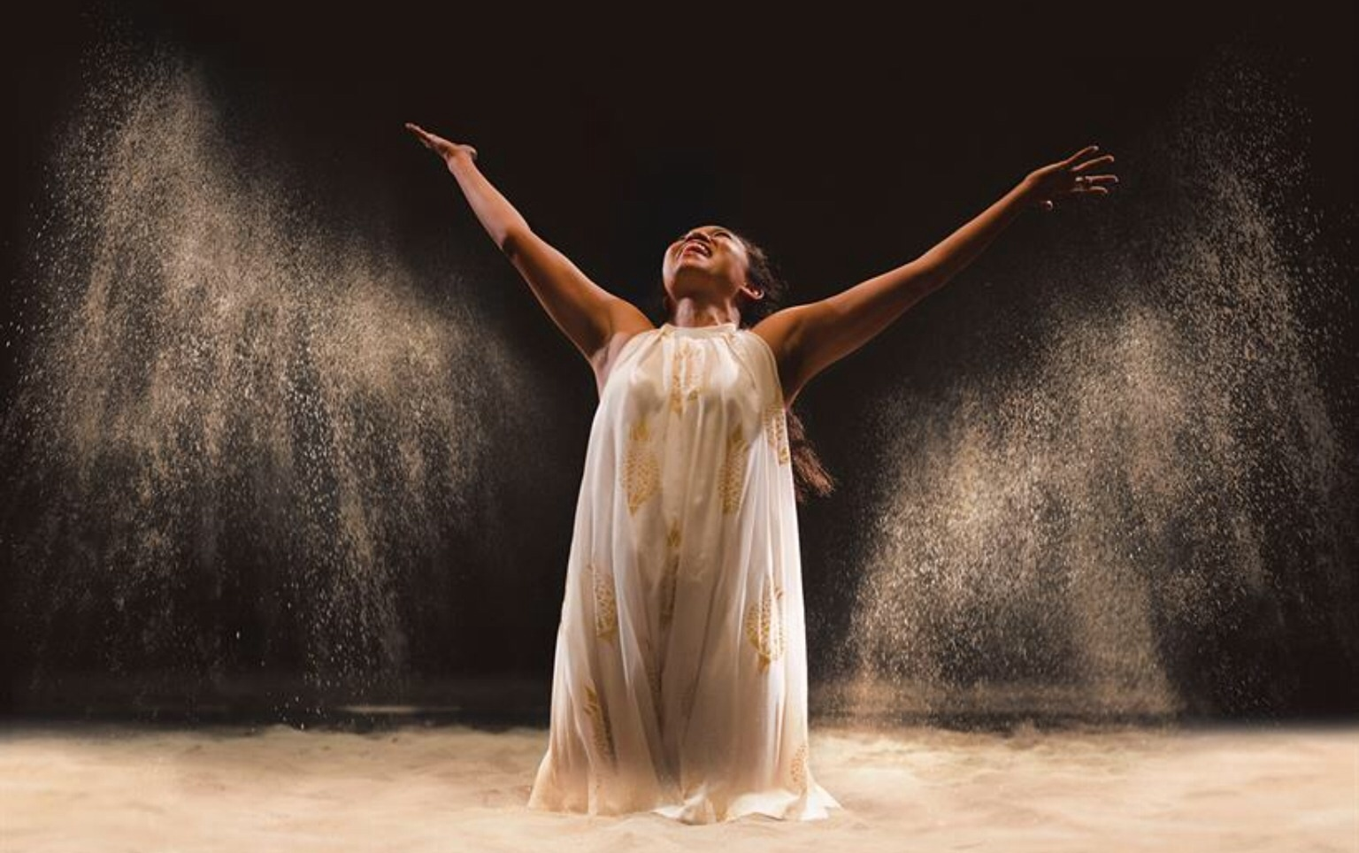
Christopher Marlowe Dido Queen of Carthage, in Kymberley Sykes 2016 RSC Production
«There was a production that happened at the National Theatre some time ago but they sort of whited out the race issue. It was motivated mainly towards people who were interested in the classics, which may have been their main focus. I went and saw it and I was probably the only black person in the audience.»
«I was unsatisfied by it because I’m from Africa and the play is set in Africa, so I didn’t understand why she didn’t seem to be African…»
Chipo Chung on an earlier Dido Production
Chipo Chung as Dido, 2016

Slide 30
Selected Bibliography
Bono, P. and Tessitore, V. M. (1998) Il mito di Didone: Avventure di una regina tra secoli e culture, Milano.
Casali, S. (1999) ‘Facta impia (Virgil, Aeneid 4.596-9)’, CQ 49.1, 203-11.
Cox, F. (2011) Sibylline Sisters: Virgil’s Presence in Contemporary Women’s Writing, Oxford.
Desmond, M. (1994) Reading Dido: Gender, Textuality, and the Medieval Aeneid, Minneapolis and London
Giusti, Elena (2018) Carthage in Virgil’s Aeneid: Staging the Enemy under Augustus, Cambridge.
Haley, Shelley P. (2009) ‘Be Not Afraid of the Dark: Critical Race Theory and Classical Studies’, in Laura Nasrallah and Elisabeth Schüssler Fiorenza (eds.) Prejudice and Christian Beginnings: Investigating Race, Gender and Ethnicity in Early Christian Studies, 27-49, Philadelphia, PA.
Hendricks, Margo (1992) ‘Managing the Barbarian: “The Tragedy of Dido, Queen of Carthage”’, Renaissance Drama n.s. 23, 165-88
Horsfall, N. M. (1973-4), ‘Dido in the Light of History’, PVS 13: 1-13 = (1990) in S. J. Harrison (ed.) Oxford Readings in Vergil’s Aeneid, 127-44, Oxford.
Schiesaro, A. (2008) ‘Furthest Voices in Virgil’s Dido,’ SIFC 100, 60-109 and 194-245.
Starks, J. H. (1999) ‘Fides Aeneia: The Transference of Punic Stereotypes in the Aeneid,’ CJ 94, 255-83.
Giusti, E. and Rimell, V. (eds.) (2021) Vergil and the Feminine, special issue of the journal Vergilius 67.

Slide 31
Thanks For Listening!
`

