Slide 1
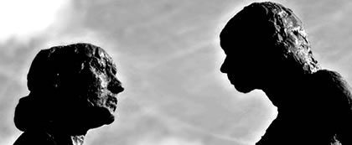
On the face of it: virtue and desire in Seneca Ep.115
Prof. Victoria Rimell
University of Warwick

Slide 2
‘Seneca seems to modify Stoicism slightly for his audience…. [he] propounds a milder Stoicism, which allows the wise man human interaction and, therefore, love. However, love to Seneca is a very pure thing, completely separated from the desires of the body’
‘Seneca is clear on the difference between love and desire’
Barr, Cresswell, Thorley, OCR Classical Civilisation Love and Relationships, ‘Seneca on love and desire’

Slide 3
Body mind desire veneration
Essentially a set-piece of Platonic provenance, …
Alex Dressler (2016) p.138 on Ep.115.3-4

Slide 4
Ep.115.12
Accedunt deinde carmina poetarum, quae adfectibus nostris facem subdant…
Verses of poets also are added to the account – verses which lend fuel to our passions…

Slide 5
Don’t write, feel: 115.1
Quaere, quid scribas, non quemadmodum; Et hoc ipsum: non ut scribas, sed ut sentias, ut illa, quae senseris, magis adplices tibi et velut signes.
You should seek what to write rather than how to write it – and even that not for the purpose of writing but of feeling it, that you might make what you write your own and as it were put a seal on it.

Slide 6
Ep.115.3
Non est ornamentum virile concinnitas
Elegance is not a manly ornament.
Cf. Graver 1998, 615-16, Dressler 2016 p.137
Concinnitas as ‘symmetry’: cf. Cicero Brutus 325, Orator 149; or as ‘excessive refinement’, OLD 1a.

Slide 7
Ornamentum [orno + mentum]
Equipment, costume, ornament, rhetorical-literary ornament, distinction
Compare 115.3, 115.9 (parietibus aut lacunaribus ornamentum, ‘decoration on walls and ceilings’)
OLD, s.v. 1 (‘equipment, accoutrements; esp. an animal’s harness’)
OLD, s.v. 6 (‘distinction, honour’)
Isid. Orig. 19.30.1: ornamenta dicta eo quod eorum cultu ora vultusque decorentur. (‘ornaments are so named because one’s face and appearance are adorned by wearing them’)

Slide 8
115.3: passionate about virtue
If we had the privilege of looking into a good man's soul, oh what a fair, holy, magnificent, gracious, and shining face (faciem) should we behold – radiant on the one side with justice and temperance, on another with bravery and wisdom! And, besides these, thriftiness, moderation, endurance, refinement, affability, and – though hard to believe – love of one's fellow-men, that Good which is so rare in man, all these would be shedding their own glory over that soul. There, too, forethought combined with elegance and, resulting from these, a most excellent greatness of soul (the noblest of all these virtues) – indeed what charm, O ye heavens, what authority and dignity would they contribute! What a wonderful combination of sweetness and power! No one could call such a face lovable (amabilem) without also calling it worshipful (venerabilem)

Slide 9
Aeneid 1.327-8, 330 [Ep.115.5]
…tunc deinde illam Vergilii nostri vocem verens atque attonitus emittat?
O quam te memorem, virgo? namque haut tibi vultus mortalis nec vox hominem sonat . . sis felix nostrumque leves quaecumque laborem.
Should we not, then, in reverence and awe, give utterance to that famous voice of Vergil…
By what name should I call you, maiden? For your face is not mortal, nor does your voice sound human…
Show grace to us, whoever you may be, and lighten this our burden.

Slide 10
Ep.115.6
Nemo, inquam, non amore eius arderet si nobis illam videre contingeret.
Nobody, I tell you, would not burn with love for this (woman/Venus/virtue?)

Slide 11
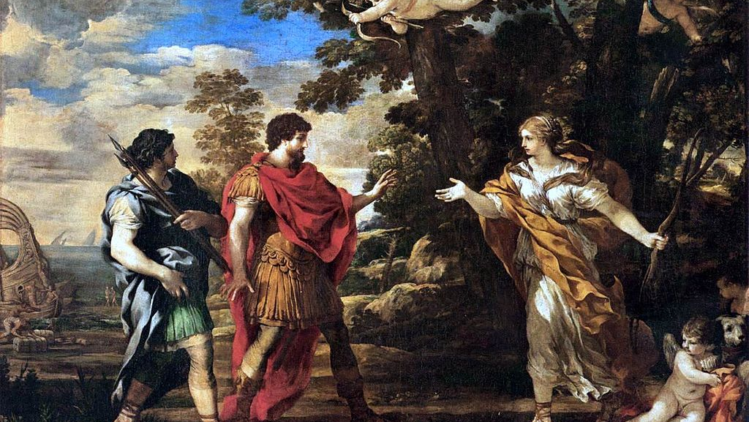
O dea certe?
O quam te memorem, virgo? namque haud tibi vultus
mortalis, nec vox hominem sonat: o dea certe!
Ep.115.5 / Virgil Aen.1.327-8

Slide 12
Themes to develop and discuss in the Letters
Seneca’s Stoic philosophy in dialogue, as a praxis, in the epistolary form
Seneca ‘in context’: the letters, written in political ‘retirement’, are almost completely devoid of cultural-political coordinates. How Neronian are they? How do they deal with themes such as speaking frankly, deception, seduction, materialism as corruption, that have a political force in the early 60s?
Letters as the cultivation of intimacy/friendship in the awareness of distance
The (gendered) ethics of style/body language/dress
The ‘problem’ of desire: but what kind of desire?

Slide 13
More themes in the Letters and in Senecan Stoicism…
The difficult, non-linear ‘learning journey’ of Stoicism, or becoming a Stoic
Emotional regulation as we read
Self-scrutiny, self-awareness and (counter-cultural) critical thinking as a key aspect of the Stoic life
Mind vs/and body
Autonomy vs. dependency: the inseparability of self-interest and the interests of others (oikeosis) in Stoic ethics. What does this mean for relationships, for a person’s sense of self?

Slide 14
Love and Relationships: A key question for debate in Ep.115
Do faces tell the truth in Seneca’s Letters and in Seneca’s Rome? Is ‘poker face’ a valid form of political resistance? [Compare e.g. Ad Polybium 5.4; also see De ira 2.33, Ep.11, Ep.66)
What happens to relationships when we can’t read faces, or when faces are deceptive or inauthentic? Discuss in relation to Aeneas and his mother, and Phaethon and his father, in Ep.115.
How are parent-child relationships thematised here and elsewhere in the Letters (or performed in the Letters themselves, addressed to the younger Lucilius)?

Slide 15
References and further reading
Bartsch, S. 2006. The Mirror of the Self. Sexuality, Self-Knowledge and the Gaze in the Early Roman Empire. Chicago.
Bartsch, S. and Wray, D. eds. 2009. Seneca and the Self, Cambridge.
Bartsch, S. and Schiesaro, A. 2015. The Cambridge Companion to Seneca, Cambridge
Berno, F.R. 2016. ‘Seneca al bivio. Il paradigma di Eracle nelle lettere 66 e 115’ Prometheus 42: 115-22.
Dressler, A. 2016. Personification and the Feminine in Roman Philosophy. Cambridge.
Edwards, C. 1997, ‘Self-scrutiny and self-transformation in Seneca’s letters’, Greece and Rome 44: 23-38
Edwards, C. 2019. Seneca: Selected Letters. Cambridge.
Edwards, C. 2021. ‘Looking for the emperor in Seneca’s Letters’ in Giusti-Geue (eds.) Unspoken Rome, Cambridge, 165-84.
Fögen, T. 2009. ‘Sermo corporis. Ancient reflections on gestus, vultus and vox’ in T. Fögen and M.M. Lee (eds.) Berlin, 15-44.
Graver, M. 1998. ‘The manhandling of Maecenas. Senecan abstractions of masculinity’ TAPA 119.4: 607-32.
Gunderson, E. 2015. The Sublime Seneca. Ethics, Literature, Metaphysics, Cambridge.
Reydams Schils, G. 2005. The Roman Stoics. Self, Responsibility, Affection, Chicago.
Rimell, V. 2015. The Closure of Space in Roman Poetics, Cambridge (chs. on Seneca)
Schafer, J. 2011, ‘Seneca’s Epistulae Morales as dramatised education’ Classical Philology 106: 32-54.
Starnone, V. 2020. Nessuno guarda Elissa. Due passi del primo libro dell’Eneide e il disagio degli interpreti. Biblioteca di Materiali e discussioni per l'analisi dei testi classici 25.

