Slide 1
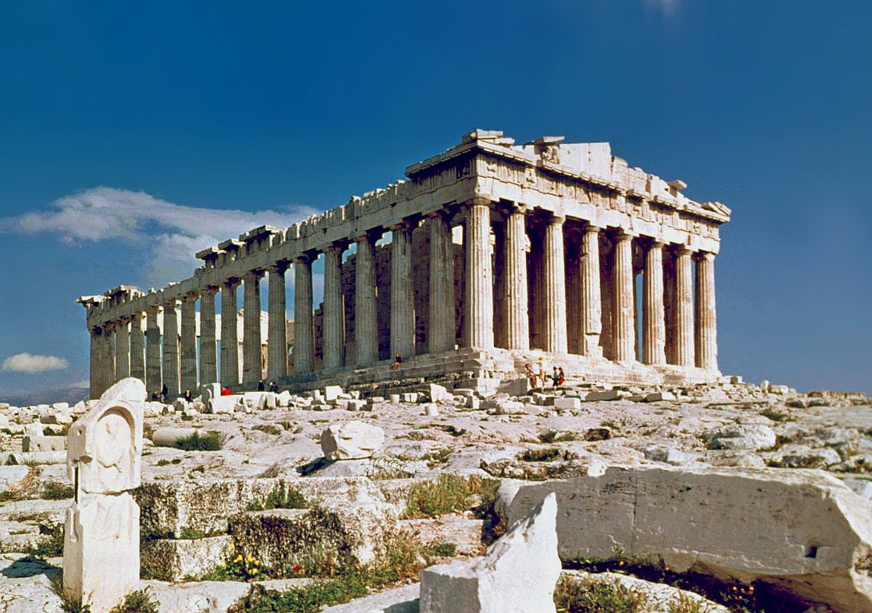
Myths in Greek Art: meanings and approaches
Professor Zahra Newby

Slide 2
Outline
Introduction to ways of approaching myths in Greek Art
Case study on Temple of Zeus
Handling of replica Greek vases
Exekias cup: Dionysus on ocean (Munich)
Euthymides amphora (Munich)

Slide 3
Resources
Web resources:
Beazely Archive Pottery Database: https://www.beazley.ox.ac.uk/carc/pottery
WebLIMC: https://weblimc.org/
Introductions and overviews
Carpenter, C. Art and Myth in Ancient Greece, 1991
Schefold, K. Gods and heroes in late archaic Greek art. 1992.
Shapiro, Myth into Art, 1994.
Woodford, S. The Trojan War in Ancient Art, 1993.
Woodford, S. Images of Myths in Classical Antiquity, 2003
Other studies:
Barringer, J. Art, Myth and Ritual in Classical Greece. 2008.
Giuliani, L. Image and Myth: A history of Pictorial Narration in Greek Art, 2013.
Junker, K. Interpreting the images of Greek Myths. 2012.
Lorenz, K. Ancient mythological images and their interpretation, 2016.

Slide 4
Some central questions/approaches
Iconography: How are myths told in Greek art and how do we recognise them? C.f Woodford, Shapiro, Carpenter.
Philological: How do images compare with texts or other retellings of these myths? Should we look for these overlaps?
Contextual: What did these visual retellings of myth mean in the contexts in which they were set up and viewed? Barringer
For a more theoretical analysis of different approaches to mythological images: Lorenz

Slide 5
How are myths told in images and how do we recognise them?
S. Woodford, Images of Myths in Classical Antiquity, 2003. Esp ch ‘Making myth recognisable’,
S. Woodford, ch in K. Dowden and N. Livingstone, Blackwell Companion to Classical Mythology, 2014
T. Carpenter, Art and Myth in Ancient Greece, A Handbook. Intro.
Labels/ inscriptions
Attributes
Odd situations/juxtapositions of figures?
Reference to literary texts?
C.f. Pausanias on the Chest of Cypselus (Temple of Hera at Olympia)
Is there always a right answer?

Slide 6
Pausanias, Guide to Greece, 5.17.5-19.10.
5.17.5-7 There is also a chest, made of cedar, with figures on it… On most of the figures on the chest there are inscriptions, written in the ancient characters.. Beginning at the bottom we see in the first space of the chest the following scenes. Oenomaus is chasing Pelops who is holding Hippodameia. Each of them has two horses, but those of Pelops have wings. …
5.17.9-11 After the house of Amphiaraus come the games at the funeral of Pelias, with the spectators looking at the competitors. Herakles is seated on a throne and behind him is a woman. There is no inscription saying who the woman is, but she is playing a Phrygian not a Greek flute…. At this point the games come to an end and Herakles with Athena standing beside him, is shooting at the hydra, the beast in the river Amymone. Herakles can be easily recognised by his exploit and his attitude (schemati), so his name is not inscribed by him.
5.19.5. there is also Hermes bringing to Alexander, the son of Priam, the goddesses of whose beauty he is to judge, the inscription on them being ‘Here is Hermes, showing to Alexander that he may arbritrate concerning their beauty, Hera, Athens and Aphrodite’. On what account Artemis has wings on her shoulders I do not know.
5.19.7. The highest space …shows no inscriptions so that we can only conjecture what the reliefs mean. There is a grotto and in it a woman sleeping with a man upon a couch. I was of the opinion that they were Odysseus and Circe, basing my view upon the number of the handmaidens in front of the grotto and what they are doing. For there are four women and they are engaged in the tasks which Homer mentions in his poetry. [c.f Od 10.348f].

Slide 7
How do images compare with texts or other retellings of these myths?
What are the problems with telling stories in images?
How do they differ from telling stories verbally?
Representation of Time and space
Focalisation
How are these overcome in art?
Monoscenic: snapshot view of a single moment
Synoptic: single image which includes references to more than one moment in time
Diachronic: individual images of different episodes in time which collectively tell a story
Continuous narration: different episodes in time placed next to one another, within single composition (generally not in 6-4th BC).
Useful discussion in Stansbury O’Donnell, History of Greek Art, ch 9 on narrative (e-book)

Slide 8
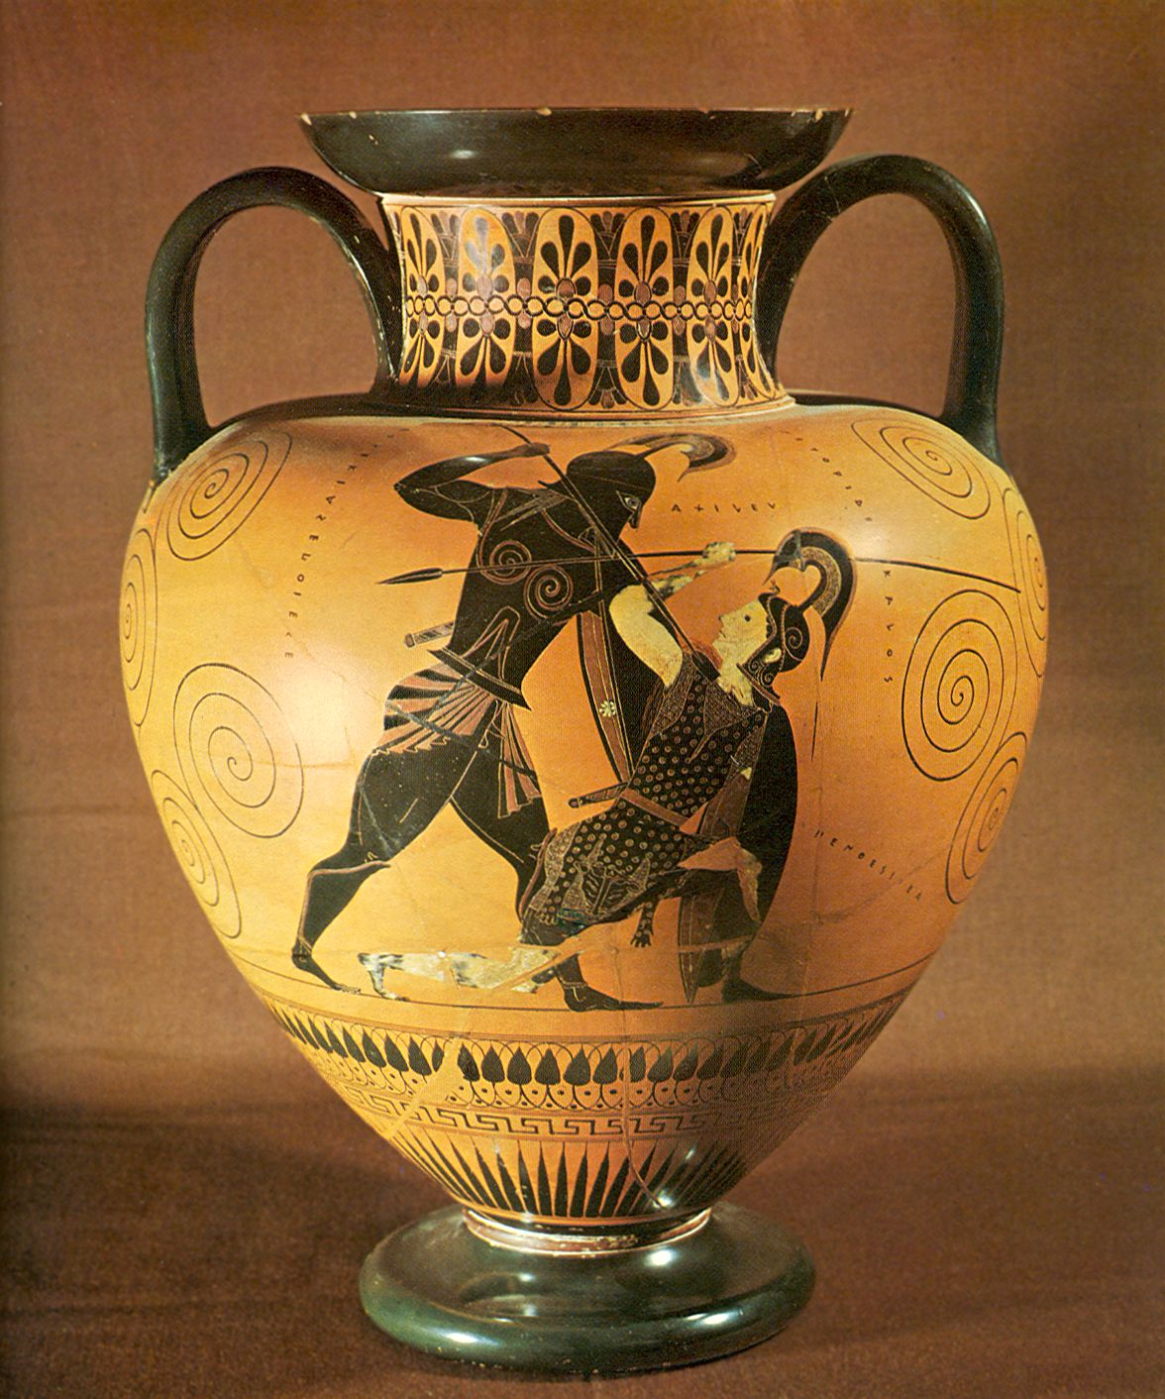
Monoscenic: snapshot view of a single moment
Black-figure amphora, signed by Exekias. c. 530 BC
British Museum, showing Achilles and Penthesilea

Slide 9
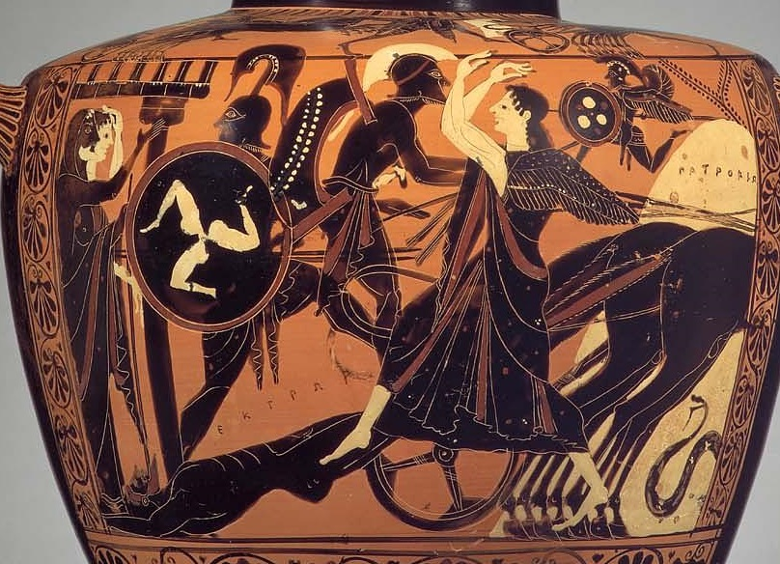
Synoptic:
Black-figure Hydria showing Achilles’ dragging Hector’s body behind his chariot, c. 520-510 BC
Museum of Fine Arts, Boston, inv. 63.473
Photo: museum

Slide 10
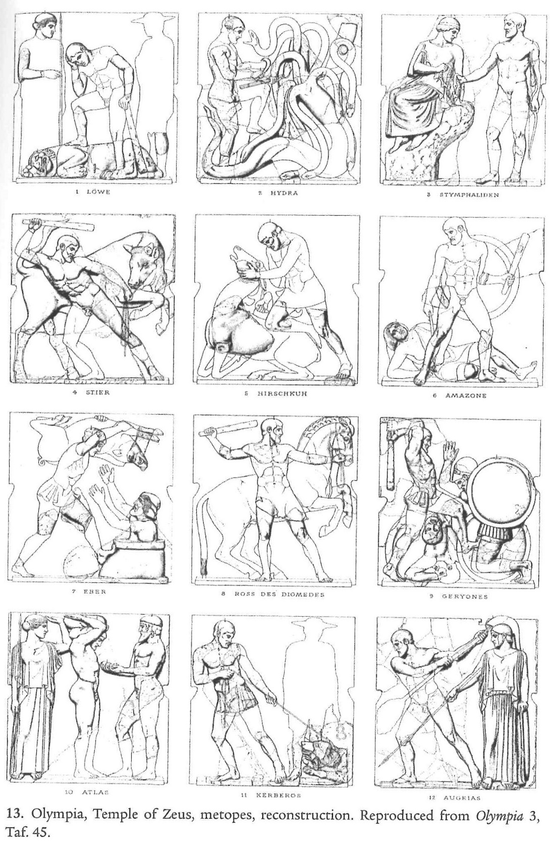
Diachronic: individual images of different episodes in time: .e.g Labours of Herakles on metopes at Olympia.

Slide 11
What did visual retellings of myth mean in the contexts in which they were set up and viewed?
Important things to consider:
Who is involved in the creation of meaning? – Artist, patron, viewer
How do myths in art relate to myths in drama/literature? Do they have the same meanings?
To what extent are workshop practices etc responsible for ways myths are depicted – how much should we read into them?
What were the constraints of the medium – are particular myths shown in particular ways due to compositional factors etc?
What do myths mean more generally in these societies?

Slide 12
Myths in Sanctuaries
Piety or Politics?
Moral warnings? Praise of the gods? Origins of rituals?
How do they speak to the viewer?

Slide 13
Temple of Zeus at Olympia Pausanias, Guide to Greece 5.10.2-10
The temple and the image were made for Zeus from spoils, when Pisa was crushed in war by the Eleans, and with Pisa such of the subject peoples as conspired together with her. The image itself was wrought by Pheidias, as is testified by an inscription written under the feet of Zeus: Pheidias, son of Charmides, an Athenian, made me.

Slide 14
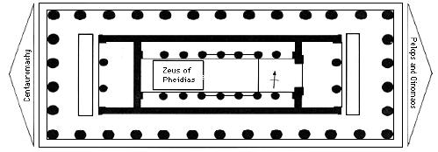
Completed 457 BC; 27.68 x 64.12 m, 13 x 6 columns, largest in Peloponnese. Limestone with marble metopes and pedimental sculptures.

Slide 15
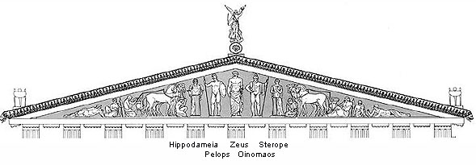
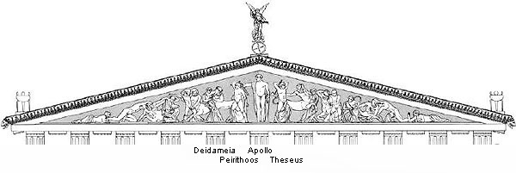

Slide 16
East Pediment: Pausanias, 5.10.6-7
To come to the pediments: in the front pediment there is, not yet begun, the chariot-race between Pelops and Oenomaus, and preparation for the actual race is being made by both. An image of Zeus has been carved in about the middle of the pediment; on the right of Zeus is Oenomaus with a helmet on his head, and by him Sterope his wife, who was one of the daughters of Atlas. Myrtilus too, the charioteer of Oenomaus, sits in front of the horses, which are four in number. After him are two men. They have no names, but they too must be under orders from Oenomaus to attend to the horses. At the very edge lies Cladeus, the river which, in other ways also, the Eleans honour most after the Alpheius. On the left from Zeus are Pelops, Hippodameia, the charioteer of Pelops, horses, and two men, who are apparently grooms of Pelops. Then the pediment narrows again, and in this part of it is represented the Alpheius. The name of the charioteer of Pelops is, according to the account of the Troezenians, Sphaerus, but the guide at Olympia called him Cillas.
The sculptures in the front pediment are by Paeonius, who came from Mende in Thrace

Slide 17
Problems of reconstruction: Pausanias’ right/left
on the right of Zeus is Oenomaus... On the left from Zeus are Pelops, Hippodameia…
Reconstruction as per A. Stewart.

Slide 18
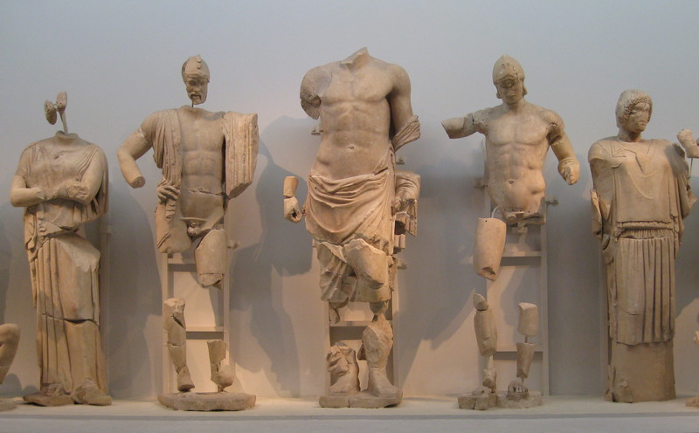
Reconstruction in Olympia Museum: Sterope, Oinomaus, Zeus, Pelops, Hippodameia.
Zeus looking towards his right? Might support Stewart’s recon… (favour)

Slide 19
Which version of the myth?
Pelops wins with winged horses given by Poseidon: Pindar Olympian 1
‘Because of that the immortals sent the son of Tantalus back again to the swift-doomed race of men. And when he blossomed with the stature of fair youth, and down darkened his cheek, he turned his thoughts to an available marriage, to win glorious Hippodameia from her father, the lord of Pisa. He drew near to the gray sea, alone in the darkness, and called aloud on the deep-roaring god, skilled with the trident; and the god appeared to him, close at hand. Pelops said to the god, “If the loving gifts of Cyprian Aphrodite result in any gratitude, Poseidon, then restrain the bronze spear of Oenomaus, and speed me in the swiftest chariot to Elis, and bring me to victory…”. So he spoke, and he did not touch on words that were unaccomplished. Honouring him, the god gave him a golden chariot, and horses with untiring wings. He overcame the might of Oenomaus, and took the girl as his bride.
Or by treachery? Bribing Myrilus, the charioteer
Pherekydes, c. 440BC (FGkH 3 F 37)
Apollonius Rhodius, Argonautica 1.752-8
And therein were fashioned two chariots, racing, and the one in front Pelops was guiding, as he shook the reins, and with him was Hippodameia at his side, and in pursuit Myrtilus urged his steeds, and with him Oenomaus had grasped his couched spear, but fell as the axle swerved and broke in the nave, while he was eager to pierce the back of Pelops.

Slide 20
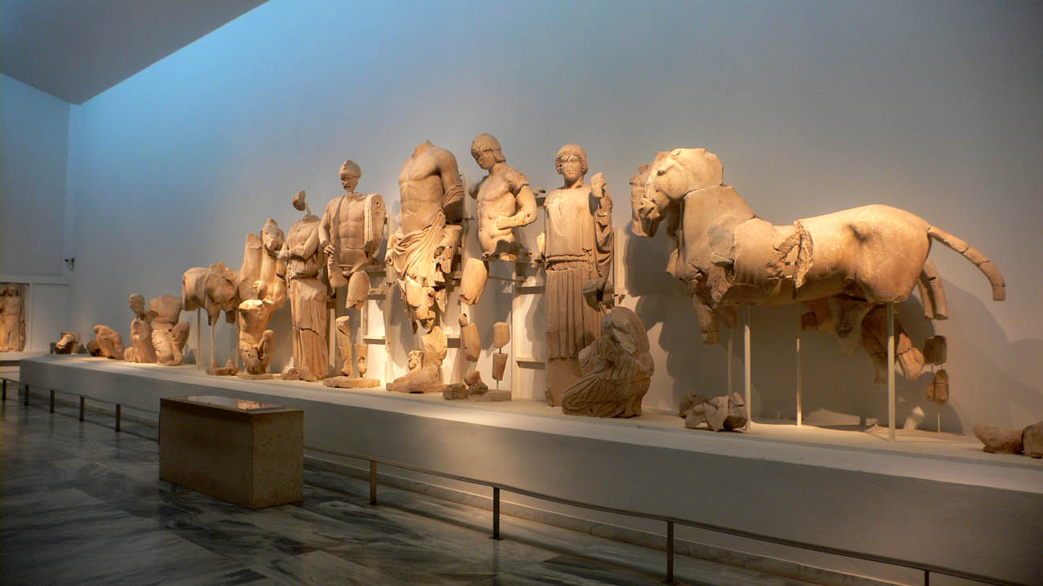
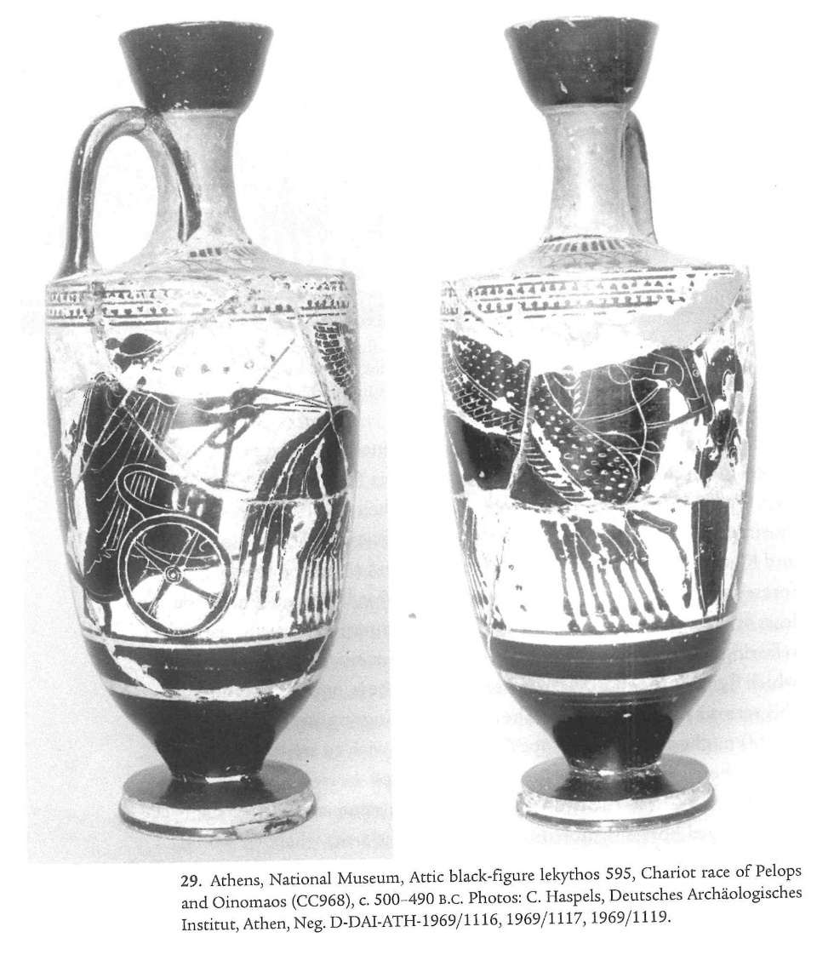
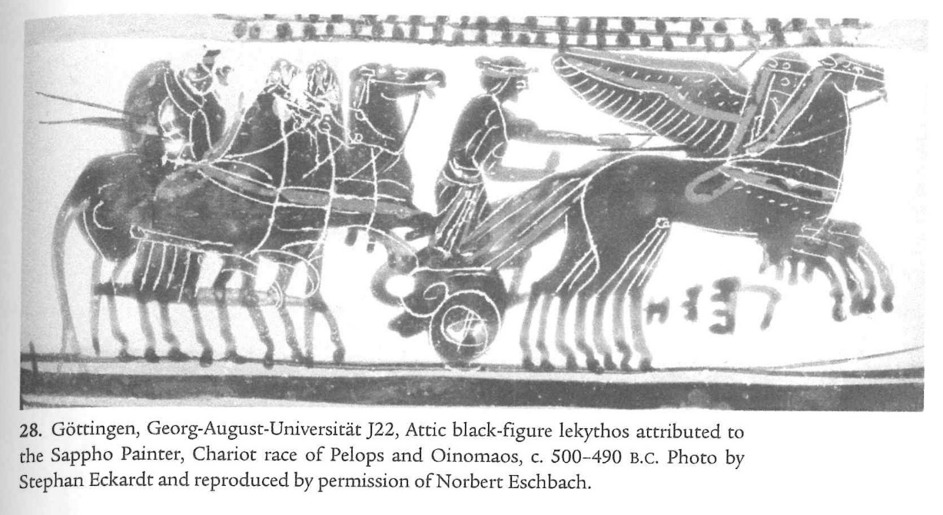
Winged horses on black figure lekythoi from Athens, c. 500-490 BC but unclear if shown here

Slide 21
Potential meanings
Praise of Pelops – important hero in the sanctuary and one of those credited with founding the games
Central role of Zeus – honours him above entrance to his temple (c.f. Parthenon with Birth of Athena)
Warning re cheating?
Centrality of the chariot race in the Olympic games

Slide 22
West pediment: Centauromachy

Slide 23
Those in the back pediment are by Alcamenes, a contemporary of Pheidias, ranking next after him for skill as a sculptor. What he carved on the pediment is the fight between the Lapithae and the Centaurs at the marriage of Peirithous. In the center of the pediment is Peirithous. On one side of him is Eurytion, who has seized the wife of Peirithous, with Caeneus bringing help to Peirithous, and on the other side is Theseus defending himself against the Centaurs with an axe. One Centaur has seized a maid, another a boy in the prime of youth. Alcamenes, I think, carved this scene, because he had learned from Homer's poem that Peirithous was a son of Zeus, and because he knew that Theseus was a great grandson of Pelops. (Paus. 5.10.8)

Slide 24
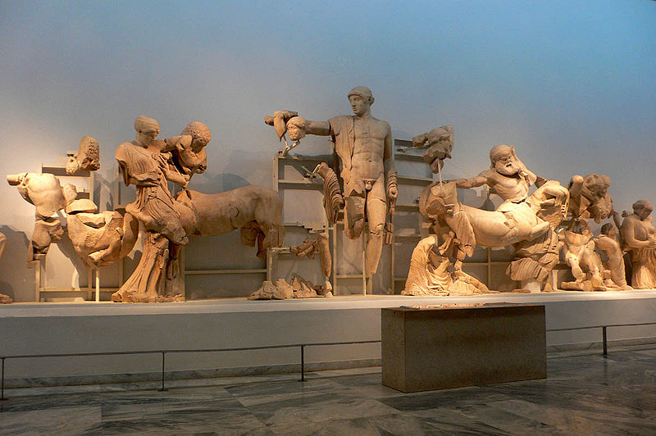
Genealogy?
Power of order over disorder? Metaphor for Persian wars?
Resonances with athletic and ritual activities (cf Barringer link with races of girls for Demeter)
Centre: Apollo (contra Pausanias)

Slide 25
Metopes
Most of the labours of Heracles are represented at Olympia. Above the doors of the temple is carved the hunting of the Arcadian boar, his exploit against Diomedes the Thracian, and that against Geryones at Erytheia; he is also about to receive the burden of Atlas, and he cleanses the land from dung for the Eleans. Above the doors of the rear chamber he is taking the girdle from the Amazon; and there are the affairs of the deer, of the bull at Cnossus, of the Stymphalian birds, of the hydra, and of the Argive lion. (Paus. 5.10.9)

Slide 26
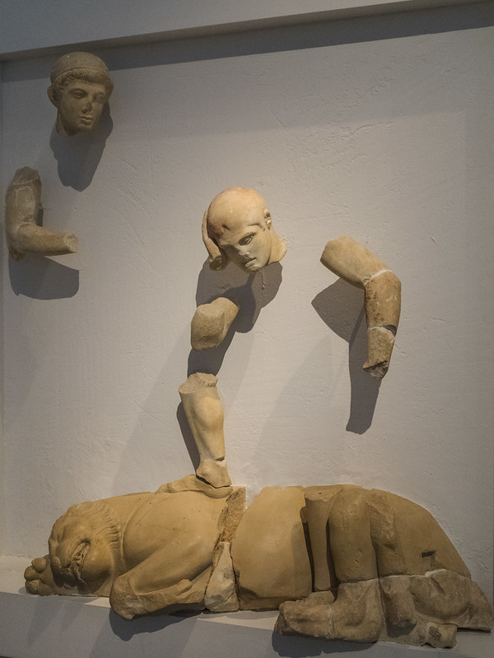
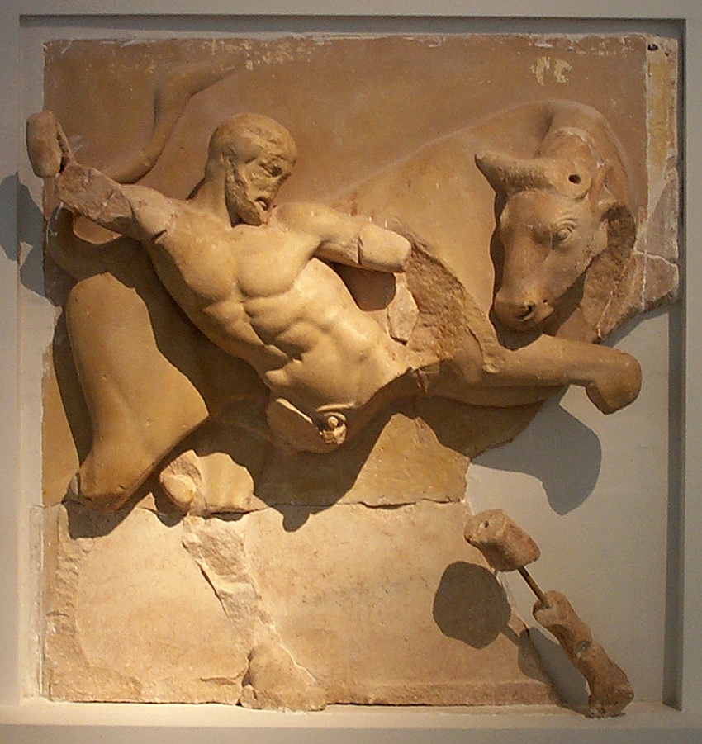
First representation of all 12 labours in art
Chronological development of Herakles from beardless youth to Bearded figure

Slide 27
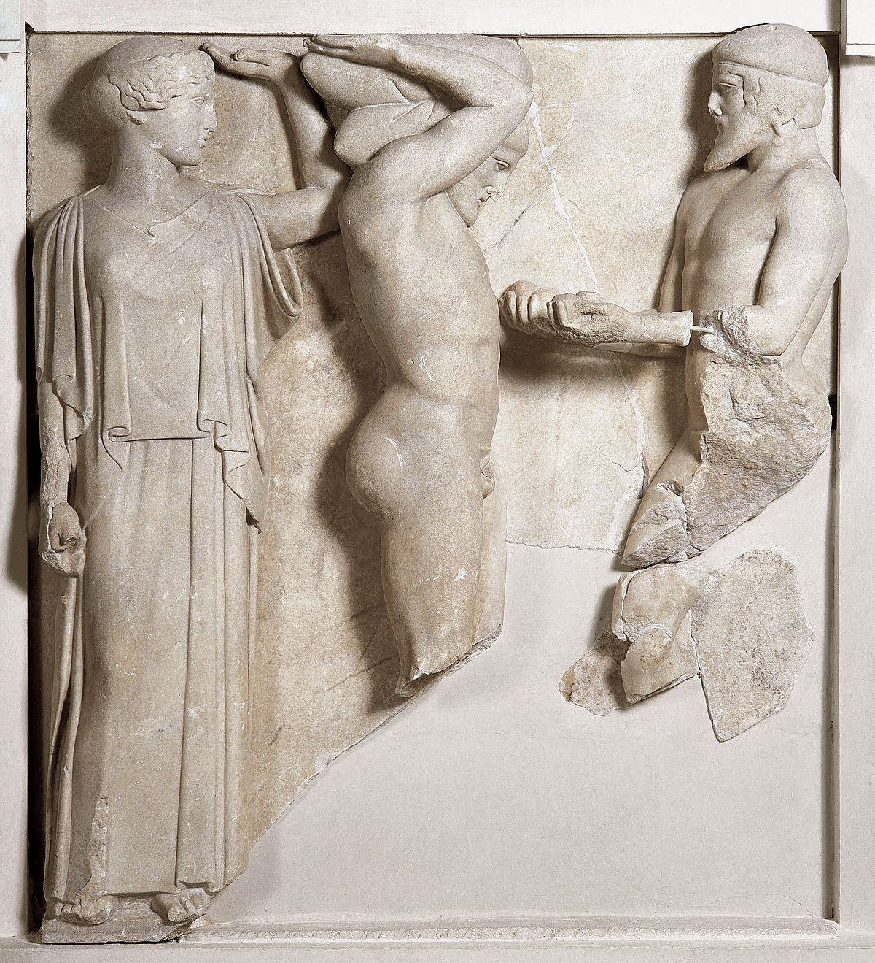
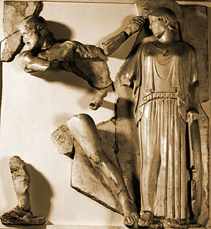

Slide 28
Histories of the Games according to Pausanias:
[5.7.6] As for the Olympic games, the most learned antiquaries of Elis say that Cronus was the first king of heaven, and that in his honor a temple was built in Olympia by the men of that age, who were named the Golden Race. When Zeus was born, Rhea entrusted the guardianship of her son to the Dactyls of Ida, who are the same as those called Curetes. They came from Cretan Ida – Heracles, Paeonaeus, Epimedes, Iasius and Idas.
[5.7.9] Heracles of Ida, therefore, has the reputation of being the first to have held, on the occasion I mentioned, the games, and to have called them Olympic. So he established the custom of holding them every fifth¹⁵ year, because he and his brothers were five in number.
[5.7.10] Now some say that Zeus wrestled here with Cronus himself for the throne, while others say that he held the games in honor of his victory over Cronus. The record of victors include Apollo, who outran Hermes and beat Ares at boxing. It is for this reason, they say, that the Pythian flute-song is played while the competitors in the pentathlum are jumping; for the flute-song is sacred to Apollo, and Apollo won Olympic victories.
[5.8.2] And about a generation later than Endymion, Pelops held the games in honor of Olympian Zeus in a more splendid manner than any of his predecessors. When the sons of Pelops were scattered from Elis over all the rest of Peloponnesus, Amythaon, the son of Cretheus, and cousin of Endymion on his father's side (for they say that Aethlius too was the son of Aeolus, though supposed to be a son of Zeus), held the Olympian games, and after him Pelias and Neleus in common.
[5.8.3] Augeas too held them, and likewise Heracles, the son of Amphitryon, after the conquest of Elis. The victors crowned by Heracles include Iolaus, who won with the mares of Heracles.
[5.8.4] Moreover, Iolaus used to be charioteer to Heracles. So Iolaus won the chariot-race, and Iasius, an Arcadian, the horse-race; while of the sons of Tyndareus one won the foot-race and Polydeuces the boxing-match. Of Heracles himself it is said that he won victories at wrestling and the pancratium.

Slide 29
Possible readings:
Praise of Zeus
History of the Games
Moral messages
Resonances with activities in the sanctuaries
Models of manhood.
Some useful discussions:
Barringer, J. 2005. ‘The Temple of Zeus at Olympia, Heroes, and Athletes’, Hesperia: 74, no. 2, (2005), pp. 211–241. JSTOR, www.jstor.org/stable/25067954.
Barringer, J. 2008. Art, myth, and ritual in classical Greece. Ch 1.
Westervelt, H. ‘Herakles at Olympia’ in P. Schulz and R. von den Hoff eds., Structure, Image, Ornament: Architectural Sculpture in the Greek World. Oxford: Oxbow. 2009: 133-52.

