Slide 1
‘From Emperors to Slaves: Inscriptions in the Roman World’
Alison Cooley
Dept of Classics & Ancient History
University of Warwick

Slide 2
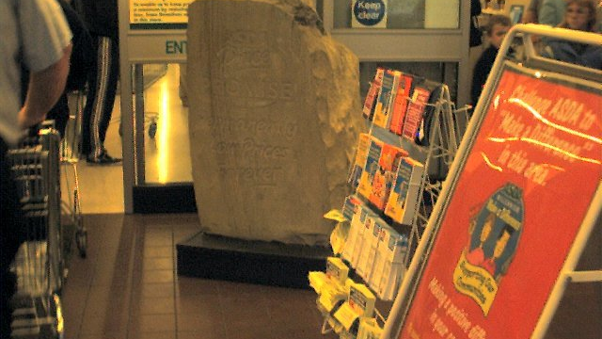
‘Asda Price Promise. Permanently low prices forever’

Slide 3
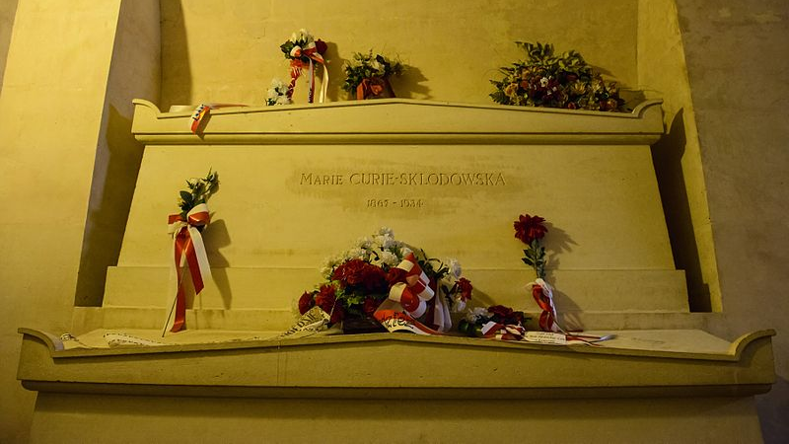
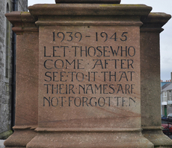
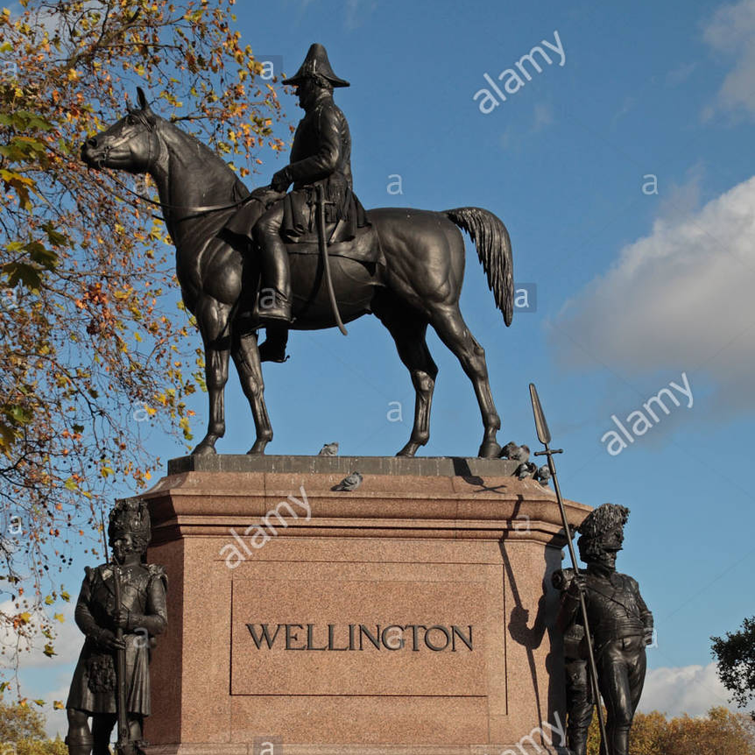

Public writing today

Slide 4
A quick question
Can you think of an example of the display of writing in the modern world?
Please jot it down/ remember it for the end of this session.

Slide 5
Res Gestae divi Augusti Achievements of the deified Augustus
Below is a copy of the achievements of the deified Augustus, by which he made the world subject to the rule of the Roman people, and of the expenses which he incurred for the state and people of Rome, as inscribed upon two bronze columns which have been set up at Rome.

Slide 6
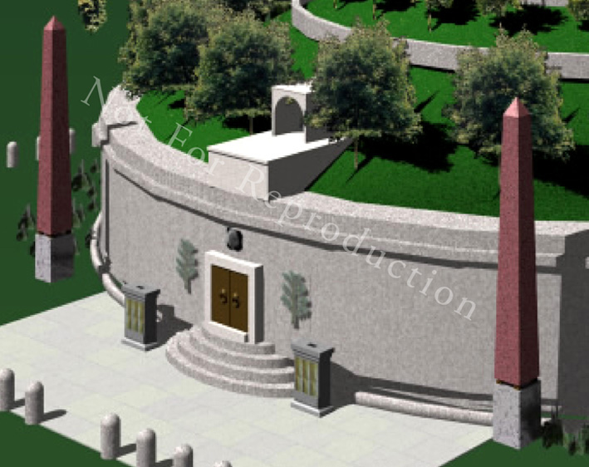
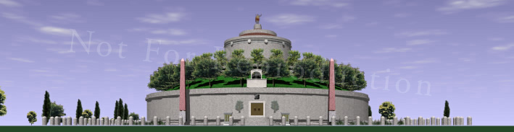
Res Gestae at Augustus’ Mausoleum – a reconstruction

Slide 7
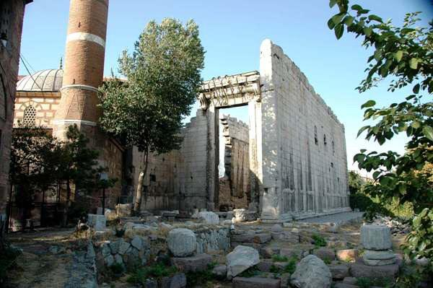
Temple of Rome and Augustus, Ancyra

Slide 8
The whole truth?
RGDA 25.1
I brought the sea under control from pirates. In this war I handed back to their masters for punishment almost 30,000 captured slaves who had run away from their masters and taken up arms against the state.

Slide 9
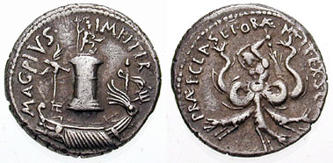
Sextus Pompey: pirate?
MAG PIVS IMP ITER
‘Great, loyal, commander for a second time’
[ship with eagle, sceptre, and trident in front of column decorated with a statue of Neptune]
PRAEF CLAS ET ORAE MARIT EX S C ‘commander of the fleet and coasts’
[Scylla, wielding a rudder as a club]

Slide 10
Augustus’ self-presentation: World Conquest
RGDA heading:
‘Below is a copy of the achievements of the deified Augustus by which he made the world subject to the rule of the Roman people’
RGDA 32:
‘Kings of the Parthians, namely Tiridates and later Phrates, son of king Phrates, Artavasdes king of the Medes, Artaxares of the Adiabenians, Dumnobellaunus and Tincomarus of the Britons, Maelo of the Sugambri, Segimerus of the Suebic Marcomanni fled for refuge to me as suppliants.’

Slide 11
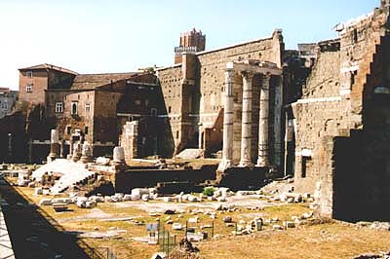
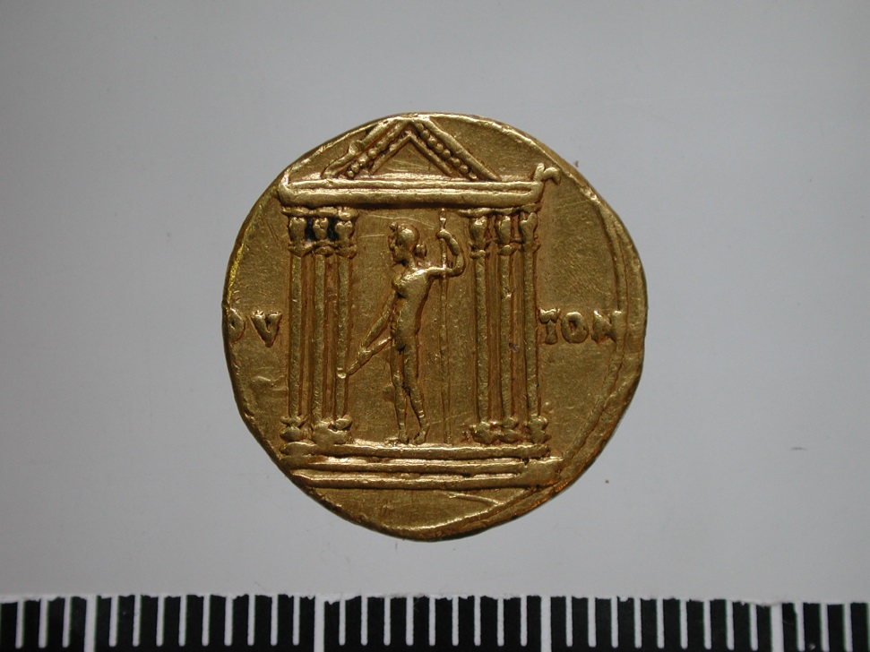
Augustus’ self-presentation: Transformation of city of Rome
Temple of Jupiter the Thunderer
Temple of Mars the Avenger in Forum of Augustus

Slide 12
Augustus’ self-presentation: Restoring religion
RGDA 7.3:
‘I have been chief priest, augur, one of the Fifteen for conducting sacred rites, one of the Seven in charge of feasts, Arval brother, member of the fraternity of Titus, and fetial priest.

Slide 13
Augustus’ self-presentation: Restoring constitutional government
RGDA 5.1
‘Even though the post of dictator was conferred upon me both when I was absent and when I was present by both people and senate in the consulship of Marcus Marcellus and Lucius Arruntius, I did not accept it.’
RGDA 6.1:
‘I accepted no magistracy conferred upon me that contravened ancestral custom’

Slide 14
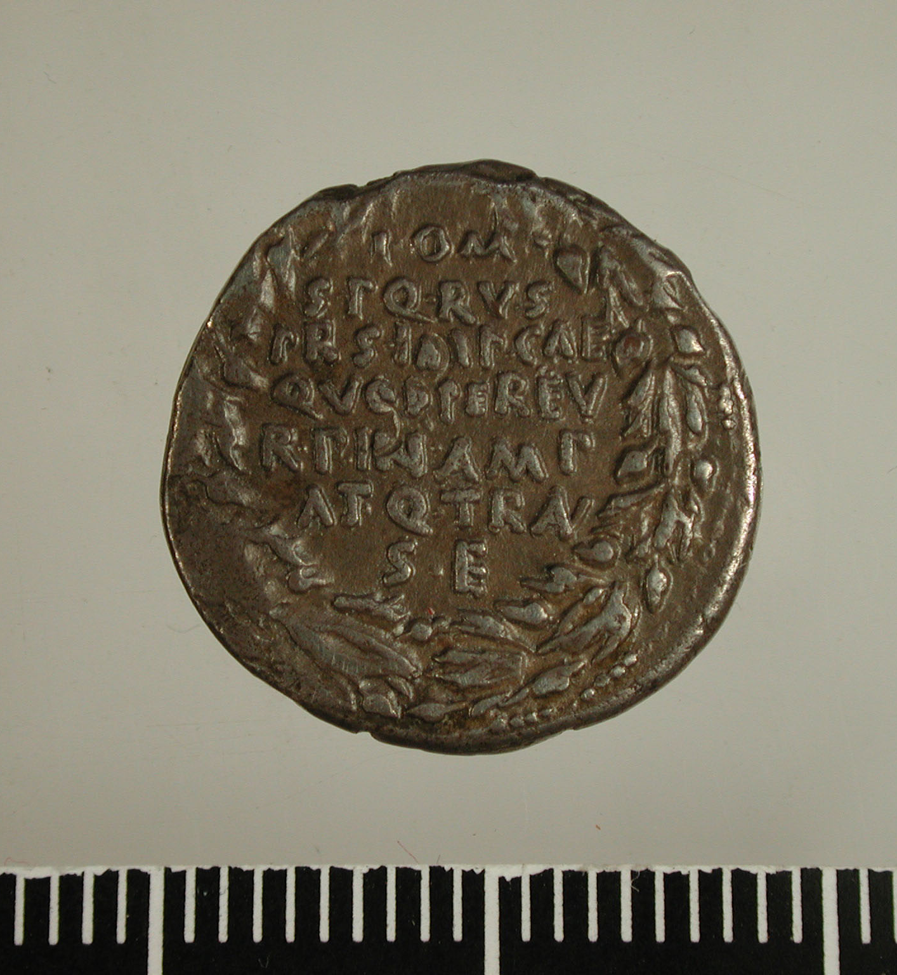
Restoring constitutional government
‘through him, the state is in a greater and more peaceful condition’
LACTOR L10. BM Coins Rom. Emp. I 17-18 nos 91-94

Slide 15
Senate and people of Rome
RGDA 14.1:
‘My sons, whom fortune snatched away from me when young men, Gaius and Lucius Caesar, the senate and people of Rome appointed as consuls when they were fourteen years old, as a way of honouring me’
RGDA 35.1:
‘When I was holding my thirteenth consulship, the Roman senate and equestrian order and people all together hailed me as father of the country’

Slide 16
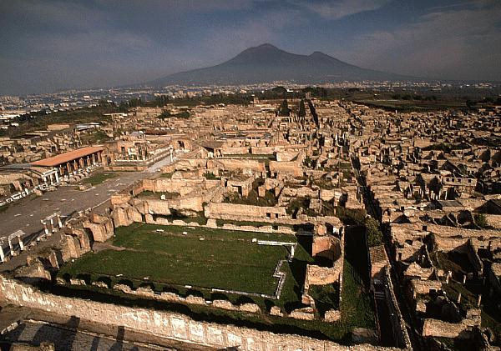
Inscriptions at Pompeii

Slide 17
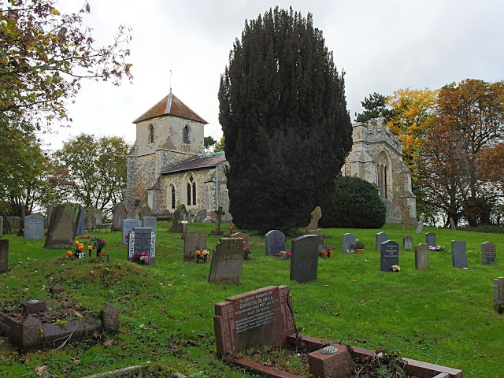
A modern churchyard

Slide 18
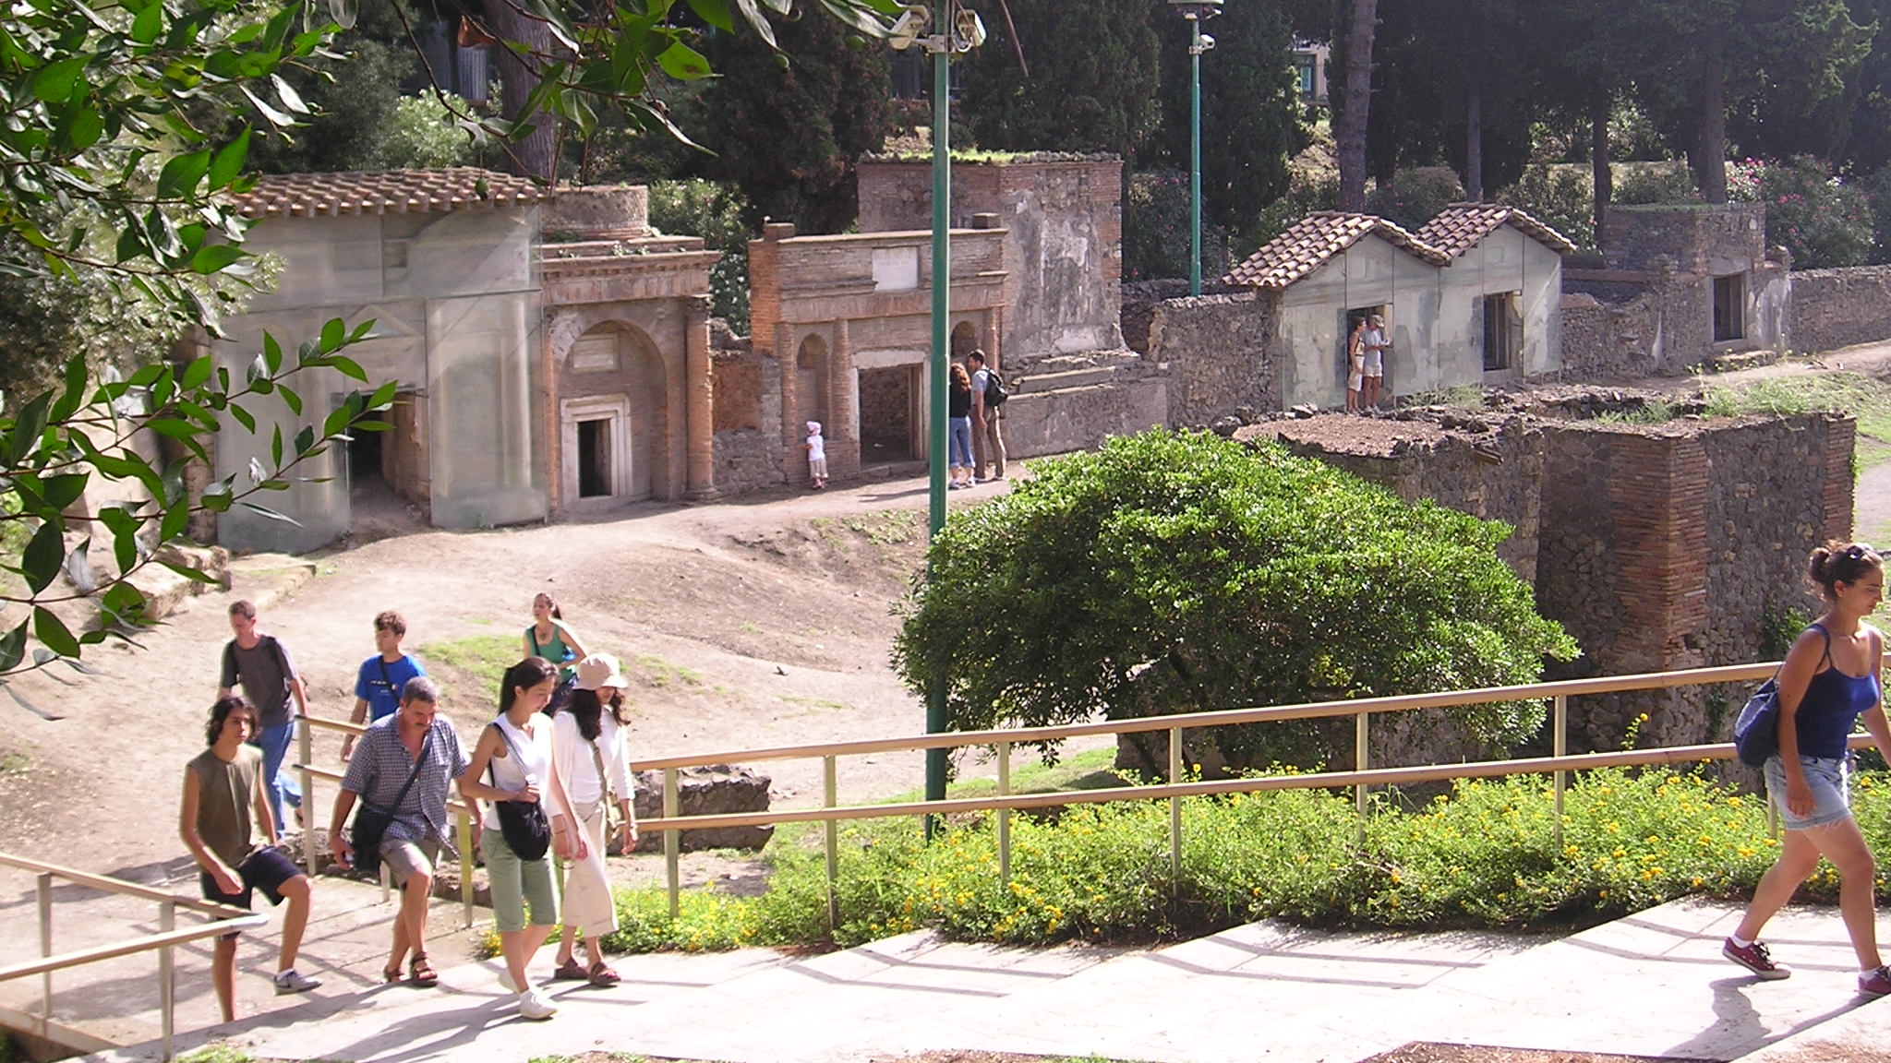
Pompeii, Street of Tombs outside Nucerian Gate

Slide 19
Tomb of Munatius Faustus
Gaius Munatius Faustus, Augustalis and Country-District Dweller by decree of the councillors, to himself and to his wife, Naevoleia Tyche.

Slide 20
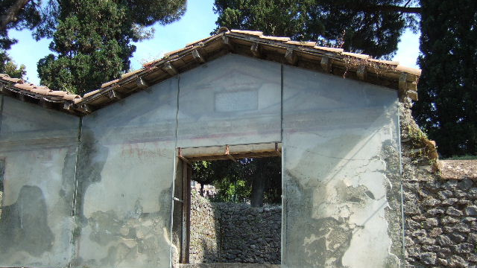
Tomb of Munatius Faustus, outside Nucerian Gate

Slide 21
Pompeii, Street of Tombs outside Nucerian Gate

Slide 22
Tomb set up by Naevoleia Tyche
Naevoleia Tyche, freedwoman of Lucius, for herself and for Gaius Munatius Faustus, Augustalis and Country-District Dweller, to whom the town councillors with the consent of the people decreed an honorific chair for his merits. Naevoleia Tyche had this monument made in her lifetime for her own freedmen and freedwomen and those of Gaius Munatius Faustus.

Slide 23
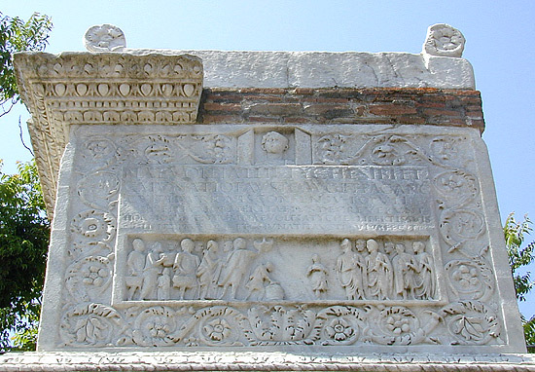
Naevoleia Tyche’s tomb: Front

Slide 24
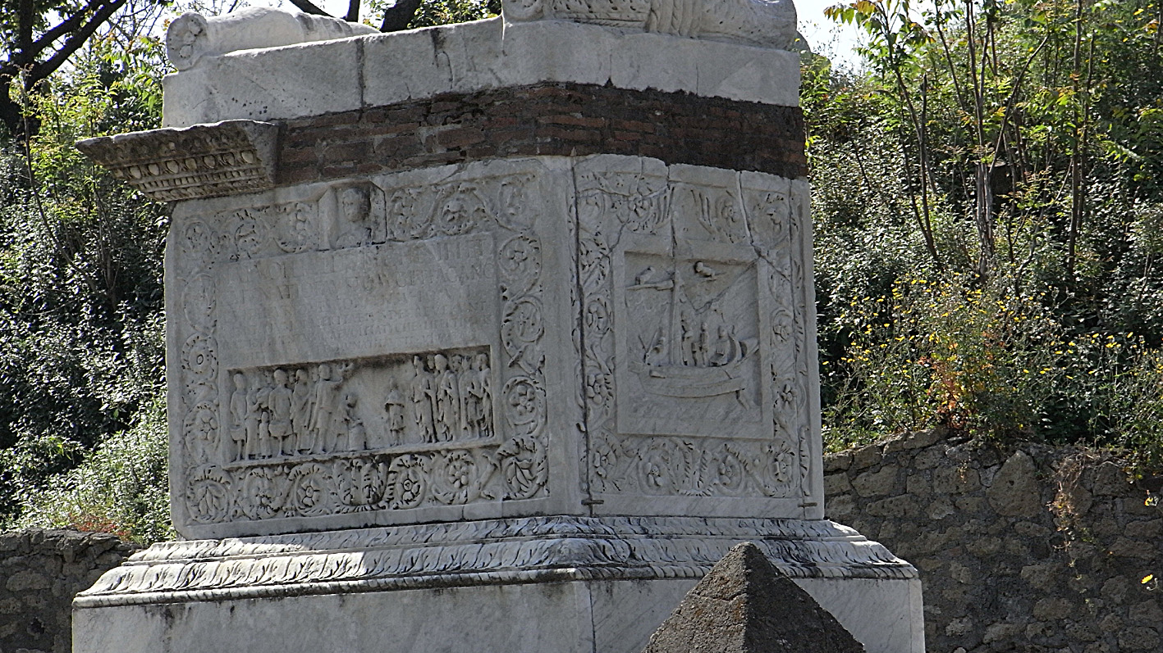
Naevoleia Tyche’s tomb – front & right side

Slide 25
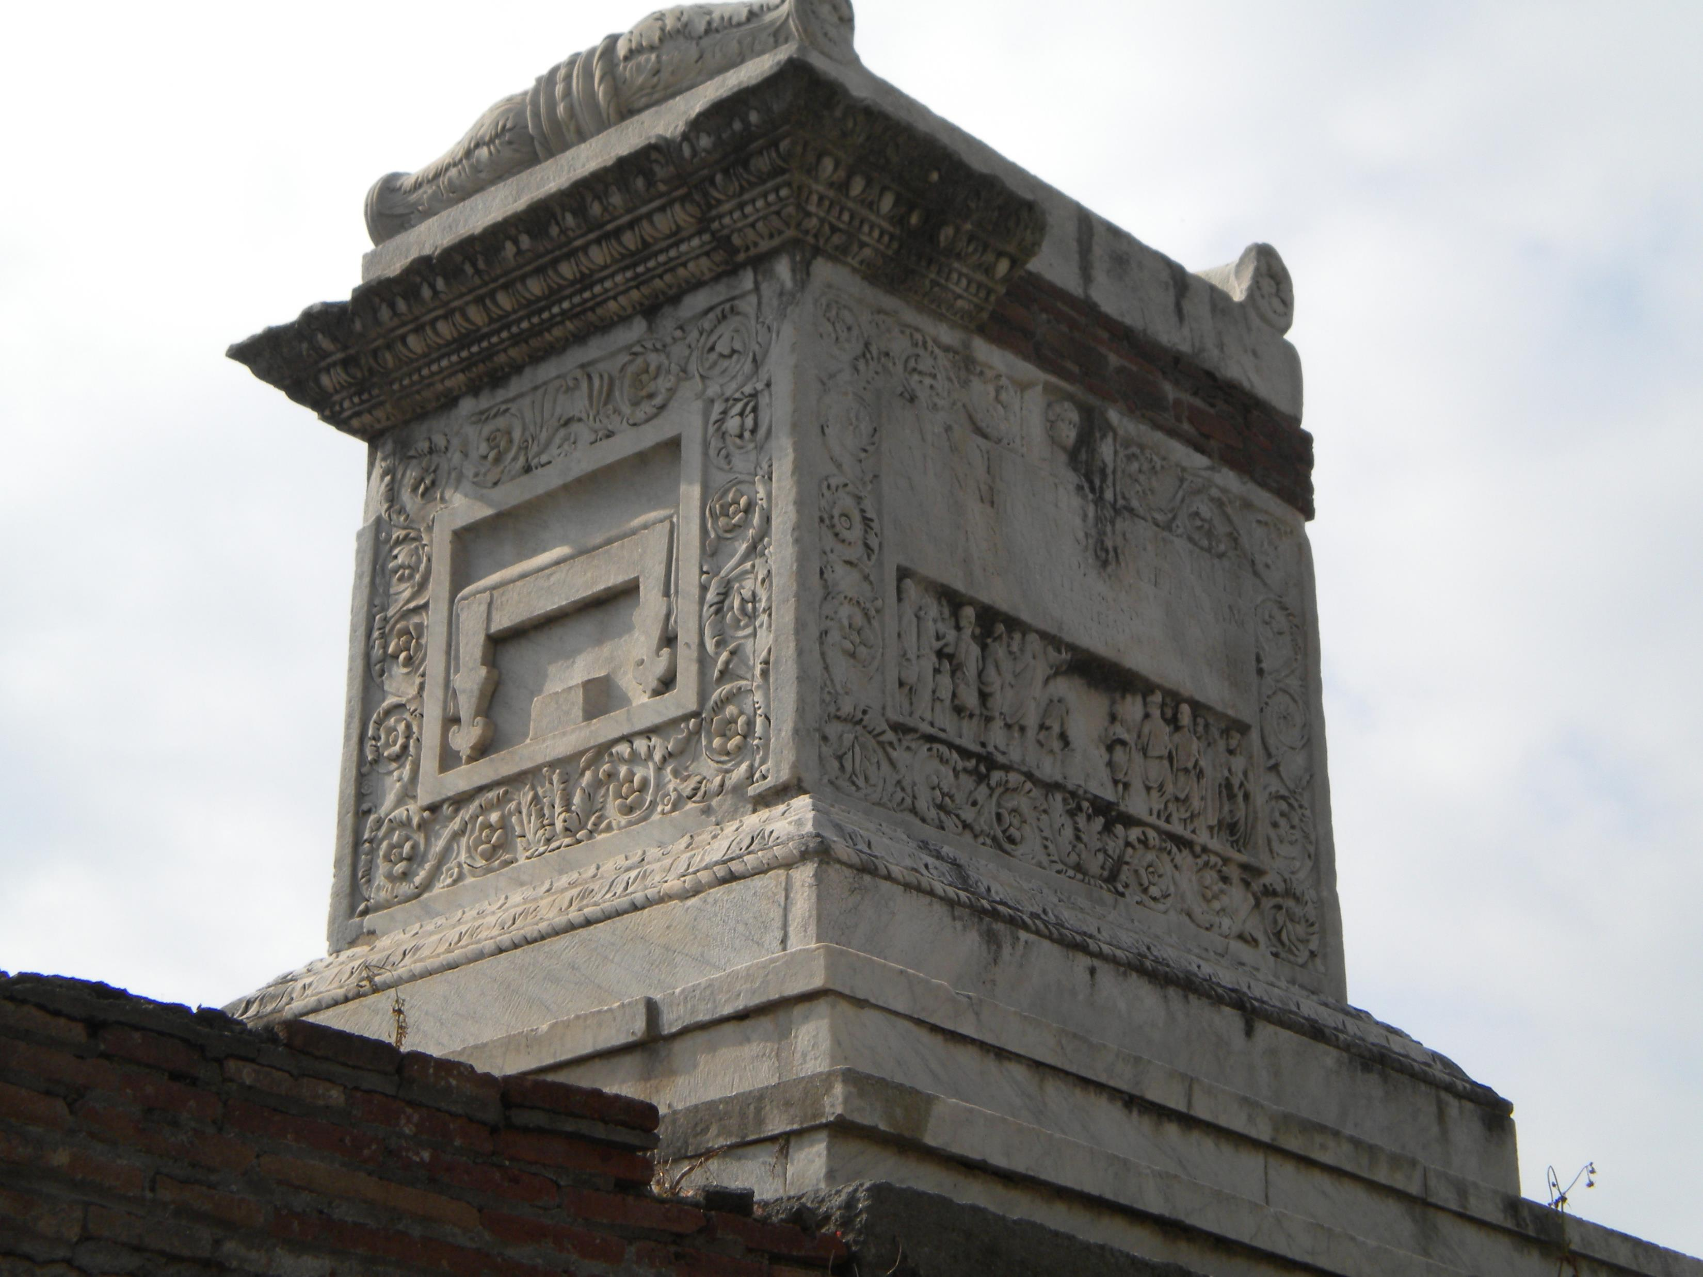
Naevoleia Tyche’s tomb: front and left side

Slide 26
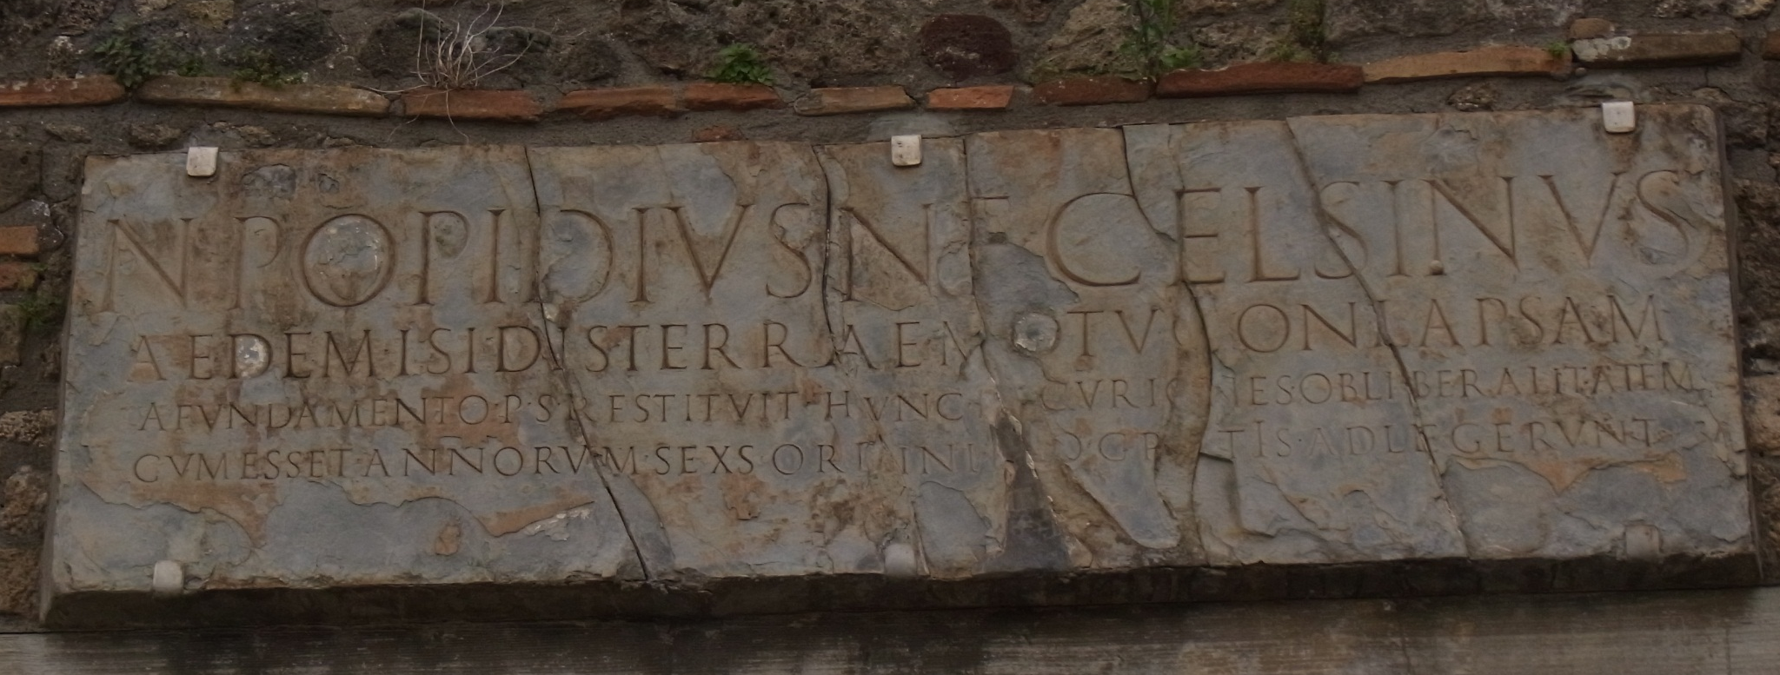
Temple of Isis
Numerius Popidius Celsinus, son of Numerius, rebuilt at his own expense from its foundations the Temple of Isis, which had collapsed in an earthquake; because of his generosity, although he was only six years old, the town councillors nominated him into their number free of charge.

Slide 27
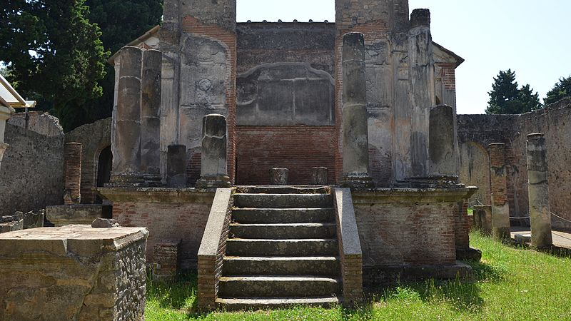
Temple of Isis, interior

Slide 28
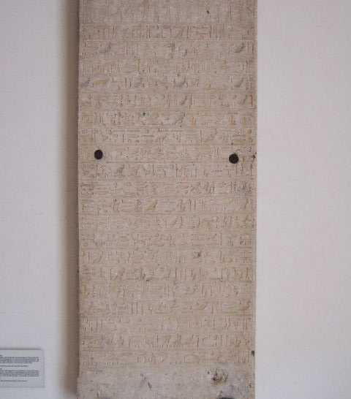
Hieroglyphic stele

Slide 29
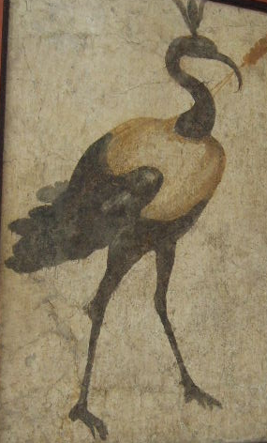
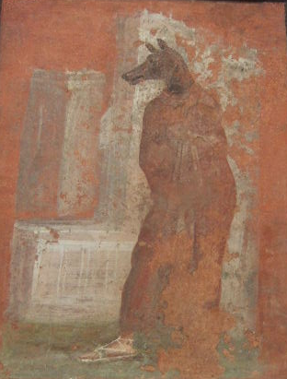
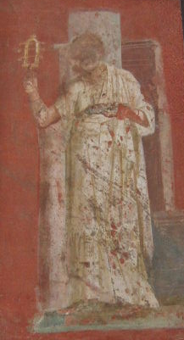
Paintings from Temple of Isis

Slide 30
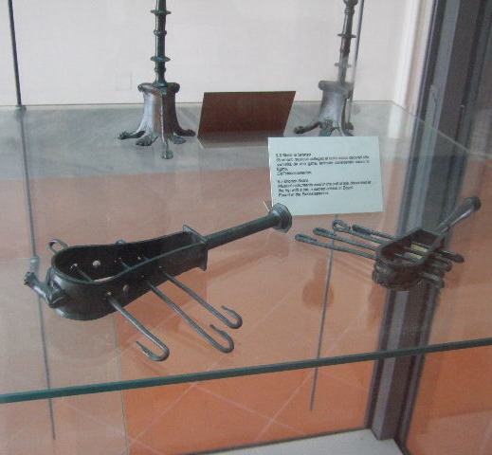
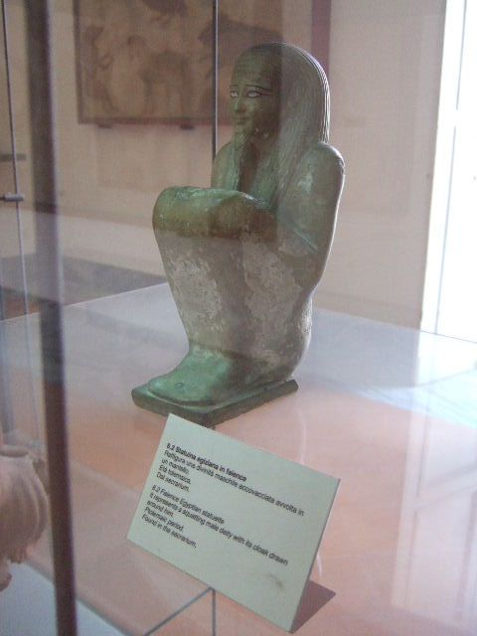
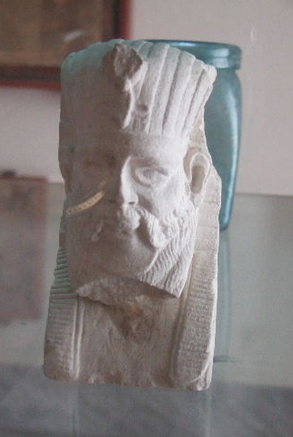
Egyptian finds from Temple of Isis

Slide 31
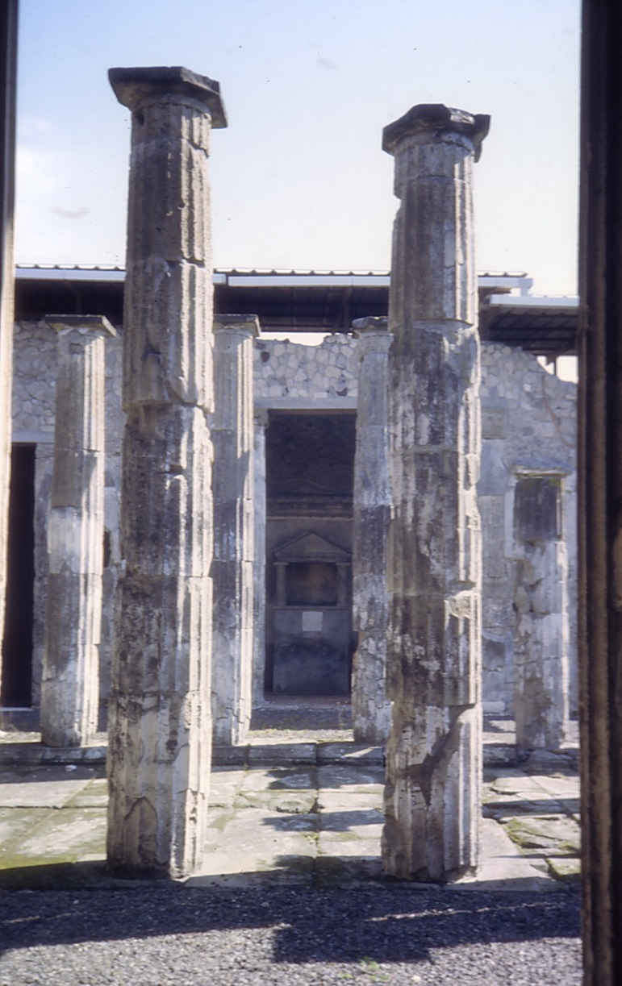
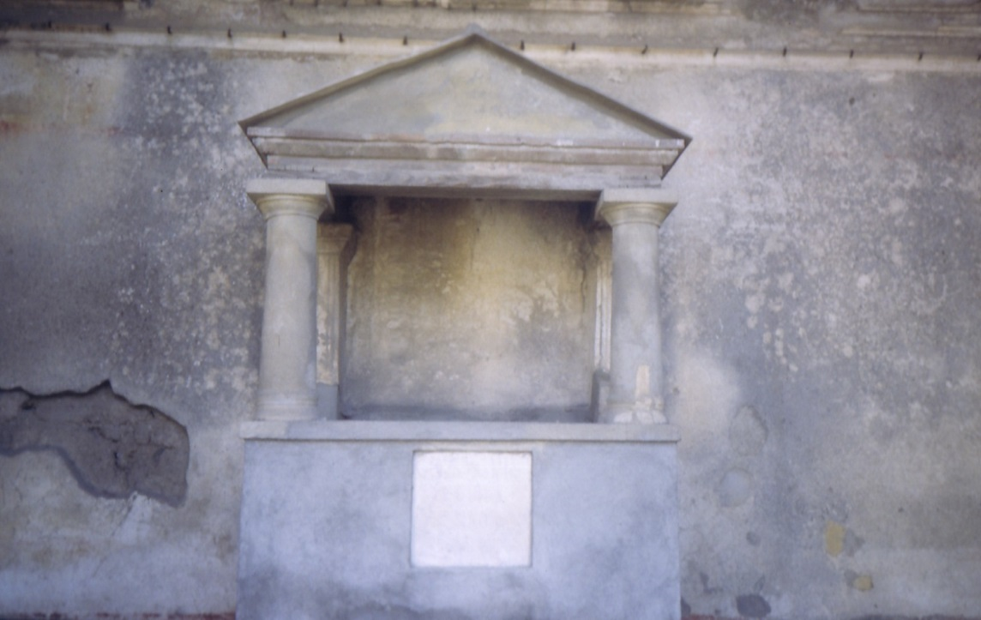
House of the Diadumeni/ M. Epidius Rufus IX.i.20,
To the genius of our Marcus and to the Lares. The two Diadumeni, freedmen (set this up).

Slide 32
Final Question
How valuable would your example of writing be for writing a history of the 21st century in 2,000 years time?

