Slide 1
A selection of Roman tokens with numbers

Slide 2
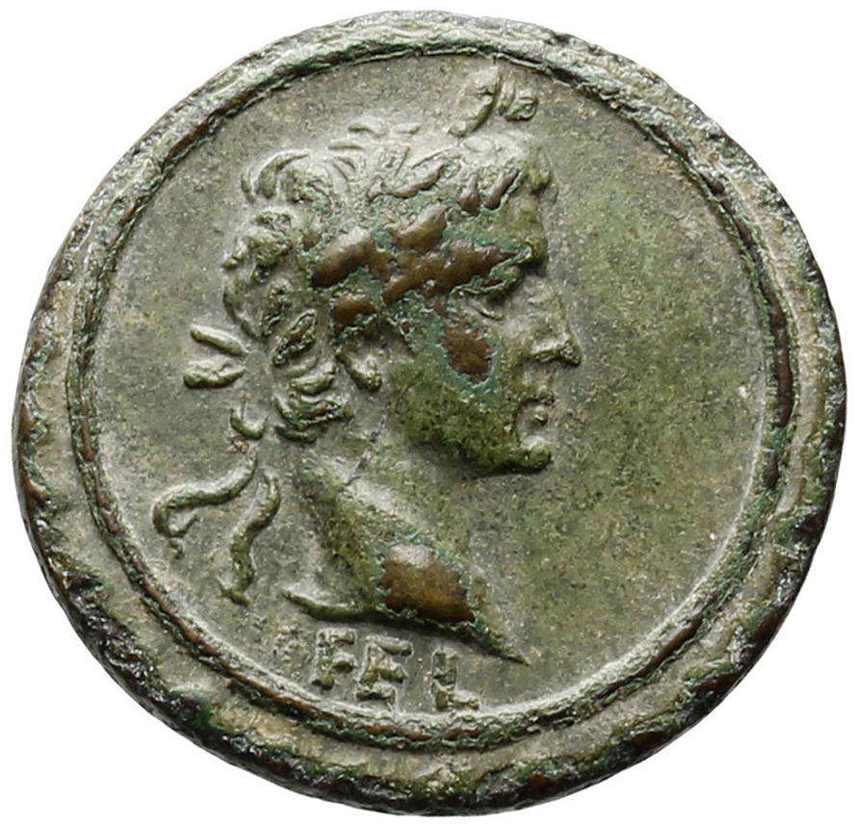
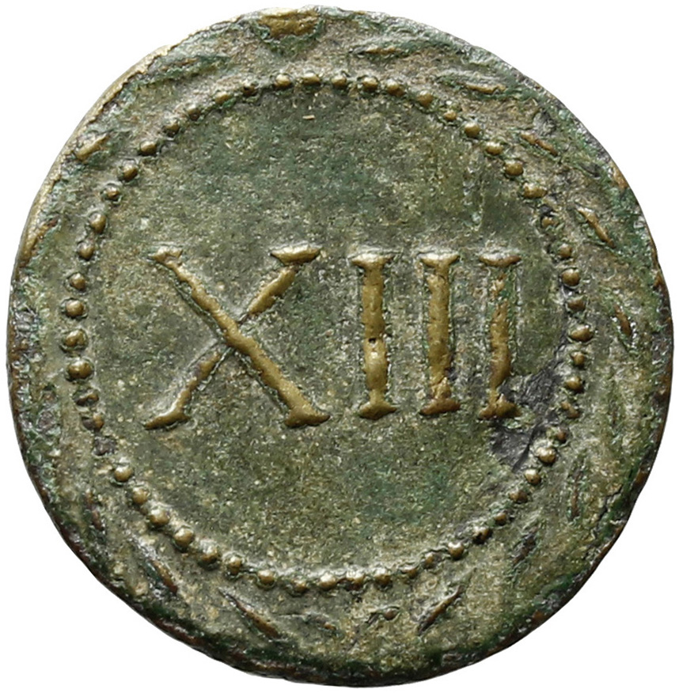
Token showing portrait of Augustus wearing laurel wreath and XIII (13). The FEL = feliciter, 'best wishes’. Now in the Ashmolean Museum, Oxford.

Slide 3
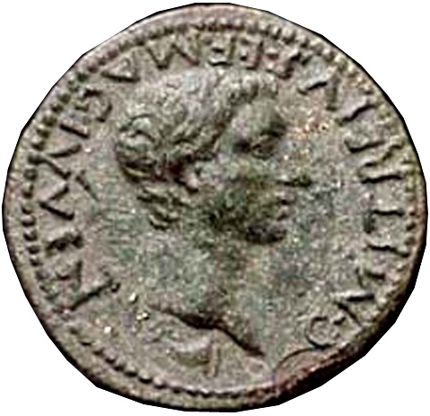
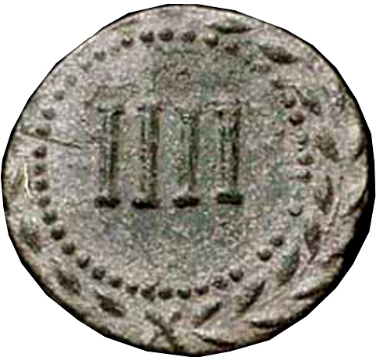
A token showing the portrait of a magistrate of the youth, Gaius Mitreius, and the number IIII (4). Sold via auction (CNG Triton IV, 5 October 2000, 449).

Slide 4
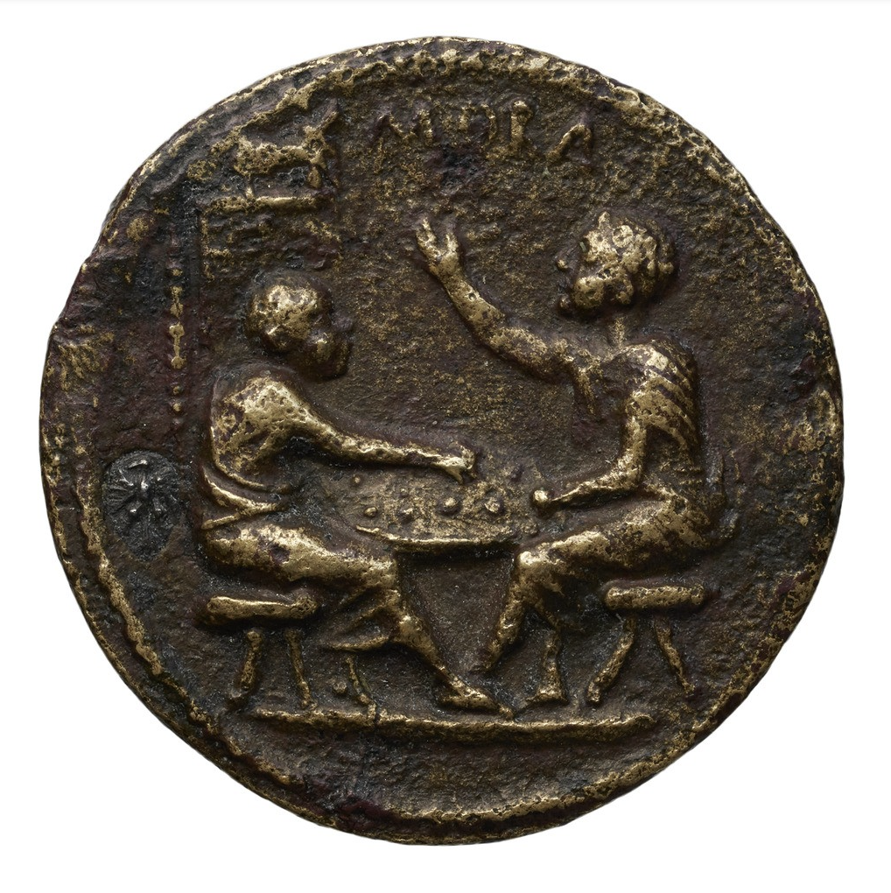
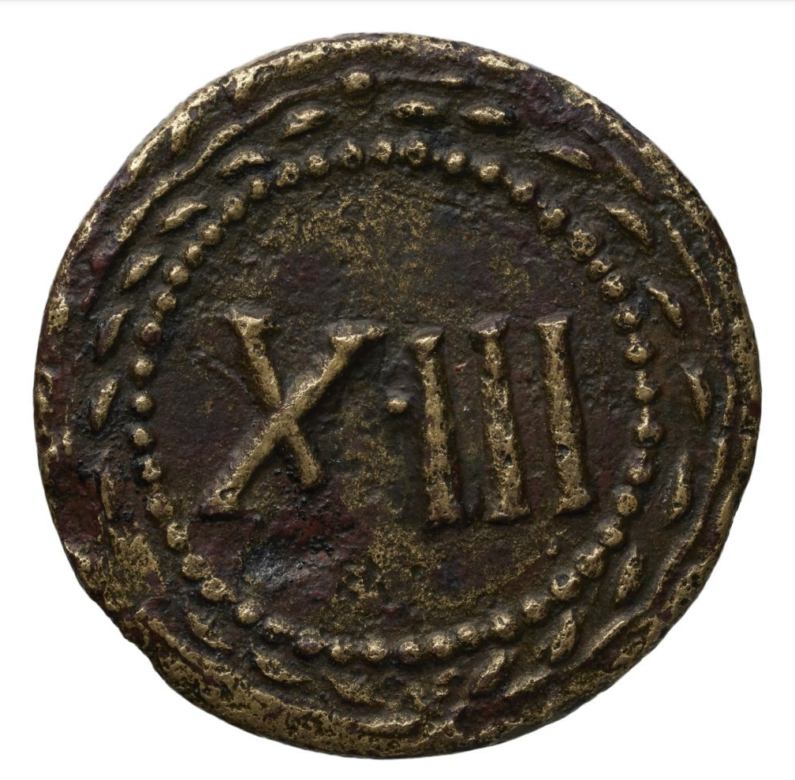
Token showing two boys or men playing a board game, one shouting MORA ("stop!"), and the number XIII (13). Now in the BnF, Paris.

Slide 5
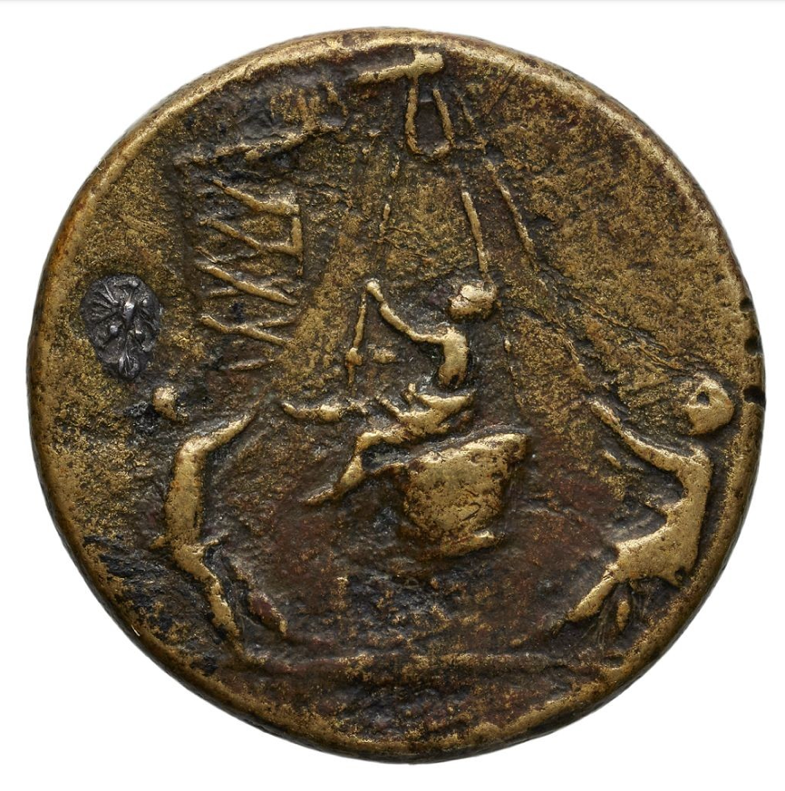
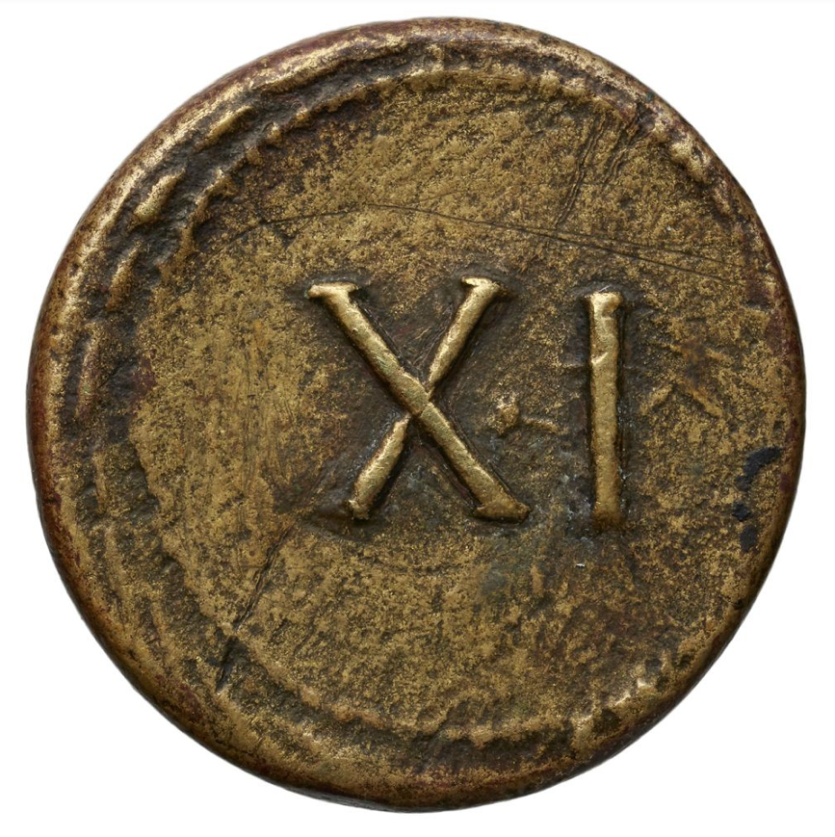
Token showing two men swinging a third person from a basket suspended from a crane, and the number XI (11). Now in the BnF, Paris.

Slide 6
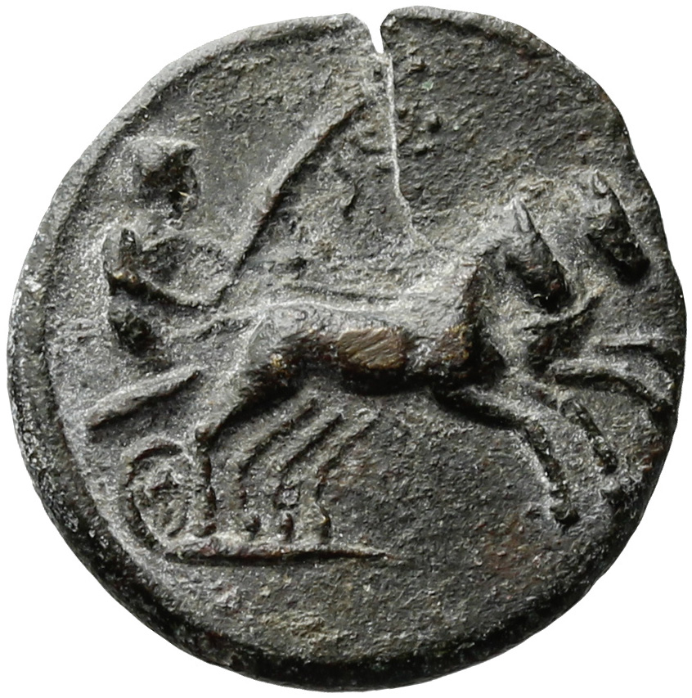
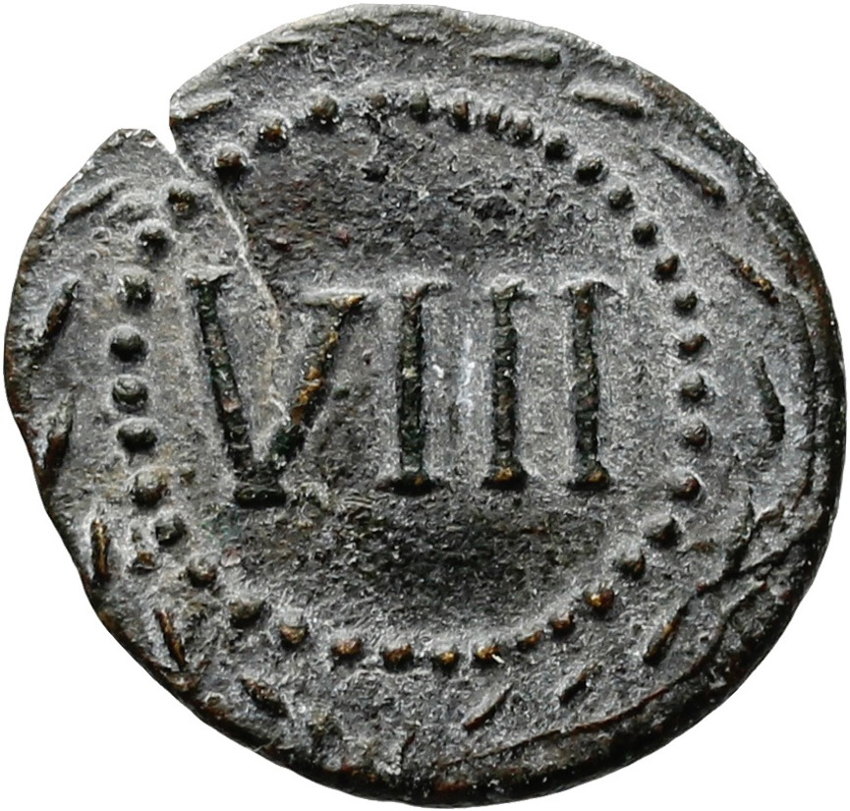
Token showing a chariot racer carrying a whip and the number VIII (8). Piece now in the Ashmolean Museum, Oxford.

Slide 7
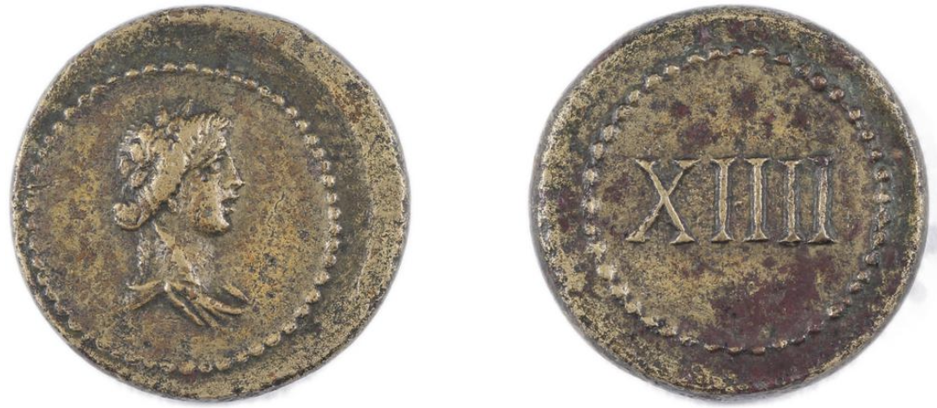
Token showing a bust of Bacchus (Dionysius) with an ivy-wreath, and the number XIIII (14). Piece now in the British Museum.

Slide 8
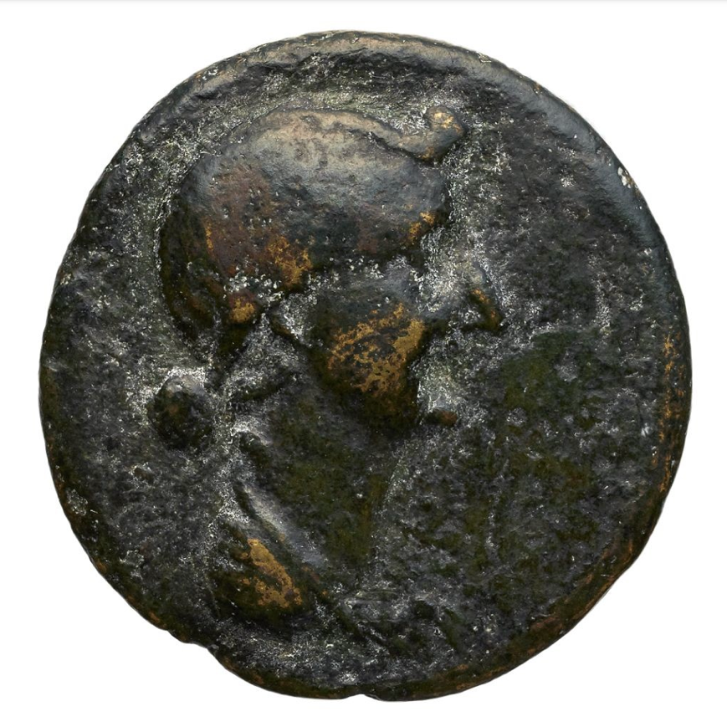
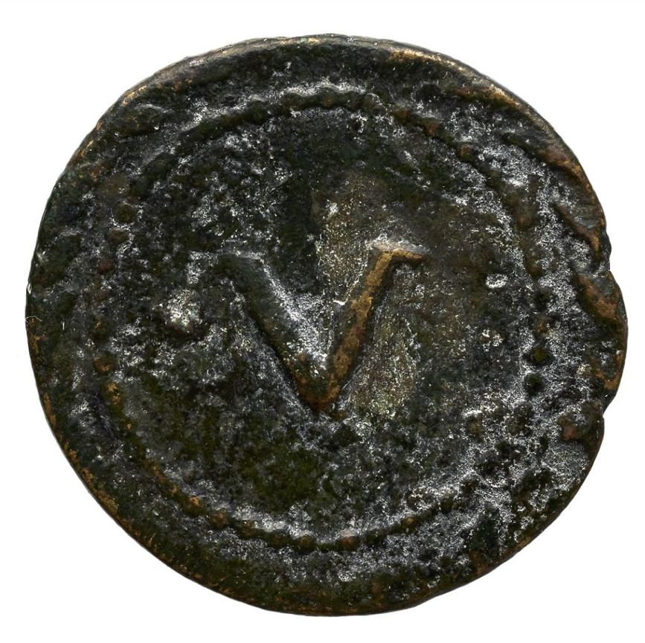
Token showing the portrait of Livia and the number V (5). Piece now in the BnF, Paris.

Slide 9
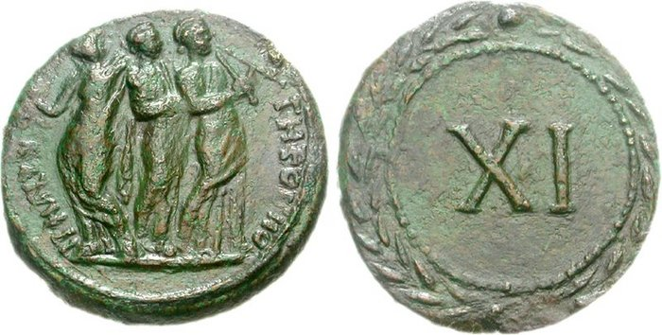
Token showing three female musicians and the number XI (11). Sold via auction (CNG Mail Bid Sale 79, 1051)

Slide 10
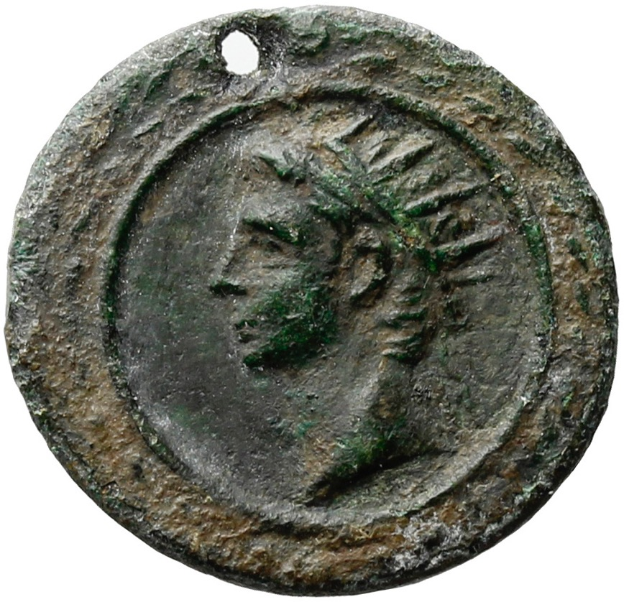
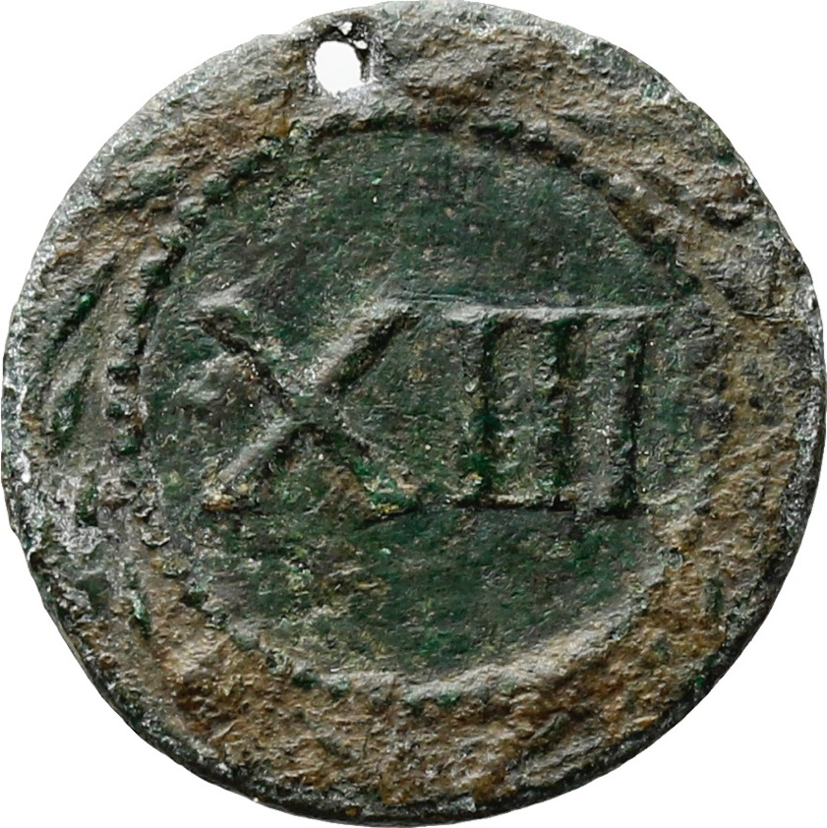
Pierced token showing the deified head of Augustus (he wears a so- called ‘radiate’ crown) and the number XIII (13). Now in the Ashmolean Museum, Oxford.

Slide 11
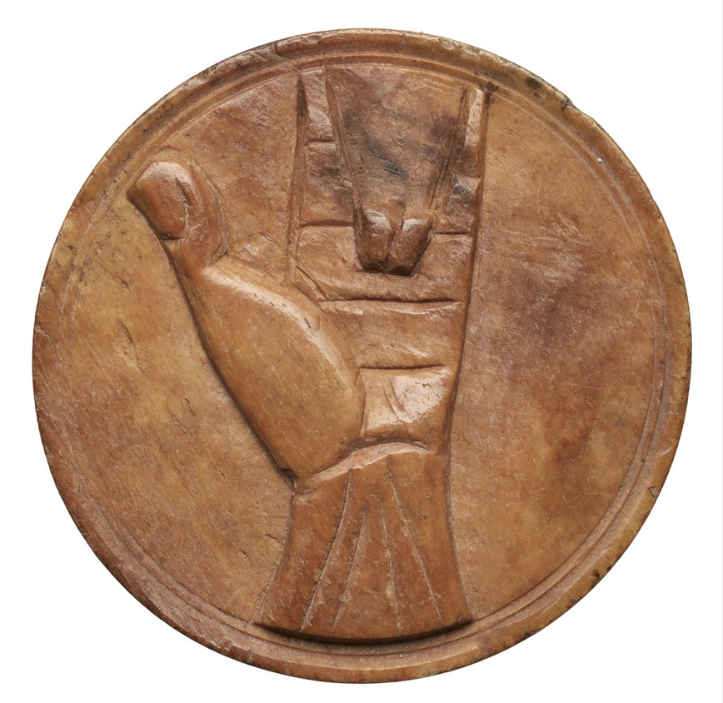
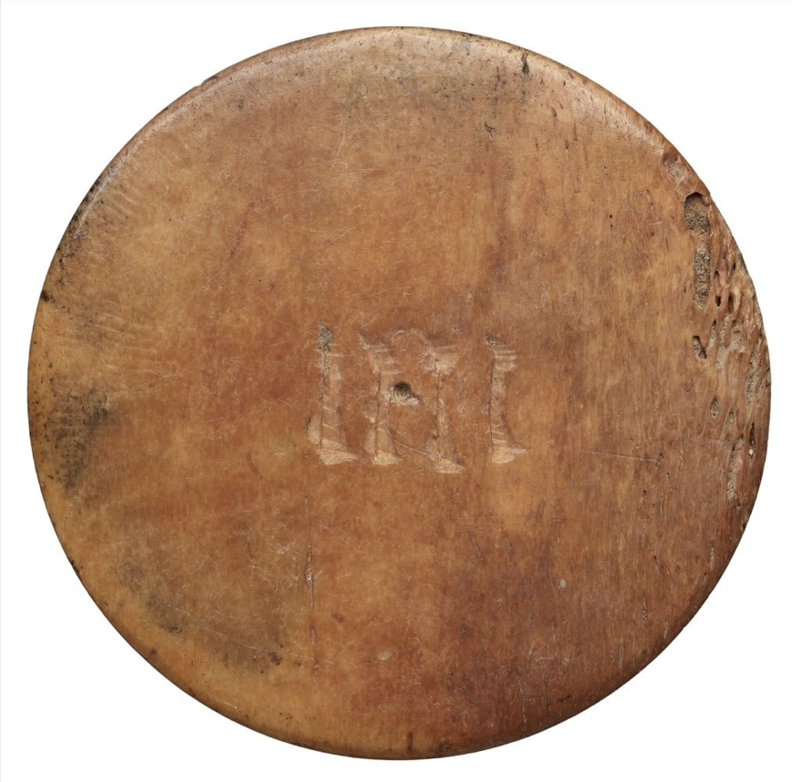
A bone gaming counter showing the Roman finger counting sign for ‘for’, with IIII (4) etched on the other side. Now in the BnF in Paris.

Slide 12
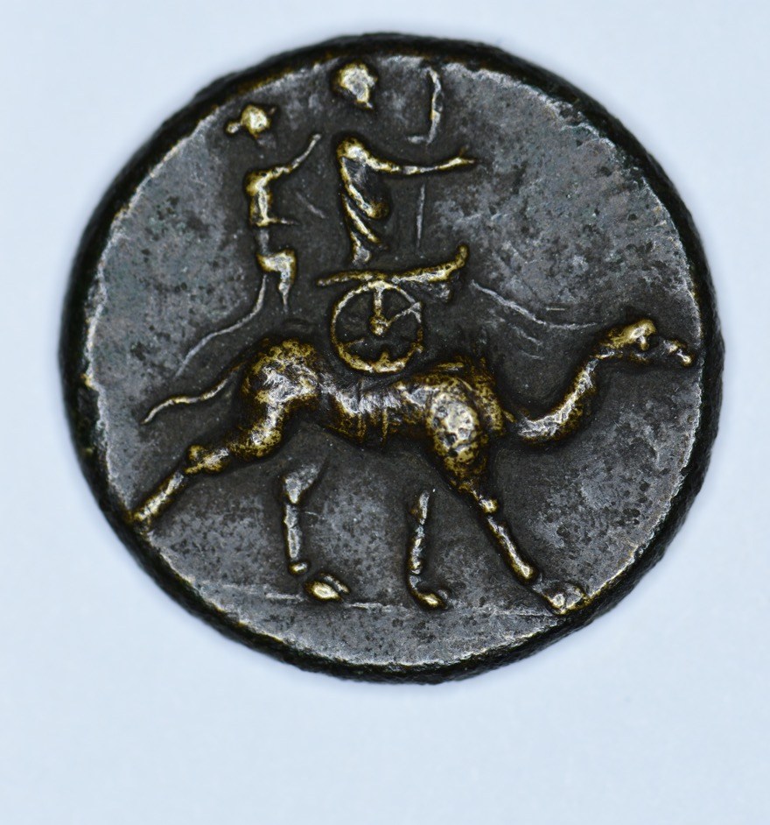
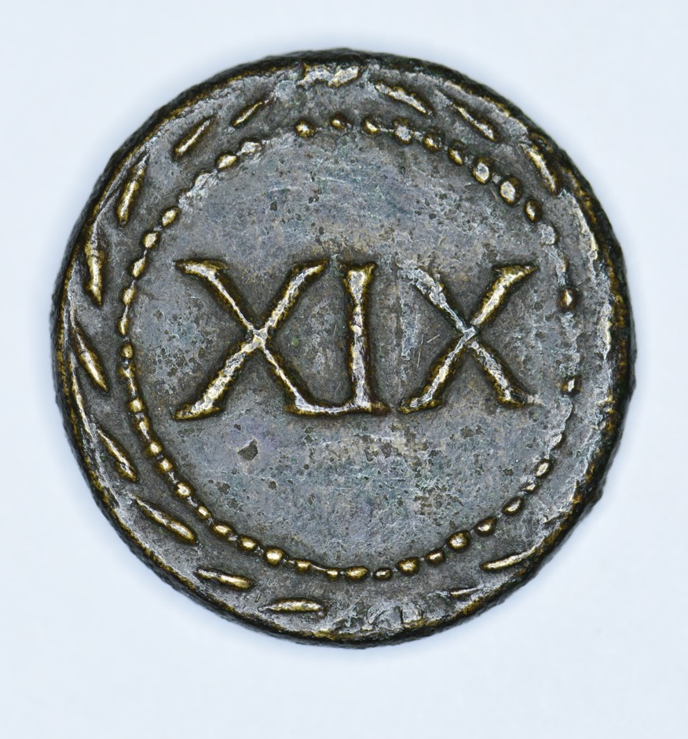
A token showing a triumphator in a chariot being crowned by a monkey, all on top of a camel, with the number XIX (19) on the other side. Now in the Hunterian Museum, Glasgow.

