Slide 1
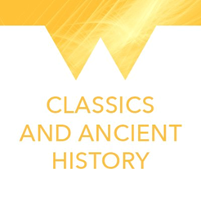
Building Communities
University of Warwick
60th Anniversary Competition

Slide 2
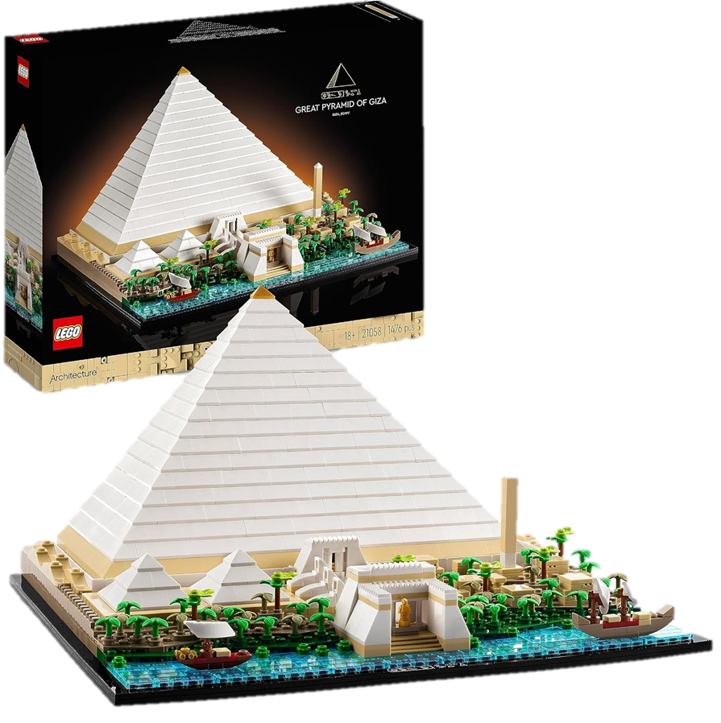
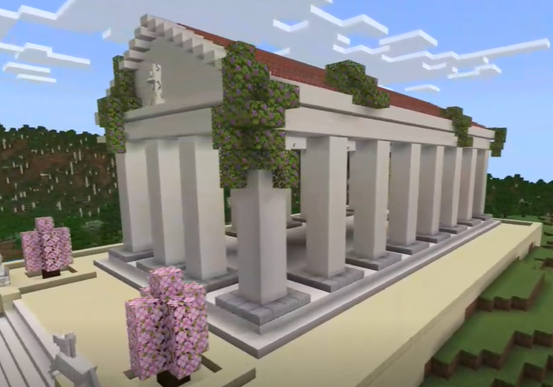
The Competition:
Win a Lego pyramid for your school!
3 Prize Categories!
Minecraft
Art (Lego, drawing, painting, etc.)
Creative Writing
Consider:
Who/what would you see?
How is your space used?
What are people doing there?
How are people interacting with the space they’re in?

Slide 3
Some ancient spaces… …and how they were used

Slide 4
The Colosseum, Rome

Slide 5
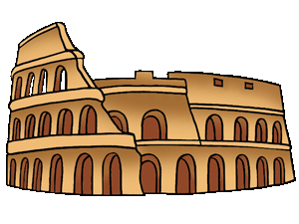
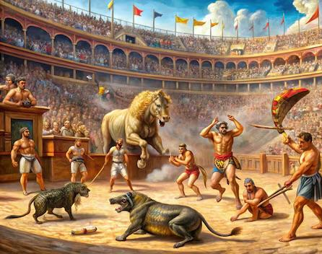
What is the Colosseum?
Largest ancient open-air theatre
Commissioned by Emperor Vespasian in AD70
Made from concrete, limestone and volcanic rock
Used for entertainment such as gladiatorial contests, staged sea battles, re-enactments of ancient myths and sports (animal hunts)
Animals were usually imported from Africa and the Middle east (rhinos, elephants, lions, crocodiles)
First games lasted 100 days, admission was free
In AD80 the bottom of the Colosseum was filled with water for display! Horses and bulls were also trained there
The Colosseum took 8 years to build!

Slide 6
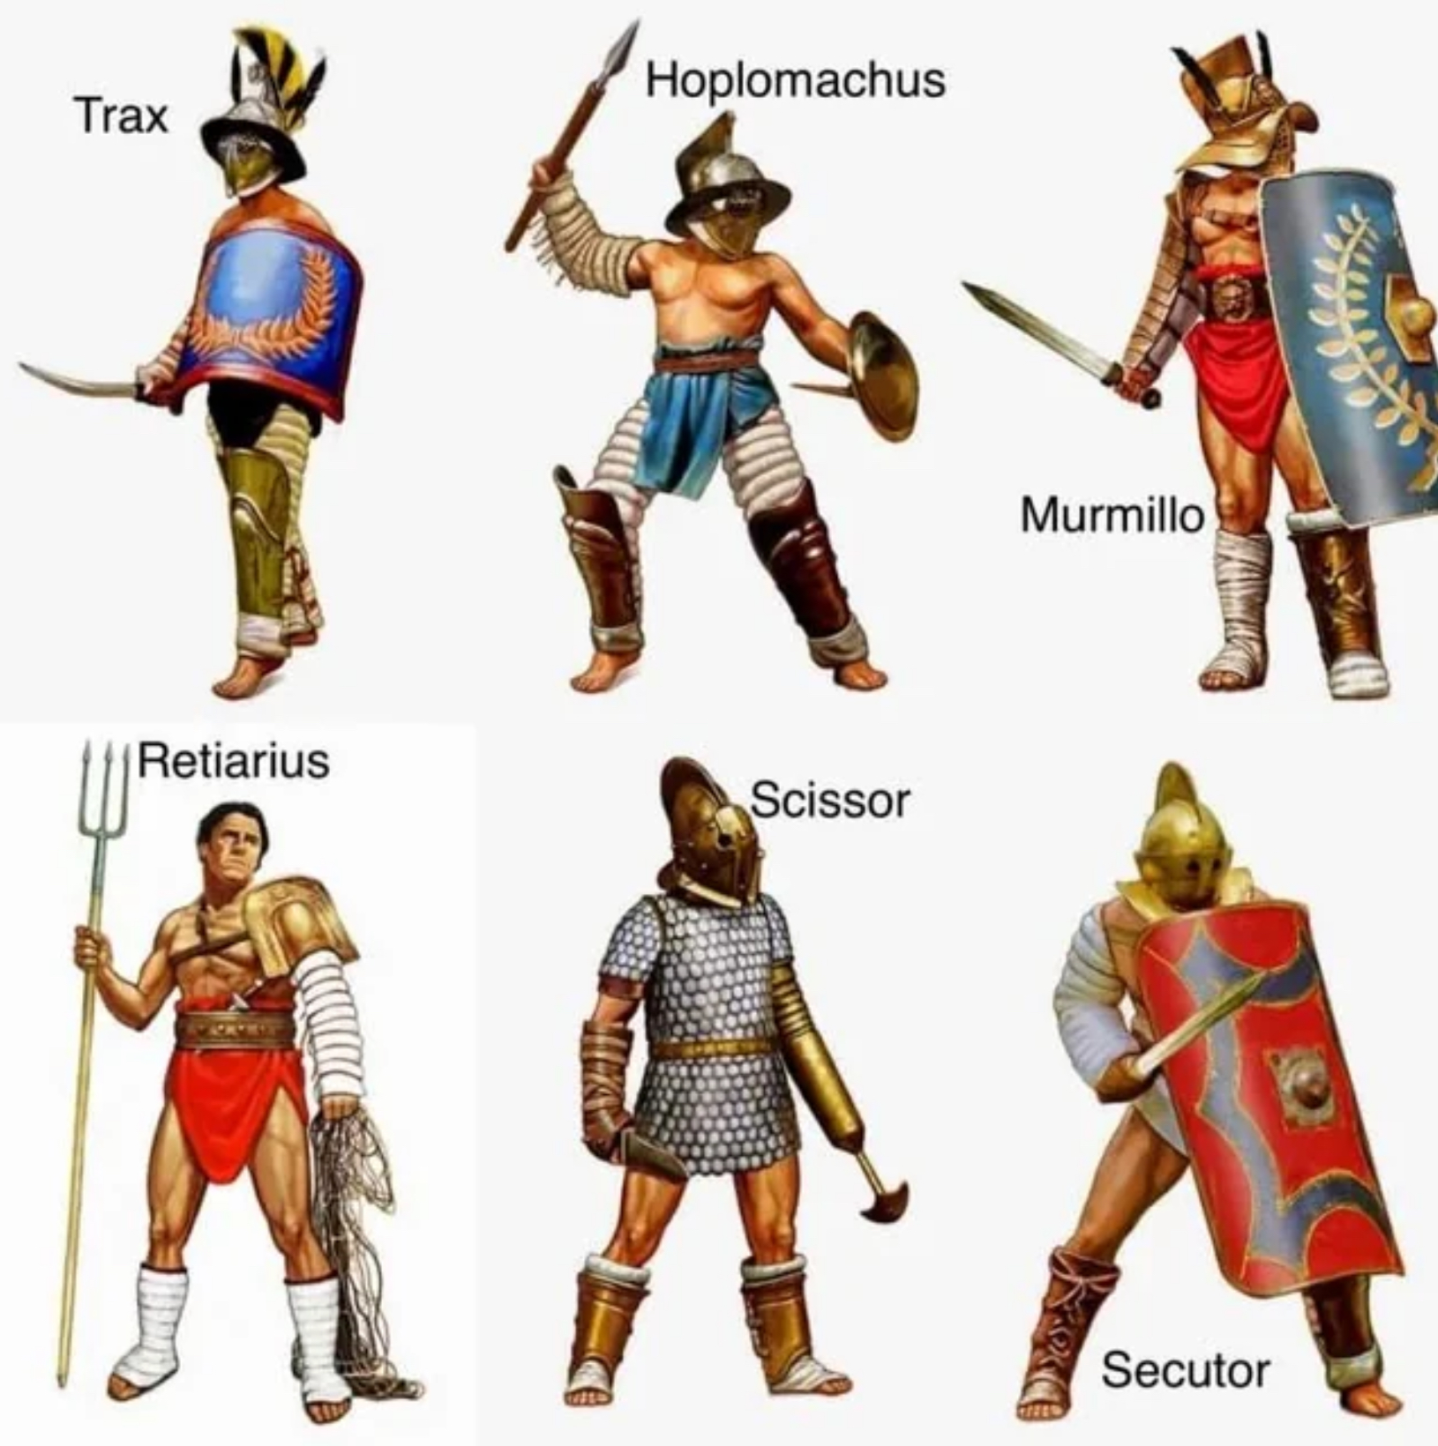
Who might you see?
TYPES OF GLADIATORS:
Trax: Also known as the Thracian, this gladiator used a small shield and short curved sword.
Hoplomachus: dressed like a Greek hoplite (soldier), carried a spear or short sword.
Murmillo: carried a short sword and rectangular shield
Retiarius: fisherman-style gladiator, carrying a net and trident
Scissor: helmet covering whole face, with a blade attached to arm
Secutor: specifically armoured to fight the Retiarius, with similar equipment to the Murmillo
image

Slide 7
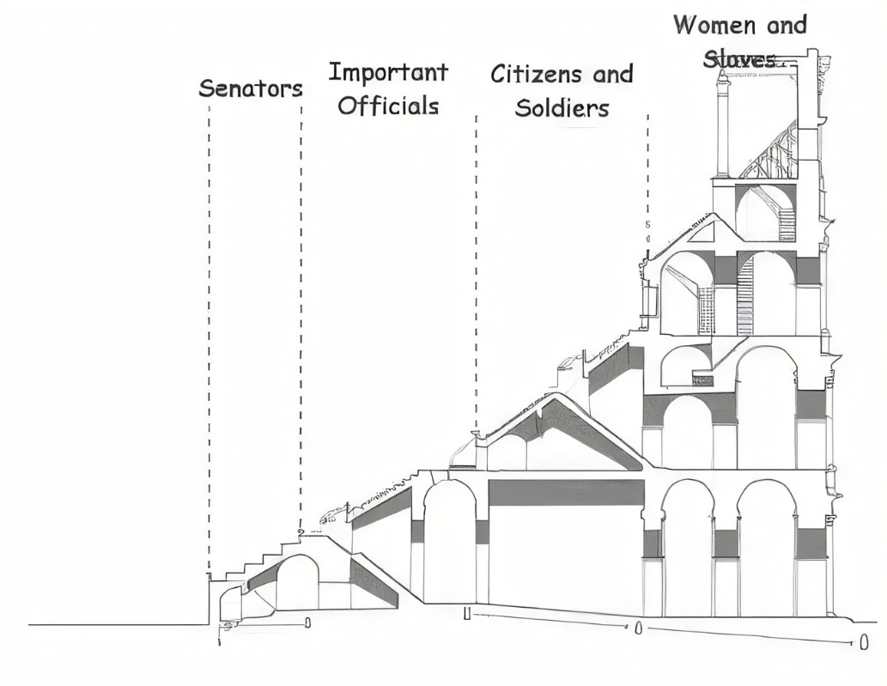
Who might you see there?
THE CROWD
The Colosseum was divided into 4 sections
The part closest to the action was for the senators and Emperor; the Emperor had his own special area
The next area was for the Knights (the so-called “Equestrian class”), important men who owned land, but were not quite as important as the senators
The next section was for normal Roman men and soldiers
Finally at the very top (furthest away) were the women and slaves
Did you know? Over 50,000 people could fit inside the Colosseum!
image

Slide 8
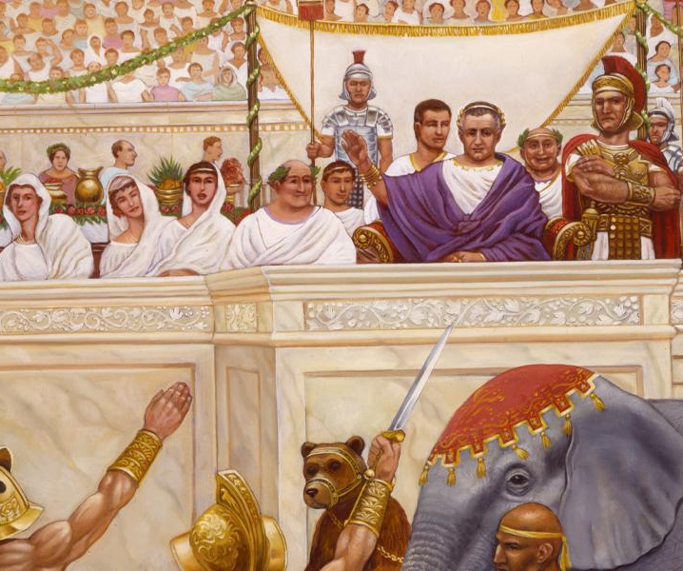
Who might you see there?
image
THE EMPEROR
Received the most luxurious treatment
North and south end seating: best view
Accessed by special entry
‘Turning their thumbs’: made the final decision of the outcome of the games
Usually adhered to wishes of the crowd
If the Emperor was not in attendance, the producer of games decided the outcome
Hosting games as a way to win the love of the people

Slide 9
The Acropolis, Athens

Slide 10
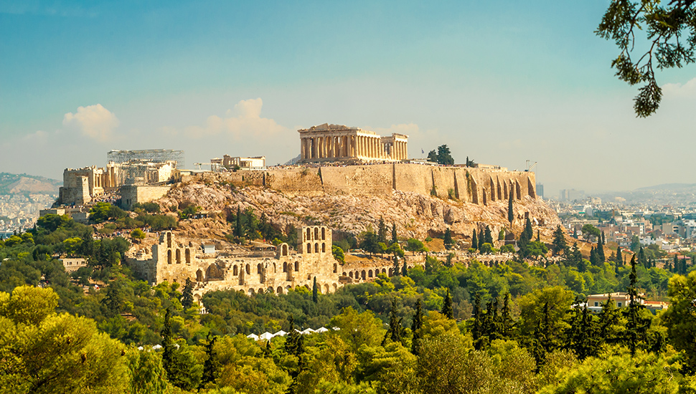
What is the Acropolis?
Sacred religious site for the whole community
The Acropolis is essentially a hill housing multiple ancient structures
“Acropolis” means “high city” in ancient Greek
Includes a number of temples: the Parthenon, Temple of Athena Nike, and Erechtheion (among others)
Parthenon was dedicated to the goddess Athena, and decorated with sculptures and depictions of Greek Myth
Buildings made of white marble
Did you know? Athena was the patron goddess of Athens! The city was named after her!

Slide 11
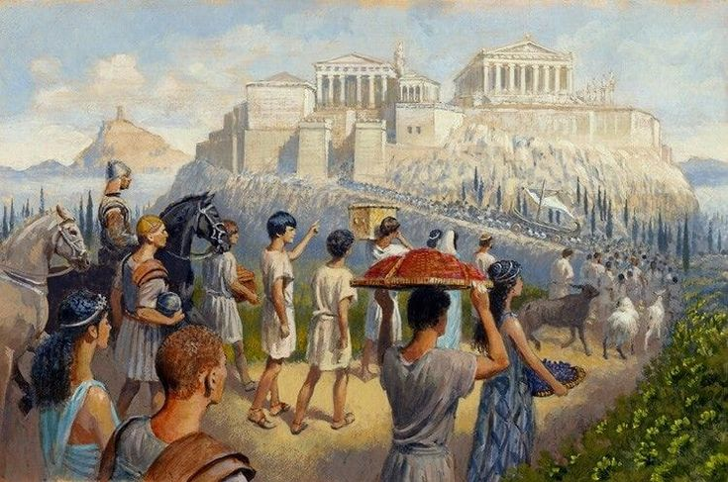
Who might you see there?
At the Panathenaic Festival, the whole community celebrated the goddess Athena! There were:
People making sacrifices
Priests
Processions: including people carrying pots on their heads
Banquets: feasting on the second day of the festival (they believed the gods shared these feasts as part of the community)
Statues of the gods and goddesses
Competitions: chariot races and athletic activities

Slide 12
So, why not investigate some other ancient sites and what happened there? And then enter our competition!

