Slide 1
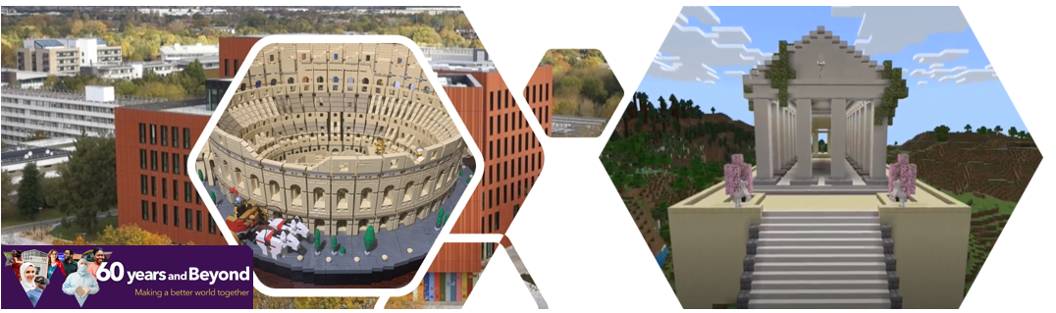


Building Communities Schools Competition
Department of Classics and Ancient History, University of Warwick

Slide 2
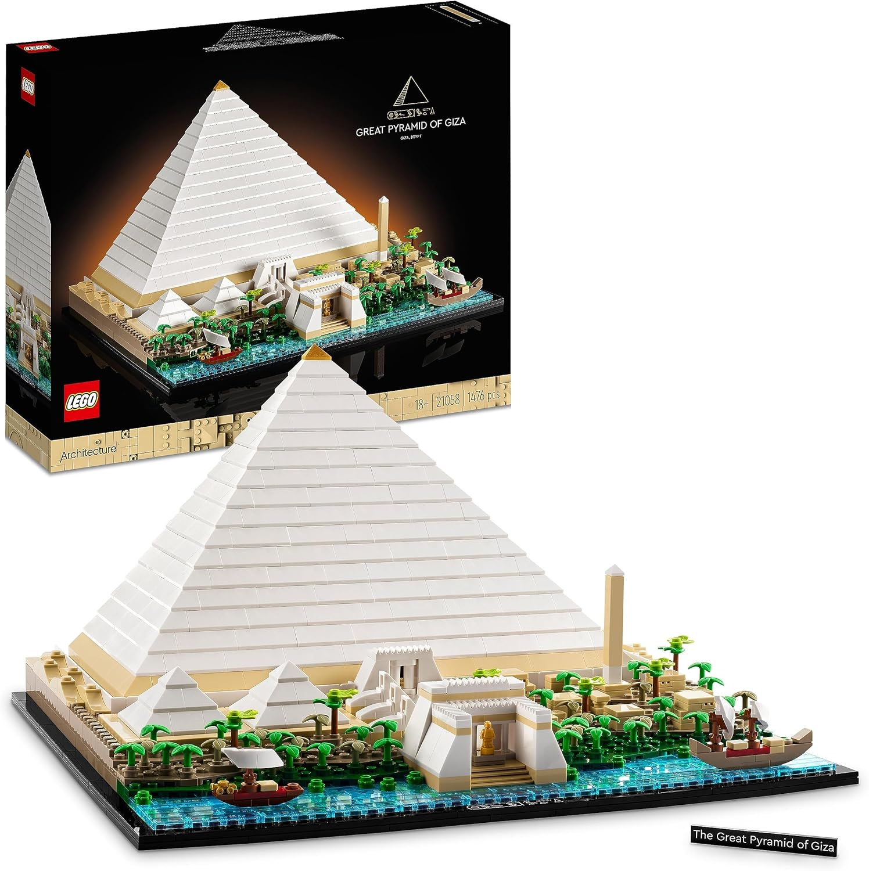
The Competition
We want pupils to create a piece of work on the theme of 'Building Communities' which looks at ancient buildings/spaces and how these were used by communities in the ancient world.
The winning entries will each win a Lego pyramid for their school.

Slide 3
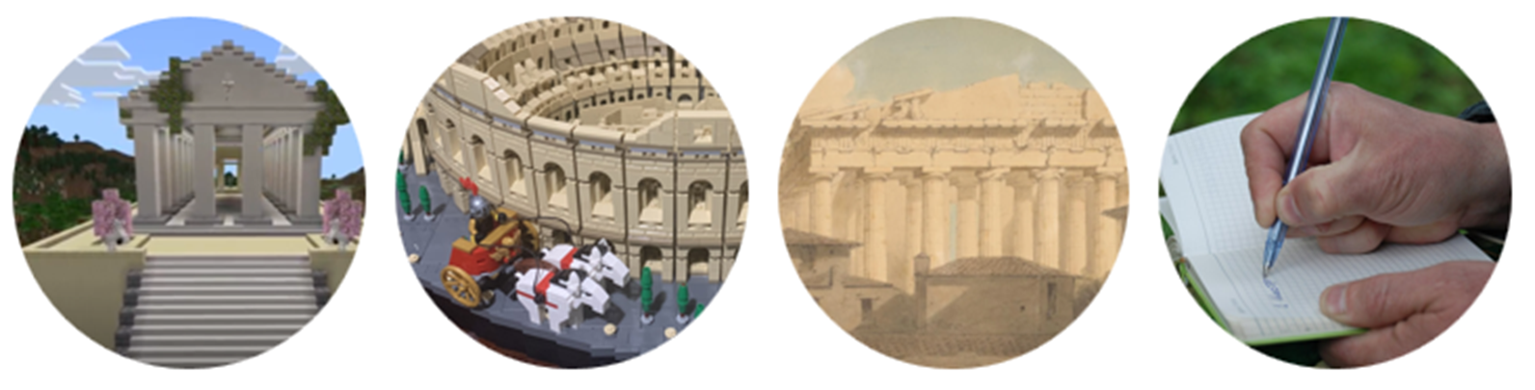
We are looking for entries from Primary and Secondary Schools in these categories:
Minecraft - if you are a whizz at Minecraft, how about recreating an ancient public space, a temple, or other public building?
Creative Design (drawing, painting, digital design, or building with Lego or other materials) – if art is your thing, how about creating an artistic recreation of an ancient site or space, or building a structure in Lego or some other material?
Creative Writing (storytelling, poetry, drama) - or if words are your strength, tell us a story or bring the ancient world to life in poetry or drama

Slide 4
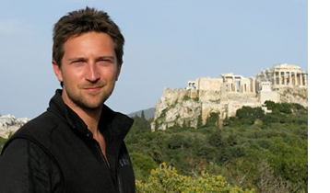
Closing Date and Judging
All entries must be sent centrally via the school/teacher
The entries will be judged by Warwick academics Prof Alison Cooley, Dr Paul Grigsby, a team of our Warwick students, and as chief judge, Prof Michael Scott (left). Michael is best known for his work on the BBC including Ancient Invisible Cities, and Ancient Greece: The Greatest Show on Earth among others.
The competition closes on 1st June 2025

Slide 5
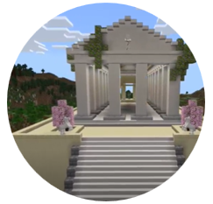
Minecraft
For those lovers of Minecraft, we want you to design a 3D ancient space, such as a temple, a marketplace or forum, a theatre, or any other space where communities came together in the ancient world.
We want this to be based on an actual ancient space and not an invented one (though you can of course be creative in this, especially if you are rebuilding some ruins). We are looking for evidence of creativity and ambition in your design. For inspiration, you can find information on a range of ancient sites on our resources page.
The Minecraft model will be accompanied by a written piece of work (around 200 words) to explain how the space you have created was used by a community and why this was important for that community. Things to consider include: Who/what would you see in your space? What are people doing? How are people interacting with the space they’re in? Can you maybe link this to anything you are studying?

Slide 6
Your actual entry to the competition will be in the form of a video fly-through of your space (you can check out our instructions on how to do this here if you are unsure).
Winning entries will be posted on our website and displayed on big screens in the Faculty of Arts Building here at Warwick.
[We are also hoping (if technology allows) to convert the winning Minecraft designs into a walk-through Virtual Reality/Augmented Reality experience here at Warwick. If this happens, we will contact the winners to get hold of the designs in a suitable format that will support the required platforms.]

Slide 7
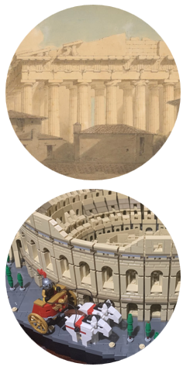
Creative Design
For those of you who prefer other types of visual or physical creative design, we have a prize category just for you.
The types of entries might include drawings, paintings, digital designs on an iPad or PC, or physical building with Lego, cardboard or even clay - whatever medium you prefer using.
Again, we are looking for a design based around an actual ancient space, such as a temple, a marketplace or forum, a theatre, or any other space where communities came together in the ancient world. We are looking for evidence of creativity and ambition in your design.
For inspiration, you can find information on a range of ancient sites on our resources page.

Slide 8
The creative piece will be accompanied by a written piece of work (around 200 words) to explain how the space you have chosen for your artwork was used by a community and why this was important for that community.
Things to consider include: Who/what would you see in your space? What are people doing? How are people interacting with the space they’re in? Can you maybe link this to anything you are studying?
To enter the competition, simply create your artwork and send us a copy of it as a photo or PDF or whatever format suits you best.
The winning entries will be posted on our WCN site and displayed on big screens in the Faculty of Arts Building here at Warwick..

Slide 9
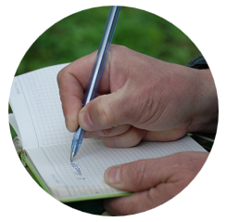
Creative Writing
For those who like using words, the third category of entries is Creative Writing. What form this creative writing takes is completely up to you - it might be storytelling, poetry, drama or anything you like.
We are looking for a creative piece based around an actual ancient space, such as a temple, a marketplace or forum, a theatre, or any other space where communities came together in the ancient world.
For inspiration, you can find information on a range of ancient sites on our resources page.

Slide 10
As with the other categories, this piece of creative work will also be accompanied by a short piece of writing (around 200 words) explaining how communities used, interacted in, and maybe were even created through these shared spaces.
Things to consider include: Who/what would you see in your space? What are people doing? How are people interacting with the space they’re in?
To enter the competition, simply send us your entry as a Word doc or PDF or whatever format best suits you (perhaps a photo of there are visual elements).
And the winning entries will be posted on our WCN site and displayed on big screens in the Faculty of Arts Building here at Warwick.

Slide 11
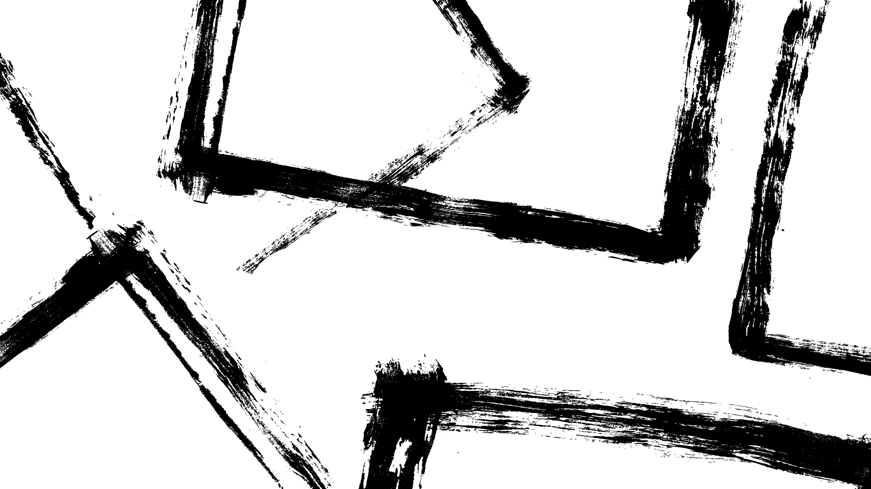
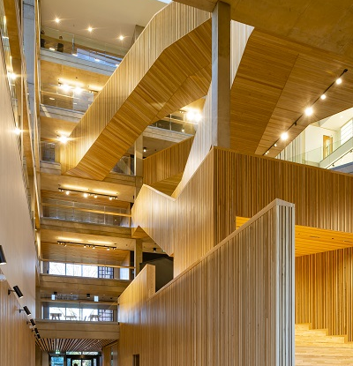
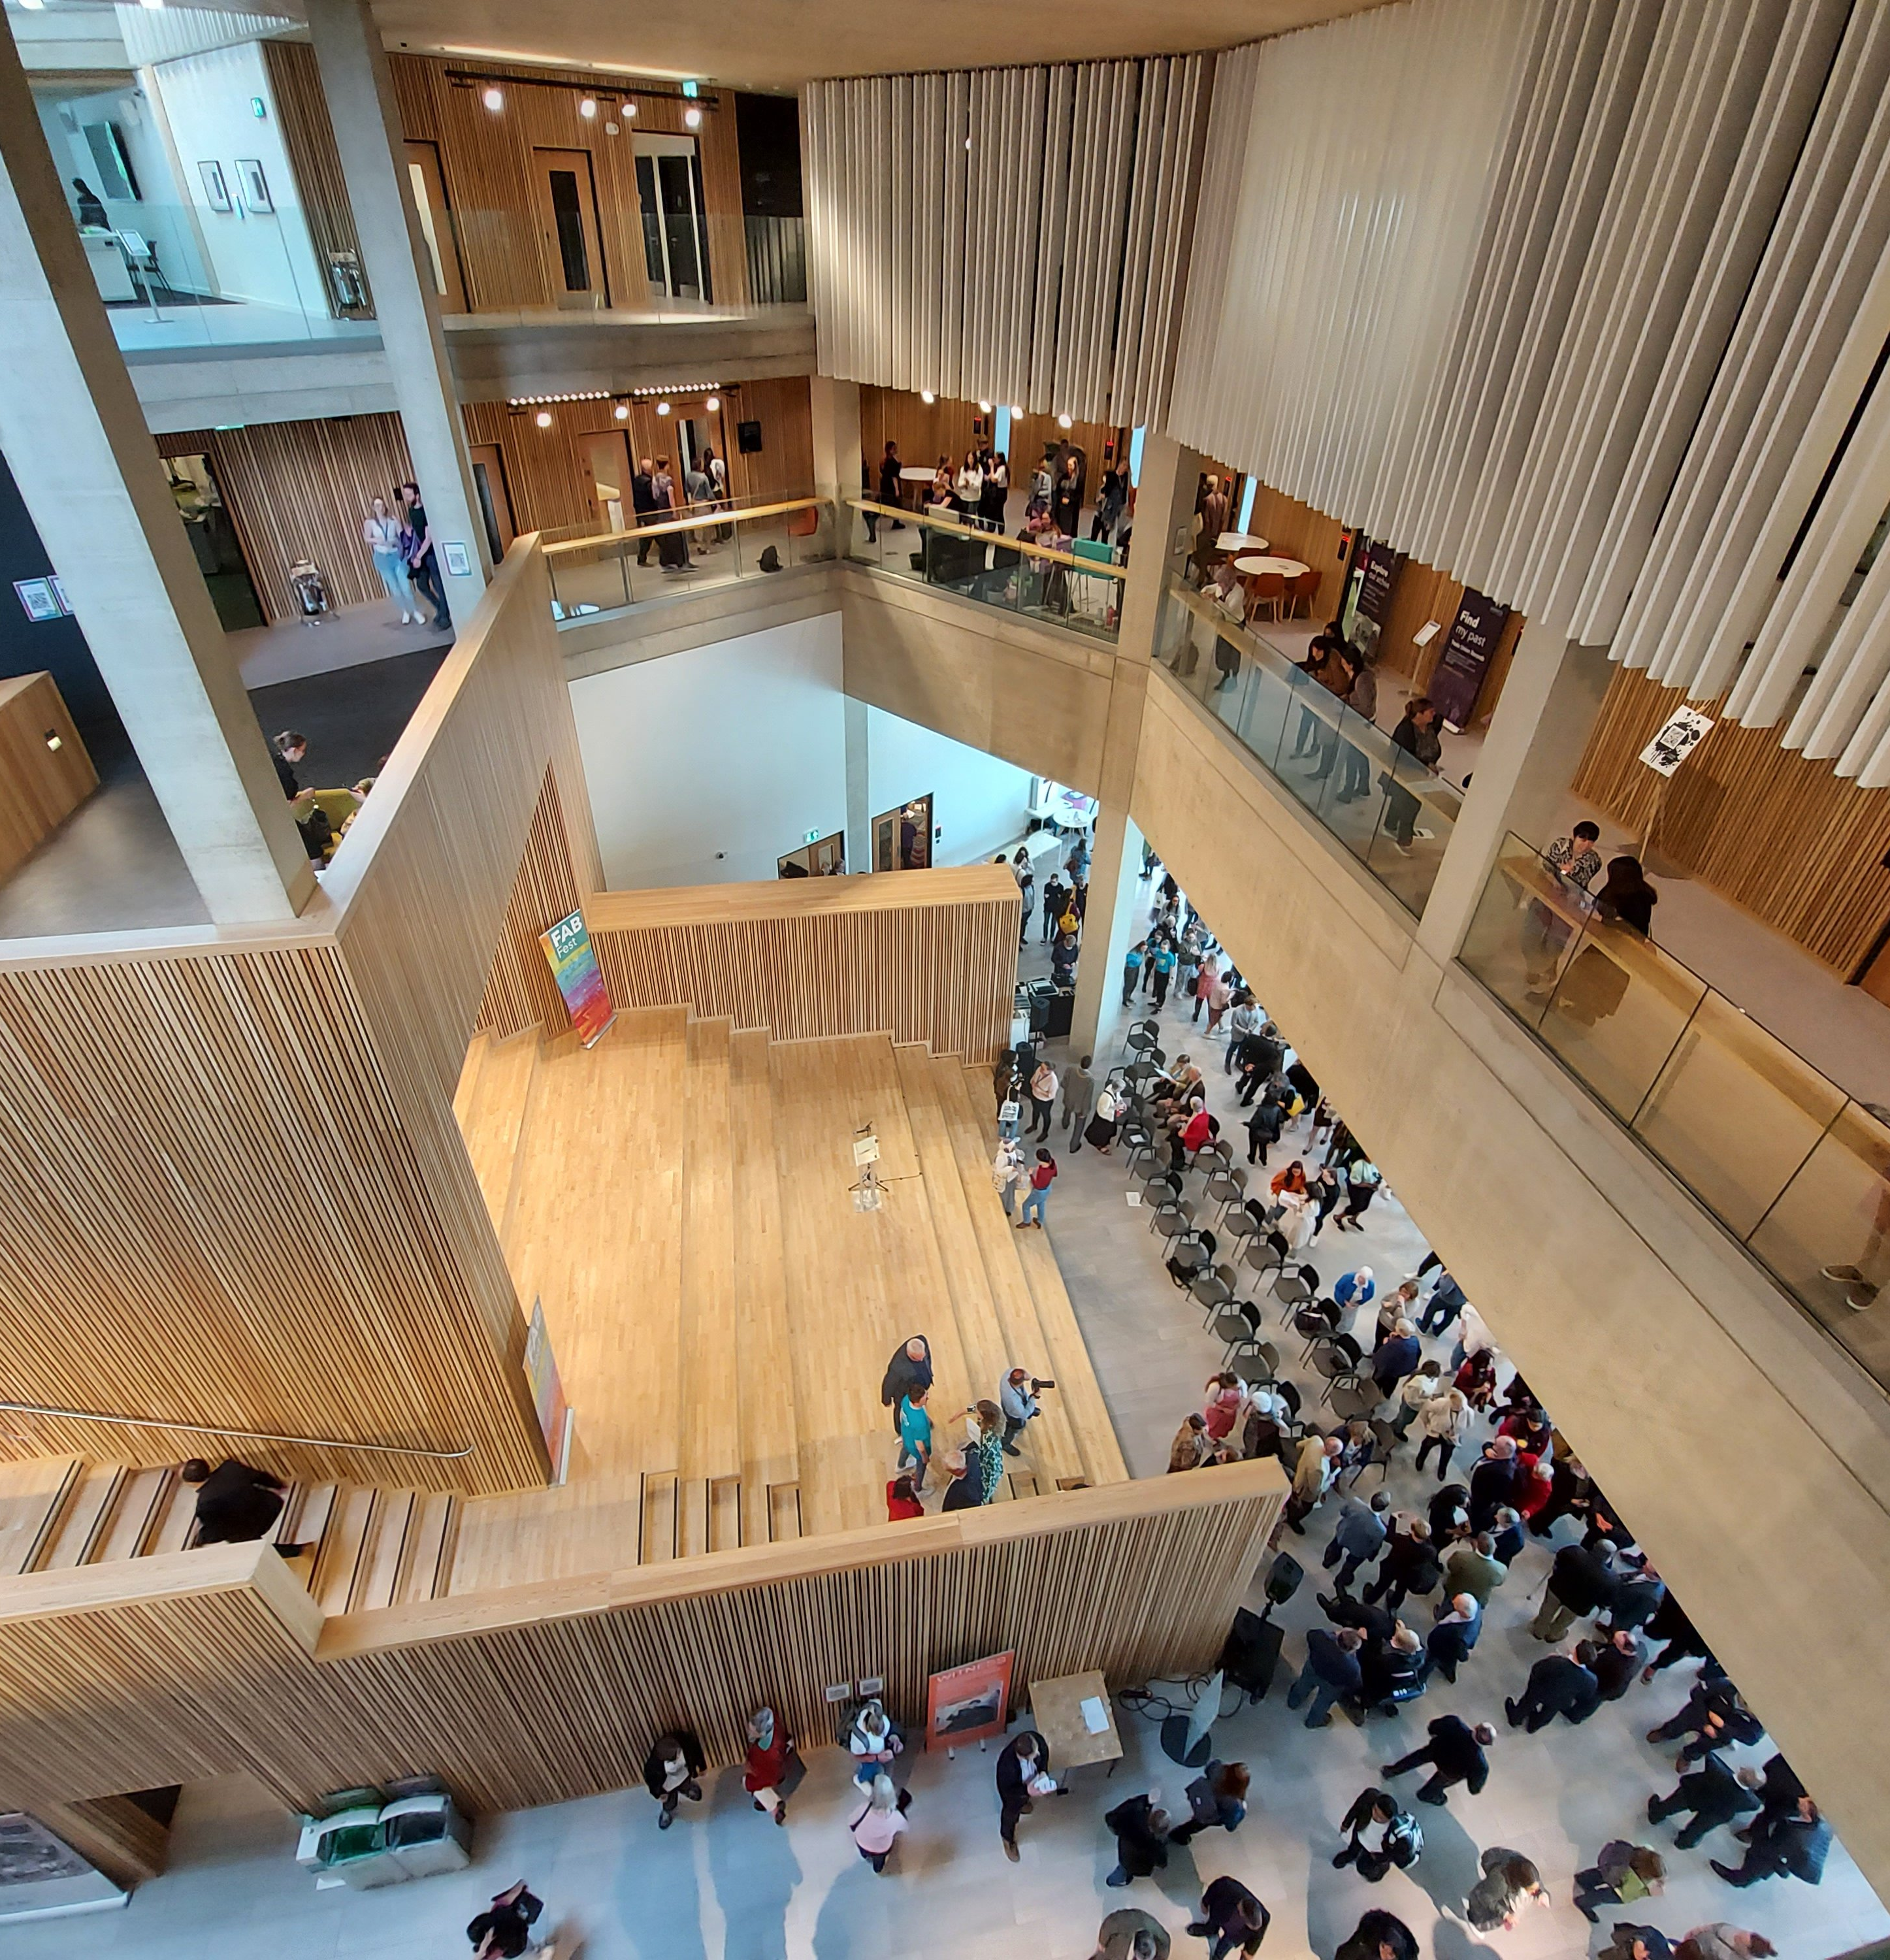
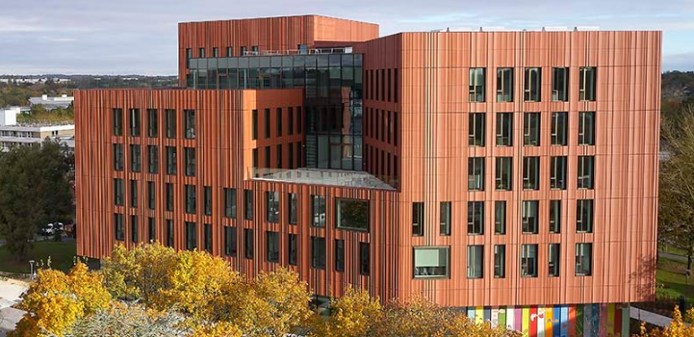
Over the past 60 years, the campus buildings at the University of Warwick have brought people together into a single community excited by continuing to learn about the world and discover new things.
The new Faculty of Arts Building (right) at the University of Warwick is a good example of how a building brings people together. People from across the University meet here and discuss projects, attend lectures, study, chat, or just hang out in the coffee shop.
For your competition entries, think about how ancient buildings and spaces also brought communities together.

Slide 12
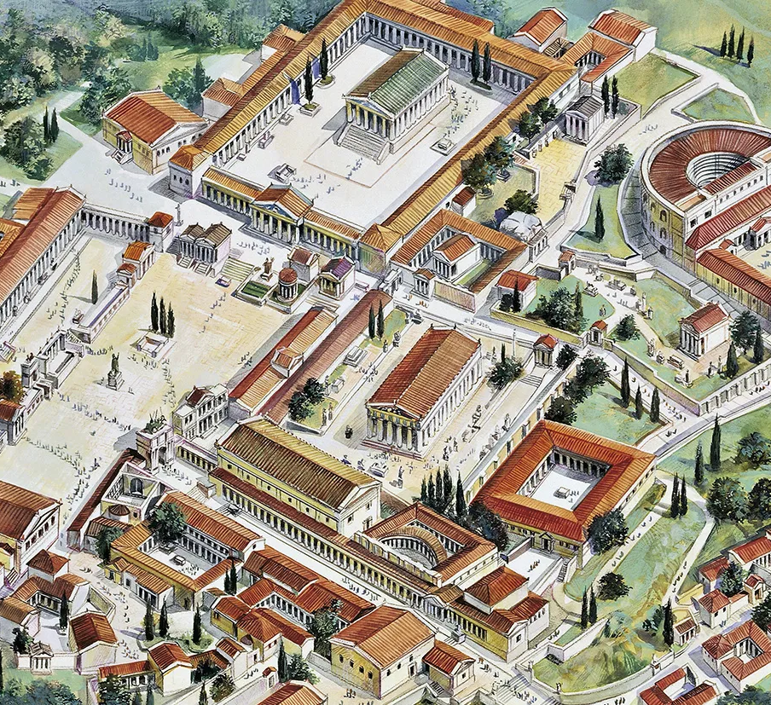
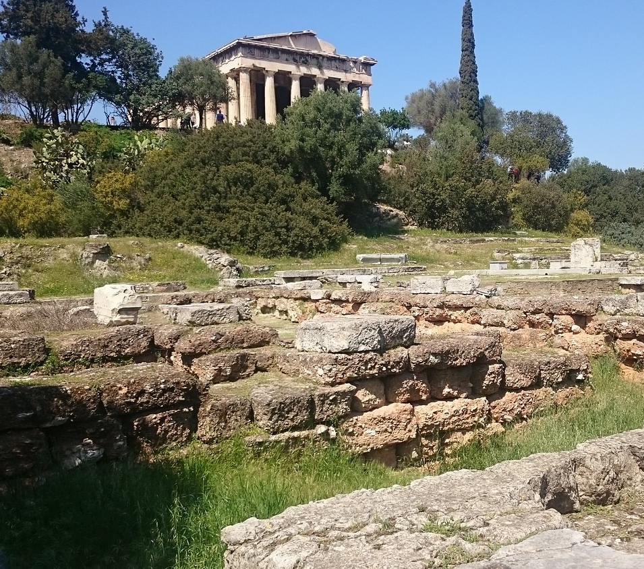
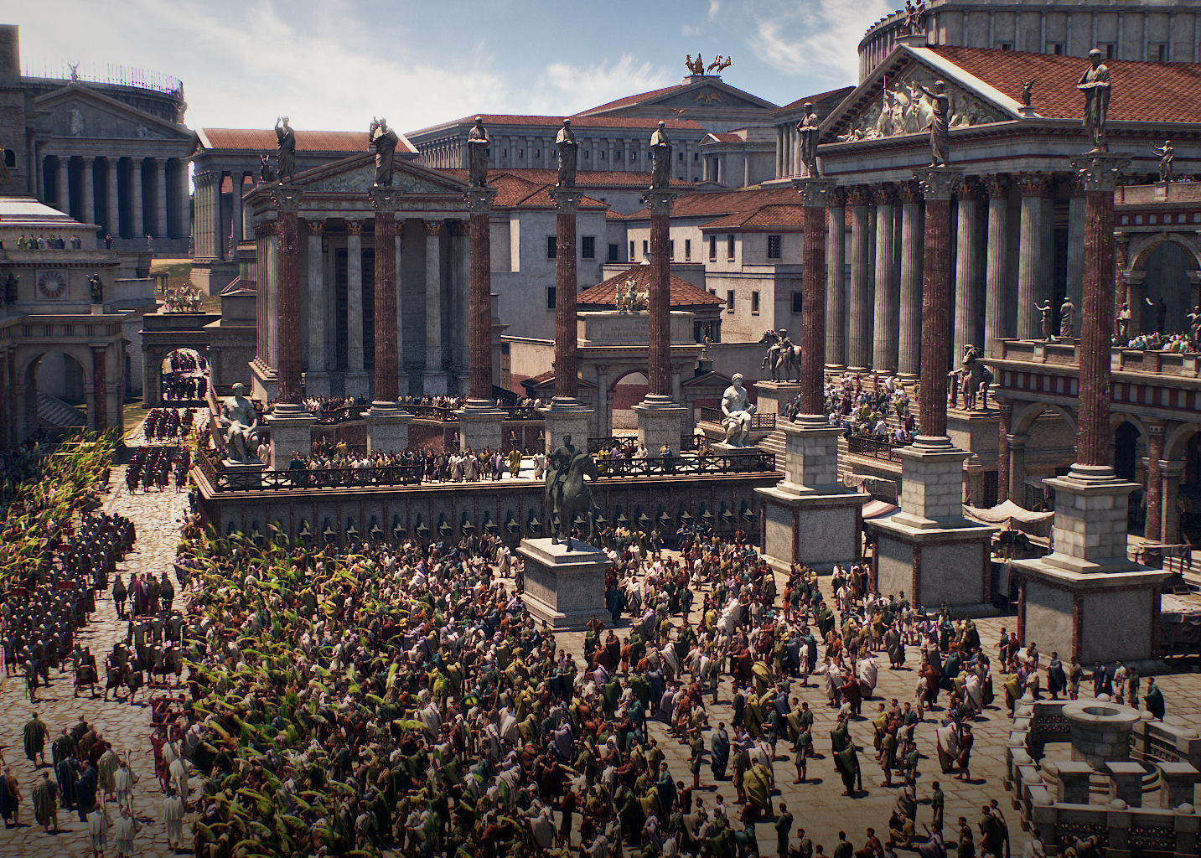
These might include public spaces such as the Athenian Agora (market-place), Corinthian Agora, or the Roman forum..

Slide 13
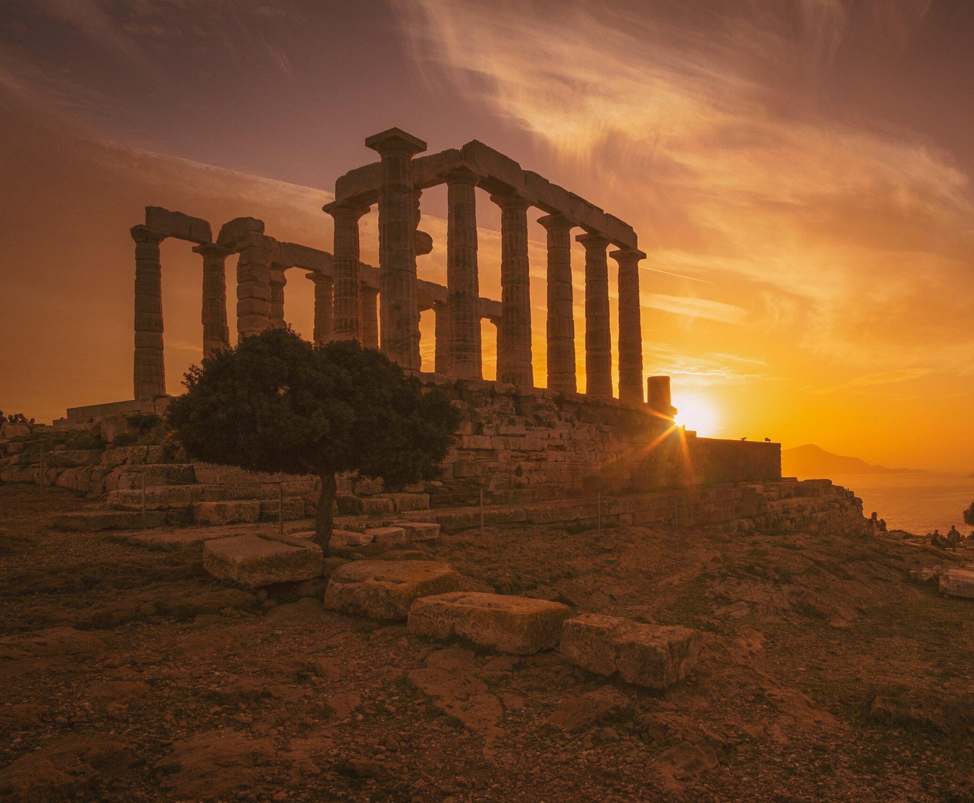
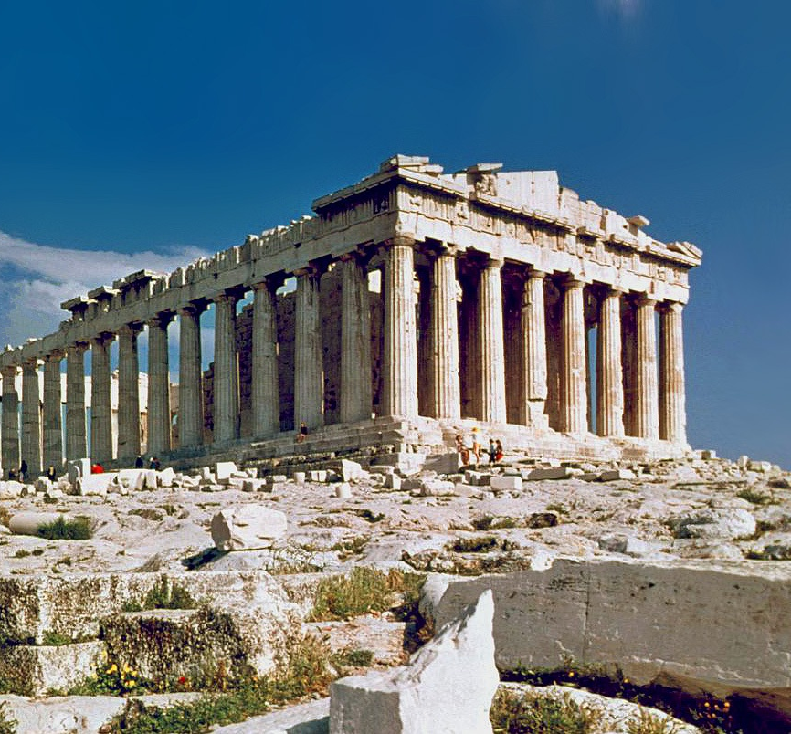
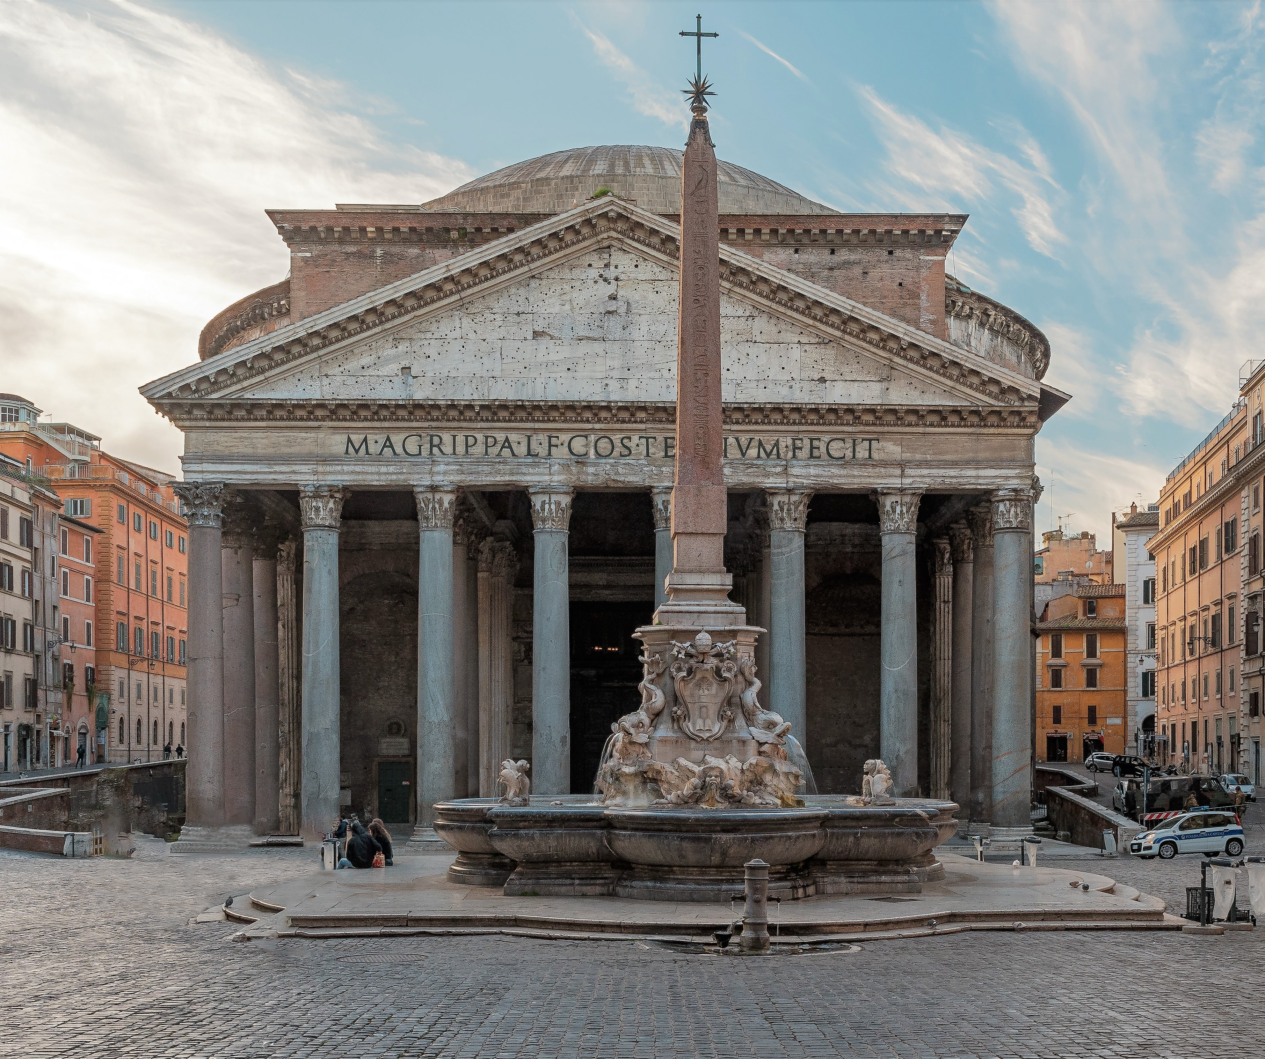
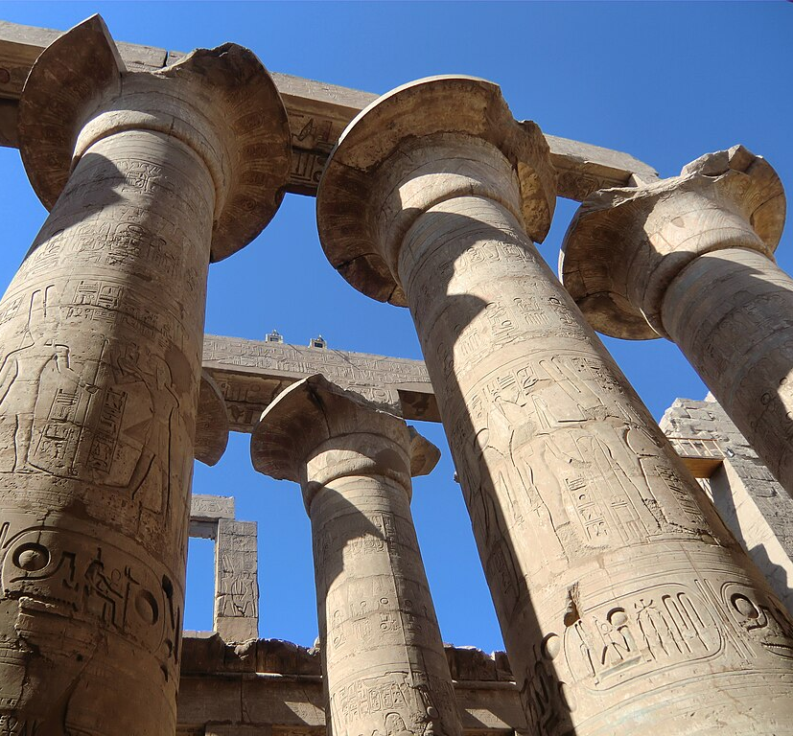
Or religious sites such as temples… like the temple of Poseidon at Sounion, the Parthenon in Athens, the Pantheon in Rome, or the temples of Karnak in Egypt…

Slide 14
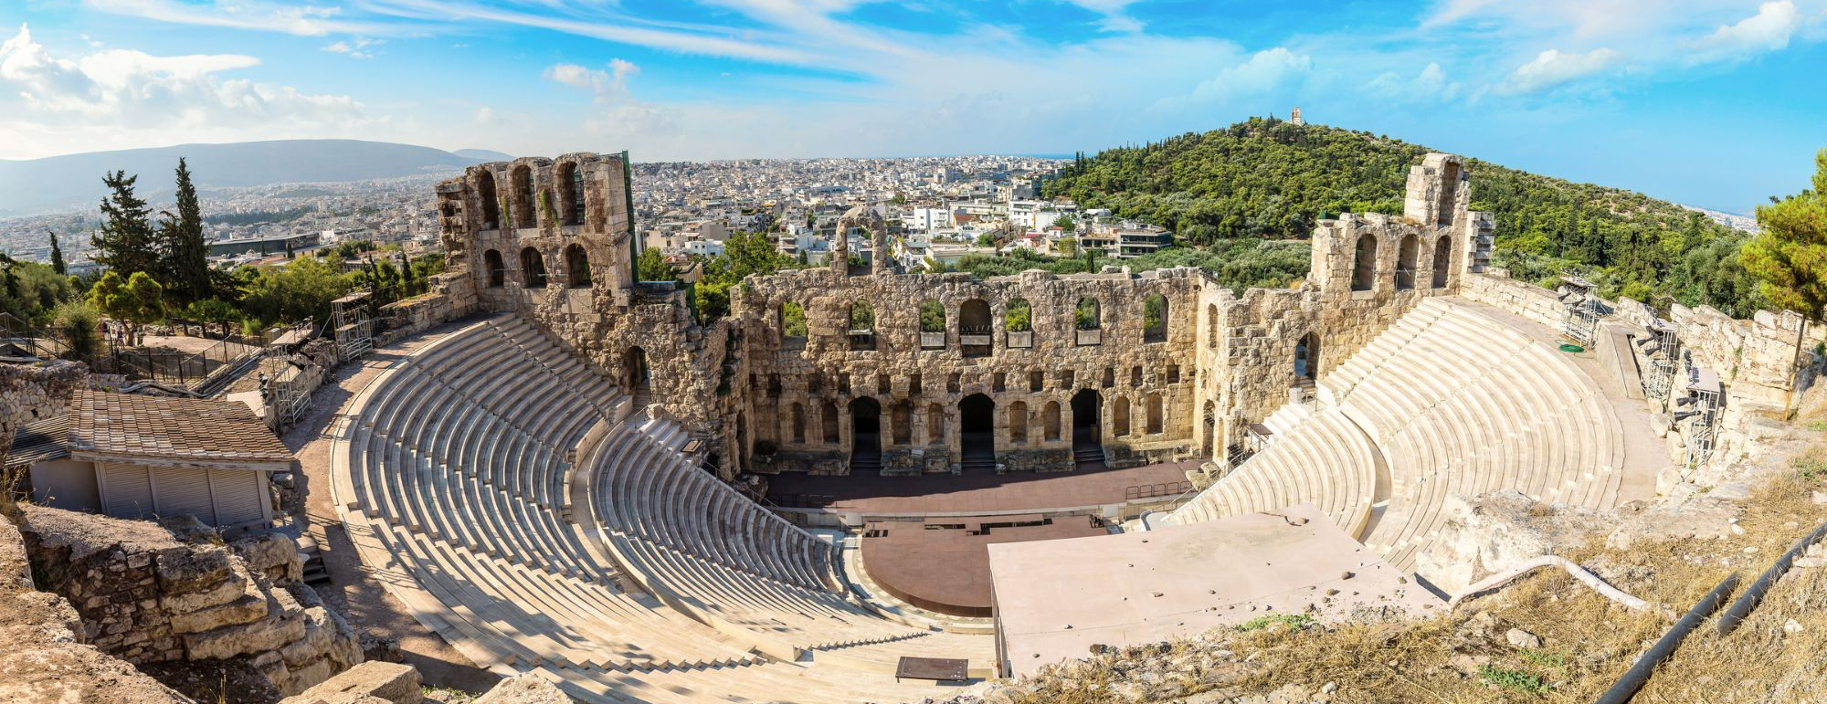
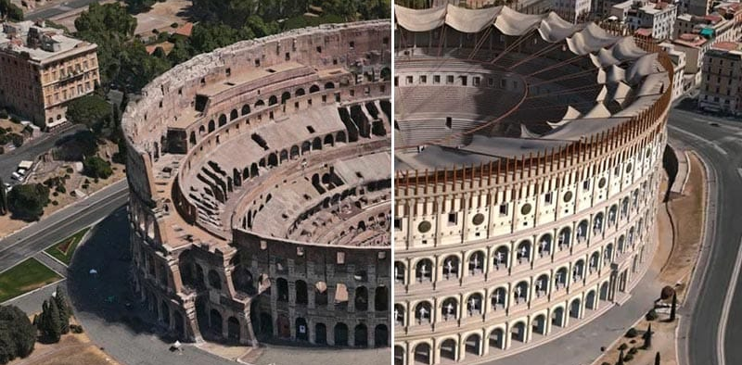
Or places of spectacle, like the theatre of Herodes Atticus in Athens, and the Colosseum in Rome…

Slide 15
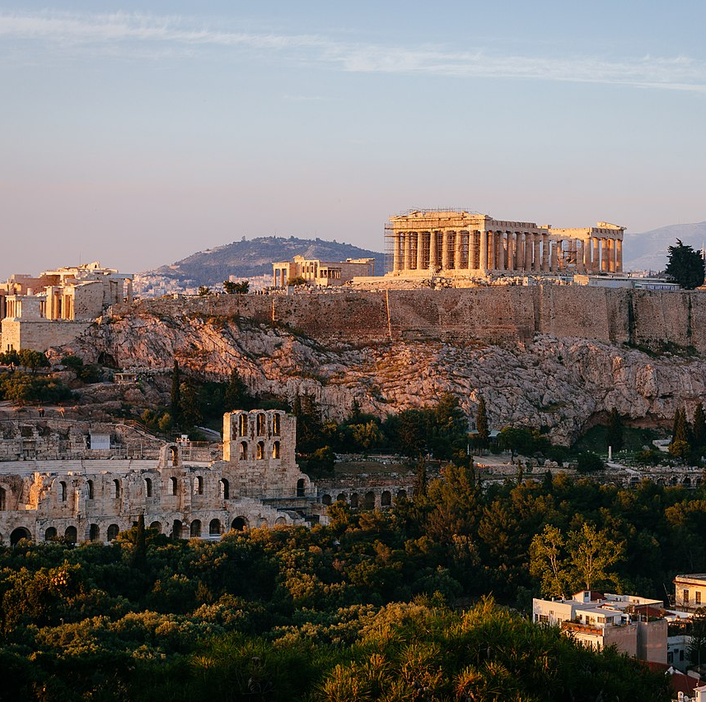
Remember to base your design on a real ancient space or building
But what you choose and how you proceed is totally up to you
We look forward to seeing how creative you can be!
Good luck!

