Slide 1

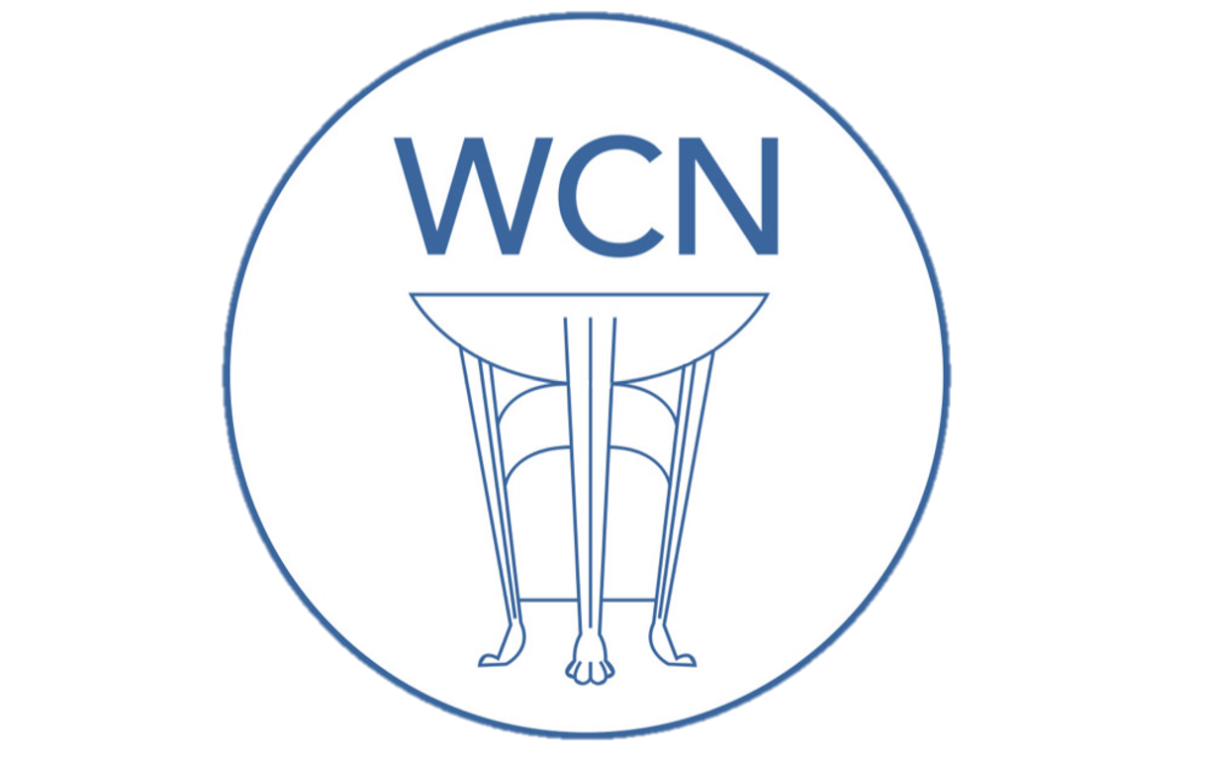
Roman Coventry and Warwickshire Project
Boudica: The Warrior Queen

Slide 2
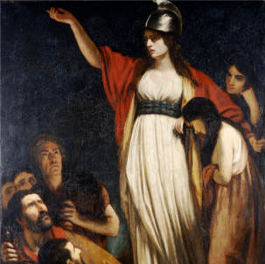
Boudica: The Warrior Queen
Boudica, queen of the Iceni based in modern-day Norfolk, is one of the most recognizable women in the Ancient Roman World.
(Right) ‘Boadicea Haranguing the Britons’ painting by John Opie (1761–1807)

Slide 3
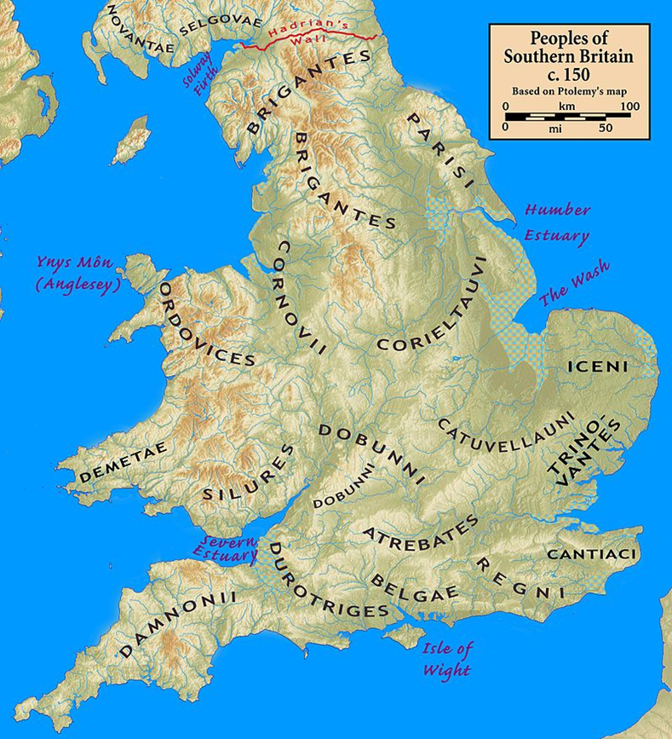
Roman Britain: An Introduction
At the behest of Emperor Claudius, legions of the Roman Army invaded Britain in AD 43 under Roman general Aulus Plautius.
The Roman Army defeated tribes in battle who would not submit to Roman rule. For those Celtic tribes who wanted to negotiate with the Romans, Claudius made the tribes into ‘client kingdoms’. The Romans allowed these tribes to maintain control of their tribal areas, and gave them wealth and status.
In exchange, the tribesmen and women had to adopt Roman ways, pay Roman taxes and give up men to fight in the Roman Army.
One famous client king was Cogidubnus of the Regni tribe who built and lived in a Roman-style villa in Fishbourne c.AD 65-90s

Slide 4
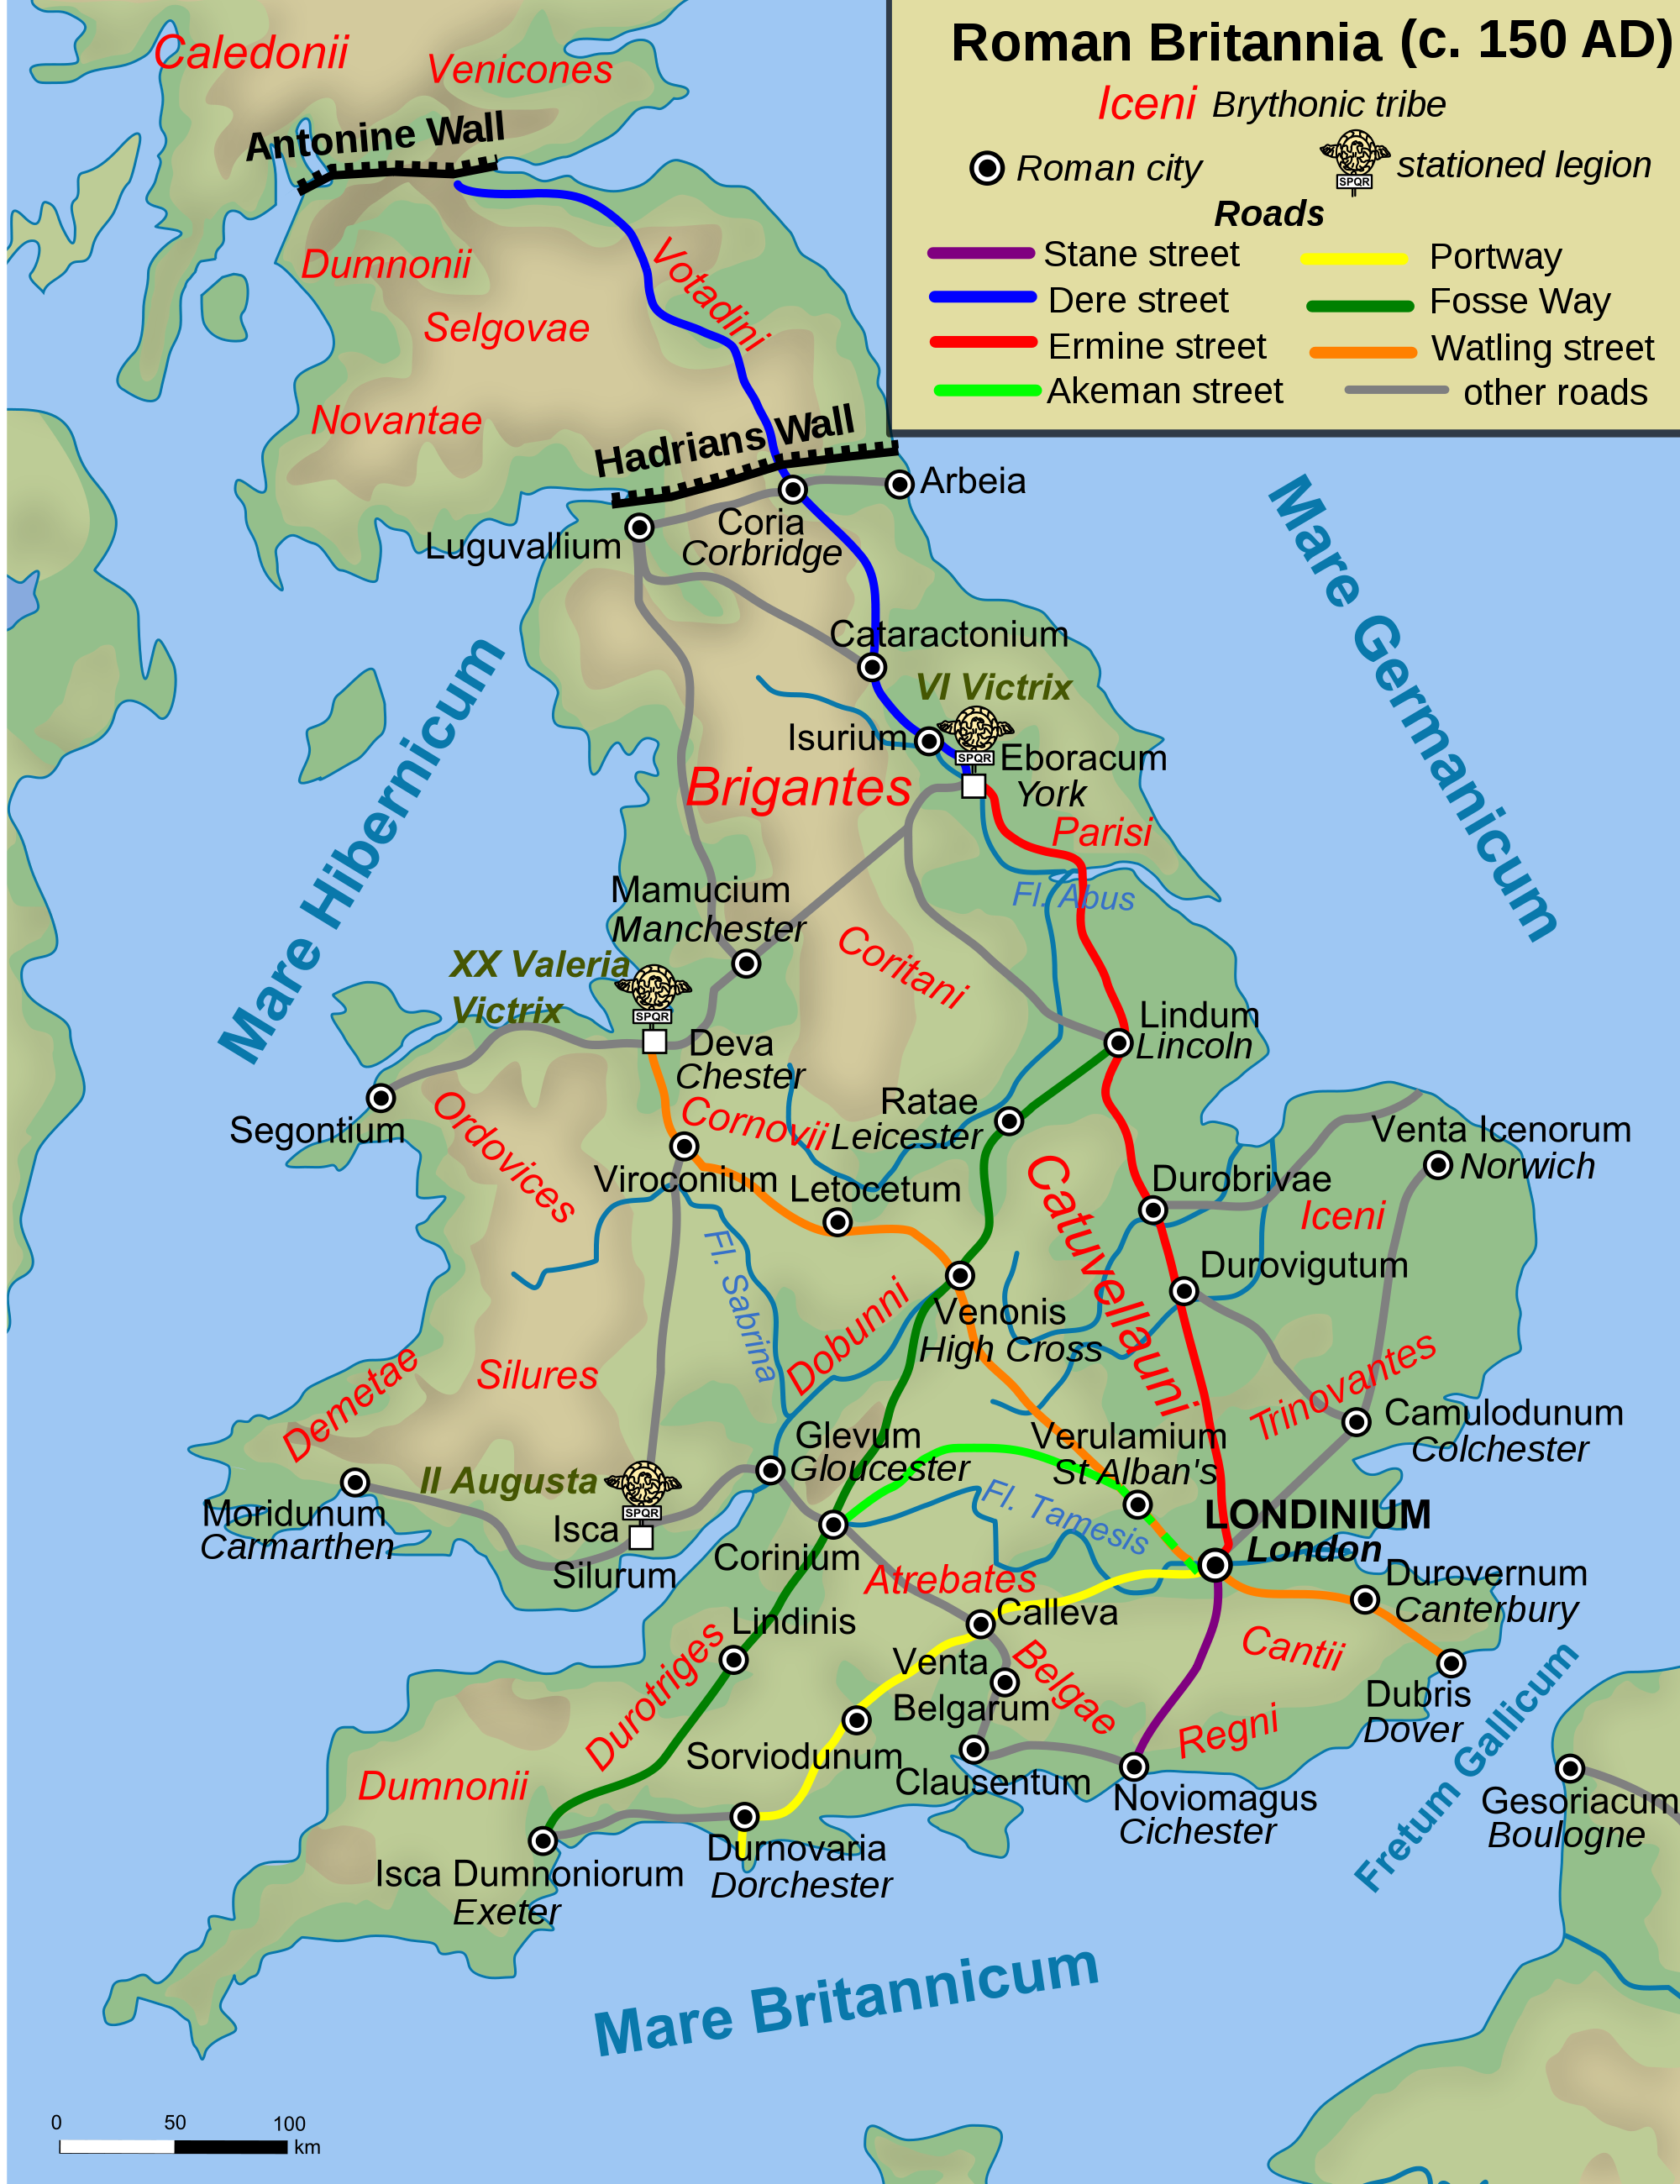
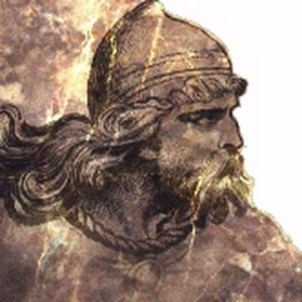
Prasutagus, Client kingship and Iceni tribe
Prasutagus (left) was the husband of Boudica and king of the Iceni tribe, whose territorial area of control was in modern day Norfolk.
When the Romans invaded in AD 43, Prasutagus allied the Iceni with the Romans.
The Iceni were proud of their independence, and had revolted in AD 47 when the Roman governor Publius Ostorius Scapula tried to disarm the peoples in Britain under Roman control after local uprisings.
Ostorius defeated them and put down other uprisings around Britain.
The Iceni remained independent under Prasutagus. But as a client king, he and the Iceni continued to support the Romans militarily after the AD 47 revolt.

Slide 5
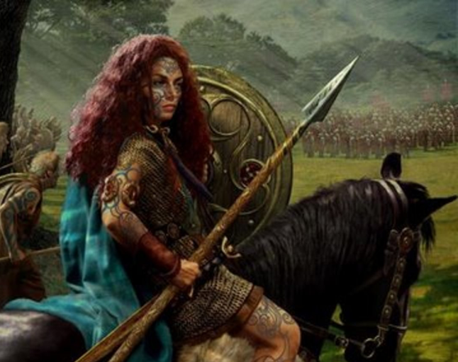
Boudica
Boudica, wife of Prasutagus, is known to historians through the writings of Roman statesmen and historians, Publius Cornelius Tacitus, and Lucius Cassius Dio.
These historians provide differing accounts of Boudica and the Iceni revolt.
After Prasutagus’ death, Boudica became the leader of the Iceni, since under Celtic law, women could govern tribes and take prominent roles in public life.

Slide 6
Boudica
Boudica’s flame-red hair is a modern artistic invention and only Cassius Dio provides historians with a description of Boudica:
  ‘In stature she was very tall, in appearance most terrifying, in the glance of her eye most fierce, and her voice was harsh; a great mass of the tawniest hair fell to her hips; around her neck was a large golden necklace; and she wore a tunic of divers colours over which a thick mantle was fastened with a brooch. This was her invariable attire.’ (LXII 2.2)

Slide 7
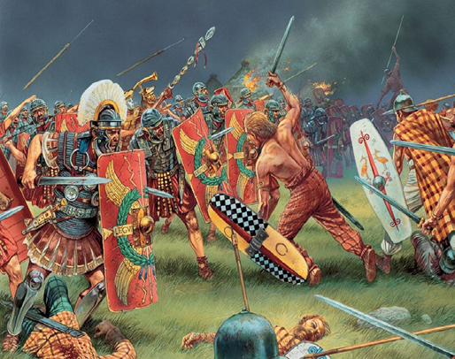
Boudica and the Iceni Revolt of AD 60-61
After Prasutagus’ death around AD 60, his will revealed that he had bequeathed the Iceni kingdom jointly to his daughters and the Roman Emperor Nero.
Prasutagus may have hoped that naming the Emperor as his heir would protect them from harm.
He was wrong. Roman legionaries pillaged the Iceni kingdom, and ransacked houses. They lashed Boudica and raped her daughters.
Boudica and the Iceni joined with the Trinovantes tribe, whom the Romans had equally mistreated.
Together they revolted against Roman rule and the Roman settlements of Camulodunum (Colchester), Londinium (London) and Verulamium (St. Albans) in succession.

Slide 8
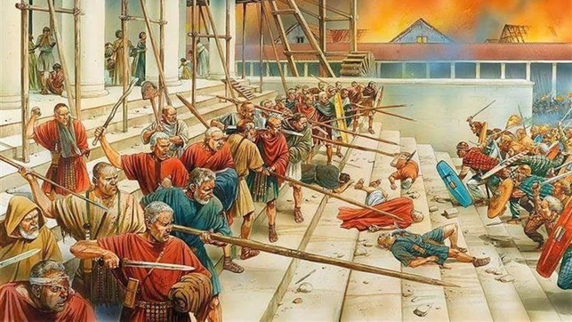
The Iceni and Camulodunum
Boudica and the Iceni and the Trinovantes tribes first attacked Camulodunum (Colchester), a Roman colonia, founded as a settlement for veterans of the Roman Army.
The veterans had mistreated local people and a temple to the Emperor Claudius was constructed in the town, making it a focus of local resentment against the Romans.
The veterans and a reinforcement of 200 auxiliary troops were no match for Boudica’s large attacking force.

Slide 9
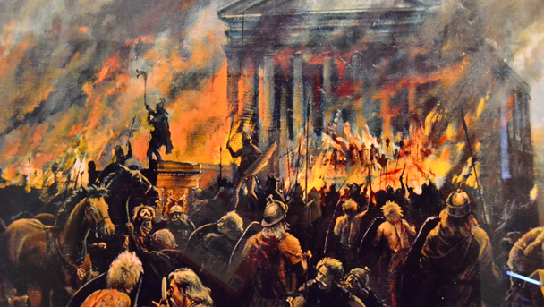
The Iceni and Camulodunum
A bronze statue to the emperor Claudius, which probably stood in front of the temple, was decapitated and its head taken as a trophy by Boudica's army. Archaeologists have shown that the city was methodically burned and raised to the ground.
The future governor Quintus Petillius Cerialis, then commanding the Legio IX Hispana, attempted to relieve the city, but suffered an overwhelming defeat. The Britons killed all except the commander and some of his cavalry who managed to escape.

Slide 10
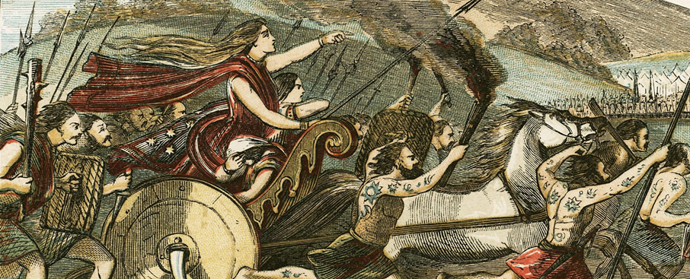
Illustration from "A History of England for the Young" by Henry Tyrrell, 1872.
Boudica and the British rebels capitalized on their victory at Camulodunum (Colchester) and advanced on Londinium (London).
When Suetonius Paulinus heard of the devastation at Camulodunum, he left a garrison at the defeated Mona and advanced ahead of his XIV (Fourteenth) Legion, with detachments from the XX (Twentieth) Legion, and auxiliary infantry and cavalry.
The Iceni and Londinium

Slide 11
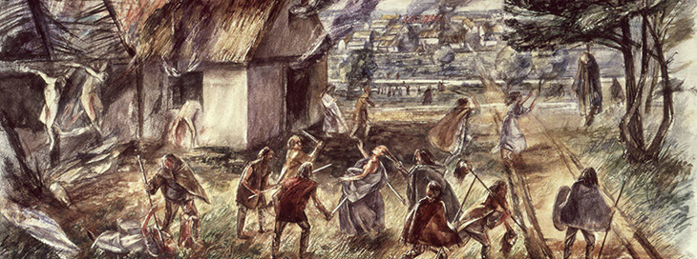
Illustration of Boudica’s massacre of Londinium, Museum of London
Suetonius learned Boudica's forces far outnumbered his own. With no walls and fewer than ten thousand troops to protect them, Suetonius told the Romans to abandon the city, and he and his troops retreated with the refugees from Londinium along Watling Street.
The rebels killed those that remained.
The Iceni and Londinium

Slide 12
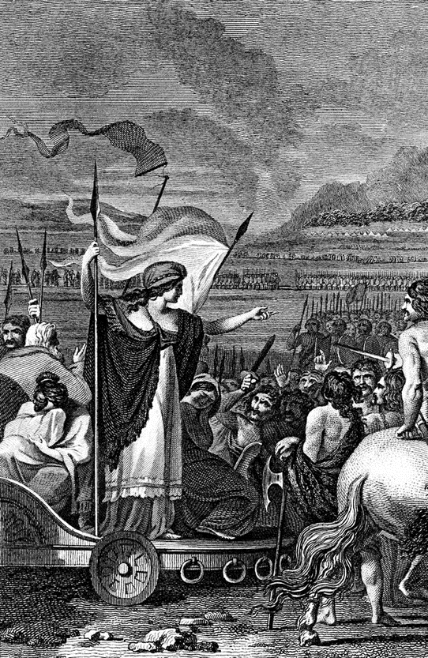

The Iceni and Verulamium
The next target of the British rebels was Verulamium, a municipium since around AD 50, meaning its citizens had what were known as "Latin Rights", a lesser citizenship status than a colonia.
Verulamium was a significant town and was in the Catuvellauni tribal area who were loyal to the Romans. As such, the Romans allowed the town a level of self-governance.
Due to being pro-Roman, Verulamium became a target for Boudica and the rebels. Boudica and the Iceni sacked and burnt it.
Suetonius offered the citizens of Verulamium the opportunity to escape with the Roman Army. Many took him up on this offer, but those that stayed suffered the same fate as those at Camulodunum and Londinium.

Slide 13
The Iceni and Verulamium
Tacitus states that 70,000 men, women and children of all ages were killed. But the true death toll is probably half that.
Suetonius offered the people of the city safe passage with his army, and while many accepted this offer, Tacitus tells us that the people of Verulamium suffered the same fate as those of Londinium (Annals 33):
  “The laments and tears of the inhabitants, as they implored his protection, found him inflexible: he gave the signal for departure, and embodied in the column those capable of accompanying the march: all who had been detained by the disabilities of sex, by the lassitude of age, or by local attachment, fell into the hands of the enemy. A similar catastrophe was reserved for the municipality of Verulamium.”

Slide 14
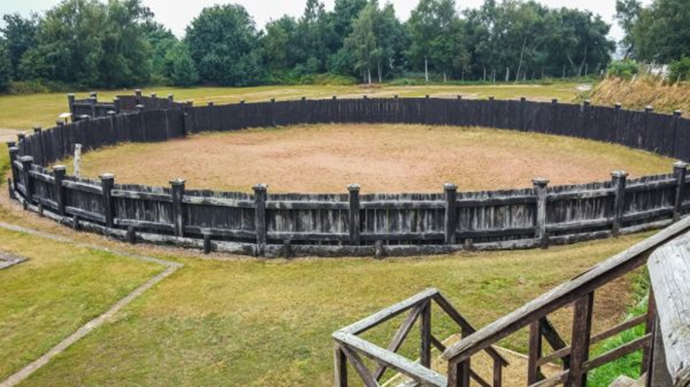
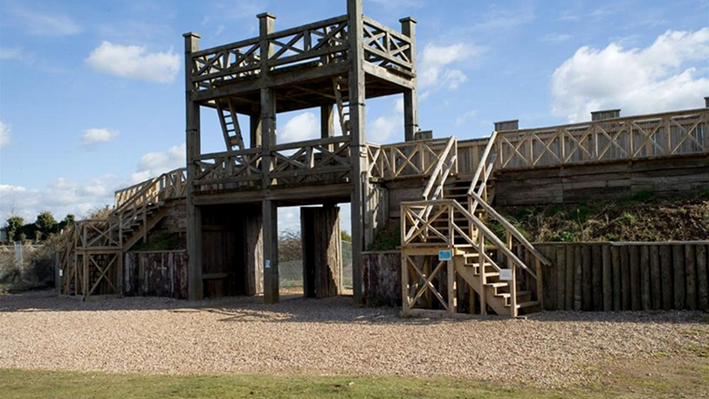
Roman Lunt and the Iceni Revolt
Lunt Roman Fort along Watling Street in modern day Baginton was a Roman military camp built in around AD 60 or 61 to deal with the revolt of Boudica and/or its aftermath.
It was a supply depot or headquarters for an unknown legion or auxiliary unit.
Histories do not know what the Romans called Lunt Fort. The name Lunt was introduced later and refers to trees or a wooded slope.
Historical knowledge comes entirely from archaeology and from how other similar sites were governed and worked.
The gyrus of Lunt (top left) was used to train Roman cavalry horses and the granary held grain for Roman legionaries

Slide 15
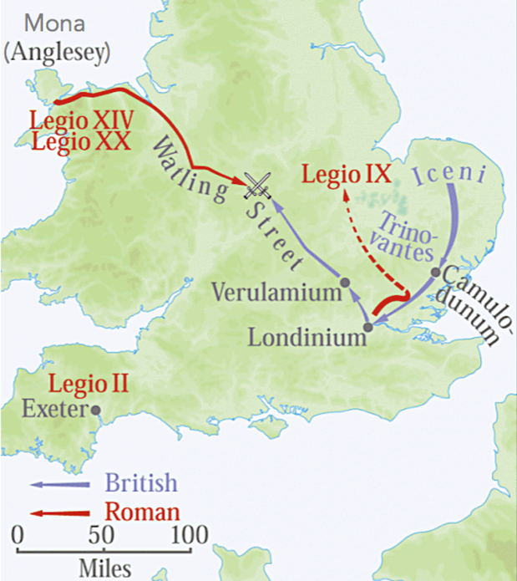
Map showing the movements of Suetonius and his legions and Boudica and the rebels towards the battle site along Watling Street. Map adapted from Military History Matters.
The Battle of Watling Street and the Death of Boudica
After sacking Verulamium, Boudica and the British rebels continued marching north. Cassius Dio claims Boudica’s numbers had swelled from 120,000 to 230,000 Britons. Webster suggests that there may have actually been 100,000 Britons.
Suetonius marched south with the legionaries from the XIV legions and detachments from two others, including the XX legion. This is estimated 11,000-13,000 Roman legionaries.
The location of Boudica's defeat remains unknown. Some historians favour a site somewhere along the Roman road Watling Street, close to High Cross, Leicestershire, on the junction of Watling Street and the Fosse Way.
It is possible that the battle took place closer to Coventry with the Lunt Fort supplying the cavalry for the battle.

Slide 16
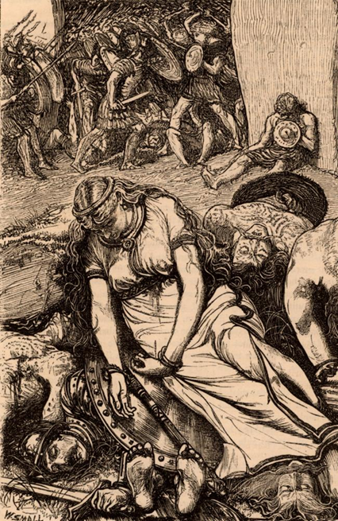
The Battle of Watling Street and the Death of Boudica
Suetonius marching south chose a narrow pass cut off by a forest to the rear.
The British rebels fought without armour, only protected by oval shields. They charged towards the Romans on chariots, and after dismounting fought with flat double-edged swords. Meanwhile the Romans fought in full armour and carried javelins and short swords.
The Romans advanced in a wedge-shaped formation, killing the rebels in hand-to-hand combat, their cavalry on the wings. The Britons became caught in the narrow defile and could not use their long swords, and were hemmed in by the women they had placed in wagons on the edges of the battlefield.

Slide 17
The Battle of Watling Street and the Death of Boudica
Suetonius’ tactic worked. Boudica’s large force, packed together in the pass, were easy targets for the Roman legionaries.
The Roman utterly destroyed Boudica’s force, and killed and captured many Britons in the forest. Defeat was due to lack of training and discipline, disorganization and overconfidence in superior numbers.
Boudica committed suicide by poison according to Tacitus and died from sickness according to Dio. With her death, the revolt of the Iceni and Trinovantes tribes ended.
(Left) An artistic illustration of Boudica’s death

Slide 18
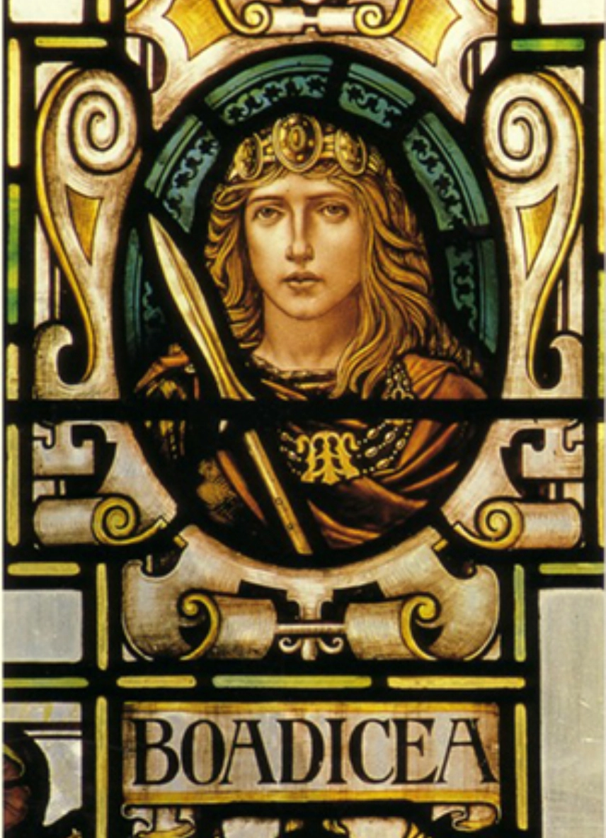
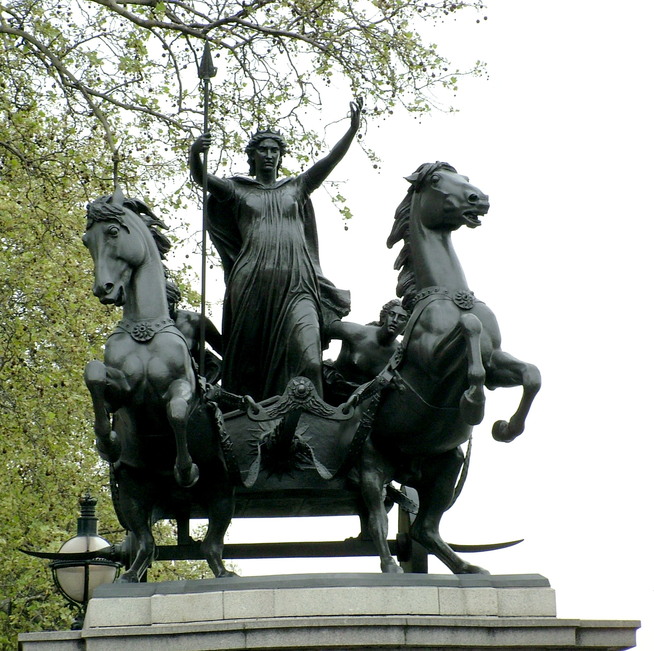
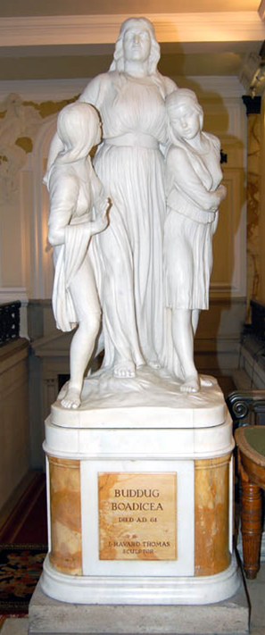
The Reception of Boudica in Britain
Boudica Stained Glass Window, detail from the Ladies Window, Moot Hall, Colchester Town Hall. 1902
Bronze statue ‘Boudicea and her Daughters’ by Thomas Thornycroft, Westminster Bridge, London, 1902
Boudica statue by J. Harvard Thomas in Cardiff City Hall

Slide 19
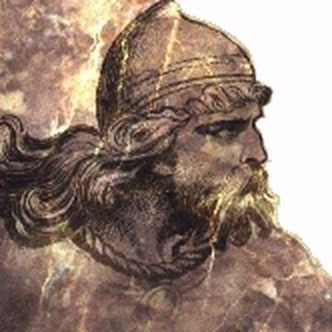
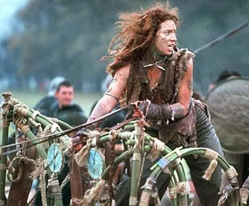
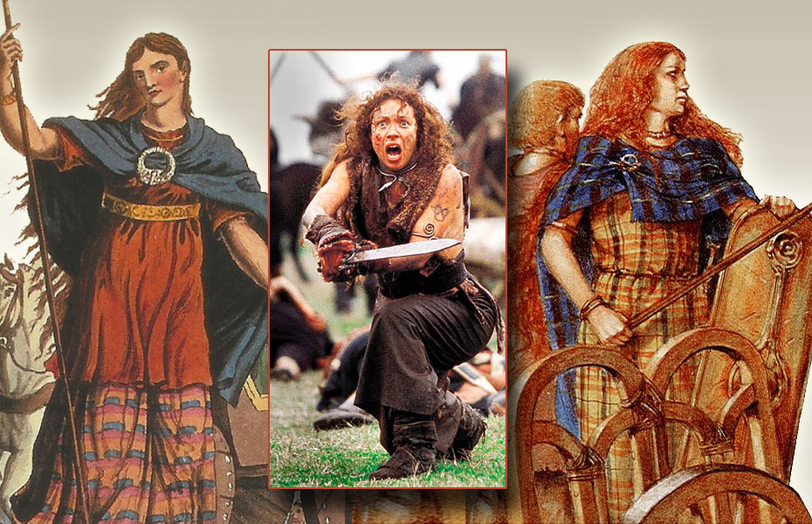
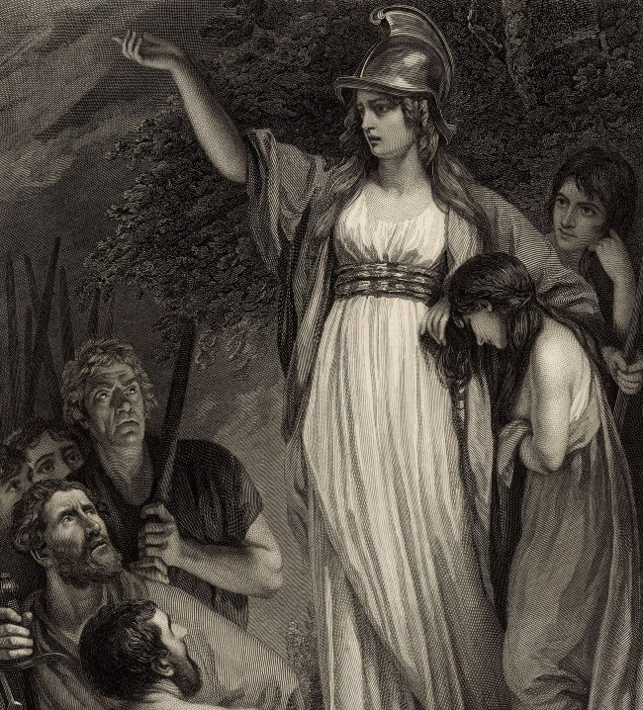
Boudica: A Warrior Queen – Conclusion
Boudica is memorialized as a symbol of freedom, nationalism, and womanhood. She provides an image of the oppressed provincial and is the female embodiment of insurgency.
Boudica was a formidable military leader, able to command many thousands of men at a time in history when women generally were subservient to men.
Although ultimately unsuccessful, her revolt makes clear that native Britons did not all embrace Roman rule and Roman ways of life willing.
The Britons reacted to Roman rule variously from enthusiastic welcome, often for personal gain, through passive acceptance, to all out rebellion, as in Boudica’s case. This reveals the complexity of Romano-British relations throughout the Roman period.
An illustration of Prasutagus

Slide 20
Further Reading
Adler, E. 2008. “Boudica’s Speeches in Tacitus and Dio.” Classical World 101: 173–95.
Aldhouse-Green, M. 2006. Boudica Britannia: Rebel, War-Leader and Queen. New York: Pearson Longman.
Allason-Jones, L. 2005. Women in Roman Britain. 2nd ed. York: Council for British Archaeology.
Andrews, I. 1972. Boudica’s Revolt. London: Cambridge University Press.
Barrett, A. A. 1990. “Claudius, Gaius and the Client Kings.” The Classical Quarterly 40 (1): 284–86.
Braund, D. 1984b. Rome and the Friendly King: The Character of Client Kingship. London: Croom Helm.
Crummy, P. 1997. City of Victory: The Story of Colchester—Britain’s First Roman Town. Colchester: Colchester Archaeological Trust.
Davies, J. 2009. The Land of Boudica: Prehistoric and Roman Norfolk. Oxford: Oxbow.
De la Bédoyère, G. 2003. Defying Rome. The Rebels of Roman Britain. Stroud: Tempus.
Ferris, I. M. 2000. Enemies of Rome: Barbarians through Roman Eyes. Stroud.
Gillespie, C. 2018. Boudica: Warrior Woman of Roman Britain. Oxford: Oxford University Press.
Hingley, R., and C. Unwin. 2005. Boudica: Iron Age Warrior Queen. London: Hambledon and London.
Hunt, R. 2003. Queen Boudica’s Battle of Britain. Kent: Spellmount.
Johnson, M. 2012. Boudica. London: Bristol Classical Press.
Mattingly, D. 2006. An Imperial Possession: Britain in the Roman Empire. London: Penguin.
Millett, M. 1990b. The Romanization of Britain: An Essay in Archaeological Interpretation. Cambridge: Cambridge University Press.
Milne, G. 1995. Roman London. London: Batsford.
Niblett, R. 2001. Verulamium: The Roman City of St Albans. Stroud: Tempus.
Trow, M. J., and T. Trow. 2003. Boudica: The Warrior Queen. Stroud: History Press Ltd.
Waite, J. 2007. Boudica’s Last Stand: Britain’s Revolt Against Rome AD 60–61. London: The History Press.

