Slide 1
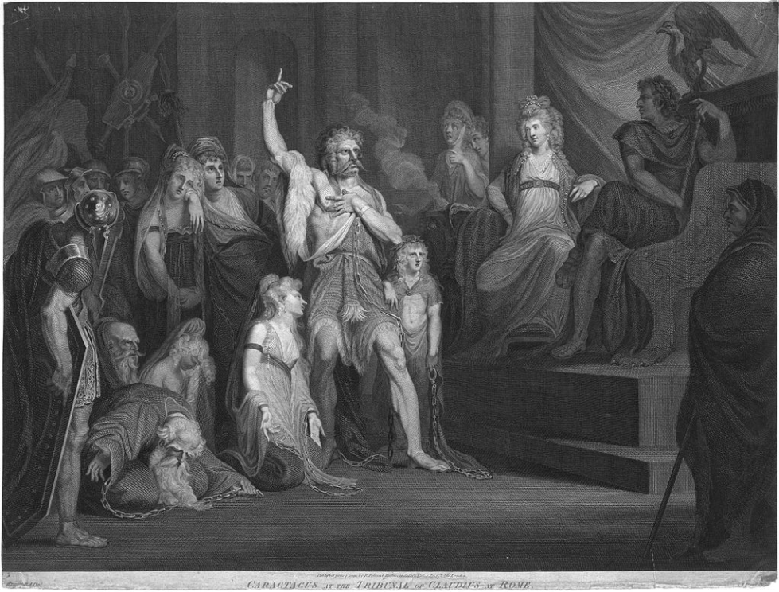

Roman Coventry and Warwickshire Project
Caratacus: Chief of the Catuvellauni

Slide 2
Caratacus: Chief of the Catuvellauni
Caratacus, the British chieftain of the Catuvellauni tribe, was a fierce opponent of the Roman Empire and led the British resistance to the Roman invasion of AD 43.
He has become a well-known figure in British history through the writings of the Roman historians Tacitus and Cassius Dio, and his frequent depiction in British art, literature and music.
This presentation tells the story of Caratacus.
(Picture) ‘Caratacus at the Tribunal of Claudius at Rome’ Engraving by Andrew Birrell of a painting by Henry Fuseli, 1792.

Slide 3
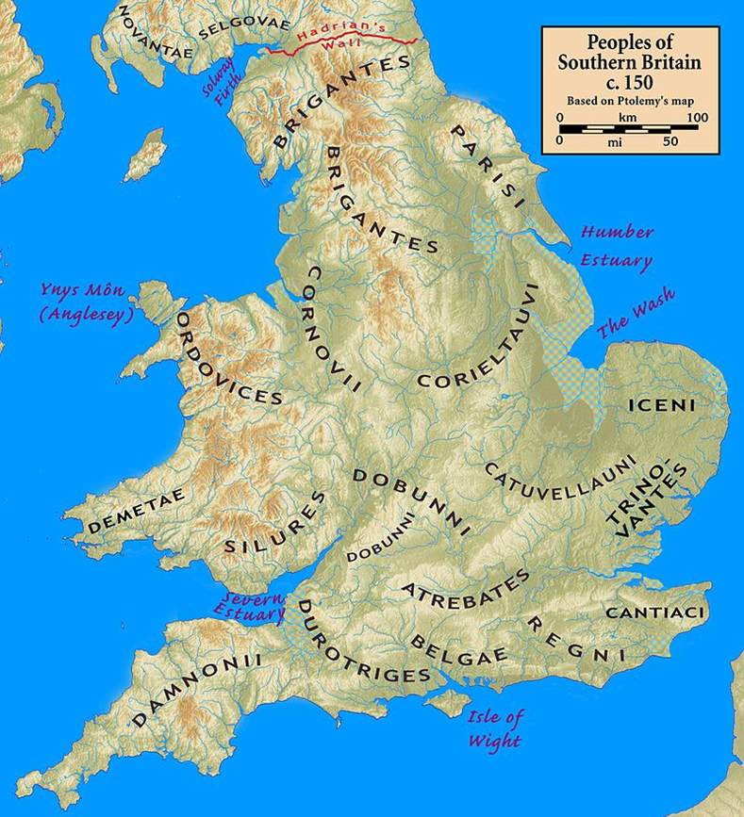
The Catuvellauni and Britain before the Romans
Before the Roman Invasion of Britain in AD 43, tribes of local Britons ruled the country with their own distinct tribal areas. The Catuvellauni operated in a large area South East England to the East of the Trinovantes and the South of the Iceni.
The name 'Catuvellauni' (Gaulish: Catu-uellauni 'war-chiefs, chiefs-of-war') stems from the Gaulish root catu- ('combat') attached to uellauni ('chiefs, commandants’).

Slide 4
The Catuvellauni and Britain before the Romans
Cassivellaunus, a member of the Catuvellauni tribe appears in Julius Caesar's Commentarii de Bello Gallico, where he was in command of the combined British forces opposing Caesar's second invasion of Britain in 54 BC, although Caesar does not mention Cassivellaunus's tribe.
After Julius Caesar’s unsuccessful invasions in 55 and 54 BC, British tribes began to form substantial economic and political links with the Roman World.
Whether or not they were formally recognized as client kings, some British chieftains regarded the Romans as powerful allies. And the Catuvellauni took part in these events.

Slide 5
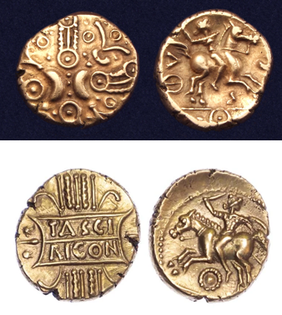
Tasciovanus, Stater, gold, 25 BC – AD 9. Obv: stylized crescents and wreaths with hidden faces. Rev: Celtic warrior on horse right, carrying carnyx.
The Catuvellauni and Britain before the Romans
Tasciovanus succeed Cassivellaunus and appears to have become king of the Catuvellauni c. 20 BC.
Although only known from numismatic evidence (coins), he ruled from Verlamion (Roman Verulamium - the site of modern-day St Albans).
Tasciovanus’ son Cunobelinus, the chieftain of the Catuvellauni, maintained throughout his long reign ( c. AD 10– 40) a skilful balance between the two bitterly opposing factions, those for, and those against, Rome.
Tasciovanus, stater, gold, 25 BC – AD 9. Obv.: TASCI / RICON: legend on stylized tablet, vertical wreath. Rev.: Horseman charging left, holding sword and shield, beaded ring below.

Slide 6
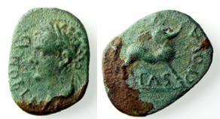
The Catuvellauni and Britain before the Romans
The links which the British tribes formed with the Romans influenced their coinage and their culture.
Despite Caesar’s demand for annual payments, the archaeological evidence suggests that wealth was flowing from the Roman world to Britain. In the decades after his expeditions, there are significant changes in the coinage of south-eastern England.
The gold coins of the pre-Caesarian period may have been deliberately withdrawn from circulation. Instead, new series began to be produced from a different stock of metal.
Cunobelinus, bronze, AD 8-41
Obv: CUNOBELINI: laureate head of Cunobelinus l. to right of and above legend. Detail surrounded by beaded border.
Rev.: TASCIOVA(NI F): legend surrounding Centaur right, blowing horn.
Size: 13mm, weight: 2.24g.

Slide 7
The Catuvellauni and Britain before the Romans
From c. 20 BC there were significant changes in the coinage of the Southern and Eastern Kingdoms.
The imagery on the coins adopted a new set of motifs, closely following the coinage of Augustus, such as laureate portrait heads.
Some issues also began to carry inscriptions: the meaning of all the inscriptions is far from clear, but some are the names of rulers known from other sources. A small number of issues bear the name with the Latin title rex. Others have the Latin formula for claimed ancestral descent, F (for filius) and a personal name in the genitive. Thus, in the Eastern Kingdom, some coins bear the inscriptions cunobelinus and tasciovani f (right).
Cunobelinus, bronze, AD 8-41
Obv: CUNOBELINI: laureate head of Cunobelinus l. to right of and above legend. Detail surrounded by beaded border.
Rev.: TASCIOVA(NI F): legend surrounding Centaur right, blowing horn.
Size: 13mm, weight: 2.24g.

Slide 8
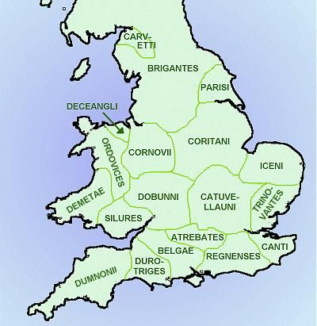
Cunobelinus, his family and the Catuvellauni
Epaticcus, a brother of Cunobelinus, expanded his influence into the territory of the Atrebates in the early AD 20s, taking the Atrebatan capital Calleva (Silchester) by about AD 25. He continued to expand his territory until his death in about AD 35.
Cunobelinus’ eldest son Togodumnus inherited the throne and with his brother Caratacus took a stance against Rome.
However a third brother, Adminius, had been given the north-east tip of Kent, which included the only land-locked harbour along the south-east coast and the Wantsum Channel into the Thames Estuary. This area included the Cantiaci tribe.

Slide 9
Cunobelinus, his family and the Catuvellauni
In AD 35, Caratacus took over from Epaticcus and the Atrebates recovered some of their territory under Verica.
Cunobelinus exiled Adminius in AD 39/40 and he fled to the Emperor Gaius ‘Caligula’ (Suet. Caligula 44).
Adminius may have persuaded Caligula that Britain was vulnerable to attack and that an invasion would be an even more famous victory for him. It is further likely that the capture of the British prince was the germ of Caligula's initiative to launch an invasion of Britain, although the invasion never happened.

Slide 10
Cunobelinus, his family and the Catuvellauni
Cunobelinus died about AD 40. Philip Crummy has suggested the Lexden Tumulus on the outskirts of Colchester as his tomb.
According to the Roman historian Suetonius, Rome's refusal to return the fugitive Adminius to his father was one of the contributory factors to growing anti-Roman sentiment in Britain, which necessitated Claudius' successful invasion of that land in AD 43 (Suet. Claudius 17).

Slide 11
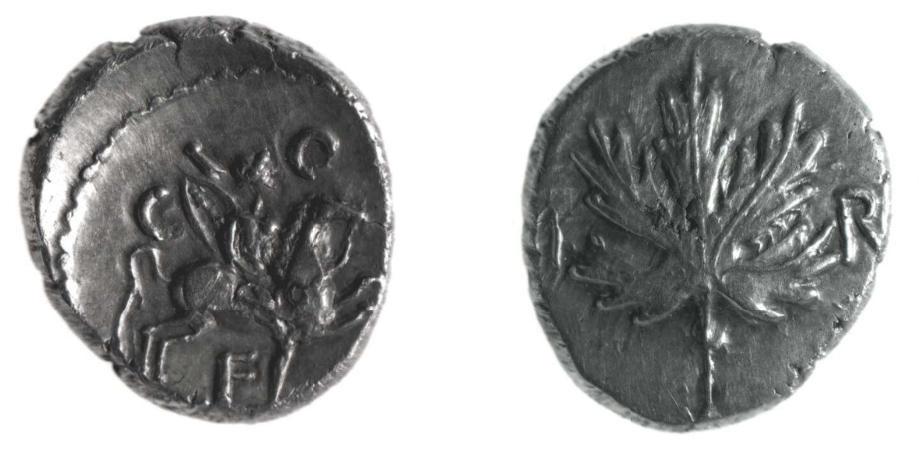
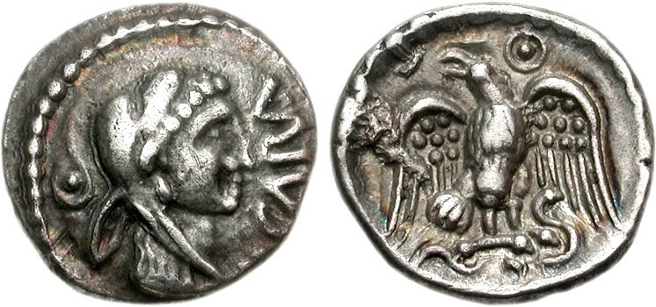
Caratacus and Verica
Caratacus's name appears as both Caratacus and Caractacus in manuscripts of Tacitus, and as Καράτακος and Καρτάκης in manuscripts of Cassius Dio. Older reference works tend to favour the spelling "Caractacus", but modern scholars agree, based on historical linguistics and source criticism, that the original Common Brittonic form was *Karatākos,, meaning "loving, beloved, dear; friend".
After Epaticcus died in about AD 35, the Atrebates, under Verica, regained some of their territory, but it appears Caratacus completed the conquest some time after AD 40.
This is because Verica was ousted, fled to Rome and appealed to the emperor Claudius for help. This was the excuse used by Claudius to launch his invasion of Britain in the summer of AD43 (Cassius Dio Roman History 60.19).
After the invasion, Verica may have been restored as king, but this is not attested in the historical or archaeological record. In any case a new ruler for the region, Cogidubnus, soon appeared. Cogidubnus may have been an heir of Verica who by this time would have been very elderly indeed.
Verica, stater, silver, AD 10-40; BM 1988,0627.264.
Obv.: VI RI: legend either side of vine leaf.
Rev: C O F: legend surrounding horseman r. with sword and spear.
Weight: 5.32g.
Caratacus, stater, silver, AD 43-50
Obv.: CARA: Head of Herakles r., wearing lion skin; ornament behind. Beaded border surrounding.
Rev.: Eagle standing facing on serpent, head l., with wings displayed; pellet-in-annulet to upper right. Beaded border surrounding.
Size: 12mm, Weight: 1.15 g

Slide 12
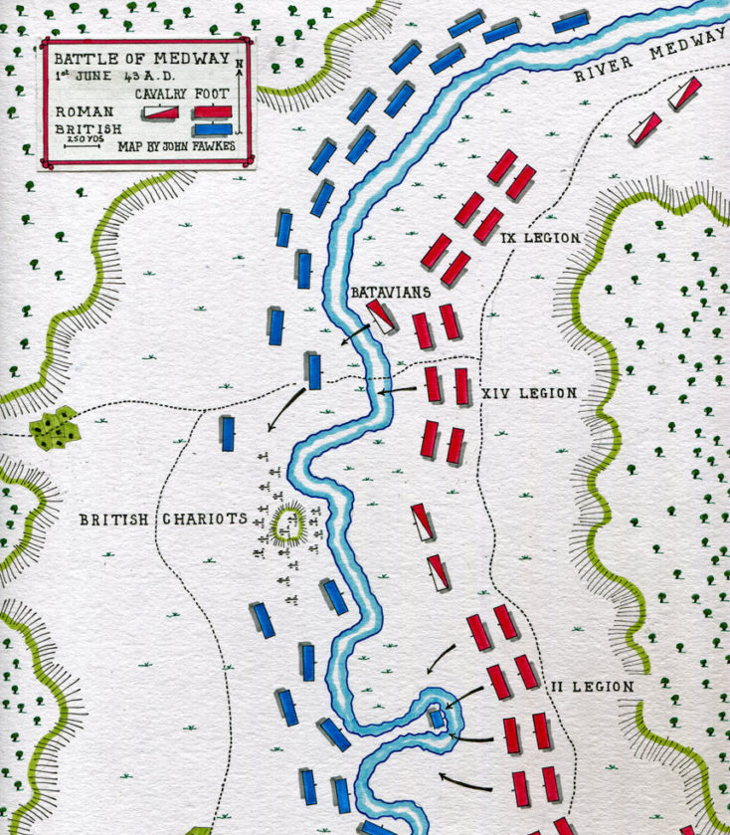
Caratacus and the Battle of the River Medway
Caratacus and his brother Togodumnus led the initial defence of the country against Aulus Plautius's four legions, thought to have been around 40,000 men, primarily using guerrilla tactics.
Cassius Dio, the only contemporary source for the Battle of Medway, stated that the Battle opened with the Batavians (a Germanic tribe) using their skill of swimming across rivers in full equipment (Roman History 60.20). They probably went a little downstream where the current was slower and where a ford may have existed.
Then the Batavians attacked the British rear and wounded the horses that pulled their chariots. British morale would have been affected by the loss of their horses and the realisation that the Romans had easily crossed the tidal river. Strategically, the British charioteers were now forced to become slow moving infantry.
Map of the Battle of Medway on 1st June 43 AD in the Roman Invasion of Britain: map by John Fawkes

Slide 13
Caratacus and the Battle of the River Medway
In the chaos that followed, the bulk of the invasion force spearheaded by Legio II Augusta under Vespasian crossed the river, under the overall command of Titus Flavius Sabinus. The natives were taken by surprise at how fully armed legionaries were able to cross the river.
The Romans were unable to press on to victory immediately, and the first day of fighting ended without a result. During the second day, a daring attack led by Gnaeus Hosidius Geta almost led to the Roman officer being captured. His troops retaliated, however, and put the Britons to flight.
Geta was awarded a triumph for securing victory, a rare honour for someone who had not been consul.
Togodumnus was killed, making Caratacus leader of the Catuvellauni.
Map of the Battle of Medway on 1st June 43 AD in the Roman Invasion of Britain: map by John Fawkes

Slide 14
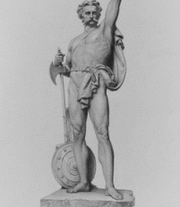
Caratacus at the River Thames
Having won the Battle of the Medway, the Romans would have followed up quickly by killing as many of the retreating British troops as possible. This was a task normally done by the auxiliary cavalry. Their objective was to kill enemy soldiers so they were no longer a threat to Rome. The four legions followed.
The British had retreated to the north bank of the Thames. The Batavian cavalry had fought well in the first phase of the Battle of the Medway by swimming across the river in full equipment.
Dio said they performed a similar role here (Roman History 60.20). The Roman Army then crossed the Thames by a bridge a little further upstream, as Dio also described.
A sketch of James Henry Foley’s statue of Caratacus

Slide 15
Caratacus at the River Thames
The bridge site may have been near the current location of London Bridge or Westminster or even at Brentford, although the latter seems a long way to the west.
Roman sources give no indication of a large battle at this stage of the invasion. This suggests that the crossing of the Thames was essentially unopposed, as the British had given up the unequal struggle.
It was probably at this time that Caratacus realised that the south east of England was a lost cause. This included his family tribal base at Colchester. This was due to the might and organisation of the Roman Army that had defeated the British at the Battle of the Medway.
A sketch of James Henry Foley’s statue of Caratacus

Slide 16
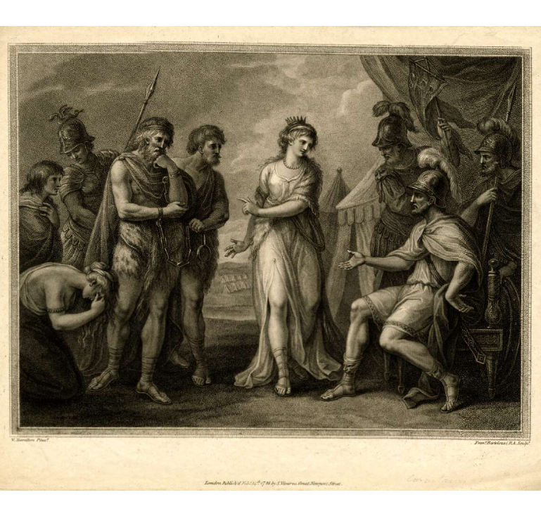
Caratacus in Exile and a Final Battle
Caratacus escaped the Romans at the River Thames and made his way to south west Wales and the Silures tribe.
By about AD 50, the Roman Army under the Roman governor Publius Ostorius Scapula had advanced into Wales.
Tacitus reports that Caratacus led the Silures and Ordovices tribes against the Roman Army (Annals 12.33).
Tacitus describes the battle between the Roman Army and the British tribesmen. Caratacus erected a rampart on a sloping hill in front of a river. Caratacus encouraged his men to fight and the Roman soldiers urged Scapula to do the same (Annals 12.34-35).
Caratacus, King of the Silures, deliver'd up to Ostorius, the Roman General, by Cartismandua, Queen of the Brigantes. Print by Francesco Bartolozzi; British Museum (1868),0808.2826

Slide 17
Caratacus in Exile and a Final Battle
The Romans initially took heavily casualties from missiles which the Britons threw from the rampart. But, after forming a testudo, they advanced, broke down the rampart and routed the armourless Britons (Annals 12.35).
The Romans captured Caratacus’ wife, daughters and his brothers surrendered.
Caratacus escaped and sought the protection of Cartimandua, Queen of the Brigantes. But, she delivered him to the Romans in chains (Annals 12.36).
Caratacus, King of the Silures, deliver'd up to Ostorius, the Roman General, by Cartismandua, Queen of the Brigantes. Print by Francesco Bartolozzi; British Museum (1868),0808.2826

Slide 18
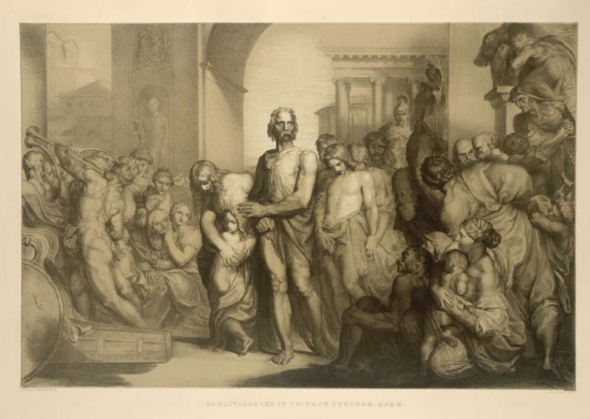
Caratacus Captive of Rome
The Roman historian Tacitus reports that Caratacus had become famous in the Roman World as a native tribesman who had long defied Roman rule.
Caratacus and his family were led through the streets of Rome in a triumphal procession as a captive spoil of war (Annals 12.36).
Tacitus records that Caratacus made an impassioned speech to Emperor Claudius:

Slide 19
Caratacus Captive of Rome
“Had my lineage and my rank been matched by my moderation in success, I should have entered this city rather as a friend than as a captive; nor would you have scorned to admit to a peaceful league a king sprung from famous ancestors and holding sway over many peoples. My present lot, if to me a degradation, is to you a glory. I had horses and men, arms and riches: what wonder if I lost them with a pang? For if you would rule the world, does it follow that the world must welcome servitude? If I were dragged before you after surrendering without a blow, there would have been little heard either of my fall or of your triumph: punishment of me will be followed by oblivion; but save me alive, and I shall be an everlasting memorial of your clemency.” (Annals 12.37)
After this speech, Claudius freed Caratacus and his family and allowed them to live freely in Rome.

Slide 20
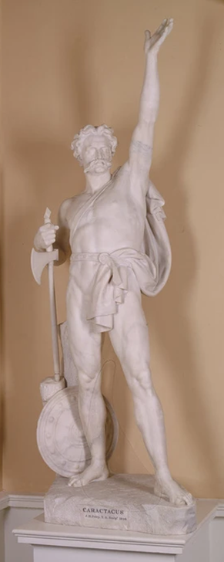
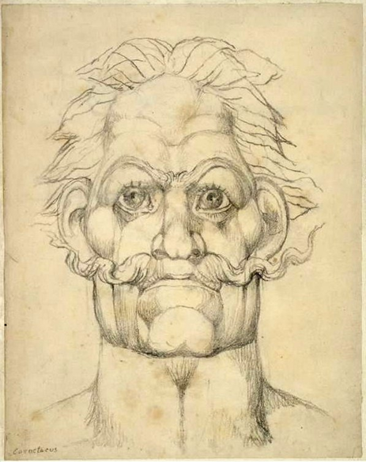
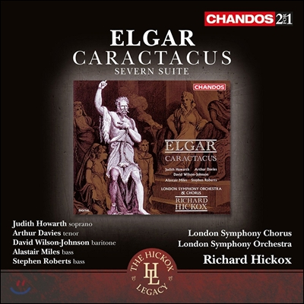
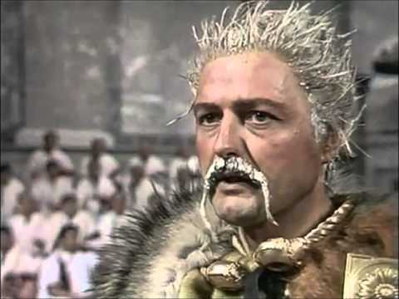
The Reception of Caratacus in Britain
The actor Peter Bowles as Caratacus in the television adaptation of Robert Graves’ I, Claudius, 1976
‘Caratacus’ by William Blake, 1819
Statue of Caratacus by James Henry Foley, 1860. Mansion House, London
‘Caratacus’ a cantata by Edward Elgar, 1897.

Slide 21
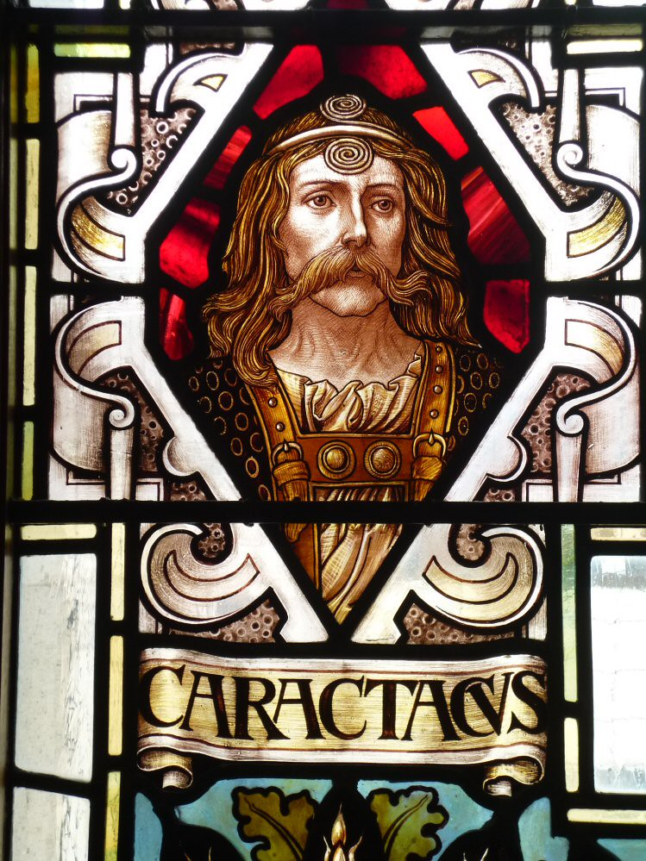
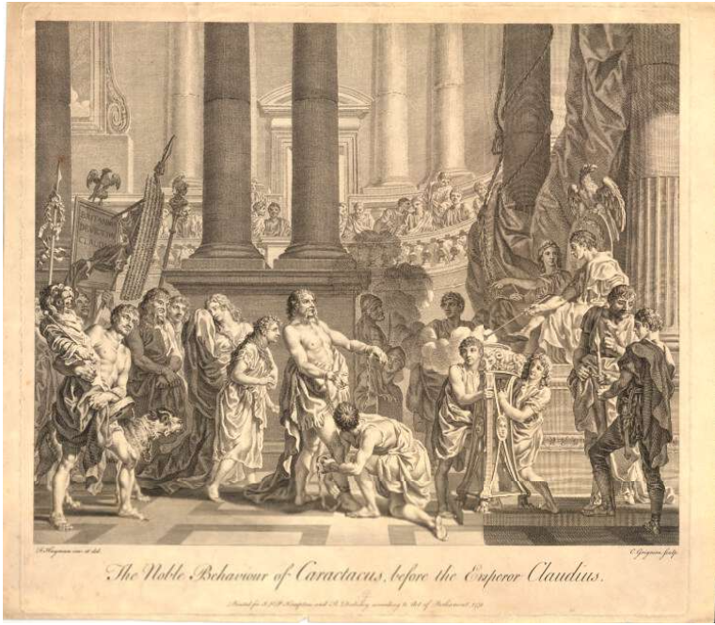
Caratacus: Chief of the Catuvellauni - Conclusion
Interaction between Britain and the Roman World created substantial change in Britain. But not all Britons greeted the arrival of the Romans warmly.
Caratacus and the Catuvellauni were among the chief opponents of Rome in the early years of the Roman occupation of Britain.
Through the writing of Tacitus and Cassius Dio, Caratacus is remembered as a valiant native British chieftain who fought repeatedly against the might of Rome, which had invaded his homeland.
Because of this, Caratacus has captured the imagination of British artists, writers and composers for centuries, and even formed part of recruiting efforts in Wales during the Great War 1914-18.
Caratacus stained glass window, Moot Hall in Colchester's Town Hall
The Noble Behaviour of Caratacus before the Emperor Claudius, 1751. Engraving by Charles Grignion after Francis Hayman; British Museum 1867,1012.758

Slide 22
Further Reading
Anon. (1904) The Welsh Historical Drama and How to Produce it. Being the Actual Experience of the Abergele County School Company in the Production of “Caratacus” (CARADOG). Illustrated by Flash-light Photographs Taken during an Actual Performance. Reprinted from “The Welsh Leader” February and March 1904. Caernarvon: Welsh Leader Office.
Bean, S. C. (2000). The Coinage of the Atrebates and the Regni. Oxford: Oxford University School of Archaeology.
Braund, D. (1996). Ruling Roman Britain: Kings, Queens, Governors and Emperors from Julius Caesar to Agricola. Abingdon: Routledge.
Carver, E. (2001). The Visibility of Imported Wine and its Associated Accoutrements in Later Iron Age Britain. British Archaeological Reports, British Series 325. Oxford: Archaeopress.
Cooley, A. (2009). Res gestae divi Augusti: Text, translation, and commentary. Cambridge: Cambridge University Press.
Creighton, J. (2000). Coins and Power in Late Iron Age Britain. Cambridge: Cambridge University Press.
Champion, C. (2016). Britain before the Romans. In M. Millett, L. Revell, & A. Moore (Eds.), The Oxford Handbook of Roman Britain (pp. 150-178). Oxford: Oxford University Press.
Creighton, J. (2006). Britannia: The Creation of a Roman Province. London: Routledge.
Crummy, P. (2007). Stanway: An Élite Burial Site at Camulodunum. London: Society for the Promotion of Roman Studies.
Elgar, Edward (1898) Caratacus: A Cantata for Soprano, Tenor, Baritone, and Bass Soli, Chorus and Orchestra, the Words Written for Music by H.A. Acworth, the Music by Edward Elgar (Op. 35), Choruses Only, with Words of Solos, Translated into Tonic Sol-Fa Notation by W.G. McNaught. London and New York: Novello
Hall, E., & Stead, H. (2020). A People's History of Classics: Class and Greco-Roman Antiquity in Britain and Ireland 1689 to 1939. Abingdon-on-Thames: Routledge.
Hall, E. (2020). British Imperialist and/or Avatar of Welshness?: Caratacus Performances in the Long Nineteenth Century. In F. Kaminski-Jones, & R. Kaminski-Jones (Eds.), Celts, Romans, Britons: Classical and Celtic Influence in the Construction of British Identities (pp. 141-159). Oxford: Oxford University Press.
McGuire, Charles Edward (2007) ‘Elgar and Acworth’s Caratacus: The druids, race and the individual hero’, In: Elgar Studies, J.P.E. Harper-Scott and Julian Rushton (eds.), Cambridge: CUP, 50–77.
Turner, H.E., Herbert Longhurst and Geo. G. Lewis (1924) Caratacus: A Juvenile Operetta for Boys and Girls and Infants. Words by H.E. Turner. Music by Herbert Longhurst and Geo. G. Lewis. London and Philadelphia, Pennsylvania: J. Curwen/Curwen Inc.
Young, D. (2021). Battle of Medway: Vespasian and the Roman Conquest of Britain in 43 AD. Retrieved from BritishBattles.com: https://www.britishbattles.com/wars-of-roman-britain/battle-of-medway/

