Slide 1


Roman Coventry and Warwickshire Project
Relations with Rome:
Cartimandua Queen of the Brigantes

Slide 2
Who was Cartimandua?
Her name is understood to be of Celtic origin, meaning “white filly”.
She appears in the historical record from 51-69 CE.
Most famous for handing over Caractacus, king of the Catuvellauni tribe to the Romans.
She was from a leading native family and was the hereditary queen/ruler of the tribe of the Brigantes.

Slide 3
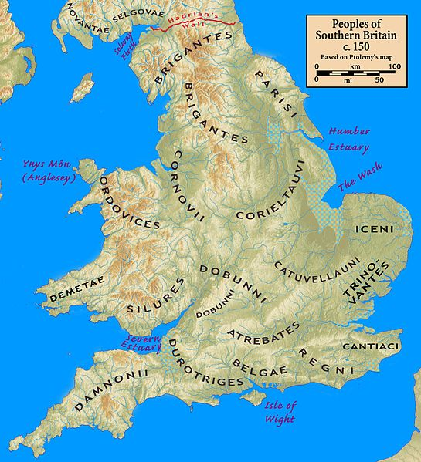
The Brigantes
A large tribe or a coalition of smaller tribes, who occupied and controlled a large part of northern England.
Seneca mentions the Brigantes as carrying dark blue shields “caeruleos scuta Brigantas” Seneca Apocolocyntosis, 12.
Likely to have been named after Brigantia - a female native deity – the personification of the tribe.
Several altars attest to her worship, by native British, Gallic and Roman people.
Iconographically Brigantia is represented similarly to Minerva and Victory.

Slide 4
Literary Sources for Cartimandua
She appears in Tacitus’ Histories and Annals.
Who was Tacitus?
A famous Roman orator, politician and historical writer.
Born ca. 56-57 CE (when Nero was emperor).
Lived and worked under several emperors including Domitian, Nerva, Trajan and Hadrian.
Consul in 97 CE, and governor of Anatolia (Asia).
Works in which Cartimandua appears:
Histories – covers time period from 1 January 69 CE to the death of Domitian in 96 CE. Only partially survives, covering January 69-August 70 CE. Published in parts from 105 CE onwards.
Annals – historical work from just before death of Augustus in 14 CE through to end of Nero’s reign in 68 CE. Some of it has not survived. Published between 115-120 CE.
Histories, 3.45
Annals, 12.36 and 12.40.

Slide 5
What does Tacitus tell us?
Caratacus
King of the Catuvellauni, and after the loss of the south-east, became leader of the Silures.
Defeated, he sought refuge with Cartimandua, but she handed him over to the Romans (51 CE).
Venutius
Husband of Cartimandu for some time before the Caratacus event. Possibly a leader of another tribe and their alliance may have strengthened Cartimandua’s hold on power.
Sometime between 51 and 57 CE, Cartimandua and Venutius divorced. Venutis then attacked, but was repelled by Cartimandua, aided by Roman forces.
Vellocatus
Venutius’ armour-bearer, who Cartimandua married and shared power with around 69 CE.
According to Tacitus, this caused a huge outcry and resulted in Brigantian uprising. Cartimandua again requested Roman assistance, but she was ousted and Venutius took control.
He was taken to Rome and paraded in Claudius’ triumph, but then released after an impassioned speech for clemency (see Tacitus Annals, 12.36-37).
Around 69 AD, he attacked again, and took power, forcing Cartimandua out.

Slide 6
Tacitus Histories, 3.45
“…Queen Cartimandua. She was ruler over the Brigantes, having the influence that belongs to high birth, and she had later strengthened her power when she was credited with having captured King Caratacus by treachery and so furnished an adornment for the triumph of Claudius Caesar. From this came her wealth and the wanton spirit which success breeds. She grew to despise her husband Venutius, and took as her consort his squire Vellocatus, whom she admitted to share the throne with her. Her house was at once shaken by this scandalous act. Her husband was favoured by the sentiments of all the citizens; the adulterer was supported by the queen’s passion for him and by her savage spirit. So Venutius, calling in aid from outside and at the same time assisted by a revolt of the Brigantes themselves, put Cartimandua into an extremely dangerous position. Then she asked the Romans for protection, and in fact some companies of our foot and horse, after meeting with indifferent success in a number of engagements, finally succeeded in rescuing the queen from danger. The throne was left to Venutius; the war to us.”
(Translation from Loeb)

Slide 7
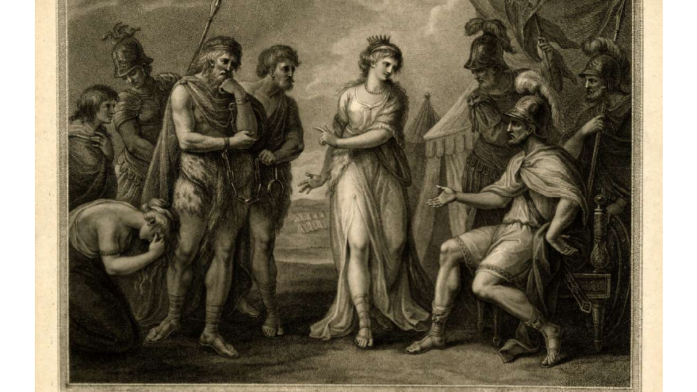
Discussion: How much can Cartimandua be understood to represent an example of positive interaction between the Romans and native tribes?
18th century print depicting Cartimandua handing over Caratacus to Ostorius, British Museum No. 1868,0808.2826

Slide 8
Cartimandua’s characterisation by Tacitus
Relationship with the Romans is a positive one, however, Tacitus does undermine her character and question her morality by highlighting the following:
Treachery.
Immoral behaviour; unfaithful to Venutius.
Negative connotations in other words he uses in Histories 3.45.
Why does he characterise her this way?
Cartimandua is non-Roman, “barbarian”.
She is a woman – female rule an alien concept to Roman thought.
Threat to Roman patriarchal society.
Reflects distrust of women.

Slide 9
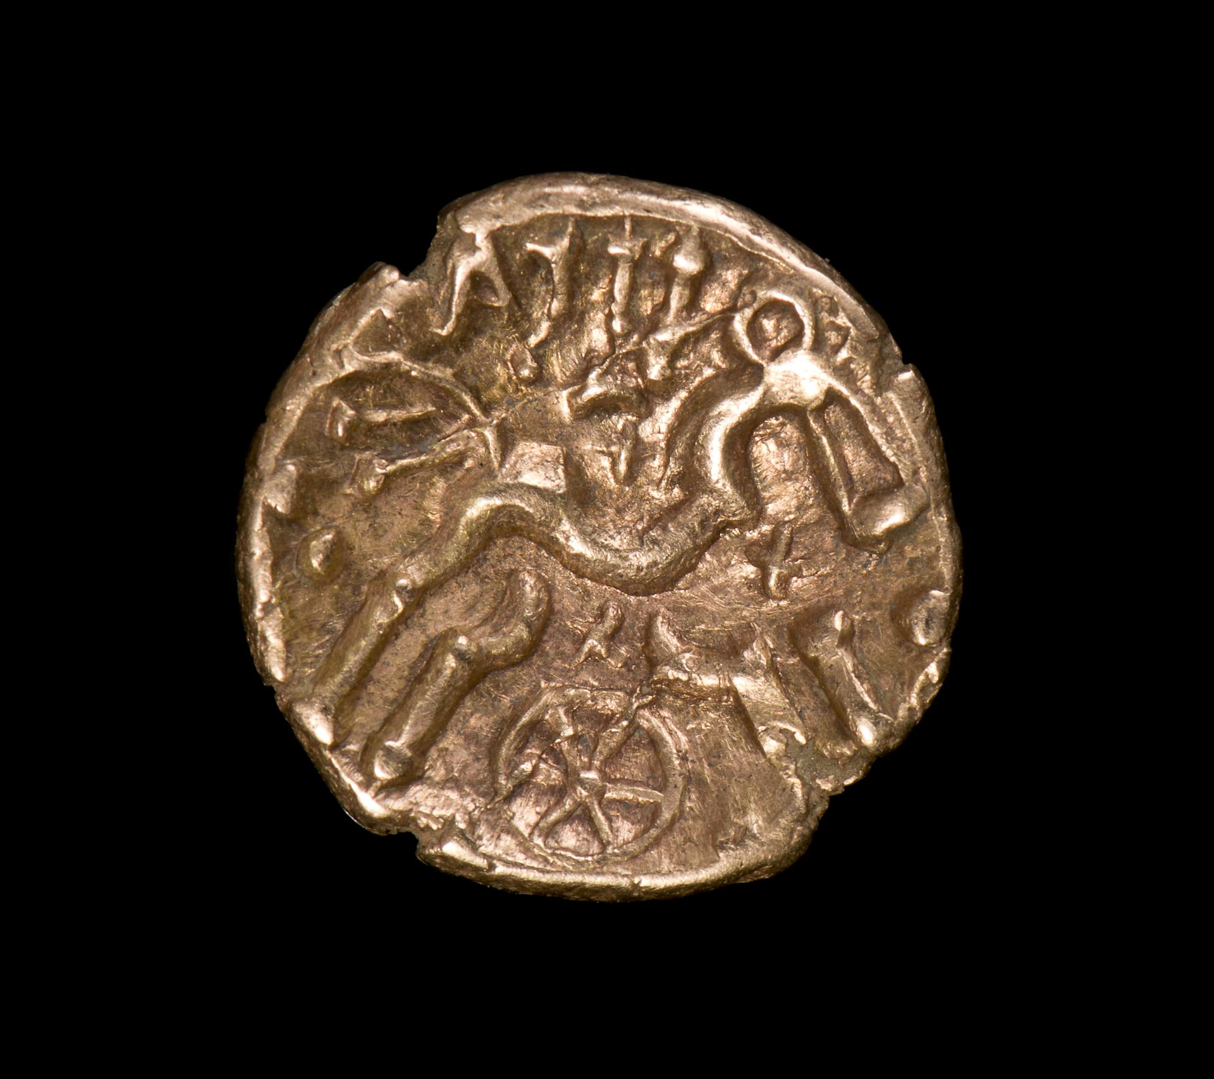
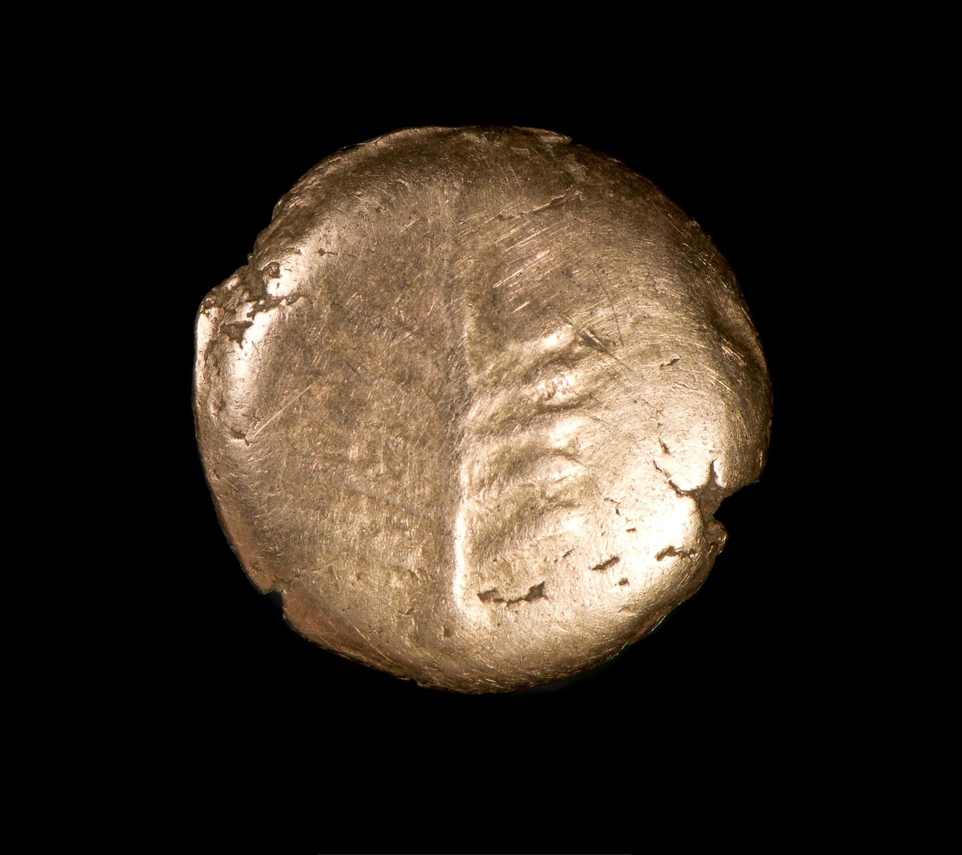
Local tribes and potential interaction with Rome
The Dobunni and Corieltauvi likely to have been the inhabitants of the area around Warwickshire and Coventry.
They would have lived in Iron-Age settlements such as the one found in 2002 on campus at the University of Warwick.
Cassius Dio Roman History 60.20 refers to the Dobunni as being subordinate to the Catuvellauni.
The Dobunni surrendered to the Roman advance of Aulus Plautius in 43 CE.
No evidence for their involvement in uprisings – possible that they had peaceful relations after initial conquest.
Gold stater of the Dobunni, 10-40 CE, National Museum Wales, Item No. 90.74H

Slide 10
Bibliography
Ancient Sources:
Petronius, Seneca, Satyricon. Apocolocyntosis, edited and translated by Gareth Schmeling, Loeb Classical Library 15, Cambridge, MA, Harvard University Press, 2020.
Tacitus, Histories: Books 1-3, translated by Clifford H. Moore, Loeb Classical Library 111, Cambridge, MA, Harvard University Press, 1925.
Tacitus, Annals: Books 4-6, 11-12, translated by John Jackson, Loeb Classical Library 312, Cambridge, MA, Harvard University Press, 1937.
Secondary Sources:
Aldhouse-Green, M. (2018) Sacred Britannia, The Gods and Rituals of Roman Britain, Thames & Hudson, London.
Allason-Jones, L. (2005)Women in Roman Britain, Council for British Archaeology, York.
Braund, D. (1984) “Observations on Cartimandua” in Britannia, Vol. 15 (1984), pp. 1-6.
Crawford, J. (2002) “Cartimandua, Boudicca, and Rebellion: British Queens and Roman Colonial Views” in eds. T.L. Hunt et al, Women and the Colonial Gaze, Palgrave Macmillan, London, pp.17-28.
De La Bédoyére, G. (2015) The Real Lives of Roman Britain, Yale University Press, New Haven and London.
Hobbs R. and Jackson, R. (2010) Roman Britain, Life at the Edge of Empire, British Museum Press, London.
Howarth, N. (2008) Cartimandua, Queen of the Brigantes, The History Press, Stroud.
Moorhead, S. and Stuttard, D. (2016) The Romans Who Shaped Britain, Thames & Hudson, London.

