Slide 1
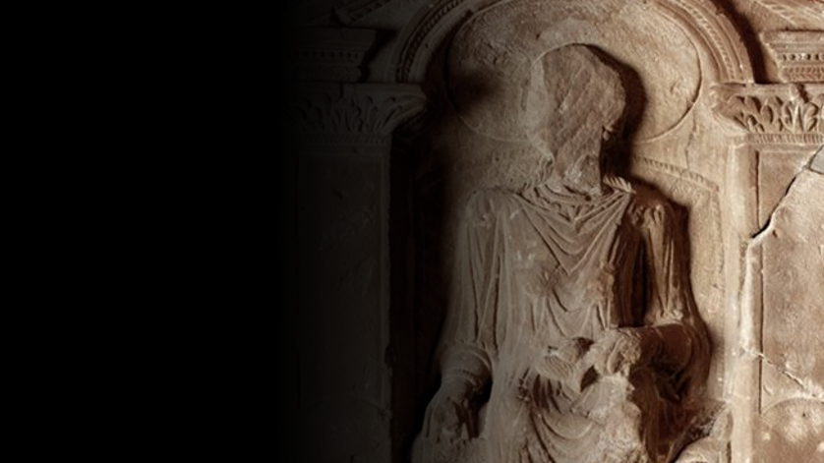

Roman Coventry and Warwickshire Project
Diversity in Roman Britain

Slide 2
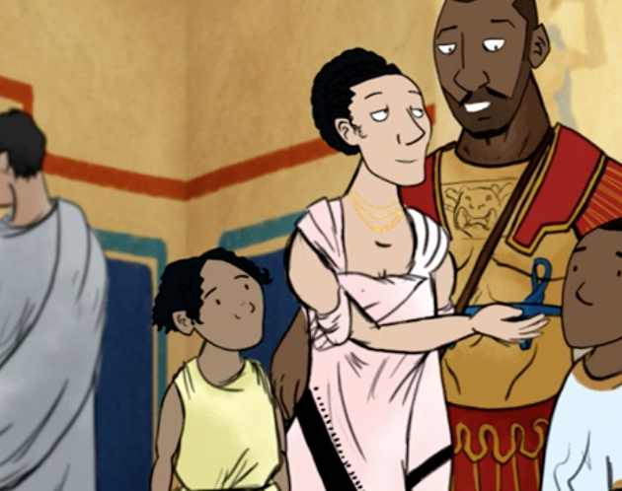
Introduction
A few years ago, in 2016, a BBC created animation on Roman Britain caused some controversy through its depiction of a typical Romano-British family as shown here.
The depiction of a racially mixed family group had some commentators up in arms. And yet evidence suggests that the scene was a perfectly plausible one for Roman Britain and in fact allows us to open up a very interesting discussion about the diverse make up of the Romans who found themselves on these shores.
Who were they are where did they come from? And what evidence do we have?

Slide 3
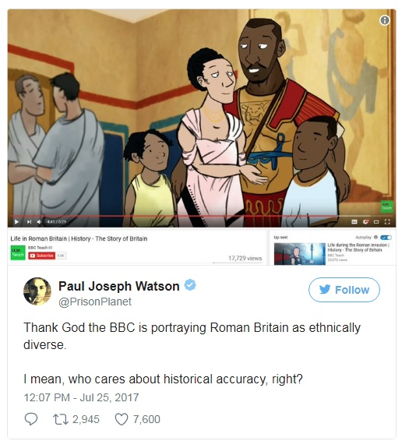
How diverse was Roman Britain?
Right is the tweet from Alt Right commentator Paul Joseph Watson, that kicked off the debate.
In what follows we will discuss the actual evidence for ethnic diversity in Roman Britain focusing on the examples of:
An Ethiopian at Hadrian’s Wall
Quintus Lollius Urbicus – an Algerian governor of Britain?
Syrians at South Shields
‘Ivory bangle Lady’ in York
Plus a few other examples and discussions on migration and mobility within the Roman empire.

Slide 4
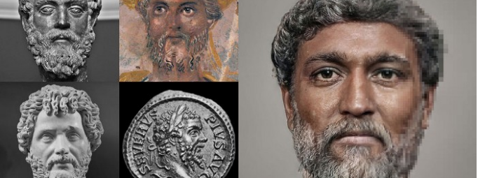
How diverse was Roman Britain? Septimius Severus and the Ethiopian
The following is adapted from a 2017 blog by Dr Matthew Nicholls of the Department of Classics, University of Reading which discusses the diversity of Roman Britain
The legions of the Roman army, recruited from Roman citizens, were posted all over the empire. Soldiers might take local common-law wives and marry them on retirement, creating new generations of Roman citizens outside Italy who would then be eligible for legionary service.

Slide 5
How diverse was Roman Britain? Septimius Severus and the Ethiopian
The internet discussion was particularly prompted by the BBCs depiction of a black Roman soldier in the detachment building Hadrian’s Wall, but in fact there is an ancient account of precisely this – the emperor Septimius Severus (himself an African, from Libya) was inspecting his troops on the Wall when one of the garrison’s well-known jokers, an ‘Ethiopian’, offered him a garland.

Slide 6
Septimius Severus
Virtual reality specialist Daniel Voshart has reconstructed realistic depictions of Roman rulers. Voshart's depiction of Septimius Severus — who hailed from present-day Libya — shows an emperor of darker complexion, with famously thick curls and a beard. Such reconstructions are always controversial, but these of Voshart certainly bring these characters to life.

Slide 7
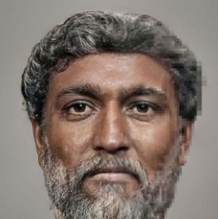
From the Historia Augusta: the meeting of Severus and the Ethiopian at Hadrian's Wall
22.1. The death of Severus was foreshadowed by the following events: he himself dreamed that he was snatched up to the heavens in a jewelled car drawn by four eagles, whilst some vast shape, I know not what, but resembling a man, flew on before. And while he was being snatched up, he counted out the numbers eighty and nine, and beyond this number of years he did not live so much as one, for he was an old man when he came to the throne...

Slide 8
From the Historia Augusta: the meeting of Severus and the Ethiopian at Hadrian's Wall
22.4. On another occasion, when he was returning to his nearest quarters from an inspection of the wall at Luguvallum in Britain, at a time when he had not only proved victorious but had concluded a perpetual peace, just as he was wondering what omen would present itself, an Ethiopian soldier, who was famous among buffoons and always a notable jester, met him with a garland of cypress-boughs.

Slide 9
From the Historia Augusta: the meeting of Severus and the Ethiopian at Hadrian's Wall
22.5. And when Severus in a rage ordered that the man be removed from his sight, troubled as he was by the man's ominous colour and the ominous nature of the garland, the Ethiopian by way of jest cried, it is said, "You have been all things, you have conquered all things, now, O conqueror, be a god."
6. And when on reaching the town he wished to perform a sacrifice, in the first place, through a mis­understanding on the part of the rustic soothsayer, he was taken to the Temple of Bellona, and, in the second place, the victims provided him were black.

Slide 10
From the Historia Augusta: the meeting of Severus and the Ethiopian at Hadrian's Wall
22.7. And then, when he abandoned the sacrifice in disgust and betook himself to the Palace, through some carelessness on the part of the attendants the black victims followed him up to its very doors.

Slide 11
From the Historia Augusta: the meeting of Severus and the Ethiopian at Hadrian's Wall
Severus was startled by the apparent omen, associating the soldier’s black colour as a portent of his own imminent death, but no-one seems to have been particularly surprised at the presence of an ‘Ethiopian’ (that is, a black African) at the northern edge of the Roman empire.
There were other Africans on the wall – a third-century AD cohort of Mauri from north west Africa are also attested in an inscription at Burgh-by-Sands near Carlisle.

Slide 12
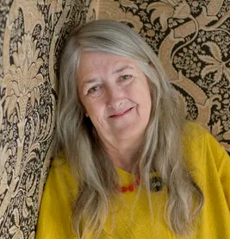
Quintus Lollius Urbicus
According to Prof Mary Beard (right) in a Guardian article, a man called Quintus Lollius Urbicus, a Berber from what is now Algeria who became governor of Roman Britain from AD 139-142, may have been the inspiration for the BBC video that triggered the storm.
Explaining that it can be difficult to be sure of ethnicity because Africans took on Roman names, she said:
“Even in the case of Septimius Severus, the first Roman emperor from Africa [Libya], we don’t actually know the colour of his skin, how far he was ‘native’, how far the descendent of Italian settler. The same goes for Quintus Lollius Urbicus, often claimed to be Berber, which he may well have been, but it isn’t certain.”

Slide 13
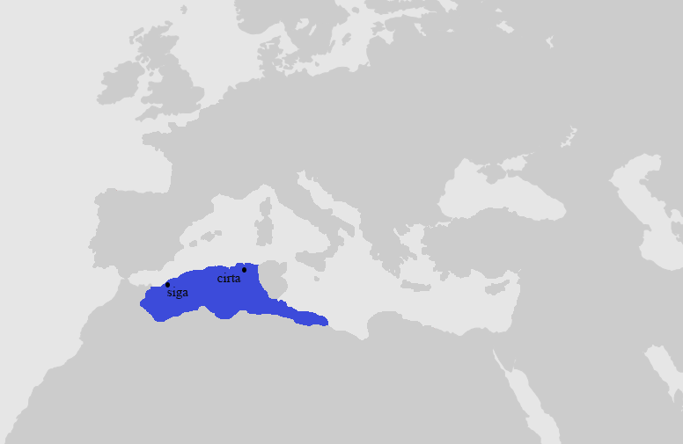
Quintus Lollius Urbicus
Quintus Lollius Urbicus was a Numidian Berber who as governor of Britain from AD 138 or ad 139 to perhaps ad 144 was responsible for the construction of the Antonine Wall in Scotland during the reign of the Emperor Antoninus Pius.
He is named in the not entirely dependable Historia Augusta, but his name appears on five Roman inscriptions from Britain; his career is set out in detail on a pair of inscriptions set up in his native Tiddis near Cirta (Constantine, Algeria), Numidia.
Beyond the colour of his skin remains the question of identity and how Quintus Lollius Urbicus viewed or thought himself. Descendent of an Italian settler? North African Berber? Citizen of the Roman Empire? All are possibilities.

Slide 14
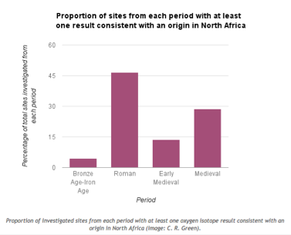
Scientific Evidence for Black Romans in Britain?
So what can we say about the depiction of the black Roman soldier in the BBC video?
Well, scientific evidence exists for the presence of North Africans in over 45% of the sites investigated as part of a study published in 2012 which identified origins using analysis of tooth enamel.
The investigation was summed up in ’A note on the evidence for African migrants in Britain from the Bronze Age to the medieval period’ from the blog of Dr Caitlin Green of the ICE Cambridge University on Monday, 23 May 2016.
The diagram from the blog (right) reveals the findings clearly for the Roman period.

Slide 15
Scientific Evidence for Black Romans in Britain?
The analysis was based on the fact that oxygen isotopes (different 'types' of oxygen molecules which differ slightly in atomic weight) found in your tooth enamel - and taken in via drinking water - will differ according to where you were brought up.
Isotopes at a level consistent with an origin in North Africa were very prevalent during the Roman era—the mid-first to early fifth centuries AD—with evidence being found at Winchester (Lankhills), Gloucester, York (three sites: Trentholme Drive, The Railway & Driffield Terrace), Scorton near Catterick, and Wasperton.
Nearly 47% of all Roman sites where the analysis was undertaken have produced evidence suggestive of the presence of people who grew up in North Africa, a significantly higher proportion than is found for any other era.

Slide 16
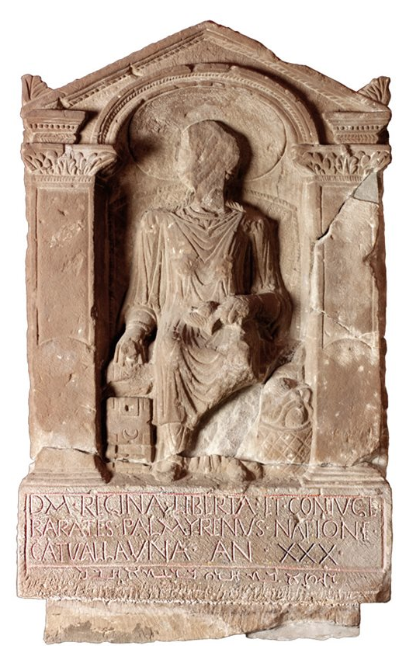
Syrians in Roman Britain
The historical presence of Syrians in Britain dates to Roman times, when Syrians were part of the Roman auxiliary forces which helped to establish and to build the province of Britannia.
In the body of Roman inscriptions from Britain, there are numerous examples of individuals who self-identify as Syrians by nationality.
The single most remarkable instance is attested on a lavish (and undoubtedly expensive) memorial that was discovered at Arbeia (South Shields), by the Eastern end of Hadrian’s wall.

Slide 17
Barathes from Palmyra
The tombstone of Regina (date uncertain but possibly second century AD) consists of a sculpture, and two inscriptions.
The ‘main’ (as in: ‘bigger, framed’) inscription is written in Latin and reads as follows:
D(is) M(anibus). Regina(m) liberta(m) et coniuge(m)
Barat(h)es Palmyrenus natione
Catvallauna(m) an(norum) XXX.
In English:
To the Spirits of the Departed. Barathes of Palmyra (sc. buries here/set this up). Regina, a freedwoman and his wife, a Catuvellaunian by origin, aged 30.

Slide 18
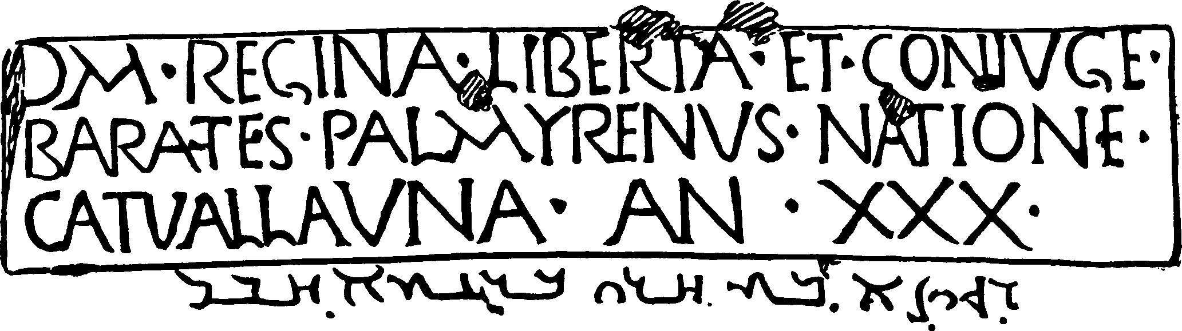
The inscription Latin above, Palmyrene below
RIB 1065

Slide 19
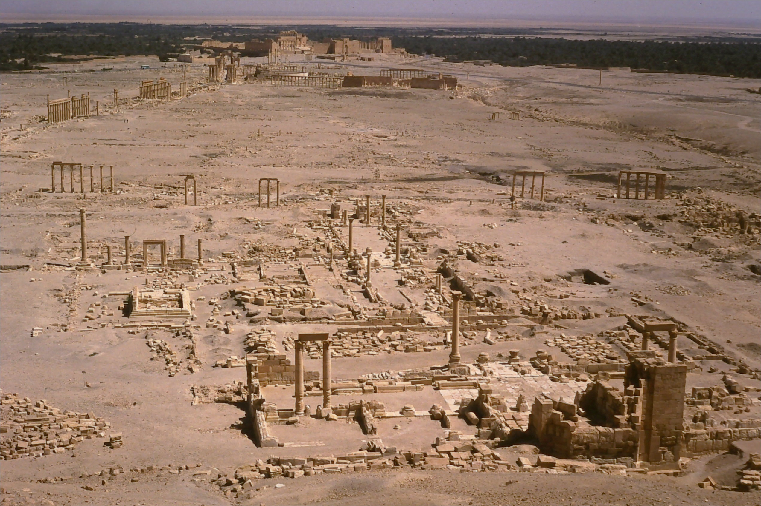
Ruins of the city of Palmyra in modern Syria (taken by Dr Paul Grigsby 2002)

Slide 20
Barathes and Regina
How did Regina end up at Hadrian’s wall?
Sold into slavery through some mischance – financial or military – she found herself in Barathes possession. Yet her name Regina (‘queen’) is Latin and was perhaps bestowed during her enslavement.
Regina may not have been a queen in real life (although we cannot rule that out) , but Barathes certainly presents her as regal in the garments and posture of a lady from Palmyra.

Slide 21
Barathes and Regina
It seems from the evidence that Barathes, the Syrian in Roman Britain, acquired, freed, and married this girl from Britain, whose life had taken a bad turn – becoming a slave, perhaps as a result of Roman campaigns.
Barathes, as the tombstone suggests, gave her dignity, safety, and made her his queen, not only in name.
An eventful and short life, dead at only 30.

Slide 22
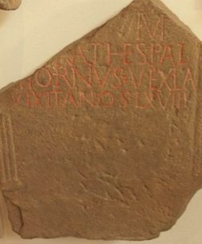
Barathes again?
Another inscription from Hadrian’s wall, discovered at the Roman fort of Coria(Corbridge) just over 25 miles away from Regina’s tombstone, mentions another citizen of Palmyra.
Due to its fragmentation, the stone does not exhibit the name in full – all that survives is the second half of it:
[- – -]rathes
Could this read Barathes, even the same Barathes of the inscription above? Barathes is not an uncommon name in Palmyrene nomenclature, but how many Barathes will have been at Hadrian’s wall at the time…?

Slide 23
Barathes again?
The Corbridge stone man’s occupation was vexil(l)a(rius), so perhaps a military ‘standard-bearer’ or ‘flag-bearer’, if indeed he was a military man.
He died aged 68 (vixit an(n)os LXVIII).
Inscriptions always seem to be missing the most important pieces! We do not know if this is a Barathes, and even less can we say this is the same man.
But maybe more evidence will turn up one day.

Slide 24
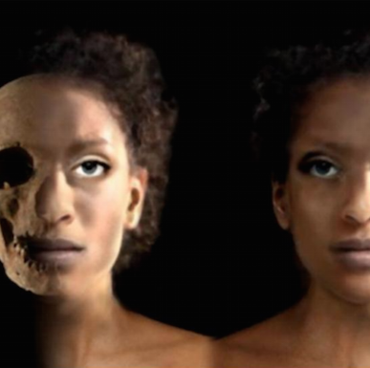
The Ivory Bangle Lady
The grave of a young woman was discovered in 1901 in Sycamore Terrace York; she was buried in a stone sarcophagus with very rich grave goods in the later 4th century.
The objects placed into her grave included bracelets made from local jet and more exotic ones made of ivory.

Slide 25
The Ivory Bangle Lady
A short inscription on a bone mount, that once probably decorated a box, suggests that this high status young woman was a Christian as it says
‘Hail, sister, may you live in God’.
Recently, the skull and teeth of her skeleton, which have been stored in Yorkshire Museum, were examined by scientists at the University of Reading.

Slide 26
The Ivory Bangle Lady
The shape of her skull suggests that she had North African ancestry; this is not very surprising in a place like York, where inscriptions and written sources mention Africans.
Archaeological scientists can also analyse the chemical signatures preserved in human teeth. The ratios of stable isotopes such as oxygen, carbon, nitrogen and strontium in human teeth can provide information about ancient diet and origin.
Studies of the remains of the Ivory Bangle Lady suggest that she was born and brought up in the south of Britain, or the continent, rather than in Africa.

Slide 27
Bibliography
BBC Story of Britain https://www.bbc.co.uk/programmes/p01zfw4w
How diverse was Roman Britain? By Dr Matthew Nicholls, Department of Classics, University of Reading https://blogs.reading.ac.uk/the-forum/2017/07/28/how-diverse-was-roman-britain/#comments
‘Mary Beard abused on Twitter over Roman Britain's ethnic diversity’ – Guardian 6th August 2017 https://www.theguardian.com/uk-news/2017/aug/06/mary-beard-twitter-abuse-roman-britain-ethnic-diversity
A note on the evidence for African migrants in Britain from the Bronze Age to the medieval period – Dr Caitlin Green https://www.caitlingreen.org/2016/05/a-note-on-evidence-for-african-migrants.html?m=1
What have the Syrians ever done for us? Peter Kruschwitz https://thepetrifiedmuse.blog/2015/09/06/what-have-the-syrians-ever-done-for-us/
Clash of Cultures?: The Romano-British Period in the West Midlands Roger White and Mike Hodder 2018. Oxbow Books.
An Imperial Possession: Britain in the Roman Empire 54BC-AD409. David J. Mattingly, 2007. Penguin History of Britain.
‘Mobility, Migration, and Diasporas in Roman Britain’ by Hella Eckardt and Gundula Müldner in The Oxford Handbook of Roman Britain Edited by Martin Millett, Louise Revell, and Alison Moore, 2016. Oxford University Press.
Dying on Foreign Shores: Travel and Mobility in the Late-Antique West. Mark Handley 2011 Journal of Roman Archaeology Suppl. 86

