Slide 1
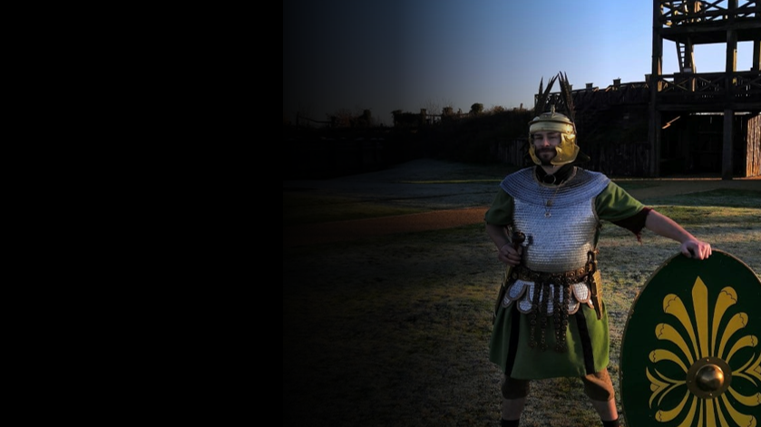

Roman Coventry and Warwickshire Project
The Roman Army

Slide 2
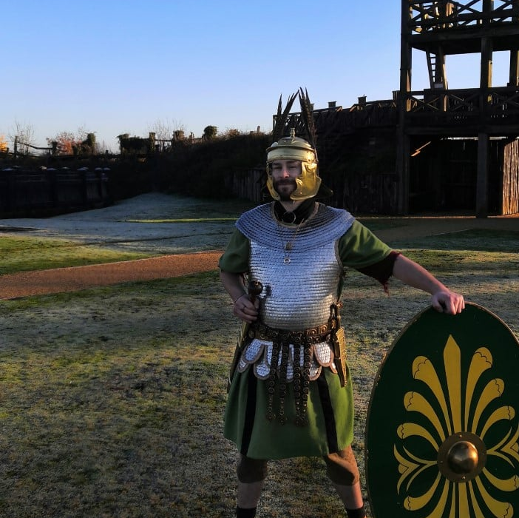
The Roman Army
When considering the Roman invasion of Britain and the battles fought by the Romans and Britons, it is important to bear in mind the military capability of the Roman Army.
The Roman Army legions under Suetonius Paulinus which marched against Boudica and the rebels were very well-equipped and well-trained. They were formed of legionaries and auxiliaries.

Slide 3
The Roman Army
The legionaries were the elite soldiers. A legionary had to be over 17 years old and a Roman citizen. Every new recruit had to be fighting fit - anyone who was weak or too short was rejected.
Legionaries signed up for at least 25 years' service. But if they survived their time, they were rewarded with a gift of land they could farm. Old soldiers often retired together in military towns, called ‘colonia’.
An auxiliary was a soldier who was not a Roman citizen. He was only paid a third of a legionary’s wage. Auxiliaries guarded forts and frontiers but also fought in battles, often in the front lines where it was the most dangerous.

Slide 4
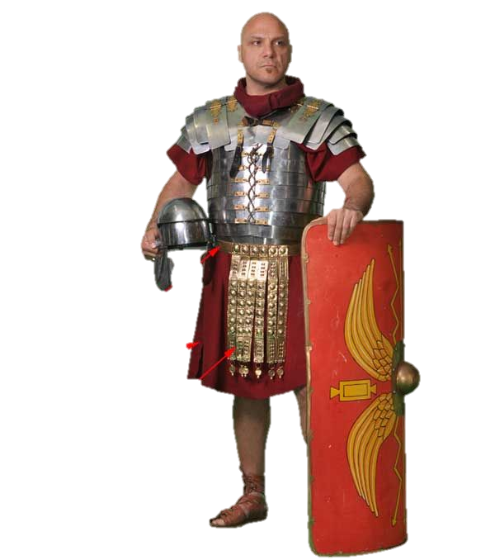
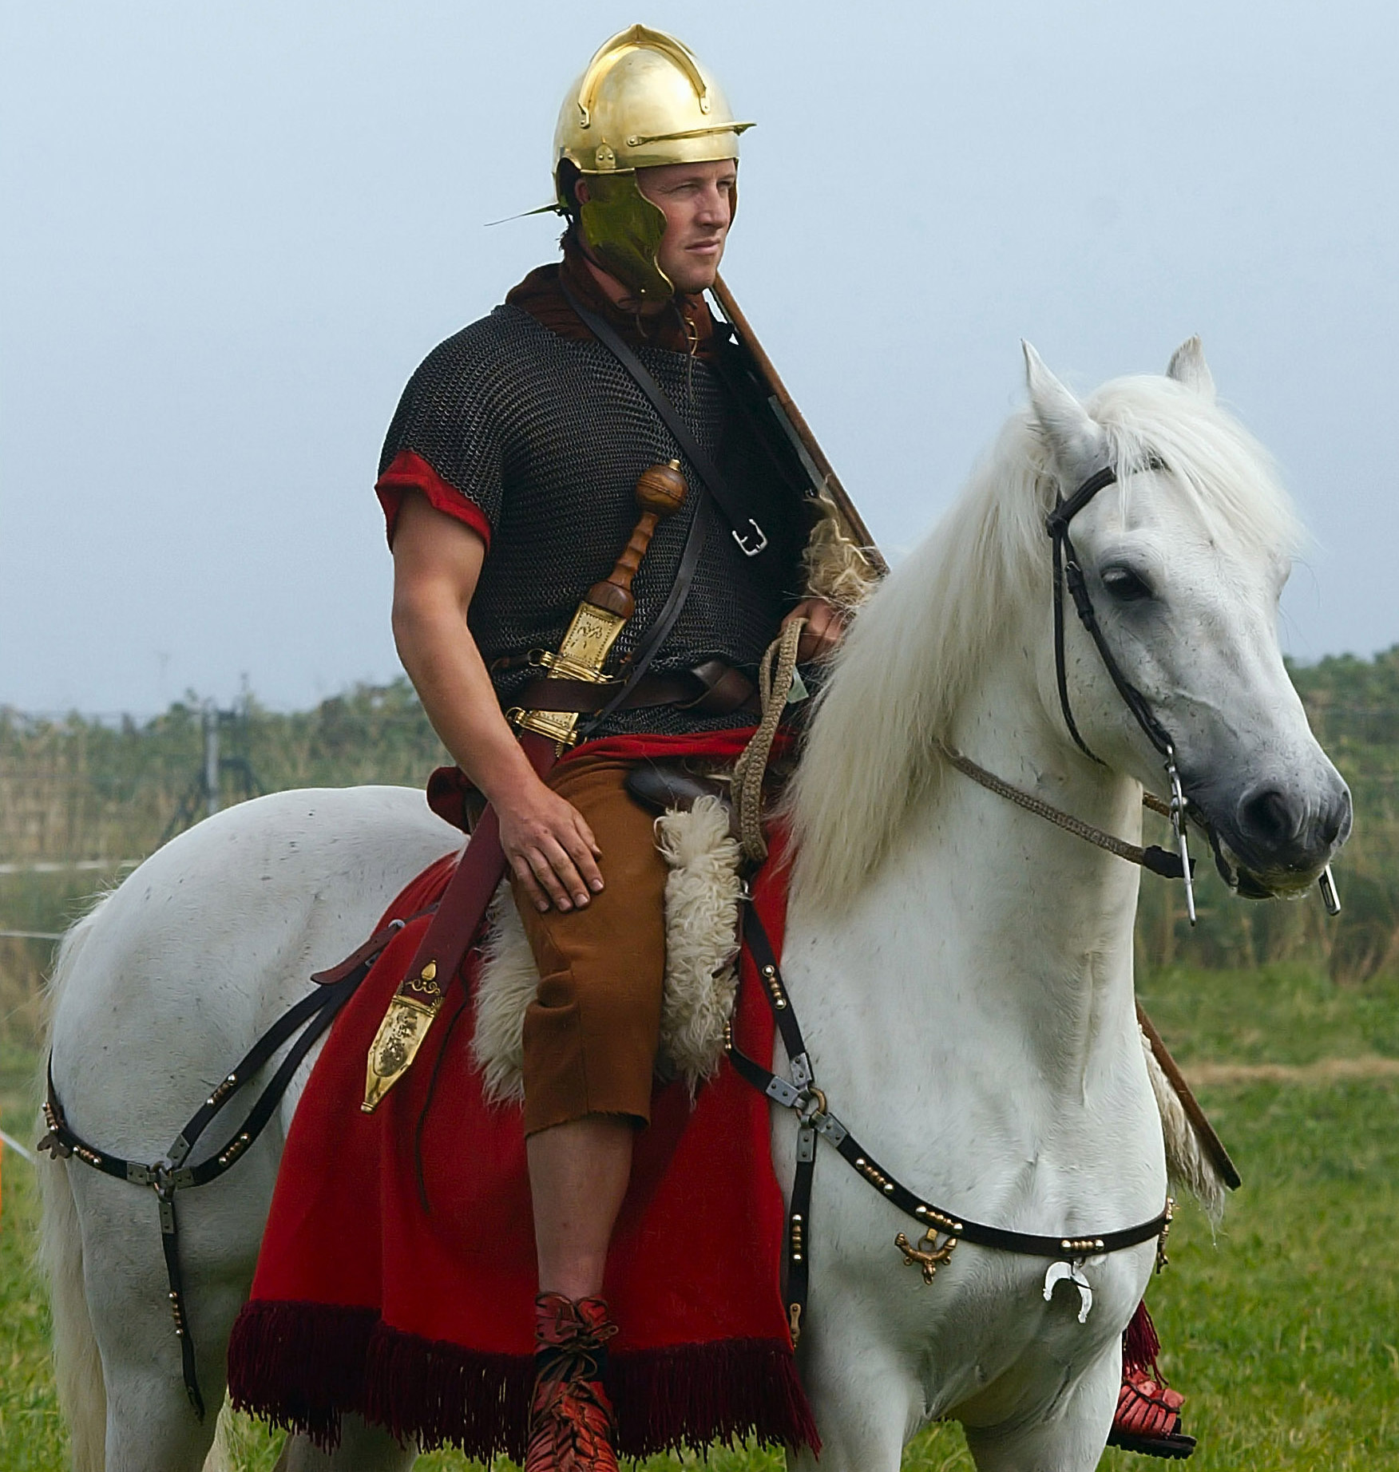
Roman Armour and Weapons
Lorica segmentata (Cuirass armour)
Galea (Helmet)
Focale
(Scarf)
Lorica hamata (Chainmail armour )
Clipeus (Cavalry shield)
Scutum
(shield)
Spatha (Cavalry sword)
Equus (Horse)
Galea or cassis
(Helmet)
Balteus
(Belt)
Tunica
(Tunic)
Horse trappings
(Phalera)
Baltea
(Dangling straps)
Caligae
(Army sandals )
The kit of an Eques (Roman horseman)

Slide 5
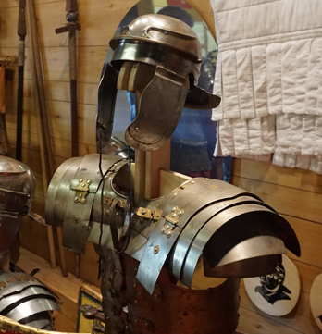
Legionaries’ Equipment
Shield (scutum): Roman legionaries carried a large rectangular shield known as a scutum. This was curved to help protect the soldier's body and it had a hard iron bulge in the middle for battering their enemies in battle. Soldiers would lift their shields over their heads for protection when fired at from above. They looked like a tortoise, so they called this formation the testudo (Latin for tortoise).
Sword (gladius): A Roman soldier's trusty sword was called a gladius. It was quite small and light, which made it good for stabbing and slashing in battle. Roman soldiers wore their swords on the right at first. But by the AD300s most Romans wore their swords on the left.
Helmet (cassis/galea): A Roman soldier's helmet was called a galea. It had special guards to protect their cheeks and neck. Soldiers could also attach a crest made of horse hair to the top of their helmets. However, ordinary legionaries probably didn't wear this in battle. Historians think that it was just used for parades and formal ceremonies.

Slide 6
Legionaries’ Equipment
Tunic (tunica): Underneath their armour, a Roman soldier wore a woollen tunic. This was probably coloured red or white. The colour may have related to the soldier's rank.
Armour (lorica segmentata): Body armour was made from overlapping iron plates held together by leather straps and brass clasps. The armour was heavy and very tough so a legionary would wear a tunic underneath for padding. A legionary had to march all day carrying his armour and weapons. Together with his cooking pots and tools, a soldier's equipment could weigh around 35kg.
Scarf (focale): Soldiers often wore a scarf called a focale too. This protected their neck from rubbing up against their armour.

Slide 7
Legionaries’ Equipment
Belt (balteus): This is the traditional belt of a Roman soldier/legionary which he used to carry his sword. The balteus is a mark of a soldier — not only that, it's really a status symbol of being a soldier.
Worn at all times, even off duty, only soldiers were allowed, by law, to wear this unique belt. It may have helped to protect the soldiers in battle. The belt may represent rank or awards but historians just don't know.
Roman objects archaeologists have discovered show that many of these belts were very elaborate. Possibly since Roman soldiers did not have a lot to spend their pay on, they spent it on making their gear fancier. (Baltea): are decorative parts of the belt.

Slide 8
Legionaries’ Equipment
Boots (Caligae): Roman army boots were called caligae. They were like sandals but much stronger. They were made from leather and had little iron studs on the soles. The iron studs on a Roman soldier's sandals meant that it was easy to slip when running on wet stones!
A legionary’s boots were actually the most important piece of his equipment because he had to march across large areas of the Roman World from one fort or camp to another. The legionary had to do all of this on his feet. And so having the right boots was significant for Roman soldiers, including those marching across Roman Britain.

Slide 9
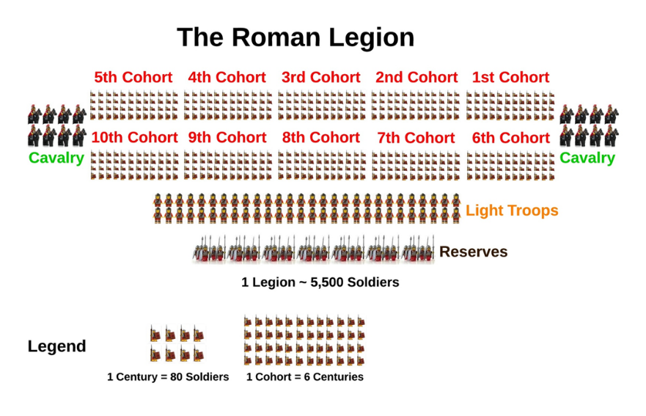
The Roman Legion: Structure
The basic structure of the army is as follows:
Contubernium (tent group): consisted of 8 men.
Centuria (century): was made up of 10 contubernium with a total of 80 men commanded by a centurion.

Slide 10
The Roman Legion: Structure
The basic structure of the army is as follows:
Cohorts (cohort): included 6 centuriae or a total of 480 fighting men, not including officers. In addition, the first cohort was double strength but with only 5 centuriae instead of the normal 6.
Legio (legion): consisted of 10 cohorts.
Additionally each Legion had a 120 man Alae (cavalry unit) called the Eques Legionis permanently attached to it possibly to be used as scouts and messengers.

Slide 11
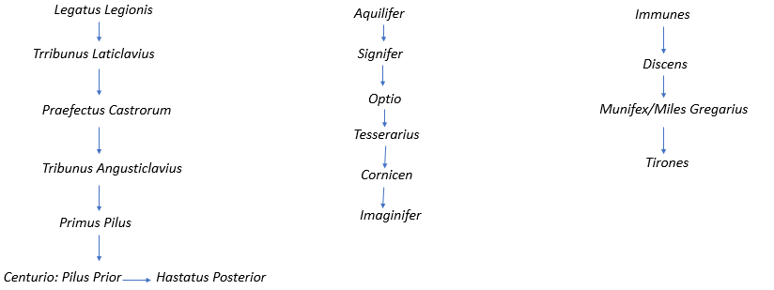
The Roman Legion: Rank Structure
High and Middle Ranking Officers
Lower Ranking Officers (Principales)
Rank and File of the Roman Army

Slide 12
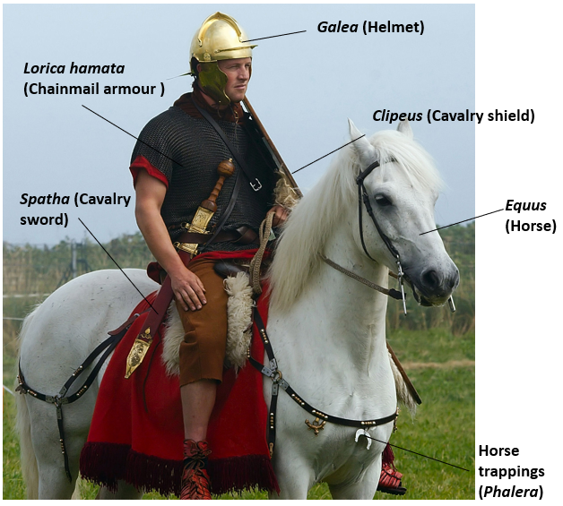
The Roman Cavalry
Roman cavalry from the 1st century BC most often came from provinces outside Italy and allied states.
The equites (a high social rank below that of the senatorial class) were required to serve up to 10 years of service in the cavalry between the ages of 17 and 46.
The Greek historian Polybius explains that Equites originally provided a legion's entire cavalry contingent. However, from an early stage, when equites numbers had become insufficient, large numbers of young men from the First Class of commoners were regularly volunteering for the service, which was considered more glamorous than the infantry.

Slide 13
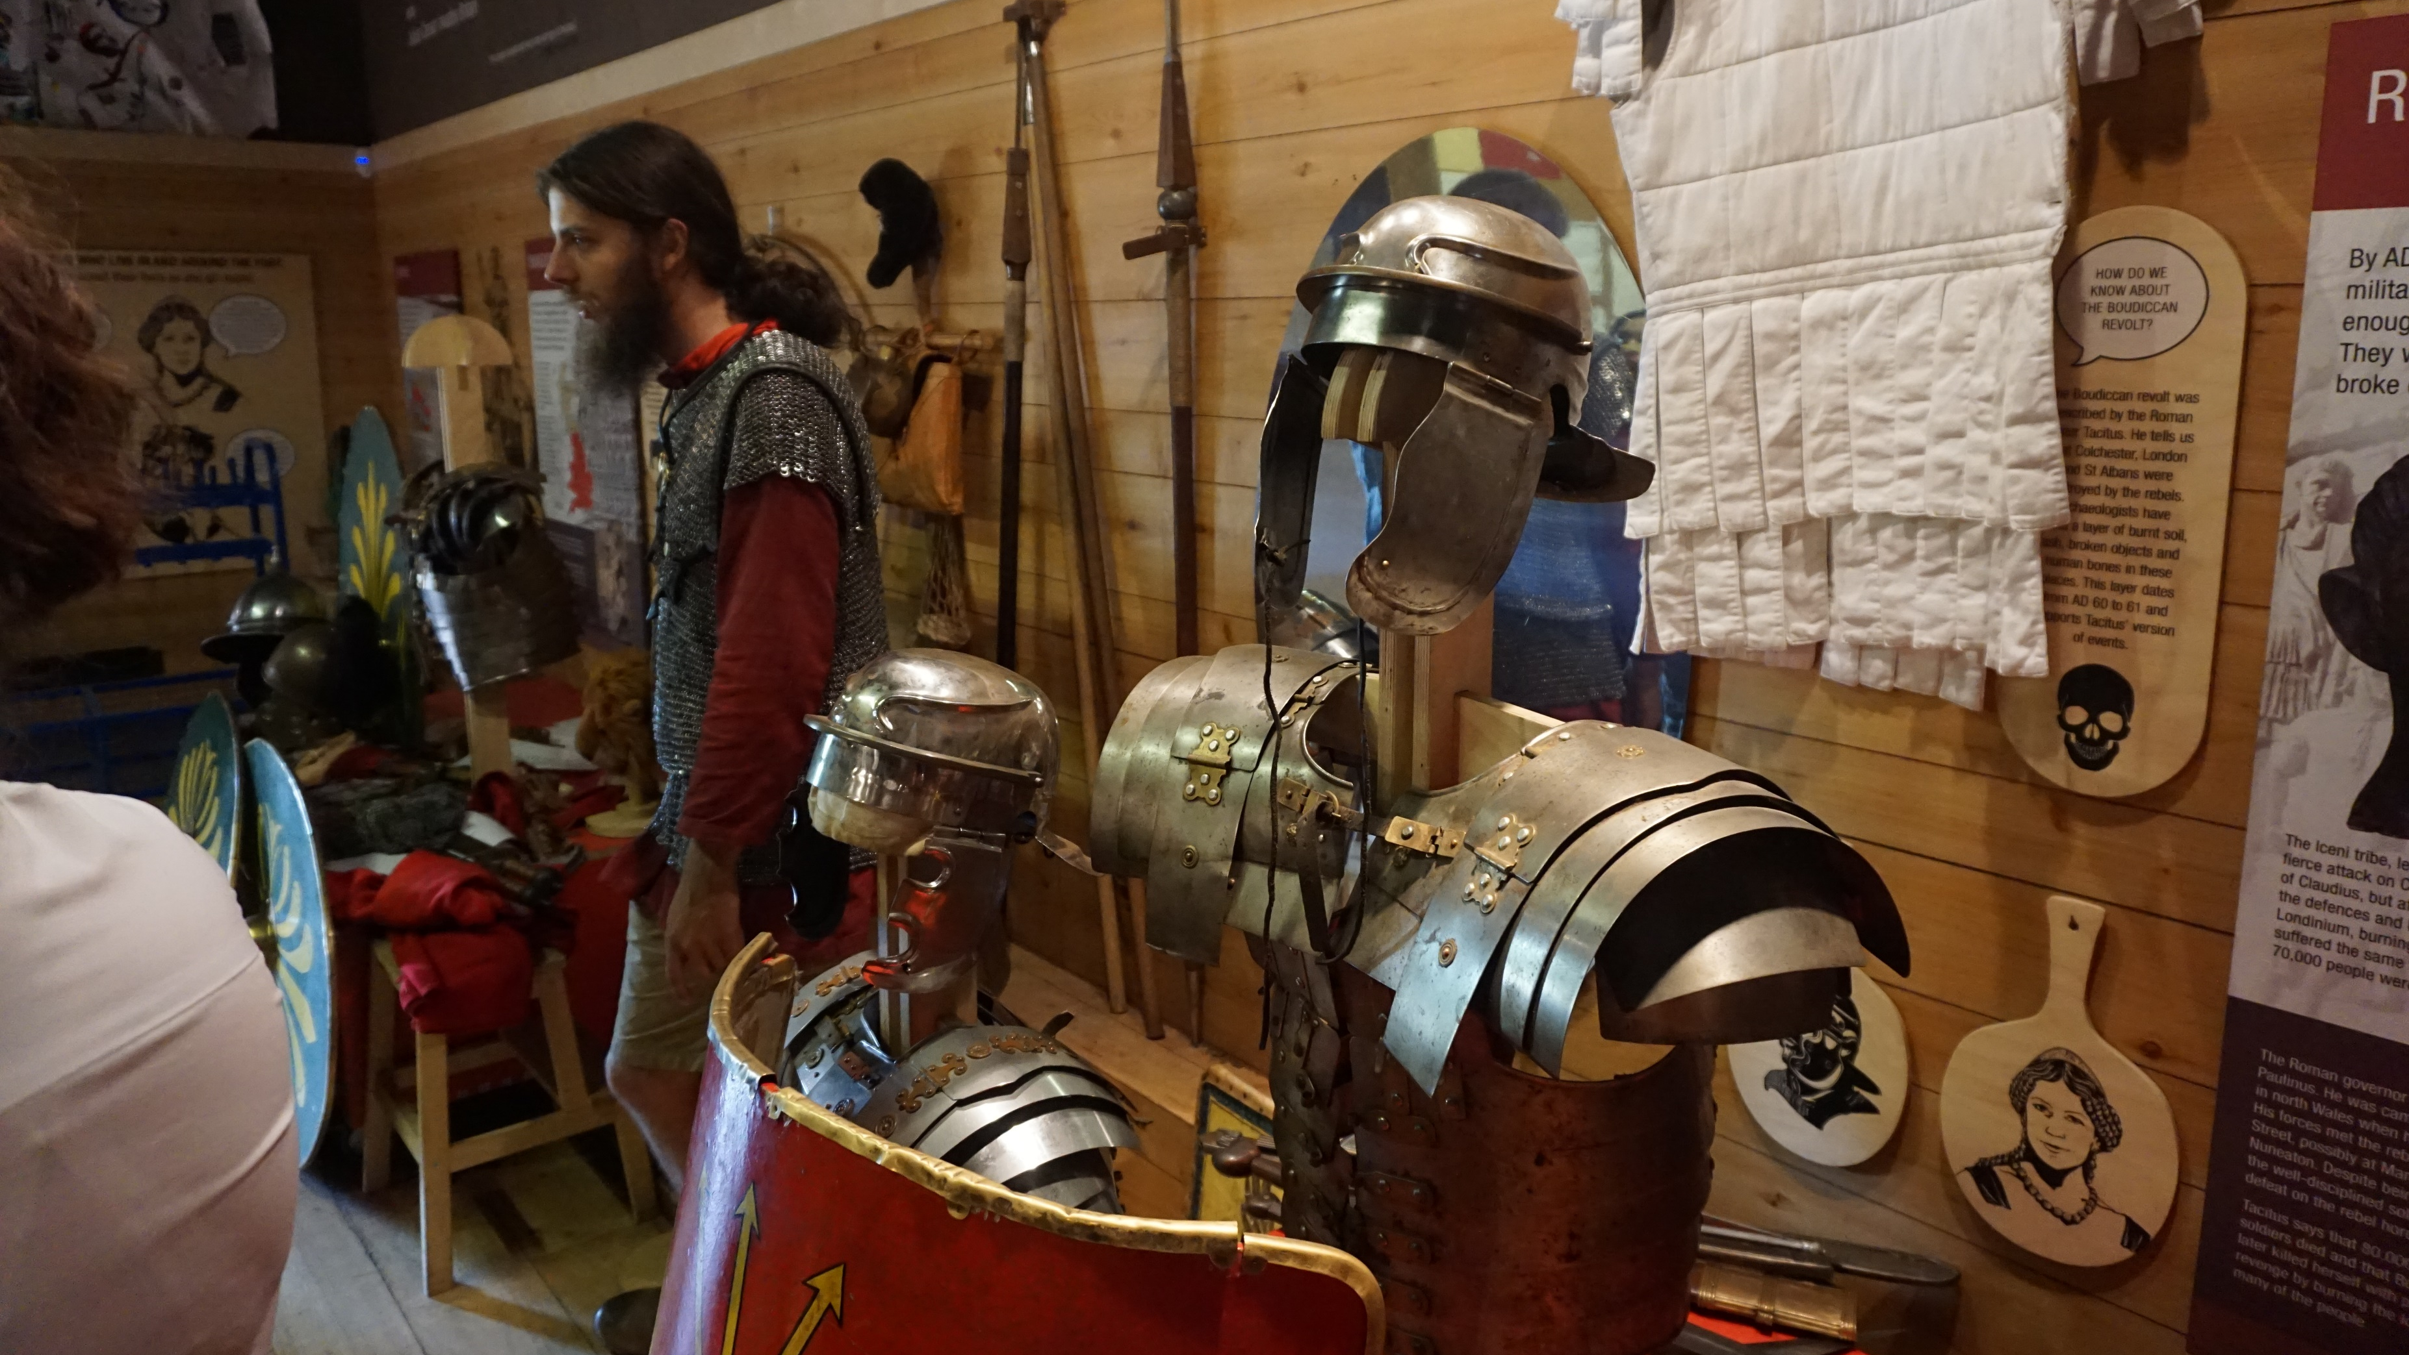
Reproductions of Roman armour at Lunt Roman Fort

