Slide 1
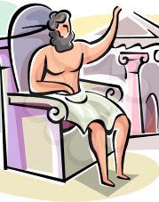
Greek myths!

Slide 2
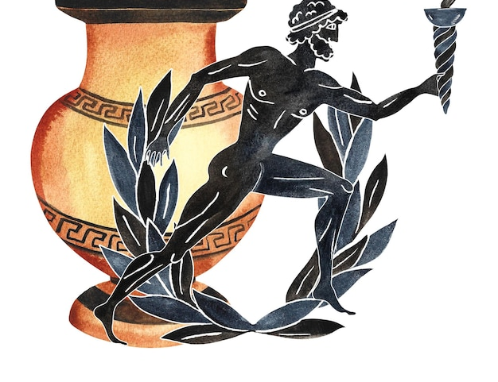
What is a Greek Myth?
Stories which get retold a lot over time, originally from ancient Greece!

Slide 3
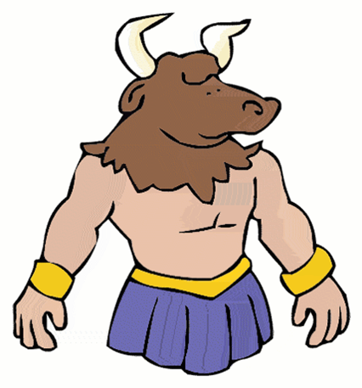
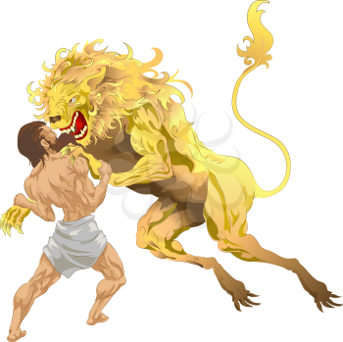
Who knows any Greek Myths?
Theseus and the Minotaur
Perseus and Medusa
Heracles
Olympian Gods

Slide 4
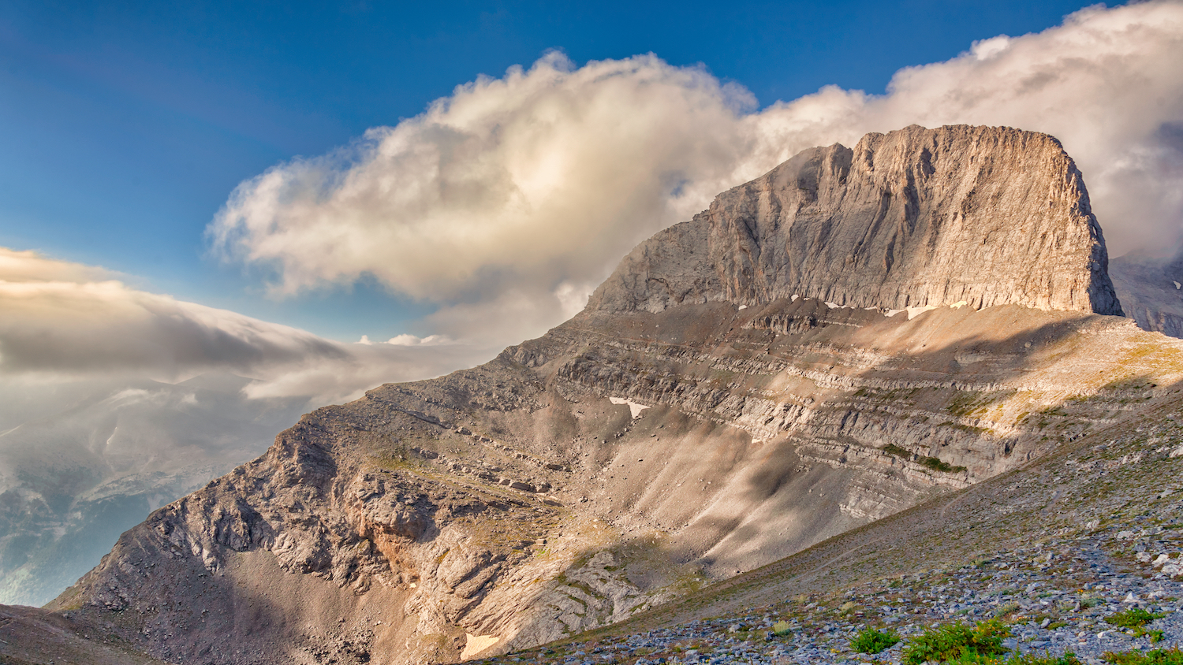
Olympian Gods
The Greeks had lots of Gods- the main ones are the 12 Olympians
They're called Olympians because they lived on Mt. Olympus!
They all had different responsibilities, and were the Gods of different things.
I.E Poseidon was the God of the sea

Slide 5
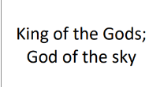
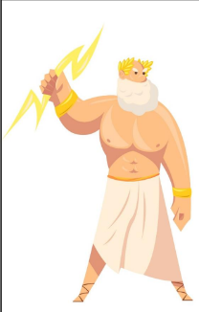
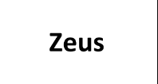

Your task
Work together to match the Gods names and titles to their picutres, and a symbol which represents them!

Slide 6
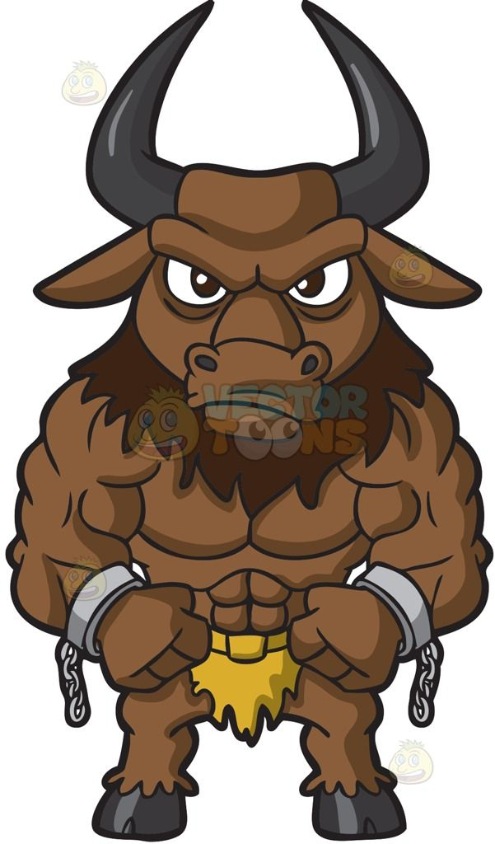
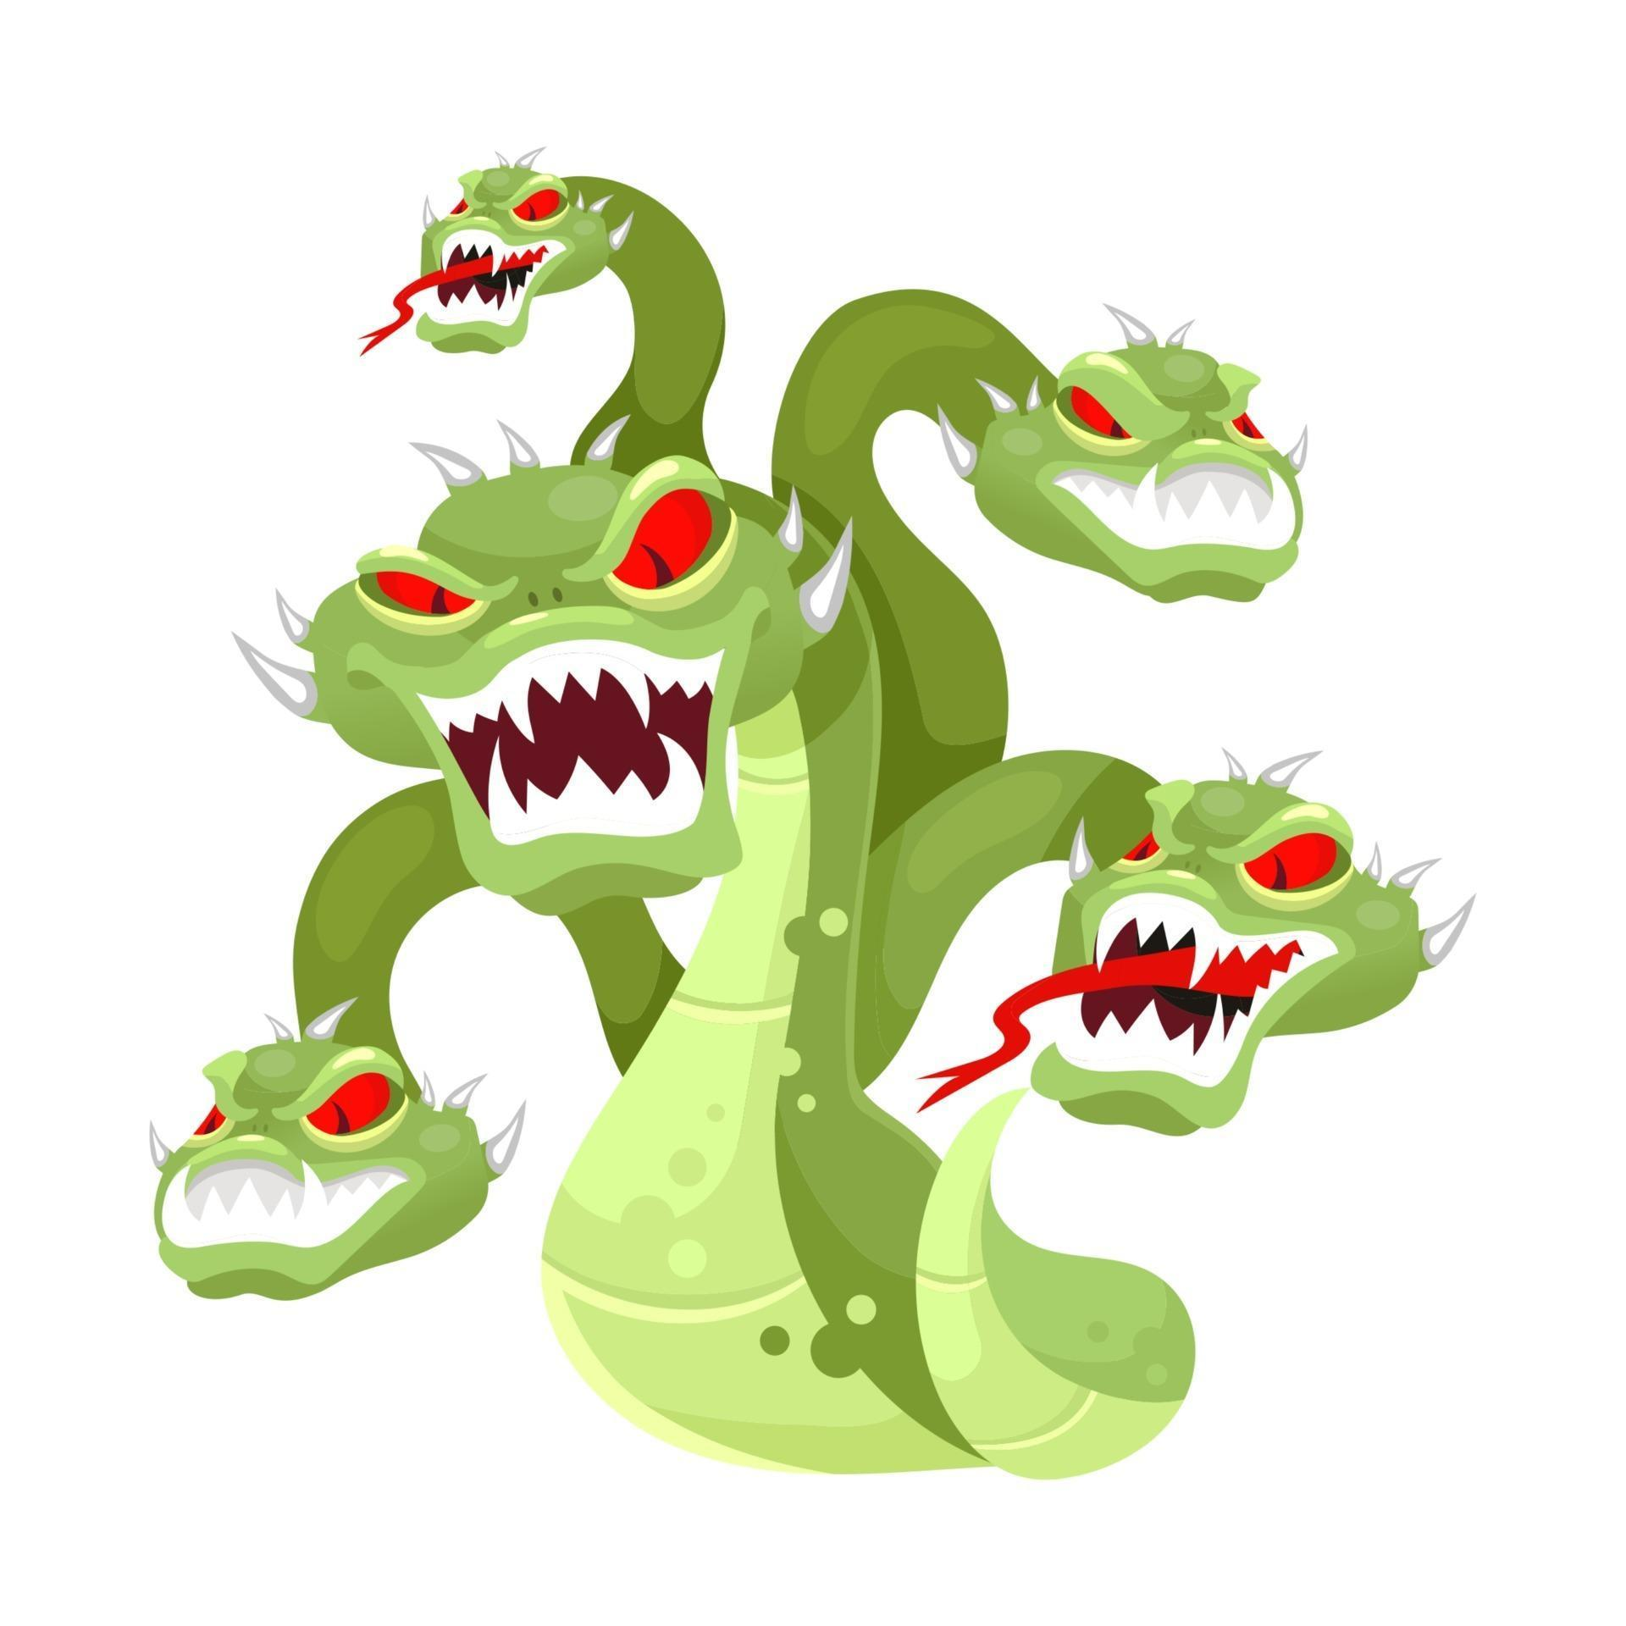
What else features in a lot of myths?
MONSTERS!

Slide 7
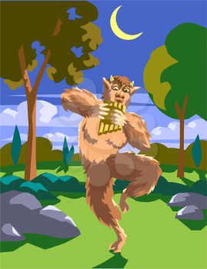
Hybrids
A hybrid is a mixture of two or more different creatures
The Greeks loved hybrid monsters
I.E. Satyrs- half man half goat
Sirens- half woman half bird
Chimeras- lions head, goats body, a snake for a tail

Slide 8
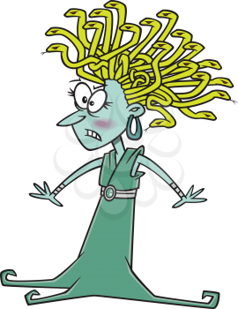
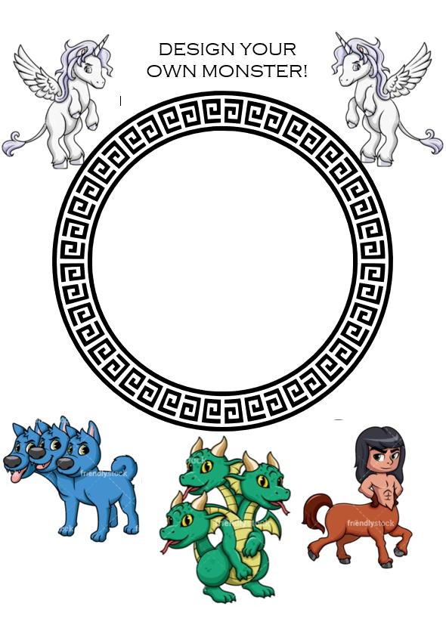
Your task
Use the template to make your monster!
Is it a hybrid? Does it have any special powers? How was it created?
Get creative and have fun!

Slide 9
What have you learnt?

