Slide 1

Greek myths!

Slide 2

What is a Greek Myth?
Stories which get retold a lot over time, originally from ancient Greece!
Most are retold orally – passed on by word of mouth.
Different variations of different myths- not one ‘correct’ version

Slide 3
Who knows any Greek Myths?
The Trojan war: Judgement of Paris, Achilles, Trojan horse
The Odyssey: The Lotus Eaters, The Cyclops, The 100 suitors
Cretan Myths: King Minos, Theseus and the Minotaur, Ariadne

Slide 4

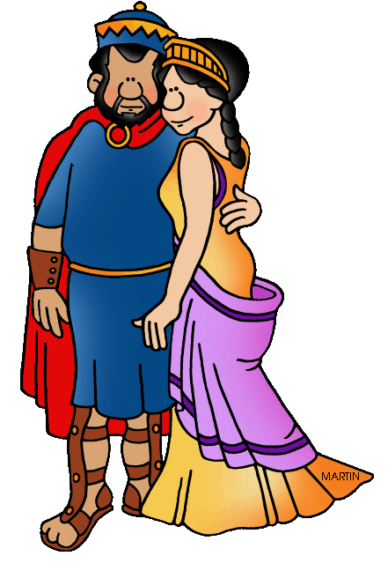
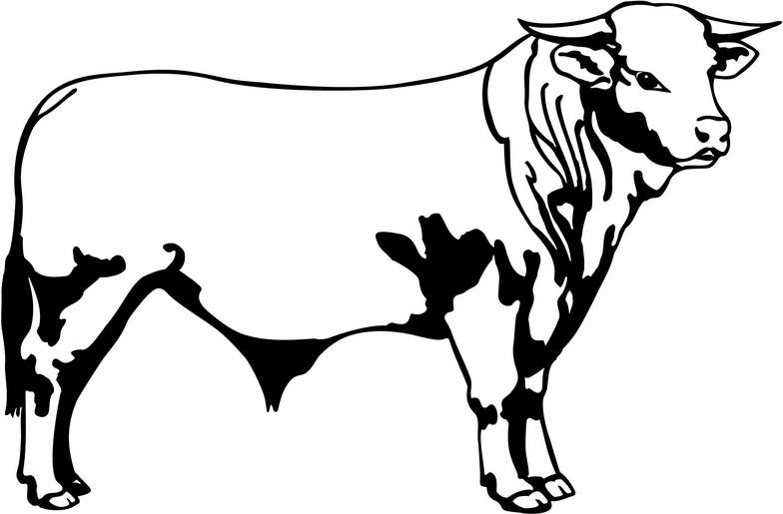
King minos and Poseidon's curse
King Minos ruled Crete, a Greek island, with his wife Pasiphae.
One day, a shining white bull appeared out of the sea.
Minos knew he should sacrifice the bull to Poseidon, God of the Sea.
But he kept it for himself, sacrificing a worse bull in its' place.
This angered Poseidon, who cursed Minos and his family.

Slide 5
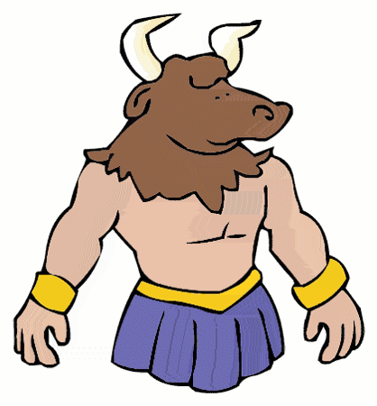
The minotaur
9 months after Minos kept the white bull, Pasiphae gave birth to a baby with a bulls head!!
When it was born, the minotaur bit off the hand of the nurse trying to deliver it.
Horrified, Minos ordered a labyrinth be built to hide the monster which longed for human flesh.
He called it the Minotaur- as punishment for a past wrong Minos ordered the city of Athens to send 7 boys and 7 girls each year to go into the labyrinth, as sacrifices.
This went on for many years....until.....

Slide 6
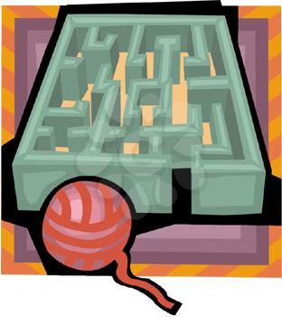
Theseus and ariadne
The Athenian prince, Theseus, was so furious at the 100s of children being sent to their deaths that he volunteered to go to Crete to kill the monster.
When he arrived, he met Ariadne- Minos' daughter.
She promised to help him, giving him a sword he could hide on him to kill the minotaur, and a ball of yarn to escape the labyrinth.

Slide 7
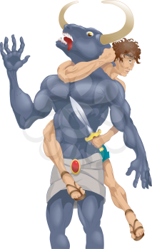
Theseus in the labyrinth
Theseus walked through the twisting labyrinth, stretching out the yarn behind him so he knew how to get back to the entrance.
Suddenly, he turned a corner and was face to face with the minotaur. A terrifying creature, towering above him- breath reeking down onto his face.
A long and hard battle followed, and Theseus managed to kill the minotaur!

Slide 8
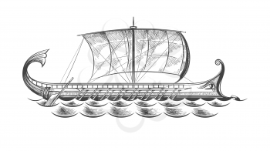
Escape!!
Using the yarn Ariadne gave him, Theseus lead the other children out of the labyrinth- the guards at the doors were so relieved the monster was finally dead they let them all out.
Ariadne knew her father would be furious at her for letting them defeat the minotaur, and so she fled Crete with them.
They all sailed away to Athens.

Slide 9
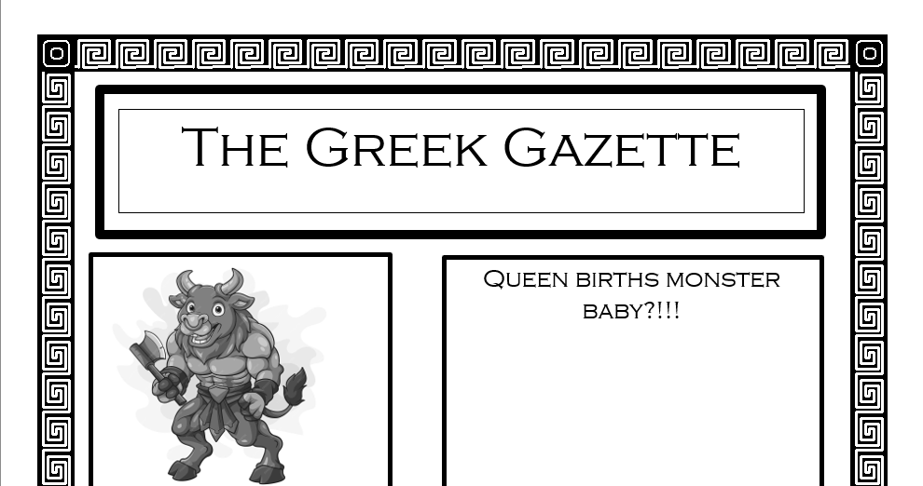
Your task
Pick a section of the myth to retell as a newspaper article!
Can be from a characters perspective, or a random outsider.
Get creative and have fun- how might some characters tell the story differently? Was the Minotaur just hungry? How did the other children in the Labyrinth feel?

Slide 10
What have you learnt?

