Slide 1
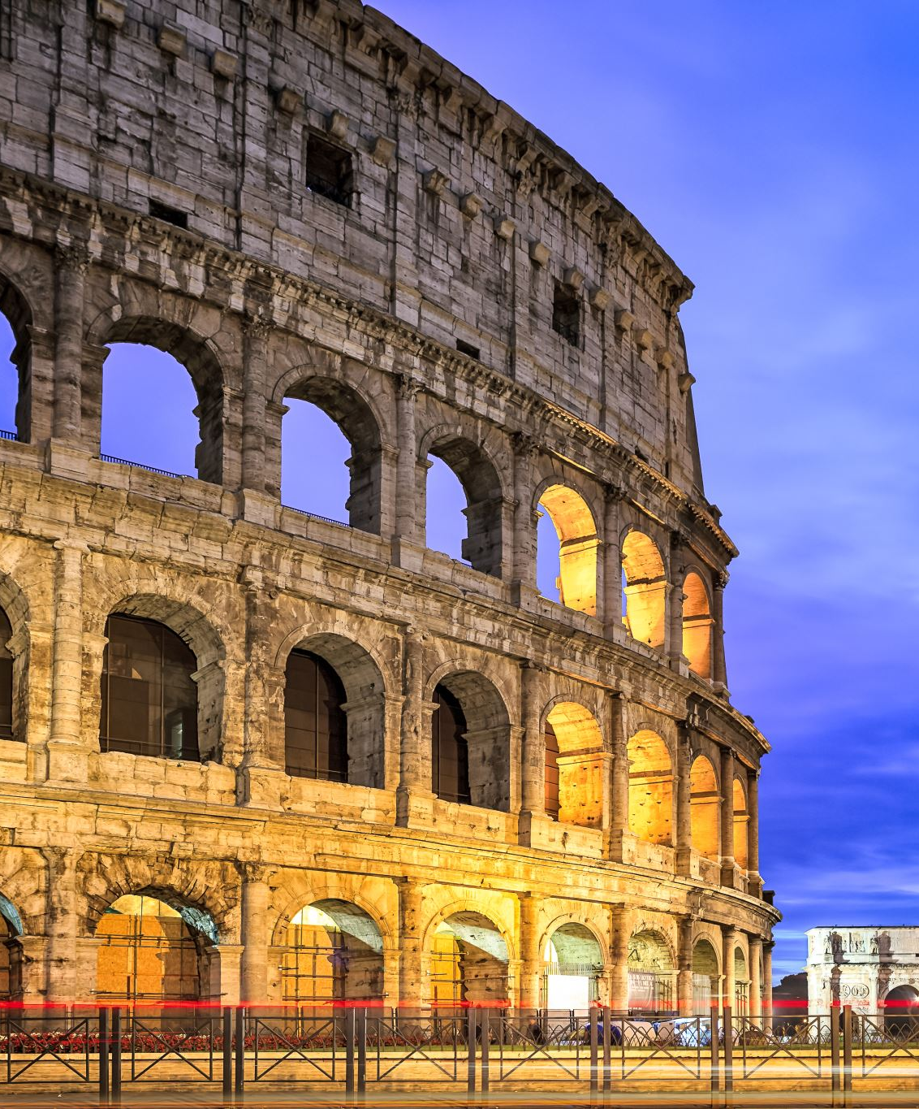
Roman Britain: How do we learn about the past?
Notes:
“does anyone have any thoughts on how we know what we know today about the past- especially the ancient past?”

Slide 2
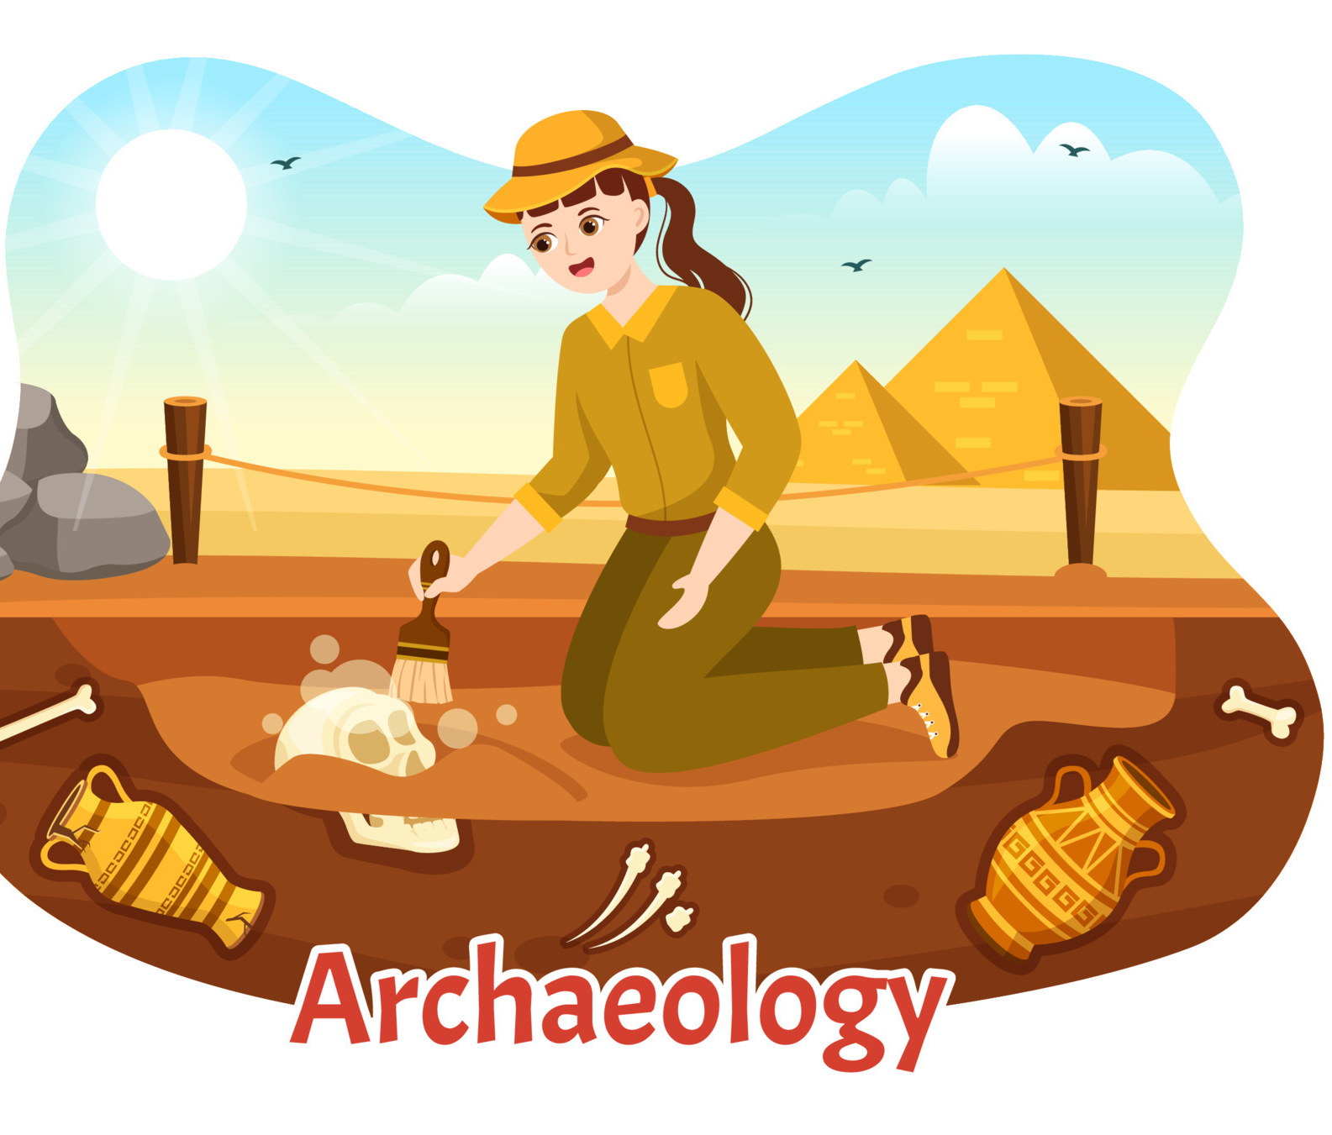
Has anyone heard of ‘Archaeology’ before?
Notes:
Archaeology is the study of human activity through the recovery of material culture: this can be anything from pots and pans, to books, to jewellery and so forth!

Slide 3
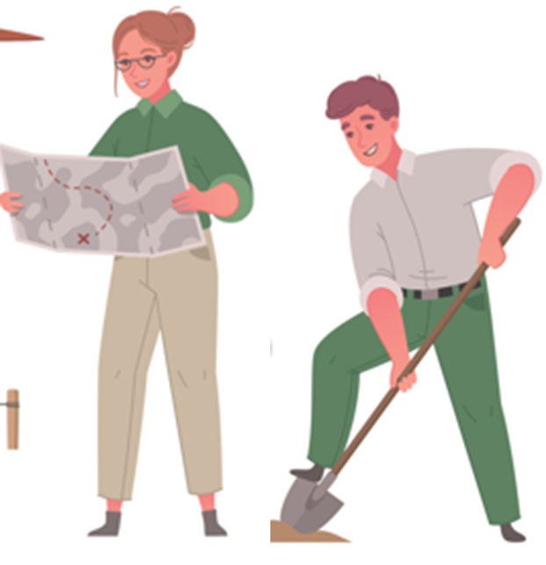
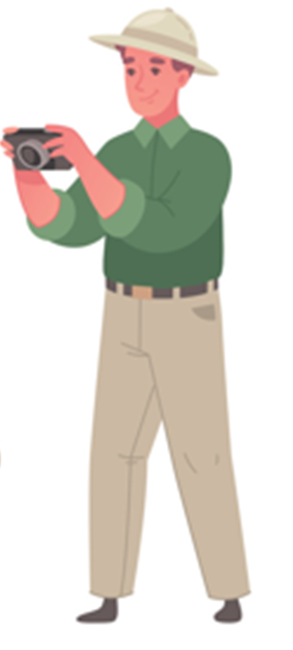
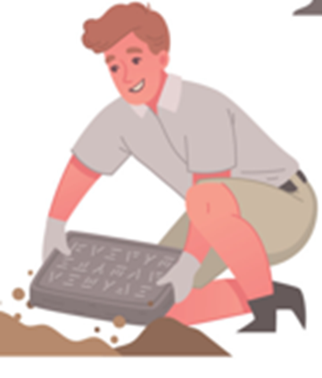
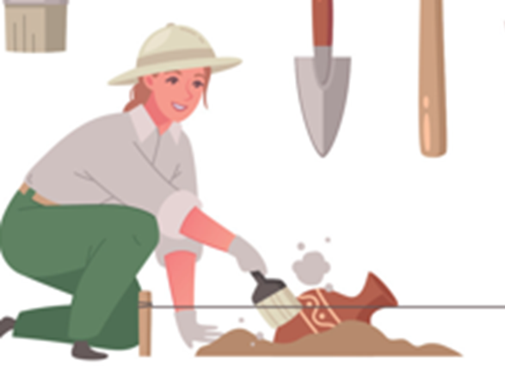
Your Job today! Become Archaeologists
Click on the sand to uncover an object!
Once uncovered click on the object to learn more!
Discuss what you think they are and what they were used for!
These objects were all found in Coventry!

Slide 4

Let’s get digging!

Slide 5

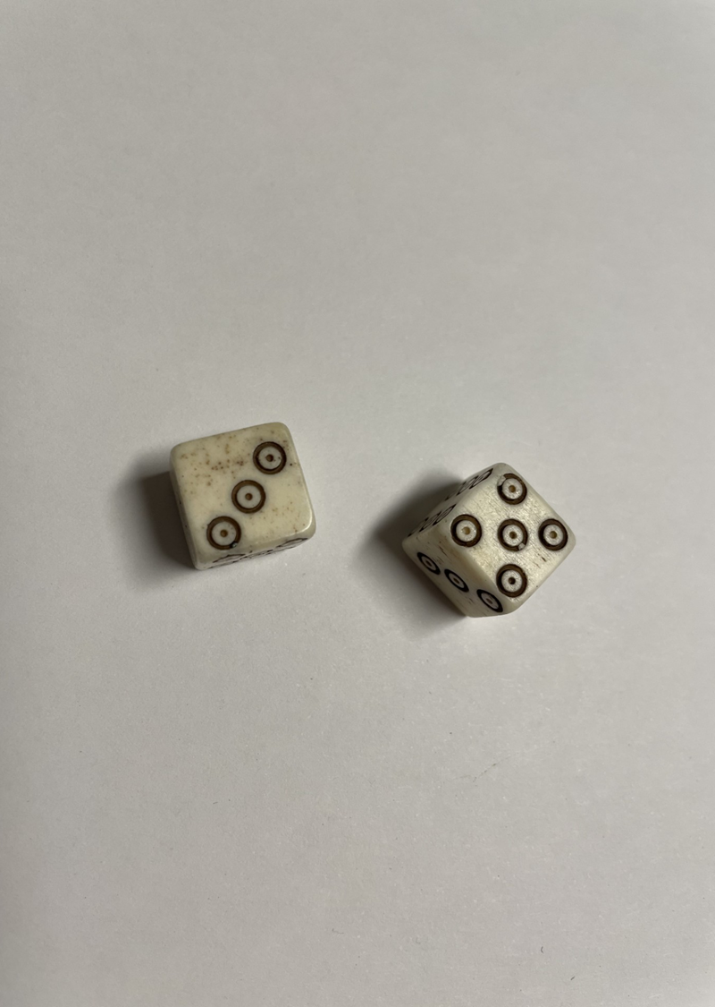
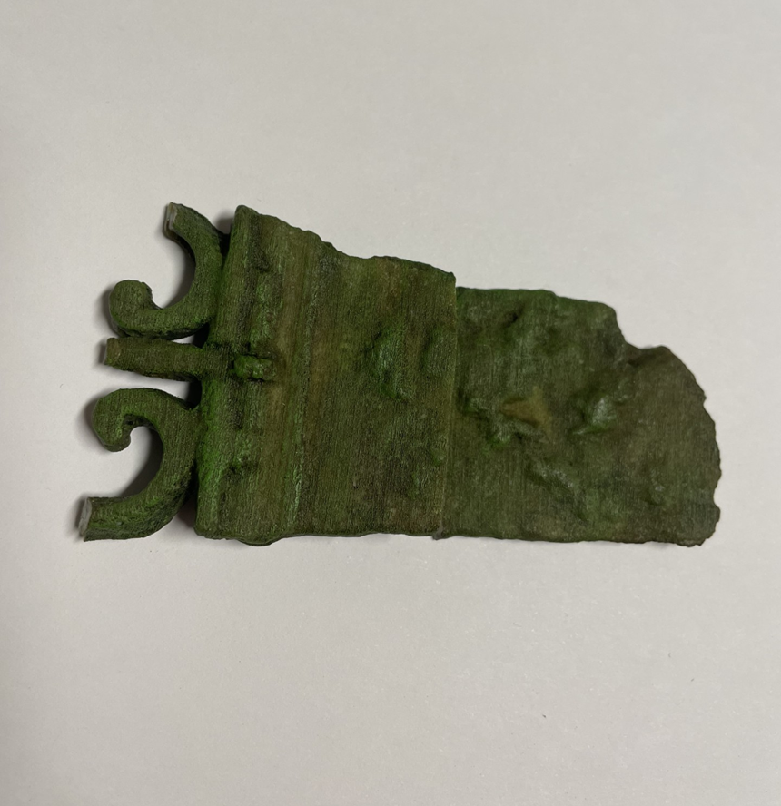
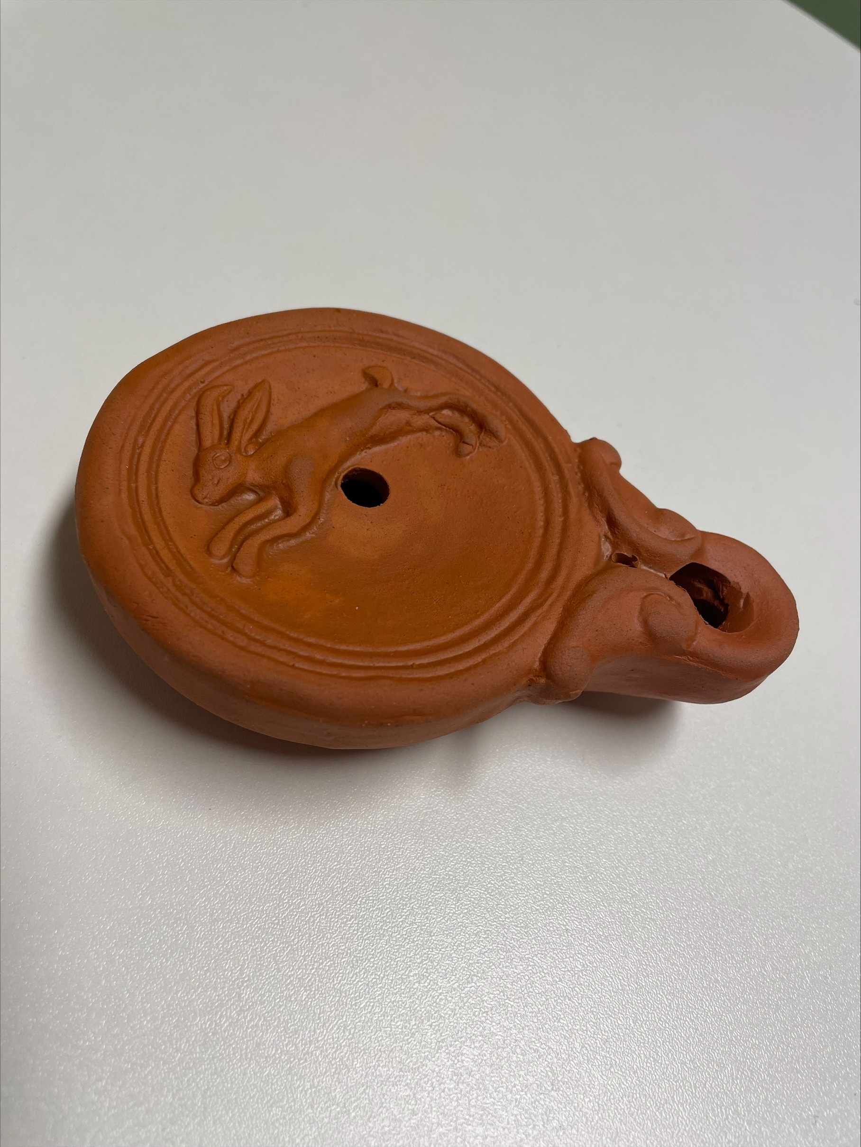

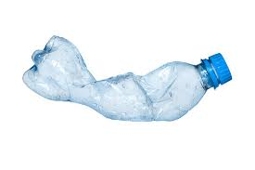
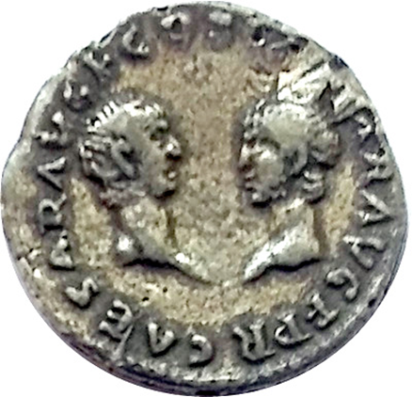

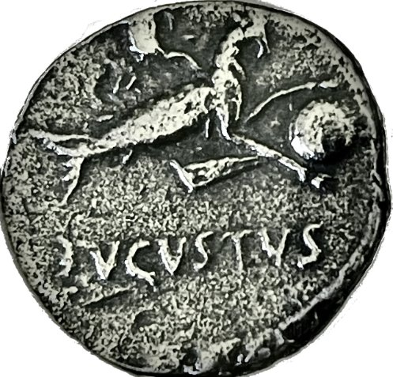
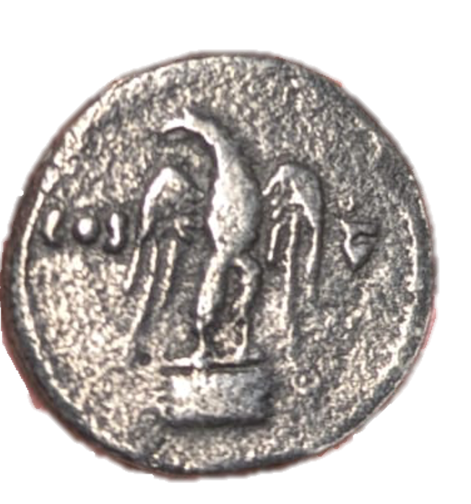
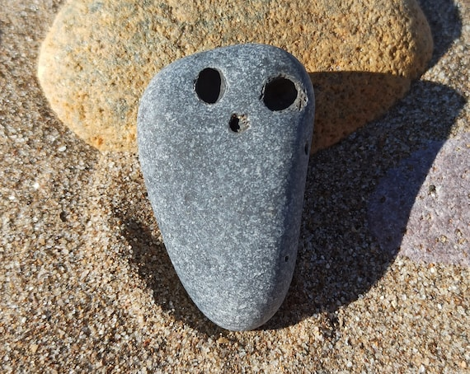
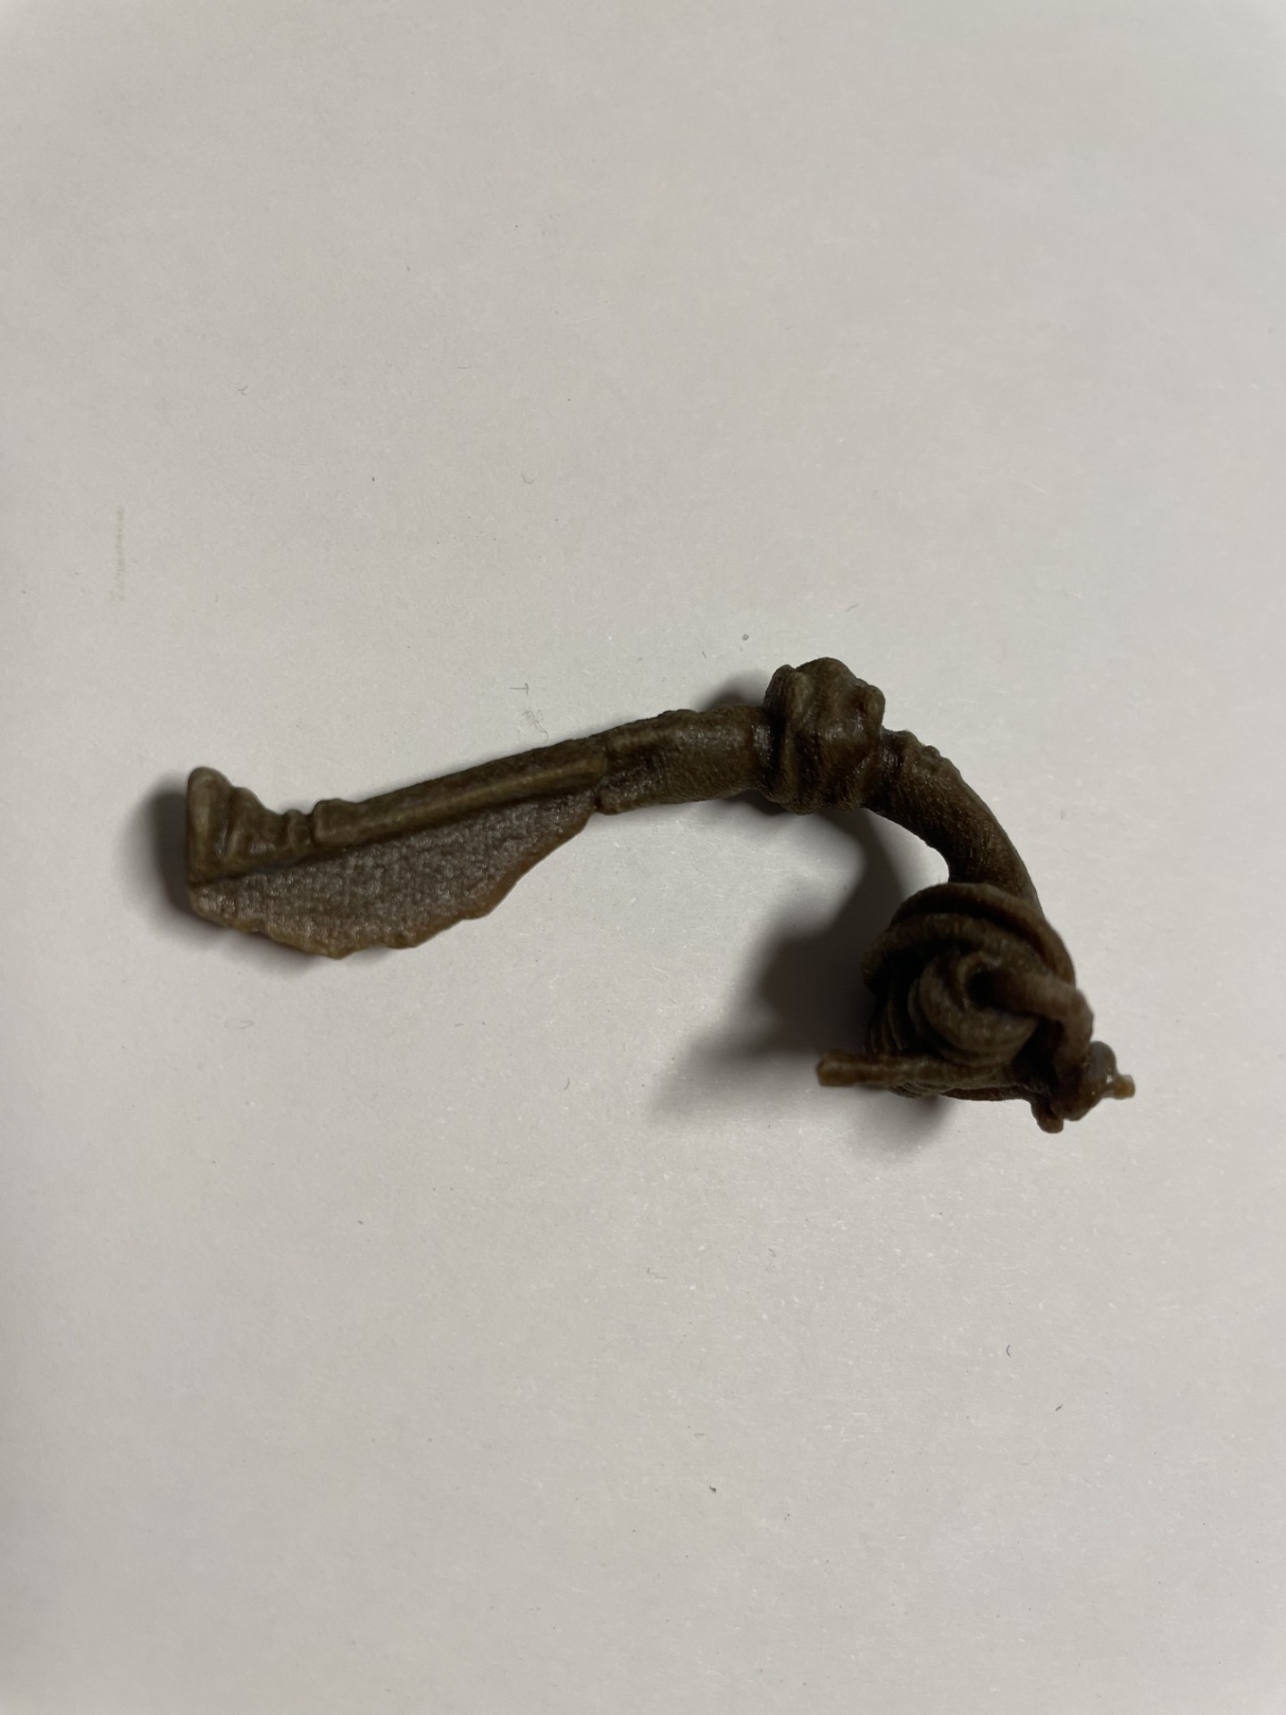

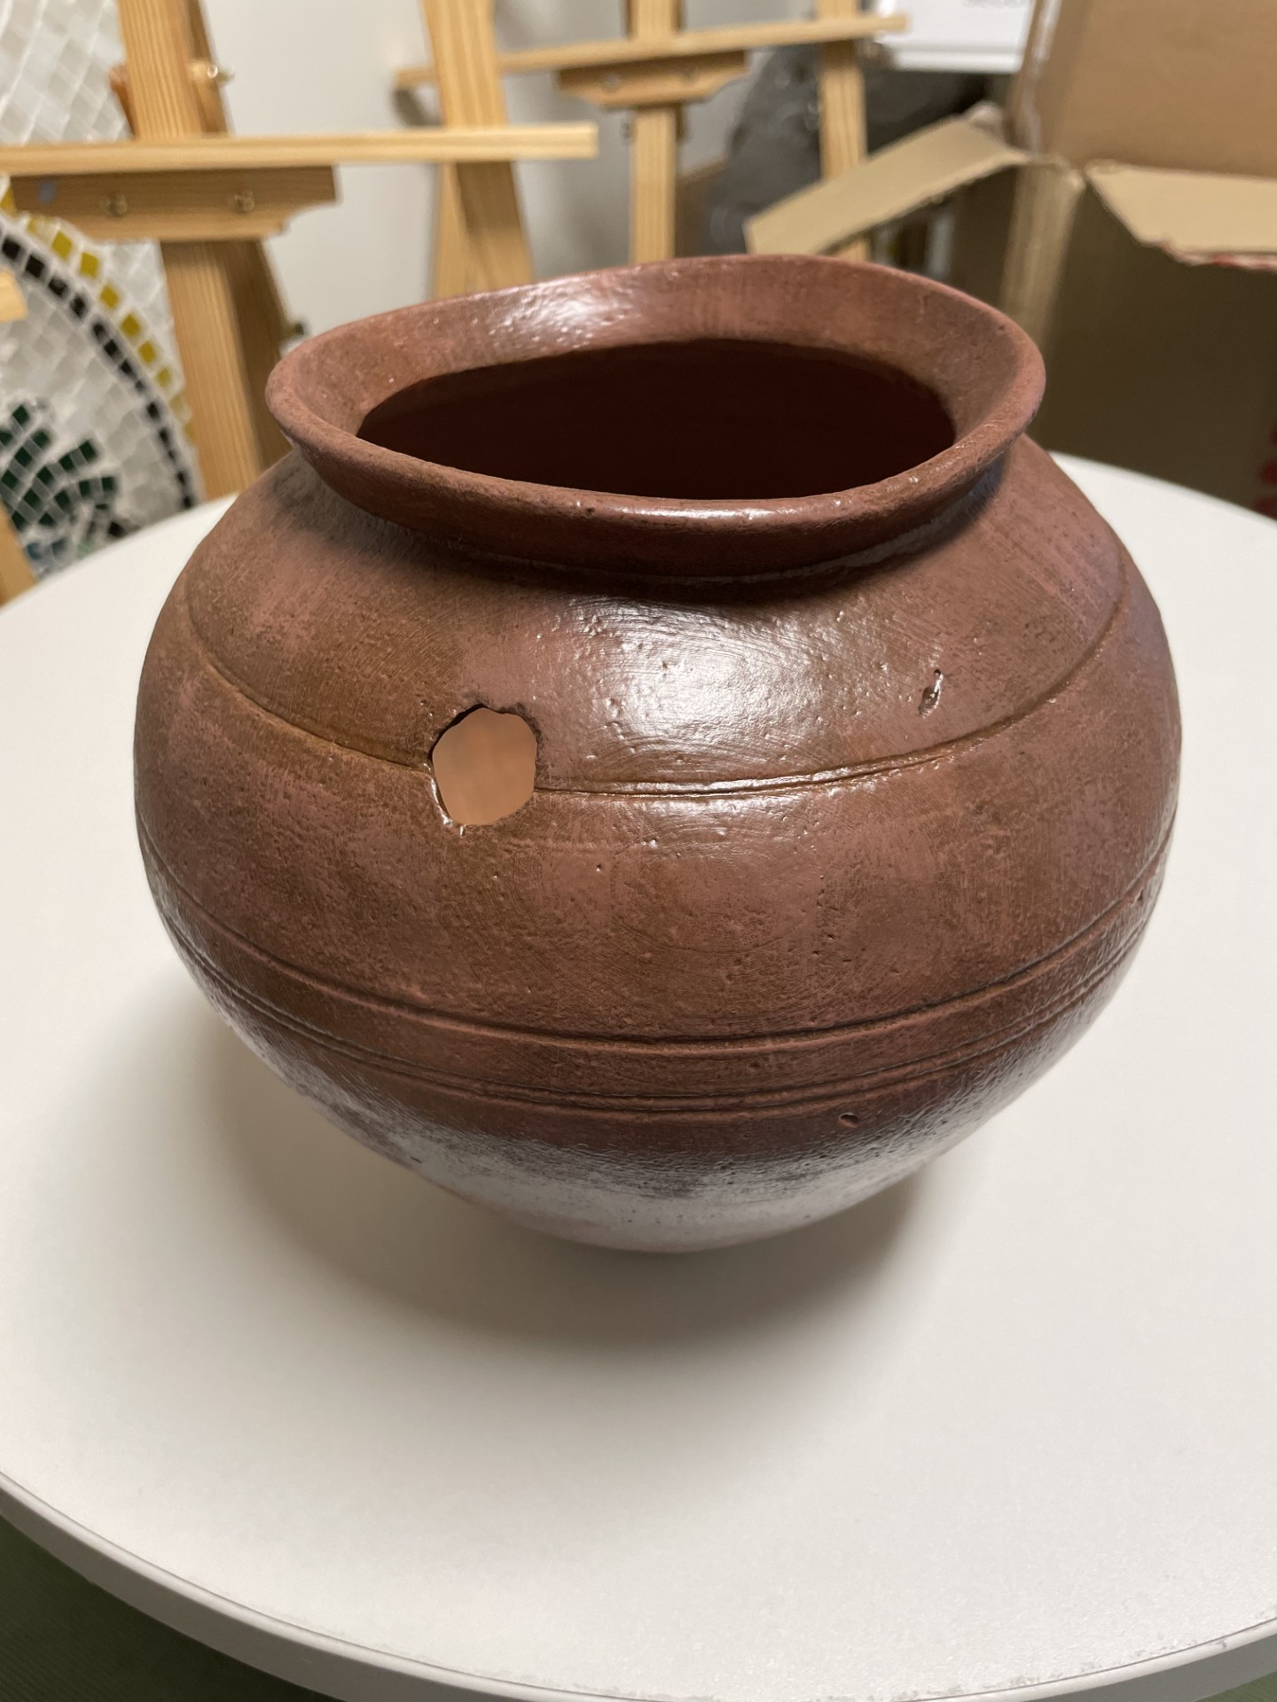
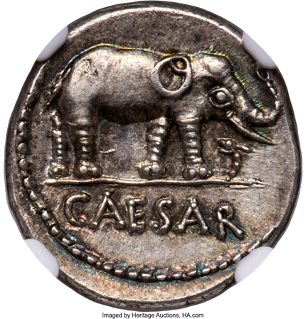
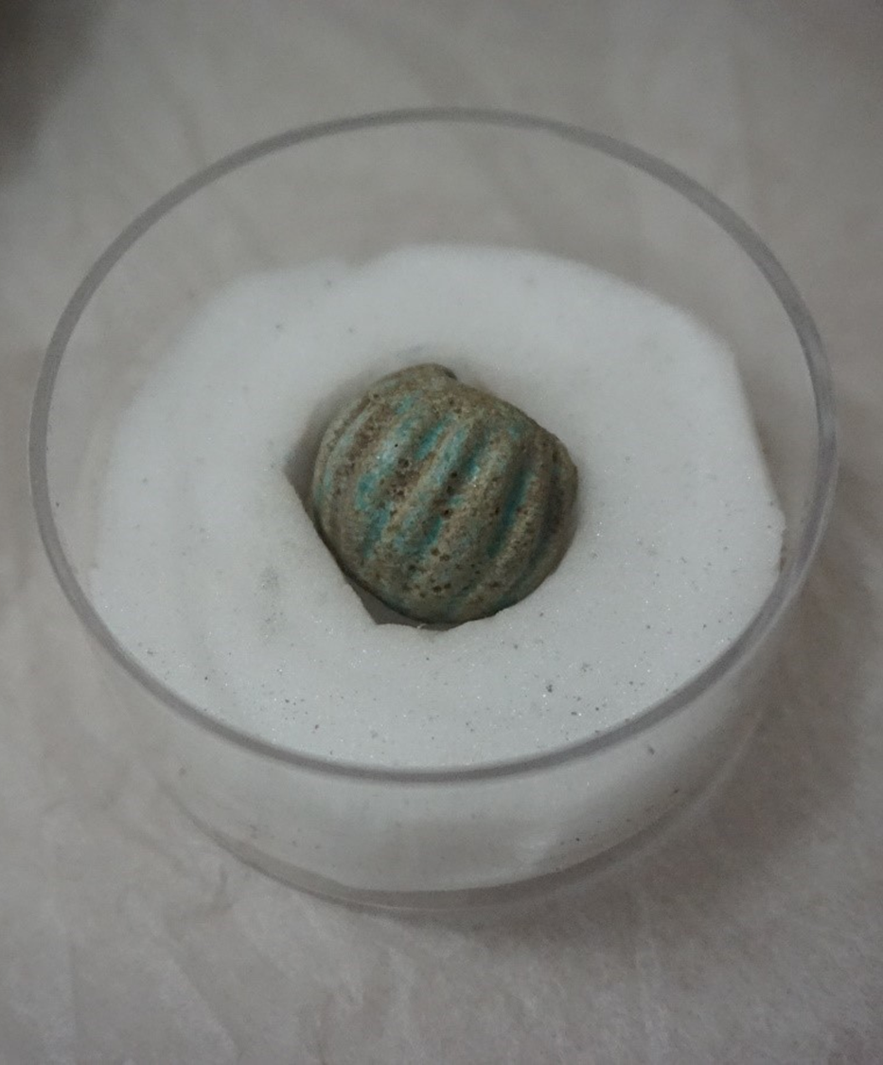
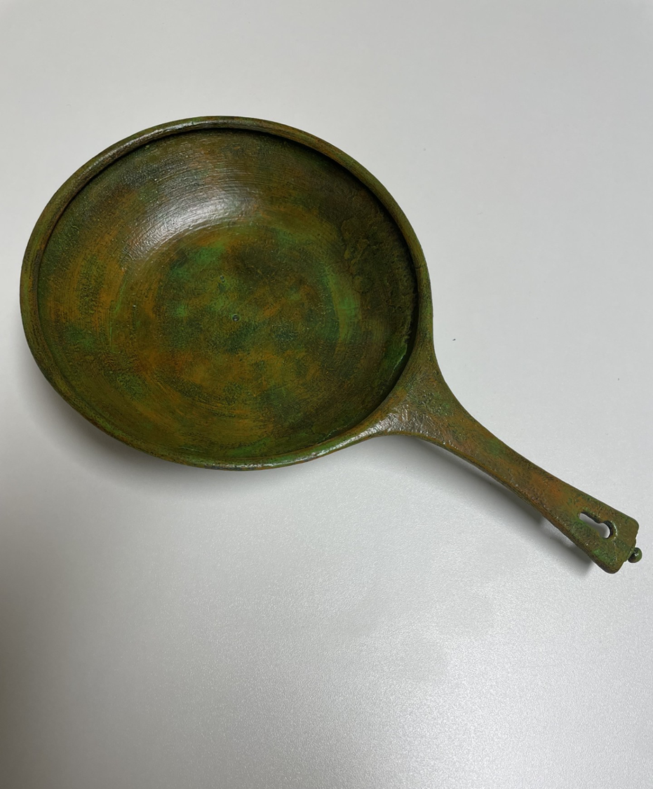
If you’ve completed the dig, click here!

Slide 6
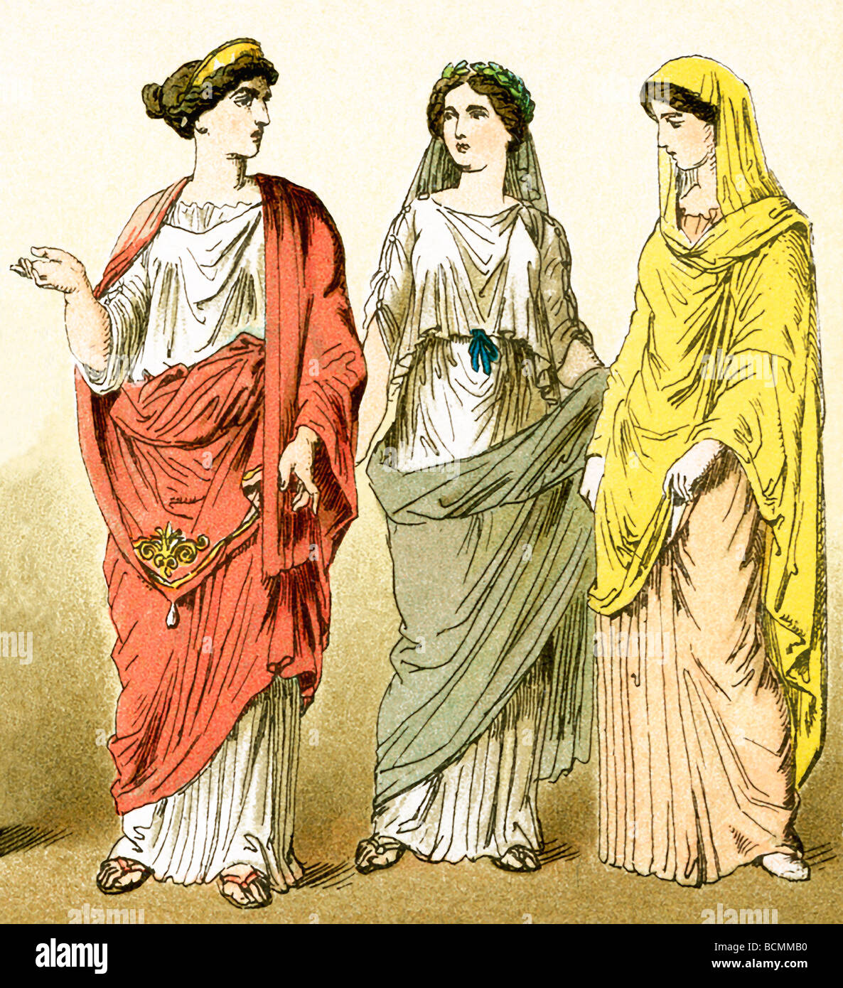

You found a Fibula! Or, a brooch!
This was used by Roman Women as a symbol of wealth and adornment!
It would have helped pin their outfits together
They were also used by Roman men to pin cloaks together
Usually made from bronze- like this one!
Some were made of gold/silver
Click here to go back to the dig!

Slide 7

You found Dice!
Used in games and gambling, both in the home and by soldiers to pass the time.
Were often not as cuboid as this – there was less standardisation of shape.
Similar to other dice from 1st c. AD
Click here to go back to the dig!

Slide 8
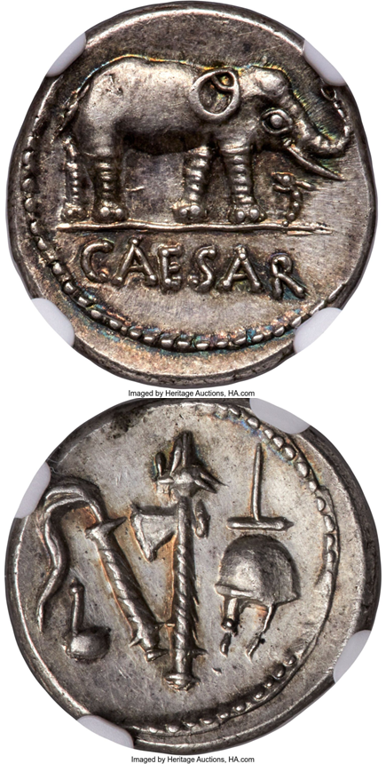
You found a coin!
On it says "Caesar“, a roman emperor!
There is an Elephant trampling a serpent! This shows the power of Rome over the East!
On the reverse of the coin are symbols of priesthood:
Simpulum (ladle)
Aspergillum (holy water brush)
Securis (axe)
Apex (the cap)
Click here to go back to the dig!

Slide 9
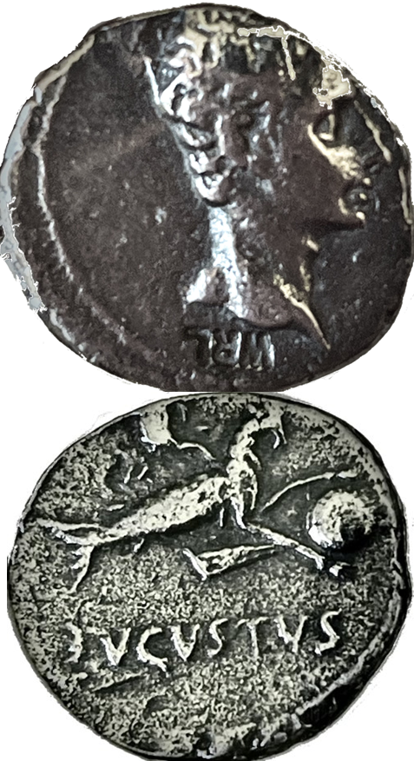
You found a coin!
On it is :
The Head of Augustus. This was the first emperor of Rome!
A goat (Capricorn) holding the globe, with a cornucopia on its back.
A cornucopia is a horn of food! Showing that the emperor would feed his people!
Click here to go back to the dig!

Slide 10
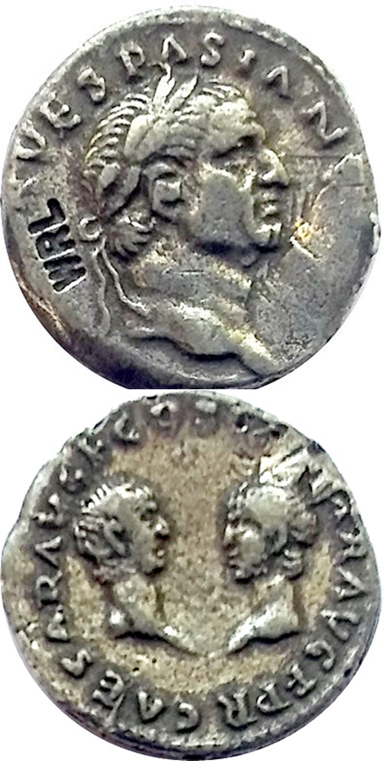
You found a coin!
On it is the Head of Vespasian
Laurelled. He has a leaf crown!
On the reverse are Heads of Titus and Domitian
It says "Caesar Augustus Filius Consul Caesar Augustus Filius Populusque Romanus“
Click here to go back to the dig!

Slide 11
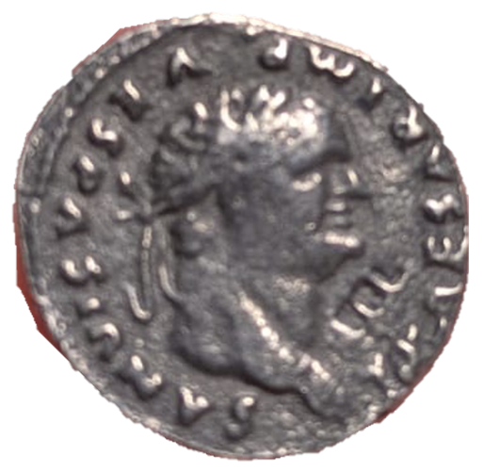
You found a coin!
It has the Head of Vespasian on it!
On the reverse is an Eagle, the symbol of Rome!
It says "Cos V" = Consul 5

Slide 12
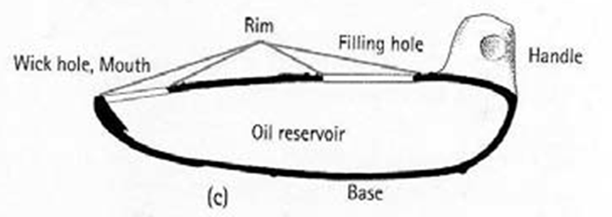
You found a lamp!
They were used for light, before we had street lights or anything of the kind
Enclosed Roman type, when production moves into industrialised Italy
Likely from 1st century AD- when the fort was first occupied!
Some evidence for a kiln- made on site?

Slide 13
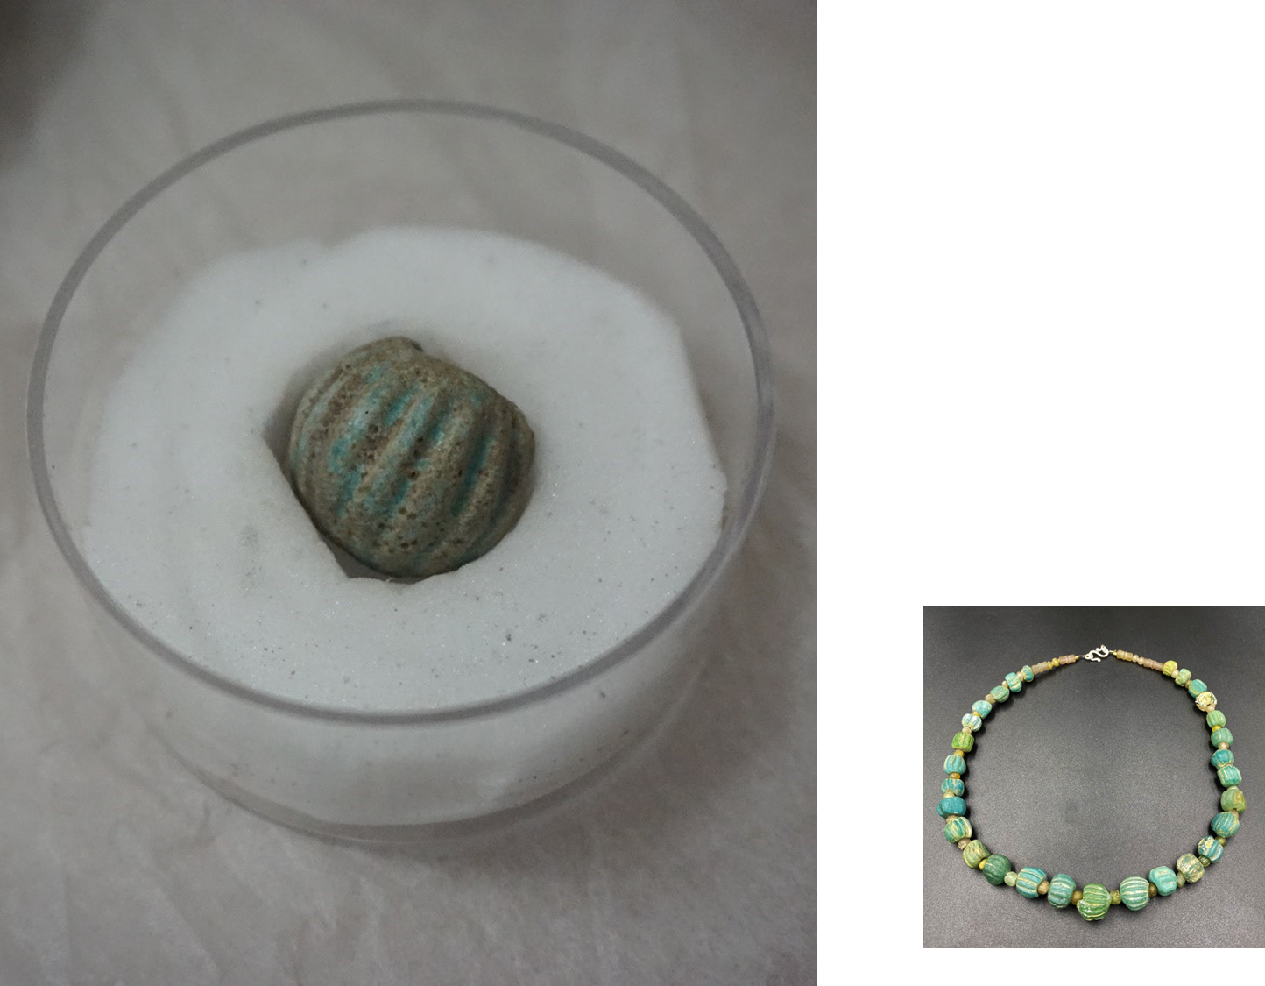
You found a melon bead!
Most common type of bead
Found all over Roman Britian
Made of glass
Strung together into necklaces
Worn by soldiers and women
Click here to go back to the dig!

Slide 14
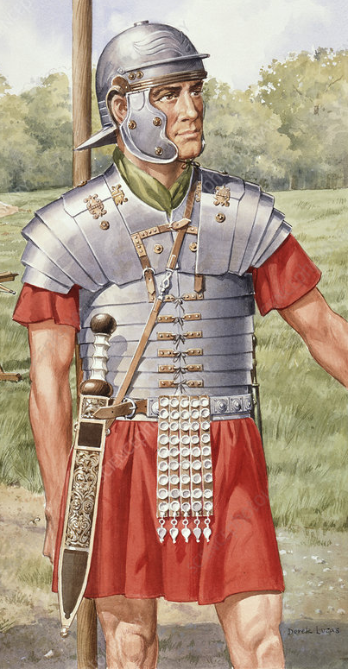
You found a belt buckle!
Only used for military armour
Rare
Lighter ones used to fasten armour
Heavier ones used for belts which held weapons
Click here to go back to the dig!

Slide 15
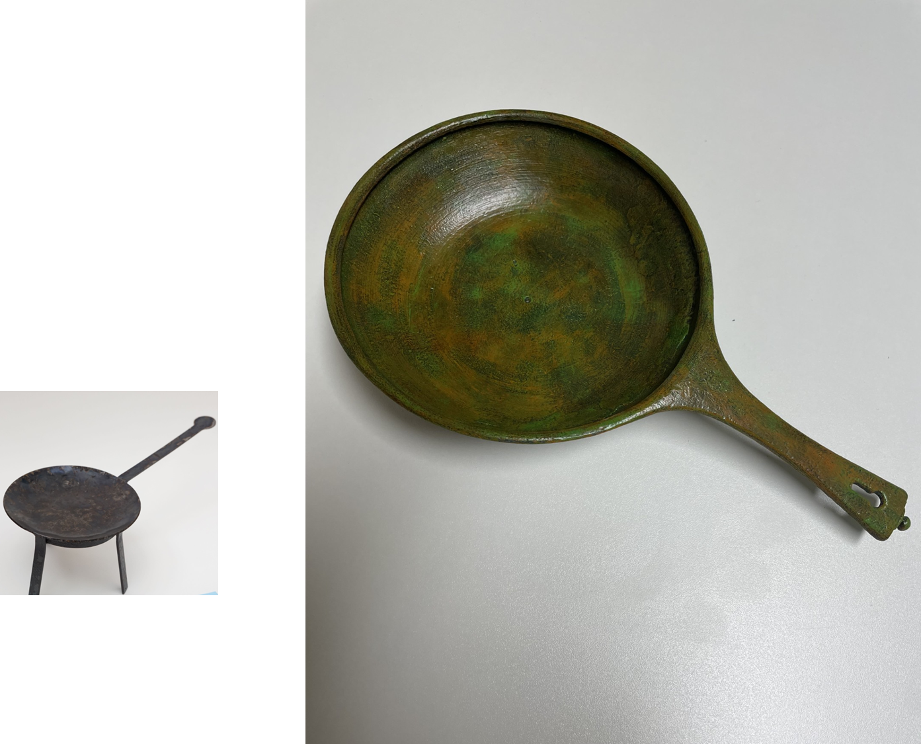
You found a frying pan!
In Latin it’s called a Frixorium
It was used in military camps by soldiers to cook food
It would be placed over tripod to cook!
Click here to go back to the dig!

Slide 16
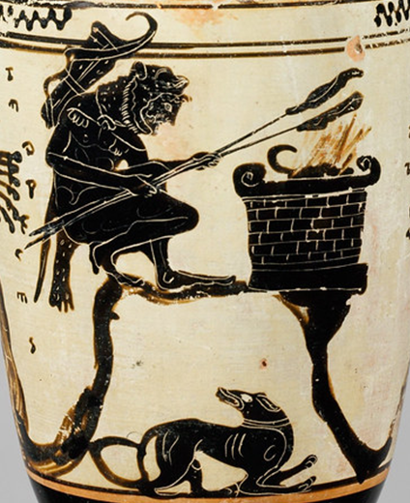
You found a pot! Called an ‘Olla’
A generic Roman cooking ware/ vessel for food storage
Sometimes used in funerary contexts, as gifts left in and near graves
Later came to hold cremated remains, like an urn.
Were often also used in sacrifices to collect and cook the entrails of the animal sacrifice.
Click here to go back to the dig!

Slide 17

Oh no! You found some litter!
Remember we should always clean up our dig sites!
Click here to go back to the dig site! Just remember to recycle first!

Slide 18

AHHHHHHHH! A SPIDER!!!!
Theres all sorts of creepy crawlies!
Remember to respect local eco-systems!!

Slide 19
That’s a weird shaped rock! Nothing special here, sorry!
Sometimes you don’t find much on a dig, don’t let that get your spirits low!

Slide 20
You’ve completed your dig! Congratulations!

Slide 21

Write down something you learned or enjoyed!! is there anything you would like to change?

