Slide 1
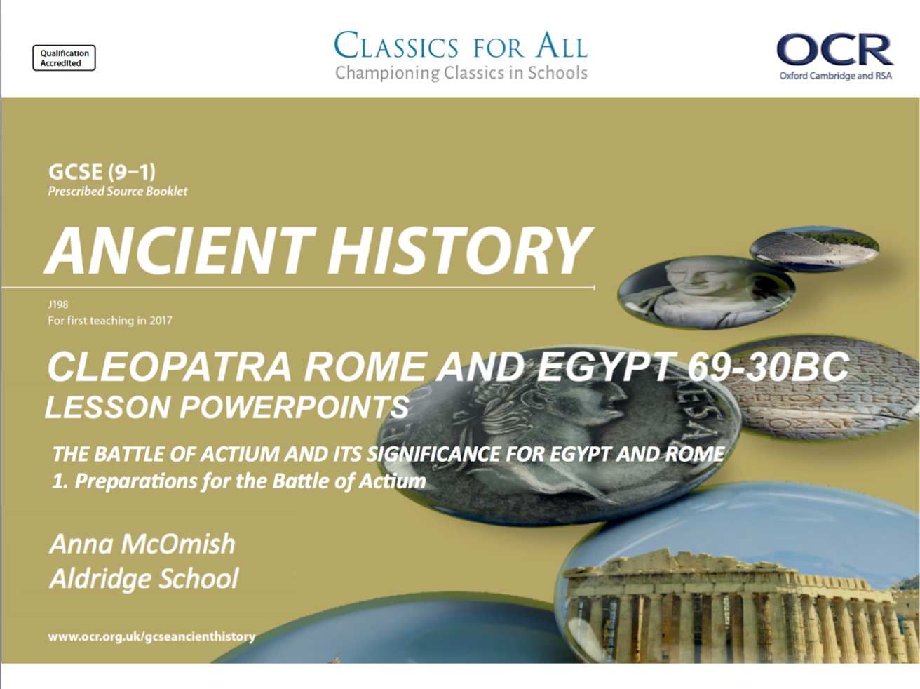

Slide 2
Review Revise Recap – Mark Anthony and Cleopatra
Name of Caesar’s legally named heir?
Political position that this heir was given in Rome?
Name of the leader of Caesar’s assassins?
Name of the political alliance between Antony, Octavian and Lepidus?
Name of that place that Cleopatra had Arsinoe imprisoned?
Where did Anthony spend the winter of 42BC?
Where did he ask Cleopatra to meet him?
Which figure does Plutarch compare Mark Anthony to, in his ‘Parallel Lives’ writings?
Why does Plutarch compare Anthony to this figure?
Name of the war that broke out in 40BC, between Anthony, Octavian and Sexus Pompeius?
What did Cleopatra ask Anthony for in return for her military and financial support?
What were the names of Anthony and Cleopatra’s twin babies?
Date of the Donations of Alexandria?
What was the most outrageous thing done at the Donations of Alexandria?

Slide 3
Preparations for the Battle of Actium
1. To understand and explain the key features of the battle of Actium.
2. To compare the roles of key individuals in the battle.

Slide 4
Causes of the war between Octavian and Anthony/ Cleopatra
By 31BC, a range of actions had been taken, by Octavian and Mark Anthony/ Cleopatra, that the relationship was completely beyond repair.
The Donations of Alexandria had confirmed for many that Anthony had become a decadent and dangerous eastern king, weak-willed and ruled by his threatening Egyptian Queen. His decision to split his half of the empire amongst his children, encouraged the belief that he was going to destroy the Roman Empire.
This was made all the worse by Octavian war of propaganda back in Rome, and his active attempts to slander Cleopatra and present her as a danger to the empire.
Most significant
TASK: read through the 6 causes on war on p. 195. draw out the scale on the left, and summarise each factor (in one sentence) where you believe it belongs on the scale.
You can only have ONE most significant, and ONE least significant.
Some others can be ranked at the same level, but you will have to give a written explanation as to why you ranked these the same!
Least significant

Slide 5
Preparations for, and build up to, the Battle of Actium
The two sides, Anthony and Octavian, quickly assembled their armies. Plutarch records that Anthony and Cleopatra had a force of 500,000 ships, 100,000 infantrymen and 12,000 cavalry men. Whereas Octavian had a far smaller force of 250 warships and 80,000 infantrymen, although a similar amount of cavalry men.
Ancient sources tend to inflate the numbers of military forces (e.g. Herodotus’ inflation of figures for Xerxes’ Persian army), but the types of forces makes it clear that a fight was expected at land and sea.
TASK: using p. 196-197 of the textbook, and the printout from Battle of Actium webpage, complete the table summarising the actions of the three key players during the preparations for the battle of Actium.
Octavian
Mark Anthony
Cleopatra
AT LEAST 3 BULLET POINTS PER FIGURE!
CHALLENGE:
Read Plutarch, Life of Mark Anthony, 60.
Why do you think that Plutarch include the stories of the omen in his account?
What effect does the inclusion of omens in his account have on our judgments of Plutarch as a historian?
Notes:
https://www.thoughtco.com/roman-civil-wars-battle-of-actium-2361202

Slide 6
Battle of Actium – www.historynet.com
Almost instantly, Octavian replaced the ‘traitor’ Anthony in the hearts of the Roman people. His manipulation of the facts had been masterful. Now all he had to do was win the war.
Anthony was confident, but he did not invade Italy right away. He thought it safer to wait until his Eastern client kings joined their forces to his. Of course, Italy’s well-defended coastline and ports and the political damage of invading his homeland with a largely foreign army were also paramount considerations.
As the winter of 32-31 bc closed in, Anthony and Cleopatra moved to Patrae (near Greece), while his defensive forces took up positions throughout Greece. Anthony’ navy was composed of large galleys called quinqueremes, their bows armored with bronze plates and their hulls built of massive square timbers bolted together with iron, making it nearly impossible for any smaller ships to ram them. As for land forces, Publius Canidius Crassus, trained by Anthony himself, commanded 19 legions; 11 more made up garrisons in Egypt, Cyrene, Syria and Macedonia. Anthony’ troops were fed on grain supplied by Egyptian stores. Some of his legions were made up of Egyptian soldiers. Cleopatra had made herself indispensable to Mark Anthony, and she had bet the freedom and wealth of her kingdom on his success.
The prospects of that success looked good at the start of 31 bc. Anthony’ force was superior in strength and supplies. Once Octavian started his men on the move, it would become a heavy burden just to feed them. And Octavian’ past performance as a general had been less than impressive.
Octavian, however, was not alone — he had Mark Vipsanius Agrippa, a lifelong friend and a brilliant general. Agrippa’s experience during the invasion of Sicily a few years earlier had been a trial by fire; now he commanded Octavian’ fleet with confidence and skill — perhaps greater skill than that of Anthony’ own admirals, Lucius Gellius Poplicola and the consul Gaius Sosius.
In fact, it was Agrippa who made the first moves in what would become the decisive battle. While Mark Anthony moved his fleet into the Gulf of Ambracia and secured the gulf entrance through the use of towers on either shore and a line of ships between, Agrippa took his own fleet far south and attacked Messenia in the Peloponnese. The damage Octavian’ admiral inflicted on the Greek shores was immeasurable — the surprise attacks and the capture of several of Anthony’ posts effectively silenced Anthony’ lines of communication.
Meanwhile, Octavian moved south and took up a position on the high ground of the gulf’s north shore, opposite the peninsula of Actium. He sent land forces to attack Anthony’s camp, but they were quickly repulsed. Anthony responded with an attempt to cut off his rival’s supplies from the north, but that, too, failed.
Momentarily stalemated, the rivals stared at each other across the strait. Months passed without any decisive action by either party. Historical records are nearly silent on those months, but it is known that in Rome tempers were hotter than the weather as heavy taxes aggravated the populace.
In the East, loyalty to Anthony was teetering. His support was further damaged when a naval battle erupted between Agrippa and Gaius Sosius. Sosius lost, though he escaped, and Agrippa set up a blockade around Actium and the gulf. Anthony was then cut off from reinforcements and supplies. Disease and famine set in. Some Antonian officers and senators began to defect to Octavian, including Sosius’ co-consul, Gnaeus Ahenobarbus. Still, Anthony retained his three best commanders: Canidius, in charge of land forces, and his admirals Sosius and Lucius Policola.
The time to fight was now or never. But fighting might not have been what Anthony had in mind. The ancient historian Dio Cassius stated that Cleopatra wanted to return to Egypt and wanted Anthony to go with her. After much deliberation he agreed, ordering his fleet to prepare for battle while he secretly made plans to escape. Although Dio might have been influenced by strong anti-Antonian propaganda, what happened at Actium was not so far off that it makes his judgment seem unreasonable.

Slide 7
Mark Anthony’s character through preparations for the battle
As he has been for some time now, Plutarch is still using historical events to portray the character of Mark Anthony. Still, we see him as weak and easily influenced by the demanding and seductive Cleopatra.
It would seem as though, even when discussing the preparations for the battle, Plutarch wants to make Anthony seem like someone who is at heart weak and cowardly. Which is somewhat surprising given Anthony’s stunning military record when he worked under Caesar… We might want to think about who else is getting the blame for this change…
TASK: in your source packs, read Plutarch, Life of Mark Anthony, 62, 63 and 64.
Answer the following questions, include quotes to support your points.
How do the sources still manage to present Mark Anthony as a coward, even though he is preparing to fight Octavian, and is a well-renowned Roman soldier?
To what extent do you agree that this is an idea that the sources have been working in for some time?
CHALLENGE:
Where do you see evidence, in the same passages of Plutarch, that Cleopatra is also being portrayed negatively?
Does the presentation match with your own knowledge of Cleopatra as a ruler?
Do you think Plutarch’s account if Cleopatra during preparations is accurate?

