Slide 1
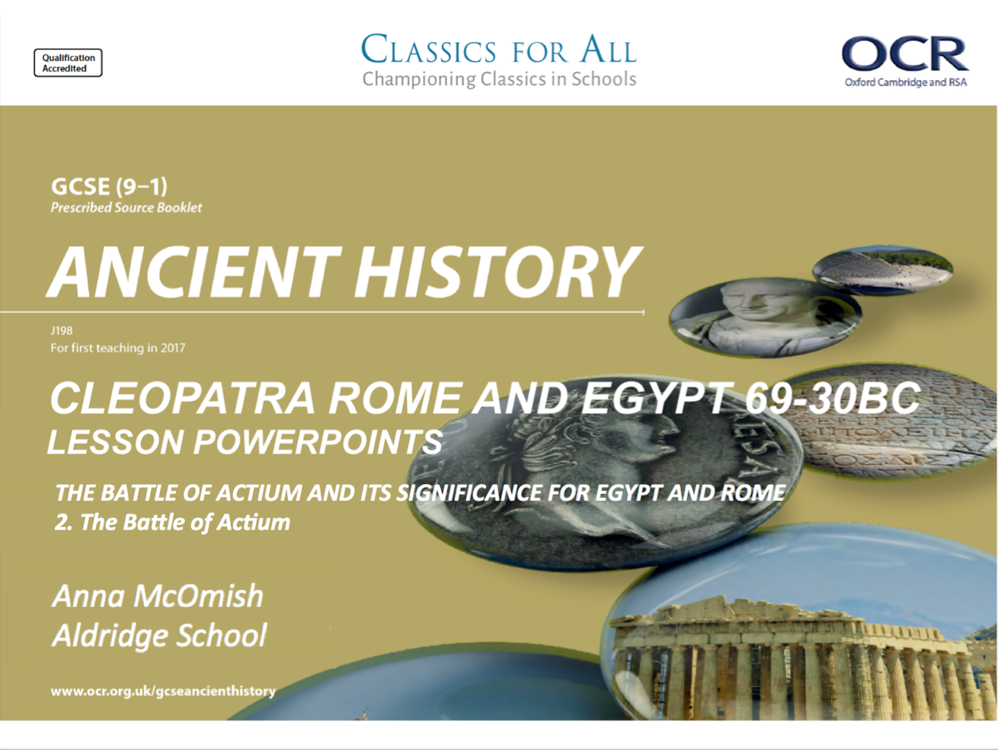

Slide 2
The Battle of Actium 31BC
To understand and explain the key features of the battle of Actium.
2. To compare the roles of key individuals in the battle.

Slide 3
The Battle of Actium Sept 2nd 31BC – key events and players
Having prepared for a decisive battle against Octavian, Mark Anthony and Cleopatra met his forces on the western coast of Greece. Octavian would win this battle and this decisive victory over Mark Antony would allow him to become the undisputed master of the Roman world.
Antony, with 500 ships and 70,000 infantry, made his camp at Actium, which lies on the southern side of a strait leading from the Ionian Sea into the Ambracian Gulf. Octavian, with 400 ships and 80,000 infantry, arrived from the north and, by occupying Corinth, also managed to cut Antony’s southward communications with Egypt via the Peloponnese.
Desertions by some of his allies and a lack of provisions soon forced Antony to take action. Either hoping to win at sea because he was outmanoeuvred on land, or else simply trying to break the blockade, Antony followed Cleopatra’s advice to use the fleet. He drew up his ships outside the bay, facing west, with Cleopatra’s squadron behind.
The following naval battle was hotly contested, with each side’s squadrons trying to outflank the other, until Cleopatra took her Egyptian galleys and fled the battle. Antony then broke off and with a few ships managed to follow her. The remainder of his fleet became disheartened and surrendered to Octavian, and Antony’s land forces surrendered one week later.
TASK: using the information from the clip, make notes on the events of the Battle of Actium.
Make sure to keep these notes in chronological order!
CHALLENGE:
How significant would you argue Agrippa was in Octavian’s success at the battle.
Notes:
https://www.youtube.com/watch?v=QPO4ms1KdgY
https://www.youtube.com/watch?v=HRT2xapt8W8 – clip from the 1963 Cleopatra film, latter stages of the battle and Cleopatra heads for Egypt

Slide 4
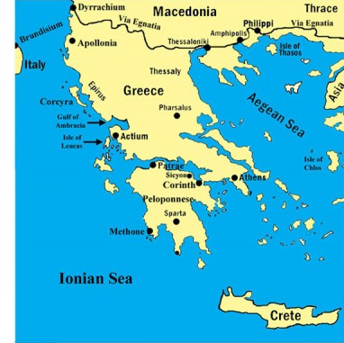
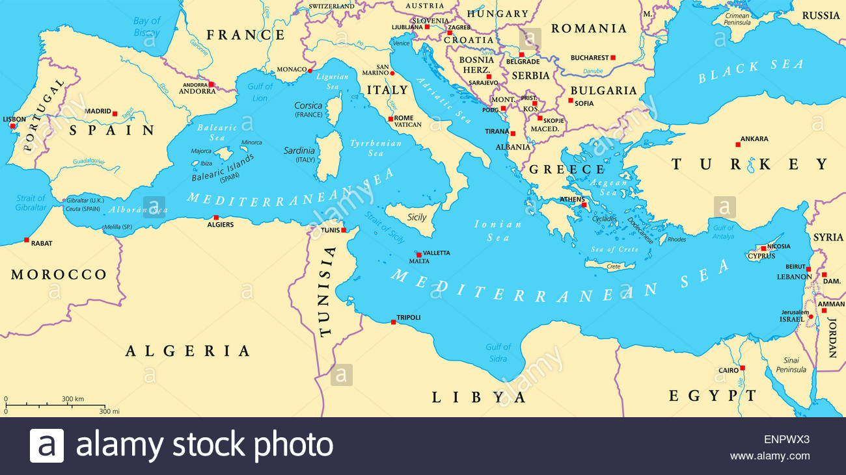
Where did the Battle of Actium take place?

Slide 5
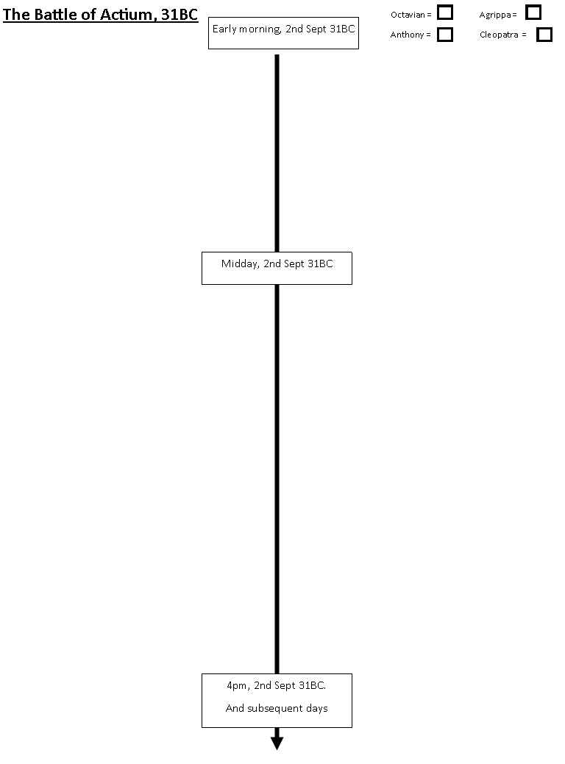
The Battle of Actium Sept 2nd 31BC – key events and players
TASK: using the following sources of information, complete a timeline of events for the Battle of Actium.
This timeline should include events/ actions from four key players, so include that detail in a different colour for each person, so you can see when/where they are active!
Textbook p. 197-198.
Plutarch, Life of Mark Anthony, 66 and 68
Print out from Ancient History Encyclopaedia.
CHALLENGE:
‘Mark Anthony’s failure at the Battle of Actium was certain, BEFORE Cleopatra abandoned the fighting’. How far do you agree with this statement?
Use your own knowledge, and knowledge of the sources, to support your point.

Slide 6
After four days of bad weather, the morning of September 2, 31 bc, dawned clear and calm, and Antonius’ massive quinqueremes rowed out of the gulf in two wings. They did not look like they were trying to escape; they remained in close formation, loaded with men, weapons and huge towers built on the decks for catapulting missiles. Octavian’ smaller ships, many of them light Liburnian vessels, were gathered north of the gulf’s narrow entrance and hesitated before meeting the opposing force. Antonius’ galleys were intimidating. If the Liburnian ships charged them, the bronze and heavy wooden armor of the quinqueremes would easily snap their ramming beaks. If they tried to go in close and attack with spears and arrows, Antonius’ men would respond from an advantageous height, pelting Octavian’ seamen with their more numerous javelins.
Nevertheless, Antonius’ offensive move could not go unopposed. Leaving the details to Agrippa, Octavian ordered his fleet into formation before the gulf. He could take some comfort in the fact that his ships, too, would be safe from ramming by Antonius’ galleys, since the giant quinqueremes could not achieve enough speed to do much damage. Octavian’ forces could therefore cluster three or four ships around each one of the quinqueremes. The small vessels, together or in turn, would harass the galleys, then row away if the Antonians tried to respond with spears, arrows, flaming missiles flung from the towers or heavy grappling irons.
As the fighting intensified, Agrippa extended his left wing even farther, hoping to row around Antonius’ flank. Lucius Policola, commanding Antonius’ right wing, moved outward to meet the oncoming force, but in so doing he became separated from the tight center. Unlike Agrippa’s veterans, Antonius’ troops were inexperienced, and the sudden movement of their right flank threw the center into confusion.
The commander of Octavian’ center, Lucius Arruntius, a loyal Caesarian republican and future consul, saw what was happening and immediately engaged Antonius’ center. If Antonius’ plans had included escape with his entire force, he was now bitterly disappointed. A major battle had erupted before his eyes.
The fighting continued all afternoon, neither side achieving any decisive gain. Burning missiles flew from the towers of Antonius’ galleys, covering the ships with a blanket of black smoke. Since neither side could ram the other — the usual means of attack in an ancient naval battle — shields, spears and arrows were used as if the men were fighting in the mountains of Gaul. The problem was, there was no line for the opponents to break through, no land for them to take and hold. The battle continued with an attack, a retreat, then another attack, until one side grew too exhausted to continue.
Safely with her squadron, astern of Antonius’ center, Cleopatra watched the battle with increasing anxiety. Finally she had enough. She raised her sails and headed for the open sea beyond with her squadron of 60 ships. If Policola’s movement from the center had thrown the formation into confusion, the sudden loss of 60 ships from their rear threw the Antonians into complete disorder.
Although they may have laid earlier escape plans, Antonius must have been shocked by Cleopatra’s sudden departure without him. The battle instantly forgotten, he boarded his personal quinquereme and hurried after his queen, with 40 of his ships in tow. The Antonians left behind to carry on the fight with Octavian were now seriously diminished in number — and leaderless.
Once clear of the fighting, the wooden towers and war tackle cluttering the decks of Antonius’ ships were thrown overboard. Sails were raised and the ships’ speed increased. Soon Antonius caught up to Cleopatra’s fleet. She hoisted a signal on her ship and allowed him aboard her royal galley, but Antonius could not bring himself to see her right away. As Plutarch wrote, Antonius made his way to the bow of the ship, unable to utter a word to anyone, and sat holding his head between his hands as the magnitude of what he had done finally hit him.

Slide 7
10 marker – Cleopatra and Alexander papers. Exam practise
Question 14. – 10 marks.
Level 5 | 9-10 | Range of detailed and accurate knowledge and a developed understanding that is fully relevant to the question. (AO1) Full explanation and thorough, convincing analysis of the issue in the question, arriving at substantiated and developed judgements. (AO2)
Level 4 | 7-8 | Accurate knowledge and a developed understanding that is fully relevant to the question. (AO1) Full explanation and analysis of the issue in the question arriving at substantiated judgements, but these are not consistently well-developed. AO2
Level 3 | 6-5 | Demonstrates accurate knowledge and some understanding that is relevant to the question. (AO1) Linked to an analysis and explanation of the issue in the question but judgements may not always be made explicit. (AO2)
Level 2 | 4-3 | Demonstrates basic knowledge and some understanding that is relevant to the question. (AO1) Basic explanation of the issue in the question. (AO2)
Level 1 | 2-1 | Basic knowledge that is relevant to the topic of the question. (AO1) Little or no attempt at a very basic explanation of the issue in the question. A02
How significant was Cleopatra’s role in the Battle of Actium? (10).
3 points of discussion
STEP 1 – Plan how many points you could make to answer this question.
STEP 2 – plan HOW each point proves/ disproves that Cleopatra was significant.
STEP 3 – decide what your conclusion will be – was she, or was she not, significant for the battle?
2-3 points of discussion
1-2 points of discussion
1, poor point of discussion

