Slide 1
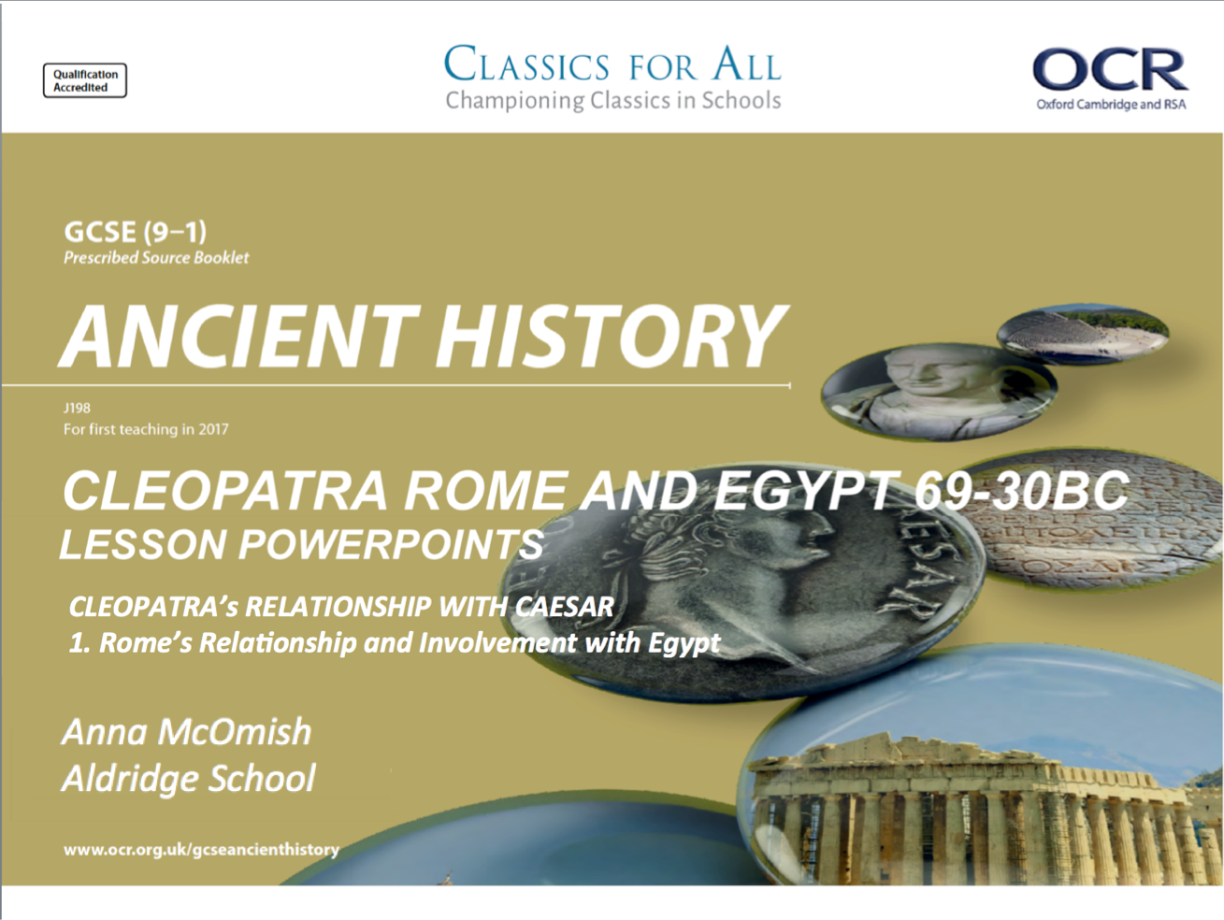

Slide 2
Rome’s relationship and involvement with Egypt
February 27, 2020
(Underline date and title using a pencil and ruler)
Revise, Review, Recap – unscramble and define
iiss
Hlileinstce
Tloycoapi ydsyant
Arolcaptoe
Naaceoris
Lesson Objectives:
To understand the type of relationship Rome had with its client states.
To assess the significance of Rome’s involvement with Egypt in the 50s and 60s BC.
Key words/Spellings: Cleopatra, significance, client state, resources

Slide 3
Client states; beneficial to everyone?
Since launching their first offensive against the Carthaginians in 264BC, Rome’s empire and influence had been steadily growing across the Mediterranean. By the time of the reign of Ptolemy Auletes, Rome was the ancient world’s dominant power.
Rome used client-kings to help ensure peace across its vast empire; these were kings that relied on Rome for the power and control of their own kingdom, so ultimately they did as Rome commanded…
TASK: using p. 168-169, draw out and complete the table summarising the ways in which the client-states benefitted the client-kings and Rome itself.
Make sure to note any drawbacks that either side experienced in this deal! Infer!
CHALLENGE:
Of the two sides involved in a client-state, the client-kings and Rome, which do you think benefitted the most out of the relationship?
Explain your answer using specific historical detail
EXTENSION:
Given the issues that Auletes had before her, to what extent would this client-state relationship have helped Cleopatra establish a trusting relationship with Rome?
Evidence that Client states were beneficial to Client-Kings | Evidence that Client states were beneficial to Rome
What were the drawbacks of a Client-State? 2 points for each side!

Slide 4
TASK:
Rank on your sheet (1-4) the most important reason for Egypt’s importance to Rome
Importance of Egypt for Rome
Location
Egypt’s location made it appealing politically and economically for Rome. Its position in the southern Mediterranean along with the Nile provided excellent trade options and resources for Rome.
Natural resources
Egypt was a land of excellent resources. The yearly flooding of the Nile created very fertile land which the Egyptians farmed very effectively.
Political Potential
Ambitious Romans knew they could harness the potential of Egypt for their own political gains
Wealth
As a result of their ample natural resources and location, Egypt had a thriving economy and was a nation of great wealth

Slide 5
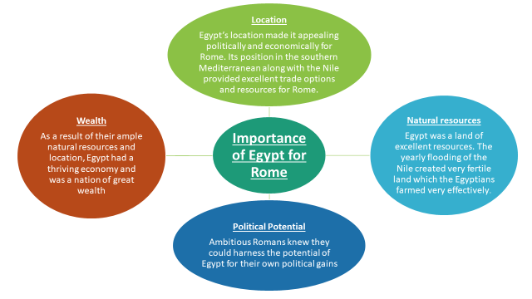

Slide 6
Rome’s involvement Egypt in the 60s and 50s
Rome’s involvement with Egypt goes back much further than their dealings with Ptolemy Auletes. As the diagram on the last slide makes clear, the advantages of having Egypt as a client Kingdom had been well-known for some time, so Rome had, had near continuous involvement with the Kingdom since 168BC. About 130years before the reign of Cleopatra!
You can see why the likes of Cicero didn’t appreciate Cleopatra shifting this power dynamic about…
TASK: using p. 169-170, annotate the timeline with information on the involvement between Rome and Egypt.
CHALLENGE:
Read Plutarch, Life of Caesar 48, and complete the practise exam questions in full.
Make sure to include clear, specific historical detail.
12. What can we learn from this passage about the benefit to Rome of Client-Kingdom relationships? (5)
13. Using details from the passage, evaluate how accurate you think this portrayal of the influence of Rome over client-states is. (5)

Slide 7
168BC
59BC
57BC
81BC
58BC
55BC
168BC
59BC
57BC
81BC
58BC
55BC

