Slide 1
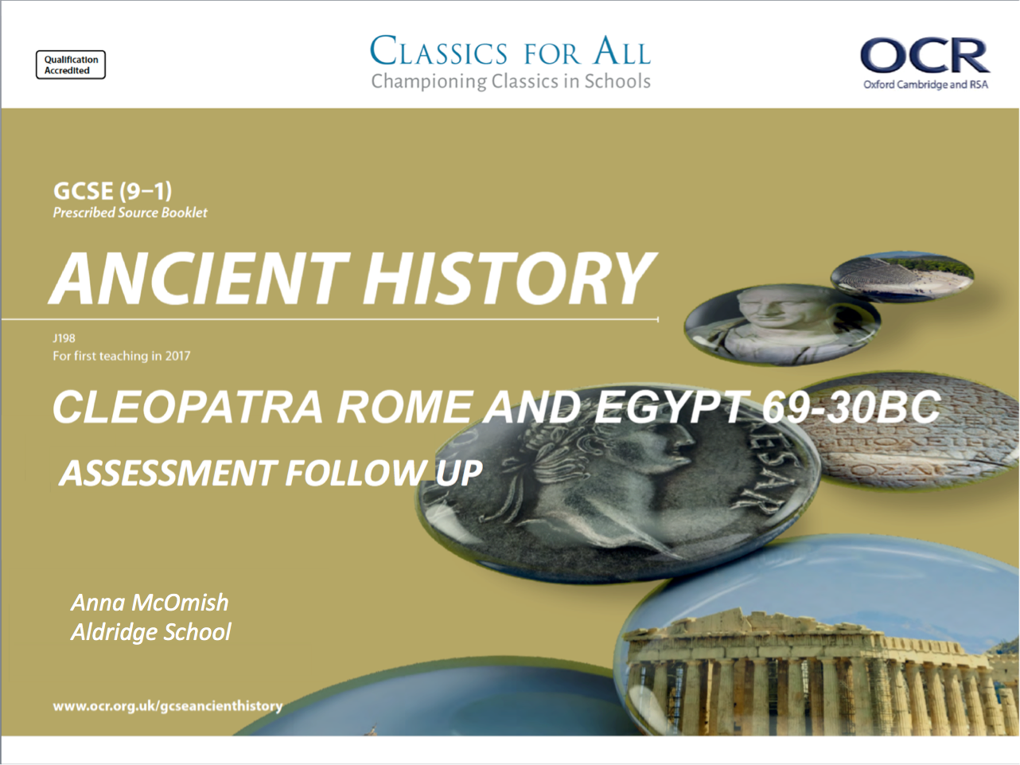

Slide 2
Assessment Follow Up – Cleopatra Assessment 1
February 27, 2020
Lesson Objectives:
To recap what skills are required for section B of the exam
To consolidate our knowledge of Cleopatra’s background and character
Key words/Spellings: Cleopatra, Macedonian, heritage, Alexandria

Slide 3
5 – marker; What can we learn from passage C about………….
5 – marker (in the accuracy of the passage); Using details from Passage C, evaluate how accurate you think………….
This is meant to be a quick ‘read and do’ question. Read the source and think about what it is telling you
For this question you don’t need own knowledge
All you need is 2-3 inferences
It should take you around 3-4mins to write
e.g. From the passage we can learn…..
I can also learn…..
The passage also tells us…..
This question just wants you to explain, based on what you know about that writer/ source, why is THAT EXACT passage/ source accurate or not. Allocate around 4-5mins for this
If you make some generic points, you’ll get average marks – 3/5.
E.g. Plutarch wrote biographies, therefore he’s less likely to be accurate as he exaggerated the stories.
For 5/5 your point about the write/ source HAS to relate to a specific part of the source.
E.g. Plutarch wrote biographies and wanted to write interesting and engaging stories, therefore it is likely he exaggerated the……because he says…….

Slide 4
10 – marker; Explain the significance of (or other S.O.C)…………..
2/3 points of explanation – focus here really is your own knowledge
You should spend roughly 10mins on this question
But we must be REALLY careful that we don’t just look at this question and think it’s like a 6-marker from the Persian Kings/Rome paper. IT. IS. NOT.
This 10marker needs far more historical detail and to do thought about THEMETICALLY (basically link to whatever they have asked for in the question), if you can.
You should be explaining the consequence of something or the significance of something – whatever is in the question focus on it!

Slide 5
Task 2
Make revision resources (either a mind map/flashcard) on key aspects of Cleopatra, focus on:
Her upbringing
Early years as Queen
Her character
How she is presented (think Isis)
This can take the form of an A3 diagram, flashcards or you can make a quiz on the information studied so far

