Slide 1
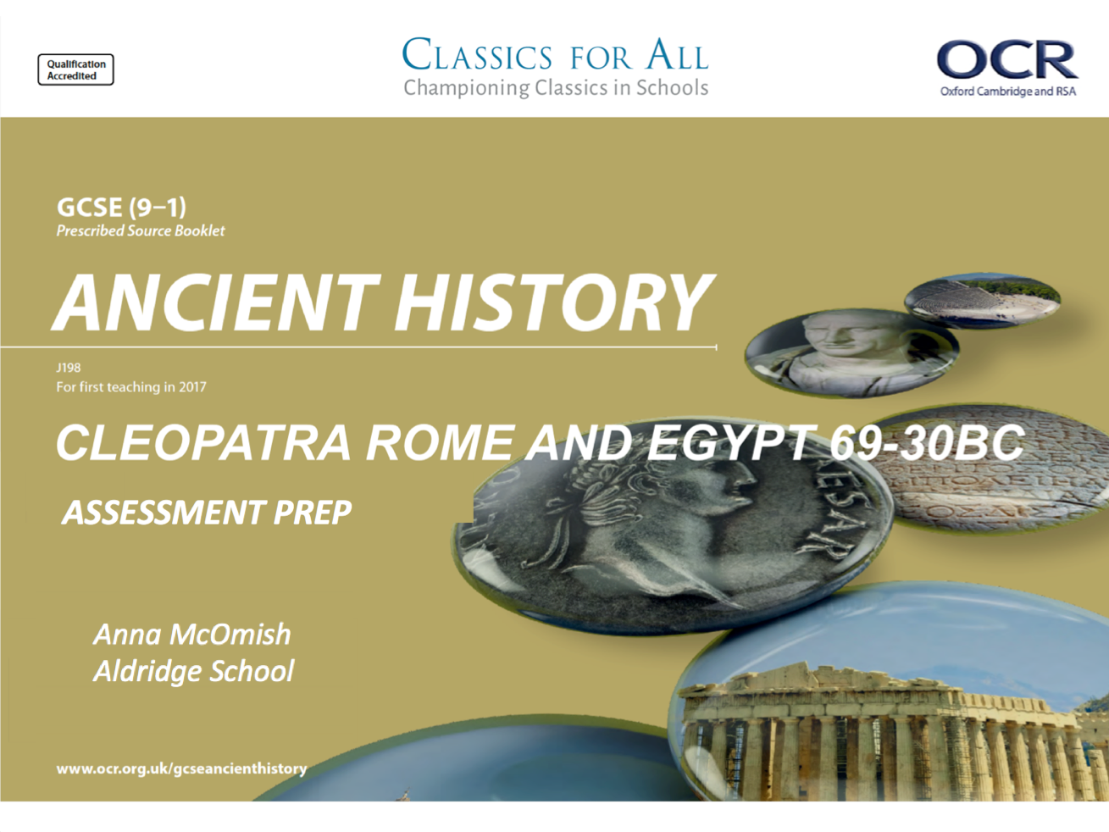

Slide 2
Assessment preparation – Cleopatra Assessment 1
February 27, 2020
(Underline date and title using a pencil and ruler)
Lesson Objectives:
To recap what skills are required for section B of the exam
To consolidate our knowledge of Cleopatra’s background and character
Revise, Review, Recap
How long is your Ancient History paper?
Do you get a choice of questions?
How many questions are in the second section?
Do you get marks for SPAG?
Should you ever leave a question blank?
Key words/Spellings: Cleopatra, Macedonian, heritage, Alexandria

Slide 3
Structure
The Cleopatra topic makes up the second section of your second paper and is paired up with the Rome topic
You will have 1hr 45mins to complete all the questions in paper
There are 5 questions in total, but question 1 is split up into 3 knowledge questions

Slide 4
Starter
Create 3 knowledge questions (two 1 mark questions and one 3) for another person in the class to complete. (Obviously make sure that you know the answers). This is the style of the first question on pretty much all the papers so you should be used to these!
E.g.
Name one area of land that Cleopatra acquired (1)
Explain why Cleopatra was well educated (3)
Name Cleopatra’s father (1)

Slide 5
Questions
After the knowledge questions there are 3 more slightly longer questions and an essay style question:
What can we learn from passage A about…. (5marks)
Using details from passage A, evaluate….. (5marks)
How far…… (10marks)
‘statement about something’ How far do you agree with the statement? You must use ancient sources and your own knowledge (20marks)

Slide 6
5 – marker; What can we learn from passage C about………….
5 – marker (in the accuracy of the passage); Using details from Passage C, evaluate how accurate you think………….
This is meant to be a quick ‘read and do’ question. Read the source and think about what it is telling you
For this question you don’t need own knowledge
All you need is 2-3 inferences
It should take you around 3-4mins to write
e.g. From the passage we can learn…..
I can also learn…..
The passage also tells us…..
This question just wants you to explain, based on what you know about that writer/ source, why is THAT EXACT passage/ source accurate or not. Allocate around 4-5mins for this
If you make some generic points, you’ll get average marks – 3/5.
E.g. Plutarch wrote biographies, therefore he’s less likely to be accurate as he exaggerated the stories.
For 5/5 your point about the write/ source HAS to relate to a specific part of the source.
E.g. Plutarch wrote biographies and wanted to write interesting and engaging stories, therefore it is likely he exaggerated the……because he says…….

Slide 7
10 – marker; Explain the significance of (or other S.O.C)…………..
2/3 points of explanation – focus here really is your own knowledge
You should spend roughly 10mins on this question
But we must be REALLY careful that we don’t just look at this question and think it’s like a 6-marker from the Persian Kings/Rome paper. IT. IS. NOT.
This 10marker needs far more historical detail and to do thought about THEMETICALLY (basically link to whatever they have asked for in the question), if you can.
You should be explaining the consequence of something or the significance of something – whatever is in the question focus on it!

Slide 8
Essay question; ‘Some kind of statement’ How far do you agree with this statement? USE ANCIENT SOURCES AS WELL AS YOUR OWN KNOWLEDGE
You will always have to discuss the element of ‘how far’ therefore this will always take the format of an agree paragraph, then a disagree paragraph and then an overall conclusion
For ALL Alexander and Cleopatra essays - Making sure that you are always stating the source that you’ve got your point from, and you’ve analysed the reliability/ accuracy of THAT source in the same passage.
Agree evidence | Disagree evidence
Each point you make must link to one of the Ancient sources you have studied – where do you have that information from? Analyse the source! | Each point you make must link to one of the Ancient sources you have studied – where do you have that information from? Analyse the source!
Overall conclusion

Slide 9
Task 1
Your Assessment will only be the first 4 questions, we are not doing the essay style question this time
As you need to look at a passage and so far we have only looked at Plutarch – I suggest you read your cheat sheet for Plutarch and make a revision card on why he writes the way he does as this will allow you to analyse his writing
Then read 2-3 extracts of Plutarch from your Prescribed Source booklet and write down 3 things you learn from that source – even bits we haven’t studied yet as this is really good practise for the ‘what can we learn question’ (remember you are reading a source blind in an assessment anyway)
We will do one together first as a practise

Slide 10
Task 2
Make revision resources (either a mind map/flashcard) on key aspects of Cleopatra, focus on:
Her upbringing
Early years as Queen
Her character
How she is presented (think Isis)
This can take the form of an A3 diagram, flashcards or you can make a quiz on the information studied so far

Slide 11
Homework
Revise for your Cleopatra 1 assessment tomorrow:
Her upbringing
Early years as Queen
Her character
How she is presented (think Isis)

Slide 12

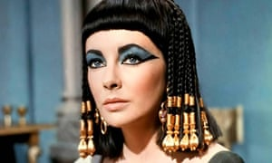
February 27, 2020
Cleopatra Assessment 1
(Underline date and title using a pencil and ruler)
Lesson Objectives:
To complete the assessment
Key words/Spellings: Cleopatra, Macedonian, heritage, Alexandria
4 Rs- Ask yourself, Are you…?
Ready to learn?
On time, fully equipped and ready to learn!
Respectful?
Respectful towards your environment, teachers/peers and your education
Responsible?
Feeling motivated to learn, individually and as part of a team
Resilient?
Driven to try again and not give up, until you succeed!

