Slide 1
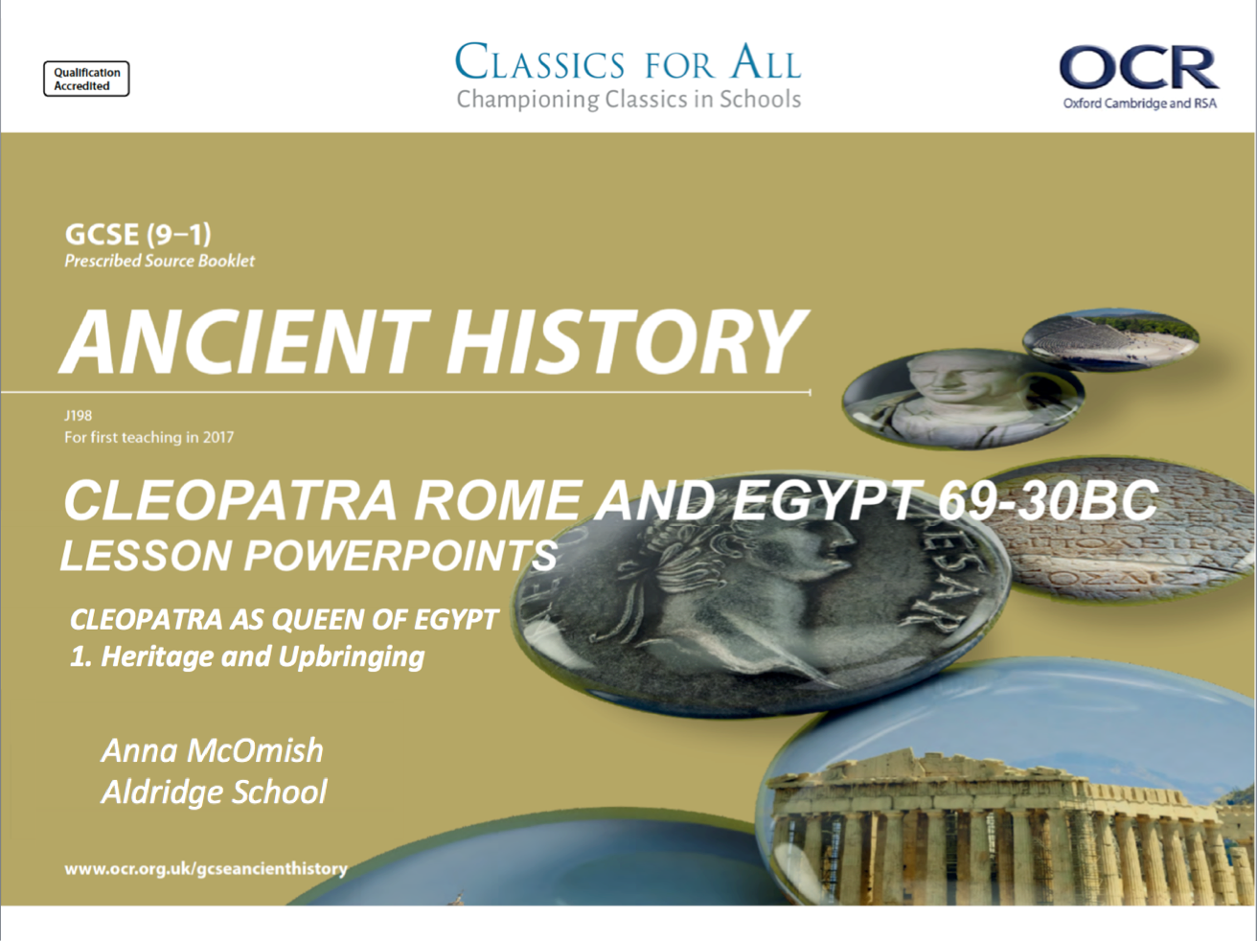

Slide 2
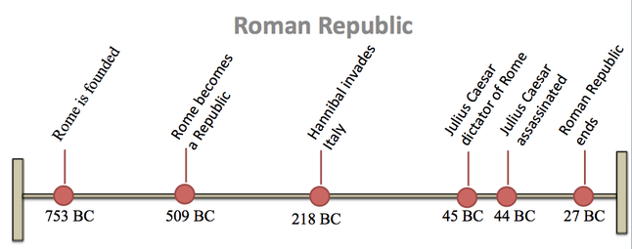
The unit we have just studied
New unit: Cleopatra is alive here

Slide 3
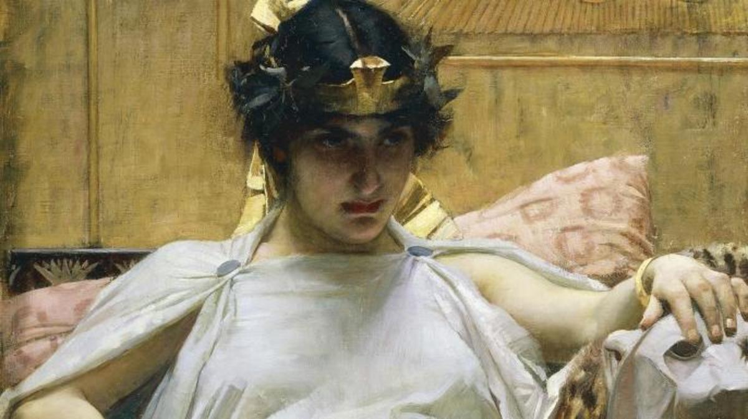
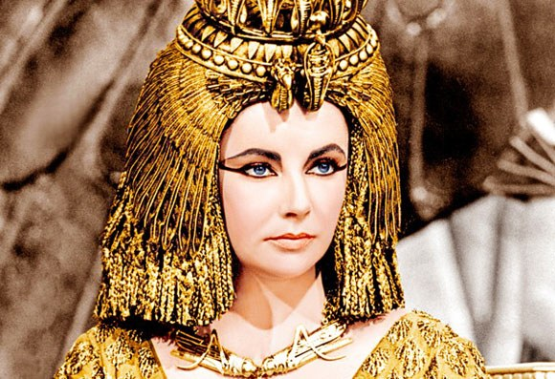
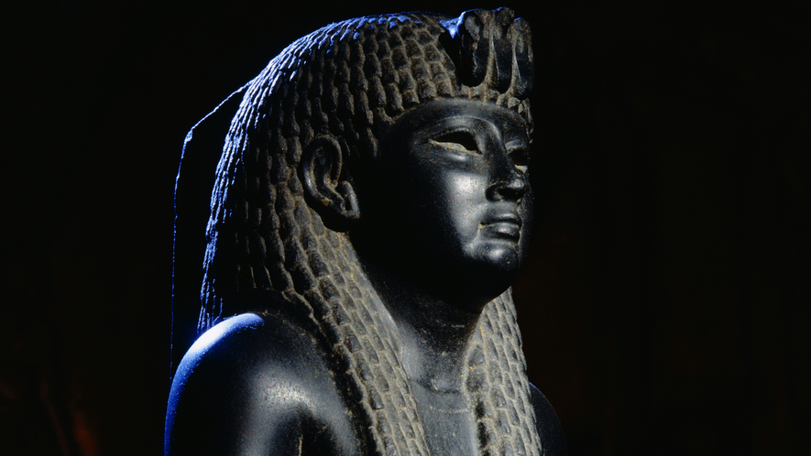
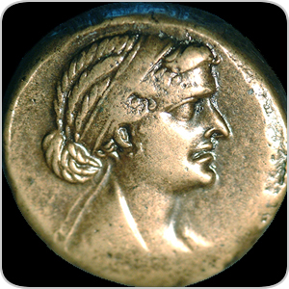
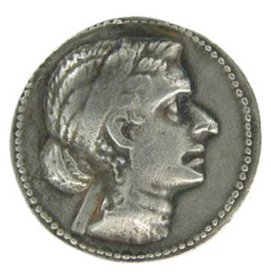
CLEOPATRA; ROME AND EGYPT 69-30BC
Write this in big letters, take an A4 page, so that you know where your notes on Cleopatra start in your book!
- There will be a second title for the actual lesson!
TASK: Study these different representations of Cleopatra VII.
Explain, what issues do these images suggest that we will have when studying the last Queen of Egypt?
https://www.youtube.com/watch?v=BJX1YQXQQPI

Slide 4
History vs. Cleopatra – challenging the stereotype
As a historical figure, Cleopatra has been subjected to more judgement and scepticism than most, an issue not helped by the fact that any documentation we have of her life is often biased against her/ women more generally.
Cleopatra has often been portrayed as a power-hungry seductress, who willingly used sex to gain control over influential male figures of the Roman republic. This is (arguably) a deeply unfair assumption, and one that we will look to challenge in this unit…
What the following TED video, and answer these questions
What are the issues with knowing what Cleopatra looked like?
What evidence is there that Cleopatra was a good ruler?
What are the more negative assumptions about Cleopatra?
In what way are these negative assumptions unfair to Cleopatra?
CHALLENGE:
What does this video tell us about the double standards between the historical accounts of men and women in the ancient world?
HINT: What is held against the character of a woman, but seemingly not a problem for men?
https://www.youtube.com/watch?v=Y6EhRwn4zkc&t=2s
Notes:
https://www.youtube.com/watch?v=Y6EhRwn4zkc&t=2s

Slide 5
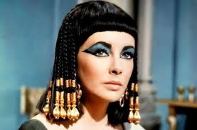
Cleopatra as queen of Egypt; Macedonian heritage, education and upbringing
February 27, 2020
(Underline date and title using a pencil and ruler)
RRR: Introduction to Cleopatra
Lesson Objectives:
An introduction to the Cleopatra unit
To understand the importance of Cleopatra’s Macedonian heritage.
To assess the significance of her education and upbringing.
Key words/Spellings: Cleopatra, Macedonian, heritage, Alexandria

Slide 6
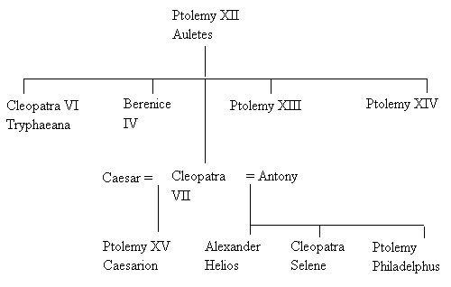
Cleopatra – A Macedonia family?
Cleopatra was born in 69BC, although some sources say 70, and we have no record of who her mother was, but given that Cleopatra was accepted as the daughter of Pharoh Ptolemy XII Auletes, we can assume that her mother must have been a legitimate wife!
She was a direct descendent of the Macedonia general, Ptolemy, who had taken Egypt for himself after the death of his leader/ King, Alexander the Great. Ptolemy’s family had ruled Egypt every since, and his name was generally used by male pharaohs, in his honour.
The Ptolemies, then, were Egyptian pharaohs that considered themselves to be Macedonian/Greek, as well as the political and religious leaders of Egyptians.
However, Auletes, Cleopatra’s father, had been drawing the kingdom into serious debt in an attempt to maintain control of the throne, and this was severely weakening the Ptolemaic dynasty, and the power of Egypt as a Kingdom.
TASK: using the summaries and p154 of the textbook, annotate your Ptolemy family tree with a brief character description for each of Cleopatra’s family.
For Ptolemy Auletes, use the PS coin on p.155 to add to your notes!
Arsinoe
EXTENSION: What can we learn from these brief summaries about the problems and tensions inherent within the Ptolemaic dynasty at this time?
Notes:
P. 234-237 of Tyldesley’s book needs to be photocopied!

Slide 7

Arsinoe
Arsinoe
Arsinoe
Arsinoe

Slide 8
Education and upbringing
Regardless of her looks, whether they were beautiful or not, the sources agree that Cleopatra was a fiercely intelligent woman. This is not surprising, given that she grew up in the city of Alexandria, which housed the greatest library/ scholars in the known world, and is likely where Cleopatra was educated as a child.
The educational opportunities she had growing up, were very different to that of other women in the ancient world, and given that Ptolemaic women could become Queens, they were heavily involved in politics and the running of the nation.
TASK 1: using p 155-156, draw up and complete this table comparing Cleopatra’s education to that of other women.
Educational opportunities for other women in the ancient world | Educational opportunities for Cleopatra
TASK 2: go to your source pack, p.9 and read Plutarch, Life of Anthony, 27;
Make notes (in full sentences) on what we can learn from Plutarch about Cleopatra’s education and intelligence.
EXTENSION:
Explain how specific examples of Cleopatra’s educational opportunities would have helped her become a successful monarch.

