Slide 1
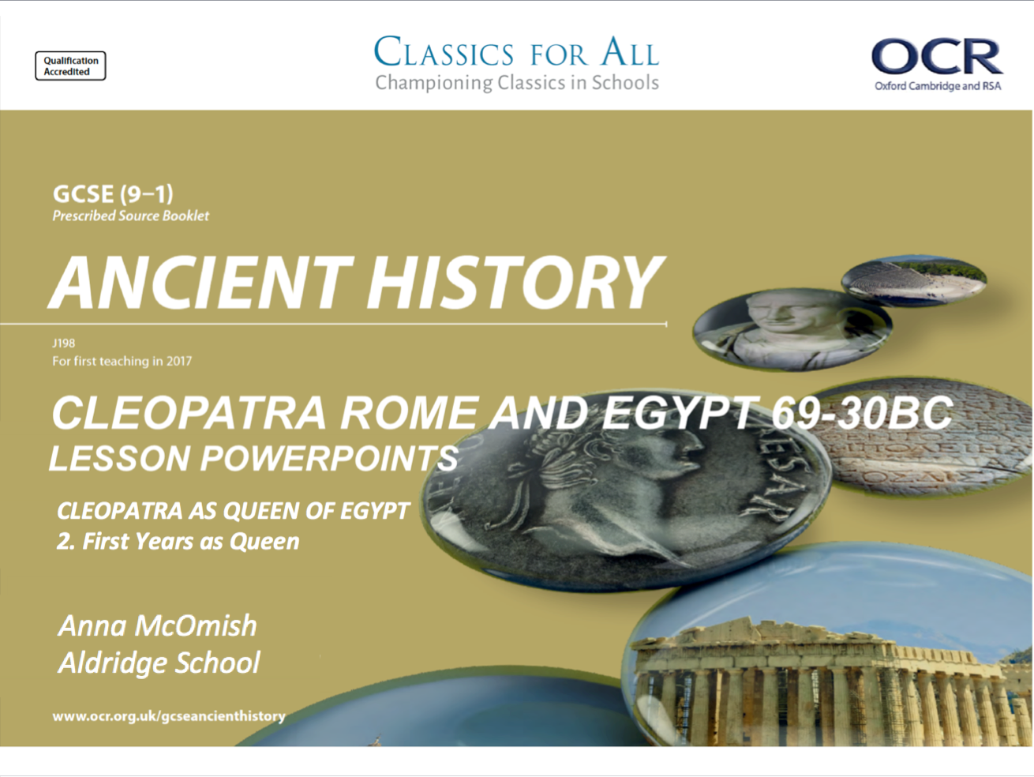

Slide 2
Cleopatra’s first years as Queen, and her relationships with her siblings
February 27, 2020
(Underline date and title using a pencil and ruler)
RRR: Cleopatra’s family
Lesson Objectives:
To understand the challenges that Cleopatra faced in becoming Queen of Egypt.
2. To assess the relationship with her brothers and Arsinoe.
Revise, Review, Recap
Name Cleopatra’s father.
Why was Cleopatra’s father in so much debt?
Name 2 challenges that Cleopatra faced in her first years as Queen.
Where was Cleopatra probably educated?
Why do the Ptolemies educate their royal women?
Key words/Spellings: Cleopatra, Macedonian, heritage, Alexandria

Slide 3
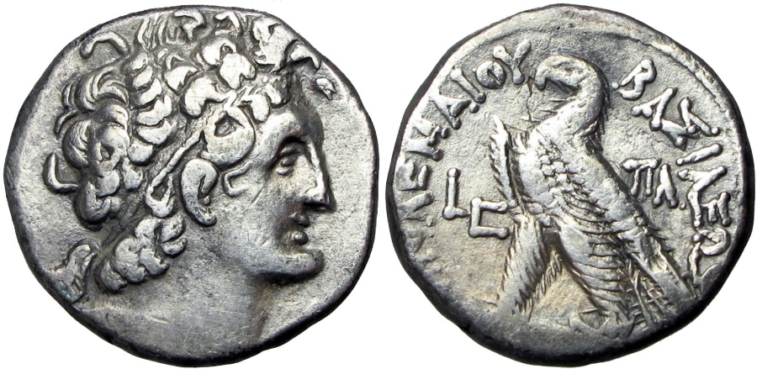
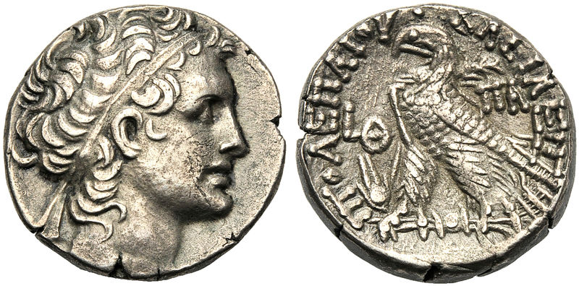
Death of Ptolemy XII Auletes and Cleopatra’s first years as Queen
Ptolemy Auletes had not been a successful, or popular, Pharaoh. He has drawn Egypt into increasingly serious debt by having to pay off mercenaries (Gabinians) to help he regain control of Egypt and Alexandria.
Auletes had written a will stating that Egypt be ruled by his eldest son and daughter, which was Ptolemy XIII and Cleopatra, but many believe that Cleopatra was already planning to rule independently of her 8yr old brother.
When Auletes died, Cleopatra and Ptolemy XIII did (technically) rule together, but Cleopatra was becoming increasingly dominant and therefore became a target for Ptolemy XIII’s ambitious advisors.
Their reign was also had serious political issues surrounding unlawful killings and having to choose between the powerful Gabinians, or Rome itself. During the early years, Ptolemy grew up and became a more genuine threat the Cleopatra’s power.
TASK: using p. 156-157, complete the revision grid on the issues and conflicts during the early stages of Cleopatra’s Queen-ship.
- Make sure to include good historical detail
EXTENSION:
Explain how significant Cleopatra’s relationship with Ptolemy XIII was.
- Consider the positive AND negative aspects of their relationships, and in WHAT KIND of ways this would be significant to Cleopatra.
Ptolemy Auletes XII
Ptolemy XIII

Slide 4
Problems created by Ptolmey Auletes | Ways in which Cleopatra increased her power
Successful challenges from Ptolemy XIII | Challenges Cleopatra faced after becoming Queen

Slide 5
Cleopatra’s relationships with her siblings
The Ptolemaic family was both complicated and competitive. Cleopatra was the second eldest child of Ptolemy XII Auletes and felt entitled to her own share of power. This brought her into direct conflict with her younger siblings, Ptolemy XIII and Ptolemy XIV, as well as her rebellious sister, Arsinoe.
Her relationships with her brothers and Arsinoe were predominantly negative, and these destructive relationships only fed the rumours that she was a dangerous and manipulative women, and a threat to ROME!
TASK: using p. 157-158 of the textbook, complete the table comparing the relationships between Cleopatra and her 3 siblings.
Make sure to focus on the ways in which Cleopatra battled with her siblings for power/control!
CHALLENGE:
Which elements of these relationships, when reported by Roman/ Greek historians, would have encouraged the perception of Cleopatra as a dangerous, deceptive and power-hungry woman?
- Reference specific detail to support your explanations.
Name of the sibling and age compared to Cleopatra | Negative aspects of the relationship | How the sibling tried to gain power | How the relationship between the sibling and Cleopatra ended
Ptolemy XIII (63-47BC)
Arsinoe IV (death 41BC)
Ptolemy XIV (60-44BC)

Slide 6
Name of the sibling and age compared to Cleopatra | Negative aspects of the relationship | How the sibling tried to gain power | How the relationship between the sibling and Cleopatra ended
Ptolemy XIII (63-47BC)
Arsinoe IV (death 41BC)
Ptolemy XIV (60-44BC)

Slide 7
HOMEWORK – expansion of Egyptian territory under Cleopatra
Using p.158-159 of the textbook, Plutarch, Life of Mark Anthony 36 (p.24) and GOOGLE(!) mark out, annotate and colour the areas of the map that Cleopatra gained during her time as Queen of Egypt.
Which of these areas of expansion do you think would have given Cleopatra the most power/ recognition? Explain you answer in full. (5-6 sentences)
Read Plutarch, Life of Mark Anthony, 36.
What can we learn from this passage about the achievements of Cleopatra during her reign as Queen of Egypt? (5).
Want a grade 6, 7, 8 or 9 in your Ancient History GCSE?...

Slide 8
