Slide 1
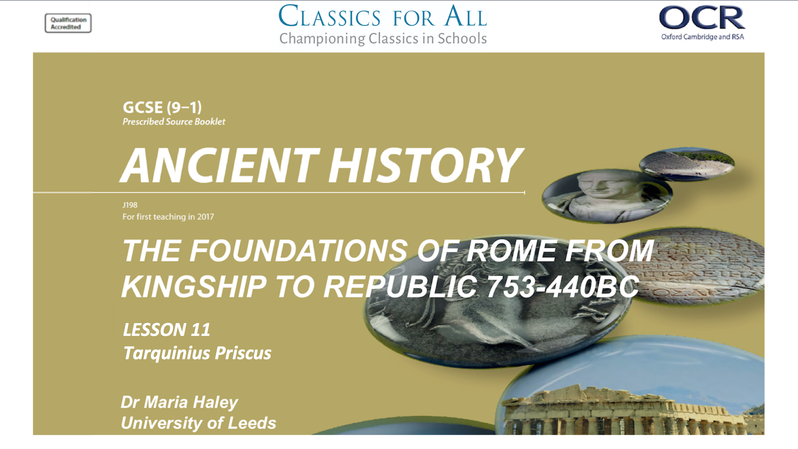

Slide 2
The Etruscan Kings 616-509BC.
King Tarquinius Priscius
To understand the events around TP’s succession. To understand TP’s political, social, religious and military reforms.
TASK:
Add the Etruscan Kings to our class timeline with his dates, using p.26 of your textbook.

Slide 3

Tanaquil and Tarquinius
TASK 1:
Read Livy 1.34
Who convinces Lucius Tarquinius to move to Rome?
How does the omen that Tarquinius receives compare to omens we have seen with other kings?
What class was Lucius Tarquinius and how did that affect his rise to power? (2 sentences)
CHALLENGE:
Using Livy 1.34, draw a family tree including:
Numa
Ancus
Tatius
What do they all have in common?
AKA Lucomo=King

Slide 4
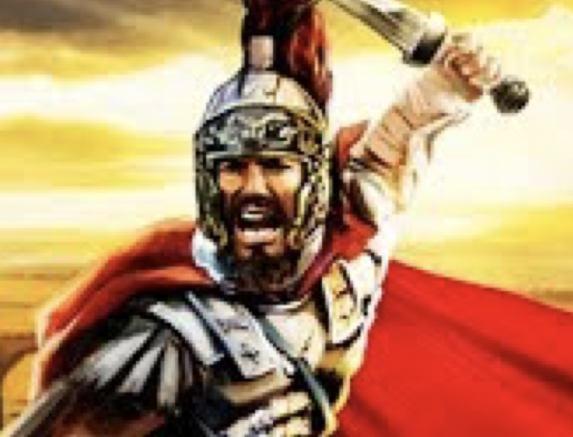
Moving on Up: Tarquinius’ Campaign for Kingship
STEP 1
Call the comitia to choose a king
STEP 2
Send Ancus’ heirs away hunting
STEP 3
Campaign for votes from the comitia
TASKS:
Read Livy 1.35 and sum up the three elements of Tarquinius’ masterplan to become king in a flow chart (see left)
CHALLENGE:
Look at the second paragraph of 1.35. What 3 reasons does Lucius T give for his claim to the throne?
Not the first outsider: Numa had become a Roman king already
He devoted his adult life to serving Rome, not his homeland
He learnt all he knew from King Ancus

Slide 5
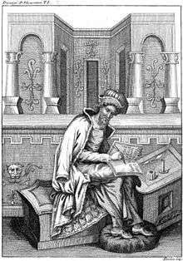
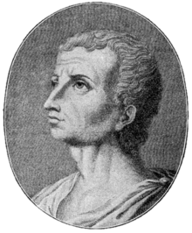
Livy v Dionysius
TASK:
Compare Dionysius 3.48 (textbook p.27)
To Livy 1.35. What reasons does Dionysius give for LT’s rise to power?
CHALLENGE:
Look at the source issues at the front of your source book. Why might their accounts be so different?

Slide 6
Priscus’ Reforms
Hands up, which of Priscus’ Reforms does the picture show?

Slide 7
Priscus’ Reforms: Homework
Reform | Social Impact | Political Impact | Religious Impact | Military Impact
HOMEWORK:
Using Dionysius on pp.55-60 of your source book, fill in the following table with the information in your text book.

