Slide 1
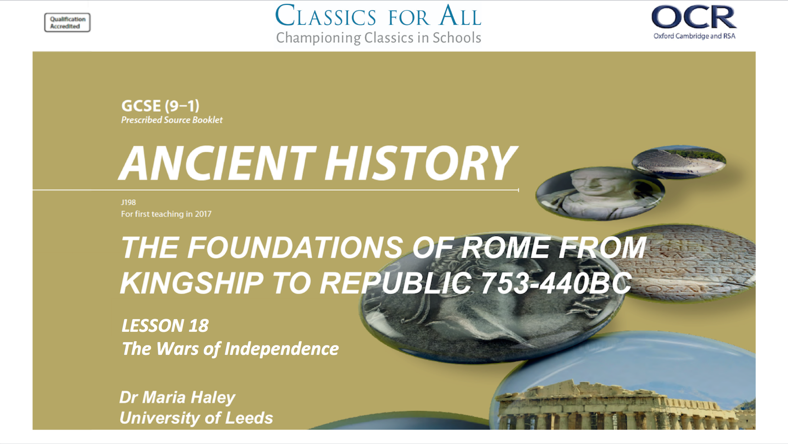

Slide 2
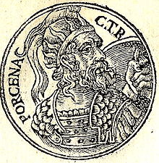
The Wars of Independence
To understand the events of the Wars of independence To analyse the significance of key individuals in the wars. To assess the consequences of the Wars of Independence.
HANDS UP TASK:
Look at pp.46-7. Who is Lars Porsena and how does he feel about Superbus?

Slide 3
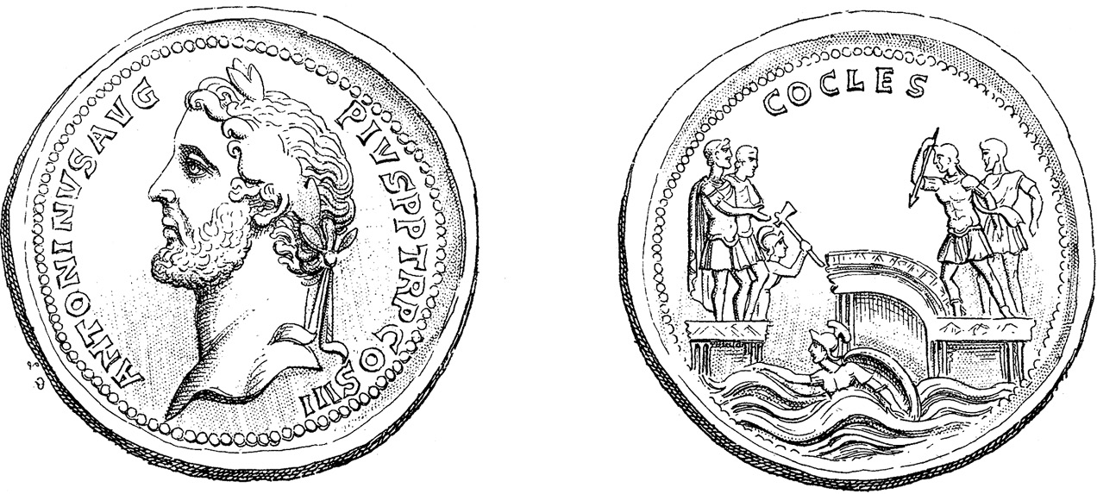
The Wars of Independence
STEP 2
STEP 3
STEP 4
CHALLENGE:
Read Livy’s accouns of Cocles in Livy 2.10.
How does Livy characterise Cocles? (3 sentences, with quotes to support)
Why does Livy present this scene as the last stand?
How does this compare to the coinage?
TASK:
Read pp.46-7 and sum up the 3 key steps to the Wars of Independence using the images to help you.

Slide 4
Gaius Muceus Scaevola
TASK: Read p.48 of your textbook. Summarise Mucius’ plan to kill Porsena and why it fell through.
CHALLENGE:
Read Livy 2.12 and label the 2 main characters in the scene to the right. Why does Livy ritualise the peace treaty in this way?
” Go free, who have dared to harm yourself more than me. […]I release you from the penalties of war and dismiss you uninjured.”
Mucius:“Look, that you may see how cheap they hold their bodies whose eyes are fixed upon renown!”

Slide 5
Porsenna’s Captive: Cloelia
TASK:
Read Livy 2.13 Which 3 main actions of Cloelia best reflect her virtuous character?
CHALLENGE:
Evaluate in 3 sentences why Livy includes the story of Cloelia. (Consider for example, how Rome then makes peace with the Sabines)

Slide 6
EXAMPLE:
This storyboard is an example for your homework task. You need to storyboard The Battle at Lake Regulius using www.storyboardthat.com

Slide 7
Half-term Homework: The Battle at Lake Regulius
HOMEWORK:
Read p.49 and Livy 2.19-22
Storyboard The Battle at Lake Regulius using www.storyboardthat.com.
Your storyboard should have:
6 frames with 1 sentence summarising the scene
Distinct characters for the figure to the left
Speech and thought bubbles where relevant, based on Livy’s description.
Marcus Valerius
Postumius
Mamilius
Titus Herminius

