Slide 1
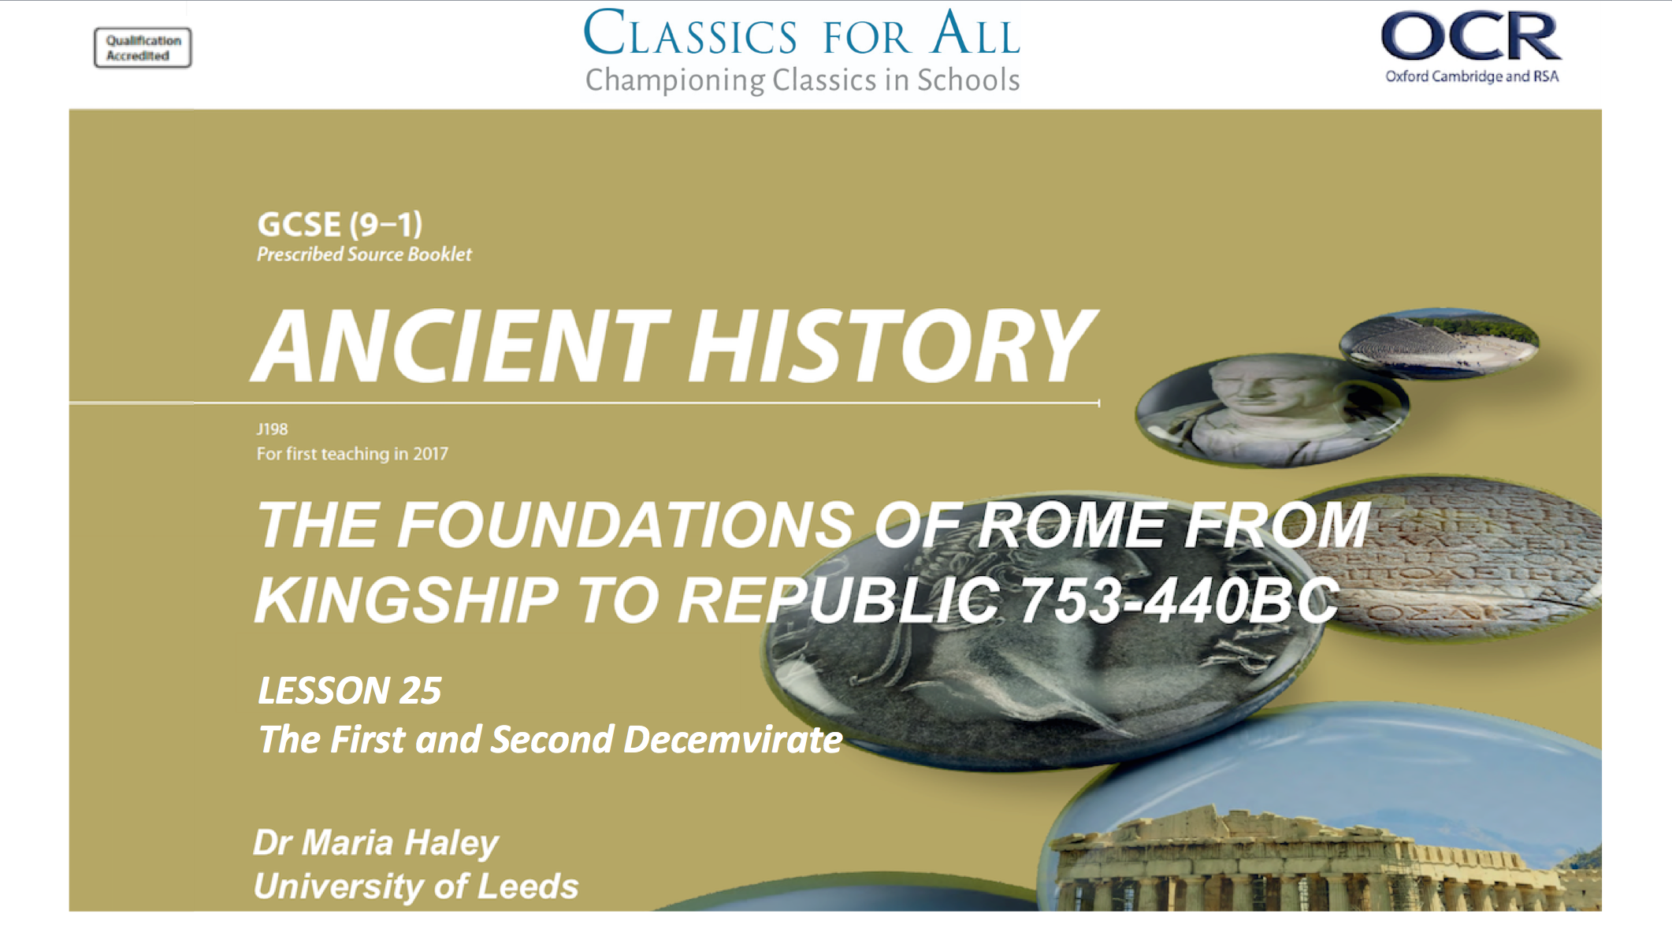

Slide 2
The First and Second Decemvirate.
To identify and explain the creation and role of the Decemvirate. To analyse opposition to the Decemvirate.
TASK:
Look at p.60 and HANDS UP
What did Gaius Terentilius do to limit the power of the consul?
Written constitution to limit the powers of the consul

Slide 3
Tribune’s Compromise
1
Scrap claim for constitution
2
But only if plebs could elect lawgivers
3
Senate investigates Athenian democracy as a model
HANDS UP:
What did the Senate do based on information from Athens?

Slide 4
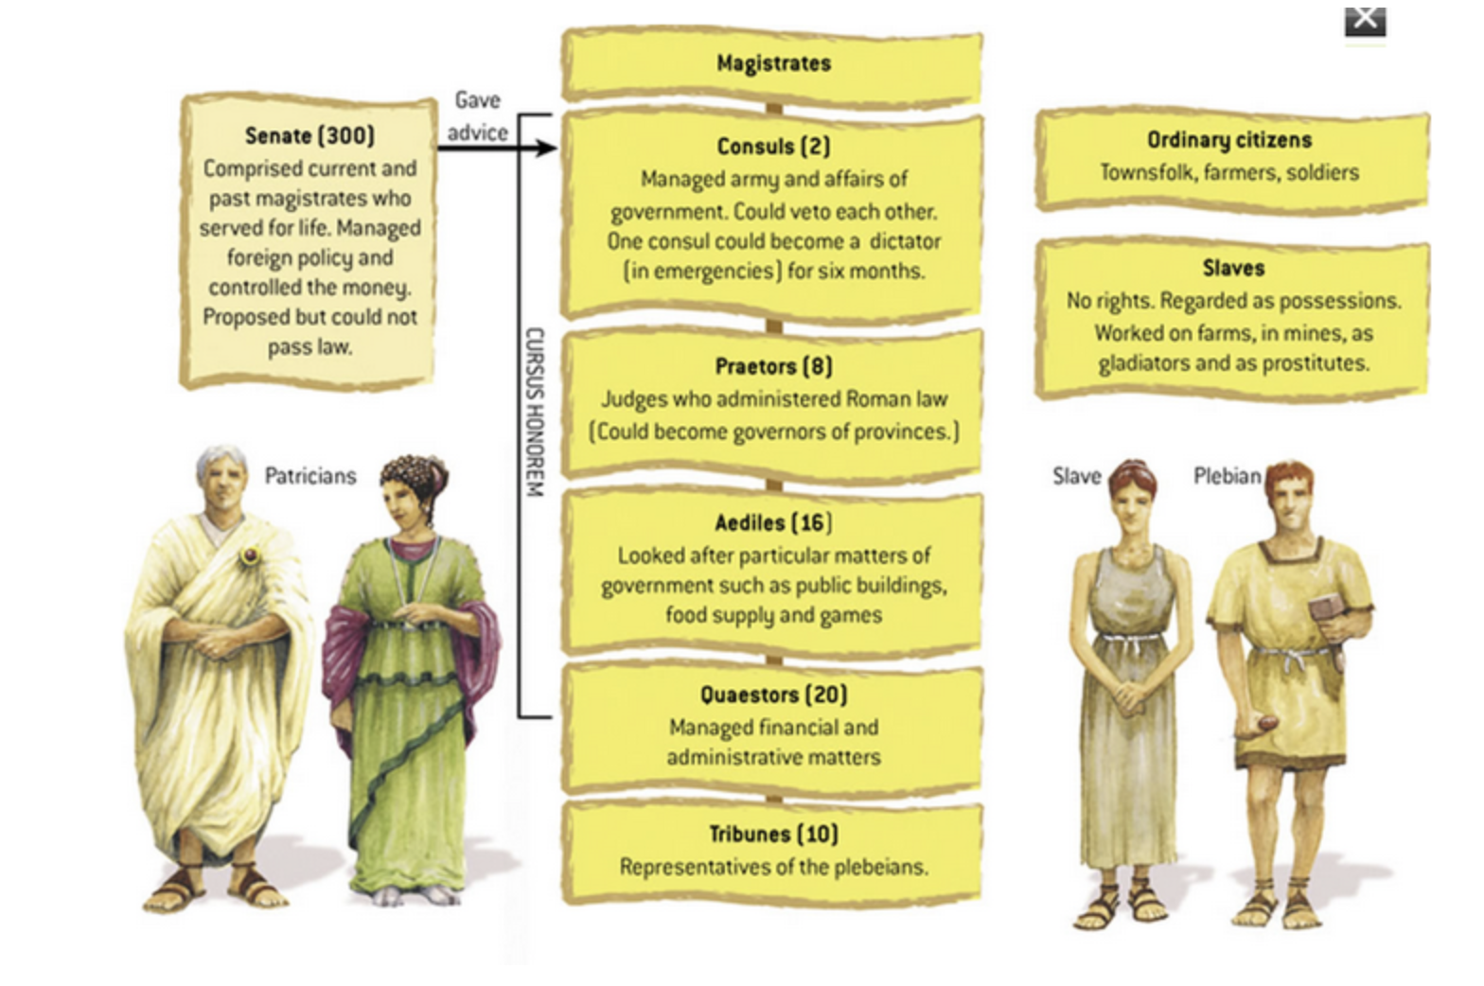
Decemvirate
(of ten men, unlike the triumvirate of three)
Replaced tribunes and Consuls and was populated by patricians

Slide 5
Remember Appius Cladius CRASSUS?
REGILLENSIS
YOUNGER REGILLENSIS
CRASSUS
REFUSED TO HELP STARVING VETERANS
RESISTED CHANGES TO TRIBUNAL ELECTIONS
PRETENDED TO SUPPORT THE PLEBS
WROTE TEN TABLES
Hands up, name which Appius Claudius is responsible!
CHALLENGE:
Read Livy 2.27. How does Servilius try to fulfil his promise to end debt? What does that say about his character? Highlight:
    3 quotes that show his actions
    2 that show the plebs’ reaction
    1 that shows Appius’ response

Slide 6
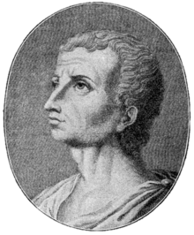
The First Decemvirate VS The Second Decemvirate
FIRST | SECOND
EITHER PARAPHRASE ME OR USE SHORT QUOTES!
TASK:
Read Livy 3.33 and bnullet point his descriptions of the first Decemvirate on the left.
CHALLENGE:
Read Livy 3.36-37 and compare by completing the column with Livy’s description of the second.

Slide 7
CRASSUS’ STATS
Hands up, name the stats!
10
“TARQUINIANS”
12
LICTORS
TASK:
Think back to Tarquinius Superbus. Why might it be problematic for the Decemvirates to be named after him? (1 sentence)
2
NEW LAWS PROTECTING
PARTICIANS

Slide 8
OPPOSITION
CHALLENGE:
Read Livy 3.39. Bullet point Marcus Horatius Barbatus’ warnings to Crassus’ new Decemvirates the Tarquinians.
TASK:
Read Livy 3.38 and list:
Which forces attacked Rome?
How did the plebs view the new decemvirate and why?
(4 sentences)
The plebs concluded that liberty had been betrayed by the senators, since those who had already gone out of office and were mere private citizens, save for the force they exercised, were obeyed by them as though they had the authority to command.

