Slide 1
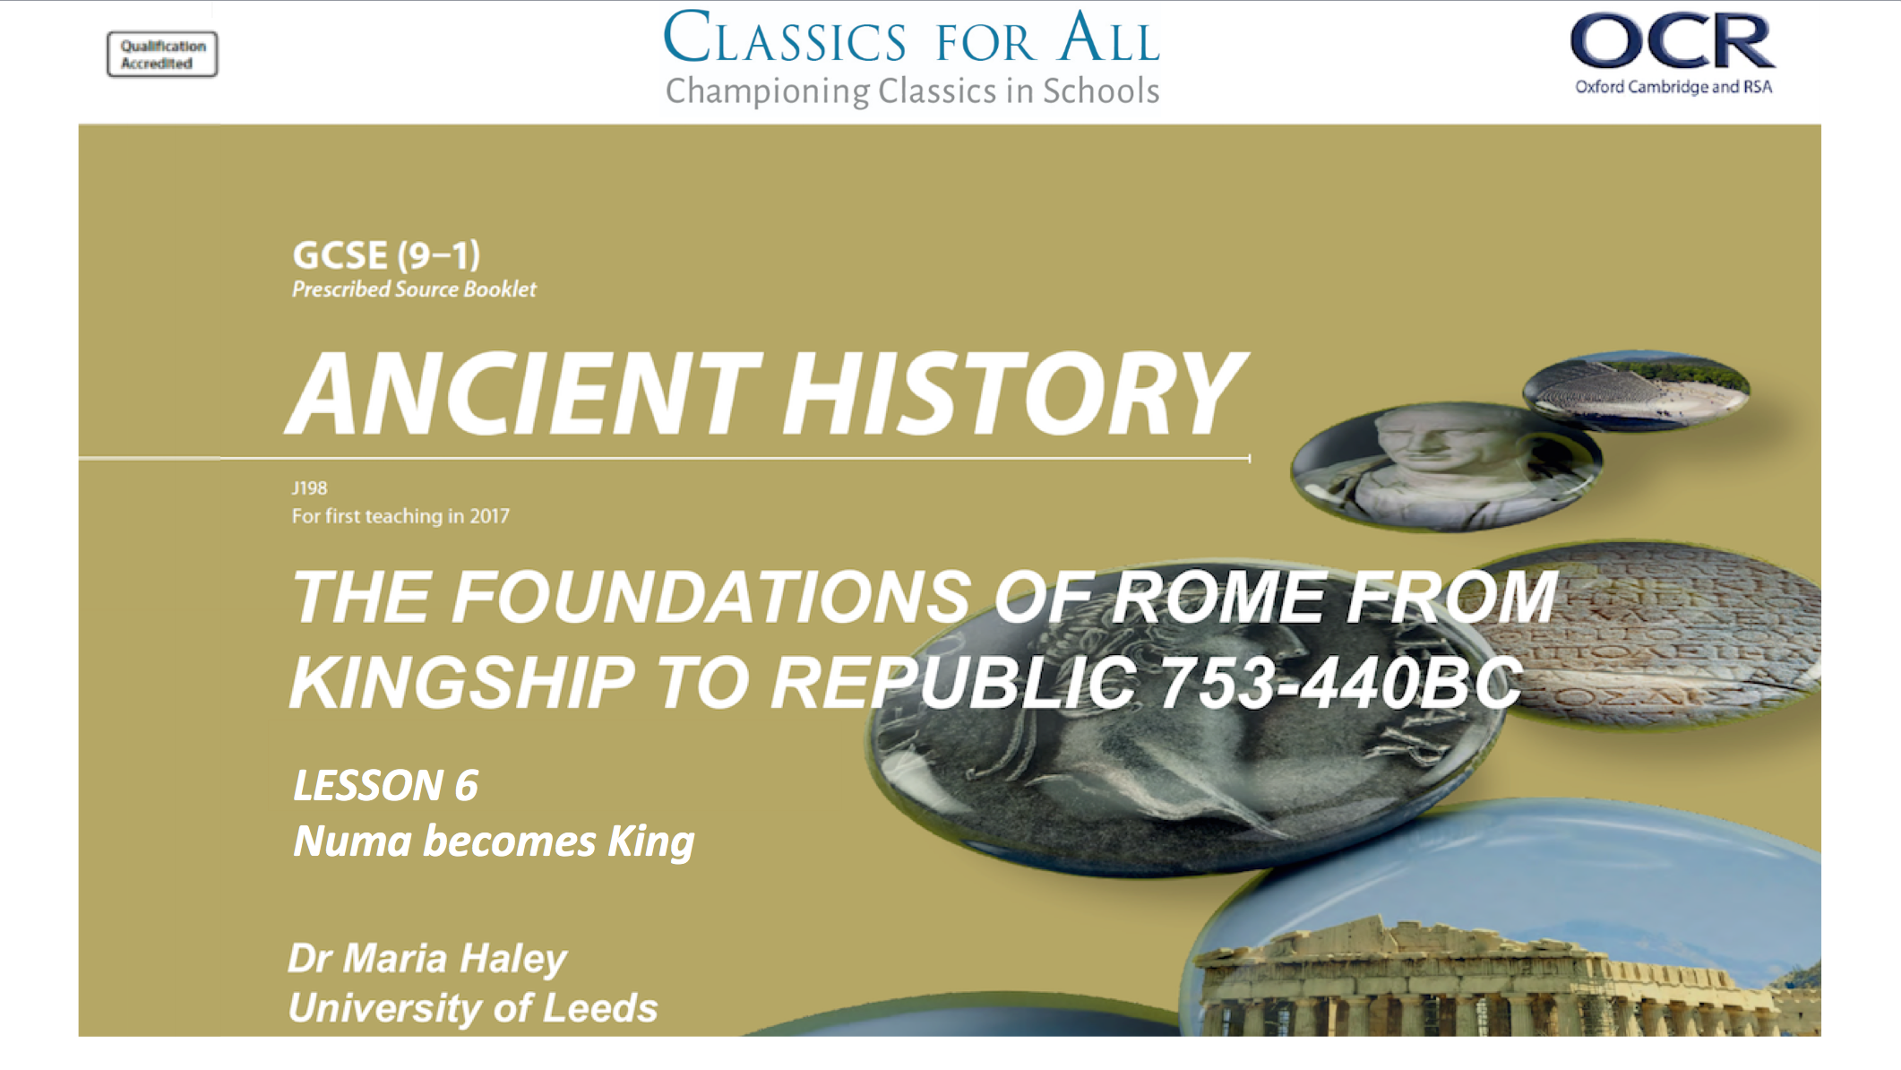

Slide 2
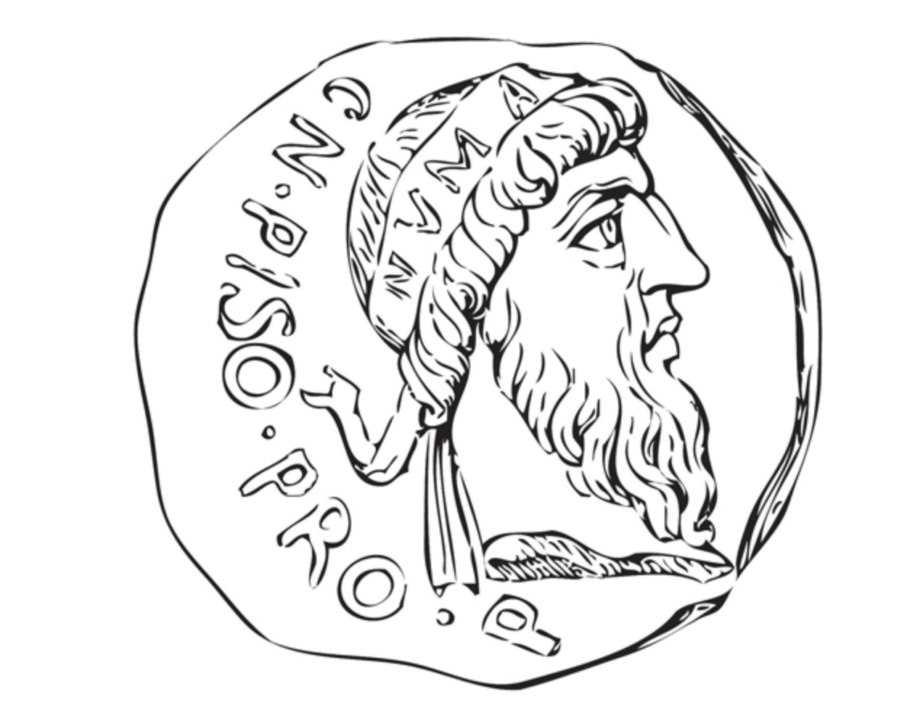
Numa becomes King
To understand the process of Numa’s appointment as King. To explain and assess his religious initiatives. To assess how successfully Numa brings peace to Rome.
TASK: Read p.17 of the book and add to your timeline from last lesson:
How the Sabines and Romans made peace according to Livy
What problems are there with Livy’s account?

Slide 3
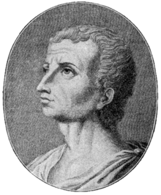
Step 1: The Interregnum
Inter= between
Regnum (from king,rex)= kings
TASKS:
Read Livy 1.17 and answer:
How long did the interregnum last?
How do long was each leader of the decury in charge?
Who really got to decide who should be king?
MATHS CHALLENGE
How many years between Numa’s birth and Livy’s?
How many years between their death dates?
CHALLENGE:
Look back over Livy’s passage in 1.17 and highlight the sections Livy could not have known for sure. Look for emotions and speeches only an eyewitness could capture!
753 BC- 673 BC
59 BC-AD 17

Slide 4
Step 2: Senate Elect a King
EXPECTATION | REALITY | EVALUATE
TASK:
Read Livy 1.18 and highlight:
Questions Livy poses to evaluate the sources that he is using.
Add what Numa’s key qualities are according to Livy to your Expectation column.
HANDS UP:
To fill the evaluate column as a class, state whether Numa fulfills the expectations we have using the evidence we have found in the texts.
CHALLENGE:
Now you have expectations of Numa’s character, read Livy 1.19 and fill in the table on the left.
E.g. we expect Numa to bring peace is that proven to be the case in 1.19?
Add these examples to your Reality column.

Slide 5
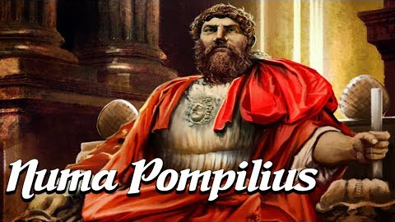
Step 3: The Augury
TASKS:
Skim read Livy 1.19-20 and number Numa’s main contributions.
Watch this video and highlight the facts confirmed by Livy in GREEN OR….
CHALLENGE
…PAIR UP WITH A FRIEND
Watch this video and highlight the facts confirmed by Livy in GREEN
The other person should add Plutarch’s comments in RED

Slide 6
Numa Rules!
Priesthood for Mars, Romulus and Quirinus.
Flamen Dialis
(Priest of Jupiter)
Pontiff
Vestal Virgins
TASKS:
Recreate this hierarchy and add in bullet points:
Their jobs, using textbook p.19
Why Numa introduced them using Livy 1.19
What they might wear using Livy 1.19.
CHALLENGE
Looking at Livy’s account decide why does Numa introduce this religious order?
Sum up in 3 sentences.

