Slide 1
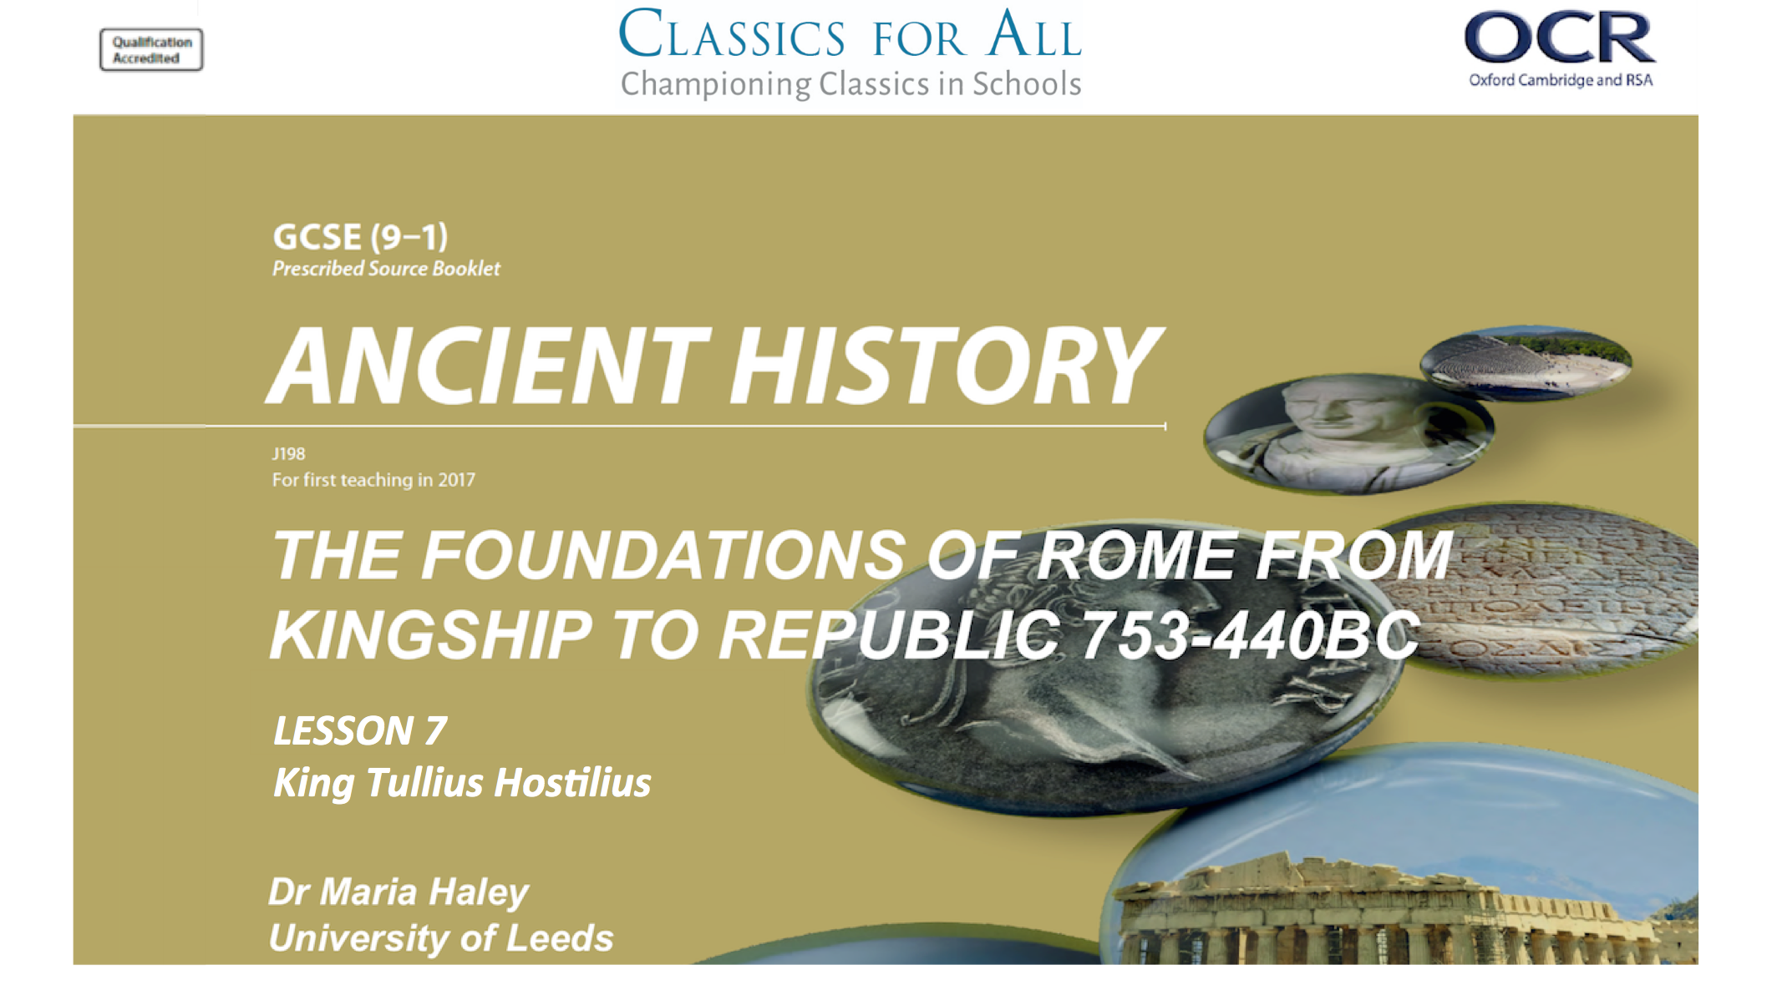

Slide 2
King Tullus Hostilius
To understand and explain Tullus’ legal and political initiatives. To assess the significance of his war with Alba.
TASK:
Add Tullius Hostilius to our class timeline with his dates, using p.19 of your textbook

Slide 3
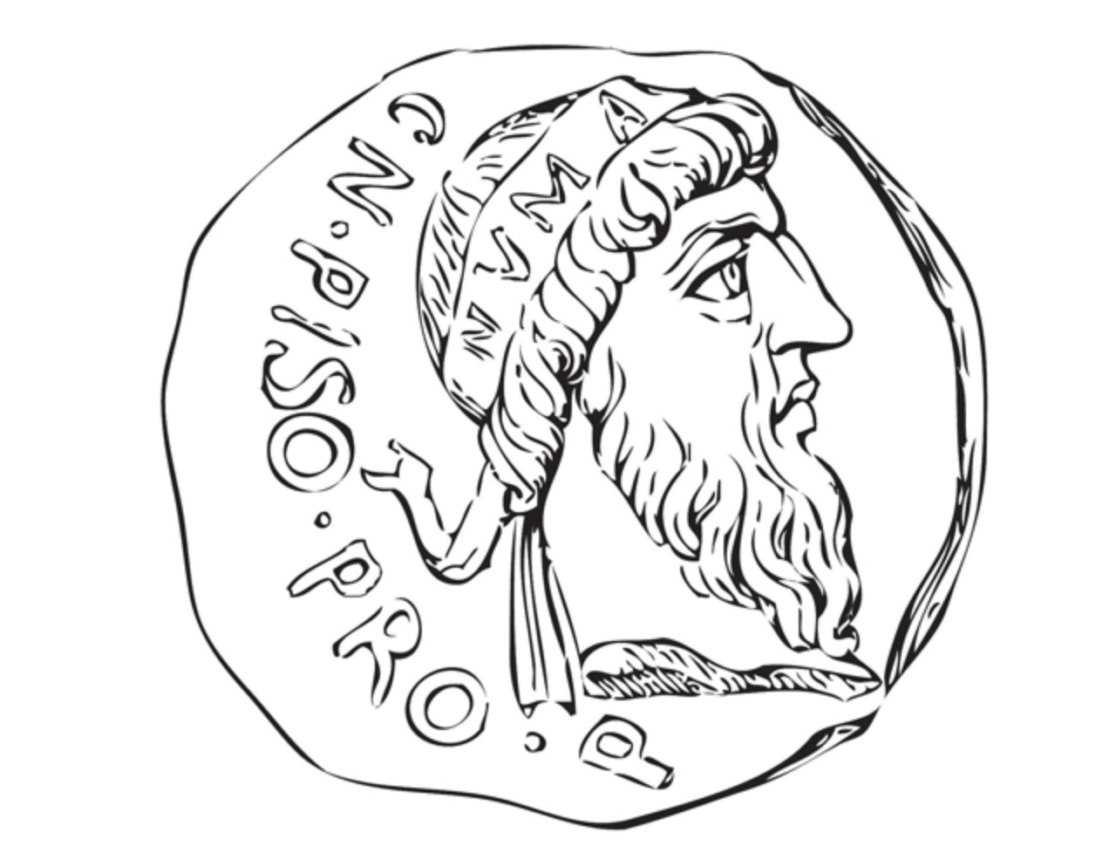
Spot the Difference: from Numa to Tullus
TASKS:
Create a venn diagram of Numa and Tullus.
Add some of Numa’s characteristics from last lesson.
Read Livy 1.22 and add Tullus’ characteristics to your diagram.
Inter= between
Regnum (from king,rex)= kings
CHALLENGE:
Add 1 quote from Livy below each side of the venn diagram that best sums up the traits you have listed.
This is your primary evidence because it is an ancient author.

Slide 4
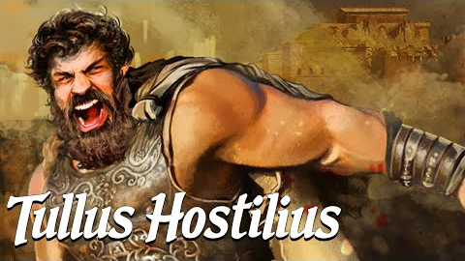
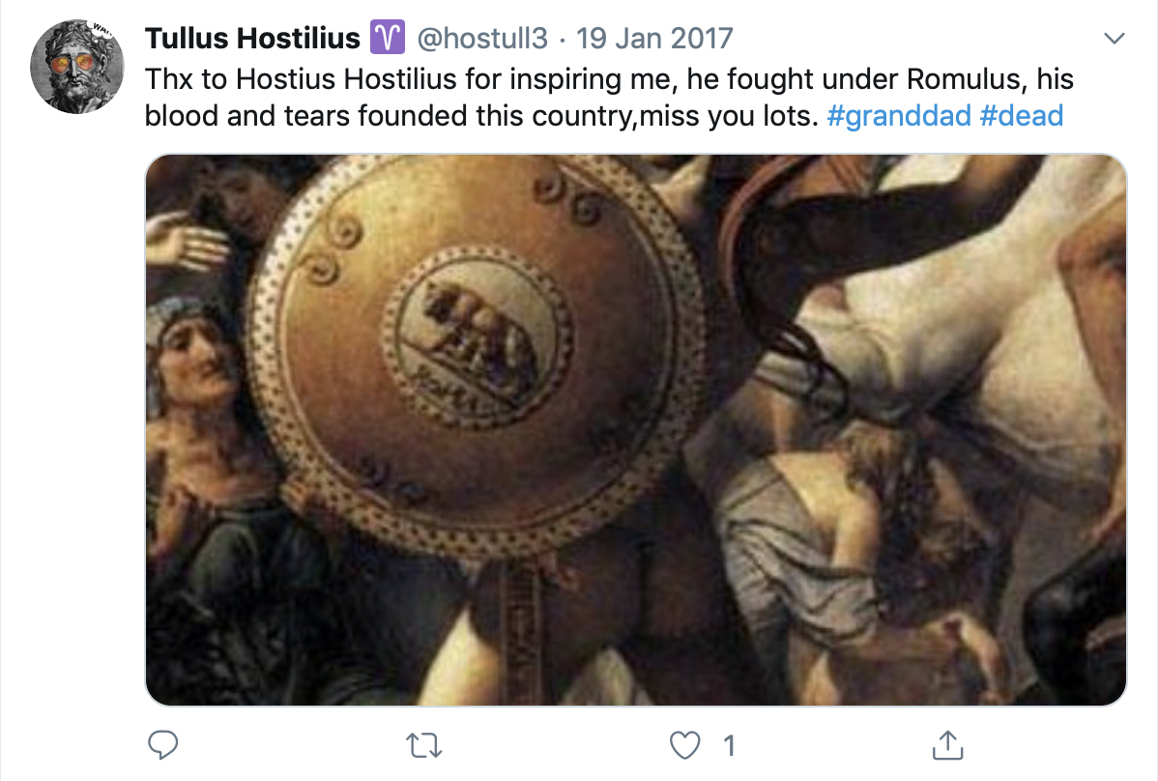
Tullus takes on the Albans
TASK:
Read Livy 1.23 and summarise in 3 sentences why Tullus goes to war with the Albans.
CHALLENGE:
Look again at the speech made by Mettius Fufetius. Sum up in 3 sentences:
What does Mettius Fufetius want and why?
What sort of character does Livy present him to be?
How does this reflect on Tullus?

Slide 5
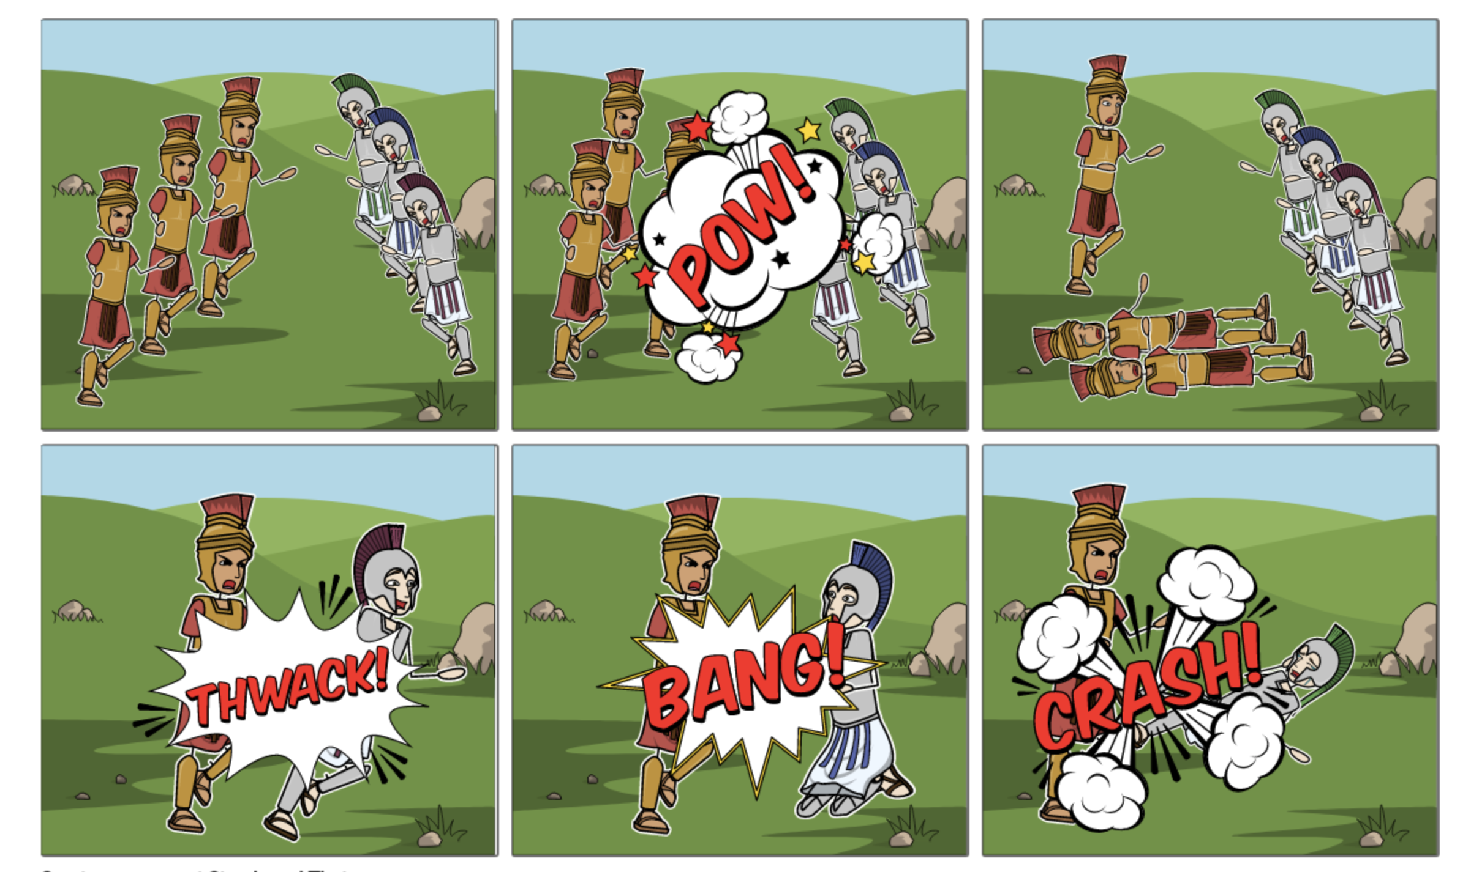
The 3 Albans
Horatii (for Rome) vs Curatii (for Alba)
TASK:
Read Livy 1.25 and add a quote that describes each cell of the storyboard.
CHALLENGE:
Using Livy 1.25 add speech and thought bubbles to show how he characterises the triplets.

Slide 6
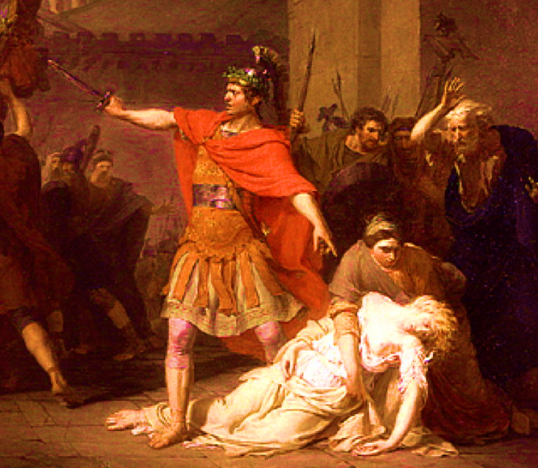
The Twist: Tullus’ Legal Positions
TASKS:
Look at Livy 1.26 and answer in 1 sentence why the Romans forgive Horatius for killing his sister.
Horatius kills his sister
HOMEWORK:
Present a legal case for or against Hostius by writing 3 sentences each under the following headings:
His motives were (un/)justified
His sister was behaving (im/)properly
His murder of the Curiatii does (/not) excuse this crime.

Slide 7
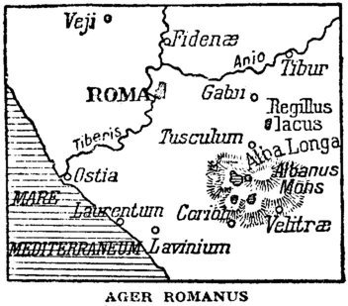
Tullus the Politician
Hands Up:
Look at p.21 of your book, what political reform does each picture show?

