Slide 1
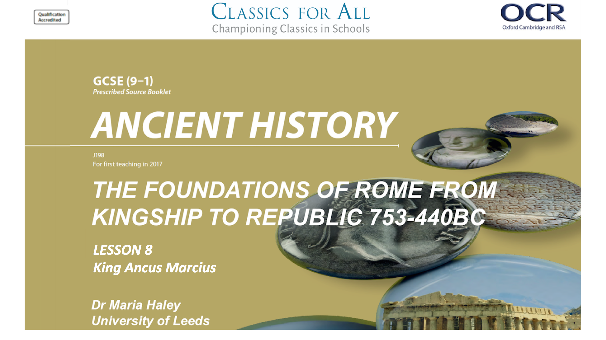

Slide 2
King Ancus Marcius
To understand Ancus’ character To assess his political, military and religious achievements
TASK:
Add Ancus to our class timeline with his dates, using p.43 of your sourcebook

Slide 3

Ancus Marcius: A New King?
TASK 1:
Watch this video and connect Ancus Marcius to Numa Pompilius and Tullus Hostilius.
Label his relationship with the previous kings.
TASK 2:
Draft a table with one column “Like Hostilius” (warring, violent) and another “Like Numa”(pious, peaceful), leaving a third column for evidence
Bullet point in your table Ancus Marcius’ actions as described in the video. Decide which category they fall into.
Inter= between
Regnum (from king,rex)= kings

Slide 4
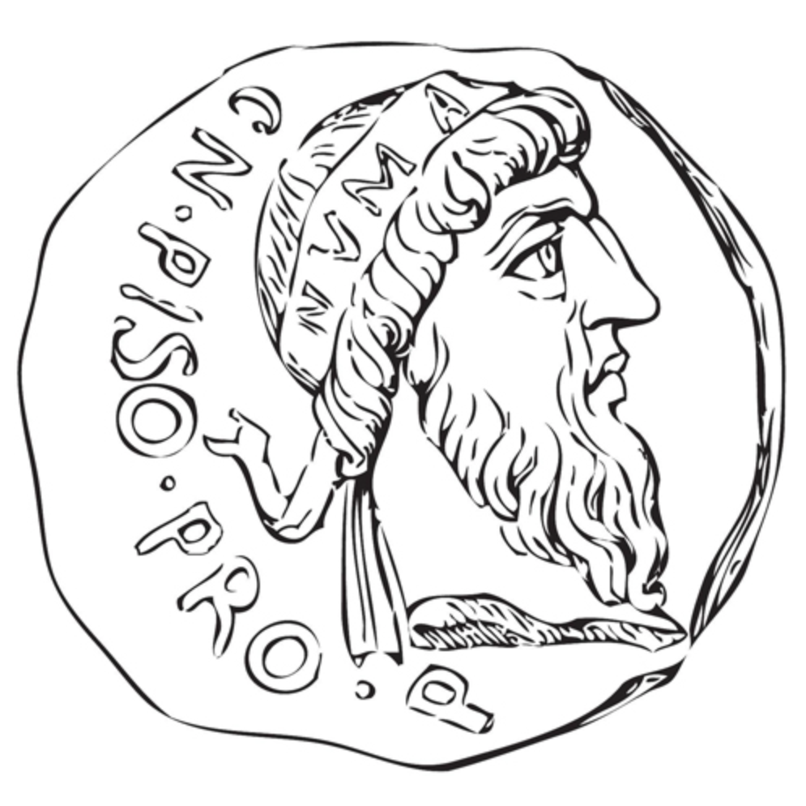
Spot the Difference: from Numa to Tullus to Ancus
Like Numa | Like Tullus | Evidence on Ancus
Focuses on religion |  | “quote from Livy”
 | Fights when necessary | “quote from Livy”
TASKS:
Read Livy 1.32 and add quotes to your evidence column for each point you learnt about Ancus in the video. (See left)
CHALLENGE:
Sum up in 2 sentences how Livy describes the challenges that face Ancus. Is Ancus, according to Livy, the best king for the job?

Slide 5
Defending Rome
TASK:
Read Livy 1.33 in your source book and label the map of Rome on the left. Who lives where?
CHALLENGE:
List all the measure Ancus took to expand Rome’s boundaries.

Slide 6
Significance?
Use your timeline and class notes to help you!
Romulus. Numa. Tullus Hostilius. Ancus Marcius
HOMEWORK:
You need to prepare for a debate. Each team will make the case for 1 king and build a powerpoint. Here are some prompts:
King X made the most significant contribution to war/politics/religion because…
If King X had not achieved Y, then Rome could not have Z…
Livy presents King X as influential because... (use a quote to support your case)
Although other kings contributed more to Z, King X was more successful at Y. This is important because…
Think of 1 question to ask your class mates about their king. What might make their king less significant?

