Slide 1
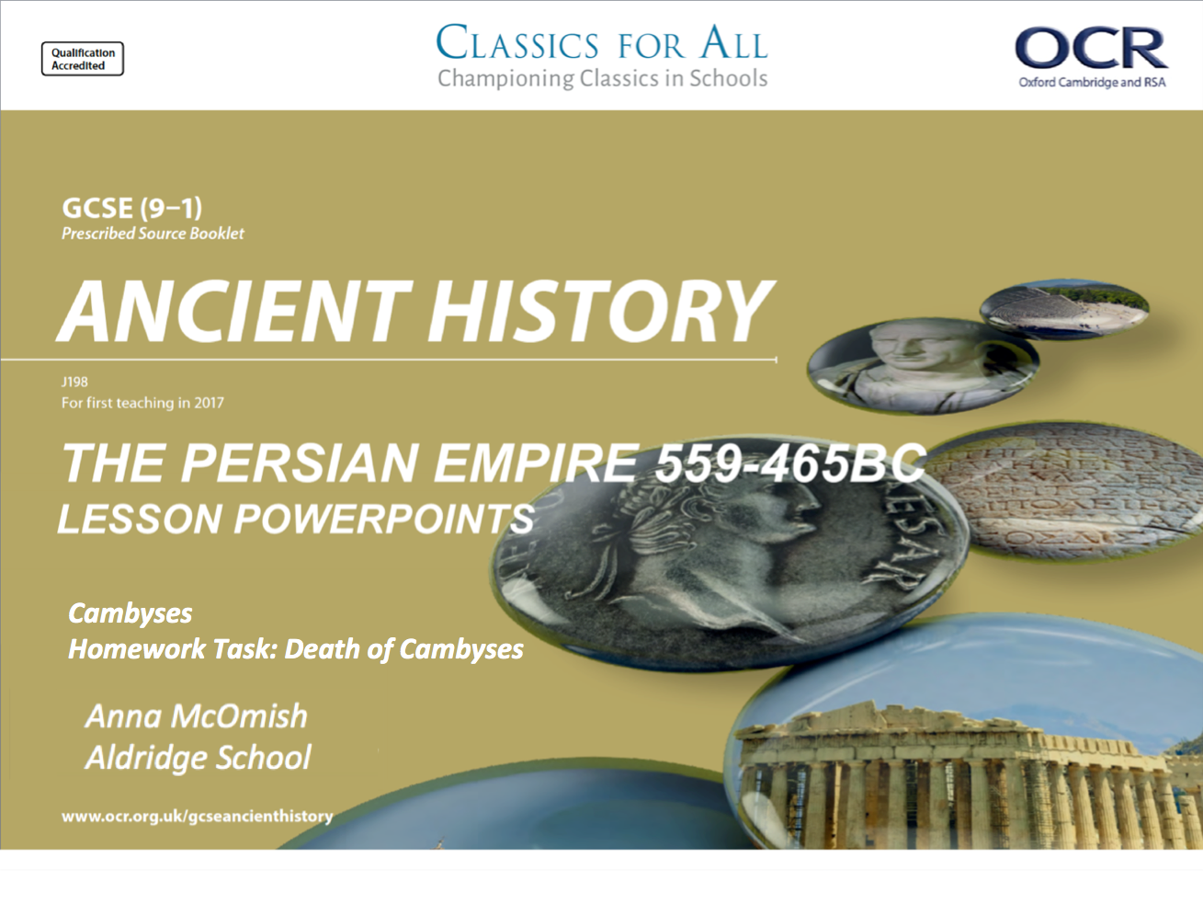
Cambyses
Homework Task: Death of Cambyses

Slide 2
HOMEWORK TASK – DEATH OF CAMBYSES

Slide 3
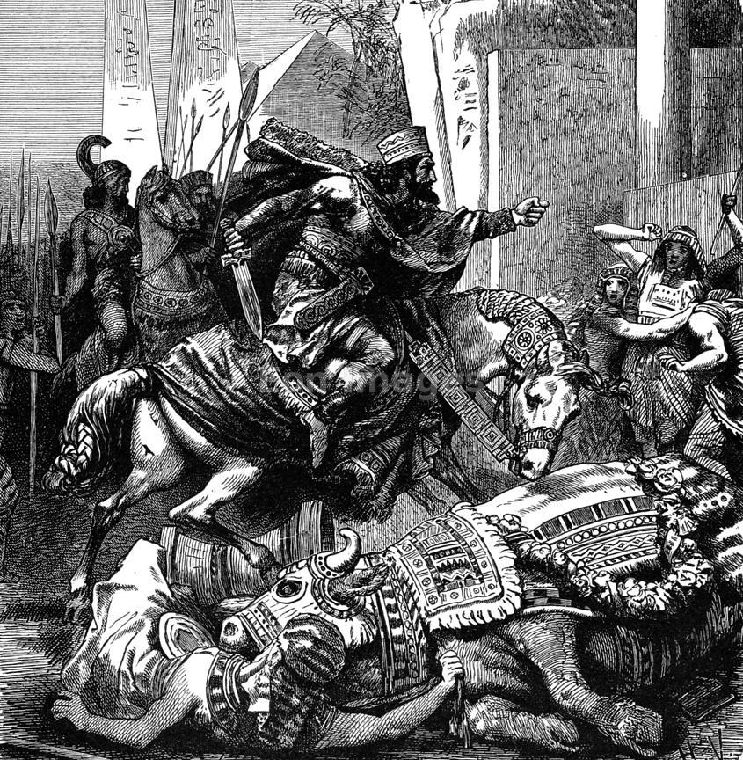
The Death of Cambyses – outline the main features
Using the hand out, covering the death of Cambyses, write out in full a practise to the following question;
Outline the main features of the death of Cambyses (6).
! Reminders !
Only list 3 main events, focusing on the most significant aspects of that topic.
Explain the main events using good historical detail. – show that you actually know what you’re talking about!
Use the question strip to correctly structure your answer!

Slide 4
It wasn't long before Cambyses met his end, about which Herodotus is again our main source (3.61-66). According to his account, two brothers launched a rebellion against him in Persia. They were both members of a priestly class in Persia, the Magi. It was their duty to perform rituals, interpret dreams and omens, and act as advisers. They also had the responsibilities of training young Persian princes and guarding the royal tombs. The Magi were traditionally thought to be from the Median religious tradition, and so some saw them as Medes rather than Persians. Nonetheless, they could hold great power at court. One of the two brothers was called Patizeithes, and he had been left in charge of the royal household by Cambyses. Herodotus reports that the other brother was called Smerdis, and by coincidence he happened to look very similar to the murdered brother of Cambyses although, as we shall see, there was one notable difference. Patizeithes convinced his brother to pretend to be the king ' s brother and to take control of the empire. The brothers sent a proclamation to the troops throughout the empire announcing that they should now take their orders from Smerdis rather than Cambyses.
A herald was sent to Egypt to read the proclamation, but he found Cambyses and his army stationed in a town in Syria called Ecbatana (it happened to have the same name as the Median royal city). When the king heard the news, he called for Prexaspes, who swore that he had killed the real Smerdis. The two men questioned the herald and between them worked out the trick that the Magi had played. Cambyses realised that hi dream did not specify which Smerdis would take the throne from him, and that he had therefore killed his brother for no good reason. He felt bitter regret.
Right after this, Cambyses mounted his horse, intending to ride immediately and attack the false Smerdis. Herodotus takes up the story:
“But as he was springing into the saddle, the cap fell off the sheath of his sword, exposing the blade, which pierced his thigh just in the spot where he had previously struck Apis the sacred Egyptian bull” Herodotus, Histories 3.64
The king then asked what town they were in. Upon hearing the name Ecbatana, he recalled a that he would die at Ecbatana. He had always assumed this referred prophecy to the Median royal city, but once again he had misinterpreted a prophecy. Cambyses realised that he was fated to die of his wound. He summoned the Persian nobles with him and told them the whole story about his murder of the real Smerdis, and the trick played by the two Magi. He commanded them to ensure that the Magus Smerdis was driven from power, reminding them that the throne would otherwise be returned to the Medes. Shortly afterwards, gangrene set in on Cambyses ' wound and he died after seven and a half years on the throne. However, his nobles did not believe what he had told them. Instead, they thought that it was a malicious invention by Cambyses to prevent his brother from taking command of the empire. The one man who could have confirmed the story was Prexaspes, but he vigorously denied the murder, knowing that it could be very dangerous to admit it now that he did not have Cambyses to protect him. Cambyses died with the Persian Empire in turmoil.

