Slide 1
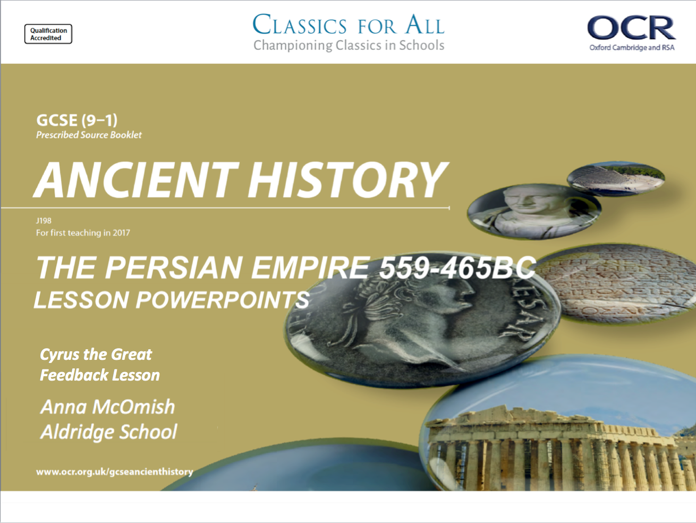
Cyrus the Great
Feedback Lesson

Slide 2
Cyrus assessment - Feedback
L.O. to assess strengths and weaknesses from the first assessment
L.O. to rewrite improved versions of assessment answers.

Slide 3
Key points from this assessment
Are you adequately revising?
If you got conquest of Lydia confused with Babylon, it suggested that you weren’t revising and recapping after lessons, and you didn’t do deep enough revision for the assessment.
Differentiating between key events/ causes/ peoples will be really important for all topics at GCSE, because these will be the basis for exam questions.
Are you being strict and strategic with your time?
If you overloaded on question 2, letting yourself get bogged down in detail, you probably struggled to get two points of discussion written out for question 3.
Remember; question 2 doesn’t need reams and reams of info. Keep it clear and clipped!
Are you using the question strips?
- They are your friends! Friends don’t ignore other friends! Why are you ignoring your friends that I took so much time to create for you?! Seriously?!?
Which of these points do you think applies to your assessment?
What will you do to improve upon this for next time?
- Think particularly about your time in lesson!

Slide 4
Example Ques 2. (6 marks) 6/6
For this question, some of us struggled and wrote about a different conquest entirely (i.e. Babylon) others didn’t give specific events, and just made general comments about Lydia as a country.
Your answer needed to focus on SPECIFIC events in the conquest of Lydia, that were the most SIGNIFICANT events of that narrative.
TASK: in pairs, read through the example answer to ques 2, this answer got full marks. Highlight/ underline;
Where each different event is identified.
Where they give historical detail about that event.
Go back to your own answer, how could you have improved your marks, even if you made 3 points?
CHALLENGE:
Were there any other key features that this answer could have discussed instead of the three it chose?

Slide 5
Example Ques 2. (6 marks) 6/6
One key feature of the conquest of Lydia was the weather the battle was fought in. This was a key feature because Croesus retreated back to Sardis, thinking that Cyrus wouldn’t follow him because of the weather, but this allowed Cyrus to quickly follow Croesus to Sardis.
Another key feature of the Conquest of Lydia was the tactics used. This was a key feature because it allowed Cyrus to gain an advantage, as Harpagus put camels in front of the army, which scared the strong cavalry horses, so Croesus couldn’t use his cavalry anymore.
The final key feature of the Conquest of Lydia was the planned execution of Croesus. This was a key feature because Croesus was meant to be burnt, but after he called out for Apollo’s help, the rain put out the pyre meant to burn Croesus. Afterwards, Croesus became one of Cyrus’ most trusted advisors, and Cyrus considered him a man of God.

Slide 6
Example Ques 3. (10 marks)
The strongest responses to this question picked out TWO different things we could tell about Cyrus’ treatment of foreign peoples, found a quote to prove their point and then explained/ developed the quote with their own knowledge.
I have not printed out a full answer, no one go 10/10, but there are 3 examples of a part of an answer, one full paragraph. This done twice over, would get close to, or on, 10/10
TASK: in pairs, read through the example paragraph you’ve been given. Highlight/ underline;
Where the point of the paragraph is identified.
Where a quote is used.
Where the quote is explained. ‘This shows…’ different event is identified.
Where own knowledge is added to support/ explain the quote and point being made.
Go back to your own answer, how could you have improved your marks, even if you wrote two paragraphs?
CHALLENGE:
All these paragraphs have chosen a similar point of discussion, is there a different one that could be made, which still answers the question?

Slide 7
Question 3. (10 marks) one paragraph #2
One thing I can learn from the passage about Cyrus’ policy towards foreign people is that he respected what they believed in. This is evidenced in the passage when it says “Let the temple be rebuilt as a pace to present sacrifices”. This shows that when he freed the Jews and let them go back to Jerusalem, he helped them rebuild a temple, showing he respected their religions. From my own knowledge, I know that Cyrus’ policy with places he conquered were that they could speak their languages and continue their religions as long as they paid their taxes and joined the army when needed.

Slide 8
Question 3. (10 marks) one paragraph #3
One thing we can infer from the passage about the policies of Cyrus towards foreign people is his acceptance of other religions. This is evidenced in the passage when it says “also, the gold and silver articles of the house of god… are to be returned to their places”. This shows that Cyrus accepted other religions because he is helping them rebuild their temple. This idea is further exemplified in the Old Testament, where Cyrus is the only non-Jew to be called a ‘messiah’, meaning someone sent from God to help.

