Slide 1
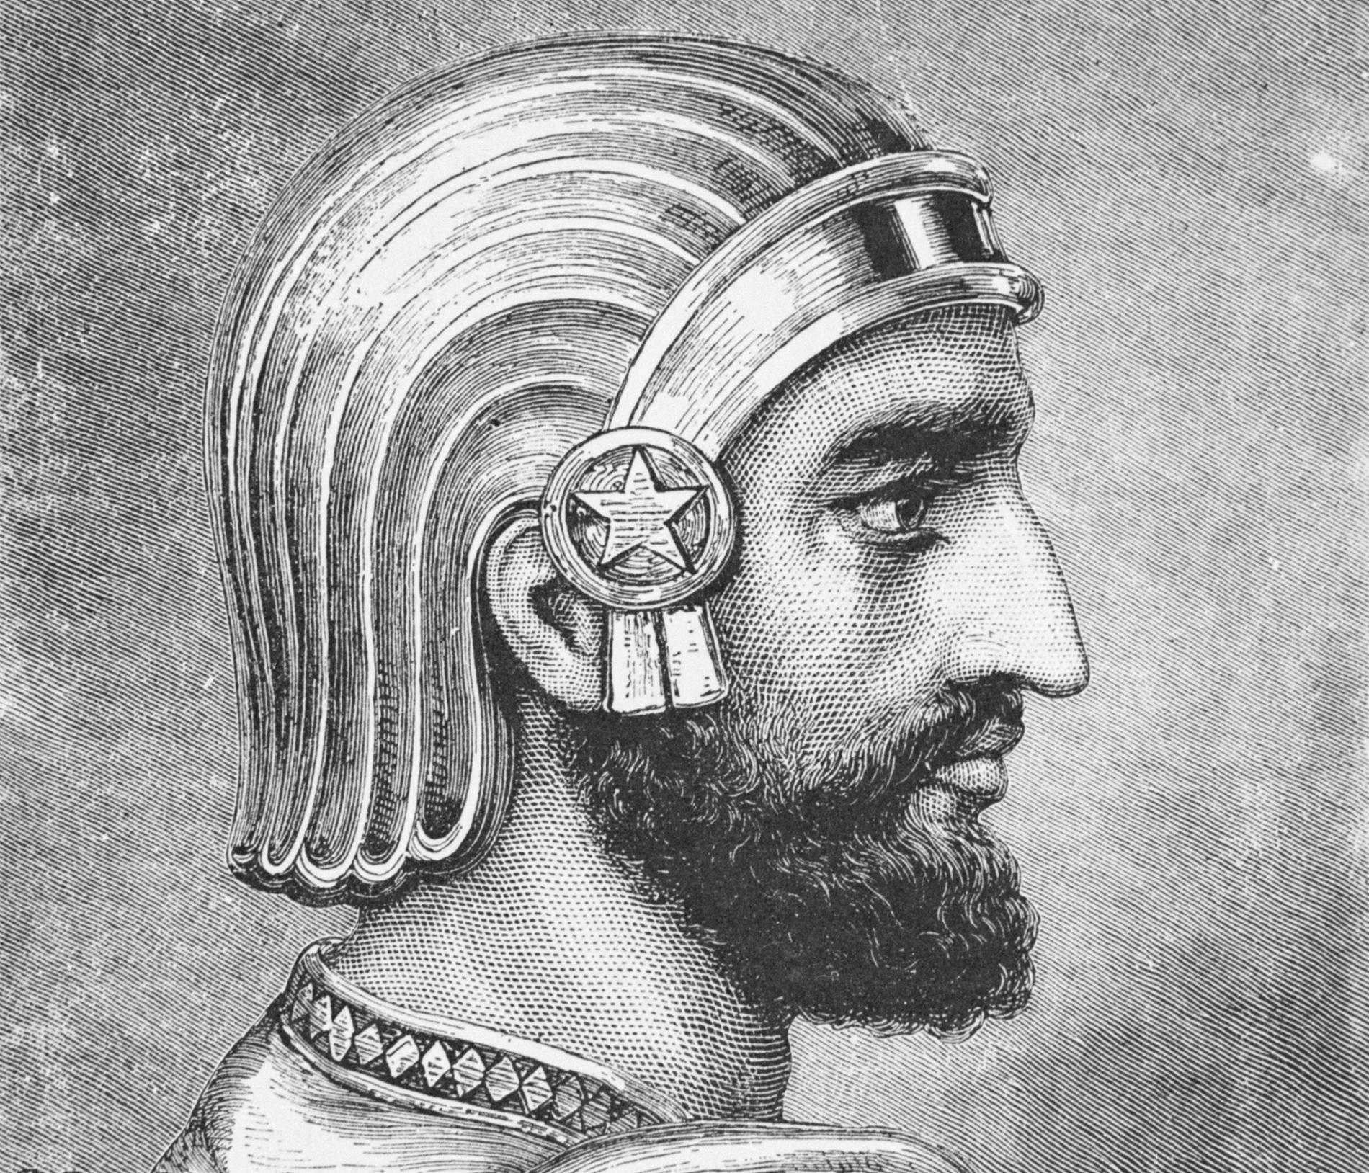
TASK 1: Take 5 colours. Colour the corner of each square to show which category it fits into.
TASK 2: Add as much information as you can in each box.
TASK 3: Add your own key terms and colour code them.
TASK 4: Create a ‘living graph’ of Cyrus’ career (see over the page)
TASK 5: ‘Cyrus contributed far more than any subsequent Persian King’ – How far do you agree?
Upbringing |  | Conquests
Tolerance |  | Pasargadae
Death
Jewish people | camels | Massagetae | Tomb of Cyrus | beheading | Ordered Cyrus to be killed | Killed in battle | Lydia | Dies peacefully in Pasargadae | 6-step step pyramid
Astyages | Sardis | Messiah | Spargapises | On the site of the battle with the Medes | Re-routing the Tigris river | ‘zendan’ – fire temple | King of the Medes | Old Testament | Harpagus
Tomyris | shepherd | Freeing the Jews | rebellion | Allows conquered peoples to keep their religions | Croesus | Re-routing the Euphrates river | Connection to Babylonian kings | ‘Tall-i-takht’ – throne hill | Babylonia
Connection to Babylonian king, Marduk | Simple design | Lydian cavalry | Nabonidus | Harpagus’ son | Liberator of the people | Cyrus Cylinder

Slide 2
TASK: Create a ‘living graph’ of the success of Cyrus’ career as King over time.
Plot an x on the graph and label it with information about each event/action in Cyrus’ career.
Note: Success is rarely a straight line!
Success
X
E.g. 601 BC – Cyrus the Great born
Time

