Slide 1
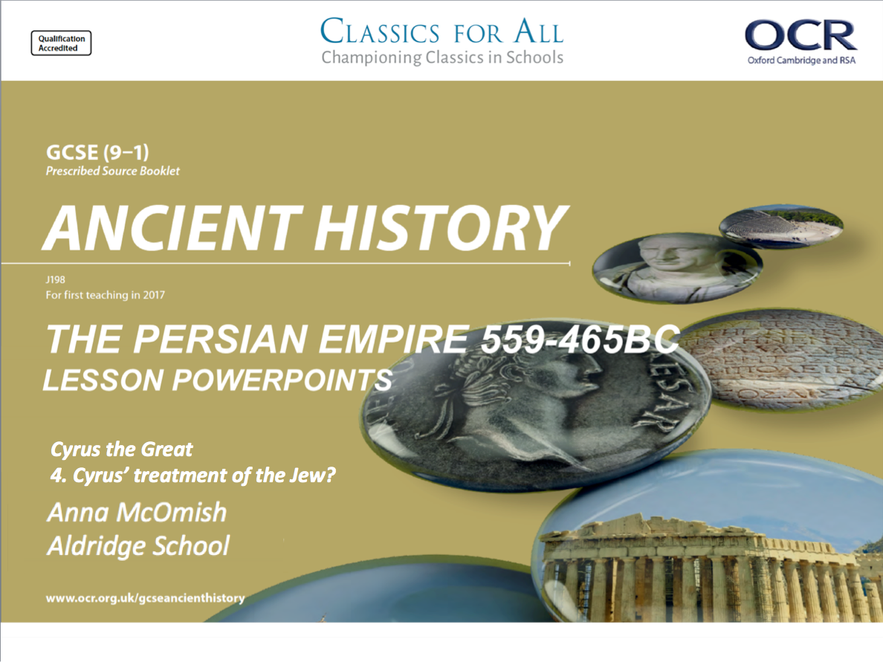
Cyrus the Great
4. Cyrus’ treatment of the Jew?

Slide 2
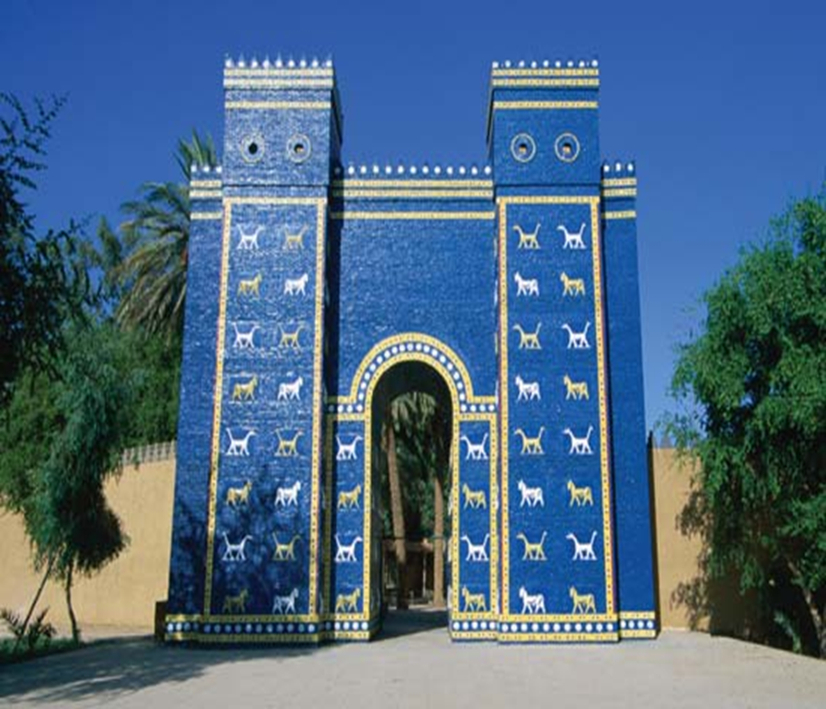
Title: Cyrus’ treatment of the Jews
February 27, 2020
Lesson Objectives:
L.O. To explain Cyrus’ actions towards the Jewish population in Babylon.
L.O. To assess what these actions tell us about Cyrus as a ruler.
TASK: The image shows us a reconstruction of the Ishtar Gate, one of the main gates of the city of Babylon.
Explain what can we infer from this gate, about the wealth and size of Babylon city?
Give a brief, 5 bullet point, summary of Cyrus’ conquest of Babylon.
Create 6 quiz questions and answers from the previous lesson on the conquest of Babylon.
RRR: How did Cyrus improve the lives of the Jews?

Slide 3
Cyrus the liberator
The fall of Babylon was a major turning point for the Persian empire. After the conquest, the Persians were able to take control of all the lands of the Levant as well. Historians do not have information on how exactly this happened, but it does seem that some people welcomed Cyrus as a liberator from unpopular Babylonian rule…
Cyrus was certainly very happy to go along with this idea, and he played off the unpopularity of the previous Babylonian leader, Nabonidus!
The Cyrus Cylinder states;
“Marduk… critically examined all the countries, and searched for a just ruler who suited his heart, he took Cyrus, King of Anshan, by the hand, proclaimed his nomination, called his name for the lordship over the world”
Babylonian sources portray Nabonidus as a wicked king who disrespected the Babylonian gods, particularly the main god Marduk when he began to favour the moon goddess Sin instead.
Cyrus played on this, by using the Cyrus cylinder to link himself to the Babylonian God Marduk, and hint that Marduk actually chose him to become king!
Why do you think Cyrus wanted to link himself to the Babylonian god?
Hint: How would that help his rule?
What does this show about Cyrus as a ruler/ his personality?

Slide 4
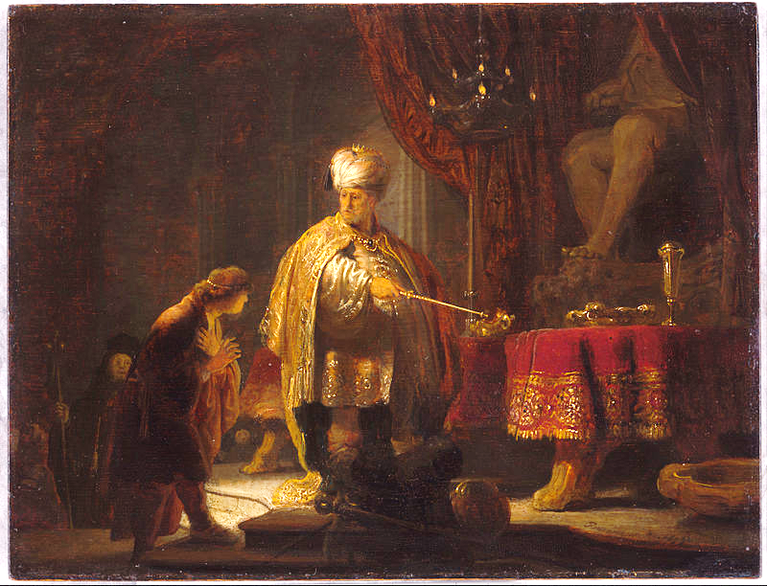
Cyrus the liberal/ liberator of the Jews
Very often in human history a conquering ruler/ nation will force the peoples they’ve conquered to convert to a new religion, take up new practises and sometimes even change language.
Cyrus and the Persians did not do this! With the Babylonians and others conquered, Cyrus was very happy for them to keep practising their own religion, and living their own way of life, as long as they did what they behaved themselves…
Old testament, Book of Isaiah 45: 1-3;
“Thus says the Lord to his anointed, to Cyrus, whom he has taken by his right hand to subdue nations before him and strip the loins of kings, to force gateways before him that their gates be closed no more: I will go before you levelling the heights. I will shatter the bronze gateways, smash the iron bars. I will give you the hidden treasures, the secret hoards, that you may know that I am the Lord”.
A group which this was particularly important for was the Jews.
The Jews had been conquered by the Babylonians since 600BC, and when they had rebelled many educated Jews were taken out of Jerusalem to Babylon as an exile/ punishment.
The Bible records that Cyrus allowed the Jews of Babylon to return to Jerusalem and set himself up as their liberator.
Jewish scribes called him a ‘messiah’, and he’s the only non-Jew to ever be called that!

Slide 5
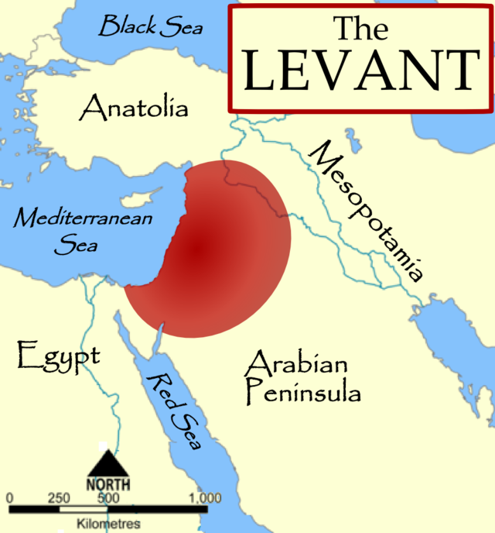
Where was the Levant?
Area now controlled by Cyrus and the Persian empire, after the conquest of Babylon.

Slide 6
How much of an impact did Cyrus have on the Neo-Babylonians?
The Cyrus Cylinder states;
“From (Nineveh), Assur and Susa, from Akkad, Esunna, Zamba, Meturnu, and Der, to the land of Gutium, the cult places on the other side of the Tigris, who sanctuaries had been deserted a long time ago, I returned (their) gods to their (rightful) place, let them be housed there forever”.
- Explaining how Cyrus protected local religions in his new lands.
1. Throws out unpopular King Nardonidus and liberates surrounding peoples from Babylonian rule.
2. Establishes himself as connected to old Babylonian kings, and chosen by Babylonian God Marduk.
3. Allows newly conquered people to continue living their own lives, with their religions and practise intact.
How significant was Cyrus’ conquest of Babylon for the Neo-Babylonian people?
Did the conquest lead to real changes for the people he conquered?
Was life different from what is was before the conquest.
4. Liberates the long-subjugated Jews, and allows them to return to Jerusalem/ rebuilds temples for them.

Slide 7
Question 4 – exam practise
In your exam, question 4 of Section A will be based on a source (which will be a surprise) and your own knowledge. You will have to use your understanding of the source and your understanding of the history to answer a question. based around a Second Order Concept.
So, if our practise question is ‘How significant was Cyrus’ conquest of Babylon for the Neo-Babylonian people?’, you’ll need to
Decide what your opinion is on the topic,
Use evidence from the source to support your argument,
Work out the second order concept
What is a second order concept?!
These are concepts (ideas) that historians use to structure their study of history. They are;
Chronology
Similarity and Difference
Change and Continuity
Significance
Cause and Effect.
When we study any period of history, we always end up using at least one.
E.g. ‘How significant was Cyrus’ conquest of Babylon for the Neo-Babylonian people?’ – Second order concept is SIGNIFICANCE

Slide 8
Question 4 – exam practise.
Passage A: “Marduk… critically examined all the countries, and searched for a just ruler who suited his heart, he took Cyrus, King of Anshan, by the hand, proclaimed his nomination, called his name for the lordship over the world… From (Nineveh), Assur and Susa, from Akkad, Esunna, Zamba, Meturnu, and Der, to the land of Gutium, the cult places on the other side of the Tigris, who sanctuaries had been deserted a long time ago, I returned (their) gods to their (rightful) place, let them be housed there forever”.
Using details from passage A and your own knowledge, ‘How significant was Cyrus’ conquest of Babylon for the Neo-Babylonian people?’
Sentence starter = “The first point when assessing the significance of the conquest of Babylon is...
REMEMBER – this is your argument and it doesn’t have to agree with the statement completely. You might want to give a weighted argument, where you mostly agree/ disagree, but have the last part of your answer talk about the other side of the argument.
E.g. Cyrus’ allowing people to continue with their own religions, daily practises and languages is a example of things staying the same, a CONTINUITY for the Babylonian people. – does that reduce the extent to which we can see the conquest as significant?
Notes:
QUESTION STRIP for this question in the exam resources folder. Labelled question 4.

