Slide 1

Darius I
1. Revolts against Darius

Slide 2
Starter:
True or false?
Smerdis was the brother of King Cyrus
2) Bringing the Phoenicians into the Empire made the Persians a sea power
3) The Bisitun Inscription was used by Darius to tell the truth of his reign.
4) Cambyses died in Ecbatana.
5)Darius plotted with 9 other nobles to kill false Smerdis.
6)Darius came to the throne in 525BC
Which account of Darius’ accession do you find the most believable, explain why.

Slide 3
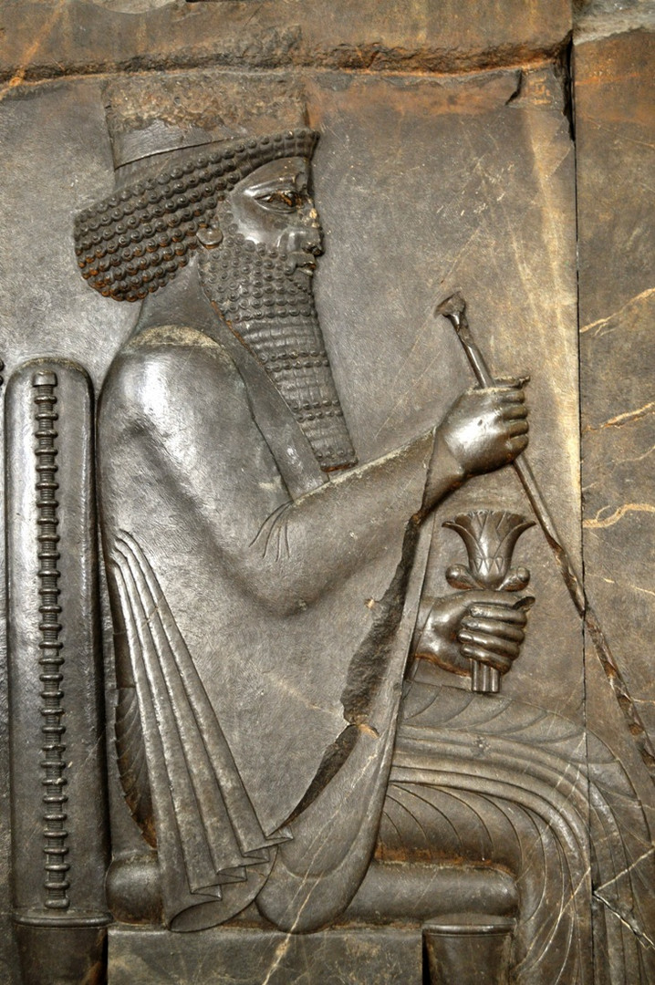
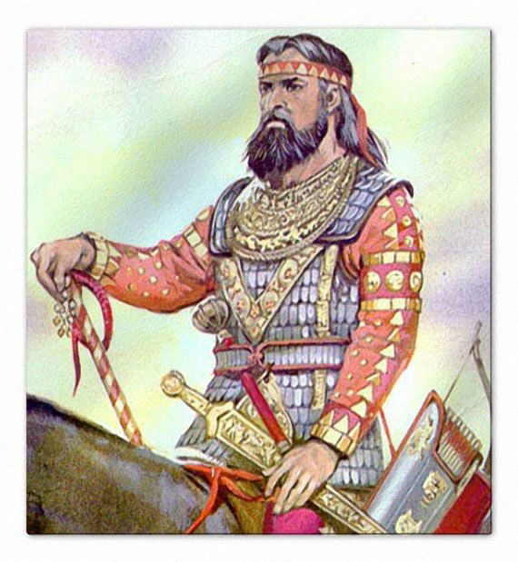
Title: Revolts against Darius
February 27, 2020
RRR: What are the two different versions of Darius’ rise to power?
Lesson Objectives:
To know the details of the series of revolts that Darius faced as new king between 522-519BC.
To assess how successfully Darius was able to crush the revolts against him.
To evaluate how Darius’ actions are portrayed in the Bisitun Inscription

Slide 4
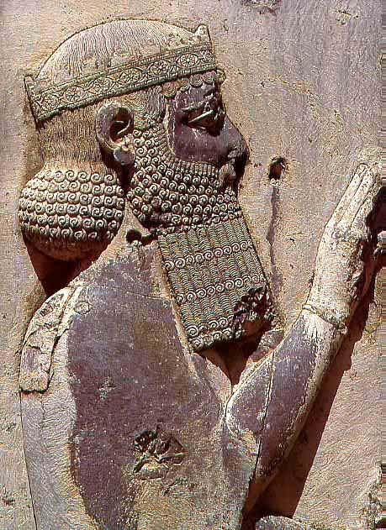
Task 1
Watch the clip giving an overview of King Darius’ reign.
Answer the questions on the A5 sheet.
CHALLENGE: From first impressions, how does Darius compare to Cyrus and Cambyses?

Slide 5
DARIUS - OVERVIEW
Question | Answer
a) When did Darius reign as King of Persia?
b) Name at least 1 new territory that Darius added to the Persian Empire
c) Give 1 policy that Darius used to get the support of conquered people
d) Give 2 ways that Darius helped improve the organisation of the Persia Empire
e) Name 1 method used to Darius to promote trade within the empire.
DARIUS - OVERVIEW
Question | Answer
a) When did Darius reign as King of Persia?
b) Name at least 1 new territory that Darius added to the Persian Empire
c) Give 1 policy that Darius used to get the support of conquered people
d) Give 2 ways that Darius helped improve the organisation of the Persia Empire
e) Name 1 method used to Darius to promote trade within the empire.

Slide 6
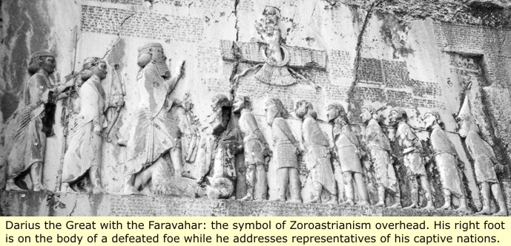
What qualities would Darius have needed to survive these rebellions against him?
Following his coronation at Pasargadae, Darius moved to Ecbatana. He soon learned that support for False Smerdis was strong, and revolts in Elam and Babylonia had broken out.
Darius ended the Elamite revolt when he captured and executed its leaders. After three months the revolt in Babylonia had ended.
While in Babylonia, Darius learned a revolution had broken out in Bactria, an area which had always been in favour of Darius, and had initially volunteered an army of soldiers to crush the revolts.
Following this, revolts broke out in Persis, the homeland of the Persians and then in Elam and Babylonia (again!), followed by in Media, Parthia, Assyria, and Egypt.
By 522 BCE, there were revolts against Darius in most parts of the Persian Empire leaving the empire in turmoil. Even though Darius did not seem to have the support of the people, Darius had a loyal army, led by close friends and nobles (including the six nobles who had helped him remove false Smerdis).
With their support, Darius was able to suppress and quell all revolts within a year. In Darius's words, he had killed a total of eight "lying kings" through the crushing of rebellions.
Darius left a detailed account of these revolutions in the Behistun Inscription.

Slide 7
Task 3
Complete a mind map on the revolts against Darius early in his reign.
Use the OCR textbook p33-34.
Use the guidance slide to help you.

Slide 8
Where did the revolts take place and when?
How did Darius deal with these revolts against him?
Did Darius find it easy to deal with the revolts?
Darius and the early revolts against him
Why were there so many revolts against Darius?
What are the issues with using the Bisitun Inscription for looking at the revolts?
GRADES 1, 2, 3 | GRADES 4, 5, 6 | GRADES 7, 8, 9
How successful was Darius in crushing the revolts against him? | Did Darius deal with rebellions in the same way as Cyrus and Cambyses? | How does Darius’ use of propaganda compare to that of previous Persian Kings?

Slide 9
How did Darius deal with these revolts against him?
Where did the revolts take place and when?
Did Darius find it easy to deal with the revolts?
Darius and the early revolts against him
Why were there so many revolts against Darius?
What are the issues with using the Bisitun Inscription for looking at the revolts?

Slide 10
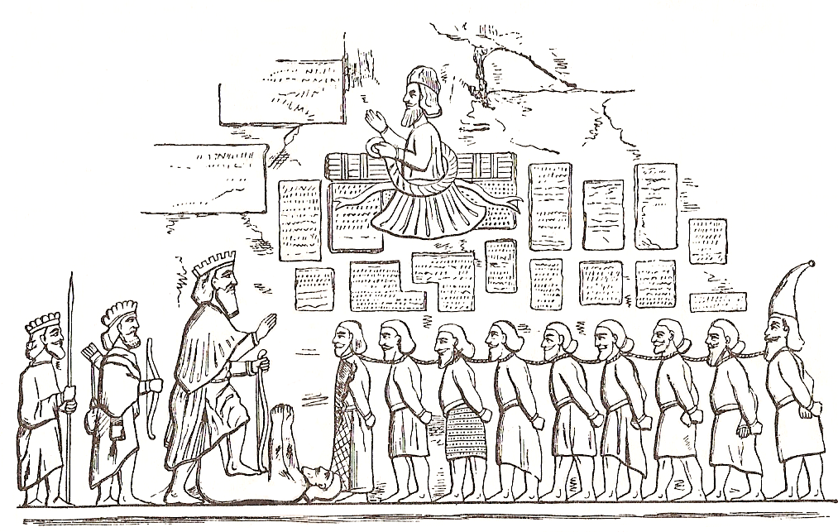
THINK, PAIR, SHARE:
- How is Darius portrayed in the Bisitun inscription relief?
- Why would he have been so keen to do this? (Think about his coming
to power and the early rebellions against him)

Slide 12
Plenary
3 revolts that Darius faced soon after becoming King of Persia?
2 ways that Darius is presented in the Bisitun Inscription
1 quality demonstrated by Darius early in his reign as king

