Slide 1

Darius I
5. Imperial Expansion under Darius

Slide 2
Starter:
Which statements are TRUE and which are FALSE?
The Persian words for truth and lie are “arta” and “drauga”.
Apadana means a great staircase in Persian.
Darius linked himself to Marduk in his ideology.
One of the Baylonian rebels against Darius was called Nidintu-Bel.
Cambyses set up the Bisitun inscription to celebrate his achievements.
Satrapies were ruled by satraps in the Persian Empire.
The royal roads connected the north of the empire to the south.
The Darius canal was constructed in Iran.
If you think a statement is false, you must REWRITE it to be correct!

Slide 3
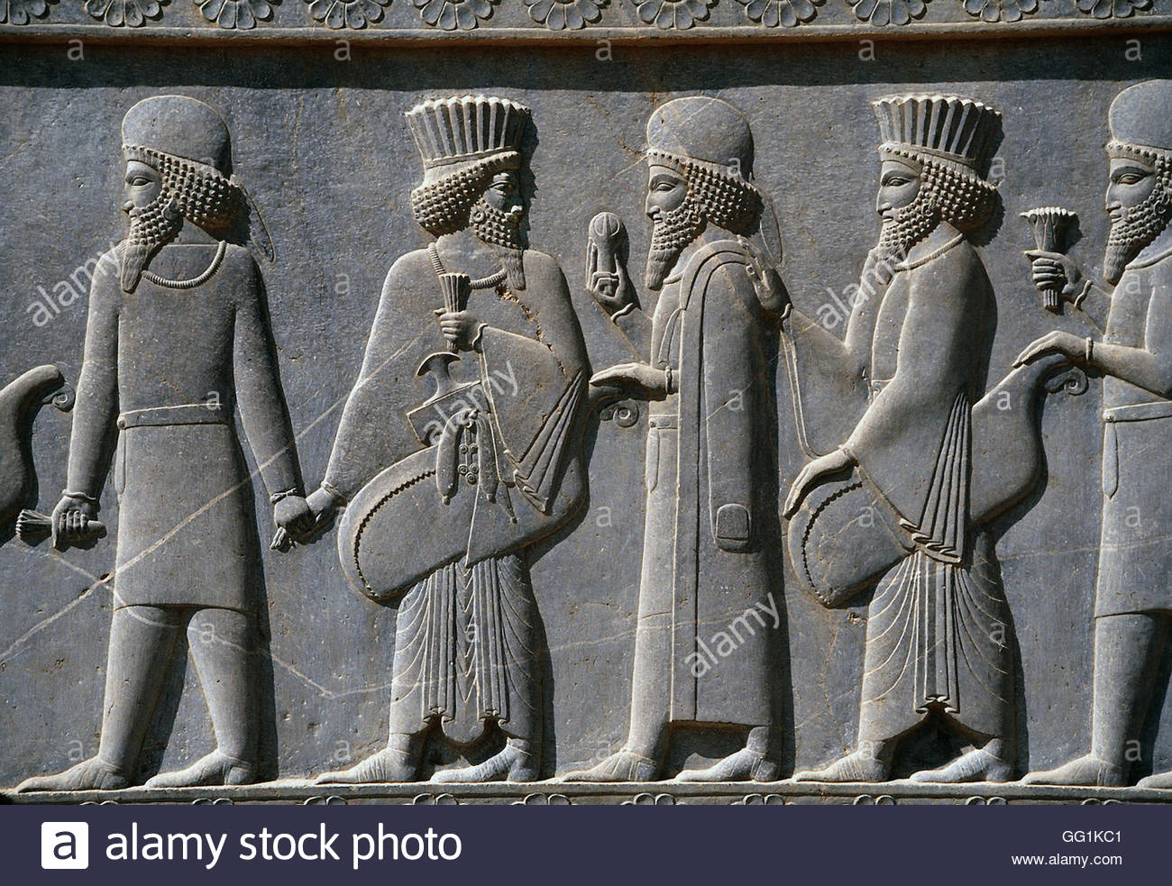
Title: Expansion of the Empire under Darius
February 27, 2020
RRR: Where did Darius manage to expand the Persian Empire?
Lesson Objectives:
To understand the reasons why Darius wanted to expand the Persian Empire.
To analyse the successful invasions that Darius carried out to expand the Persian Empire.
To begin to compare Darius’ expansion with other Persian kings.
.

Slide 4
Task 1 – Why would Darius want to expand?
Task: Using Herodotus 3.134 and your own knowledge, list as many reasons as possible as to why Darius would want to expand the Persian empire;
You can do a spider diagram or bullet point list
Why did Darius want to expand the Persian empire?
Challenge | Core | Foundation
What similarities do Darius’ motivations for expansion share with previous Persian Kings. Explain your answer. | Which factor (reason) do you think would be the most significant TO DARIUS. Explain your answer. | Which reason do you think is the best for Darius to be expanding? Explain why you chose that reasons

Slide 5
HERODOTUS 3.134
Atossa spoke privately to Darius in their bedroom: “O King, although you have so much power you are idle, acquiring no additional people or power for the Persians. The right thing for a man who is both young and the master of great wealth is to be seen bettering himself, so that the Persians know too that they are ruled by a man. On two counts it is in your interest to do this, both so that the Persians know that their leader is a man, and so that they be occupied by war and not have time to plot against you. You should show some industry now, while you are still young: for sense grows with the growing body, but grows old too with the aging body and loses its edge for all purposes.”
…he replied with this: “Woman, what you have said is exactly what I had in mind to do. For I have planned to make a bridge from this continent to the other continent and lead an army against the Scythians; and this will be done in a short time.”
“Look,” Atossa said, “let the Scythians go for the present; you shall have them whenever you like; I tell you, march against Greece. I have heard of Sparta and Argive and Attic and Corinthian women, and would like to have them as servants”.

Slide 6
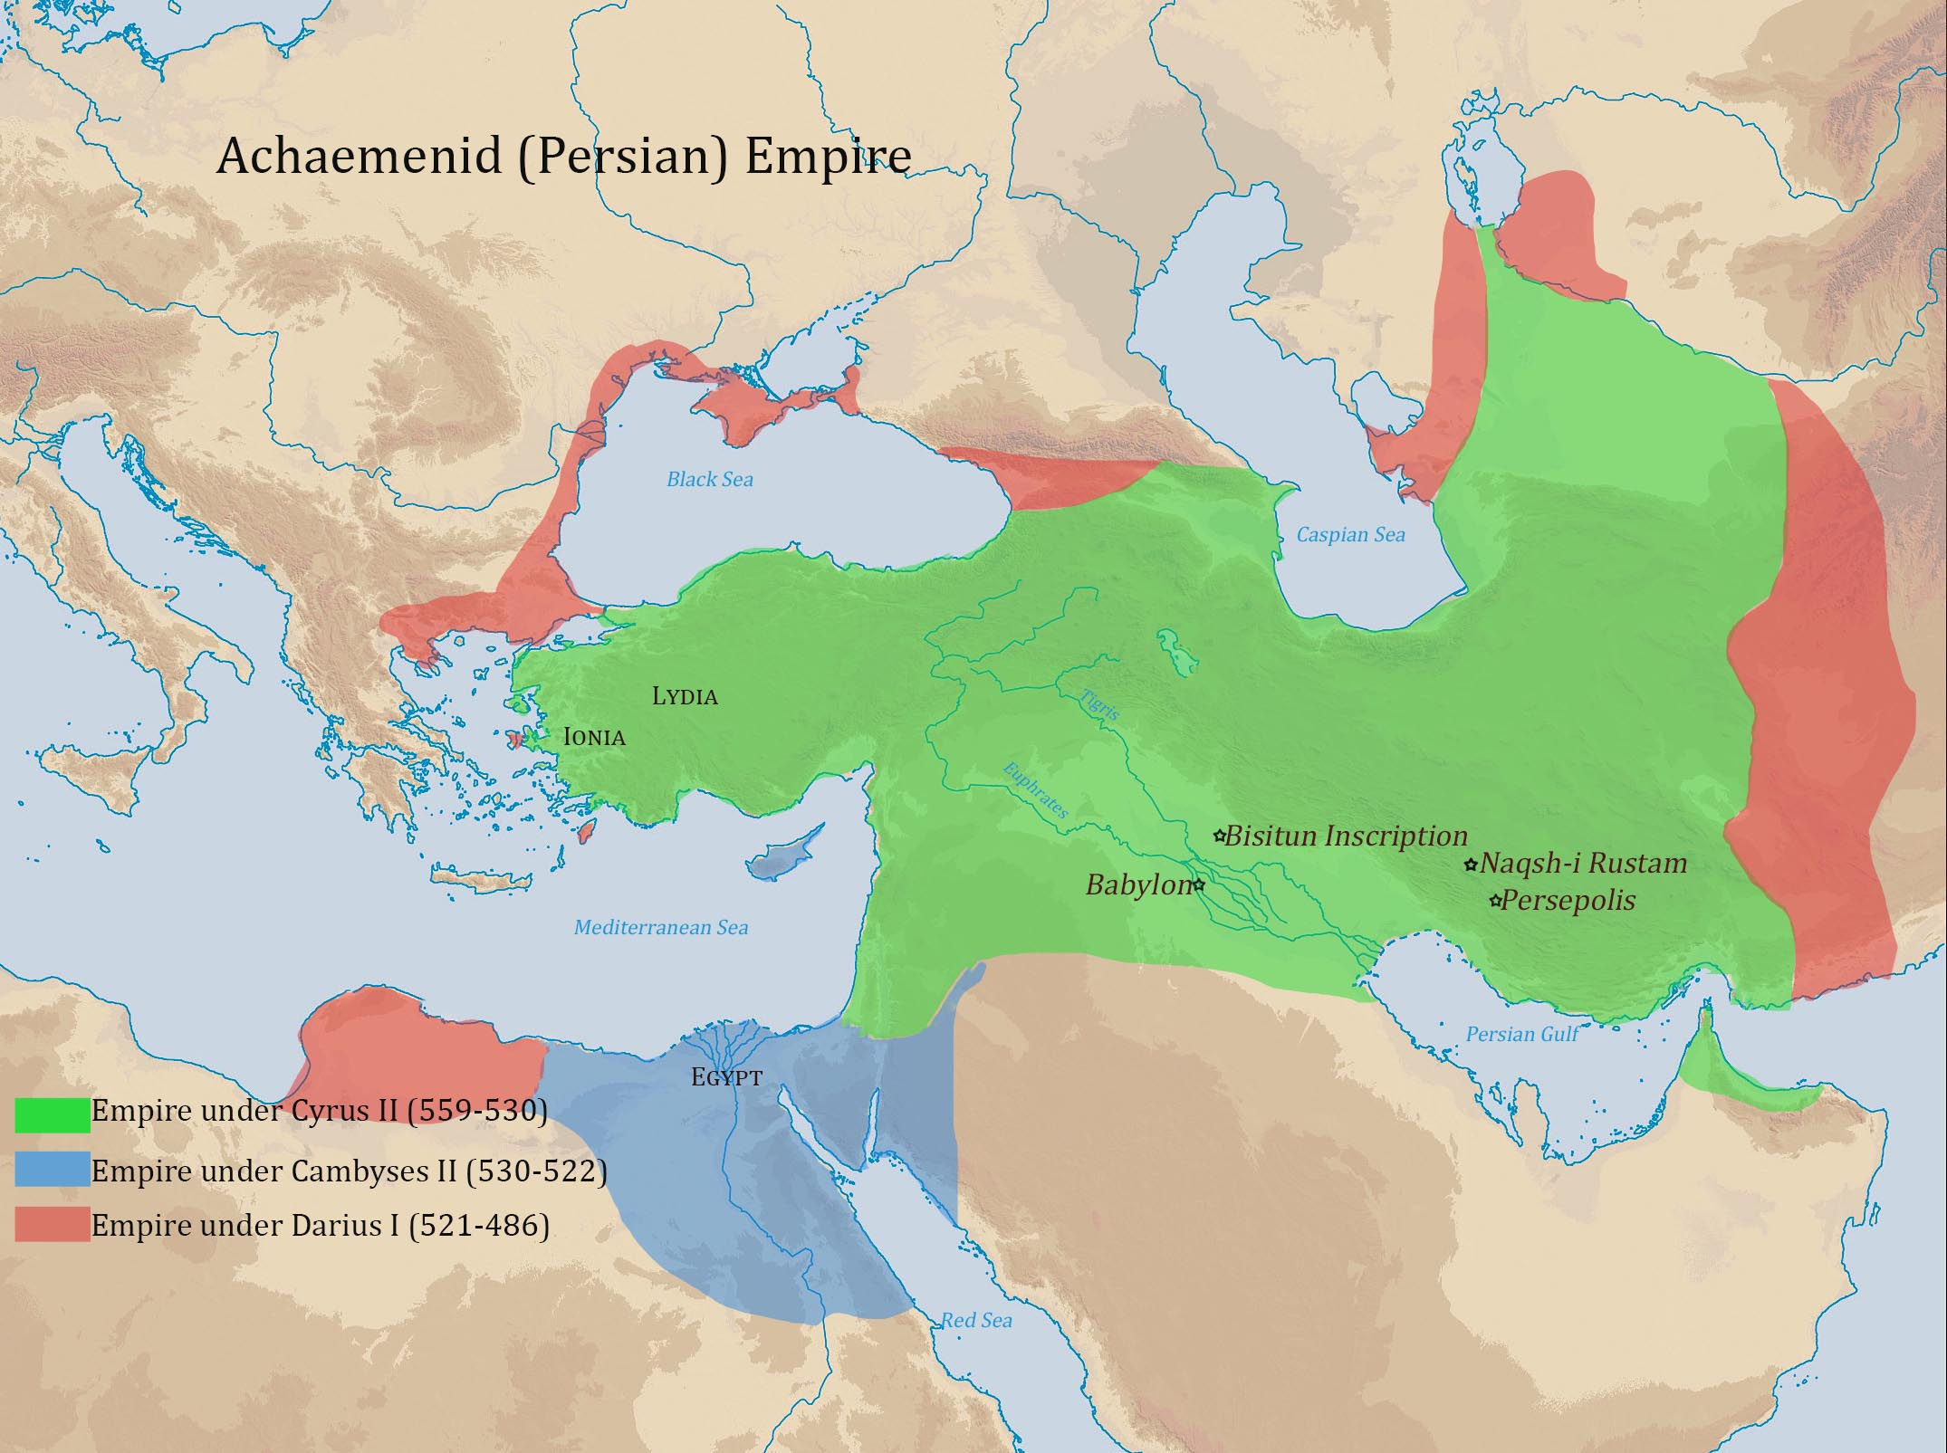

Slide 7
Task 2 – Darius’ expansion; case studies
TASK: using the textbook p40 (Indus Valley + Aegean Islands) and p42 (Macedonia and Thrace). Complete the A4 map showing the successful conquests of King Darius.
For each conquered territory;
How did Darius conquer this territory?
What benefits were brought by adding this land to the Persian Empire?
EXTENSION: use the extra reading from Herodotus to expand on your notes for Macedonia and the Indus Valley
CHALLENGE | CORE | FOUNDATION
How successful were the methods of expansion used by Darius compared to other Kings? | How similar were the methods of expansion used by Darius and other Persian Kings? | Which new territory taken by Darius was the most important and why?

Slide 8
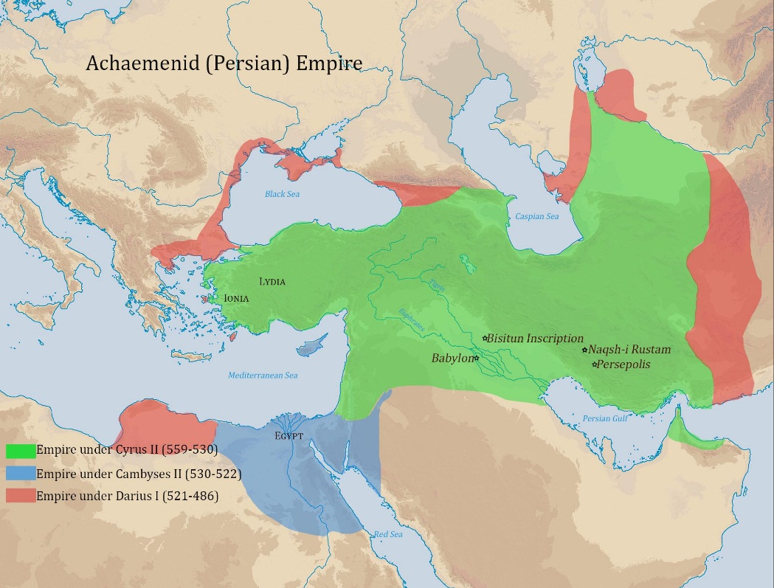
Macedonia
THE PERSIAN EMPIRE’S EXPANSION UNDER DARIUS
India and Indus Valley
The Aegean Islands of Samos, Lesbos and Chios
Thrace

Slide 9
Herodotus. 4.44 -Darius journeys to the Indus Valley
But as to Asia, most of it was discovered by Darius. There is a river, Indus, second of all rivers in the production of crocodiles. Darius, desiring to know where this Indus empties into the sea, sent ships manned by Scylax, a man of Caryanda, and others whose word he trusted; these set out from the city of Caspatyrus, and sailed down the river toward the east and the sunrise until they came to the sea; and voyaging over the sea west, they came in the thirtieth month to that place from which the Egyptian king sent the Phoenicians to sail around Libya. After this circumnavigation, Darius subjugated (took control of) the Indians and made use of this sea. Thus it was discovered that Asia, except the parts toward the rising sun, was in other respects like Libya.
Herodotus. 5.17 – The Persian Empire moves to take Macedonia
Then Megabazus, having made the people of Paeonia captive, sent, as messengers, into Macedonia the seven Persians who (after himself) were the most honorable in his army. These were sent to the city of Amyntas to demand earth and water for Darius the king.
Now there is a very straight way from the Prasiad lake to Macedonia. First there is near the lake that mine from which Alexander later drew a daily revenue of a talent of silver, and when a person has passed the mine, he need only cross the mountain called Dysorum to be in Macedonia.

Slide 10
Plenary
Who were the following things/people from today’s lesson;
SKUDRA
MEGABAZUS
EARTH AND WATER
SCYLAX
THRACE

