Slide 1
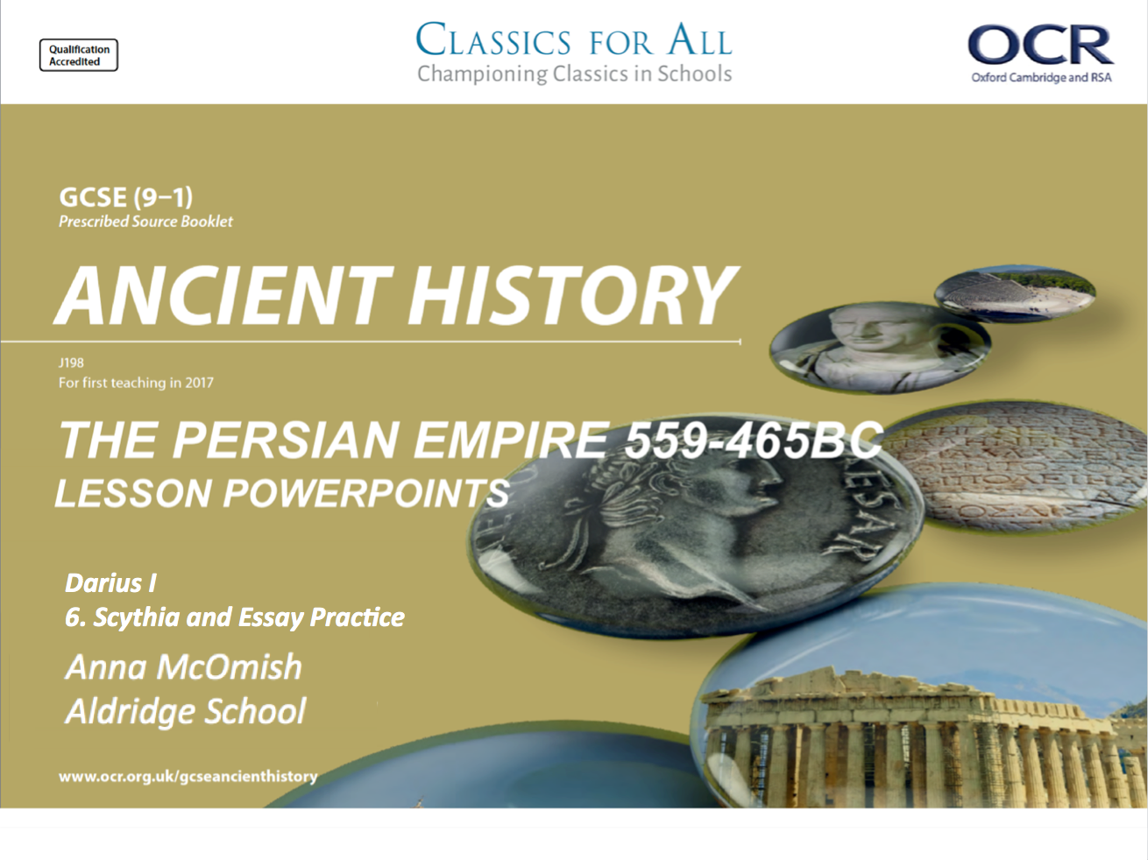
Darius I
6. Scythia and Essay Practice

Slide 2
Recap Quiz
Name three key features of Darius’ palace at Persepolis.
What would you argue is the purpose of the Apadana staircase?
Name two other building projects from Darius’ reign.
What was the royal road used for?
Darius conquered the *** Valley. – what name is missing?
What year did Darius launch his invasion into Europe/ Thrace?
How many men does Herodotus claim that Darius has in his army?
Which troops were left the guard the bridge built over the river Ister?

Slide 3
Recap Quiz
Hall of 100 columns, Apadana Staircase, main courtyard, etc.
To show his power/ control. To make people feel included in the empire.
Royal road, Darius Canal
Movement of trade, royalty and the King’s eyes
Indus
513BC
700,000
The Ionians

Slide 4
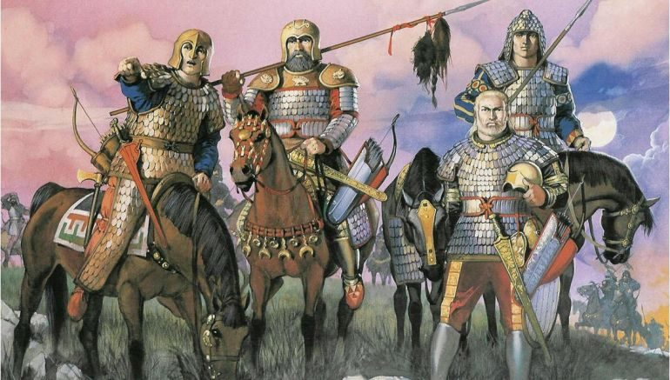
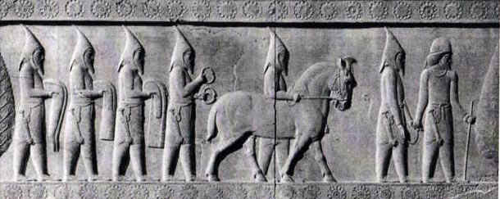
Title: Darius in Scythia
February 27, 2020
Lesson Objectives:
L.O. to understand and explain Darius’ failings in Scythia.
L.O. to compare Darius’ imperial expansions to that of Cyrus.
RRR: Why did the expedition to Scythia fail?

Slide 5
Darius moves into Scythia
Darius’ invasion of Scythia was far less successful than his expansion in Thrace. Upon arrival in Scythia Darius was greeted by a terrain of unending plains apparently utterly deserted.
The Scythians were a nomadic peoples, and they developed this lifestyle into a tactic to avoid confrontation with Darrius, while exhausting his troops.
They continuously retreated from the Persians, drawing them further and further into the plains, and baiting the Persians by leaving out groups of cattle as potential food.
After several months is was clear that the campaign had been a disaster, and Darius retreated back to the river Ister. The Persians got lost on the way back, and the Scythians (beating them there) did try to persuade the Ionians to burn the bridge and abandon the King.
The Ionians eventually decided to stay with Darius and protect the bridge, although the Ionian tyrant Miltiades had argued strongly they should take the Scythian advice…
Key facts for Scythia!
Darius moves into Scythia as part of his expansion into eastern Europe.
He finds the land mostly empty, as the Scythians are nomadic.
He can’t catch the Scythians, as they know the land better and keep raiding/ retreating.
Scythians draw Darius into barren land, and army starts to run out of food.
Expedition fails, Darius heads home, Ionians almost convinced to cut down the bridge back to Persia.

Slide 6
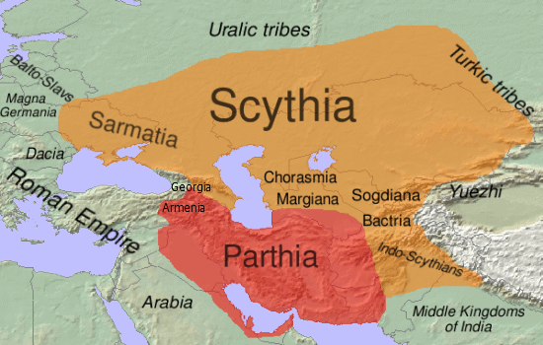
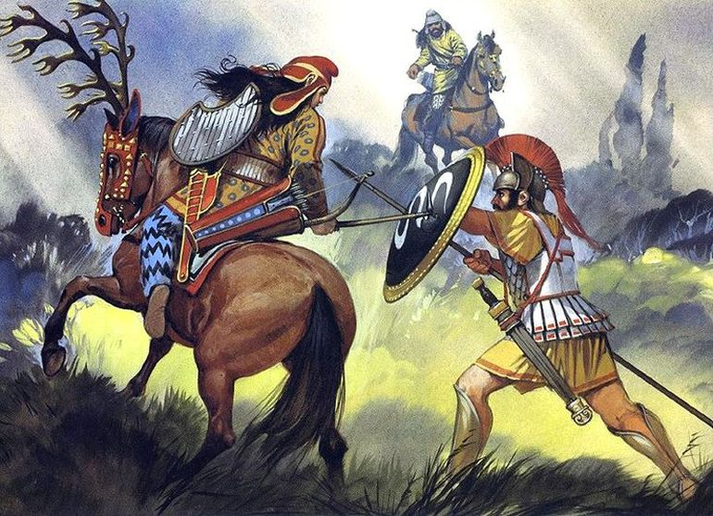
Darius in Scythia
TASK: Starting with article A, read through the information on Darius’ expedition of Scythia, and answer the questions for that article.
EXTENSION: Read the sections of Herodotus and explain a.) what we can learn about the Scythians, and b.) what can we learn about why the campaign failed.
CHALLENGE: read the British Museum blog on Darius, Scythia and Herodotus, and answer the relating questions.

Slide 7
Article A Questions.
What were Darius’ aims/ objectives for the Scythian Campaign?
Why did the Ionians Tyrants decide NOT to destroy Darius’ bridge?
How did the Scythians make it difficult for the Persians to fight and survive on the plains?
How did the campaign end for Darius?
Why do you think that Darius’ campaign failed? – what factors lead to its failure?
Herodotus Questions.
What does Darius demand that the Scythians do, in his letter to the King?
What do the Scythians do when they see that the Persians are shaken by their expedition?
How does Darius feel about the Scythian tactics?
What is Histiaeus’ argument for NOT turning against Darius?
BM Blog Questions.
What does the blog suggest is one of the main reasons as to why Darius felt the need to attack Scythia.
How does the writer (Tom Holland) connect Herodotus to this period of Persian History?
Notes:
https://blog.britishmuseum.org/darius-herodotus-and-the-scythians/ - BM article, print it out for most able.

Slide 8
Herodotus on the Scythian expedition
4.126: As this running away went on for a long time and did not stop, Darius sent a horseman to Idanthyrsus the Scythian king, with this message: “You crazy man, why do you always run, when you can do otherwise? If you believe yourself strong enough to withstand my power, stand and fight and stop running; but if you know you are the weaker, then stop running like this and come to terms with your master, bringing gifts of earth and water.”
4.130: The Persians thus gained very little in the war, for when the Scythians saw that the Persians were shaken, they formed a plan to have them remain longer in Scythia and, remaining, be distressed by lack of necessities: they would leave some of their flocks behind with the shepherds, moving away themselves to another place; and the Persians would come and take the sheep, and be encouraged by this achievement…After such a thing had happened several times, Darius was finally at a loss.
4.137: Then the Ionians held a council. Miltiades the Athenian, general of the Chersonesites of the Hellespont, advised that they do as the Scythians said and set Ionia free by destroying the bridge. But Histiaeus of Miletus advised the opposite. He said, “It is owing to Darius that each of us has control of our city; if Darius' power is overthrown, we shall no longer be able to rule, I in Miletus or any of you elsewhere; for all the cities will choose democracy rather than despotism.”
Necessities = food and water. Despotism = when one person is in complete control without being voted in.

Slide 9
Question 5 – the essay question!
The essay question will ask you about a topic that will stretch across at least two different kings, and you will be expected to compare and contrast these as part of your answer.
Sometimes the question might DIRECTLY ask you to compare two kings, e.g. ‘Xerxes continued the work and policies of Darius in every way’ how far do you agree with this.
OR, you will be given a topic that clearly wants you to compare how that issue was dealt with across Kings, e.g. ‘Persians treated the peoples they conquered well.’ How far do you agree with this statement?
What do I need to do?
Know about the topic of the question.
Know how it changes or stays the same across the named Kings.
Read and understand the question, to answer that specific angle.
AO1 = 10 marks = Demonstrate knowledge and understanding of the key features and characteristics of the historical periods studied. – do you know your history, can you explain it fully!
AO2 = 10 marks = Analyse and explain historical events and historical periods to arrive at substantiated judgements. – can you create an argument, follow it through and write a conclusion that supports your argument?

Slide 10
Question 5 – Essay question planning
‘Darius’ imperial expansion was more successful than that of Cyrus’, how far do you agree with that statement?
TASK 1:
What is this question asking you about?
- Written statement in your books, in simple terms what is this question asking you?
What is your knowledge about this topic?
- Spider diagram or bullet point list, what history do you know to help you answer this question? – start planning!
TASK 2:
What do you think your conclusion will be?
Do you agree that Darius was more successful than Cyrus, in terms of their imperial expansion?
AO1 = 10 marks = Demonstrate knowledge and understanding of the key features and characteristics of the historical periods studied. – do you know your history, can you explain it fully!
AO2 = 10 marks = Analyse and explain historical events and historical periods to arrive at substantiated judgements. – can you create an argument, follow it through and write a conclusion that supports your argument?

Slide 11
Question 5 – Essay question planning
What do we mean by ‘successful’??
Define your terms!
‘Darius’ imperial expansion was more successful than that of Cyrus’, how far do you agree with that statement?
Evidence that Darius’ expansion was more successful | Evidence that Cyrus’ expansion was more successful
1. 2. 3. | 1. 2. 3.
Level 5 17-20/20 – a top answer!
AO1 = Response demonstrates a wide range of fully relevant and accurate knowledge, with a good level of detail throughout. There is a thorough understanding of all the key features and characteristics discussed.
AO2 = Response has a full explanation and thorough, convincing analysis of the issue in the question, arriving at substantiated and developed judgements. (AO2)
Generally = There is a well-developed and sustained line of reasoning which is coherent, relevant and logically structured
Conclusion – overall what do you think?
‘To conclude, it is clear that Darius’ imperial expansion was/ was not more successful than that of Cyrus’ because…’

Slide 12
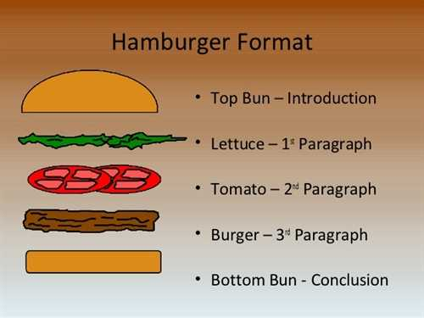

Slide 13
Using PEE to answer the question.
One reason why I disgree with the statement is that both Cyrus and Darius were both able to conquer lots of new territories for the Persian Empire. For example; Cyrus was able to start the expansion off by conquering areas such as Media, Mesopotamia and most importantly, Babylonia. Similarly, Darius was also very successful, expanding the empire into the Indus Valley (modern day India and Pakistan) as well as taking the empire westwards into Thrace and some of the Aegean Islands. As a result, both leaders proved themselves to be successful in expansion, being effective military commanders and making the Persian Empire more powerful.
THE WOW FACTOR
However it should be stated that Darius’ imperial expansion westwards into Europe was only made possible due to Cyrus laying the foundations and conquering powerful empires like the Lydians with their rich King, Croesus.

