Slide 1
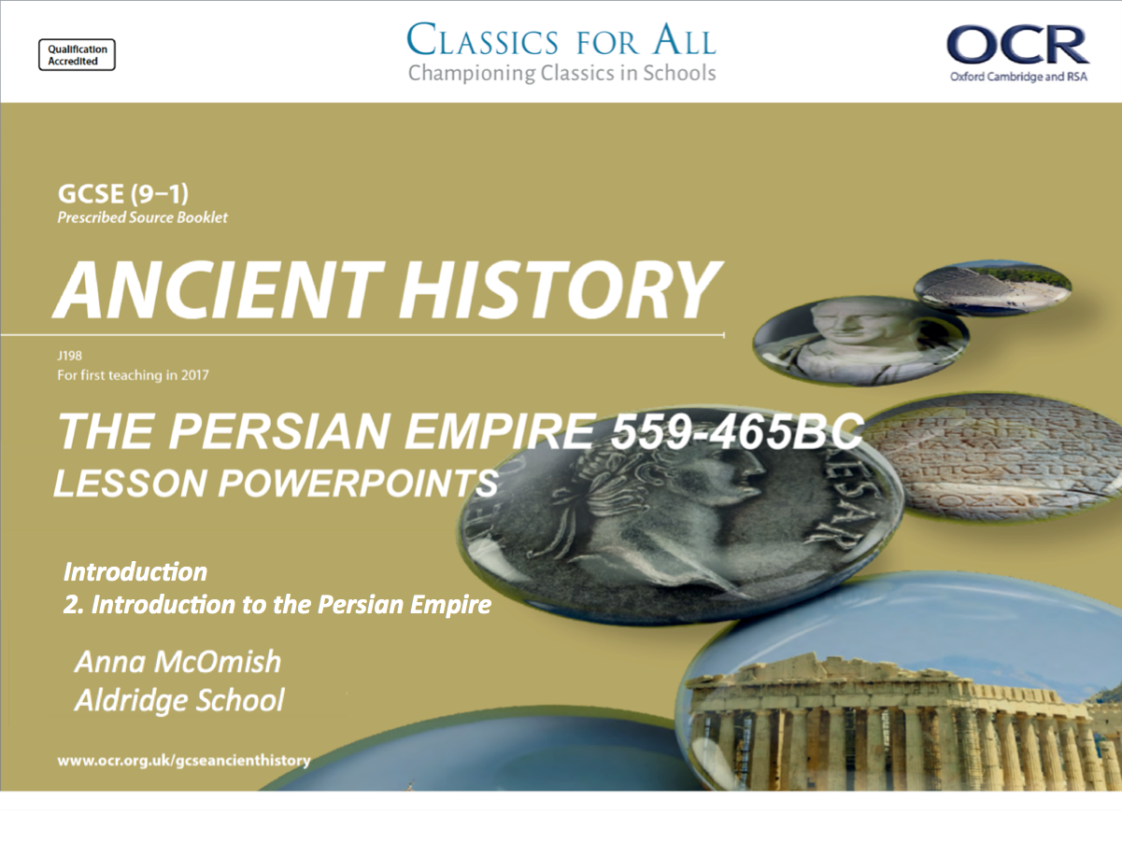
Introduction
2. Introduction to the Persian Empire

Slide 2
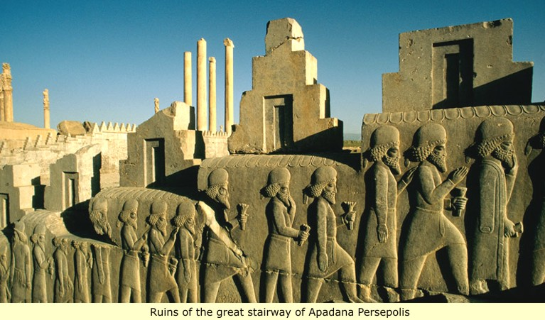
Starter:
What impression do you get of the Persian Empire?

Slide 3
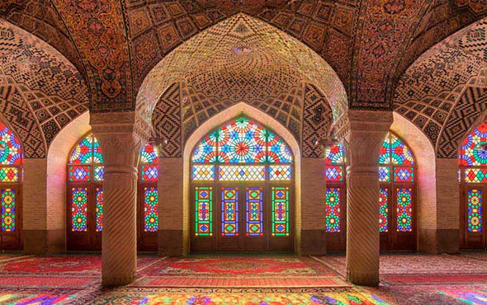
What impression do you get of the Persian Empire?

Slide 4
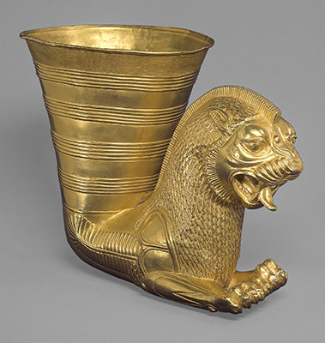
What impression do you get of the Persian Empire?

Slide 5
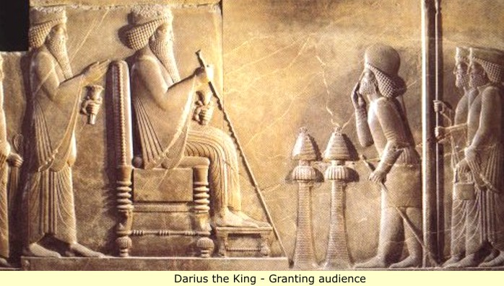
What impression do you get of the Persian Empire?

Slide 6
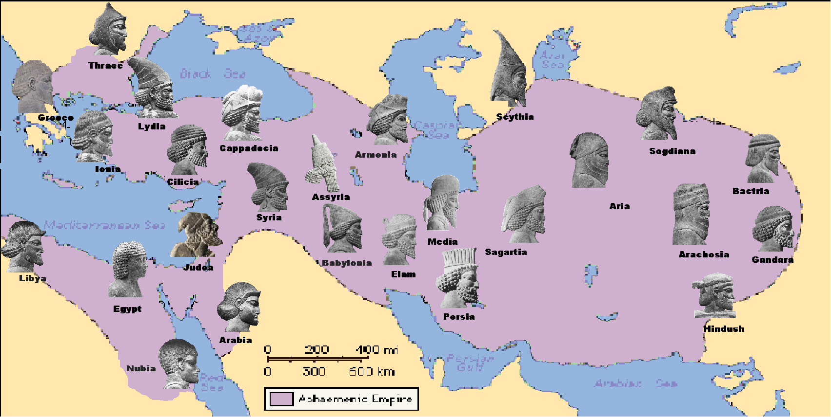
What impression do you get of the Persian Empire?

Slide 7
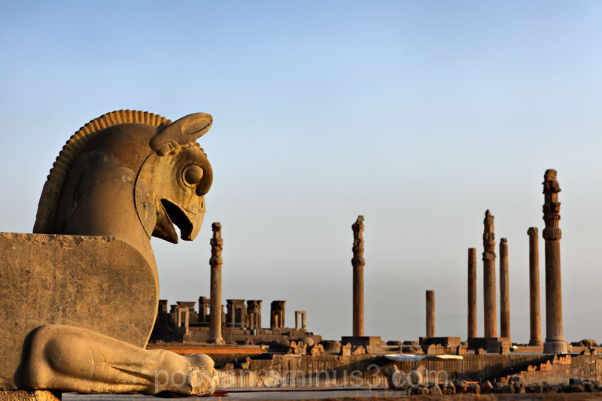
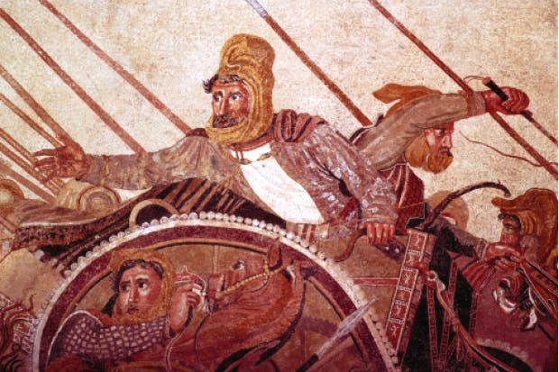
An introduction to the Persian Empire
Lesson Objectives:
To know the names, places and some of the Kings of the Persian Empire.
To gain a first impression and an overview of the Persian Empire topic.

Slide 8
Task 1
Watch the clip about the Persian Empire.
Fill in the table from the information you have learned.
Important places | Important kings | Adjectives to describe the Empire
Notes:
https://www.youtube.com/watch?v=q49SxV84qec – alternative clip, 44mins long, can just watch the first 13mins or so.

Slide 9
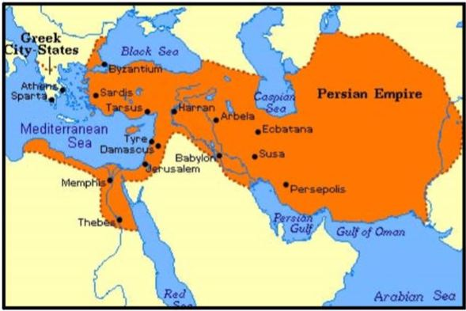
Task 2
What modern day countries were in the Persian Empire at its height?

Slide 10
Iran,
Afghanistan,
Pakistan,
Tajikistan,
Egypt,
Azerbaijan,
Armenia,
Georgia,
Turkey,
Iraq,
Lebanon,
Palestine,
Syria, (there are more than these!)

Slide 11
Introduction to the Persian Empire
The heart of ancient Persia is in what is now southwest Iran.
In the second half of the 6th century B.C.E., the Persians (also called the Achaemenids) created an enormous empire reaching from the India to Northern Greece and from Central Asia to Egypt.
The Empire became very tolerant (understanding of other people). Persia was the first empire known to have acknowledged the different religions, and languages of its peoples.
In the lands which they conquered, the Persians allowed people to speak their own languages and religions. For example, the Persians accepted hieroglyphic script written on papyrus in Egypt.

Slide 12
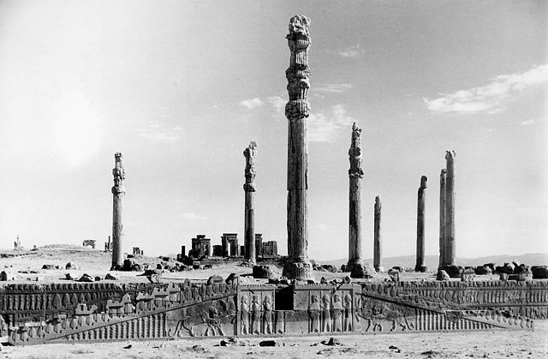
Apadana staircase - Persepolis

Slide 13
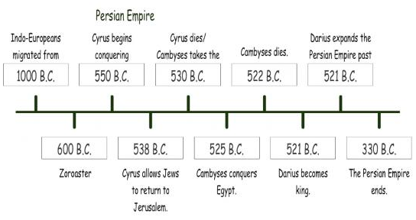
PREZI overview of the Persian Empire.

Slide 14
Task 2
Use the inscription found on Darius I tomb.
What does it tell us about how Persian Kings wanted to be viewed by their people and by history?
Concepts of Persian Kingship

Slide 15
Task 3
Discussion point;
Why would a Persian King want to show these qualities to his people and to history?

Slide 16
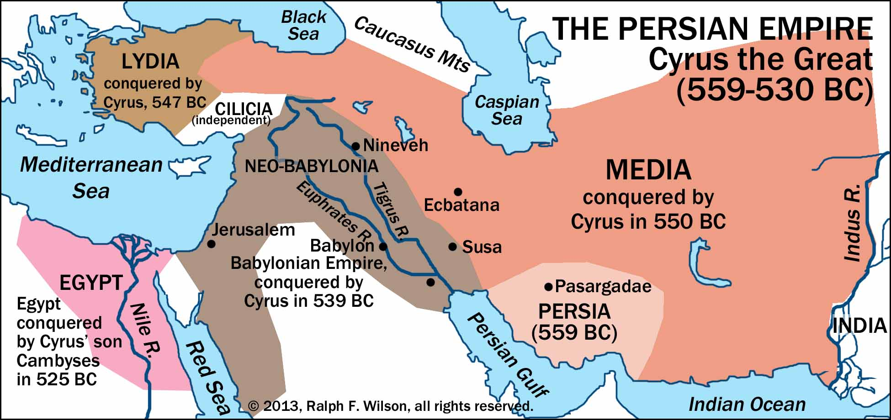

Slide 17
Plenary - recap your knowledge
3 territories that was part of the Persian Empire.
2 important Kings of Persia.
1 important city in the Persian Empire.

