Slide 1
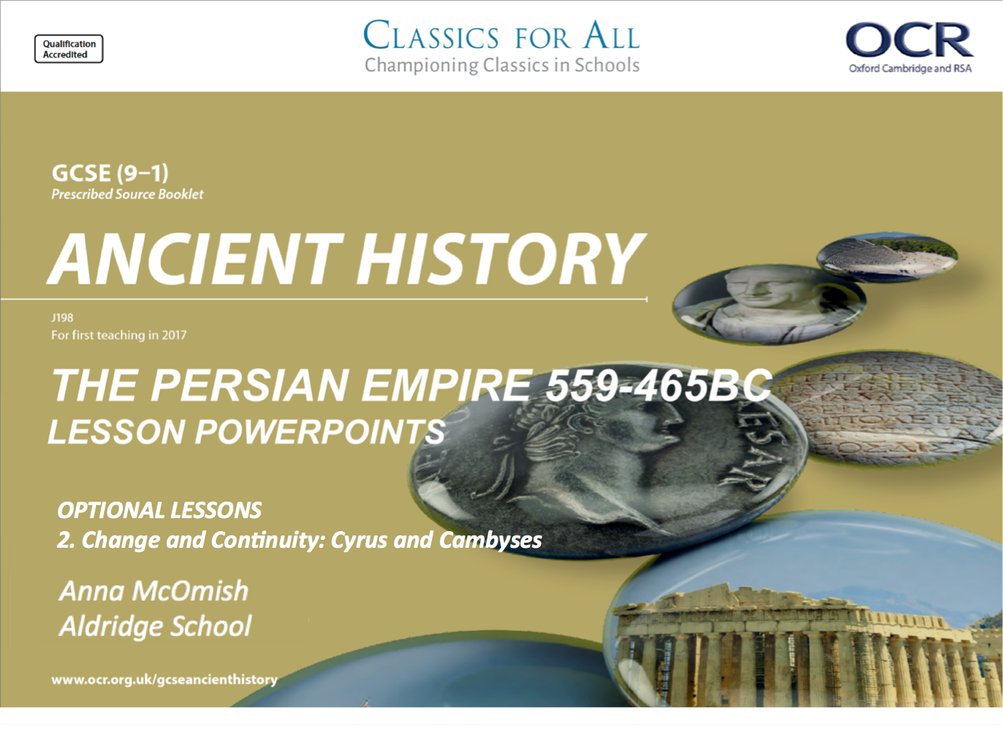
OPTIONAL LESSONS
2. Change and Continuity: Cyrus and Cambyses

Slide 2
Starter:
Put the following events in the correct CHRONOLOGICAL order:
CYRUS CONQUERS THE LYDIANS
CYRUS BECOMES KING OF PERSIA
CYRUS TAKES THE CITY OF BABYLON
KING CROESUS IS SPARED ON THE FUNERAL PYRE
CAMBYSES BECOMES KING OF THE PERSIAN EMPIRE
THE BATTLE OF PELUSIUM
ASTYAGES DREAMS THAT HIS GRANDSON WILL OVERTHROW HIM
CYRUS IS KILLED IN BATTLE
CAMBYSES KILLS THE APIS BULL ACCORDING TO HERODOTUS

Slide 3
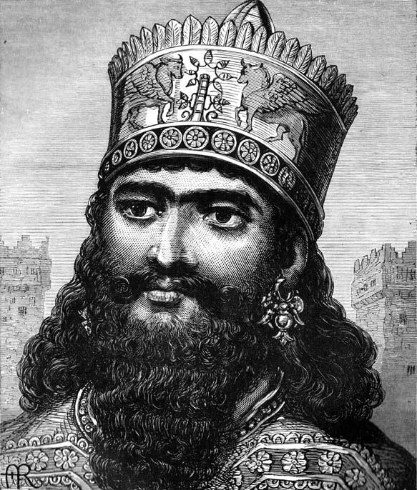
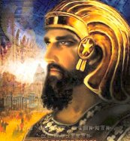
How similar were the policies carried out by Cyrus and Cambyses?
Lesson Objectives
To know the details of the policies carried out by both kings
To analyse the change and continuity between the kings
To come to a substantiated judgement on the key question

Slide 4
Task 1
Who did the following? Cyrus or Cambyses II?
Colour code the following;
Conquered the Medes | Followed the advice of Harpagus
Won the Battle of Pelusium | Allegedly killed the Apis Bull
Lost 50,000 men in the Sahara desert | Conquered the Egyptians
Allegedly murdered his pregnant sister-wife | Freed the Jews and allowed them to return to Jerusalem
Brought the Phoenicians into the Persian Empire | Built the city of Pasergadae
Died whilst trying to expand the empire | Conquered the Lydians
Brutally crushed a Lydian revolt | Allowed Astyages to go into retirement after defeating him

Slide 5
Task 2
Second Order Concepts in Ancient History.
In pairs come up with a definition for the following;
CHANGE AND CONTINUITY
SIMILARITY AND DIFFERENCE
SIGNIFICANCE
CAUSATION
CONSEQUENCE
Today we will focus on CHANGE AND CONTINUITY

Slide 6
Task 3
Look back over your work on Cyrus and Cambyses II so far.
Complete the A3 table showing the continuity and change between the two Persian Kings.
CHALLENGE- include evidence from the ancient sources such as;
CYRUS CYLINDER
HERODOTUS
NABONIDUS CHRONICLE

Slide 7
Cyrus and Cambyses: Change and Continuity
 | Treatment of individuals | Religious policy/ tolerance | Military capability/ leadership | Expanding the Persian Empire
Continuity – what stayed the same across both kings
Change – what did Cambyses do that was new/ a change from how his father ruled?

Slide 8
Plenary
How much continuity was there between the reigns of Cyrus and Cambyses II?

