Slide 1

Xerxes
2. Succession and Revolts

Slide 2
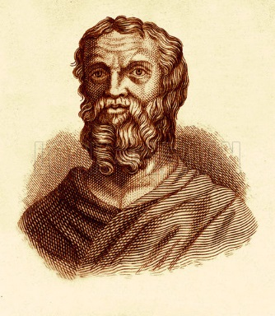
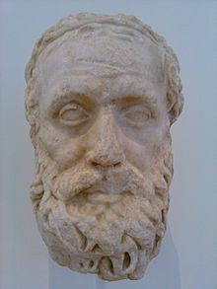
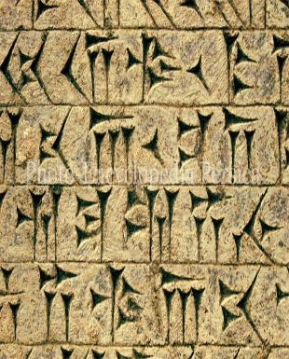
Starter – sources on Xerxes
Herodotus presented Xerxes as ….
A great god is Ahuramazda, who created this earth, who created heaven, who created man, who created happiness for man, who made Xerxes king, one king of many kings, commander of many commanders.
I am Xerxes, the great king, the king of kings, the king of all countries and many men, the king in this great earth far and wide, the son of Darius, an Achaemenid.
Aeschylus presented Xerxes as ….
Persian Inscriptions presented Xerxes as ….
CHALLENGE: what can we learn about Xerxes’ attitudes towards being King from this passage.

Slide 3
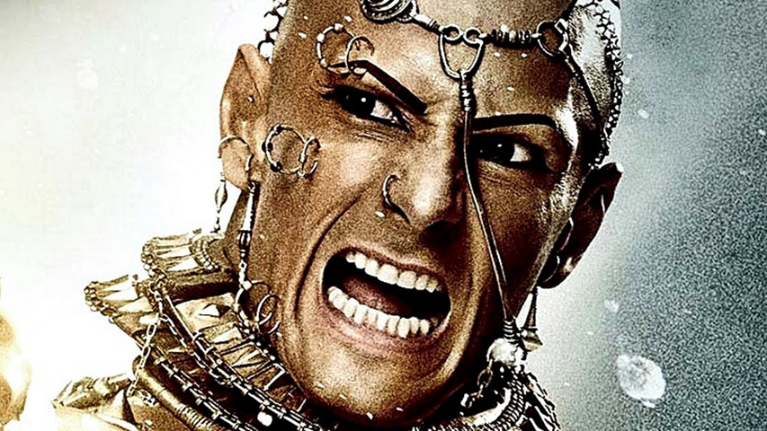
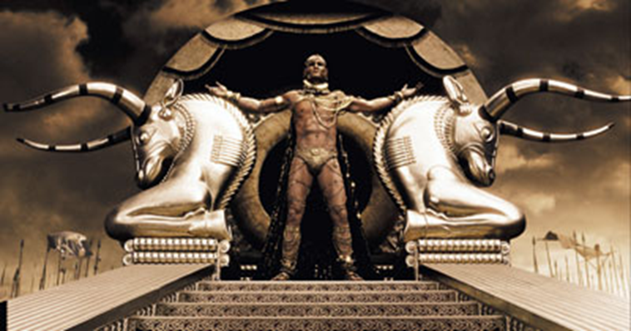
Succession of Xerxes and Revolts in Egypt/ Babylon
February 27, 2020
Lesson Objectives:
L.O. to understand the conflict surrounding Xerxes’ succession to the throne.
L.O. to explain the revolts Xerxes faced in the early stages of his reign.
RRR: What was Xerxes’ route to the throne?

Slide 4
Xerxes’ succession to the throne
When Darius died, he left behind him many sons, which meant that Xerxes’ succession was not as simple as it might have seemed. Herodotus tells us that Xerxes was NOT the first born son, and therefore not necessarily the first in line to the throne…
However, Xerxes was ambitious and knew he wanted to be king, so he went to the ex-Spartan King, Demaratus, for advice on the matter!
Demaratus advised Xerxes to argue to follow an old Spartan practise, where the throne was passed to first child born AFTER THE FATHER BECAME KING! For Darius, the first child he had after becoming king was Xerxes!
Persian Inscription commissioned by Xerxes
Darius had other sons, but - thus was Ahuramazda's desire - my father Darius made me the greatest after himself. When my father Darius went away from the throne, by the grace of Ahuramazda I became king on my father's throne.
When I became king, I did much that was excellent. What had been built by my father, I protected, and other I added other buildings. What I built, and what my father built, all that by the grace of Ahuramazda we built.
TASK: read the source above and answer the following questions;
How does Xerxes present his own succession (coming to the throne) to the people reading the inscription?
How does Xerxes justify the fact he became king, even though he wasn’t the first-born son?
Why do you think Xerxes commissioned this particular section of the inscription?

Slide 5
Xerxes’ succession to the throne - Herodotus
TASK: read the section on Herodotus and use the information to plan a 15marker exam question.
Herodotus’ account of Xerxes’ succession
While Darius was making preparations against Egypt and Athens, a great argument began amongst his sons concerning the chief power in the land. They held that before his army marched he must declare an heir to the kingship according to Persian law. Three sons had been born to Darius before he became king by his first wife, the daughter of Gobryas, and four more after he became king by Atossa daughter of Cyrus. Artobazanes was the oldest of the earlier sons, Xerxes of the later; and as sons of different mothers they were rivals. Artobazanes pleaded that he was the oldest of all Darius' offspring and that it was everywhere customary that the eldest should rule; Xerxes argued that he was the son of Cyrus' daughter Atossa and that it was Cyrus who had won the Persians their freedom… Demaratus then came and advised Xerxes that as he had been born when Darius was already king and ruler of Persia, Xerxes could do as they did in Sparta, where it was customary that the succession to the kingship belongs to the son before after the father becomes king. Xerxes followed Demaratus advice, and Darius judged his plea to be just and declared him king.
4. Using the details from your passage and your own knowledge, how similar was Xerxes succession to the throne, compared to the other Kings?
Your plan needs to include;
One way in which Xerxes’ succession is SIMILAR to that of another king.
One way in which Xerxes’ succession is DIFFERENT to that of another king.
An overall CONCLUSION on whether his succession is more similar or different to other kings.
A THIRD similarity/ difference to discuss.

Slide 6
Herodotus’ account of Xerxes’ succession
While Darius was making preparations against Egypt and Athens, a great argument began amongst his sons concerning the chief power in the land. They held that before his army marched he must declare an heir to the kingship according to Persian law. Three sons had been born to Darius before he became king by his first wife, the daughter of Gobryas, and four more after he became king by Atossa daughter of Cyrus. Artobazanes was the oldest of the earlier sons, Xerxes of the later; and as sons of different mothers they were rivals. Artobazanes pleaded that he was the oldest of all Darius' offspring and that it was everywhere customary that the eldest should rule; Xerxes argued that he was the son of Cyrus' daughter Atossa and that it was Cyrus who had won the Persians their freedom… Demaratus then came and advised Xerxes that as he had been born when Darius was already king and ruler of Persia, Xerxes could do as they did in Sparta, where it was customary that the succession to the kingship belongs to the son before after the father becomes king. Xerxes followed Demaratus advice, and Darius judged his plea to be just and declared him king.

Slide 7
Revolts in Egypt and Babylon
The Egyptians had revolted from the Persian empire in the final years of Darius’ reign, it is not clear what lead to them revolting, but it was probably a combination of factors. Darius was ageing and nearing the end of his life, they may have drawn inspiration after the Persian loss of the battle of Marathon and they may have resented having to pay and contribute to the large fleet that Darius was preparing for a second invasion.
Xerxes approached Egypt, where a usurper had been governing for two years. But he was forced to use much stronger methods than had Darius: in 484 BC he ravaged the area and reduced the country to a condition of near slavery.
Xerxes then learned of the revolt of Babylon, where two pretenders had appeared, as a result a violent repression ensued. Babylon's fortresses were torn down, its temples pillaged, and the statue of Marduk destroyed; this latter act had great political significance: Xerxes was no longer able to "take the hand of" (receive the patronage of) the Babylonian god.
Xerxes hints at his issues with Babylon when he commissions an inscription attacking the god Daevas, who is thought to be the patron god of Babylon at the time of the rebellion.
Persian Inscription hinting at Babylon
And among these countries (in rebellion) there was one where, previously, Daevas had been worshipped. Afterward, through AhuraMazda's favour, I destroyed this sanctuary of Daevas and proclaimed, "Let Daevas not be worshipped!" There, where Daevas had been worshipped before, I worshipped Ahura Mazda.
Herodotus writing about the conquest of Egypt
Xerxes first marched against the rebels in the year after Darius death. He subdued them and laid Egypt under a much harder slavery than in the time of Darius, and he handed it over to Achaemenes, his own brother and Darius' son.
Using details from both sources, and your own knowledge, what can we learn about Xerxes and his first few years in power?
Make at least 3 points of discussion
CHALLENGE: using a question strip, turn this question into a practise ques 3/ 10marker.

Slide 8
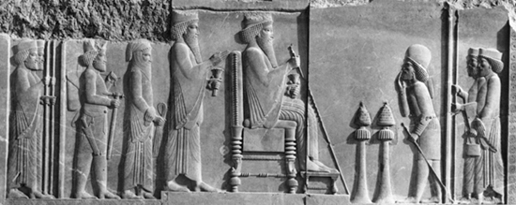
This carving depicts Xerxes as crowned prince, standing behind his Father, Darius on the throne.
How true to life do you consider this carving to be? Is it a realistic depiction of Xerxes’ succession and the kind of king he became? – from what you know so far!

