Slide 1

Xerxes
3. Why did Xerxes invade Greece?

Slide 2
Starter:
1)In what year did Xerxes become king of Persia?
2)Which god did Xerxes associate himself with?
3)Name 1 area where there was a rebellion at the start of Xerxes’ reign
4)At which battle was Darius’ invasion defeated in 490BC?
5)Who was the leader of the Ionian revolt?
6)Which leader of Athens did Darius want to put back in power?
7)What inscription did Darius carve into a mountain?
8)Which city state sent help to the Ionian revolt?
9)To which Greek god did Darius leave an offering on Delos?
10)What was the name of the play written by Aeschylus about the Persian invasion?

Slide 3
Starter:
486
Ahuramazda
3) Egypt, Babylon
4) Marathon
5) Aristogoras
6) Demaratus
7) Bisitun
8) Athens
9) Apollo
10) The Persians

Slide 4

February 27, 2020
Why did Xerxes want to invade Greece in 480BC?
RRR: Why did Xerxes invade Greece?
Lesson Objectives:
L.O. to understand the conflict surrounding Xerxes’ succession to the throne.
L.O. to explain the revolts Xerxes faced in the early stages of his reign.

Slide 5
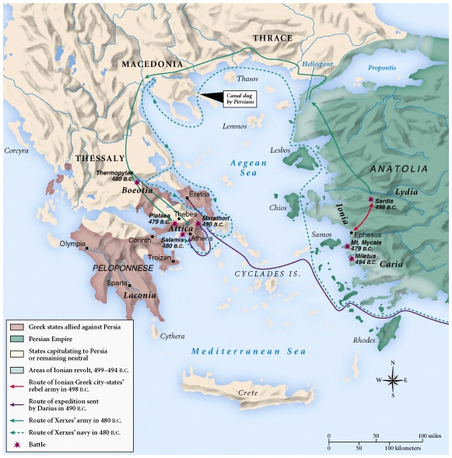
Persian Wars: 499 BCE – 480 BCE
How were Darius’s invasion (purple line) and Xerxes invasion (Green lines) of Greece different?
Why do you think Xerxes planned a different route?

Slide 6
Task 2
At some point in the late 480sBC, Xerxes called a council of his senior military commanders to discuss an invasion of Greece.
Present at this meeting were;
Mardonius, a Persian nobleman who had taken part in the first Persian invasion.
Artabanus, Xerxe’s uncle.
As a class read Herodotus p53-54 describing the discussion.
Create a spider diagram of the reasons why Xerxes wanted to invade Greece.
Why did Xerxes want to invade Greece in 480BC?
CHALLENGE: To what extent is Xerxes presented as an independent and strong-minded king in this passage?
2-3 points/ paragraphs
Explain each point with detailed own knowledge

Slide 7
Task 3 – Xerxes vs. Darius
Complete the table below to help you answer this question.
Reasons why Darius wanted to invade in 490BC | Reasons why Xerxes wanted to invade in 480BC
CHALLENGE TASK:
How similar were Xerxes’ reasons for invading compared to his Darius?
STRUGGLING?
Use the textbook p45-46 to help you with the reasons for Darius’ invasion

Slide 8
Reasons why Darius wanted to invade in 490BC | Reasons why Xerxes wanted to invade in 480BC
Reasons why Darius wanted to invade in 490BC | Reasons why Xerxes wanted to invade in 480BC

Slide 9
After discussing the invasion of Greece with Mardonius, Xerxes’ uncle Artabanus spoke.
In contrast to Mardonius, Artabanus warned Xerxes not to invade Greece for the following reasons;
Artabanus claimed the Greeks had an excellent reputation as warriors. After all, they had already defeated the Persians at Marathon.
If the Persian fleet was defeated by the Greeks then Xerxes would be trapped in Greece and could be killed.
Artabanus warned Xerxes of being too confident;
“…God strikes down the great with his thunderbolt…. The tallest buildings and trees are always the ones he blasts. It is God’s way of bringing down the mighty.”
There is no way that Herodotus could have known about this conversation at Xerxes’ court. It appears that Artabanus plays the role of a wise man, whose advice is ignored by the arrogant, hot headed king.

Slide 10
Task 4 – using Herodotus as a source
We must remember that Herodotus was an Ionian Greek, so considered himself culturally Greek and was writing for an Athenian audience, decades after they’d successfully defeated the Persians in the Persian Wars. So why should we be careful about his presentation of Xerxes?
Read the sheet explaining the issues of Herodotus’ presentation and answer the following questions;
How reliable do you think this account by Herodotus is?
Where do you think he got his information from? How does this affect his account’s reliability?
What does Herodotus’ account tell us about how the Greeks viewed Xerxes?
CHALLENGE:
In spite of the issues surrounding Herodotus’ pro-Athenian bias, to what extent does your OWN KNOWLEDGE of Xerxes match with Herodotus’ presentation of the king?
Notes:
IF YOU RUN OUT OF TIME, YOU CAN LEAVE THIS, PARTICULARLY FOR WEAKER GROUPS!

Slide 11
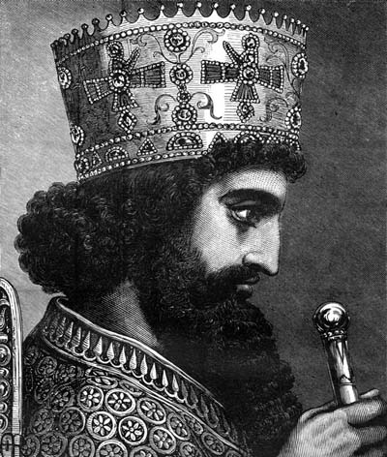
Plenary
What advice would you give to Xerxes for his invasion of Greece?
What could he learn from his father’s previous invasion?

