Slide 1

Xerxes
4. Preparations for the March to Greece

Slide 2
STARTER:
Quickly draw up a table in your books, and give two examples for each king, on their personality/ nature and expansion of empire.
Cyrus | Cambyses | Darius | Xerxes
CHALLENGE:
To what extent do you agree that Xerxes’ motivations for invading Greece were justified?

Slide 3

How did Xerxes prepare for his invasion of Greece?
February 27, 2020
RRR: How did Xerxes prepare to attack Greece?
Lesson Objectives:
L.O. to understand and explain the preparations that Xerxes made for his march to Greece.
L.O. to assess what we can learn about Xerxes’ nature based on his behaviour during the preparations and march.

Slide 4
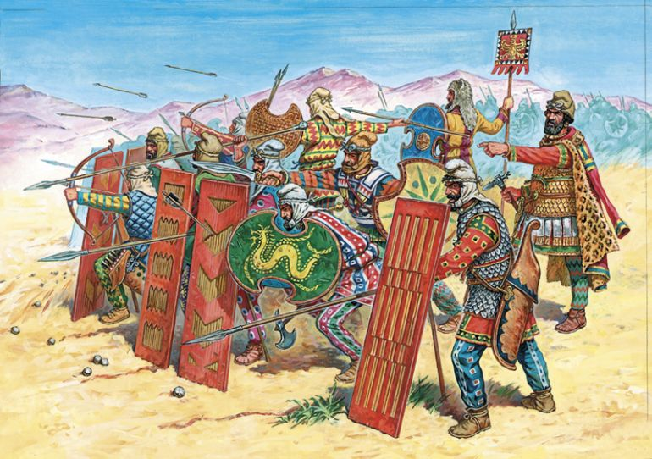
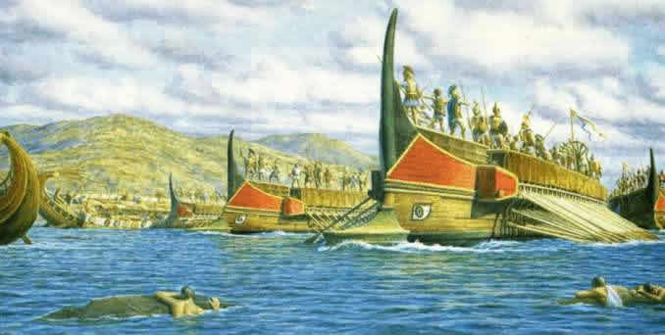
Xerxes gathers his troops…
When Xerxes came back from Egypt he began to draw soldiers from across the vast Persian empire. Sources from the time make hugely exaggerated claims about the sizes of the army, that are dismissed by historians today.
Herodotus claimed that the army consisted of 2.6 million men, drawn from over 47 different countries. This was in addition of a fleet of ships that both Herodotus and Aeschylus say numbered at 1,207 ships.
Historians reckon that the numbers are actually closer to 60-80,000 men, and 300-600 ships. Which is still an incredible number for that time.

Slide 5
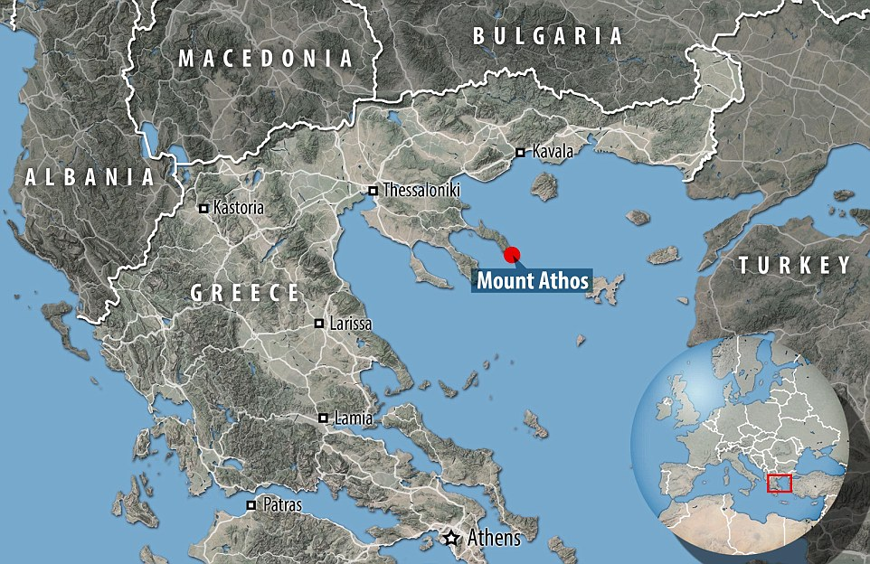
Making way for the Persian army
Herodotus says that Xerxes spent 4 years preparing the way for his advance on Greece, this included creating a canal for his ships so that they didn’t have to go round the peninsula of Mt Athos and bridges that allowed the army to cross the stretch of water known as the Hellespont.
These were incredible feats, that demonstrated the power of the Persian empire.
TASK: use the sources to answer the questions below.
Hellespont
What can we learn about the preparations Xerxes made for invasion from these sources?
- At least three points from across the two sources.
What can we learn about the type of King Xerxes was from these sources?
- Minimum of two points discussed
How do these preparations by Xerxes compare against the preparations of other kings we have studied? Does he look better or worse than others?
- Hint; Ethiopia? Scythia?

Slide 6
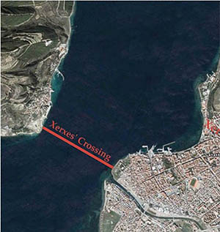
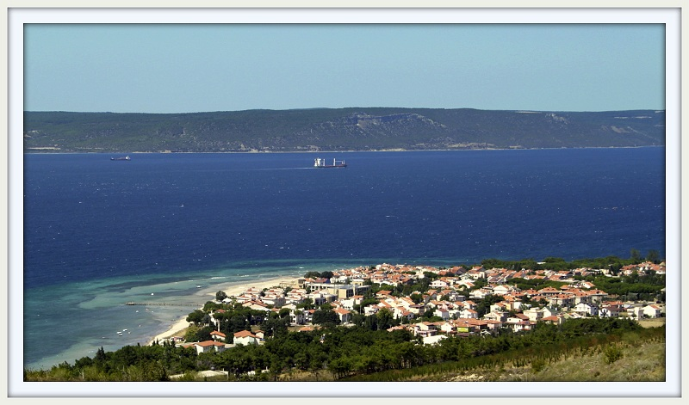
How the Hellespont looks today. Giving us a clear indication of the scale of Xerxes’ preparations to go to war against the Greeks.

Slide 7
Herodotus’ account of building the Canal at Mt Athos.
Since those who had earlier attempted to sail around Athos had suffered shipwreck, for about three years preparations had been underway there. Triremes were anchored off the coast in the Chersonese; with these for their headquarters, all sorts of men in the army were compelled by whippings to dig a canal, coming by turns to the work; the inhabitants about Athos also dug.
Athos is a great and famous mountain, running out into the sea and inhabited by men. At the mountain's landward end it is in the form of a peninsula, and here is a place of level ground or little hills, from the sea to the sea opposite.
As far as I can judge, Xerxes gave the command for this digging out of pride, wishing to display his power and leave a memorial; with no trouble they could have drawn their ships across the gap, yet he ordered them to dig a canal from sea to sea, wide enough to float two triremes rowed abreast.
Herodotus’ account of the first bridges being built at the Hellespont
Meanwhile his men were bridging the Hellespont from Asia to Europe. The men who had been given this assignment made bridges starting from Abydos across to that headland; the Phoenicians one of flaxen cables, and the Egyptians Papyrus cables. From Abydos to the opposite shore it is a distance of seven stadia (3miles). But no sooner had the strait been bridged than a great storm swept down, breaking and scattering everything.
How the second, better bridges were built
New engineers set about making the bridges. They made the bridges as follows: in order to lighten the strain of the cables, they placed 360 ships to support the bridge to the north, and 314 ships to support the other side; all lay against the current of the Hellespont. After putting the ships together they let down very great anchors, both from the end of the ships on the Pontus side to hold fast against the winds blowing from the Black Sea, and from the other end, towards the west and the Aegean, to hold against the south/west winds. After doing this, they stretched the cables from the land, twisting them taut and assigning for each bridge two cables of flax and four of papyrus. Flax and Papyrus = types of plant-based textiles

Slide 8

Omens against the invasion
Artabanus has a word…
Not everyone in the Persian army is convinced of the invasion, and the high-ranking Artabanus spoke out to Xerxes, arguing that there would not be harbours for the ships in the Persian fleet, nor adequate supplies for the troops as they moved down into Greece.
Xerxes was not interested in doubts, and although he thanked Artabanus for his advice, his response was to send him back to Susa to run the empire in the King’s absence.
2. Herodotus warns of Hubris
Herodotus heavily implies that the reason the first bridge broke is that Xerxes was being offensive to the gods in bridging the Hellespont, as stretches of water were considered divine and by creating a bridge across water/ punishing it with whips Xerxes has basically tried to enslave a god.
This is Xerxes demonstrating ‘Hubris’ or being ‘Hubristic, which means being excessively proud/ full of pride, and Greeks believed this would ultimately lead to failure and divine revenge (called Nemesis).

Slide 9
Question 1 | Question 2
How far would you agree that Xerxes has been a GOOD king of Persia, so far? What about him as has made him a good King? | How far do you agree that Xerxes has already proven himself to be a better king than Cambyses?

Slide 10
Xerxes’ behaviour during the invasion
Herodotus gives us an insight into the mentality of Xerxes and his style of Kingship, which often portrays Xerxes quite poorly. He recalls how on the journey through Lydia, he spotted a tree of such beauty that the demanded it be covered in gold and set one his top ‘Immortals’ guards to stay with the tree forever to guard it. This is just one story…
TASK: use the sources to answer the questions below.
Hellespont
How is Xerxes characterised (made to look) in these two sources? – Think about his character/ personality
- At least three points from across the two sources.
How does his mental stability/ personality compare against that of Cambyses in Egypt?
- Minimum of two points discussed
Can we fully trust Herodotus’ portrayal of Xerxes and the events surrounding the march to Greece?
- Hint; why might he have sought to portray Xerxes in a negative light?

Slide 11
Xerxes’ response when he hears the first attempt to bridge the Hellespont has failed
When Xerxes heard of this, he was very angry and commanded that the Hellespont be whipped with three hundred lashes, and a pair of fetters be thrown into the sea. I have even heard that he sent branders with them to brand the Hellespont.
He commanded them while they whipped to utter words outlandish and presumptuous, “Bitter water, our master punishes you, because you did him wrong though he had done you none. Xerxes the king will pass over you, whether you want it or not; in accordance with justice no one offers you sacrifice, for you are a turbid and briny river.” He commanded that the sea receive these punishments and that the overseers of the bridge over the Hellespont be beheaded.
Turbid = muddy/ dirty. Briny = salty
Xerxes’ response when the Lydian Pythius doubted the invasion and asked for his 1st and favourite son to be spared
Xerxes became very angry and thus replied: “you miserable fellow, you see me marching against Greece myself, and taking with me my sons and brothers and relations and friends; do you, my slave, who’s duty it was to follow me with all your household and your very wife, now try to speak to me of your son? … You and four of your sons are saved by your hospitality that you have shown me; but you shall be punished by the life of that one you most desire to keep”.
With that reply, he immediately ordered to find the favourite of Pythius’ sons and cut him in half, then to set one half of his body on the right side of the road and the other on the left, so that the army would pass between them

Slide 12
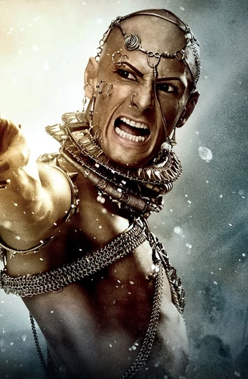
Plenary – Xerxes’ preparations
Which preparation do you think was most central to the potential success of Xerxes’ invasion?
What type of a mental state does Xerxes appear to be in as he begins his invasion of Greece?
To what extent do you think that Xerxes was attempting to out-do the legacy of his father’s imperial expansion?

Slide 13
Homework – Persian military
TASK: Research the structure and different parts of the Persian military to create an A4 page fact file.
Make sure your fact file researches and include discussion of The Immortals!
Weapons and armour used
How the army was organised
Persian Archers
Persian Cavalry
Persian Navy
EXTRA CHALLENGE:
Outline the key features of Xerxes’ preparations for the invasion of Greece (6).
- See me for a question strip to help you with this!

